Slide 1
Question today imagine tomorrow create for the future
Daniel Rosberg, Technical Director, Fire & Risk

Slide 2
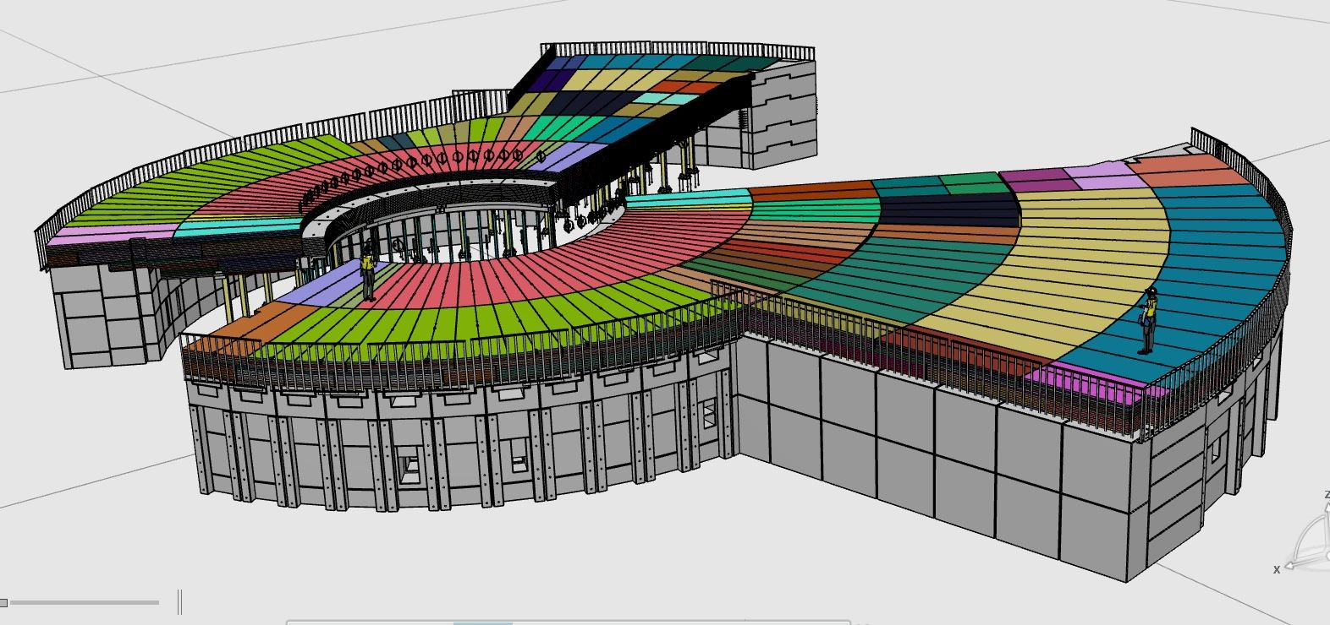
The Bunker
Structural Steel
Provides a shielding structure around the monolith
Part of Experimental Hall D01 and D03
Radius 15/28 m.
5 m high
310+330 m² roof footprint area
VKR 100x100x8
VKR 100x100x10
Utilization factor 0.5
3- and 4-side exposure

Slide 3
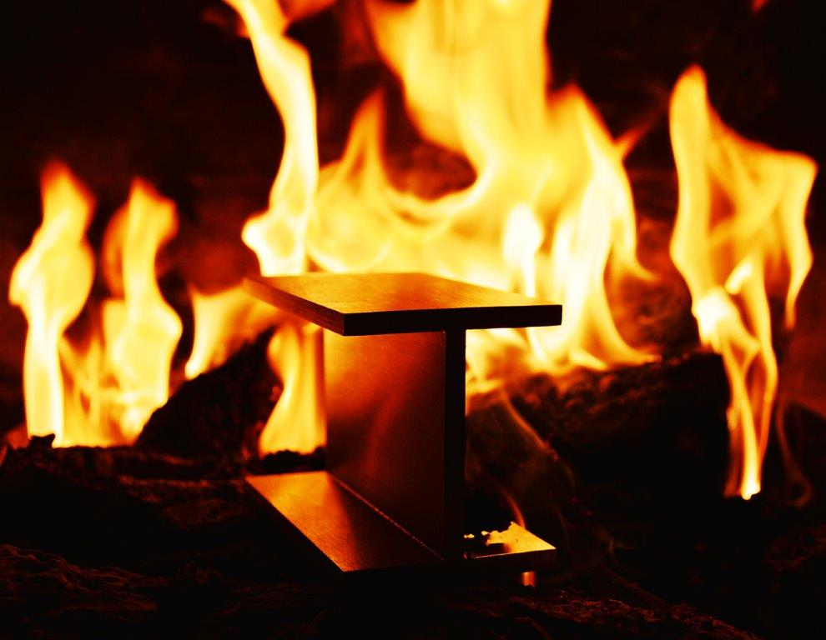
The Requirements
Fire load density
Fire safety classification (Bsk)
Design fire exposure (temperature)
Requirements
Design
Temperature domain
Mechanical behavior
Provided by the Swedish building regulations, EKS
Bunker is part of the experimental halls and BSK is adopted from a high building classification
Fire protection

Slide 4
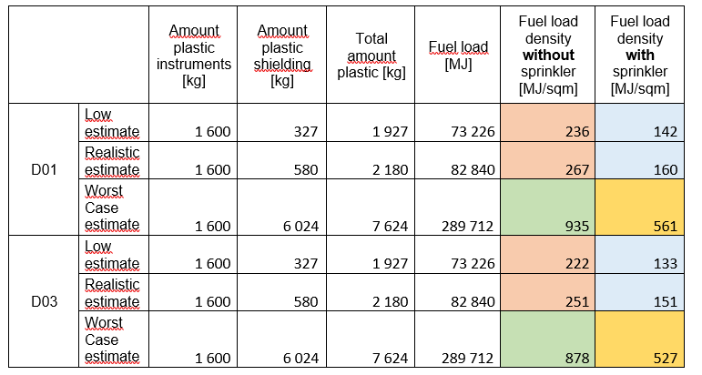
Fire load density
12 instruments (8 long and 4 short) are assumed.
A total amount of 1600 kg plastics is introduced by the instruments.
Shielding material is (Mirrobor) consist of 20% combustibles (plastic).
Three different values on the amount of shielding material are presented for each bunker:
A low estimate (only optics shielded)
A realistic estimate (Optics+side+½ rear of the instruments)
A worst case (Optics+side+rear+roof+floor of the instruments)

Slide 5
Sprinkler
Provides some reduction if fire protection is designed using the classification method
Low and realistic estimate on shielding = R60 (no effects of sprinkler)
High estimate on shielding = R90 (R120 without sprinkler)
Fire load density may be reduced to 60% using the design method of a natural fire
Sprinkler inside the bunker
Rescue service operation inside bunker is difficult
Defense in depth
Safe egress
Reduce fire load
…

Slide 6
Analysis of a natural fire
Method by European standard SS-EN 1991-1-2 to find the temperature exposure
Takes several parameters into consideration
Building geometry
Fire load density
Surrounding materials
Opening factors
Sprinkler
Steel temperature can be calculated using European standard SS-EN 1993-1-2
Critical temperature 585°C

Slide 7
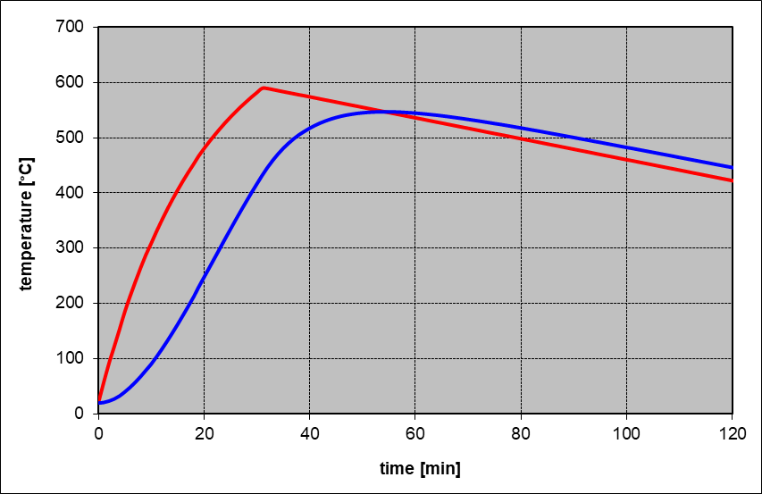
The results
Worst case estimate
No sprinkler
Fuel load density >800 MJ/sqm
High (steel) temperature
R120 using classification method
With sprinkler
Fuel load density >800 MJ/sqm
High (steel) temperature
R120 using classification method
Low and realistic estimate
No sprinkler
Critical temperature is exceeded
With Sprinkler
Low steel temperature in the fully developed fire (<585°C)
Localized fire
The localized fire will require a safety distance or fire insulation

Slide 8
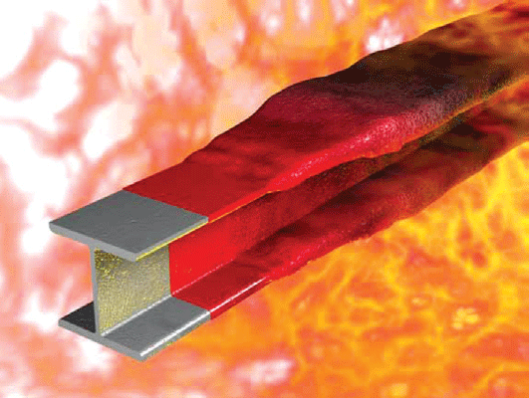
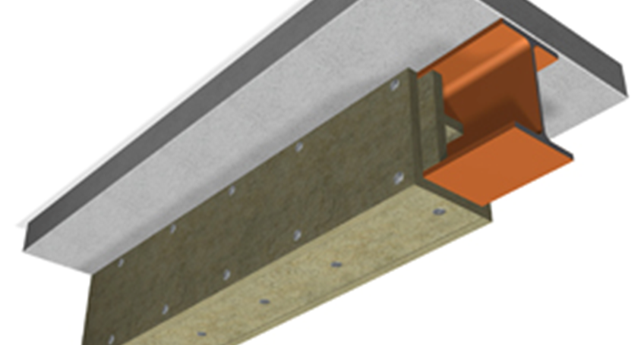
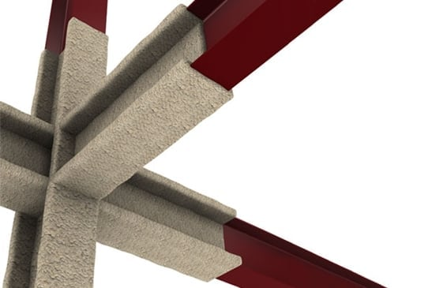
The future
Determine the exact amount of shielding
Possibility to use safety distances to fire sources
Decide on the means of protection
Or
Back to basics and the possibility to revise the fire safety classification of the steel members

Slide 9
Thank you!
wsp.com

