Slide 1
Evacuation Plan
Fredrik Jörud
Fire Protection Engineer
European Spallation Source ERIC
190510

Slide 2
Why?
the licencee shall in conjunction with an evacuation, as far as reasonably possible, verify that relevant areas and spaces have been evacuated

Slide 3
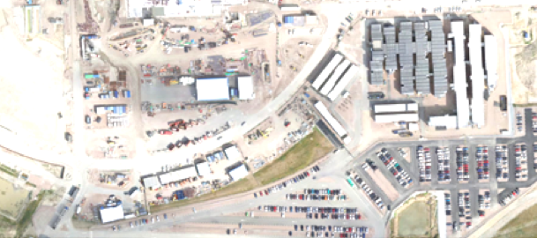
Office area assembly points
Thursday
SEC Reception
Your position
ESS Reception

Slide 4
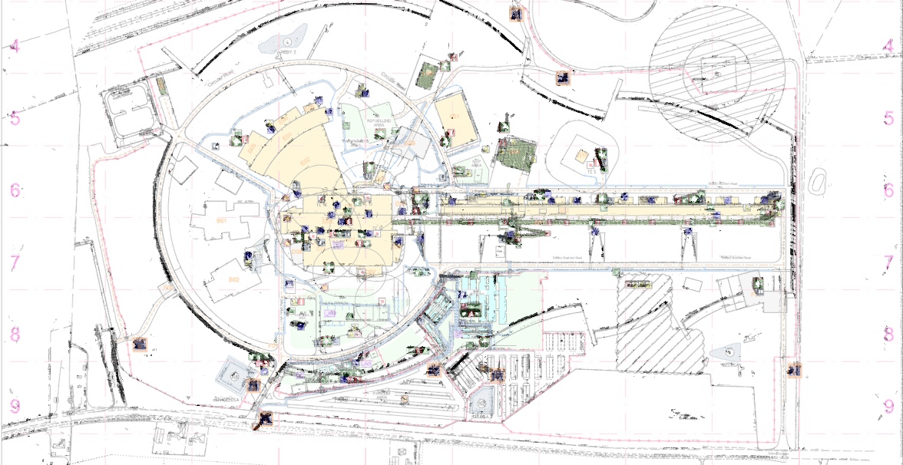
Temporary assembly points
Your position

Slide 5
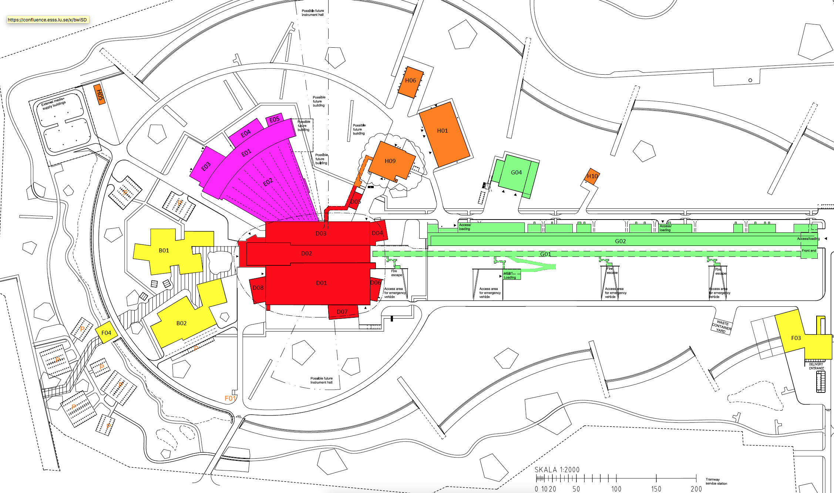
H06
H05
H01
H09
H10
4
2
MCR
D02
5
D01
D08
D06
D07
3
1

Slide 6
Atmospheric release
H06
H05
H01
H09
H10
4
2
D02
MCR
D02
5
MCR
D01
D01
D08
D08
D06
D06
D07
1
D07
3

Slide 7
ESS-0082385 ”ESS Site Evacuation Plan” - Three pillars!
Training
Card reader system
Organisation
Evacuation alarm types
Access card
Evacuation leader - Area 1, Building A
Evacuation leader - Area 2, Building A
Assembly points
ENTRANCE
Swipe
Assembly point coordinator
“Every person entering this area swipes their card”
- “In case of an evacuation alarm, I will evacuate immediately"
Building “A” is evacuated
radio
Access card
Swipe
automatic
Main control room shift leader
receives the balance

Slide 8
Assembly point coordinator (APC) operations
1

Slide 9
On my way to AP#
1
SL
2
APC
*Use “Gate Guard” until SL is operational in the emergency preparedness organisation

Slide 10
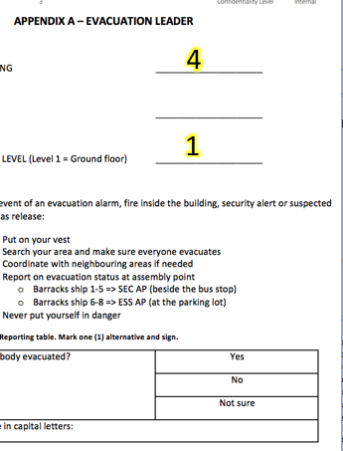
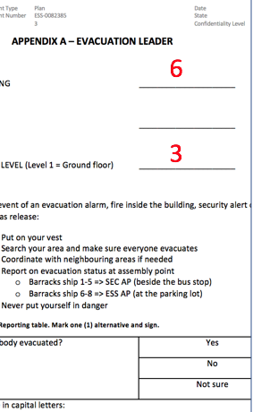
Assemble evacuation notes
3
APC
Collect the evacuation notes!
EL
EL
EL

Slide 11
Keep evacuees informed
4
APC
Evac alarm in offices
– Root cause is not yet known
– Swipe access cards
- evacuees coming from Building# assemble behind me!
EL

Slide 12
STATUS to Shift Leader (SL)
5
SL
Radio from APC.
“SL, SL
– Everybody is evacuated from Building#
– Evacuation is not confirmed from Building#
APC
*Use “Gate Guard” until SL is operational in the emergency preparedness organisation

Slide 13
Bad weather
Check if you can access building xx – use megaphone - call for people to follow you indoors!
APC
Because of bad weather - we will go indoors – Follow me!
EL

Slide 14
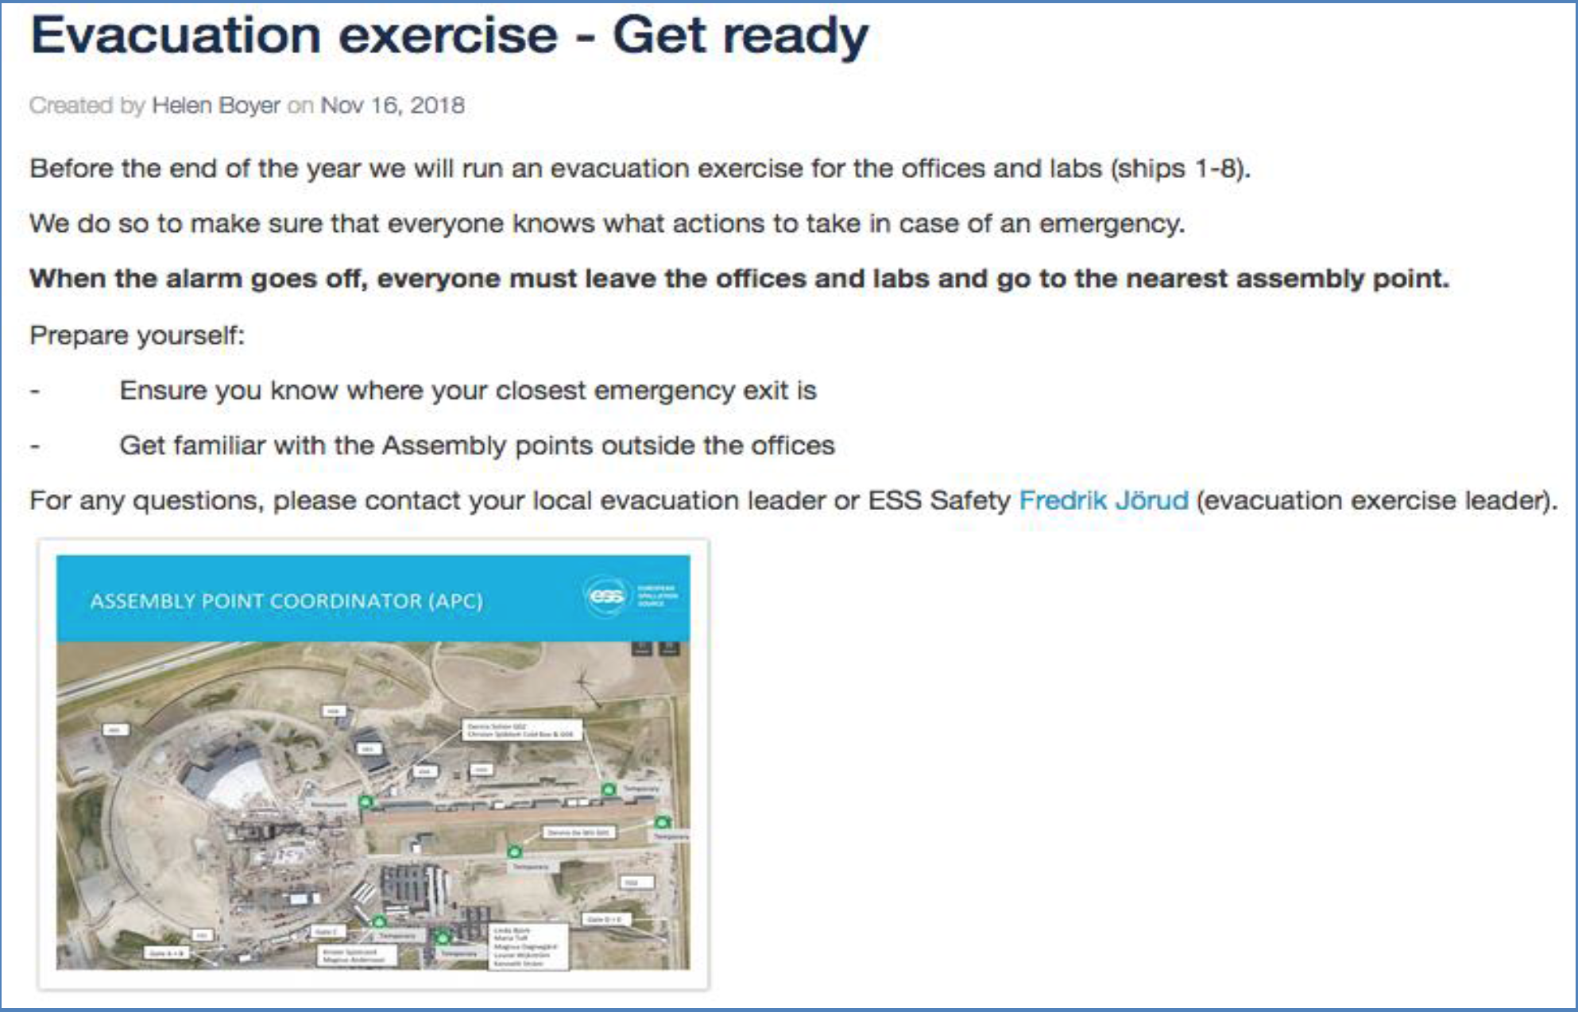

Slide 16
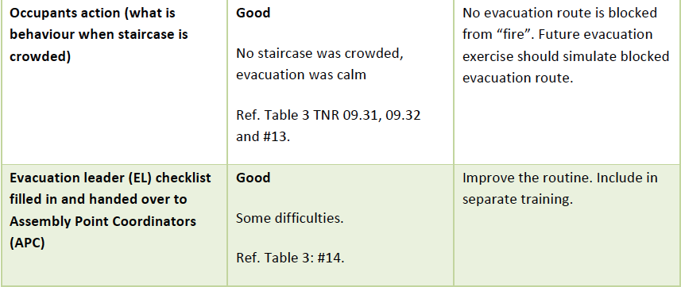

Slide 17
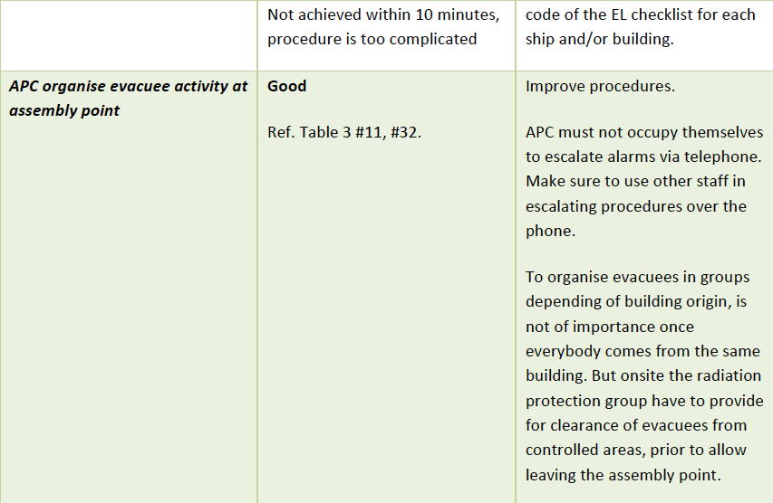

Slide 19
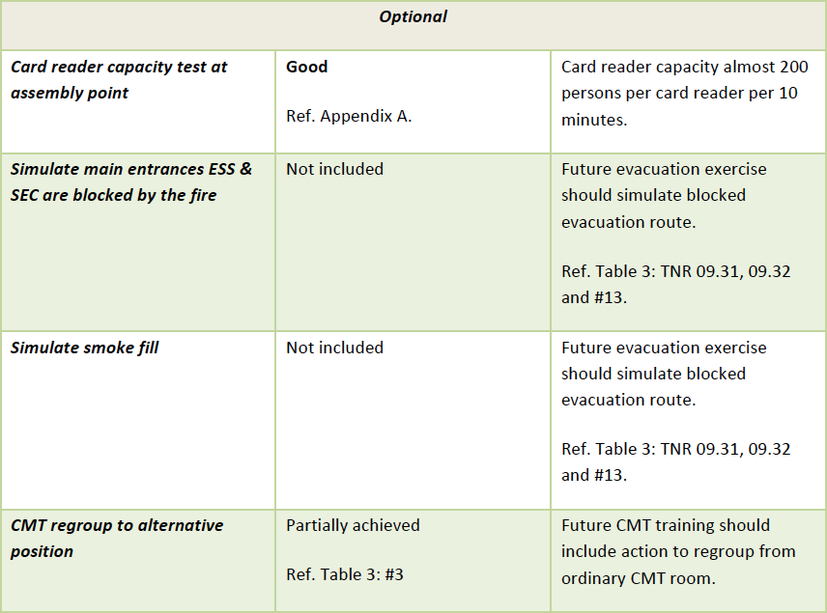

Slide 20
The End

Slide 21
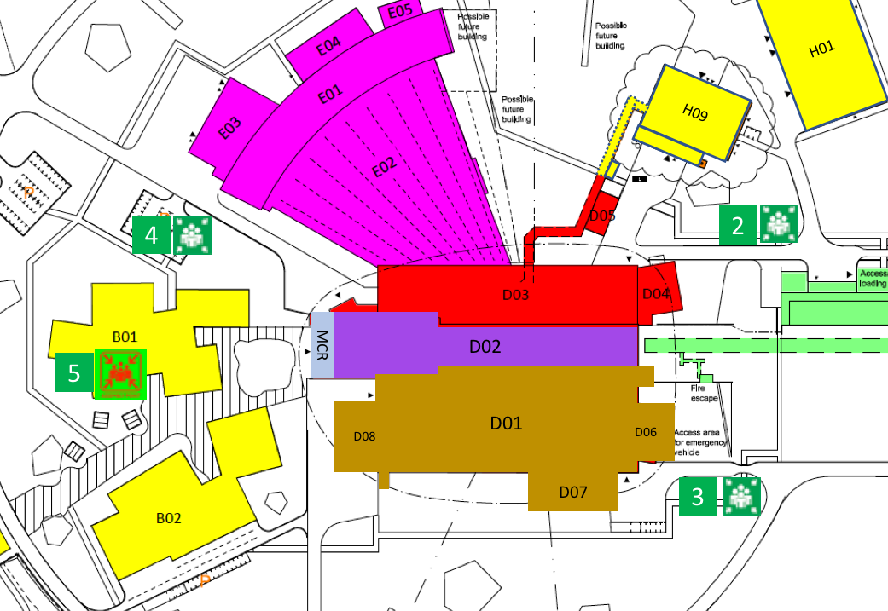

Slide 22
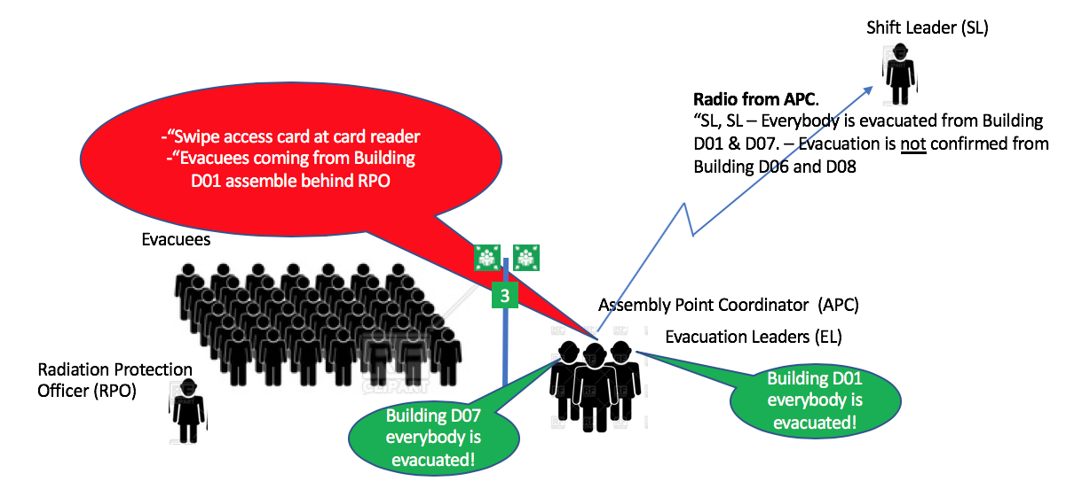
The Objective
*Use “Gate Guard” until SL is operational in the emergency preparedness organisation

Slide 23
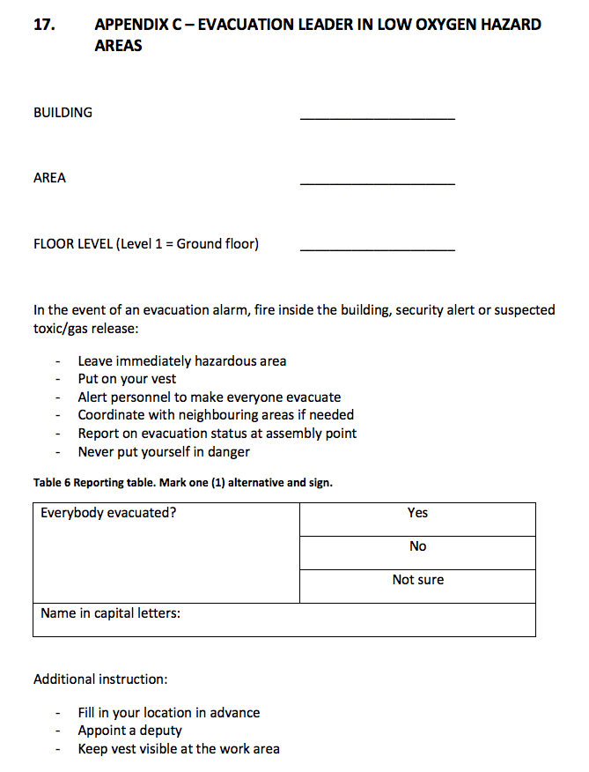
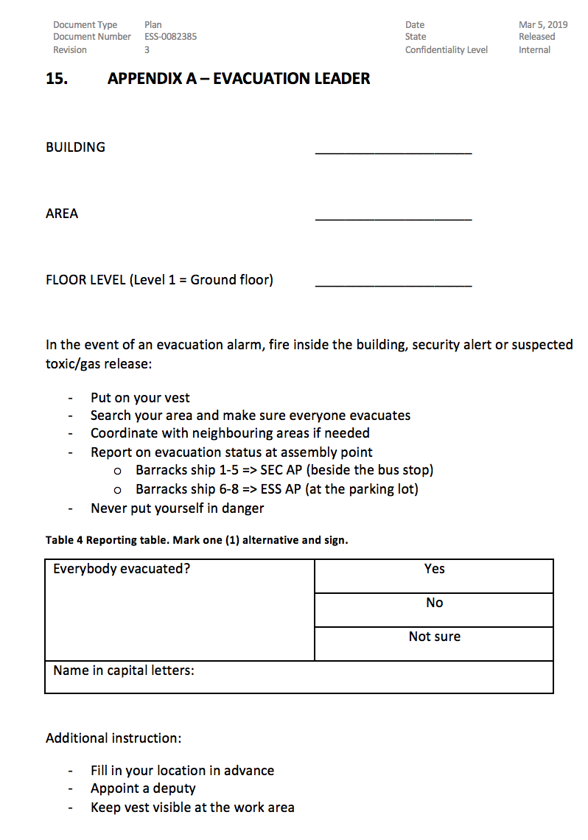
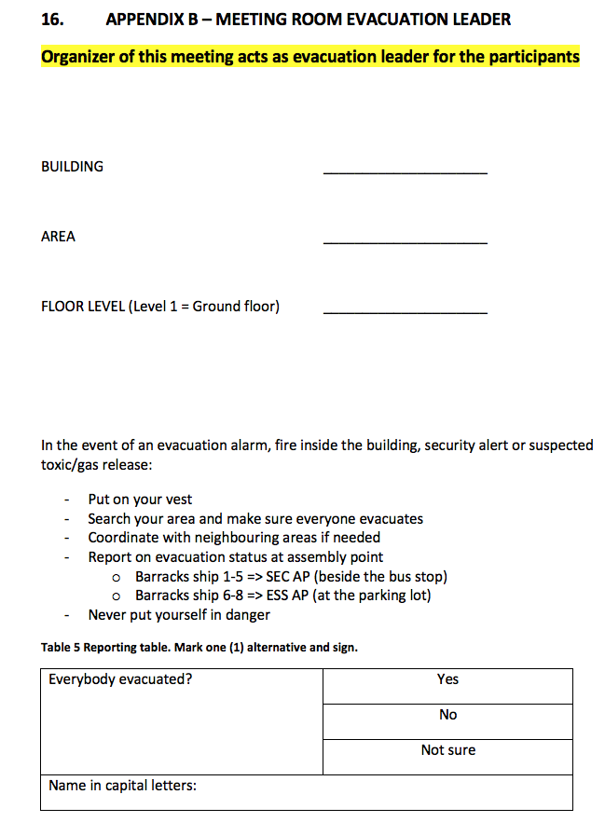
Evacuation notes - Examples
In conference room
At ODH area
On site
G02
1
Cold Box
G02
Test stand
Brightness
100
100
2

