Slide 1
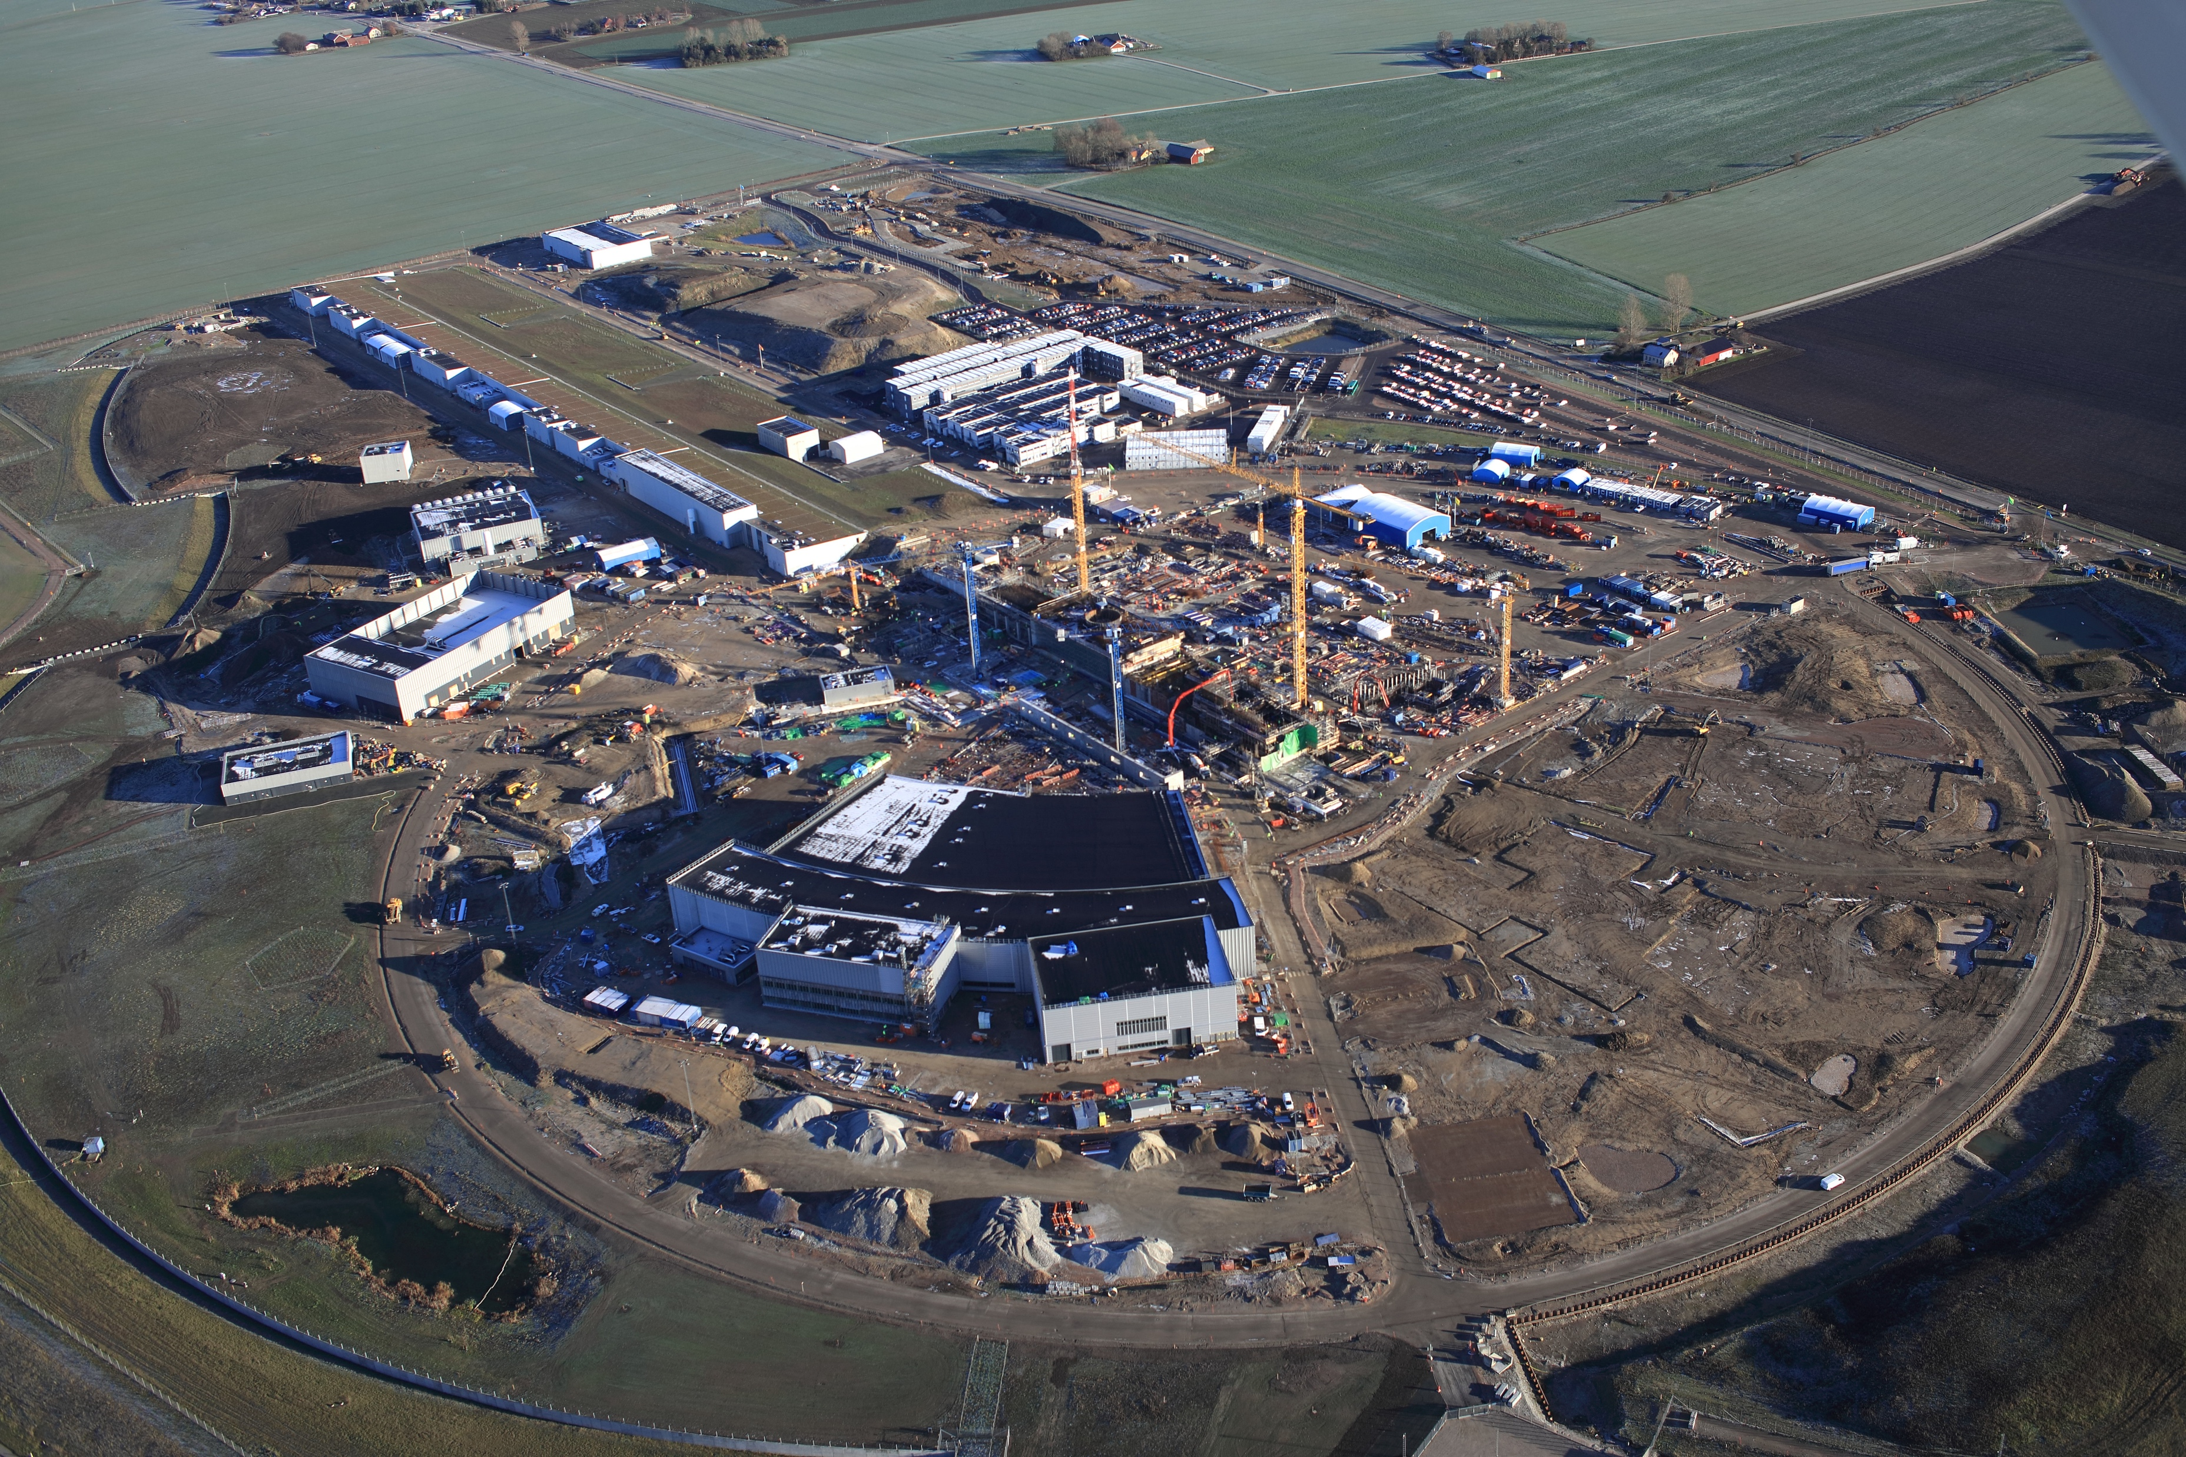

Fire Safety
Bert Manzlac
Enrico Zennini
Andreas Hoppe
Peter Jacobsson
Nina Åsvatne
Fredrik Jörud
Helen Boyer
IT
SF
IT
SF
20
19
20
19

Slide 2
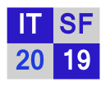
Day 1 – Fire Safety
Areas
Design of facility
Desing of systems
Experience
Fire & Radiation
Presentation from:
J-Lab
CERN
Lund University
ESS (WSP, Lloyds, BRIAB)
RACE

