Slide 1
Addressing Instrument Safety during Design Phase at ESS
Helena Ramsing
OHS Engineer, NSS
European Spallation Source ERIC
2019-05-14

Slide 2
The NSS Project
Enabling Science
Neutron Scattering Systems – a project delivering the science enabling parts of ESS
Instrument projects
Science support systems – Sample Environment, User Labs, User Office
Instrument Technologies – Choppers, Detectors, Motion control
This presentation will focus on the instruments

Slide 3
The NSS Project
Enabling Science
A suite of 15 instruments and 1 Test Beam Line
20 in-kind partners involved, representing 11 countries
Instrument team owns the instrument up until hot commissioning
ESS takeover includes an independent safety readiness review as well as internal NSS reviews

Slide 4
Instruments – Phases and Tollgates
Tollgates conducted by NSS between the stages to make sure all demands are met
Demands are set on design, documentation, CE marking, H&S…

Slide 5
Instrument Hazard Analysis – The Full Concept
Needs to cover all aspects of hazards coming from each instrument and the instrument suite.
Radiological hazards, Defence in Depth, Conventional Safety
An NSS-wide approach was needed as to not end up with 15 different versions and maybe not all the sought-after information
The instruments will conform to European standards (CE marking) in which a hazard analysis is mandatory.
Input for Personnel Safety Systems

Slide 6
Conventional Safety
The conventional safety of an instrument is recorded in an NSS-wide template.
The template will build up a register of all identified hazards for each instrument in operation and maintenance modes
The design documentation as well as the operation and maintenance manuals will show how the hazards will be treated

Slide 7
Conventional Safety
We ask the teams to provide:
System designation
Hazard Category
Source
Likelihood/Severity → Level of Risk (Green/Yellow/Red)
Hazard Treatment Type
Hazard Treatment
Treatment Responsible
Treatment Reference
L.O.R. after implemented treatment
Additional treatment needed

Slide 8
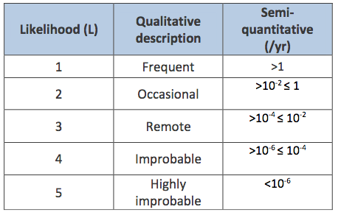
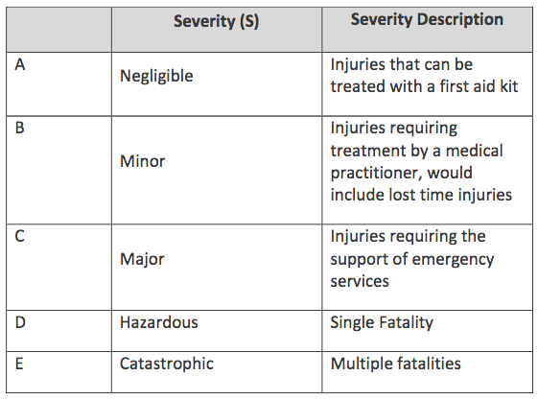
Safety Matrix
The ESS-wide matrix for conventional safety along with descriptions
Instrument’s lifetime is at maximum 50 years and it will be rebuilt during that lifespan.

Slide 9
Personnel Safety System
The PSS is developed from the findings of the hazard analysis
Developed, installed and validated by the ICS group at ESS, the future operation and maintenance is still undecided within ESS
The PSS is developed to protect the personnel from ionising radiation (not residual) as well as other hazards. With an activated PSS access to hazardous areas are prevented.
Hazards to be mitigated by the PSS: Cryo, HV, Magnetic fields, Vaccum, Lasers, ODH, Motion

Slide 10
Review of the Instrument Hazard Analysis – CS
The CS-IHA will not be approved, only accepted in current form
At handover to ESS, ESS also accepts responsibility for the inherent hazards, which is why we need to be involved from design to finished instrument
Things to focus on for accepting the current form:
Have any obvious hazards been missed?
Is the L.O.R. correct for the hazard?
Is the suggested treatment appropriate?
Does the hazard treatment lie with the correct function?
Shielding calculations and dose restrictions are reviewed by the shielding coordination group and the radiation protection group.

Slide 11
Challenges
Consolidate hazards that are not hazardous in one instance but will be across the suite
Communicating Swedish legislation to 11 different countries.
Standardised solutions
Defining boundaries and limitations of instruments
Complying with CE requirements – making sure everything is captured
Quantifying the likelihood of events

Slide 12
Thank you for your attention!
Any questions?

