Slide 1
Student Safety Program at Jefferson Lab
International Technical Safety Forum
2019
European Spallation Source
Lund, Sweden
Bert Manzlak, CSP

Slide 2
U.S. National Laboratories

Slide 3
Thomas Jefferson National Accelerator Facility
Jefferson Lab Newport News, Virginia
Its primary mission is to enable basic research for building a comprehensive understanding of the atom’s nucleus
12 GeV Electron Beam Accelerator
~1,400 meters CEBAF Four Experimental Halls
First beam - 1995
~ 750 Staff
~ 1,500 Users (~ 200 daily)
~ 200 Students (~100 daily)

Slide 4
Jefferson Lab

Slide 5
Student Safety Program at Jefferson Lab
Student Mentorship Program
Equals
Risk Reduction
“Students at Jefferson Lab are not considered to have sufficient practical work experience or hazard-recognition skills for the equipment or processes to which they may be exposed. They require on-the-job observation and coaching to a greater degree than would a new employee with prior experience.”
Jefferson Lab EH&S Manual Chapter 2600

Slide 6
Student Safety Program at Jefferson Lab
Finding Value in
Program Investment
“Students are assigned a Mentor while at Jefferson Lab. Mentors are expected to inform Students of the hazard issues associated with their tasks. Students also receive training to understand and mitigate these hazards. Mentors provide coaching and on-the job observation or assign a local supervisor to ensure that individuals who are considered "Students" receive the proper training, coaching, and oversight.”
Jefferson Lab EH&S Manual Chapter 2600

Slide 7
Student Safety Program at Jefferson Lab
“1/3 of U.S. PhDs in Nuclear Physics carried out their research at Jefferson Lab”

Slide 8
Unwanted Student Events
Student Fatalities
@ National Laboratories
@ Jefferson Lab

Slide 9
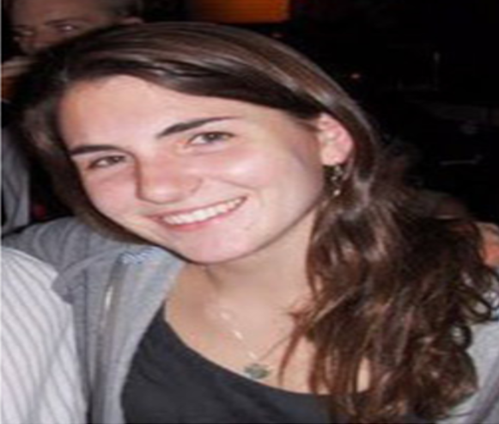
Student Fatality
Machine Shop Accident – April 2011
Location: Yale University Sterling Chemistry Laboratory Machine Shop
Injury: Death
All information provided here is summarized from media accounts of the incident
Description:
Michele Dufault, a Yale undergraduate student, was working in a laboratory machine shop late at night finishing her senior research project.
Apparently she had been working late on a number of occasions to finish before graduation.
While working alone, it appears her long hair was caught in lathe and she died due to asphyxia from neck compression. (Students under Yale policy are not to work unsupervised.)

Slide 10
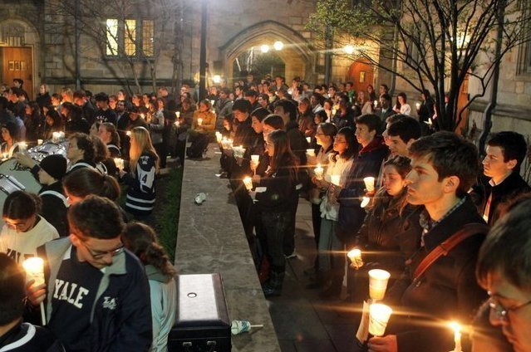
Student Fatality
She was found at 2:30 a.m. by other students in the building who then called emergency services.
Michele was trained in machine shop safety.
Causes: Possible issues include not using buddy system;
no enforcement of Yale safety policy on oversight.
Possible Stressors: Fatigue (2:30 a.m.) time crunch (finish her project)

Slide 11
Student Fatality
Chemistry Lab Accident – December 2008
Location: University of California, Patrick Harran Chemistry Laboratory Los Angeles
Injury: Death
All information provided here is summarized from media accounts of the incident
Description:
“Sheri” Sangji a UCLA research assistant, suffered severe burns from a fire that occurred when a plastic syringe she was using to transfer the pyrophoric reagent (tertbutyllithium) from one sealed container to another came apart, spilling the chemical and igniting a fire.
The chemical manufacturer had provided detailed instructions for safe handling.
The researcher learned to make the chemical transfer from a laboratory postdoctoral researchers.

Slide 12
Student Fatality
The postdoctoral researcher would later
admit he had not read the instructions
and did not follow them.
The fire/fatality would ignite a landmark
legal case and the first-ever felony
charges for safety violations against
an American professor.
The legal proceedings have lead to a
significant increase in the safety
standards of research laboratories
in academic settings.

Slide 13
US Department of Energy Laboratories
Every year more than just a few students are injured while working at the DOE National Laboratories.
Examples:
Electrical Shocks
Chemical Exposures
Machine Shop Events
Laser Exposures

Slide 14
Unwanted Student Events at Jefferson Lab
July 12, 2012
Graduate Student
RF Cavity Cell Failure
Student hit with glass on arm, clavicle and face
~200 torr glass flange failure
July 24, 2013
Undergraduate Student
Electrical Shock while Testing High Voltage Cables
+/- 10 Vdc to 3000 Vdc with 0 to 10 mA load current
Student reenactment

Slide 15
Students at Jefferson Lab
Annual Average
High School ~ 10
Undergraduate ~ 30
Graduate ~ 170
Plus
Summer Programs ~ 80

Slide 16
Government Requirement
Department of Energy
10 C.F.R. 851
Workers Safety and Health Plan
General requirements —
Contractors must provide a hazard free place of employment and ensure that all work performed is in compliance with the worker safety and health program.

Slide 17
Student Safety Program at Jefferson Lab
Strategic Approach
at
Jefferson Lab

Slide 18
Jefferson Lab’s Student Safety Strategic Approach
Program Policy and Procedures
Risk Assessment of Workplace Hazards
Mentor Skills Assessment and Training
Safety Observations
Annual Review

Slide 19
Student Safety Program at Jefferson Lab
Associate Director ESH&Q
Human Resources Manager
User Liaison Group Manager
Education Division Manager

Slide 20
Workplace Task Hazard Analysis
All tasks at Jefferson Lab are evaluated for hazards prior to performance. A determination of risk is then assigned which dictates the relevant mitigating functions. A graded approach, commensurate with the risk code assigned, programmatic impact, and quality assurance, is used to determine the level of rigor allotted for each activity.
Jefferson Lab EH&S Manual Chapter 3210

Slide 21
Task Hazard Analysis

Slide 22
Task Hazard Analysis

Slide 23
Mentor Skills Assessment & Training

Slide 24
Safety Observations

Slide 25
Safety Observation Form

Slide 26
Associate Director of ESH&Q Message to Mentors

Slide 27
EH&S Review of Student Scope of Work & Training Record

Slide 28
What Else?
Student Survey
Mentor Survey
Student Safety Orientation Training Code SAF 099
EH&S Manual Chapter 2600 Student Safety Program
Administrative Manual Section 203.07 Students, Co-Op Programs, and Mentoring
Lessons Learned
Annual Review
Opportunities for Improvement

Slide 29
Bert Manzlak, CSP
manzlak@jlab.org
Jefferson Lab Finds Value in
Program Investment
Student Mentorship Program
Equals
Risk Reduction

Slide 30
Back Up Slides

Slide 31
Student Mentorship Program Equals Risk Reduction
“Students at Jefferson Lab are not considered to have sufficient practical work experience or hazard-recognition skills for the equipment or processes to which they may be exposed. They require on-the-job observation and coaching to a greater degree than would a new employee with prior experience.”
Jefferson Lab EH&S Manual Chapter 2600

Slide 32
Finding Value in Program Investment
“Students are assigned a Mentor while at Jefferson Lab. Mentors are expected to inform Students of the hazard issues associated with their tasks. Students also receive training to understand and mitigate these hazards. Mentors provide coaching and on-the job observation or assign a local supervisor to ensure that individuals who are considered "Students" receive the proper training, coaching, and oversight.”
Jefferson Lab EH&S Manual Chapter 2600

Slide 33
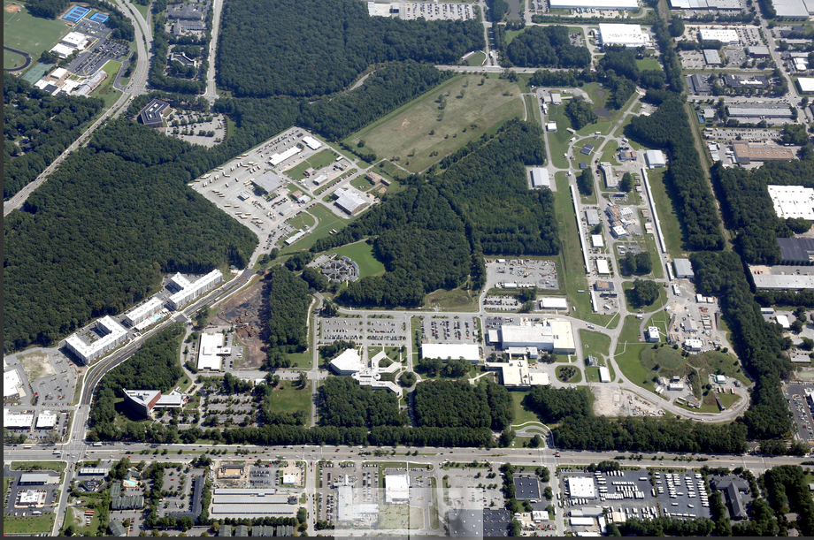

Slide 34
Experimental Halls

