Slide 2

International Technical Safety Forum
ITSF 2019
14th May 2019, European Spallation Source
A Multi-Hazard approach to structural safety: the POPS-B technical building
Anne Funken (CERN, BE Safety Unit, LIU Project Safety Officer)
Fulvio Boattini (CERN, TE-EPC-HPC)
Raul Fernandez Ortega (CERN, SMB-SE-TOD)
Marco Andreini, Giordana Gai, Saverio La Mendola (CERN, HSE-OHS-IB)
Giordana Gai
EDMS 2150706v.1

Slide 3
International Technical Safety Forum 2019, Session “New projects and challenges”
A Multi-Hazard approach to structural safety: the POPS-B technical building
Outline
Introduction to structural safety concepts and presentation of the case study
Seismic safety considerations
Structural fire assessment
Analysis and assessment of the explosion effects
Giordana Gai
EDMS 2150706v.1

Slide 4
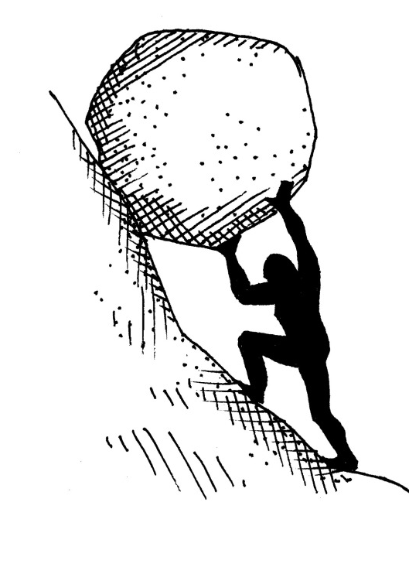
International Technical Safety Forum 2019, Session “New projects and challenges”
A Multi-Hazard approach to structural safety: the POPS-B technical building
Structural Hazard Performance Demand
What’s determining the structural Demand?
Dead loads (e.g. self weight)
Imposed or live loads
Environmental loads (e.g. snow and wind)
Accidental loads (e.g. fire and explosions)
Earthquake loads
D
C
What’s the Capacity?
Measure of the capability of a structure and its elements to withstand the applied loads
Structural Assessment
D < C
Greek myth of Σίσυφος (Sisyphus)
Giordana Gai
EDMS 2150706v.1

Slide 5
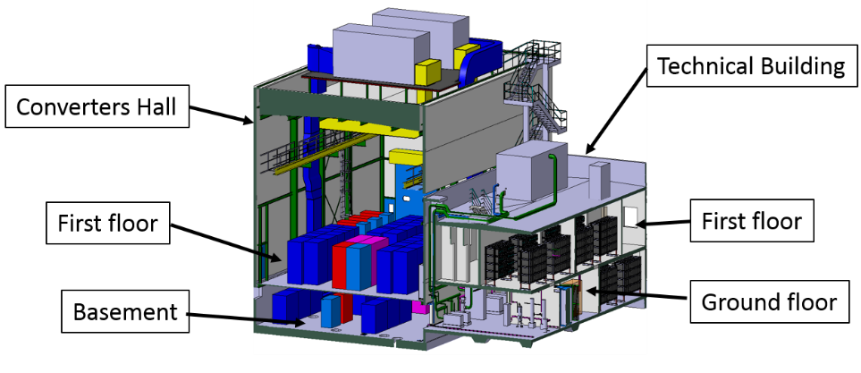
International Technical Safety Forum 2019, Session “New projects and challenges”
A Multi-Hazard approach to structural safety: the POPS-B technical building
Building 245 – POPS-B
Building 245 is foreseen that will house the new Main Power Supply of the PS Booster accelerator rings, in the frame of the 2 GeV energy increase requested by the LHC Injectors Upgrade (LIU) project.
This building is made of two parts:
Converters Hall - two story steel building 14.20 x 20.90 x 15 m
Technical building - two story concrete building 9.6 x 19.55 x 7.85 m
Giordana Gai
EDMS 2150706v.1

Slide 6
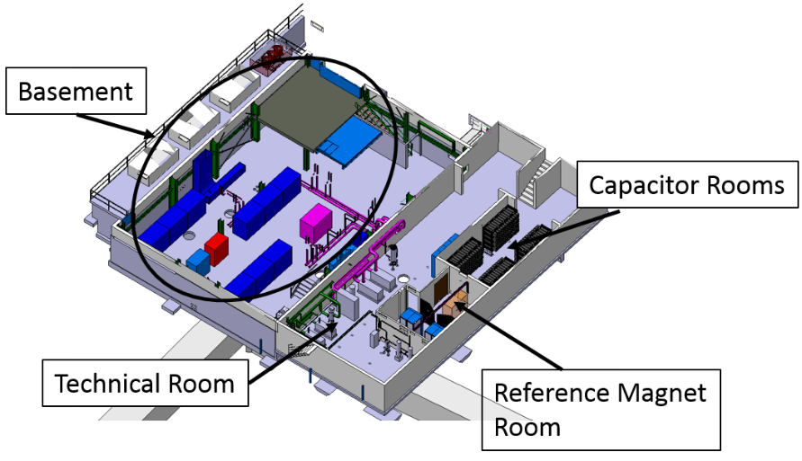
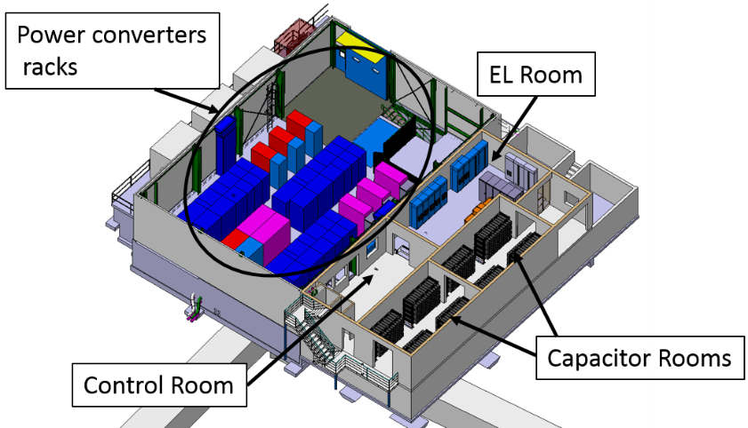
International Technical Safety Forum 2019, Session “New projects and challenges”
A Multi-Hazard approach to structural safety: the POPS-B technical building
Building 245 – POPS-B
The Technical Building is divided in the following main rooms listed by floor:
Ground floor
Technical Room (S-402) with the pumping station equipment and the electrical cabinets needed for its operation;
One room for capacitor banks (S-401);
Reference Magnet room (S-403) with magnetic field measuring equipment (a magnet and some electronics).
First floor
Two rooms for capacitor banks (R-401 and R-403);
EL Room (R-004) with electric switchgears and UPS systems.
Giordana Gai
EDMS 2150706v.1
Notes:
Capacitor banks: explosion risk
Technical room: fire risk

Slide 7
International Technical Safety Forum 2019, Session “New projects and challenges”
A Multi-Hazard approach to structural safety: the POPS-B technical building
Introduction to structural safety concepts and presentation of the case study
Seismic safety considerations
Structural fire assessment
Analysis and assessment of the explosion effects
Giordana Gai
EDMS 2150706v.1

Slide 8
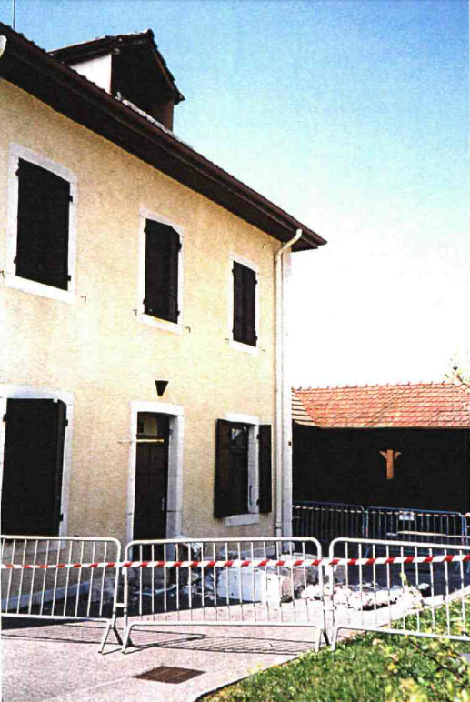
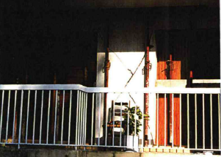
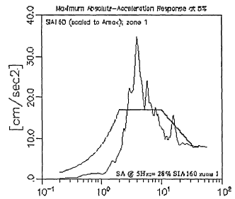
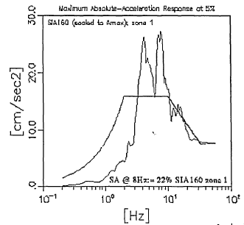
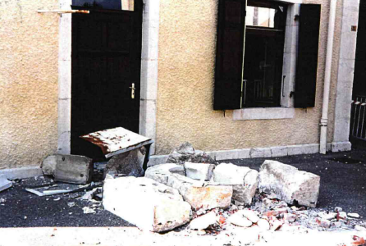
International Technical Safety Forum 2019, Session “New projects and challenges”
A Multi-Hazard approach to structural safety: the POPS-B technical building
Seismic hazard
One of the most significant events: Annecy 1996
How CERN felt such an earthquake
N-S
E-W
Giordana Gai
EDMS 2150706v.1
Notes:
Annecy earthquake. Non structural element damage. Could have been equipment.
Design spectrum was lower than the earthquake that occur for certain frequencies. Now design spectrum has been increased.

Slide 9
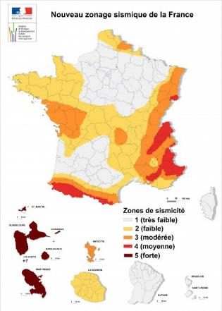
International Technical Safety Forum 2019, Session “New projects and challenges”
A Multi-Hazard approach to structural safety: the POPS-B technical building
Seismic hazard map
What the regulations say for CERN
Peak Ground Acceleration having a probability of exceedance of 10% in 50 years, that means:
Return Period = 475 years
Frequency = 0.002/year
Décret nº 2010-1255 du 22 octobre 2010:
Seismic zone 3;
Reference peak ground acceleration on type A ground, a_{gR} equal to 1.10 m/s² = 0.11 g
Design ground acceleration a_{g} is equal to a_{gR} times the importance factor γ_{I} (max 1.5)
Giordana Gai
EDMS 2150706v.1
Notes:
Design for this type of event.
Importance factor is related to the consequences. It depends on the type of building. At CERN it is considered 1.0 (industrial buildings); in general it can be 1.5 (hospital).

Slide 10

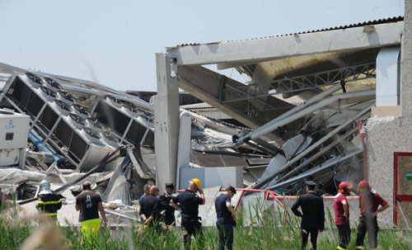
International Technical Safety Forum 2019, Session “New projects and challenges”
A Multi-Hazard approach to structural safety: the POPS-B technical building
Seismic hazard map
What the regulations say for CERN
Code de la construction et de l'habitation - Article R112-1
"…les règles concernant la nature et les caractéristiques des bâtiments, des équipements et des installations et les mesures techniques préventives doivent respecter les dispositions … relatif à la prévention du risque sismique… "
Finale Emilia (Italy – 2012)
a_{gR} =1.1 m/s²
Giordana Gai
EDMS 2150706v.1

Slide 11

International Technical Safety Forum 2019, Session “New projects and challenges”
A Multi-Hazard approach to structural safety: the POPS-B technical building
Seismic hazard map
Standards on Structures: EUROCODES
The analysis of the structure has been carried out in conformity with the Eurocode 8 (EN 1998)
The safety verifications of the steel elements have been performed in accordance with the Eurocode 3 (EN 1993)
The concrete elements, including the foundations, have been verified following the Eurocode 2 (EN 1992)
Giordana Gai
EDMS 2150706v.1

Slide 12
International Technical Safety Forum 2019, Session “New projects and challenges”
A Multi-Hazard approach to structural safety: the POPS-B technical building
Introduction to structural safety concepts and presentation of the case study
Seismic safety considerations
Structural fire assessment
Analysis and assessment of the explosion effects
Giordana Gai
EDMS 2150706v.1

Slide 13
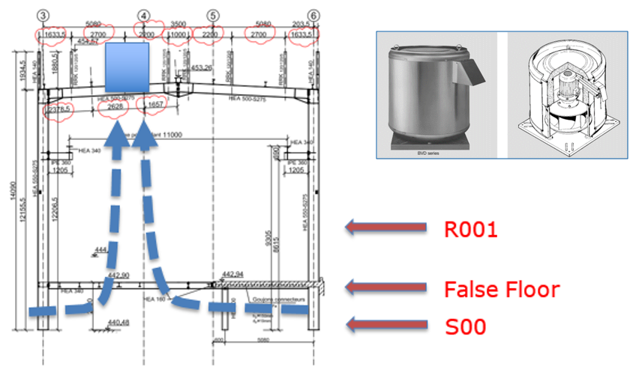
International Technical Safety Forum 2019, Session “New projects and challenges”
A Multi-Hazard approach to structural safety: the POPS-B technical building
Fire safety strategy
Smoke extraction (manual, as typically installed in CERN’s facilities)
Giordana Gai
EDMS 2150706v.1

Slide 14
International Technical Safety Forum 2019, Session “New projects and challenges”
A Multi-Hazard approach to structural safety: the POPS-B technical building
Fire safety strategy
Detection system in all rooms (see table below)
Element | Action
Siren alarms | Switch on
Power converters in R-001 | Emergency switch off
Ventilation of all B245 (concrete and steel parcels) | Emergency switch off
Air exhaust dampers | Close the panels (motor driven)
Fire Dampers | Close (motor driven)
Smoke extraction openings | Open the panels (motor driven or passive)
Low voltage switchgears | No actions. The general emergency stops are installed close to entry doors
Giordana Gai
EDMS 2150706v.1

Slide 15
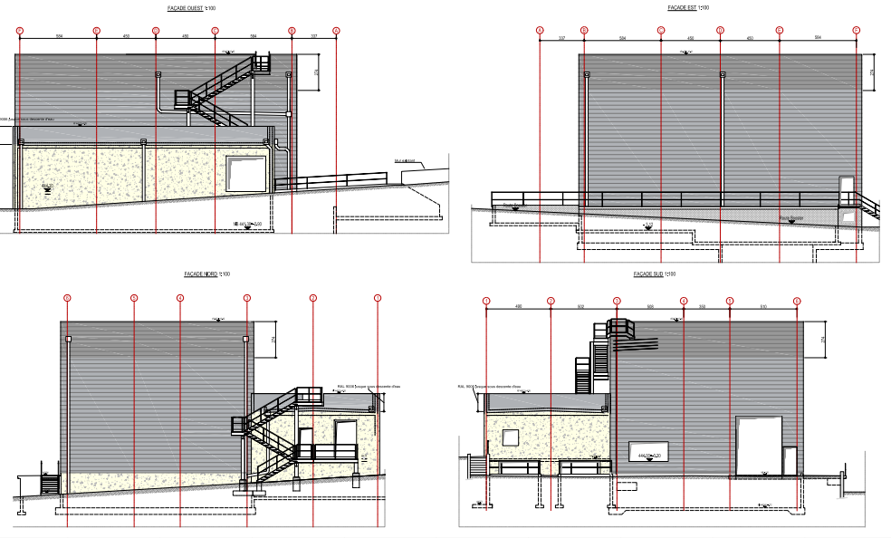
International Technical Safety Forum 2019, Session “New projects and challenges”
A Multi-Hazard approach to structural safety: the POPS-B technical building
Fire safety strategy
Ventilation openings
Giordana Gai
EDMS 2150706v.1

Slide 16
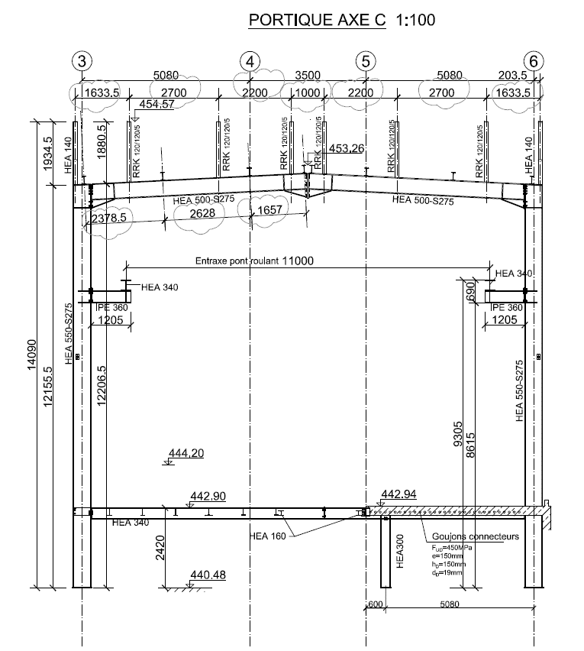
International Technical Safety Forum 2019, Session “New projects and challenges”
A Multi-Hazard approach to structural safety: the POPS-B technical building
Steel structure
Steel beam HE 500 A profile
Structural scheme of a simply supported beam
Vertical applied load of 9.5 kN/m horizontally distributed (steel platform, beams)
Giordana Gai
EDMS 2150706v.1

Slide 17

International Technical Safety Forum 2019, Session “New projects and challenges”
A Multi-Hazard approach to structural safety: the POPS-B technical building
Fire load calculation
Assumptions (EN 1991-1-2, Annex E)
$$q_{f,k}=m_{k}∙H_{u}∙\text{ψ}$$
$$q_{f,d}=q_{f,k}∙k∙δ_{q1}∙δ_{q2}∙δ_{n4}∙δ_{n5}∙δ_{n6}$$
From EN 1991-1-2, Annex E (Table E.1 and E.2)
Characteristic fire load
Design fire load
Coefficient | Description | Characteristics
δ_{q1} = 1.5 | Danger of activation | Compartment area > 250 m²
δ_{q2} = 1.22 | Danger of fire activation | Occupancy (manufactory for machinery & engines)
δ_{n4} = 0.73 | Function of Active Fire Fighting Measures | Automatic fire Detection & Alarm
δ_{n5} = 0.87 |  | Automatic alarm transmission to FB
δ_{n6} = 0.61 |  | Work FB on site
Fast growth (1MW in 150 sec)
k is the combustion factor: 70 %
Giordana Gai
EDMS 2150706v.1
Notes:
Mk is amount of combustible material, Hu is net calorific value, psi is for protected fire loads
Factors: activation risk due to size of the compartment, type of occupancy, active FF measures
Combustione non perfetta…

Slide 18
International Technical Safety Forum 2019, Session “New projects and challenges”
A Multi-Hazard approach to structural safety: the POPS-B technical building
Fire load calculation
Fuel quantity and location
Fuel | Room | m_{k} kg | H_{u} MJ/kg | k comb.factor | q_{f,k} MJ | m_{k, total} kg_room | liters l | ρ kg/m³
Insulating supports inside POWER converters (Epoxy) | R001 | 1450 | 34 | 0.7 | 34510.0
Rapeseed oil of capacitors | R001 | 529.2 | 42 | 0.7 | 15558.5 |  | 540 | 980
Ethernet Cables Polyethylene | R001 | 22.3 | 44 | 0.7 | 685.7 | 70
High density resin | False floor (38 cm, 169.8 m²) | 9678.6 | 20 | 0.7 | 135500.4 |  |  | 1500
Ethernet Cables Polyethylene | R-006 | 1.7 | 44 | 0.7 | 52.0 | 70
Ethernet Cables Polyethylene | S001 | 22.3 | 44 | 0.7 | 685.7 | 70
Low Voltage Cables (EPR) | S001 (1/3 of the tot) | 153.3 | 43 | 0.7 | 4615.3 | 460
6kV/18kV power cables (Polyethylene) | S001 (60% of the tot) | 270.0 | 44 | 0.7 | 8316.0 | 450
Giordana Gai
EDMS 2150706v.1

Slide 19
International Technical Safety Forum 2019, Session “New projects and challenges”
A Multi-Hazard approach to structural safety: the POPS-B technical building
Fire scenario #L01
#L01. Localized fire scenario
(1MC burning, 180 l of rapeseed oil of capacitors)
EN 1991 – Annex C
Heskestad&Hasemi methods
T critical
GAS. Max temp 622 °C at 19 min
STEEL. Max temp 173 °C at 21 min
Giordana Gai
EDMS 2150706v.1
Notes:
Realistic fire scenario

Slide 20
International Technical Safety Forum 2019, Session “New projects and challenges”
A Multi-Hazard approach to structural safety: the POPS-B technical building
Fire scenario #G01
#G01. Generalized fire scenario
(first S001, then after t = 800 sec R001 & R006)
Zone model
Ozone v.3.0.3
T critical
500 °C
GAS. Max temp 836 °C at 52 min
STEEL. Max temp 775 °C at 57 min
Giordana Gai
EDMS 2150706v.1
Notes:
Per sicurezza. Molto + irrealistico , generallizato… analisi a 35 minuti. Talmente gravoso (beni – persi, not interested in the fire resistance not even in the structure), ff intervention (defense strategy).

Slide 21


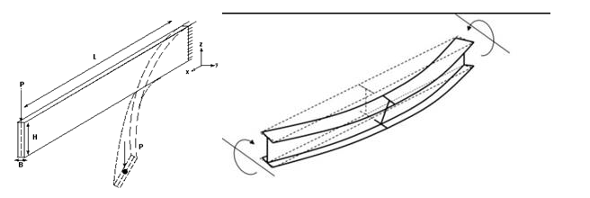
International Technical Safety Forum 2019, Session “New projects and challenges”
A Multi-Hazard approach to structural safety: the POPS-B technical building
Structural safety verifications
Transveral beam (HE 500 A), vertical load of 9.5 kN/m
Four side of exposure
Combined bending and compression with latero-torsional buckling is taken into account
Giordana Gai
EDMS 2150706v.1

Slide 22
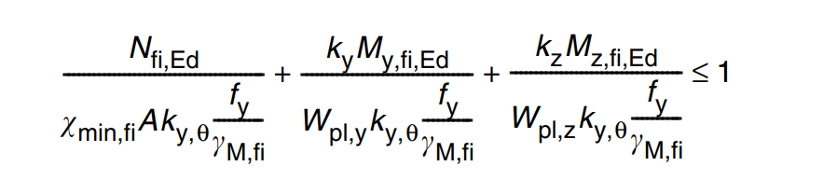
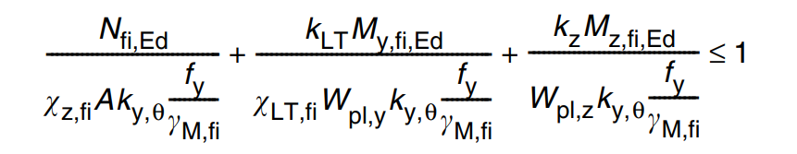

International Technical Safety Forum 2019, Session “New projects and challenges”
A Multi-Hazard approach to structural safety: the POPS-B technical building
Structural safety verifications (Elefir-EN)
L01 #Localized fire scenario
(1MC burning, 180 l of rapeseed oil of capacitors)
Eq. 4.21 a), EN 1993-1-2
Eq. 4.21 b), EN 1993-1-2
Eq. 6.31 EN 1991-1-1
G01 #Generalized fire scenario
(first S001, then after t = 800 sec R001)
Eq. 4.21 a), EN 1993-1-2
Eq. 4.21 b), EN 1993-1-2
Eq. 6.31 EN 1991-1-1
fire resistance verified during the entire duration of the fire
fire resistance verified at 35 minutes
The verification was carried out using Elefir-EN software (fire resistance according to Eurocodes) and hand calculations
$$M_{Ed}≤M_{N,Rd}$$
Eq. 4.21 a)
EN 1993-1-2
Eq. 4.21 b)
EN 1993-1-2
Eq. 6.31
EN 1991-1-1
Giordana Gai
EDMS 2150706v.1

Slide 23
International Technical Safety Forum 2019, Session “New projects and challenges”
A Multi-Hazard approach to structural safety: the POPS-B technical building
Verification #G01 (Elefir-EN)
Analysis at 500 °C (35 minutes of generalized fire scenario #G01)
The interaction formula is verified!
(Eq. 4.21 a), EN 1993-1-2)
0.337 < 1.0
(Eq. 4.21 b), EN 1993-1-2)
0.65 < 1.0
The cross-sectional resistance is verified!
(Eq. 6.31, EN 1993-1-1, adapted for fire situation)
269.580 kNm < 799.908 kNm
demand
capacity
Giordana Gai
EDMS 2150706v.1

Slide 24
International Technical Safety Forum 2019, Session “New projects and challenges”
A Multi-Hazard approach to structural safety: the POPS-B technical building
Introduction to structural safety concepts and presentation of the case study
Seismic safety considerations
Structural fire assessment
Analysis and assessment of the explosion effects
Giordana Gai
EDMS 2150706v.1

Slide 25
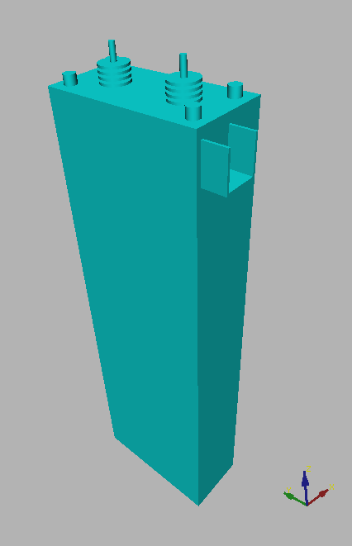
International Technical Safety Forum 2019, Session “New projects and challenges”
A Multi-Hazard approach to structural safety: the POPS-B technical building
Accident scenario
Explosion accidents can occur in consequence of electric faults in oil insulated electrical components.
Giordana Gai
EDMS 2150706v.1
Notes:
First, definition of the accident scenario.

Slide 26

International Technical Safety Forum 2019, Session “New projects and challenges”
A Multi-Hazard approach to structural safety: the POPS-B technical building
Accident scenario
Gaseous pyrolysis products
Explosion accidents can occur in consequence of electric faults in oil insulated electrical components.
An electric arc inside the component causes the pyrolysis of part of the oil ...
Pyrolysis reaction
Electric arc
Giordana Gai
EDMS 2150706v.1

Slide 27


International Technical Safety Forum 2019, Session “New projects and challenges”
A Multi-Hazard approach to structural safety: the POPS-B technical building
Gaseous pyrolysis products
Accident scenario
When the internal pressure reaches the withstand capability of the enclosure, a primary explosion scenario takes place: the enclosure fails, violently releasing the oil and gaseous products herein contained.
oil
Giordana Gai
EDMS 2150706v.1

Slide 28
International Technical Safety Forum 2019, Session “New projects and challenges”
A Multi-Hazard approach to structural safety: the POPS-B technical building
oil mist
Accident scenario
When the internal pressure reaches the withstand capability of the enclosure, a primary explosion scenario takes place: the enclosure fails, violently releasing the oil and gaseous products herein contained.
Part of the oil jet is turned into oil mist and forms an explosive atmosphere together with the gaseous pyrolysis products.
The liquid phase oil forms a pool...
liquid oil pool
Giordana Gai
EDMS 2150706v.1

Slide 29
International Technical Safety Forum 2019, Session “New projects and challenges”
A Multi-Hazard approach to structural safety: the POPS-B technical building
Secondary Explosion scenario
Accident scenario
Two subsequent fault scenarios can take place, if an ignition source is available:
secondary explosion scenario
pool fire scenario
Pool fire scenario
Giordana Gai
EDMS 2150706v.1

Slide 30
International Technical Safety Forum 2019, Session “New projects and challenges”
A Multi-Hazard approach to structural safety: the POPS-B technical building
Methodological approach
external
effects
modelling enclosure
structural response
geometry data (concrete and rebars)
electric system characteristic data
enclosure characteristic data
geometry data
flammable amount and composition
turbulence field
internal
effects
pressure field
flame front
arc energy
modelling
electrical
fault
modelling
primary
explosion
modelling
secondary
explosion
modelling
structural
response
operation conditions
fault location
arc duration
pyrolysis reaction duration
oil mist amount
cloud position
ignition position
ignition delay
venting layout
configuration of doors&panels
material data
boundary conditions
other loads
load combinations
Giordana Gai
EDMS 2150706v.1

Slide 31
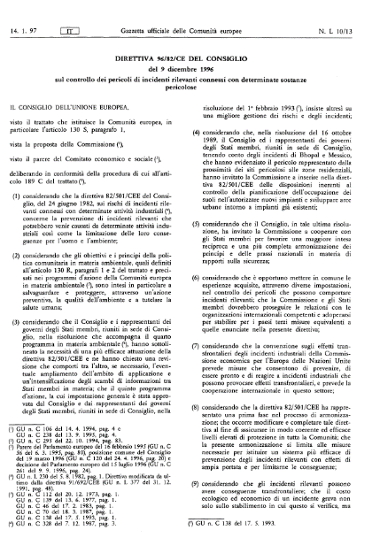
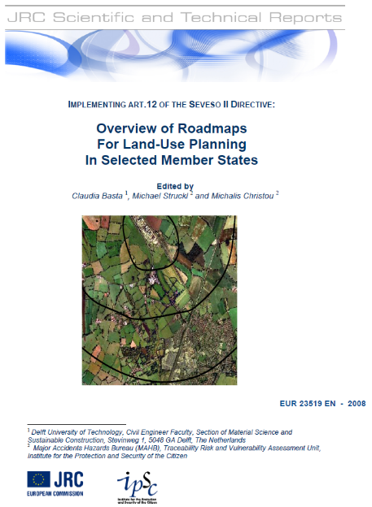
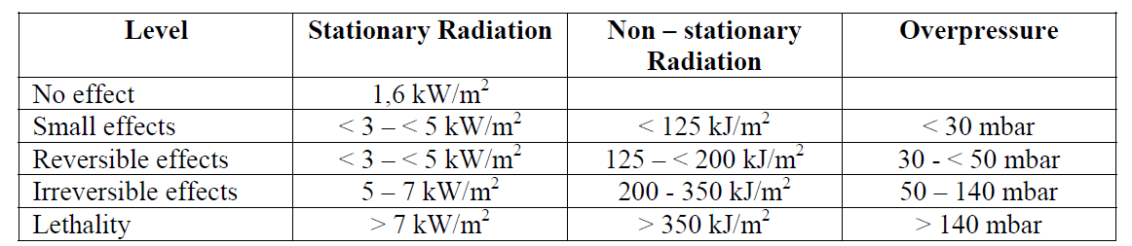
International Technical Safety Forum 2019, Session “New projects and challenges”
A Multi-Hazard approach to structural safety: the POPS-B technical building
Checking external and structural effects
Definition of admissible threshold values
External Effects: Seveso directives
Structural Effects:
Building 245: Serviceability Limit State (SLS) - The material shall not present any irreversible damage
Giordana Gai
EDMS 2150706v.1
Notes:
Life safety → seveso directive
Conservative for structural effects (SLS)

Slide 32
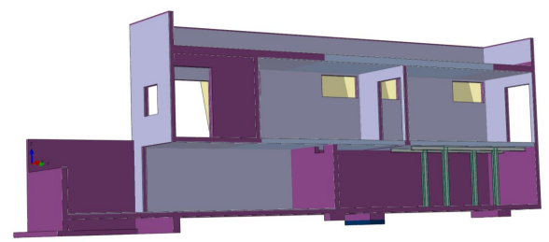
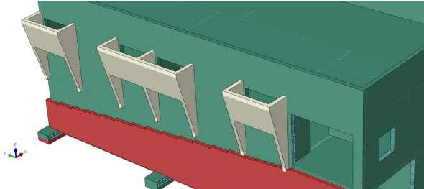
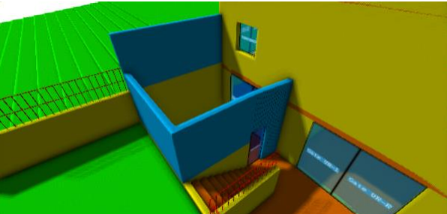
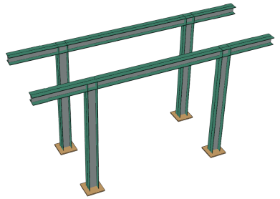
International Technical Safety Forum 2019, Session “New projects and challenges”
A Multi-Hazard approach to structural safety: the POPS-B technical building
Bldg 245 Retrofitting strategy
  Realize compartments: blast resisting doors
  Additional venting areas and RC barriers
  Structural stiffnesses and reinforcements
Giordana Gai
EDMS 2150706v.1
Notes:
On the top, panels that are released in case of an explosion. Contrafforti. Shape: deviate the flux towards the top and gives stiffness in the horizontal plan.
Barriers to protect the area
Blast resisting doors + steel structure to reinforce and sustain the top level.

Slide 33
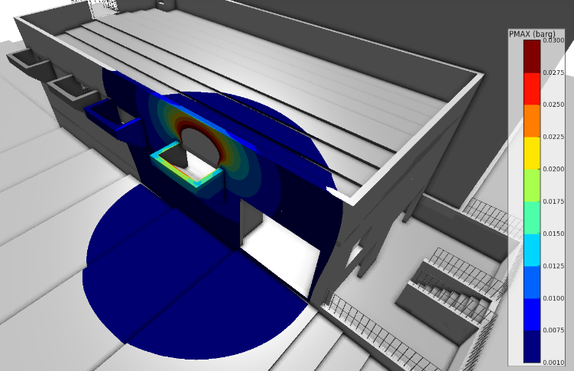
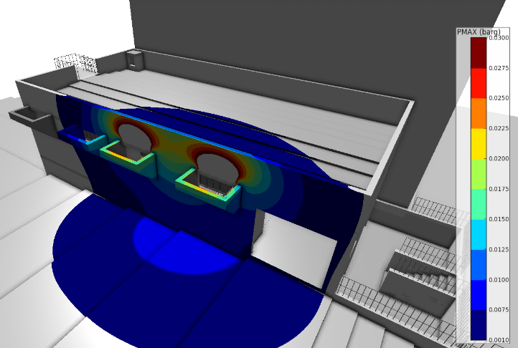
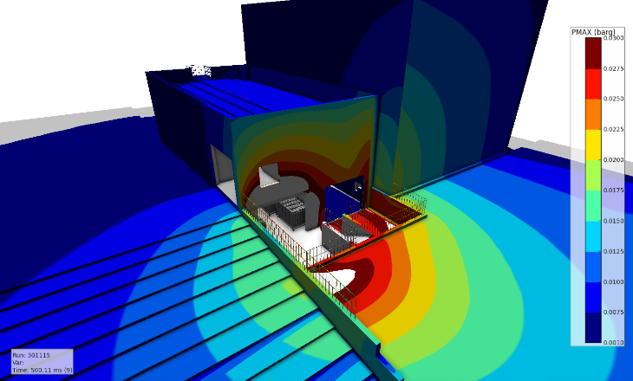
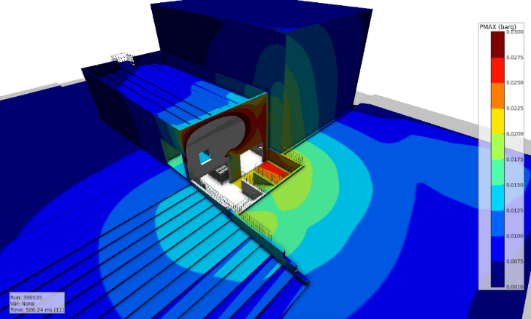
International Technical Safety Forum 2019, Session “New projects and challenges”
A Multi-Hazard approach to structural safety: the POPS-B technical building
Bldg 245 External pressure
First floor: 1 venting area
First floor: 2 venting areas
Ground floor without barriers
Ground floor with barriers
Giordana Gai
EDMS 2150706v.1
Notes:
While is > 30 mbar

Slide 34
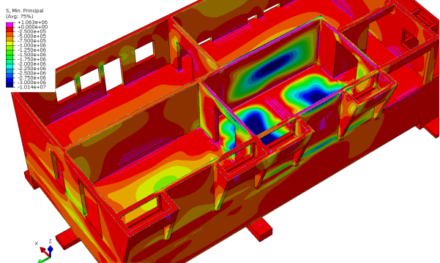
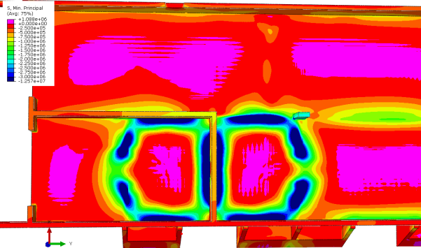
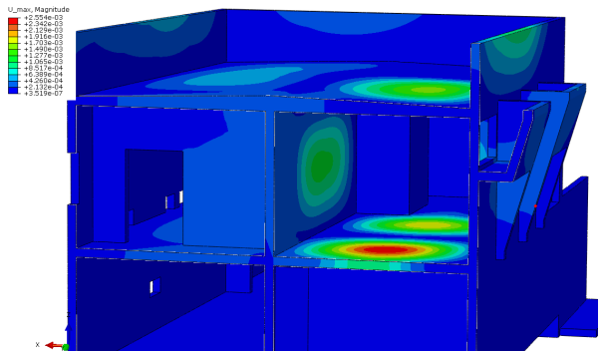
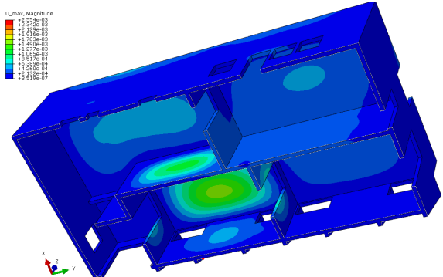
International Technical Safety Forum 2019, Session “New projects and challenges”
A Multi-Hazard approach to structural safety: the POPS-B technical building
Bldg 245 Structural members - Internal stress / displacement
Giordana Gai
EDMS 2150706v.1

Slide 35
International Technical Safety Forum 2019, Session “New projects and challenges”
A Multi-Hazard approach to structural safety: the POPS-B technical building
Conclusions
The structural design has been carried out in conformity with the Eurocodes 8, which guarantees an admissible safety margin toward the earthquake risk.
The considered localized fire scenario (1 MC with 180 l of rapeseed oil of capacitors) is analyzed. The steel structure is verified according to the EN 1993-1-2.
The presented generalized fire scenario is more unrealistic. Fire resistance of the steel structure is guaranteed at 35 minutes, anyway the materials inside the building would be lost. Fire fighting strategy in this case would be defensive.
  Advanced CFD and FE analyses of the explosion effects allowed to:
  characterize and compare different venting solutions for blast mitigation
  provide input (blast loads data) for subsequent structural assessment or design
  check solution admissibility with respect to external and structural effects
Giordana Gai
EDMS 2150706v.1

