Slide 1
Welcome and ESS/NSS
Project update
Shane Kennedy
Deputy Director for Science
and NSS Project Leader
www.europeanspallationsource.se
Joint STAP meeting: Users & Samples/Sample Environment, 2-3 April 2019
45´

Slide 2
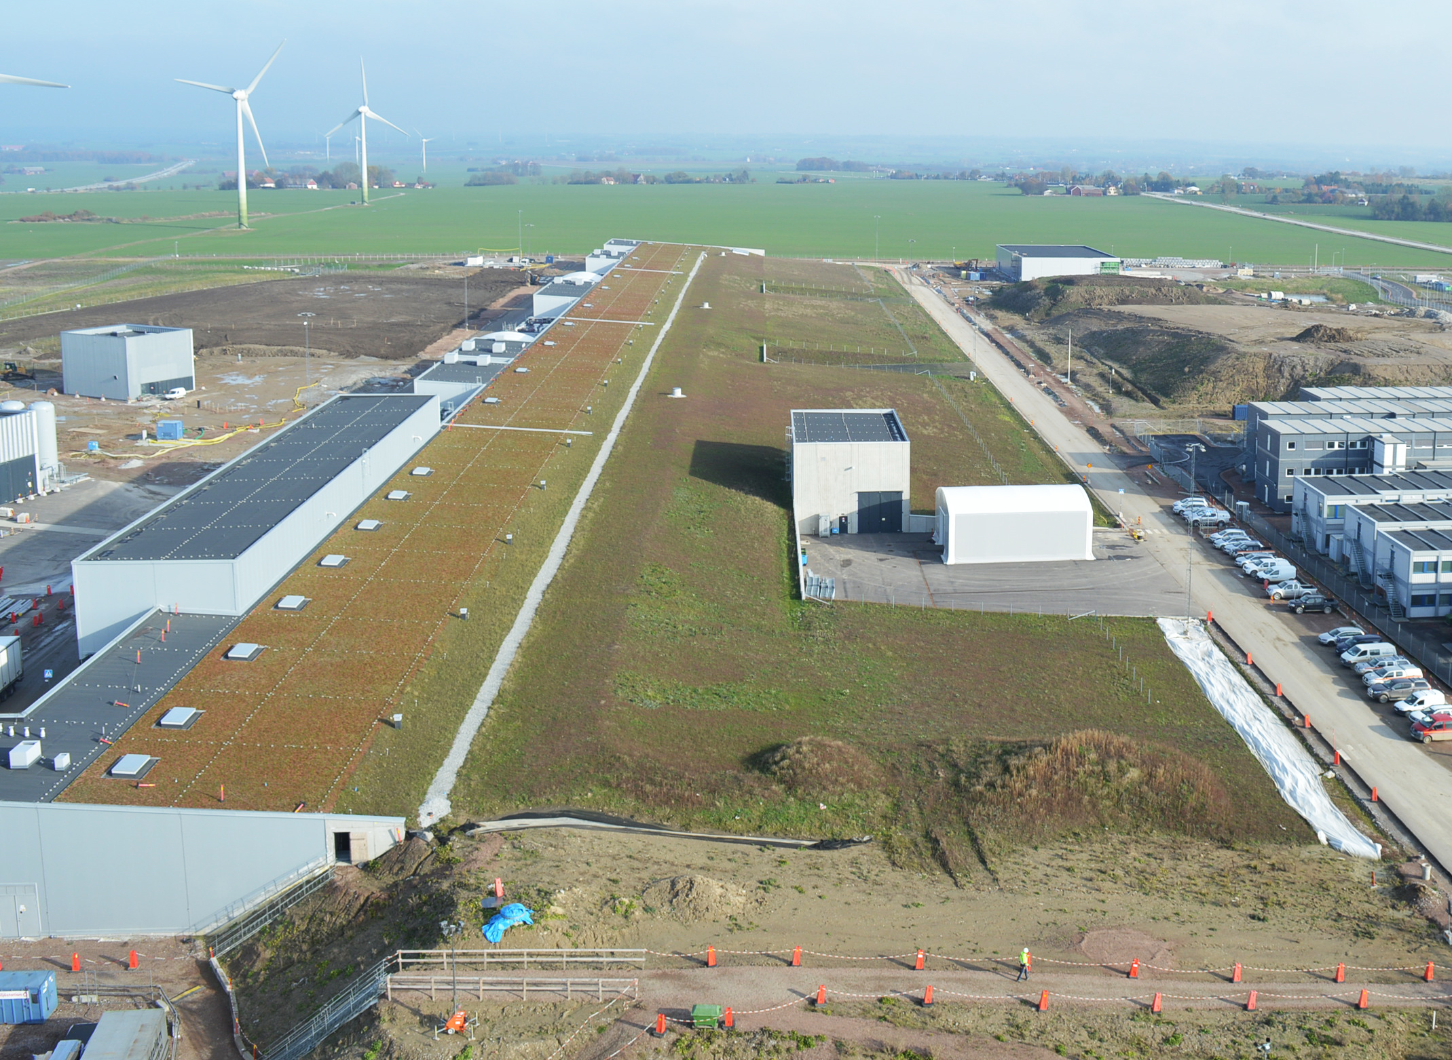
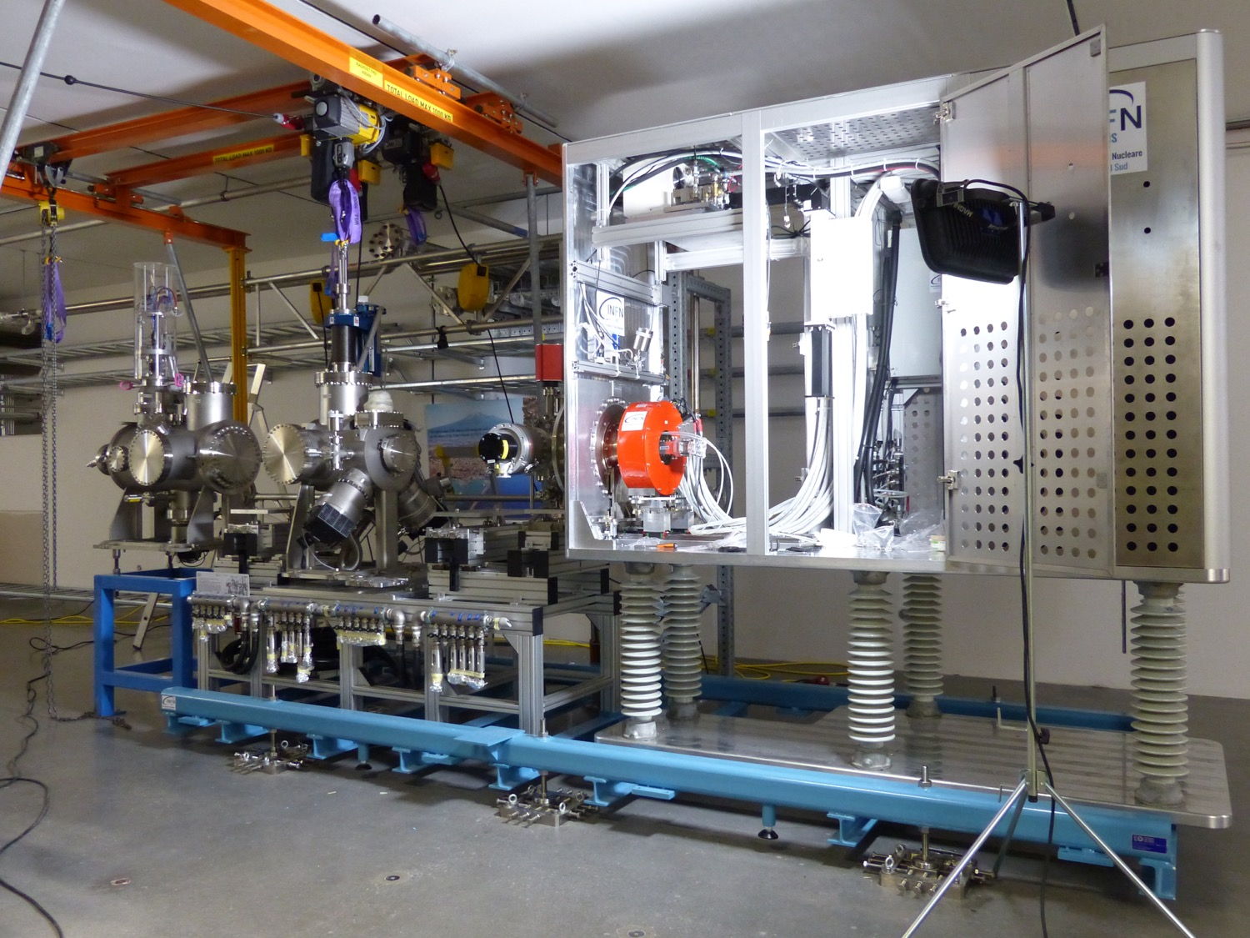
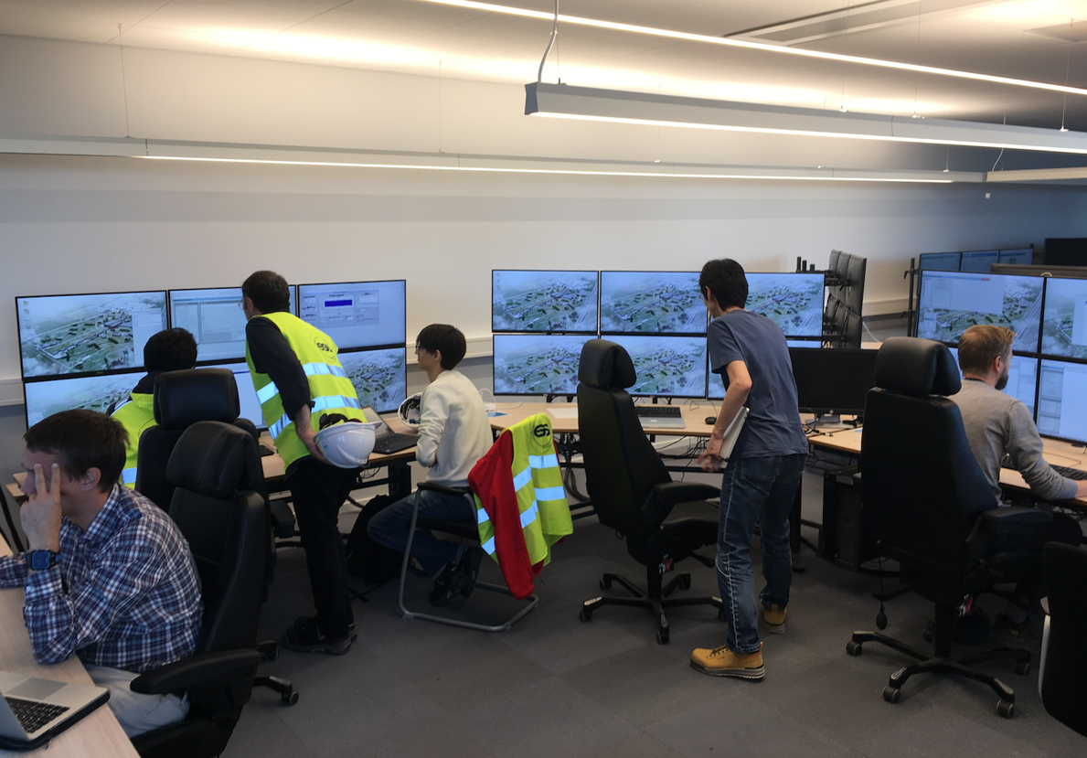
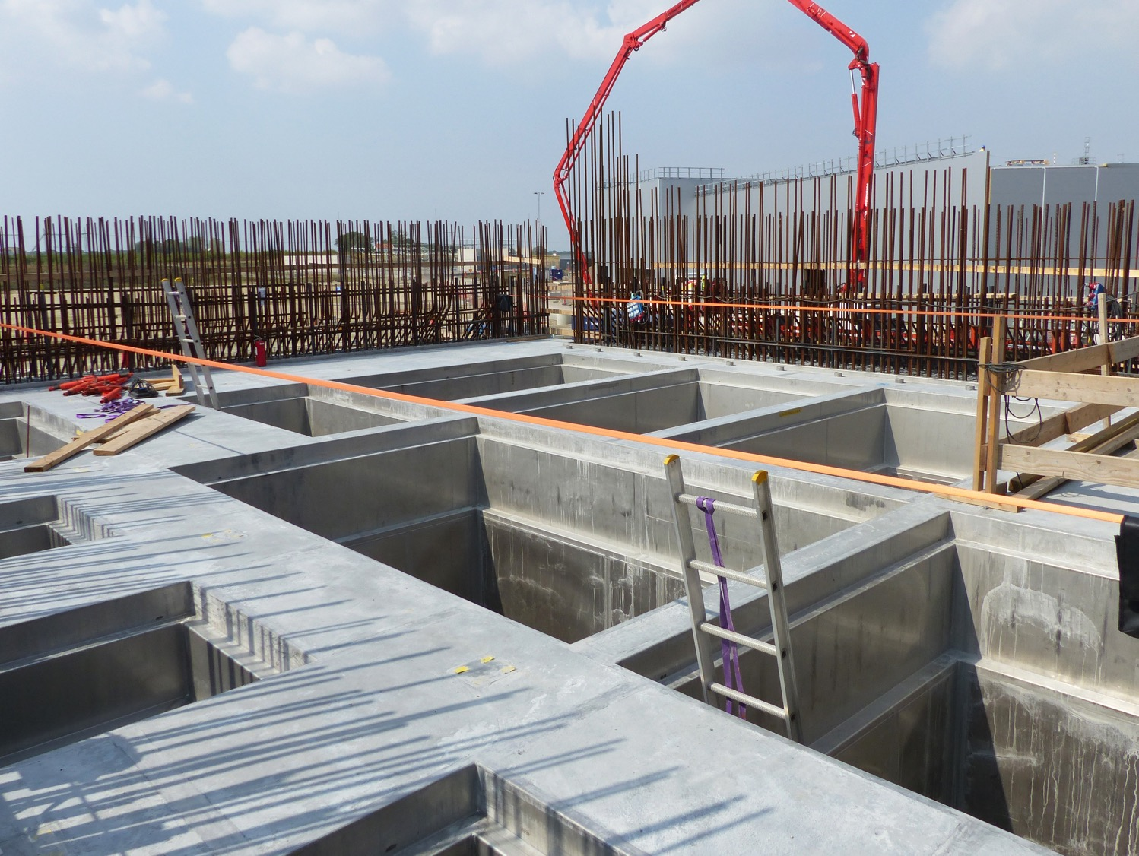
2018 ESS project highlights
Established new ESS-wide baseline plan to improve coordination, communication, execution, and tracking of work
Handed-over klystron gallery and two more buildings from construction partner to ESS
Structural design of Target Building and Instrument Halls no longer on critical path
Formed new Infrastructure Subproject to be ready for Accelerator equipment deliveries and commissioning
Began commissioning Ion Source and LEBT and three helium cryo-plants
Installed Active Cell infrastructure embedded in buildings - waste pits, Active Cell liner

Slide 3

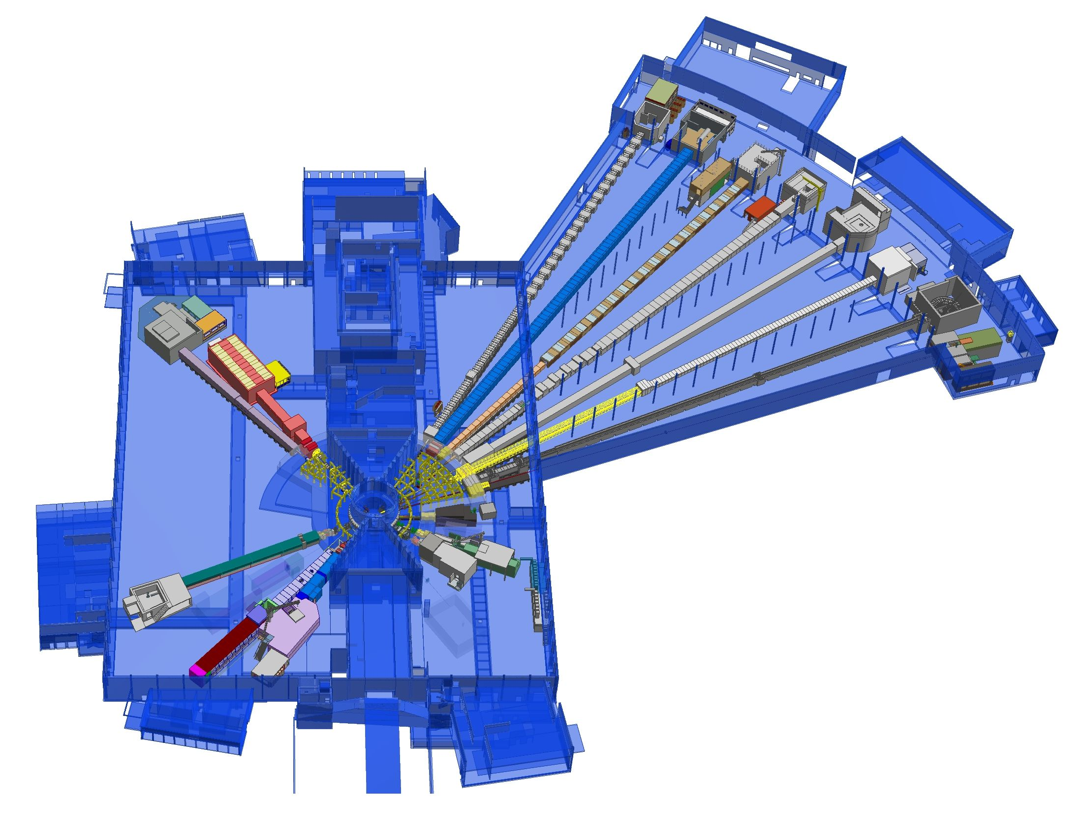











NSS Project scope: 15 neutron instruments + test beamline + support labs
+
Nuclear Physics Institute
ESS Lead Partners for instrument construction
E03
+
NMX
BEER
C-SPEC
BIFROST
E04
D08
MIRACLES
MAGIC
ODIN
T-REX
DREAM
HEIMDAL
Test Beam Line
D07
VESPA
LOKI
FREIA
SKADI
ESTIA
+
ESS In-Kind Partners also collaborate on sample environment, data management, lab fitout (D04, D08, E03 & E04) etc.
D04
ESS Instrument Layout (September 2017)

Slide 4
Schedule Overview

Slide 5
ESS Summary Schedule and Critical Path for Remaining Work
FS added in response to rebaseling review
BOT - Beam on Target
FS - ‘First Science’
SOUP - Start of User Programme
EOC - End of Construction project
RXXX - Ready for XXX
2018
2019
2020
2021
2022
2023
2024
2025
BOT
FS
SOUP
EOC
Warm LINAC Commissioning Steps
1.3 GeV Capability Installed
CF, Target, and NSS (Bunker) teams holding zero-float Critical path to BOT
Float to Accelerator RBOT reduced from 14 months to 11 months due to IK delivery slippage
Accelerator + ICS
Hi-Beta Install
Beam on Dump
(570 MeV)
Accel RBOT
Accelerator Schedule Float
CF + Target + NSS (Bunker+TBL) + ICS
Bunker and Test Beam Line RBOT
Access for Monolith Installation
Target RBOT
15th Instrument Complete (Ready for hot commissioning)
NSS Instruments + ICS
Instrument Hall Access for Start of Installation
Start beam commissioning for 1st Instruments
RSOUP
Red line indicates critical path

Slide 6

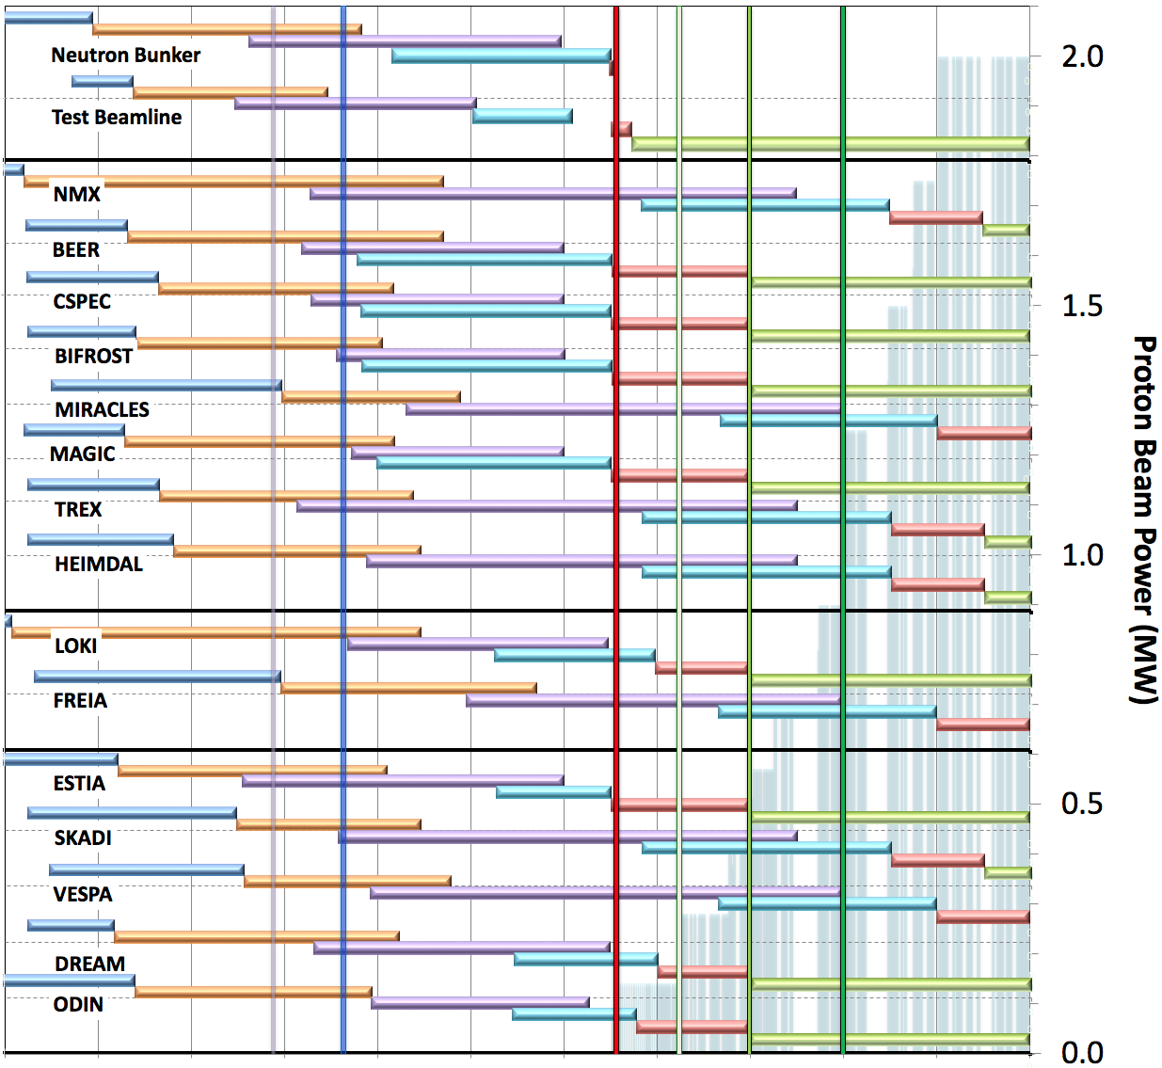
Rebaseline schedule for Neutron Beam Instruments (V4.1, 29th November 2018)
aligned with accelerator ramp up (ESS-0420218)
Preliminary Design
Detailed Design
Manufacturing & Procurement
Installation & Integration
Hot Commissioning/Early science
Operation
Current date
First access to NSS bldg (E01)
BOT
&
HC
SOUP
(3NBI*)
8NBI* in User Program
FS
First 3 NBI selected for SOUP: DREAM, LOKI & ODIN (best chance for early impact, as agreed by NSS, SAC and Council)
Back-up instruments (for risk of late access to D01 & D03) BEER, CSPEC, MAGIC or BIFROST, ESTIA
West sector
March 2023:
First Science (FS) with expert teams on any instrument above
Review progress of first 3 NBI for SOUP, implement backup plan if needed.
North sector
East and South sectors
2016 2017 2018 2019 2020 2021 2022 2023 2024 2025 2026
* NBI = Neutron Beam Instrument

Slide 7
Budget Overview

Slide 8
Available contingency is more than forecast increases, but little remains for unforeseen items
ESS Project is 58 % complete
Item | M€
Available Budget, i.e. Total Project Cost (TPC)* | 2210
Budget at Completion (BAC) (No contingency) | 2044
Contingency available (TPC- BAC) | 166
Estimate-at-Completion (EAC) | 2171
Forecast Increase (EAC-BAC) | 127
* Per Council resolution 13.06.a assumes full initial funding (1843 M€₂₀₁₃ plus additional host state contribution) plus additional 135 M€₂₀₁₃ based on unforeseen costs for handling seismic and antagonistic threat requirements
Forecast increases are less than available contingency, but leaves only 39 M€ for unforeseen items
A new round of cost reduction measures is underway (decisions due in April)

Slide 9
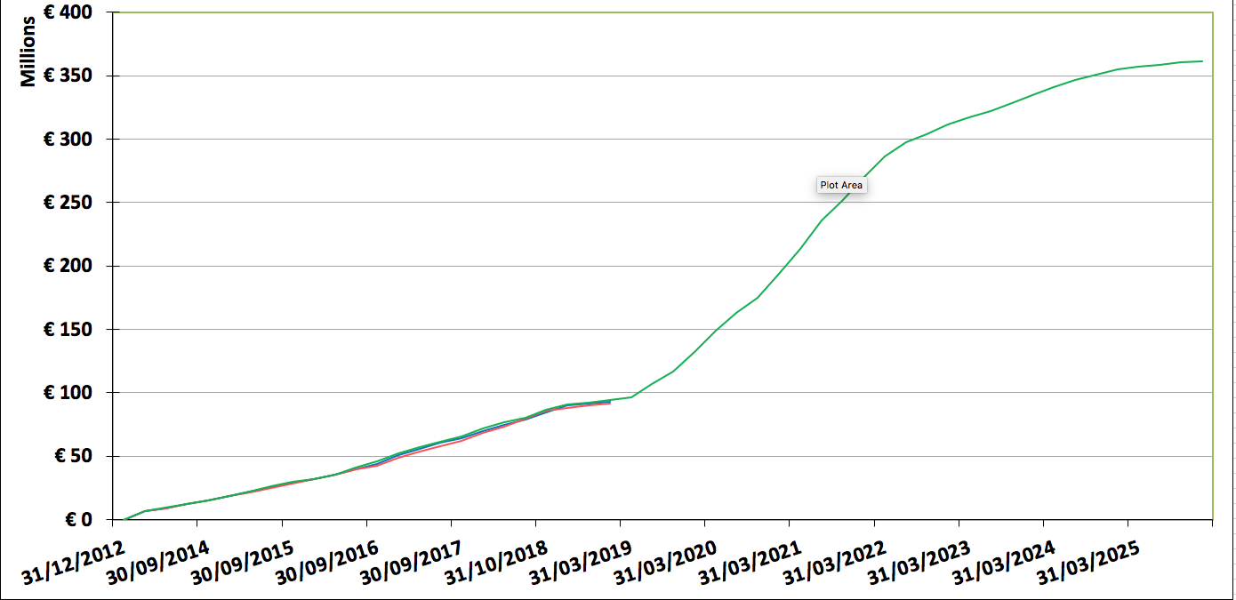
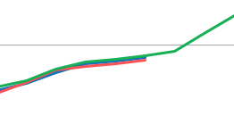
Construction project : NSS performance 2019 progress (to end of February)
NSS budget = 361 M€
NSS Project is 27.1 % complete Cash Spent = 78.03 M€
In Kind Spent = 13.67 M€
Manufacturing &
Procurement
~ 222 M€ by IK partners
- In part treated as cash IK
NSS Contingency
Estimated need = 28.64 M€
Available funds = 22.96 M€
Shortfall (EAC – BAC) = 5.68 M€
SV -0,9 M€ & SPI = 0,99
  IK instrument projects progressing without signed TA.
CV 1.5 M€ & CPI = 1,02
SPI & CPI of ‘cash’ components are within variance reporting thresholds
Notes:
91,7
338,04
---
Variance analysis thresholds at subproject level (Level 2):
Cumulative Cost Variance threshold: CPI < 0.95 and CV < - 0.5 M€
Cum Schedule Variance threshold: SPI < 0.95 and SV < - 0.5 M€
Note: These values are fairly tight since we have re-baselined each year

Slide 10
Recent & upcoming activities

Slide 11
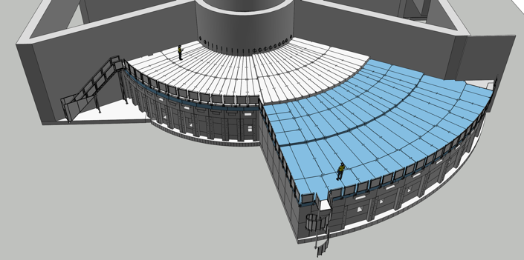
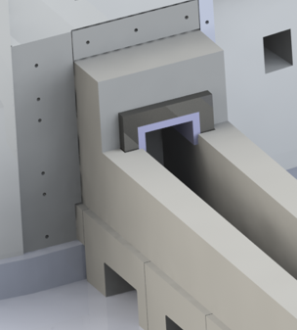
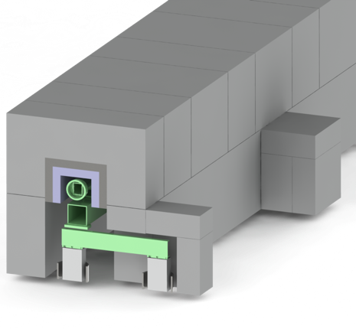
NSS Major Procurements:
Neutron bunker & Common guide shielding
Shielding work packages
1. Neutron Bunker (Total Budget = 18 M€)
Bunker shielding material changed from steel/HDPE to Heavy Concrete
Bunker wall thickness unchanged (at 3.5 m)
Bunker roof is now stepped (from 1.5 m -> 1.0 m) & 30 % lighter.
2. Common Guide shielding (Cost Est. ~ 10 M€)
Scope set to 9 neutron instruments Instruments (more may join)
Concept: 50-70 cm concrete + 0-20 cm steel inner
Neutronics & mechanical design advancing to PDR & costing (Jan 2019)

Slide 12
Next Six Months:
•First 8 instruments move into manufacturing*
•Prepare to install 4 instruments in E01
TG2 passed
2018-2019 | Oct | Nov | Dec | Jan | Feb | Mar | Apr | May | Jun | Jul | Aug | Sep
LOKI
SKADI
ESTIA
FREIA
NMX
MAGIC
HEIMDAL
DREAM
BEER
ODIN
CSPEC
BIFROST
MIRACLES
T-REX
VESPA
STAP
s
10-11
s
Intermediate
Design Review
s
s
s
s
s
IKON16
DMSC STAP
IKON17
16-17
29
3-4
s
8
s
Subsystem TG3
(intermediate)
s
s
18-19
s
Final TG3
s
Sub-TG4
ILL-ESS User Meeting
Council-14
s
12
s
s
s
s
ICB12
s
s
21
s
s
1-3
ICB11
s
s
s
8
SAC21
s
s
s
S
IKRC16
IKRC16
SAC22
IKRC16
s
s
s
* Seven NBOA already in manufacturing
s
s
s

Slide 13
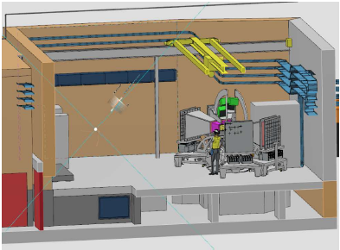
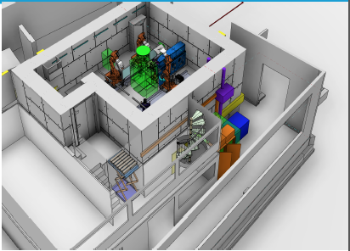
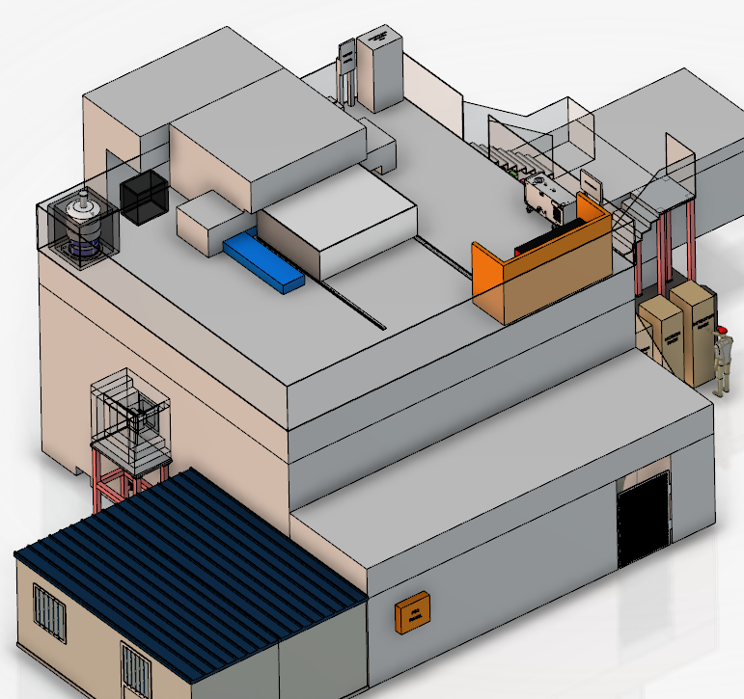
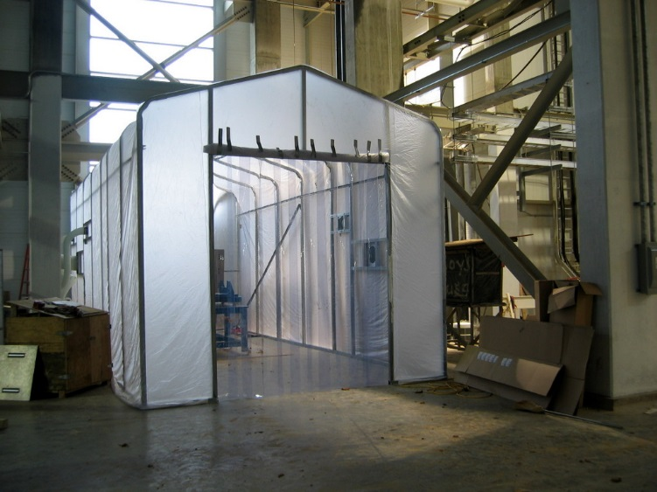
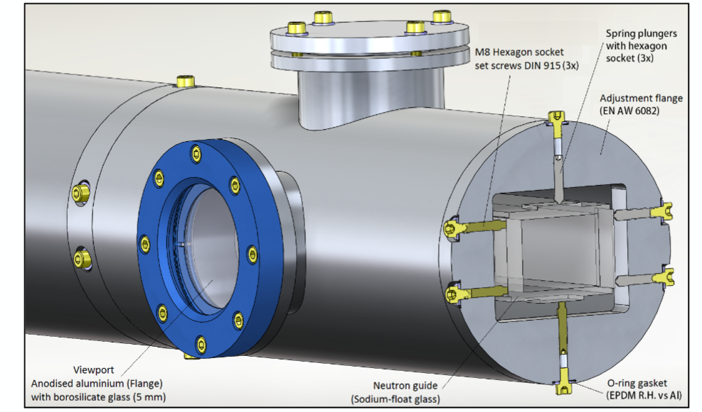
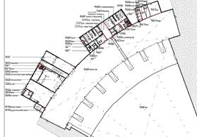
Preparing to start Installation in E01 & E02 in 2019
BEER cave (E01), September
NMX cave (E01), November
BIFROST cave (E01), December
E04
E03
Fit-out of labs & workshops
(E03 & E04), starts in 2020
NBOA Integration (E01), December
CSPEC guides (E02), December

Slide 14
NSS Summary
NSS Project is 27% complete & is on budget (EAC within 2 % of BAC)
All instruments are now in detailed design & manufacturing has commenced (7 NBOA + ODIN choppers)
Bunker is now in manufacturing
Common shielding project is ready to move to detailed design and manufacturing for 5 instruments
Accelerator ramp-up and operation plans agreed with Accelerator, Target, ICS & ES&H
Design of common beam monitor systems has commenced (by ESS - Detector Group)
NSS major goal for 2019 is start installation in E01 & E02/1
Initial Operations Budget is under review as we settle contributions from ESS member states
- reductions are likely to impact plans for further capital investment (Instruments 16-22, Instrument 1-15 upgrades, SEE etc.)

