Slide 1
Mounting & Alignment
Malcolm Guthrie
www.europeanspallationsource.se
1 April, 2019

Slide 2
Scope of project(s)
Define standard interface for SEE at ESS
All instruments
All equipment
Facilitate positioning of <1 mm samples
Minimise lost beamtime for aligning
Optimise signal-to-background

Slide 3
Concept: Universal Coordinates
Kinematic Positioning
Interface has two separable parts:
High positional repeatability when they are connected:
Equipment mount
Instrum. mount
Equipment mount
Instrum. mount

Slide 4
Alignment protocol* (*assumes known sample position “+”)
Before alignment:
Beam
Calib’Standard
Inst. 1
Inst. 2
Inst. “n”

Slide 5
Alignment protocol* (*assumes known sample position!)
Install standard
Beam
Calib’Standard
Inst. 1
Inst. 2
Inst. “n”

Slide 6
Alignment protocol* (*assumes known sample position!)
Install standard
Adjust mount to align
Beam
Calib’Standard
Inst. 1
Inst. 2
Inst. “n”

Slide 7
Alignment protocol* (*assumes known sample position!)
Install standard
Adjust mount to align
Repeat on Inst 2
Beam
Calib’Standard
Inst. 1
Inst. 2
Inst. “n”

Slide 8
Alignment protocol* (*assumes known sample position!)
Install standard
Adjust mount to align
Repeat on Inst 2
Beam
Calib’Standard
Inst. 1
Inst. 2
Inst. “n”

Slide 9
Alignment protocol* (*assumes known sample position!)
Install standard
Adjust mount to align
Repeat on Inst 2
Etc…
Beam
Calib’Standard
Inst. 1
Inst. 2
Inst. “n”

Slide 10
Alignment protocol* (*assumes known sample position!)
Install standard
Adjust mount to align
Repeat on Inst 2
Etc…
Beam
Calib’Standard
Inst. 1
Inst. 2
Inst. “n”

Slide 11
Alignment protocol* (*assumes known sample position!)
Install standard
Adjust mount to align
Repeat on Inst 2
Etc…
Beam
Calib’Standard
Inst. 1
Inst. 2
Inst. “n”
Expect periodic recalibration (beam drift, concrete subsidence etc.)
Note: Samples must be calibrated relative to “equipment” mount
This can be done offline by calibrating an “alignment station” in exactly the same way as the instruments

Slide 12
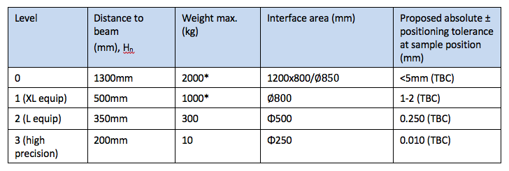
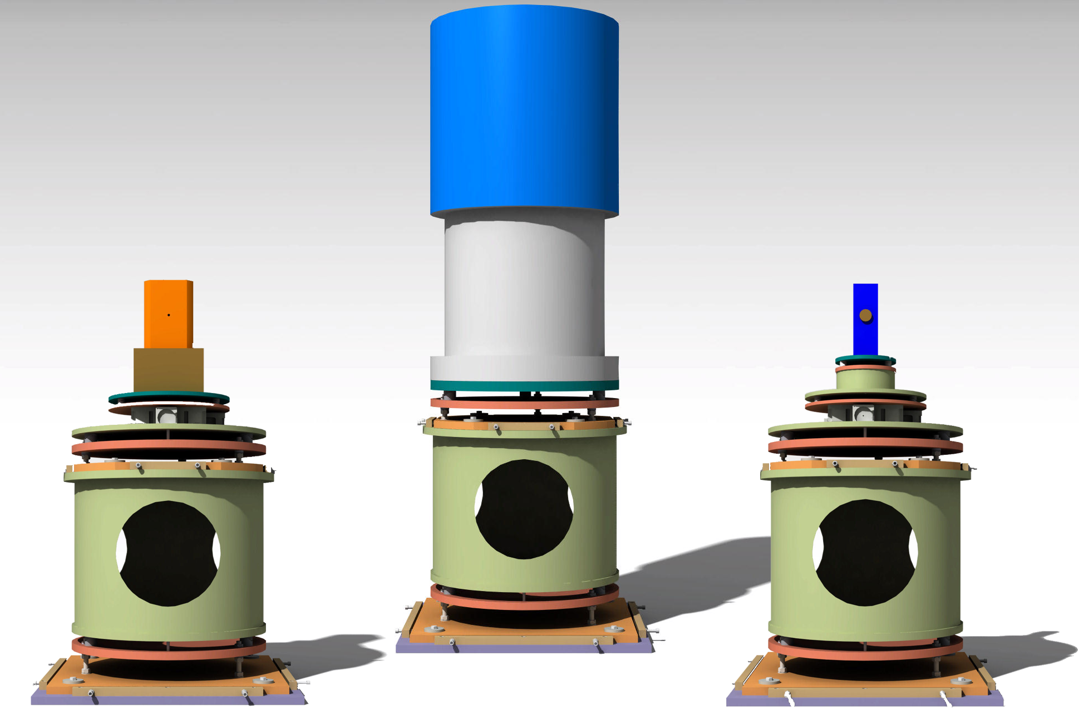
Floor-mount system

Slide 13
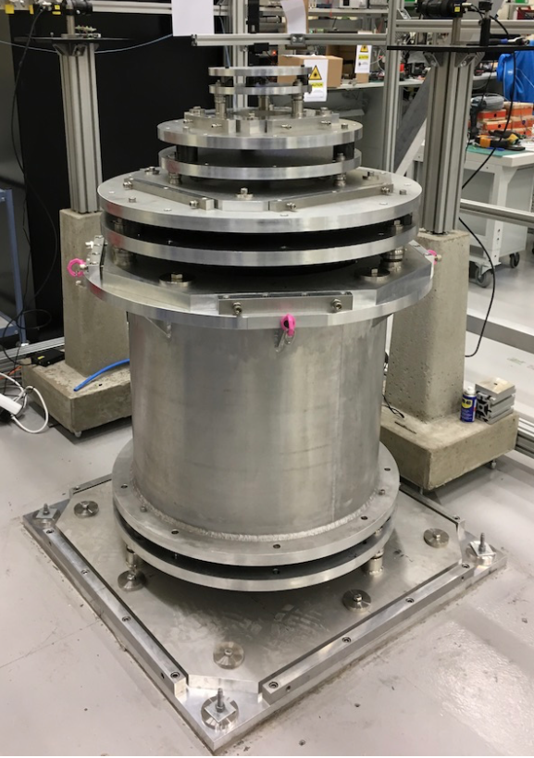
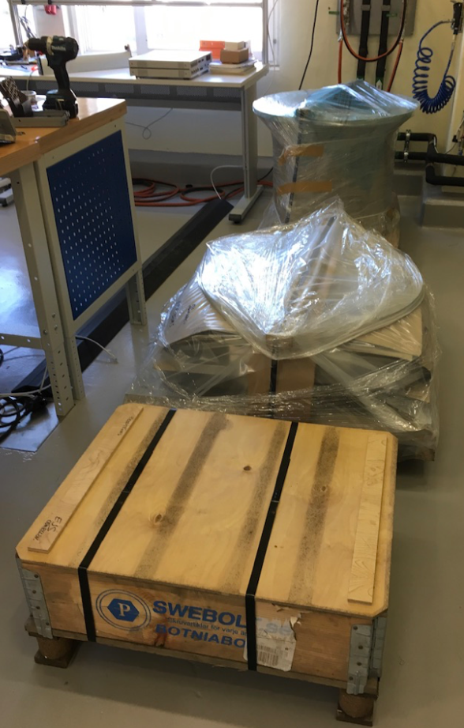
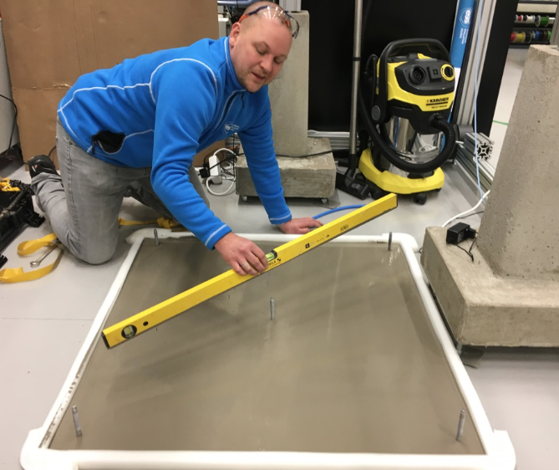
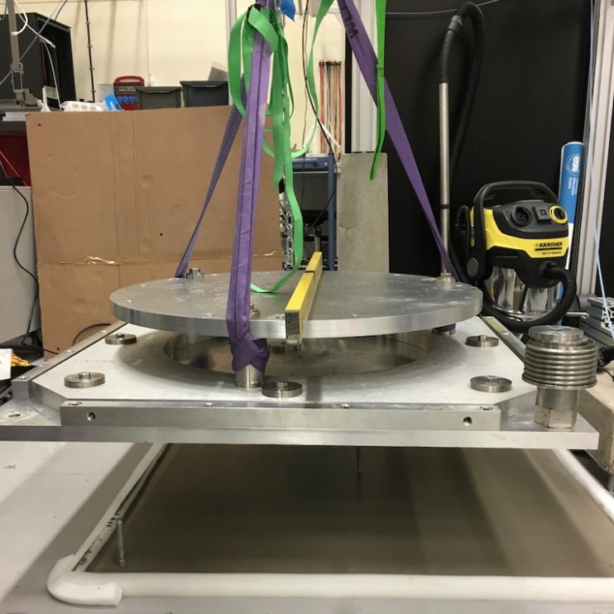
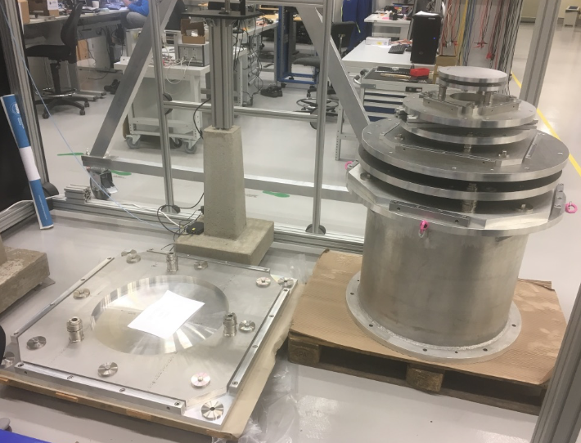
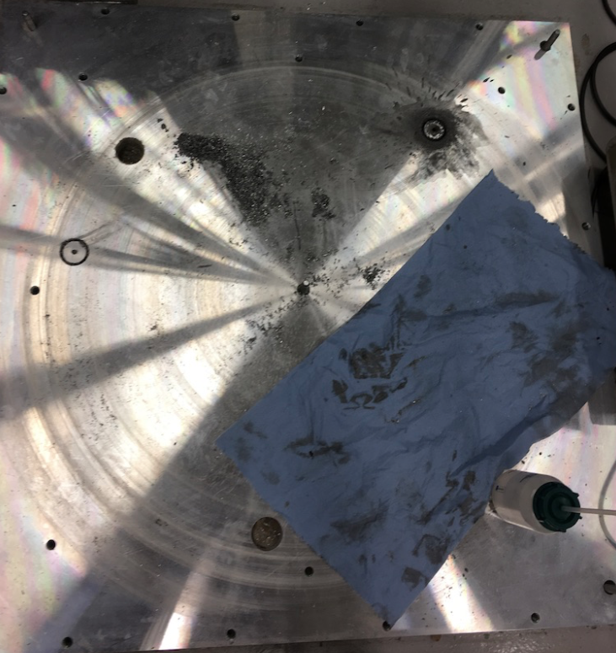
Floor-mount system: status
Prototype manufactured and installed in Utgård

Slide 14
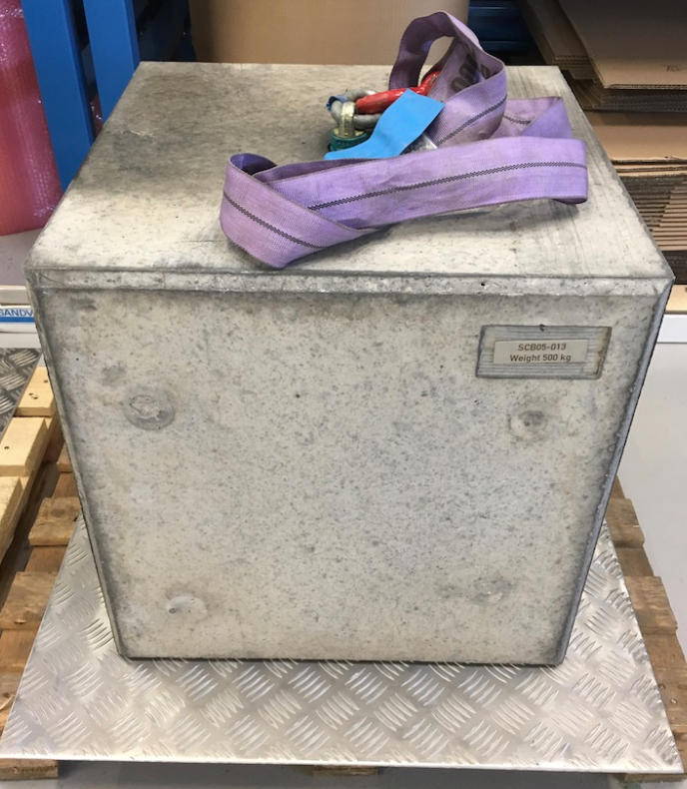
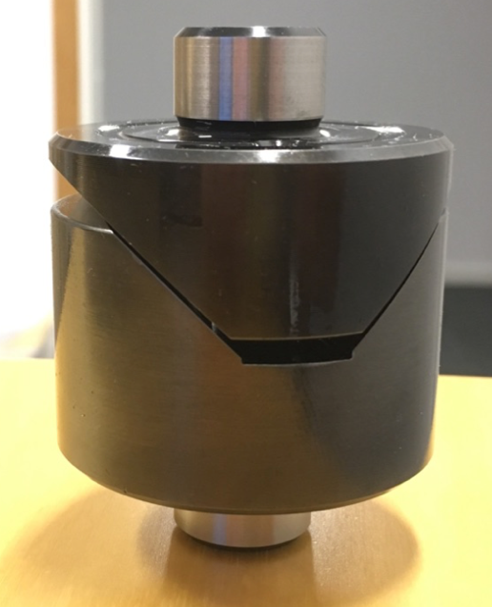
Floor-mount system: status
Initial testing proves basic principle
Reproducibility ~ 20um
On-going testing to determine tolerances
Load testing:
Alternative kinematic components
SE integration beginning (first system PE cell)

Slide 15
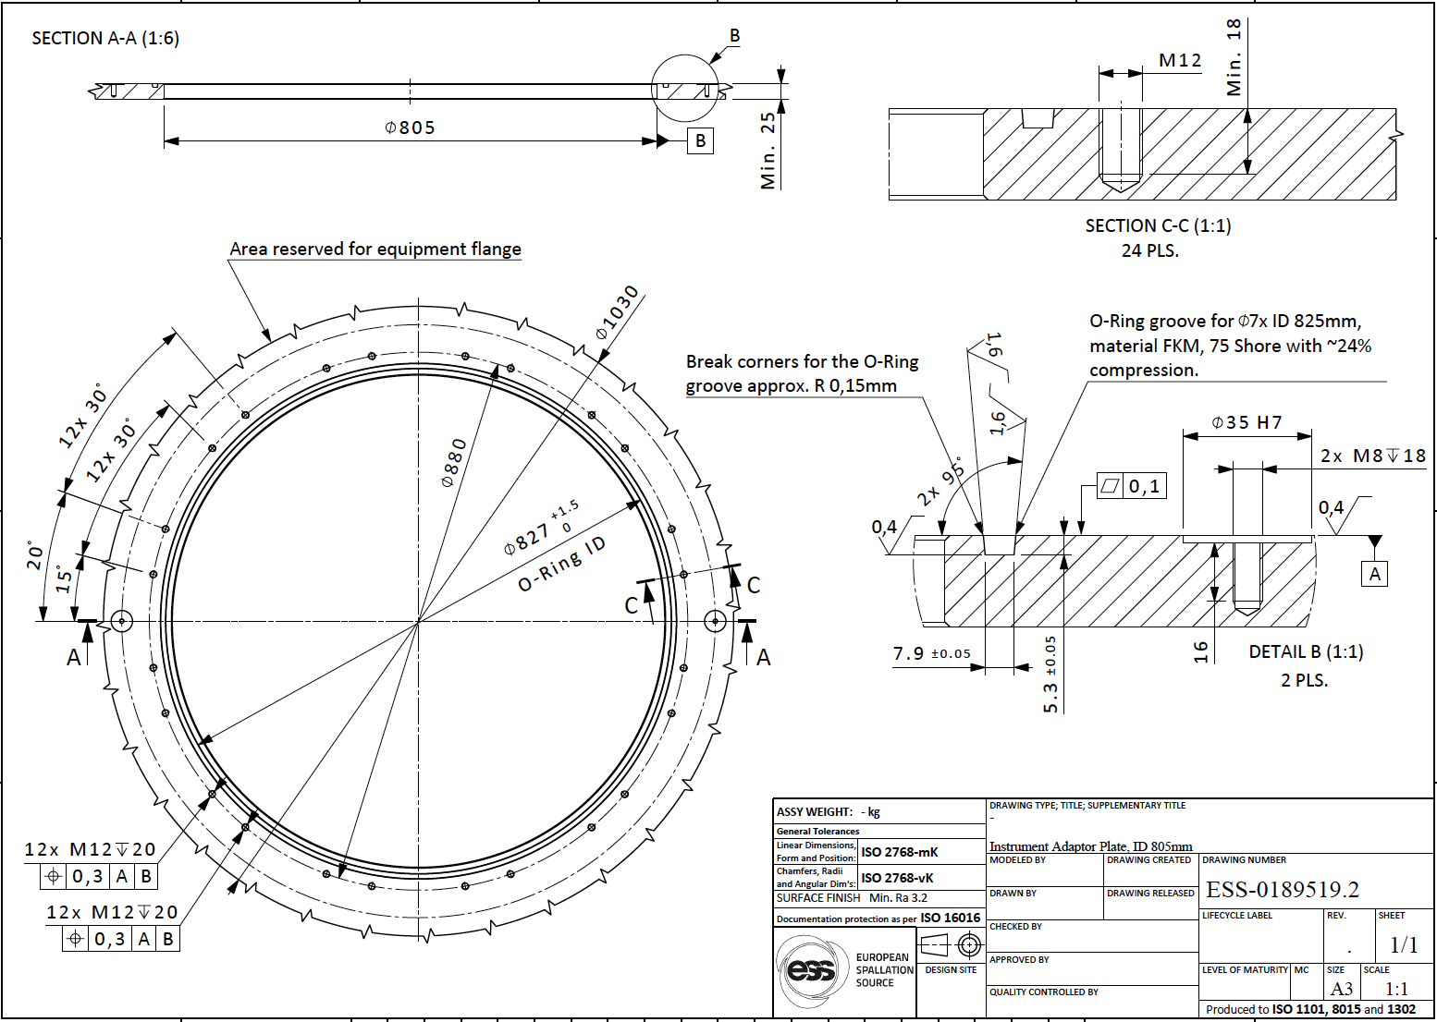
Flange mount: Level 1 status
Level 1: interface designed

Slide 16
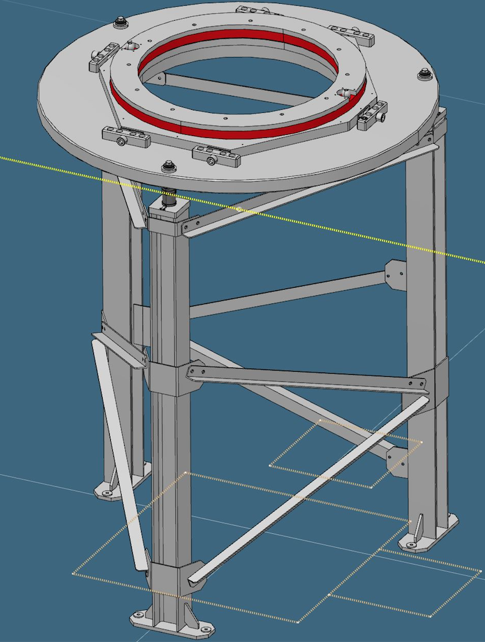
Flange mount: Level 1 status
Level 1: interface designed
Test station also designed
Delay due to lost engineering resource

Slide 17
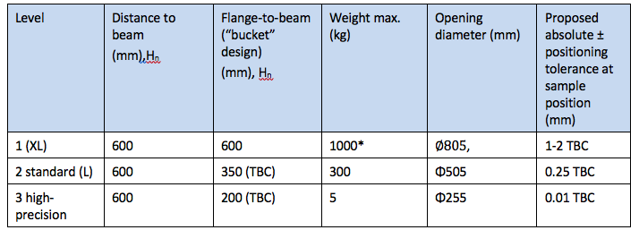
Levels 2 & 3: Do we want Bucket Flanges?

Slide 18
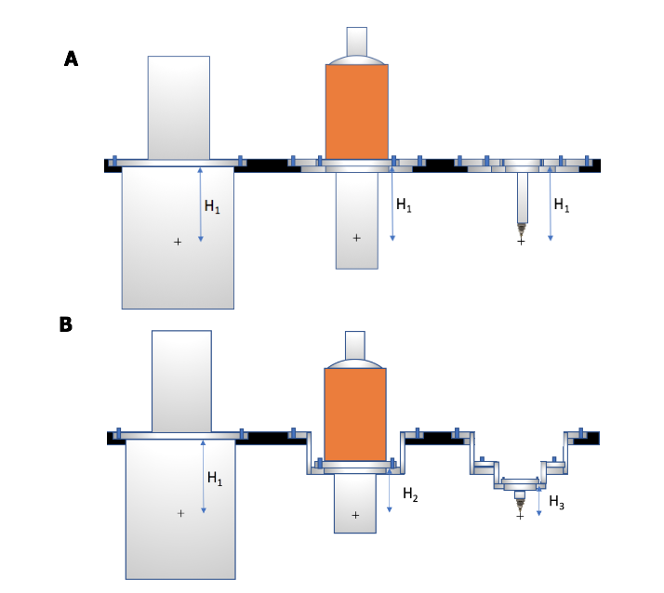
Levels 2 & 3: Do we want Bucket Flanges?
“Bucket”:
Higher precision
greater stability
less bulky equipment
Poor ergonomics
Would value STAP opinion!

Slide 19
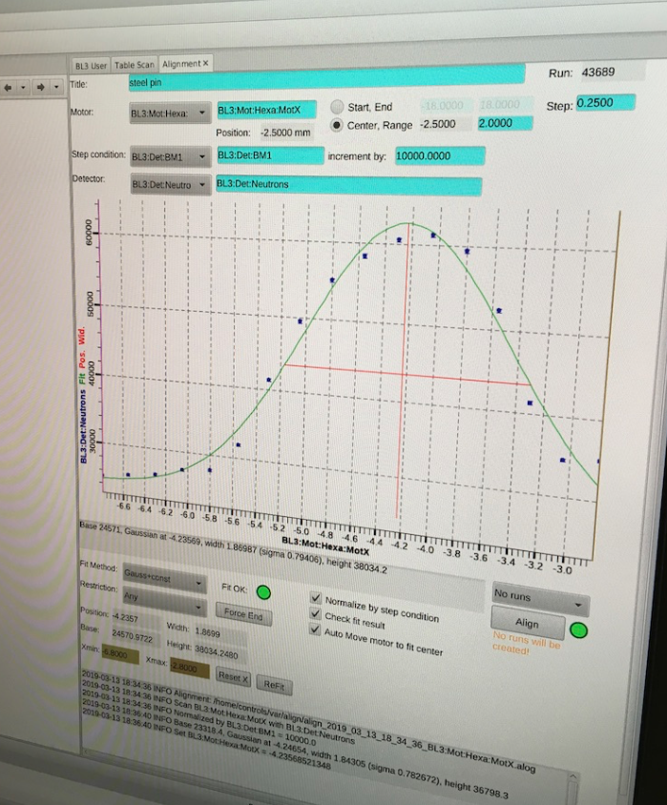
Alignment scanning
Still need to ultimately map Flanges/Kinematic mounts onto beam position…
Will use beam scanning
Approach is now routine at SNS (used for all samples on SNAP)
Developing portable scanning station at ESS. Test on V20 (Berlin) next week

