Slide 1
DRAM updates
Thomas Holm Rod
Feb 1st, 2019

Slide 2
In brief
Staff. Two new group members and one new secondment
  ➡️ Started to reorganize work (agile project organization)
Dev. Projects. Current projects, primarily in house:
  Ready for operation of LoKI (DONKI)
  sci++ project (C++ library for experimental data sets)
  Computational Diffraction Environment (CoDE) / Visualization in Python (VisPy)
Diffraction. Started collaboration with ILL and LLB as well as in house CoDE project.
Instrument data scientists. Started pilot project
Milestones. More or less on track.
External funding.
  Last SINE2020 WP10 workshop in May
  PaNOSC started
  AMEN VR project funded
  PARADISE H2020 project submitted
Stakeholders. Challenges from reflectometry stap & annual review

Slide 3
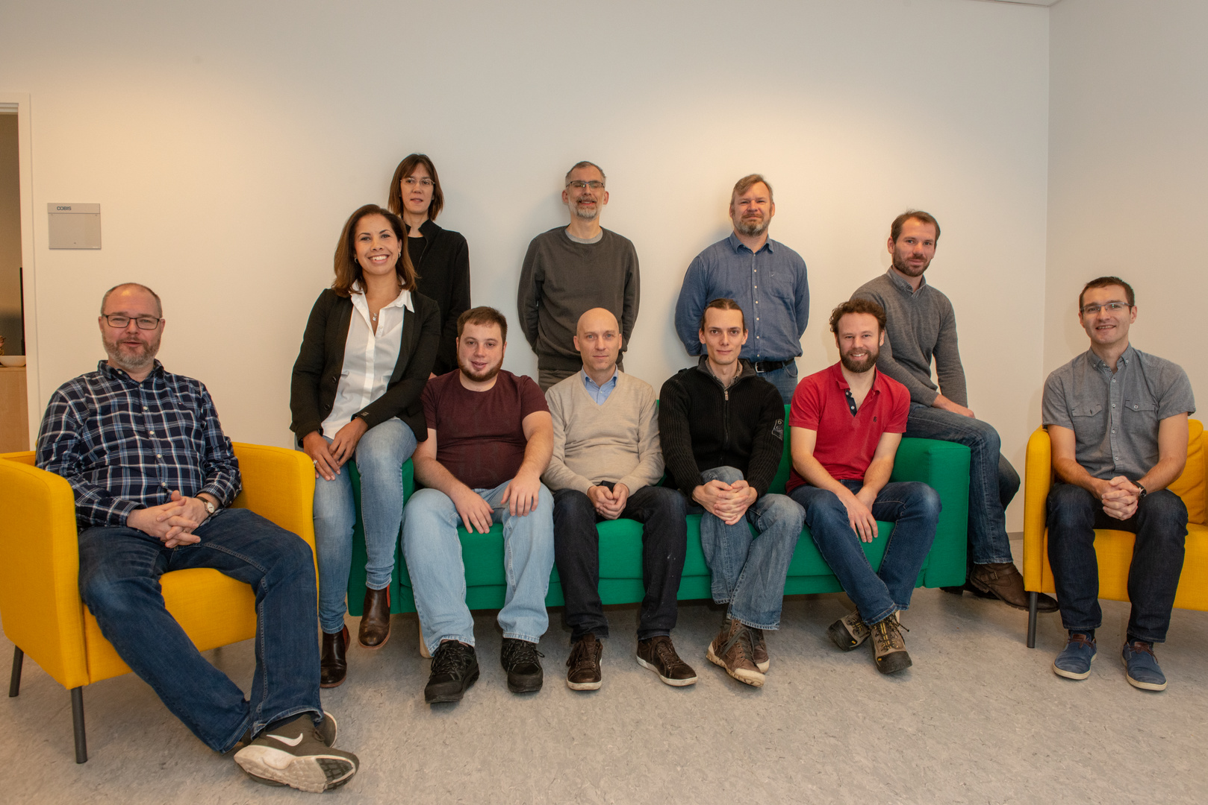
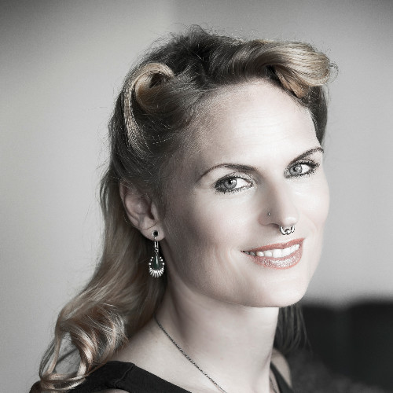
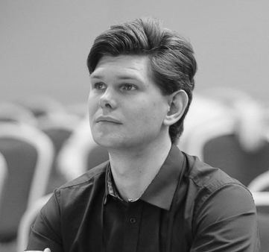
Staff
3 local Mantid developers (+ 1 ½ @ ISIS)
Diffraction user expert
Spectroscopy user expert
Full-time McStas expert
Many people, but also large scope:
13 (ESS) + 7 (IKC) head counts
11.5 (ESS) + 5 (IKC) FTEs
8 different instruments
4 EU work packages (SINE2020 + PaNOSC)
3 VR projects
Céline is a pilot instrument data scientist for diffraction
Simon W looks after spectroscopy
Wojtek looks after large-scale structures
=> In the process of reorganizing how we work

Slide 4
Updated timeline diagram
- delays in core development
- recruitment is still pretty much on track
Andrew Sazonov
(15th December)
Mads Bertelsen
(2nd January, 2019)

Slide 5
DRAM Time line and milestones (Fall 2018)
- Version: March 2018
Plann. | Antici. | Description | Status
’18-07 | ’19-05 | SasView ready for SOUP (aka SasView 5 released). SasView compliant with non-functional and functional requirements. | Delayed. SasView 5 demonstrated and tested at codecamp at ESS in September. ⍺-version presented at SAS2018 in October at dedicated workshop for ~40 persons. β1- and β2-version released. Final release expected in May.
’18-08 | ’19-05 | FullProf development begun. Collaboration with ILL kicked off | Delayed but started. Had ILL meeting in December. Two persons will visit ILL for a week in May to get collaboration started. LLB collaboration started in parallel.
’18-Q3 | ’18-11 | Recruitment of 2 persons for Mantid, 1 for SpinW, and 1 for analysis in general. | ✅ Neil, Igor, Simon W and Andrew Sazonov recruited (+ Mads for PaNOSC)
’18-09 | ’18-09 | Office move. | ✅ Presumably completed – now with curtains!
’18-09 | ’18-08 | Reduction on the fly. Data can be reduced on the fly for SANS2D for acceptance test but only low flux. | ✅ Demonstrated on local setup reading data from kafka stream.
’18-10 |  | Data reduction from NeXus. Data reduction of test workflow available from NeXus files. | ✅ have been possible for a long time
’18-11 | ’19-04 | Integration of reduction and analysis services. Data can be reduced and analyzed on the fly for limited flux for instrument(s) chosen for acceptance test. | ✅ Works, although not with Kafka
Notes:
SasView:
Serious QA (Richard Heenan) at codecamp revealed several bugs. Thus, only alpha version will be used at codecamp.
Proper resolution function for ToF is not implemented (version 5.1)
Lessons-learned for next STAP meeting
Fullprof:
We do not get the feeling that the diffraction group at ILL is embracing the collaboration or open sourcing the software. We have not been able to setup a meeting so far, they have a lot of requirements for such a collaboration. Scientific computing group has not been involved.
Conclusion:
1) We should collaborate with ILL diffraction group but not rely on this collaboration

Slide 6
DRAM Timeline and milestones (2019)
- Version: March 2019
Planned | Anticipated | Description
’19-01 | ’19-05 | PaNOSC recruit(s) started. Linda Udby and Peter Willendrup seconded. ✅ 1 person recruited.
’19-02 |  | ✅ Data view integrated. Data on detector can be live-visualized with EC (Widget from Mantid).
’19-03 |  | ✅ Reduction view integrated. Reduced data can be live-visualized with EC (Widget from Mantid).
’19-05 |  | Software performance and integration testing validated. Data can be reduced and analyzed on the fly for expected flux of LoKI when in full operation Post batch processing can be performed on CPH cluster
’19-06 |  | Proof of operation (reduction). Data can be reduced on the fly for expected flux of LoKI when in full operation. Data are received from DAQ & Streaming system. Data can be post rereduced on cluster Need to be able to define the scaling parameter for the architecture rather than actually physically demonstrate
’19-09 |  | SINE2020 completed

Slide 7
DRAM Timeline and milestones (2020 and beyond)
- Version: March 2019
Very tentative!
Planned | Description
’19-12 | LoKI data reduction & analysis ready for operation
’20-12 | ESTIA data reduction & analysis ready for operation
’20-12 | QENS data analysis ready for operation
’21-06 | ODIN data reduction & analysis ready for operation
’21-12 | BEER, DREAM, MAGIC data reduction & analysis ready for operation
’21-12 | CSPEC & BIFROST data reduction & analysis ready for operation
Planned | Latest possible start for Instrument Data Scientist (Cold Commissionig)
’22-01 | ESTIA
’22-01 | ODIN
’22-01 | BEER
’22-01 | CSPEC
’22-06 | BIFROST
’22-06 | LoKI
’22-07 | DREAM
’22-07 Beam On Target

Slide 8
DMSC integration milestones – on track (v.5 – April 2018)
1. Cph server room
Start procurement
Procurement complete
Server room tested and validated
Hardware and link
installed and configured
CUB
access date
2. Lund server room
CUB ready for installation
DMSC hardware installed in CUB
Data available
in Scicat
Mantid data views in NICOS
3. DAQ & Streaming
NeXus file definition ready
BrightnESS complete
File writer complete
Data available for
reduction and analysis
DAQ & Exp.Control
Integrated on
test beamline
4. Experiment Control
Data view
integrated
Proof of
exp. Control
of DAQ
SANS2d
Reduction view
integrated
5. Data Reduction
Data processing for some flux
Data reduced on the fly
Proof of Operation
Software performance &
Integration testing validated
6. Data Analysis
Integration of
Analysis & reduction software
SINE2020 ends
Proof of Operation
0. DMSC
Data set and rate defined for acceptance testing
Data processing for expected flux
Batch post-processing
Full integration
DMSC ready for BOI
LoKI McStas
External dep
V20 epics &timing
networks available
V20 closes
Notes:
Add figures from Torben and GitHub

Slide 9
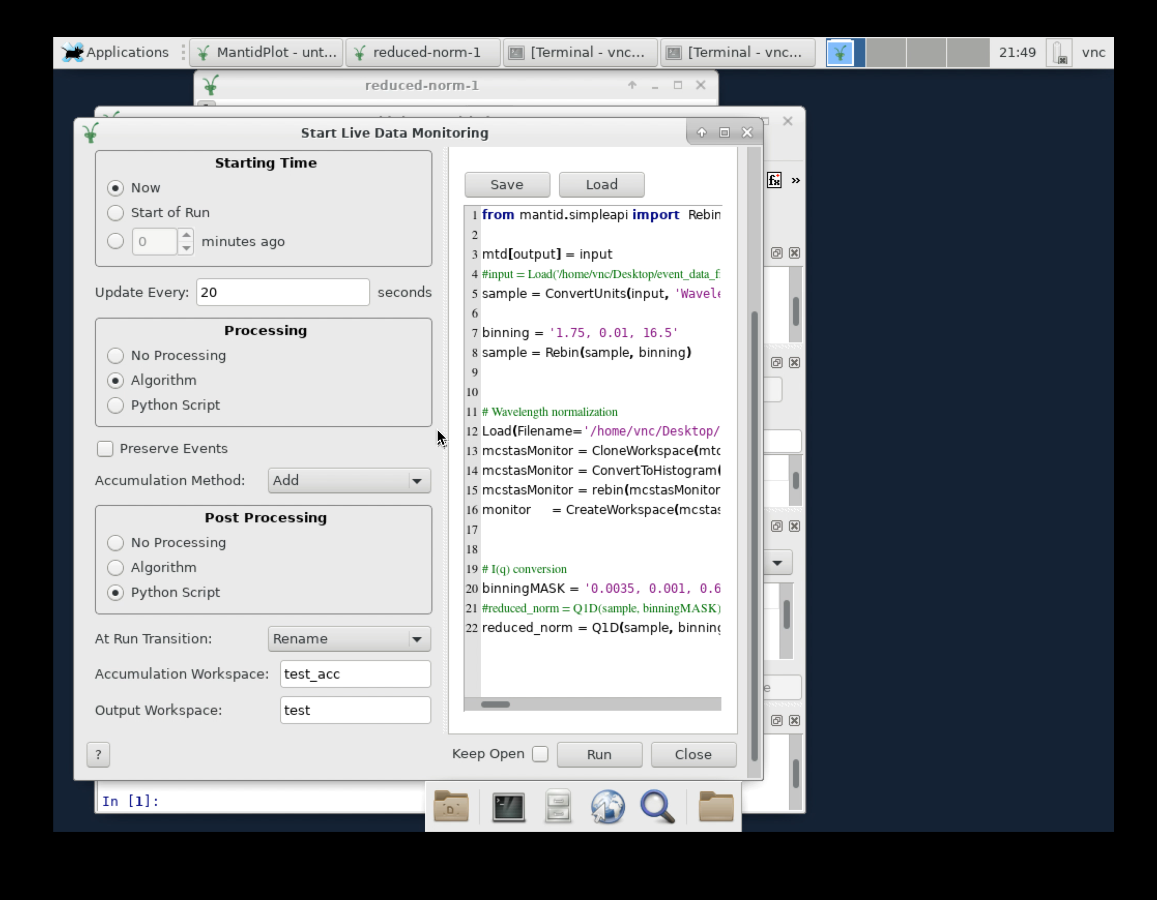
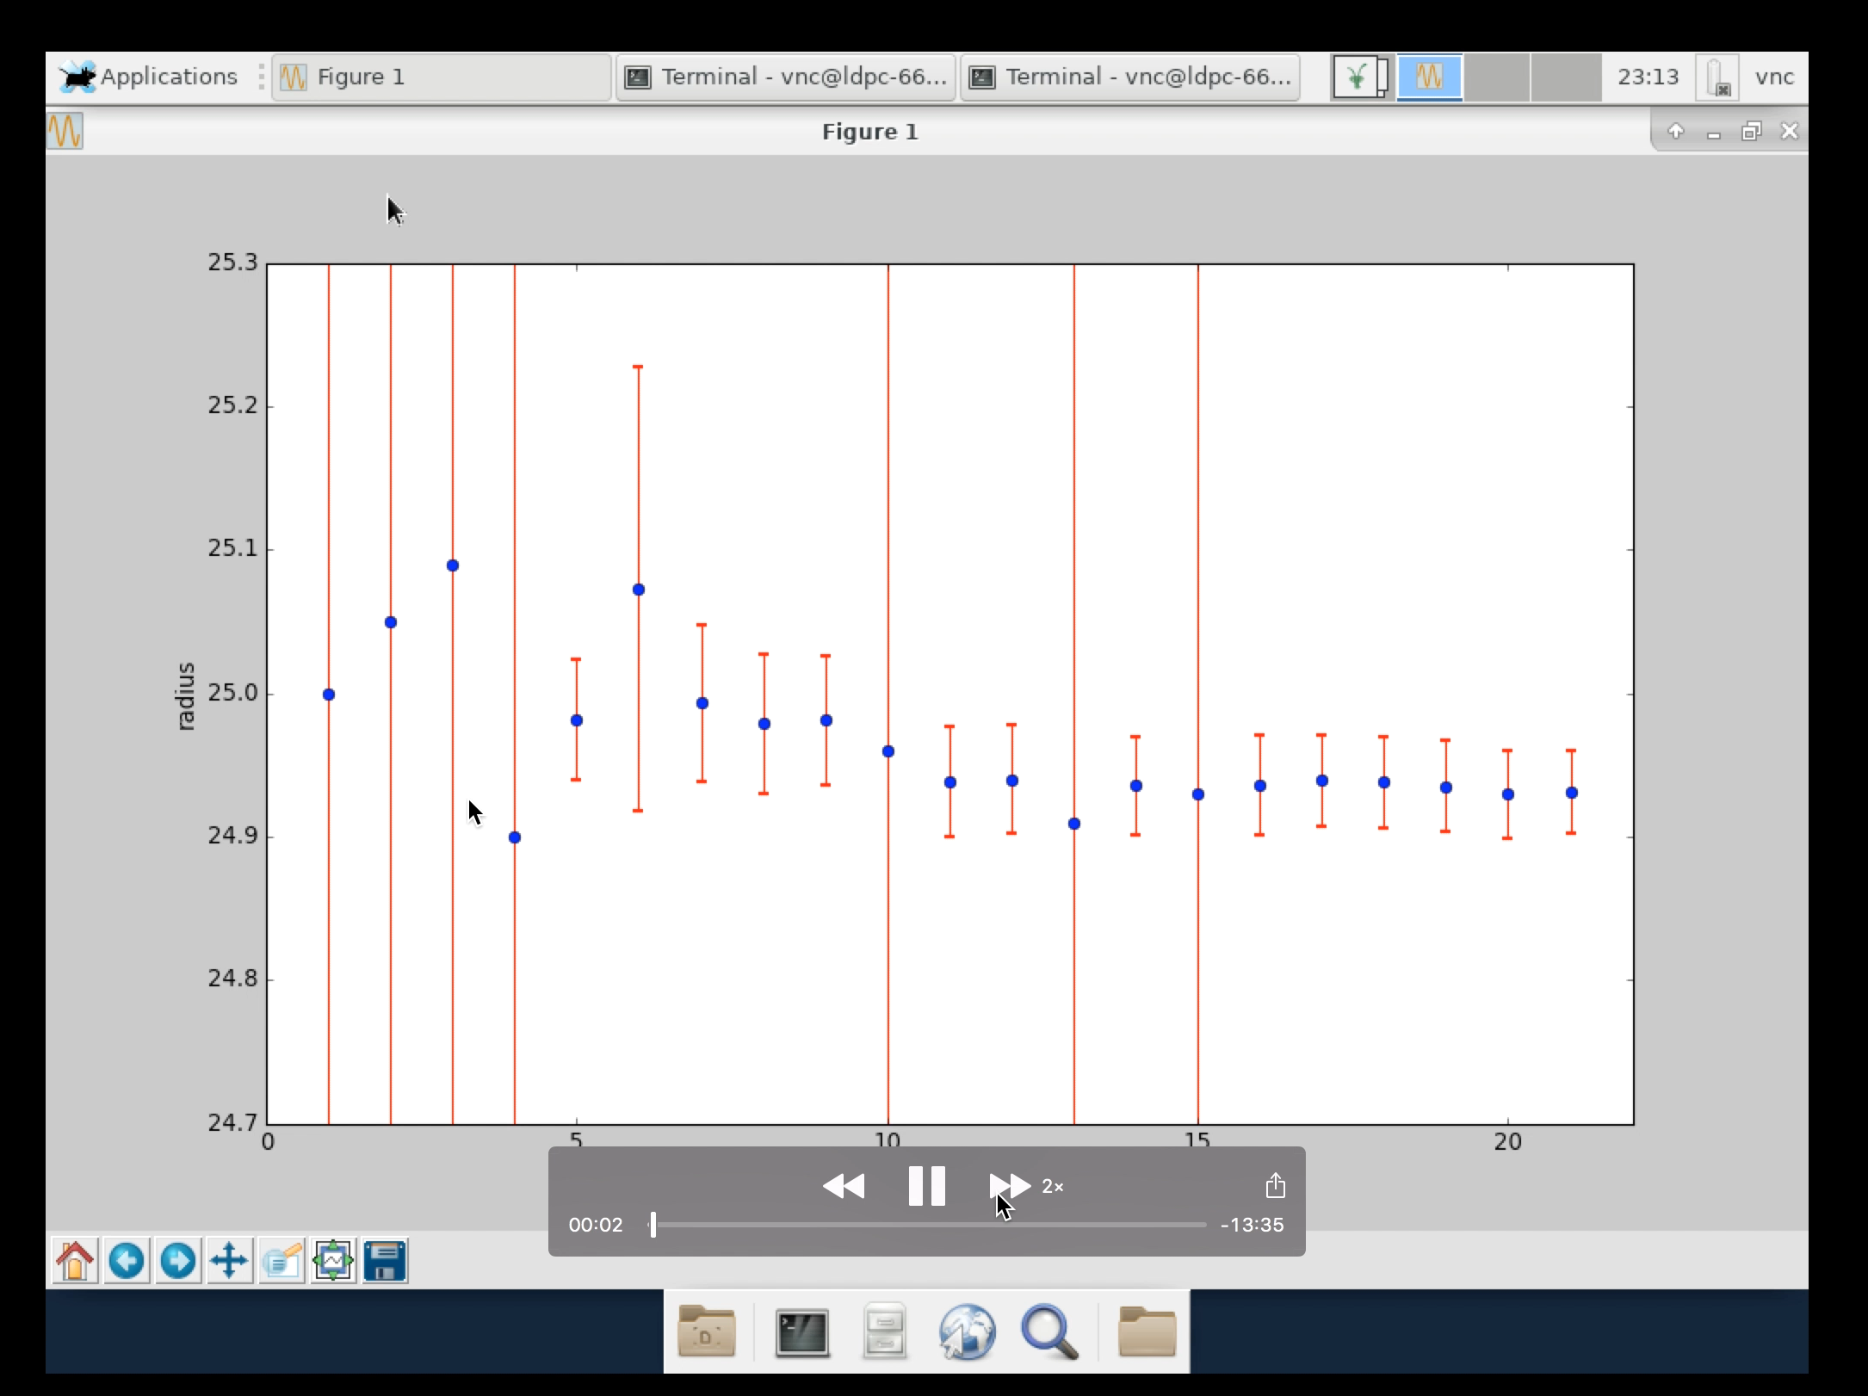
DMSC integration milestones – on track (v.5 – April 2018)
1. Cph server room
Start procurement
Procurement complete
Server room tested and validated
Hardware and link
installed and configured
CUB
access date
2. Lund server room
CUB ready for installation
DMSC hardware installed in CUB
Data available
in Scicat
Mantid data views in NICOS
3. DAQ & Streaming
NeXus file definition ready
BrightnESS complete
File writer complete
Data available for
reduction and analysis
DAQ & Exp.Control
Integrated on
test beamline
4. Experiment Control
Data view
integrated
Proof of
exp. Control
of DAQ
SANS2d
Reduction view
integrated
5. Data Reduction
Data processing for some flux
Data reduced on the fly
Proof of Operation
Software performance &
Integration testing validated
6. Data Analysis
Integration of
Analysis & reduction software
SINE2020 ends
Proof of Operation
0. DMSC
Data set and rate defined for acceptance testing
Data processing for expected flux
Batch post-processing
Full integration
DMSC ready for BOI
LoKI McStas
External dep
V20 epics &timing
networks available
V20 closes
Notes:
Add figures from Torben and GitHub

Slide 10
Testing - Feedback from previous STAP
Testing:
For LoKI tests are performed for SANS2D data and LoKI McStas data at full flux and scaled SANS2D data (we have a NeXus streamer)
This model for testing will be used for all instruments
Have repository with updated instrument models
Have started collaboration with SAD to simulate impact of sample environments

Slide 11
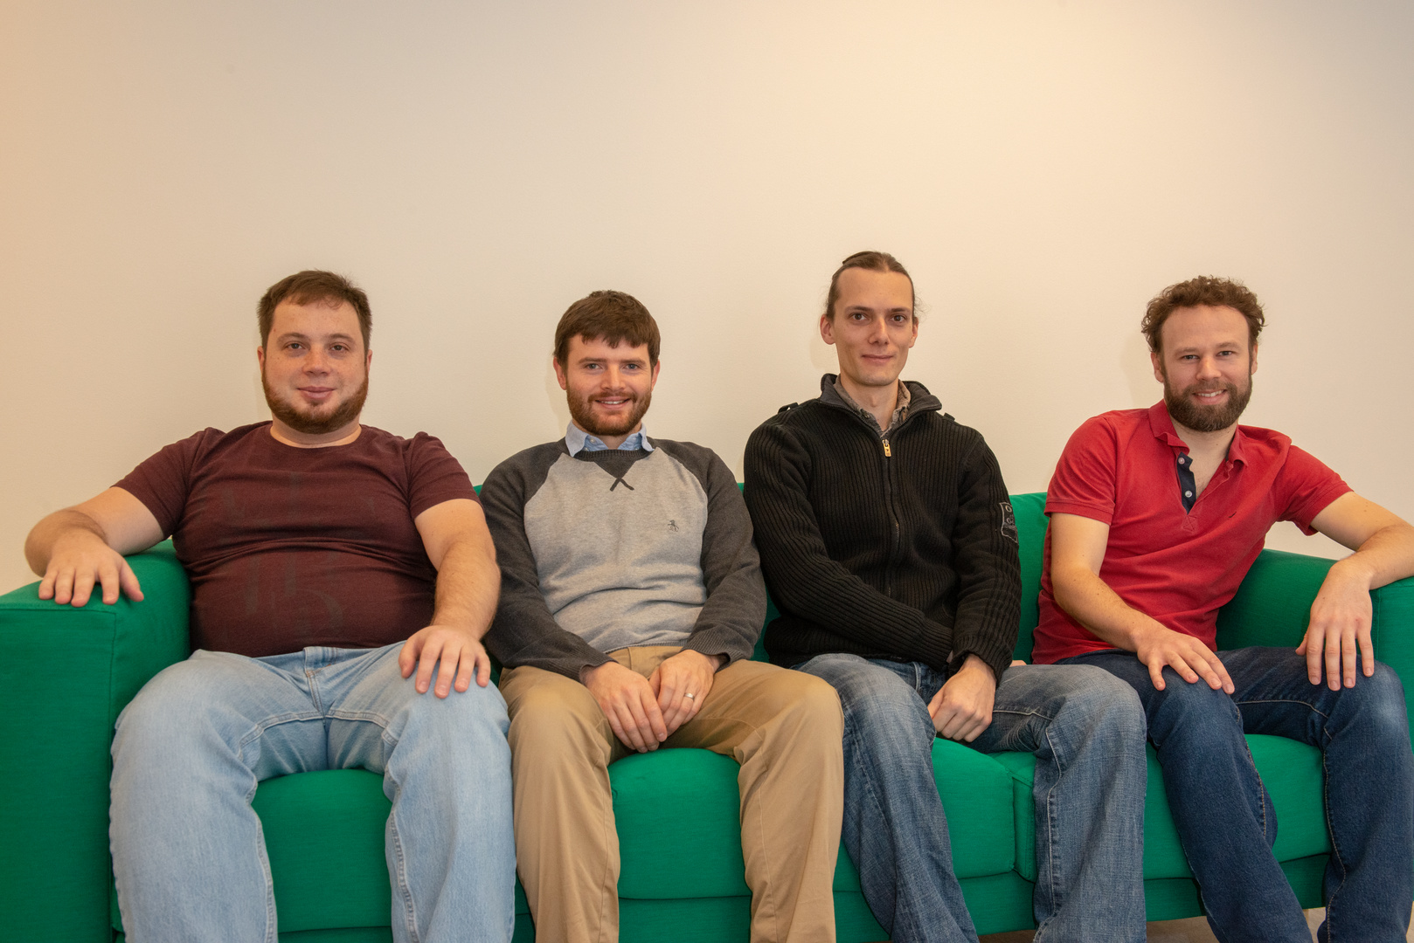
Mantid Team
Neil Vaytet
Igor Gudich
Will also train the rest of DRAM group in developing / contributing to Mantid

Slide 12
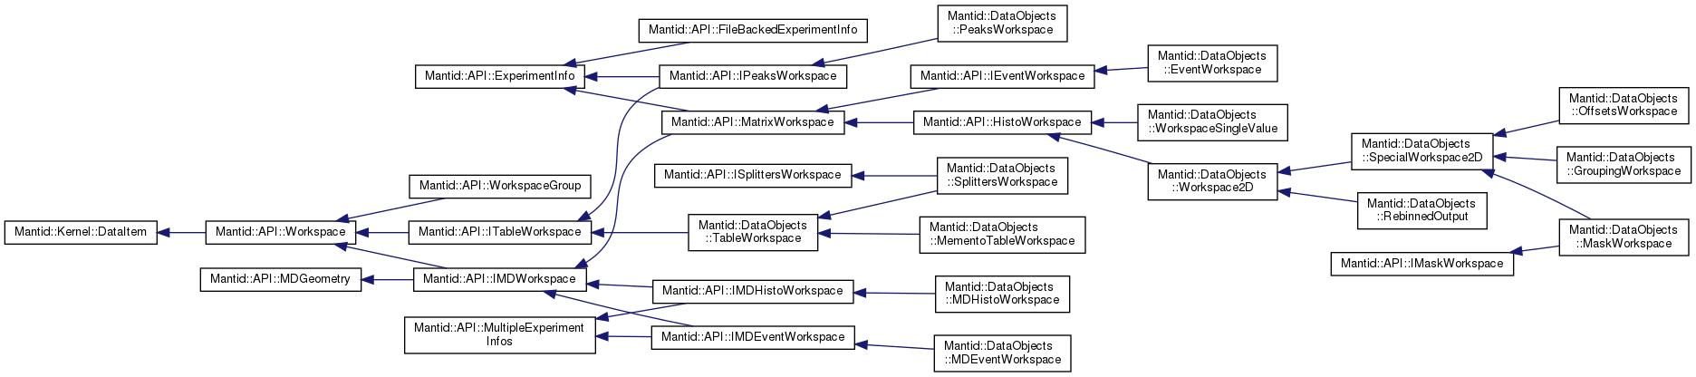
The need for redesigning / refactoring the Mantid core
... and it is still not sufficiently flexible

Slide 13
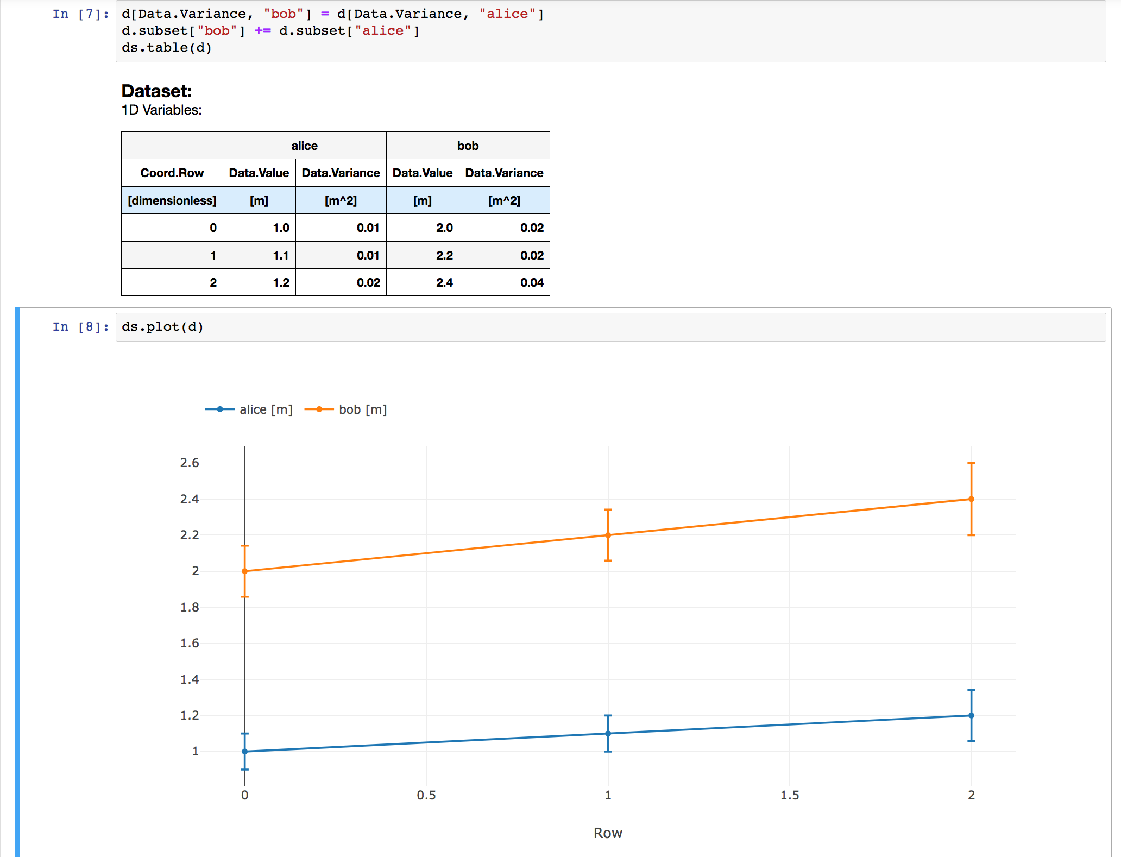
DataSet aka sci++
C++ library designed for handling experimental multi-dimensional datasets
Handles units, variance, and histograms
DREAM is used as driver
  To which extend can we avoid MPI?
Suggest to run sci++ independently of Mantid even though Mantid is the primary driver
Looking for opportunities to off-lift the burden of maintenance

Slide 14
Reflectometry STAP
Reflectometry STAP. The STAP was advised that resources for data management and software were reduced. The STAP did not recognize ESS’s decision to invest resources in a new specular reflectometry data analysis software tool as compelling. The NIST REFL1D specular reflectometry analysis tool is widely used, robust, correct and supported by a team of software engineers. The STAP questions why reinvent the wheel?
Report in response: ESS policy to support all techniques with analysis software, realities of SINE2020 and in kind contributions. Ensure we have maintainable software when needed. The alternative would be to just install refl1d, which would not have made users happy.
Up-prioritised GUI work, have mockups for reflectometry work (resulted in up-prioritising similar work for diffraction). Created reference user group.

Slide 15
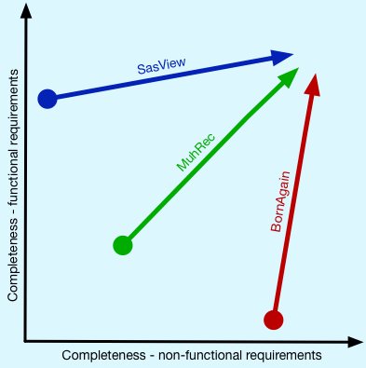
Comparing SasView/SANS and BornAgain/reflectometry
Ver | Date
5.0 Demo | Sep 2018 | Code camp
5.0 alpha | Oct 2019 | SAS2018
5.0 beta1 | Oct 2019
5.0 beta2 | Feb 2019
5.0 released | May 2019?
Still some missing features
Still technical debt, e.g. single point of failure
Ver | Date | Features (simplified)
1.11 | Mar 2018 | Refl in Core
1.12 | May 2018 | Refl in GUI
1.13 | Oct 2018 | Fitting in GUI
1.14 | Dec 2018 | More fitting
1.15 | Feb 2019 | TOF in Core
Still some missing features
Need more user involvement - created reference user group

Slide 16
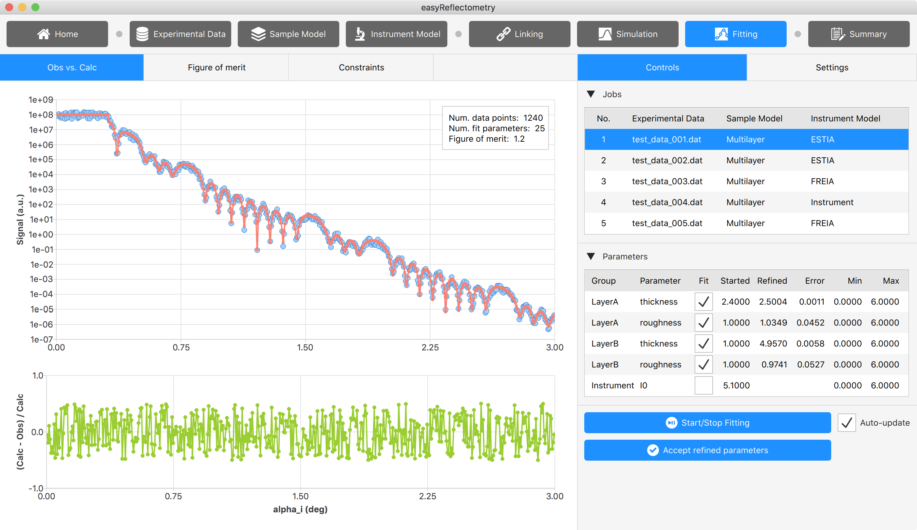
Example of reflectometry mockup

Slide 17
Diffraction
Powder diffraction (ILL) | Single crystal diffraction (LLB) | Computational Diffraction Env (CoDE)
Got some agreement to get collaboration started Céline and Andrew will visit ILL for a week in May to work jointly with Juan on CrysFML First objectives: ESS line profiles | Have had mutual ESS-LLB visits LLB developed library which replicates some functionality of CCSL, which they will now open source Will hook library into CoDE library | Python environment for diffraction Harmonized interface to different diffraction libraries, e.g. Fullprof and CCTBX Can use joint technologies across diffraction and spectroscopy, e.g. Atomic Simulation Environment (ASE), vtki for visualization, Avogadro for crystal visualization, etc. Links to sci++ and PaNOSC WP4 Enable us to assess specific technologies without involving partners and external libraries (e.g. for 2D Rietveld). I.e. we can collaborate without relying on it.
Established diffraction team
(Andrew, Céline, Piotr, Neil)

Slide 18
STAP recommendations
STAP | Response
Data and Reduction views in NICOS at the next STAP meeting | Data View in NICOS but some documentation is still missing.
mitigate at-scale unkowns that have plagued previous generation facilities | NeXus streamer: real data, scaled real data and McStas simulations, V20. Have McStas instrument model repo.
Recruit the Data Scientists as soon as possible in 2020 | Pilot project with Céline for diffraction. Also have persons looking after large-scale structures and spectroscopy, but not necessarily instrument data scientists. Imaging? Ongoing.
Aspire to have a general look and feel independently of instrument (UX) | We aspire, but only have limited control of software across techniques. Ongoing.
Have clear and detailed requirements for the instrument teams software demands for the period 2021-2023 (commissioning needs through to steady state operations) | Have pretty good requirements, but still evolving. Ongoing.
take a leadership role for powder and single crystal diffraction, running user workshops to define a long-term strategy | have only run one user workshop so far on single crystal diffraction, but this should be an ongoing activity in the coming years. We have started collaboration with ILL and LLB and started our own in house project.
Carefully manage instrument team- and User community- expectations of longer-term analysis and modelling provision | Ongoing.

Slide 19
PARADISE

Slide 20
In brief
Staff. Two new group members and one new secondment
  ➡️ Started to reorganize work (agile project organization)
Dev. Projects. Current projects, primarily in house:
  Ready for operation of LoKI (DONKI)
  sci++ project (C++ library for experimental data sets)
  Computational Diffraction Environment (CoDE) / Visualization in Python (VisPy)
Diffraction. Started collaboration with ILL and LLB as well as in house CoDE project.
Instrument data scientists. Started pilot project
Milestones. More or less on track.
External funding.
  Last SINE2020 WP10 workshop in May
  PaNOSC started
  AMEN VR project funded
  PARADISE H2020 project submitted
Stakeholders. Challenges from reflectometry stap & annual review

Slide 21
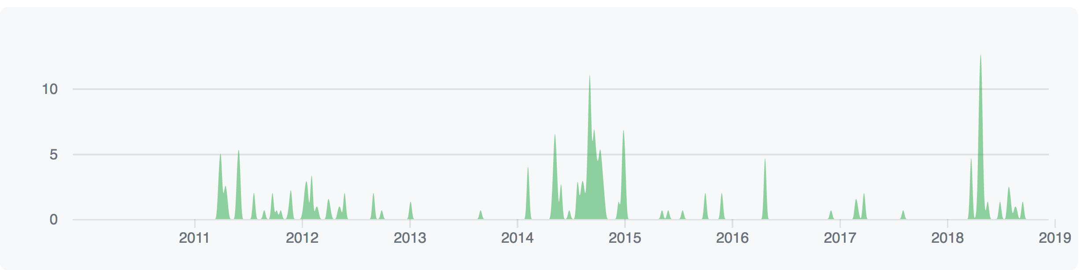
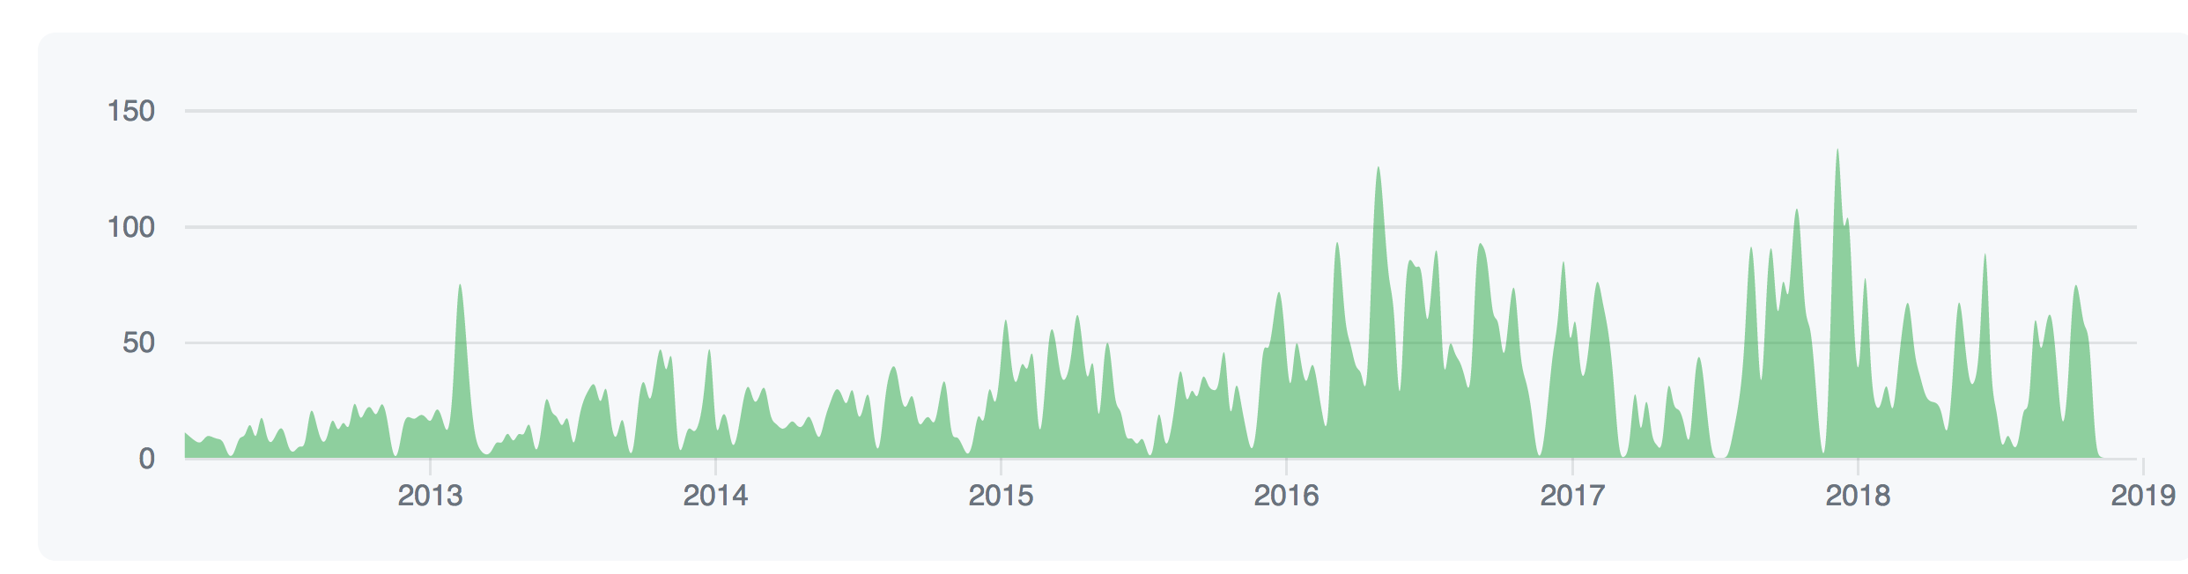
BornAgain vs FZJ - Commits at GitHub
Refl1d
BornAgain

