Slide 1
WP3 Kickoff Meeting Connection with other WP and ExPaNDS
23 May, 2019
Author: Alessandro Olivo, Software Developer CERIC

Slide 2
Outline
Connection with WP2
Connection with WP4
Connection with WP6
Connection with ExPaNDS
Resource

Slide 3
Outline (Connection with WP2 )
WP2 keywords and discussion

Slide 4
WP2 keywords and discussion
Data Policy describes how data and metadata will be managed
Some key words:
Embargo period - Where should we insert this information ?
GDPR compliant - Which information we can exactly store ?
Data and metadata curation max period - How would we manage the end of data curation?

Slide 5
Outline (Connection with WP4 )
WP4 at a glance
WP4 current roadmap
Discussion

Slide 6
WP4 at glance
Data analysis services
Make analysis tools and services available for remote execution
Cloud - EOSC (WP6)
Local (each facility)
Technologies
Remote desktop (VISA)
JupyterHub | BinderHub
Challenges
Software environment + Hardware requirements + Data access
Facility independent
Executed in different hardware e.g. IT systems of research facilities, desktop of users, EOSC

Slide 7
WP4 Roadmap (discussed in the last WP4 telco)
Find scientific notebook use cases
Move to BinderHub
Facility independent data access
Providing small sets of files (fetch data on demand)
Improve modularity (software environment) and performance (hardware)

Slide 8
Discussion
Portal to select data sets and analysis methods
Is this part of T3.2? Provisioning Federated Search
Where is the common portal that offers multiple Notebooks for analysis of a particular data set?
Could this be a link (URL) in the RIs data catalogue (scicat, icat) that shows data sets from all PaNOSC facilities?

Slide 9
Outline (Connection with WP6 )
WP6 at a glance
WP6 update
Discussion

Slide 10
WP6 at glance
EOSC Integration
Make PaNOSC services available from EOSC
Authentication and Authorization Infrastructure
Data transfer services
Technologies
AARC Blueprint Architecture with OpenID, UbrellaID, EduTEAM (propose by GÉANT)
FTS (they will talk about in the next meeting)
Main challenges
Access a cloud-hosted JupyterHub and run notebooks that read-write data from the Community Data Repository
Authenticate and Authorize users that want to access data repository (embargo period)

Slide 11
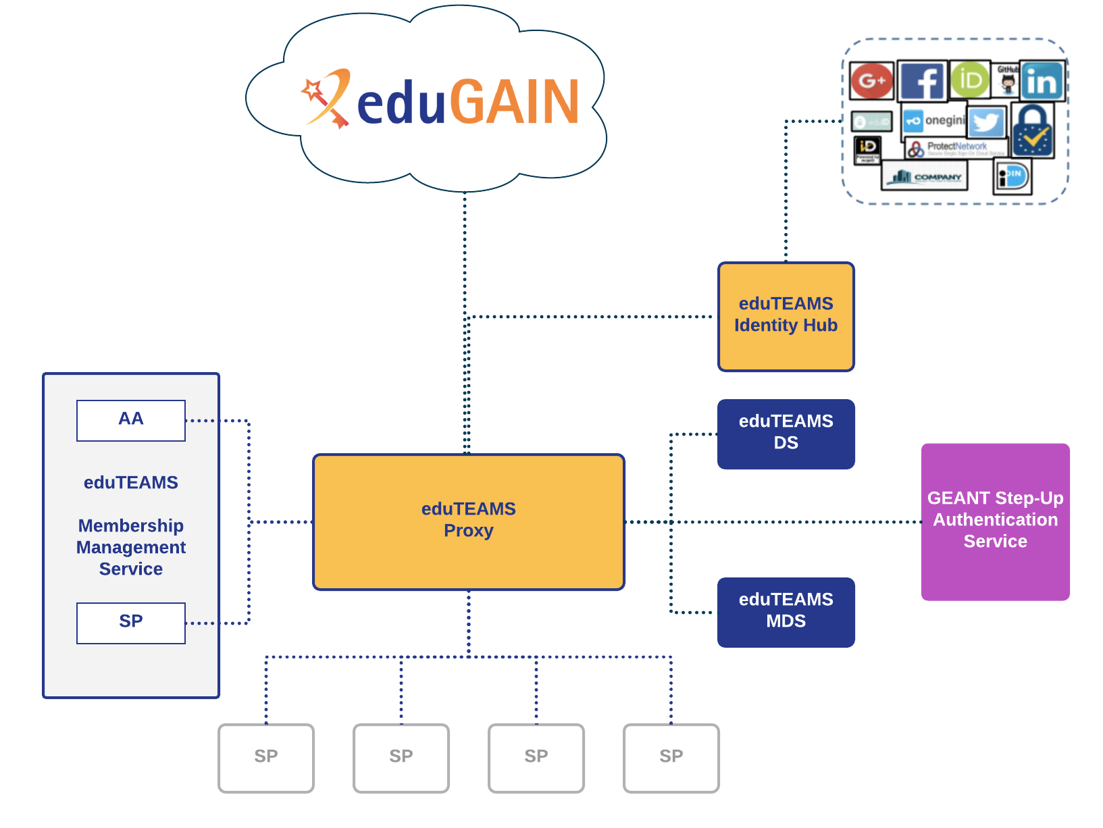
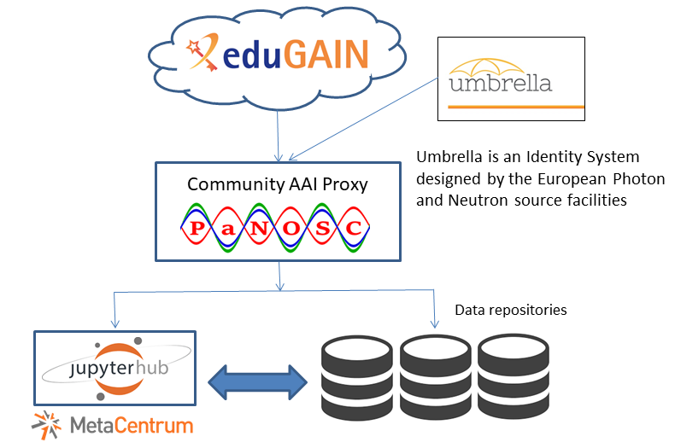
WP6 Update
They are working on a Roadmap
Main topics are: AAI and data transfer according with use cases.
PaNOSC Community AAI Proxy (not formal decision yet)
Single entry point to PaNOSC (and EOSC-Hub)
Based on GEANT eduTEAM (figure 1)
Umbrella IdP will be used
During the EOSC-hub week it was identified a use case and its implementation shown in figure 2.
Notebooks and RI Repository are services providers
EGI provide the set-up of the JupyterHub
CESNET-MetaCloud allocate the resources
Figure 1.
Figure 2.

Slide 12
Discussion
In terms of PaNOSC AAI Proxy (AARC Blueprint) the metadata catalogue should be intended as a service provider (SAML or OpenID to implement) ?
In the implementation point out in the previous picture where metadata catalogue is supposed to be inserted ?
Should we manage the authorizations to access the metadata or it should be managed to another level ?

Slide 13
Outline (Connection with ExPaNDS)
ExPaNDS Overview
ExPaNDS Metadata catalogue
Discussions

Slide 14
ExPaNDS Overview
ExPaNDS and PaNOSC have commons goals and they will work close
It is strongly based on EOSC ecosystem:
EOSC will be used to deliver analysis services
EOSC-portal as single entry point to reach its services
Activity will feed into the OpenAIRE infrastructure
Compliant to the Rules of Participation of the EOSC (EOSC-Hub, OPENAir-Advance help)
Data management will follow FAIR Principles
National PaN Infrastructures: DESY, PSI, DLS, UKRI, Soleil, EGI, ALBA, HZB, HZDR, MaxIV, Elettra
The project will last 3 years
Kick-off meeting on 11 and 12 September 2019

Slide 15
ExPaNDS Metadata catalogue
WP3 is dedicated to metadata catalogue services
EGI will assist ExPaNDS in the integration of the data catalogue in the EOSC ecosystem
They will adopt the PaNOSC standardisation of NeXus (they will propose to link experimental report to the dataset)
They will standardise and link all the relevant National PaN RIs catalogues to ensure that a user has access to the raw data collected and the relevant peer review articles, then they will link them to PaNOSC catalogue.
Development of ontology for all the elements of the catalogues and taxonomy strategy

Slide 16
Discussion
ExPaNDS will work alongside PaNOSC and it supposed they learn lessons from PaNOSC implementation
How we will interface with this complementary project ?
EGI could be our middleman ?
Should we choose some solutions in concert with ExPaNDS ? ( e.g. OAI format, metadata ontology, NeXus format … )

Slide 17
Resources
WP4 roadmap
EOSC-portal
PaNOSC Github
ExPaNDS proposal 857641

Slide 18
alessandro.olivo@ceric-eric.eu
Acknowledgments: Carlos Reis, Georgios Kourousias

