Slide 1
Brief introduction to Bayes’ theorem
Alex Holmes
European Spallation Source ERIC
Date

Slide 2
The meaning of probability
A statement X is true or false
The probability P(X) is the subjective belief in whether something is true or not. It is real number between 0 (definitely false) and 1 (definitely true).
Conditional probability P(X|Y) is the probability of X given that Y is true.
Joint probability P(X,Y) is the probability that both X and Y are true.

Slide 3
Bayes’ theorem
Consider the joint probability of two events X and Y
$$P\left(X,Y\right)=P\left(X | Y\right)P\left(Y\right) \\ =P\left(Y | X\right)P\left(X\right)$$
$$⟹P\left(X | Y\right)=\frac{P\left(Y | X\right)P(X)}{P\left(Y\right)}$$
X
Y

Slide 4
Bayes’ Theorem IS Science!

Slide 5
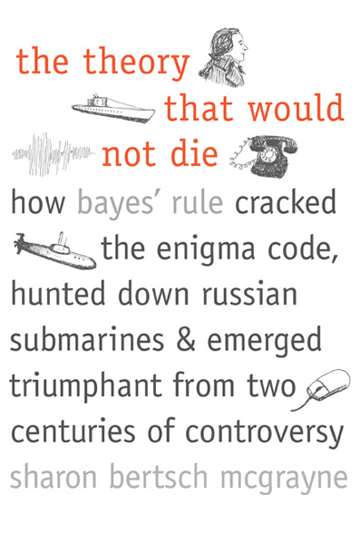
Bayes’ Theorem: A Historical Digression
First discovered by Reverend Thomas Bayes in the 1740s and promptly forgotten.
Probably not Thomas Bayes (c. 1701 – 1761)

Slide 6
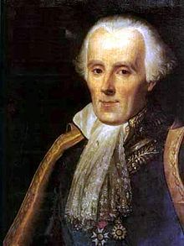
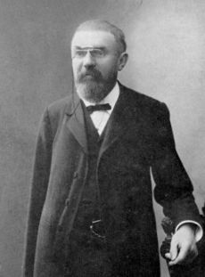
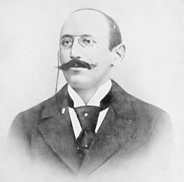
Most of the hard work done by Laplace, who used it to calculate the masses of Jupiter and Saturn to within 1% (amongst other things)
Pierre-Simon Laplace (1749-1827)
Used by Poincaré to help acquit Dreyfus (1899)
Jules Henri Poincaré (1854–1912)
Alfred Dreyfus (1859-1935)

Slide 7
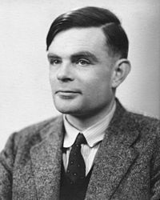
World War II:
Alan Turing uses Bayes’ theorem to decode the Enigma, but its use is classified after the war.
Alan Turing (1912 –1954)
Bayes becomes taboo amongst statisticians (who hated the “subjectivity”), but the knowledge is kept alive by physicists, business schools, computer scientists and the military (because it works).

Slide 8
Bayes’ theorem: a more complete version
likelihood
posterior
prior
evidence
Often:
{D} = data
= parameters
I = background information

Slide 9
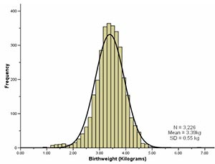
What is the mean of a gaussian variable with known s.d.?
Assuming uniform prior and independent data
Gaussian distribution:
$$\frac{1}{\sqrt{2π}σ}e^{−{{(x−μ)}^{2}}/{{2σ}^{2}}}$$
Maximise (log) likelihood to find μ

Slide 10
(1)
(2)
(3)
(4)
(5)

