Slide 1
Education and Training at SINQ
Christof Niedermayer :: Laboratory for Neutron Scattering and Imaging
ILO Meeting Budapest, June 2019

Slide 2
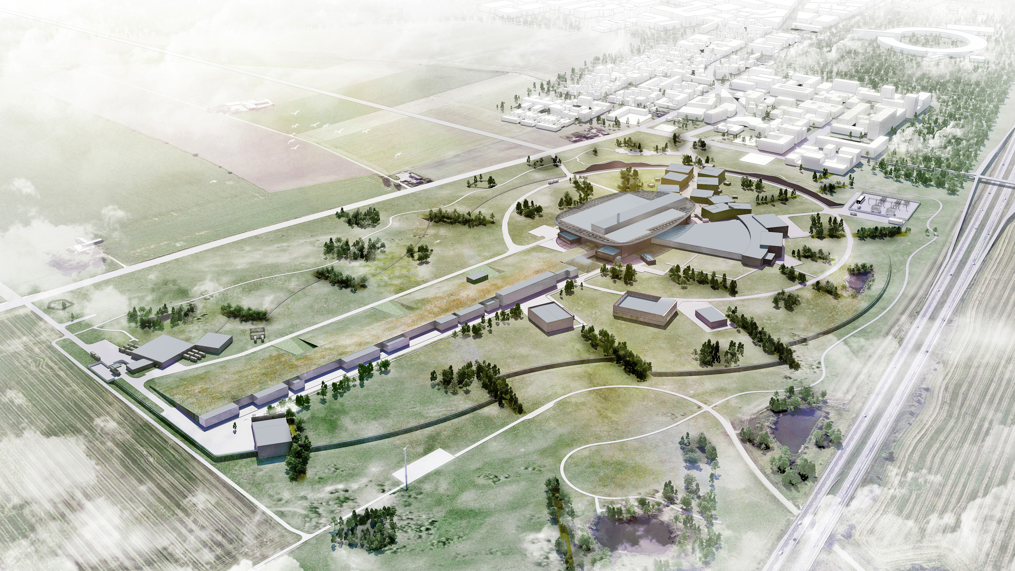
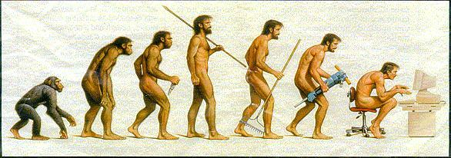
Scientists for the future

Slide 3
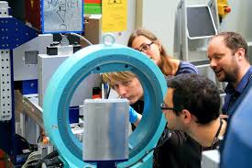
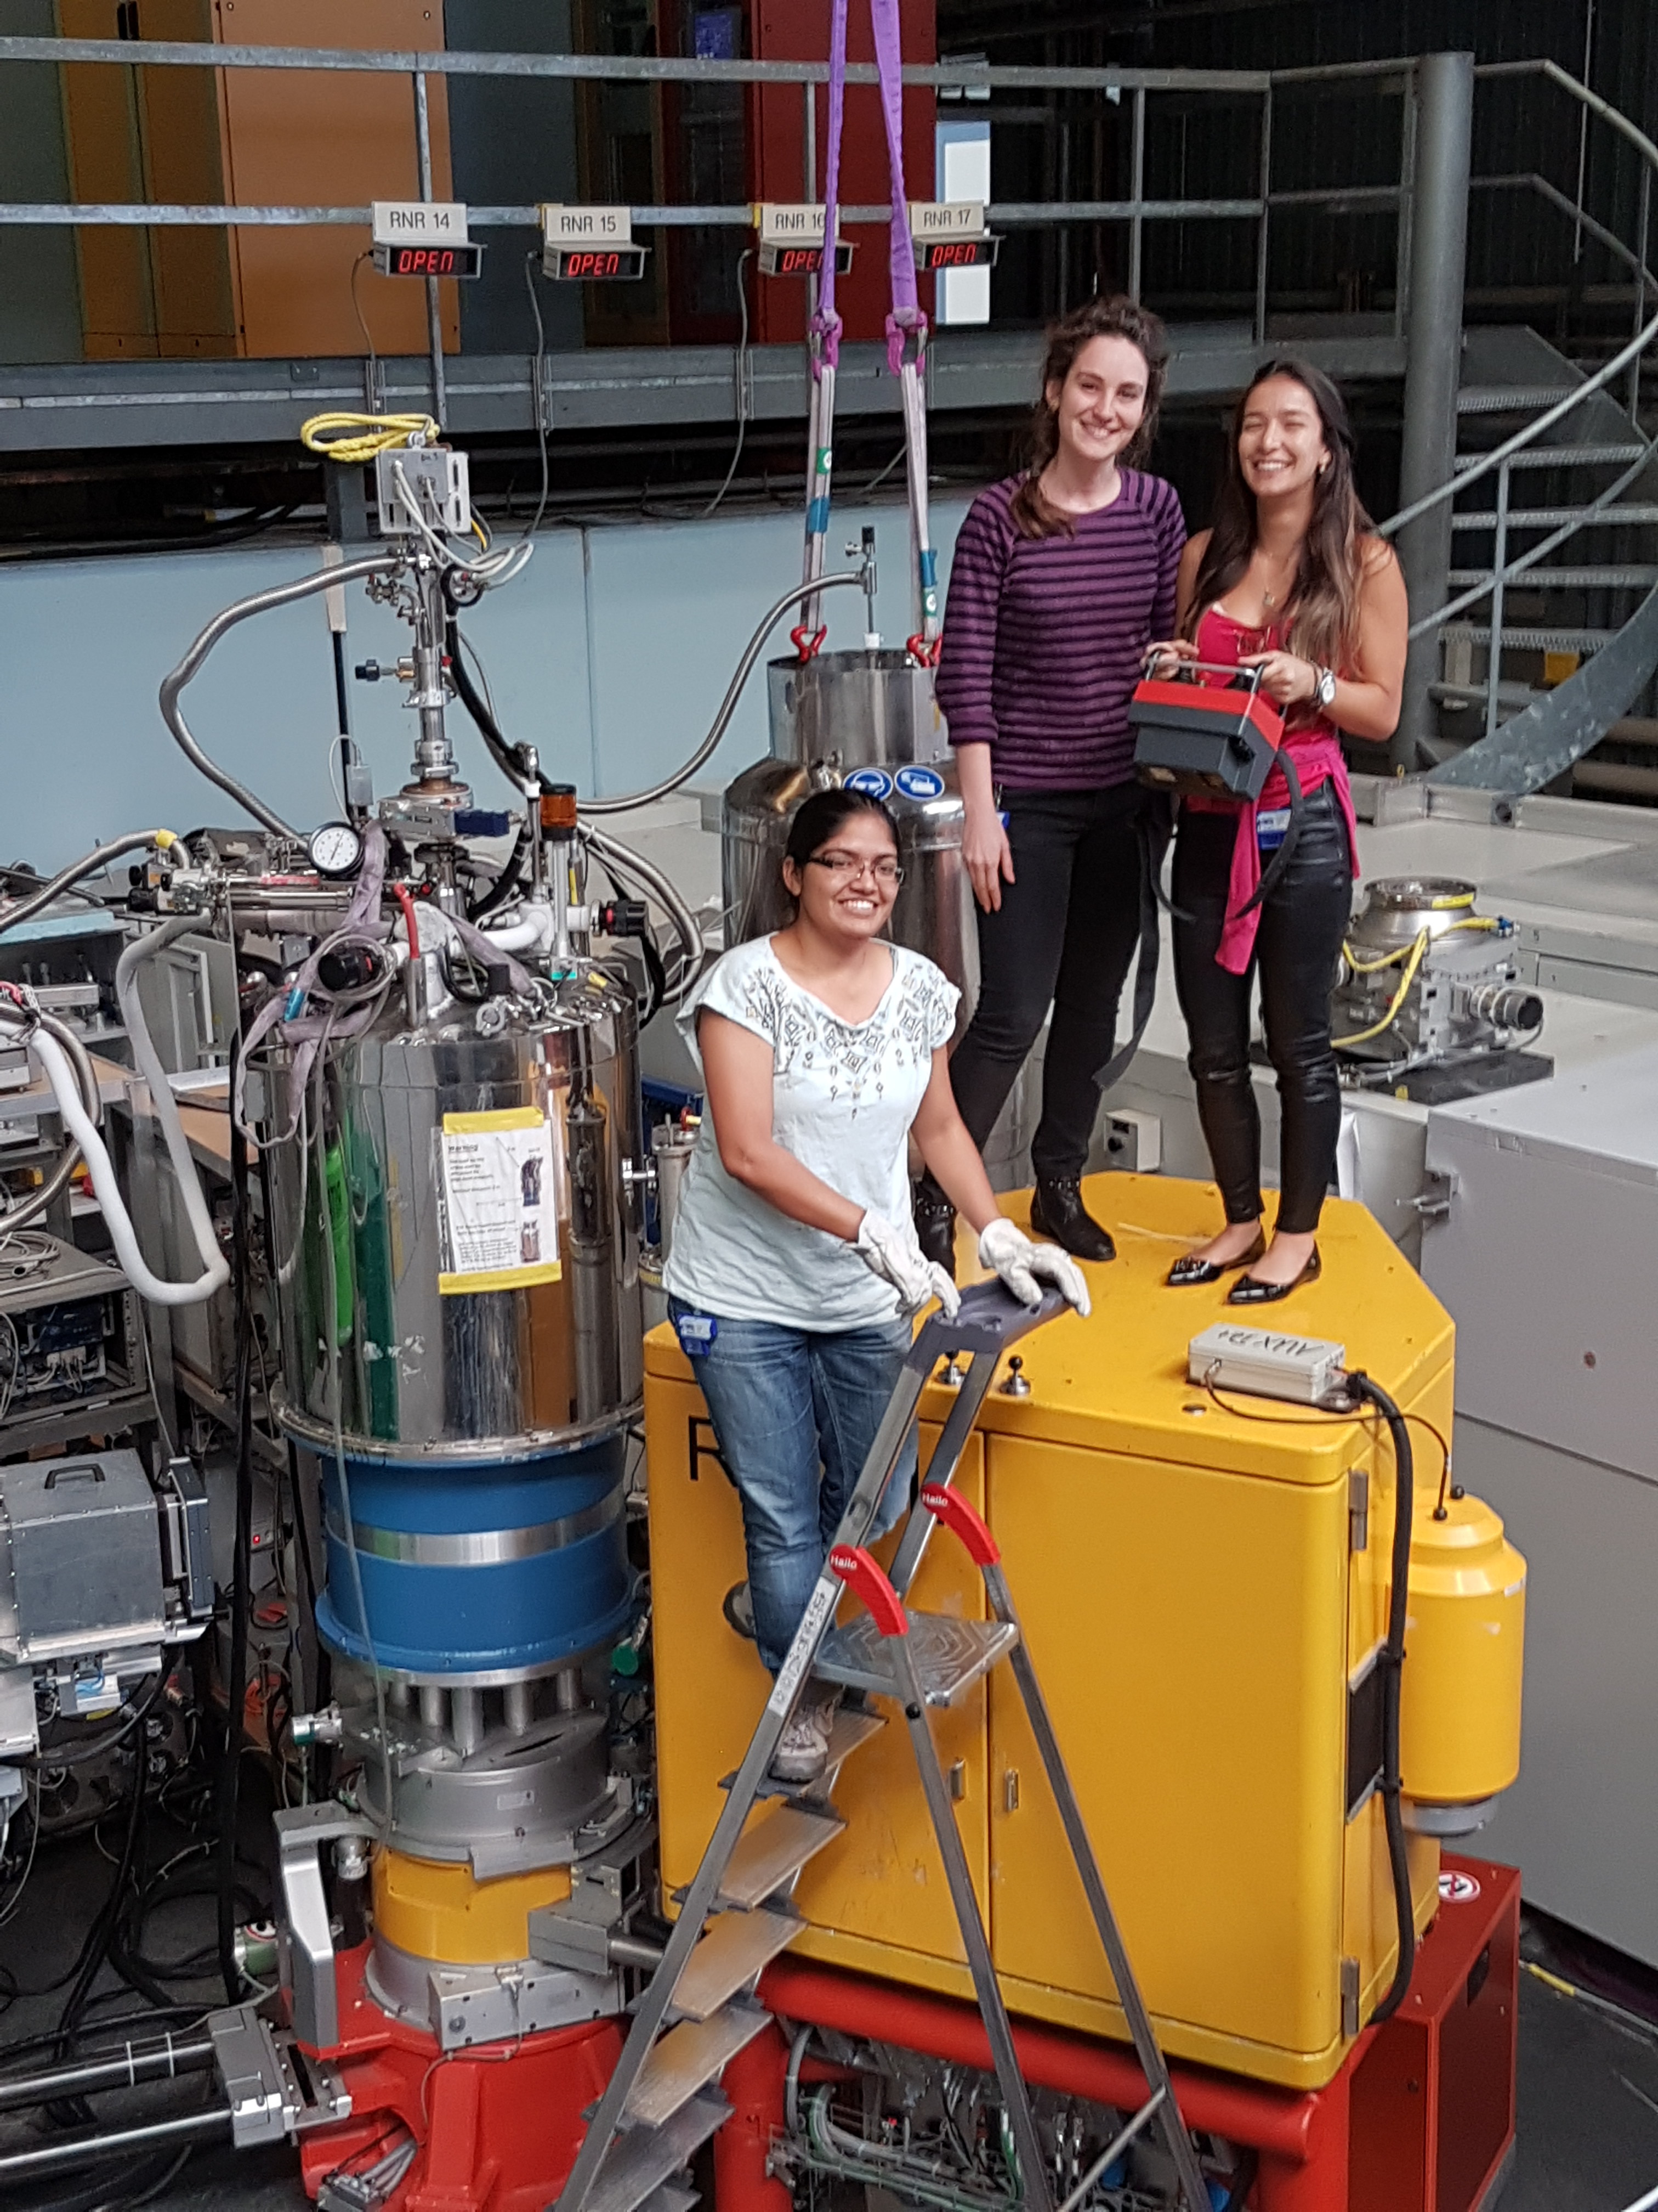
Practical Courses and Training at SINQ
https://www.psi.ch/en/lns/training

Slide 4
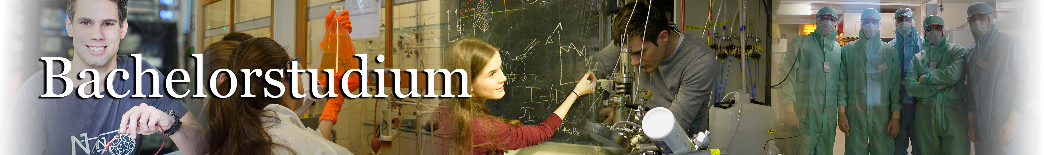
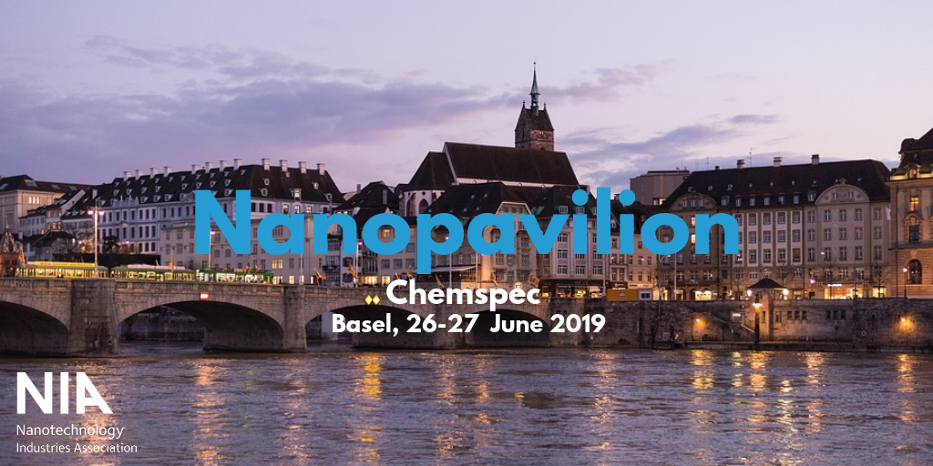
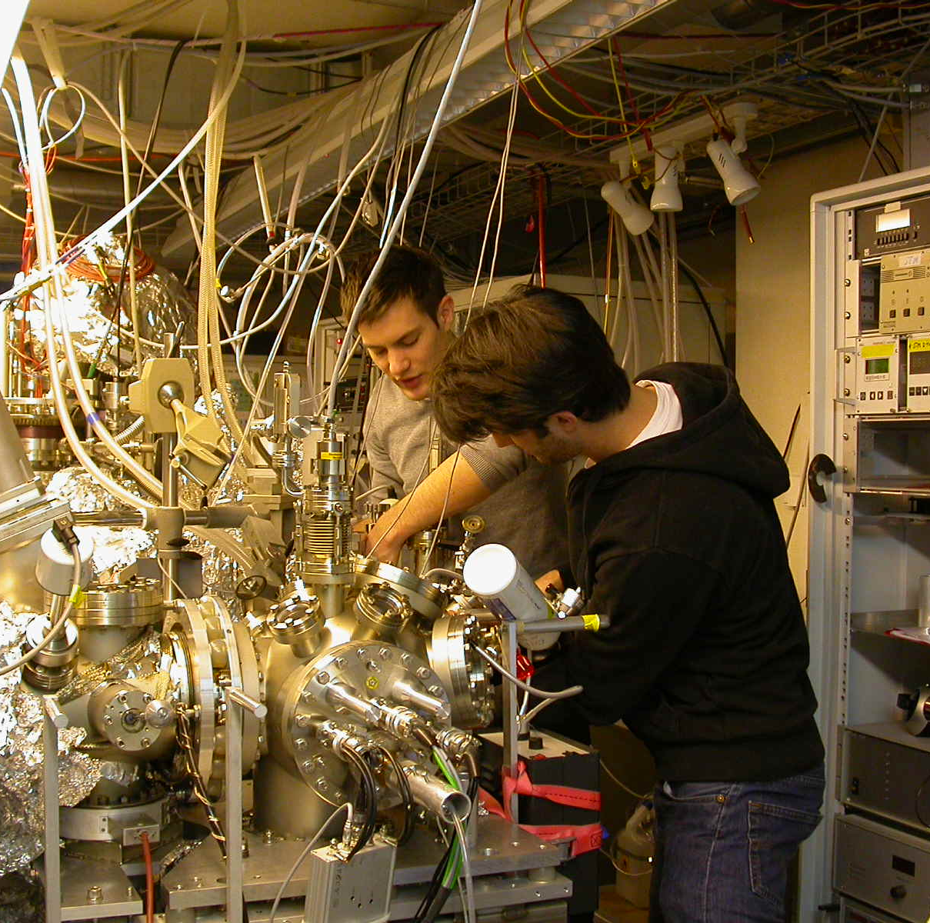
Swiss Nanoscience Institute, University of Basel
Block Course for students of Bachelor of Nanoscience.
NIA's Nanopavilion at Chemspec Europe 2019
showcasing Members and nanotechnology at important industrial meetings around Europe.

Slide 5


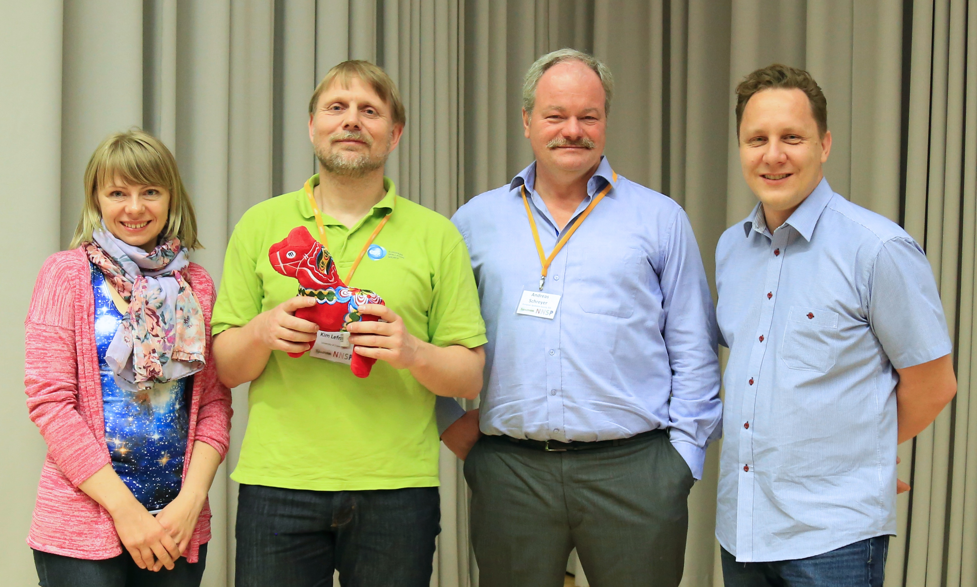
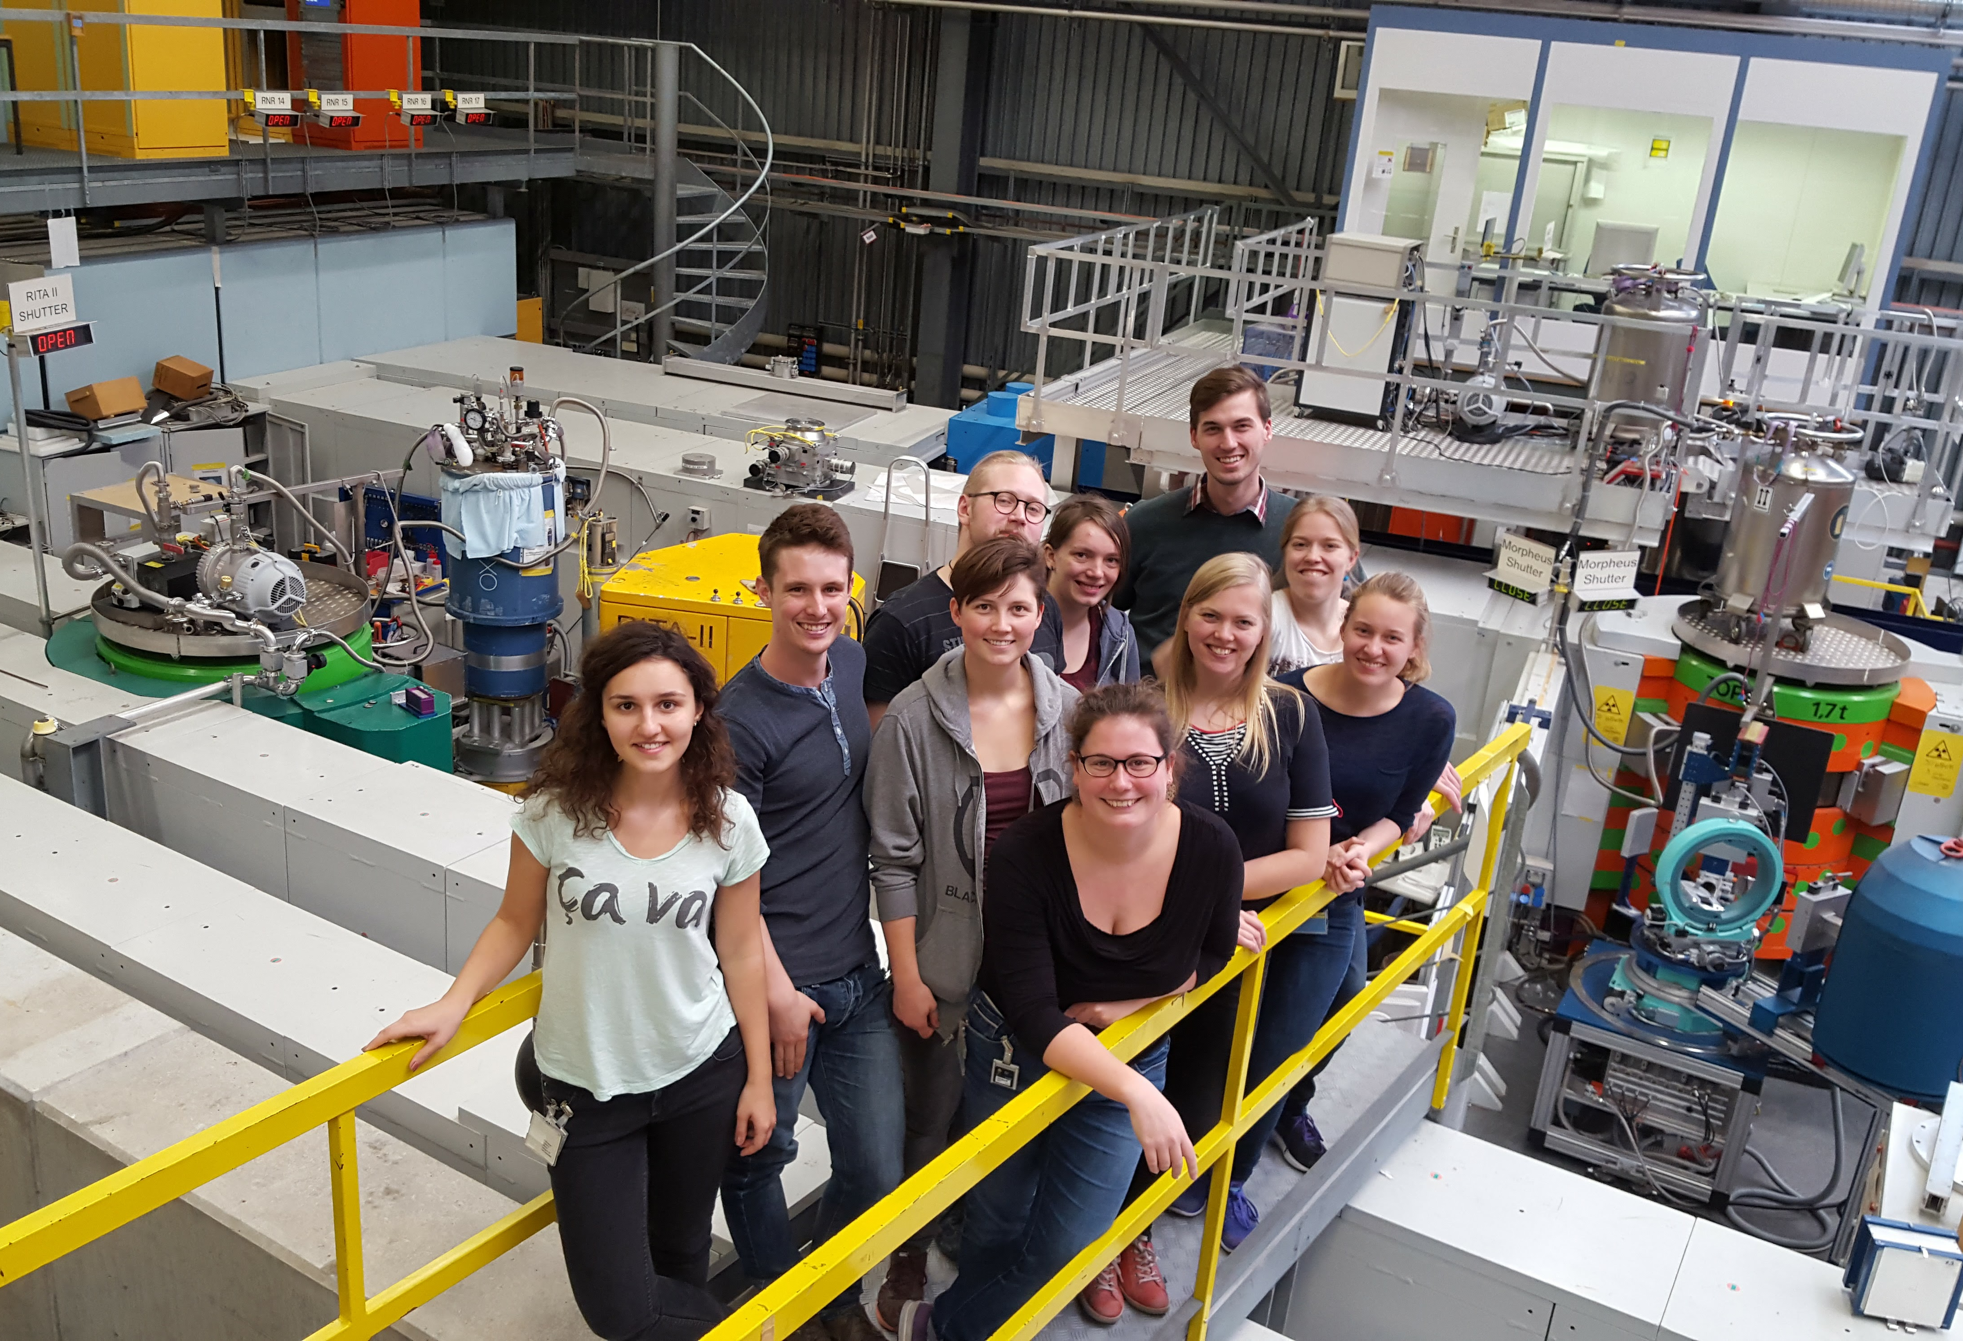
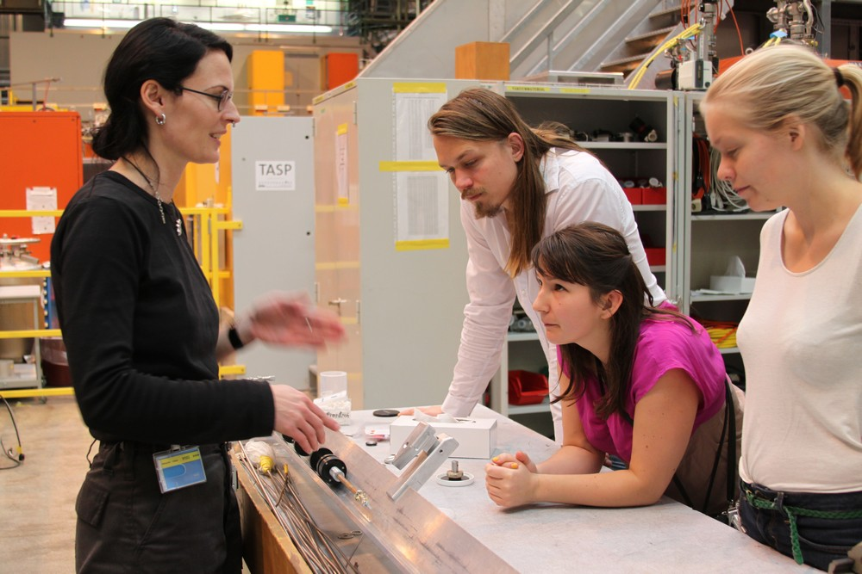
Nordic and Baltic states have come together to increase competence in neutron scattering among young researchers and raise the number of neutron users in the region.

