Slide 1
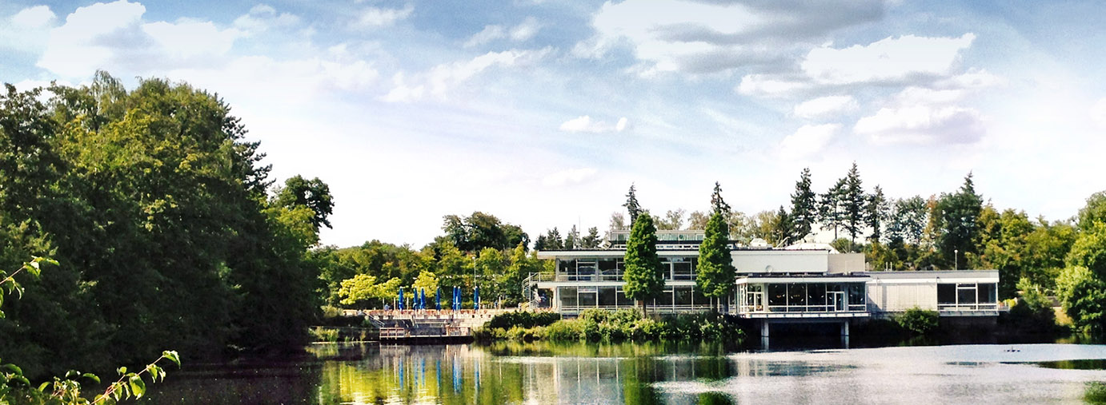

German Contributions to the ESS
ILO Strategy Workshop / Budapest
Prof. Dr. Ghaleb Natour , ESS ILO Germany
Director Central Institute of Engineering, Electronics and Analytics (ZEA) – Engineering and Technology (ZEA-1)
University Professor at Faculty of Mechanical Engineering RWTH Aachen University

Slide 2
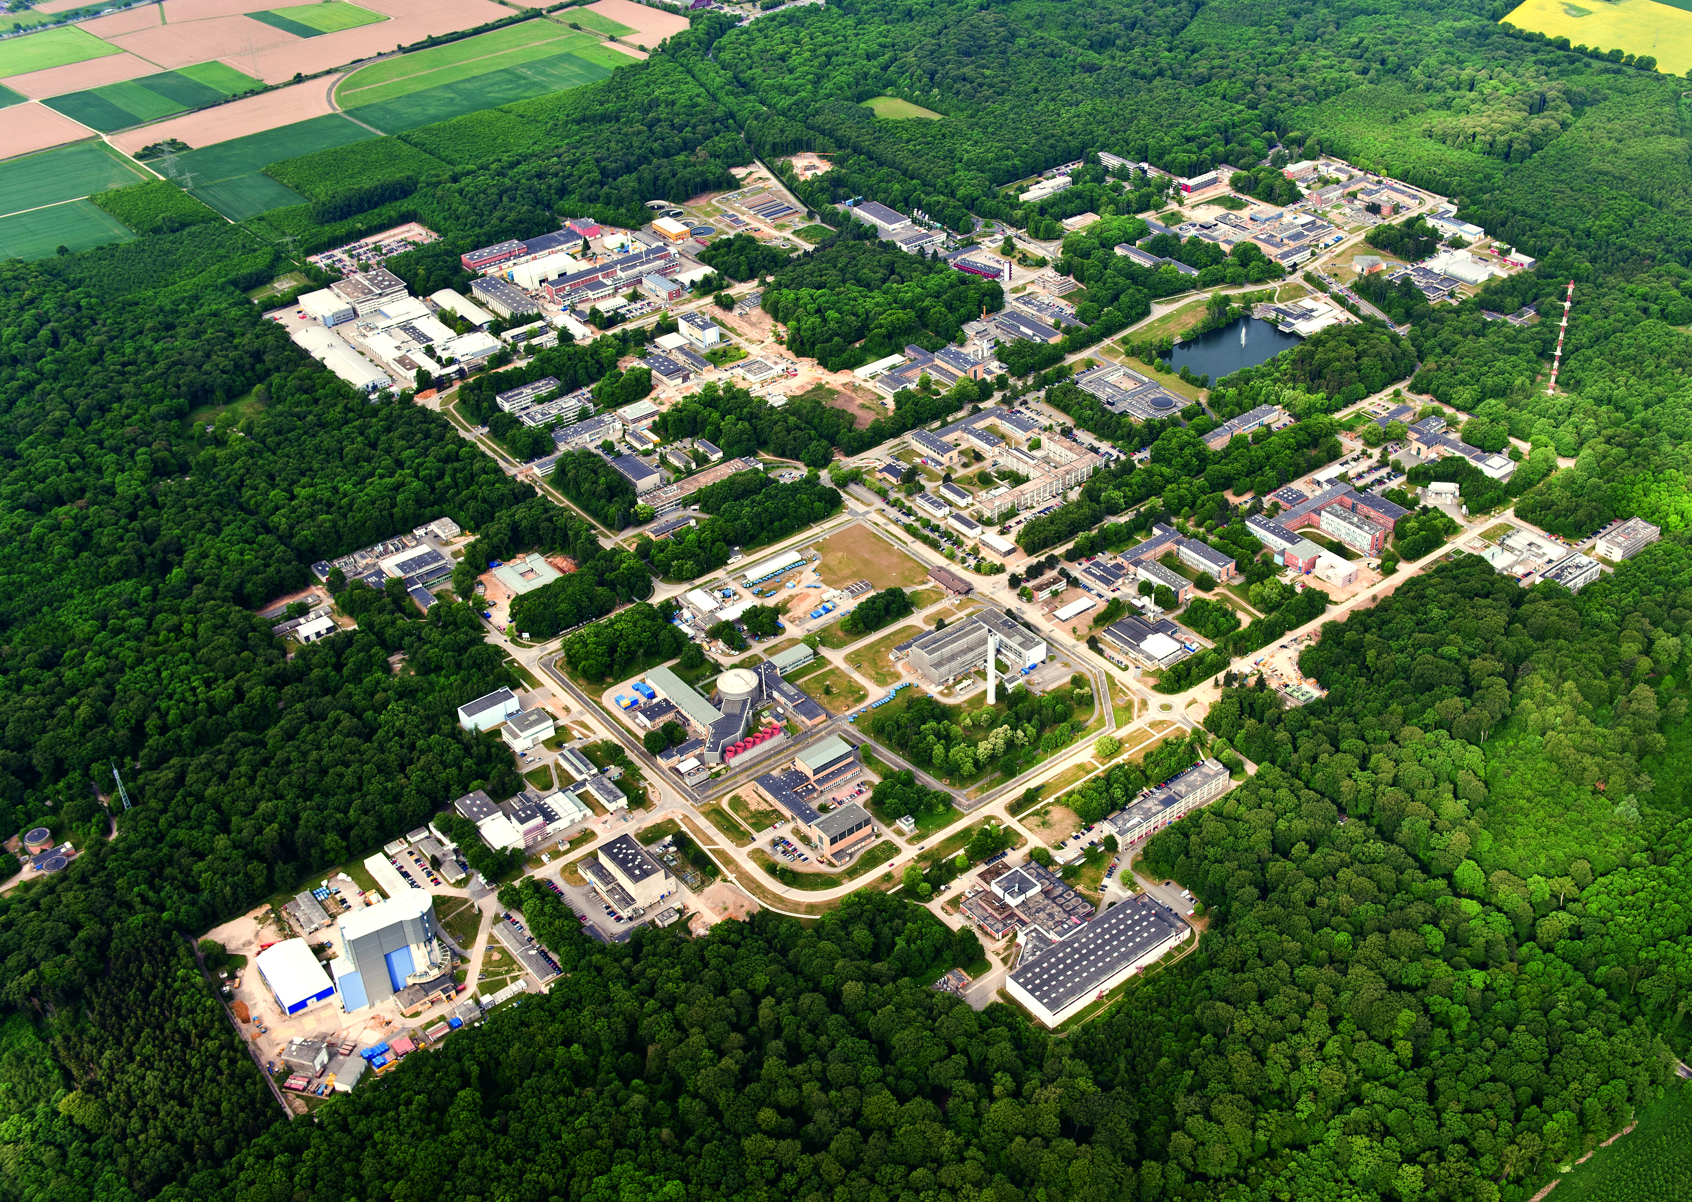
Forschungszentrum Jülich
At a glance
Facts and Figures
1956
FOUNDATION
December
Shareholders
90 % Federal
10 % State NRW
11
INSTITUTES
2 project
management organizations
609.3
million euros REVENUE
total
(40 %
external funding)
5,914
EMPLOYEES
2,165 scientists
900 doctoral researchers
323 trainees and students
867
VISITING
SCIENTISTS
from 65 countries
ZEA-1 | Technology for Excellent Science

Slide 3
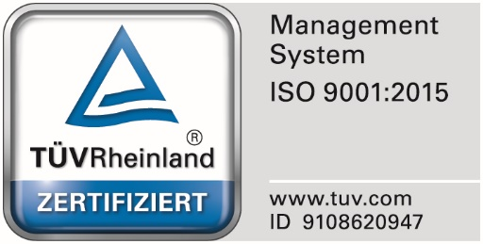
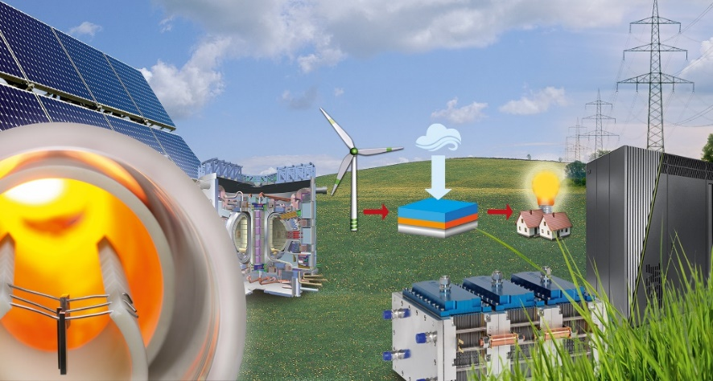
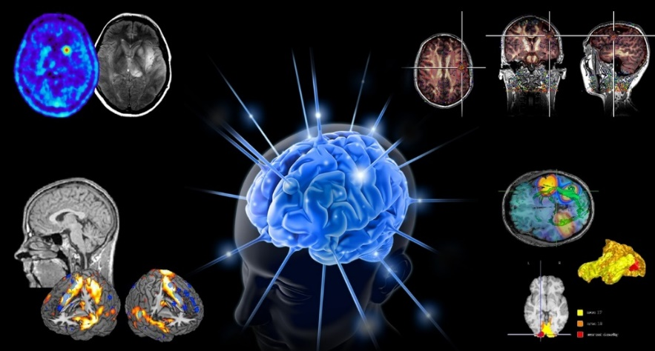
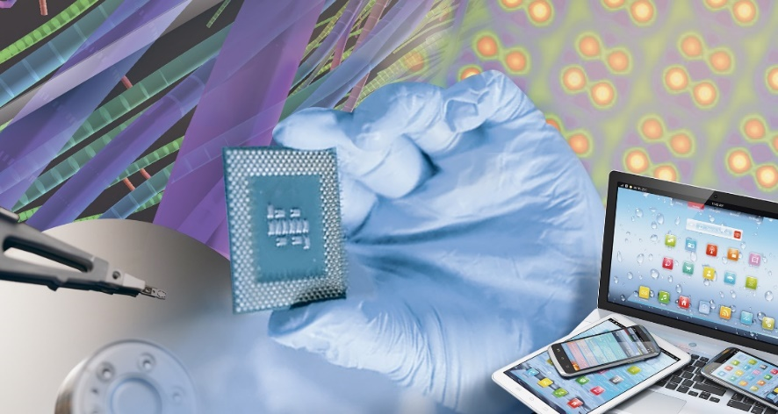
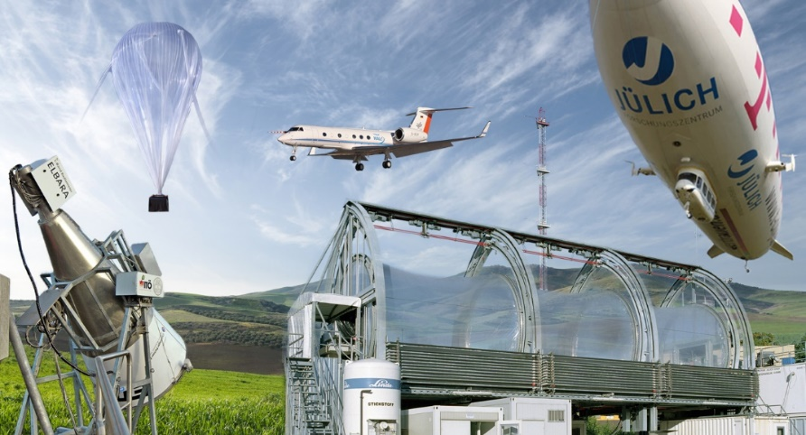
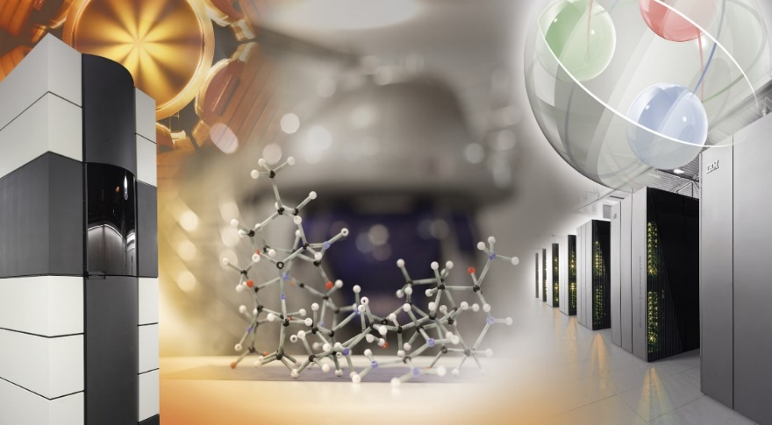
Research Forschungszentrum Jülich
and contributions of the Central Institut of Engineering, Electronics and Analytics (ZEA)
ZEA-1 160, ZEA-2 80, ZEA-3 30 Employees
Energy production, storage and materials
Brain research and neuroscience
Information
In close cooperation with scientists
at Forschungszentrum Jülich
develops and builds:
- Devices/Instruments
- Processes
- Measuring and control equipment
- Detector systems
- Imaging techniques
required for excellent science and
are not available on the market
Atmosphere, climate research /
Earth and envirnoment
Nuclear physics, neutron science

Slide 4
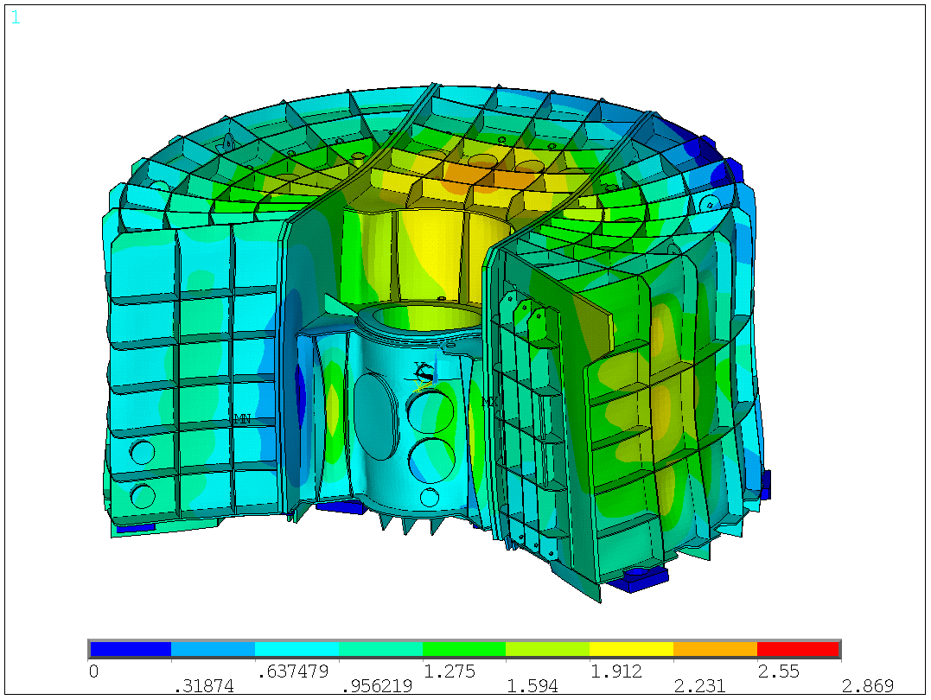
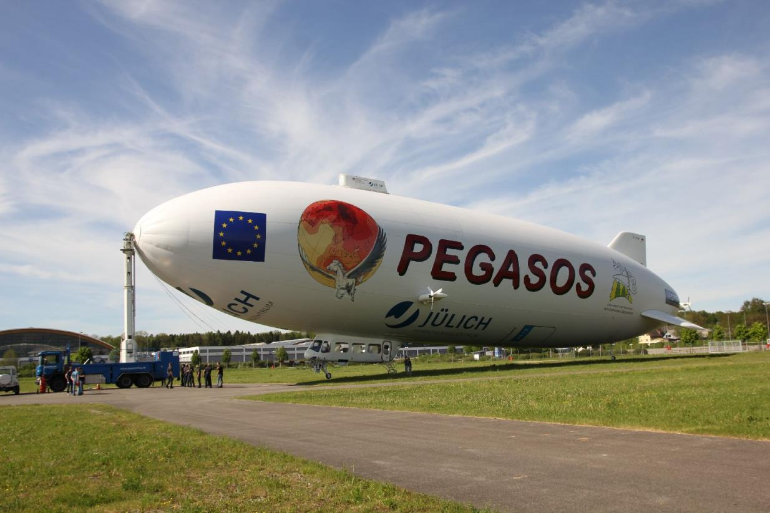
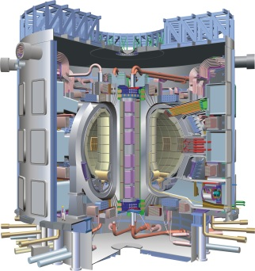
Research Areas And Projects ZEA-1 contributions
Neutron Science (JCNS, MLZ-FRMII, SNS, ILL and ESS)
  Instruments and Target components for advanced Neutron sources
  Choppers for Neutron scattering (magnetic bearing)
Hadron Physics (IKP, COSY, HESR, PANDA, PAX)
  Accelerator components (magnets, cooler units)
  Detector systems for Proton – and Antiproton beams
  Neuro Science (INM: Institutes for Neuroscience and Medicine)
  Hardware and system aspects for MRT- PET- set ups
  Climate (IEK: Institutes for Energy and Climate Research) GLORIA, HALO, PEGASOS
  Setups for investigation of processes in the atmosphere, atmosphere simulation champers
Energy (IEK: Institutes for Energy and Climate Research) W7-X, ITER
  Instruments for Nuclear Fusions Research
  material science, joining technologies and measurement technologies
  for photovoltaic, full cells and battery research
Bio-Geo Science (IBG: Institute for Bio- und Geo Science)
  Equipment and instrumentation for plant and soil investigations
32%
ZEA-1 | Technology for Excellent Science

Slide 5

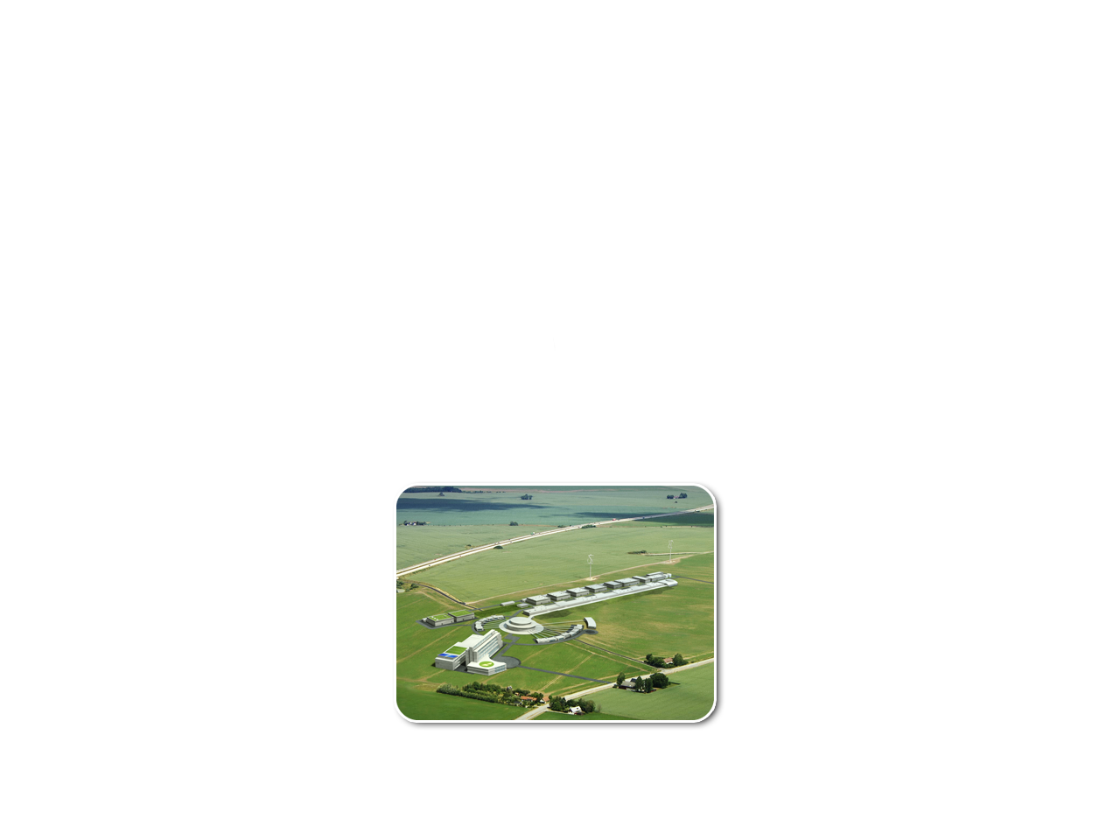



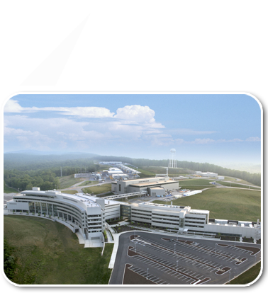
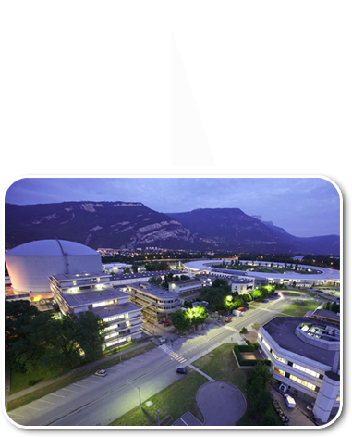
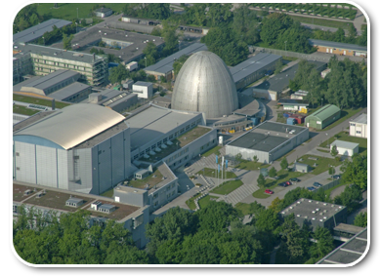
JCNS: Jülich Center for Neutron Science
Neutron Research and Instrumentation
450 users per year @FRMII
ESS: Most powerful spallation source
in the world!
ESS
FZJ
1(+2) Instruments
4(+1) Instruments
14 Instruments
14 Instrumente
operates world-class instruments at the world‘s leading
Neutron sources FRM II, HFR@ILL, SNS
5

Slide 6
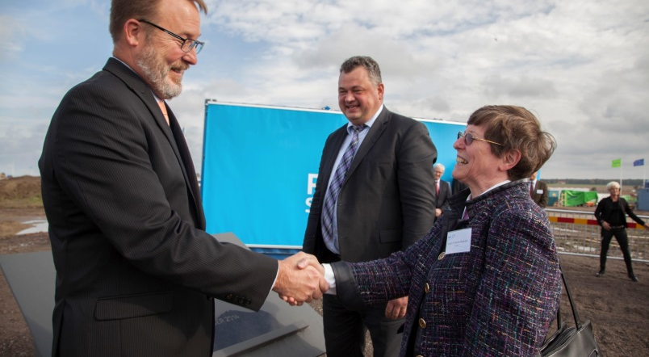
German Involvement in ESS
Germany has one of the largest neutron science communities in Europe (approx. 1.500 members), i.e. 25% of Europe’s users
Founding member of the European Spallation Source ERIC
Total contribution of 202.5 MEUR
(incl. pre-construction phase)
German In-kind Partners
  FZJ: Forschungszentrum Jülich
  (JCNS/ZEA-1: Instruments, ZEA-1:Target Systems, Chopper)
  HZG: Helmholtz-Zentrum Geesthacht
  TUM: Technische Universität München
ESS Council members Dr. Beatrix Vierkorn-Rudolph, BMBF and Prof. Dr. Sebastian Schmidt, FZJ at the ESS Foundation Stone Ceremony, October 2014
Contribution to:
Instruments: BEER, C-SPEC, SKADI, DREAM, ODIN, T-REX, MAGIC
Target systems:
moderator and reflector plugs, NBEX
ZEA-1 | Technology for Excellent Science

Slide 7
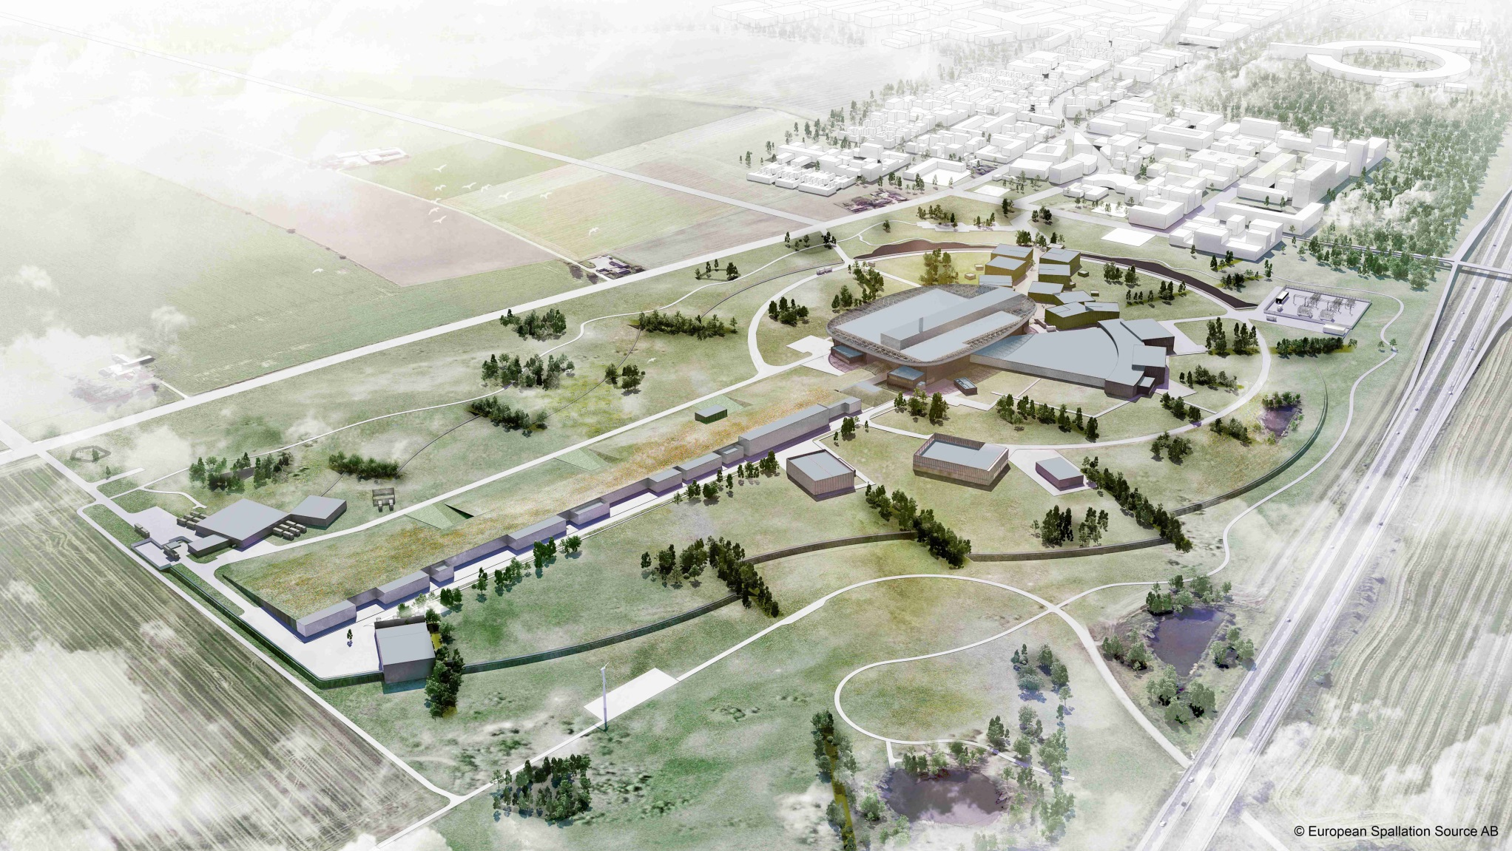
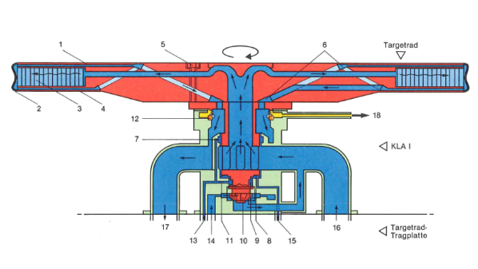
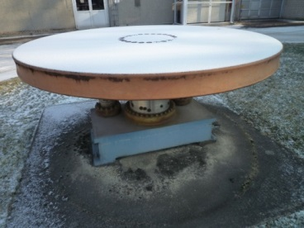
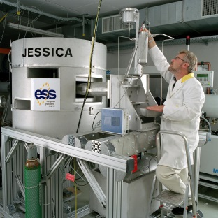
History FZJ Contribution
Decades of Experience in Neutron Techniques
80‘s
Feasibility Study on Spallation Neutron Sources
Günter Bauer “invented” the target wheel (ZEA-1)
2000‘s
FZJ hosting the ESS management team
ESS Science Director: Dieter Richter (FZJ)
90‘s
ESS Technical Design:
JCNS
ZEA-1
IKP
2010 – 2014
Project Management: ESS Design-Update
7 German Partners: Accelerator, Target, Instruments
20.5 M€ of 40 M€ in-kind to the pre-construction
ZEA-1 | Technology for Excellent Science

Slide 8
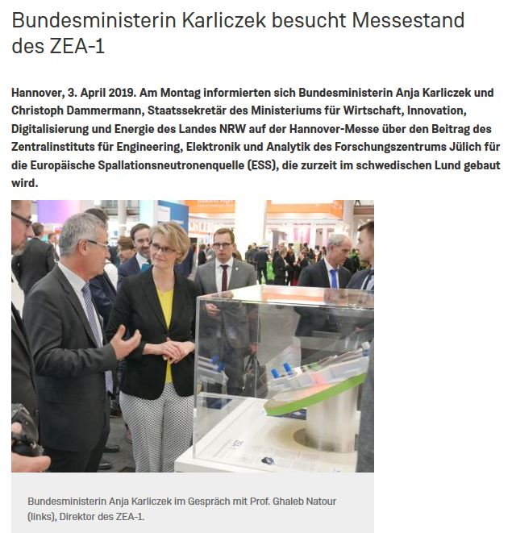
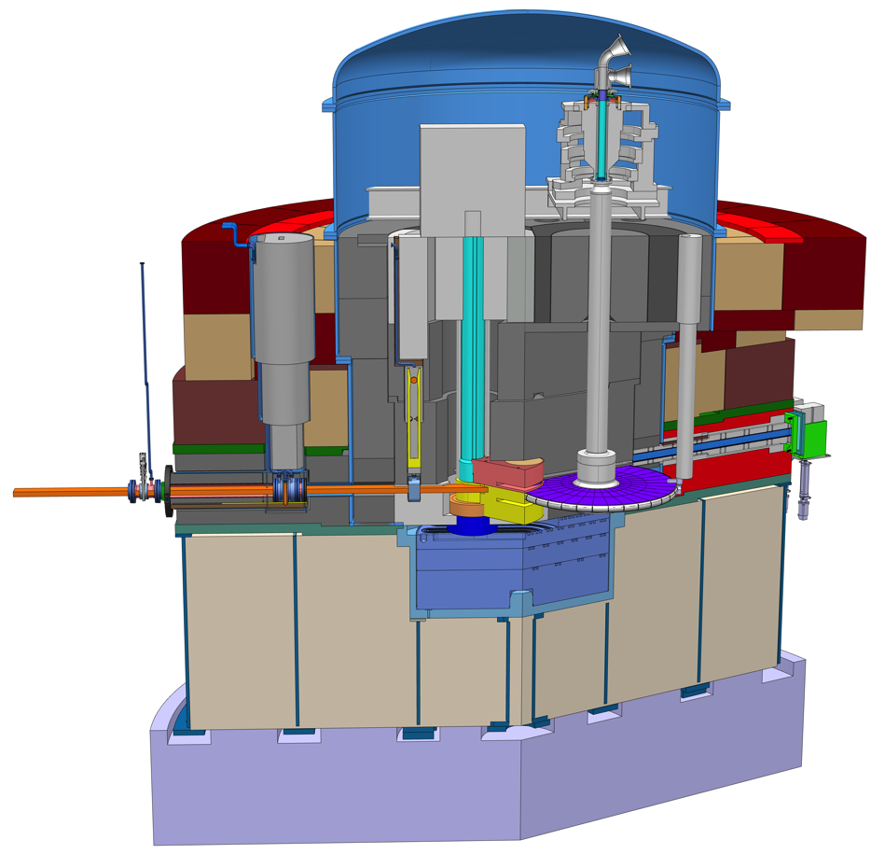
ESS Target Monolith
5,800 t
Neutron Beam Extraction
Proton beam window
Shutters
Proton beam
13m
Rotating target wheel
Moderator & Reflector insert
ZEA-1 | Technology for Excellent Science

Slide 9
German Contributions to the ESS

Slide 10
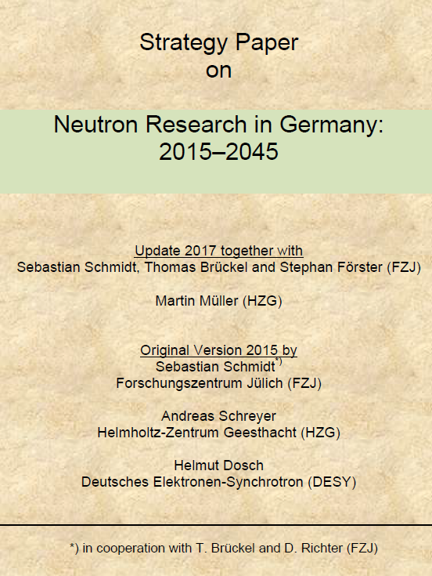
Benefits of “In-Kind” Contributions
Solving technological challenges
Enabling cutting-edge science:
  Addressing the grand challenges of society
Integral part of the the German Neutron Strategy
Being involved in the construction of the leading facility serving the world largest neutron scattering community
Helping to bridge the gap in the neutron sources due to decommissioning of existing facilities
ZEA-1 | Technology for Excellent Science

Slide 11
Challenges
Construction
ERIC did not fullfill all expectations
Due to VAT issues the entire funding scheme had to be revised and is not optimal for IKC
Exhausting negotiations on the Contribution Agreement and Technical Annexes
As a consequence, money (which is available at the Ministry) is not accessible by partners
Many instruments done in partnership between different countries, which have their own Challenges
Delay of contract signing → for institutes and ILO difficult communication with industry
Operations
Unclear VAT situation
Crediting (CBV) is significantly lower than the „real“ costs -> inacceptable discrepancy
Too many administrational issues
No balance between challenges/costs and benefits
ZEA-1 | Technology for Excellent Science

