Slide 1
Swiss In-Kind contributions to ESS
Christof Niedermayer :: Laboratory for Neutron Scattering and Imaging
ILO Meeting Budapest, June 2019
Notes:
1: Brief introduction of organization, key in-kind contributions, your involvement as ILO
2: Benefits of IKC for the partner country and the contributing organization
3: Challenges associated with IKC

Slide 2
Paul Scherrer Institute – ETH Organisation
⬅ Zurich
Alps ⬆
Baden ⬇
Bern/Geneva ➔
Swiss Light Source SLS
Swiss Muon Source SμS
Swiss Neutron Source SINQ
Free Electron Laser SwissFEL
PSI East
PSI funds (federal) 280 MCHF
External funding (grants) 100 MCHF
Staff (heads) 2100
incl. doctoral students 320
apprentices 100
teaching at University 100
External users: 4100 visits/year
Patients (proton therapy): 6300 visits/year
PSI West

Slide 3
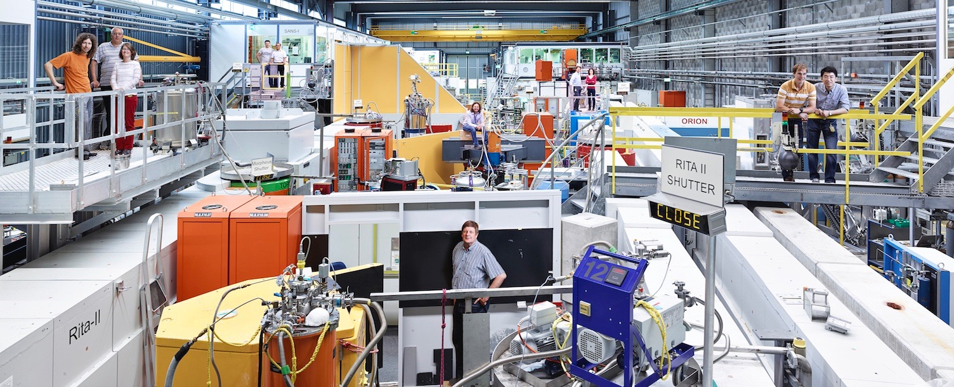
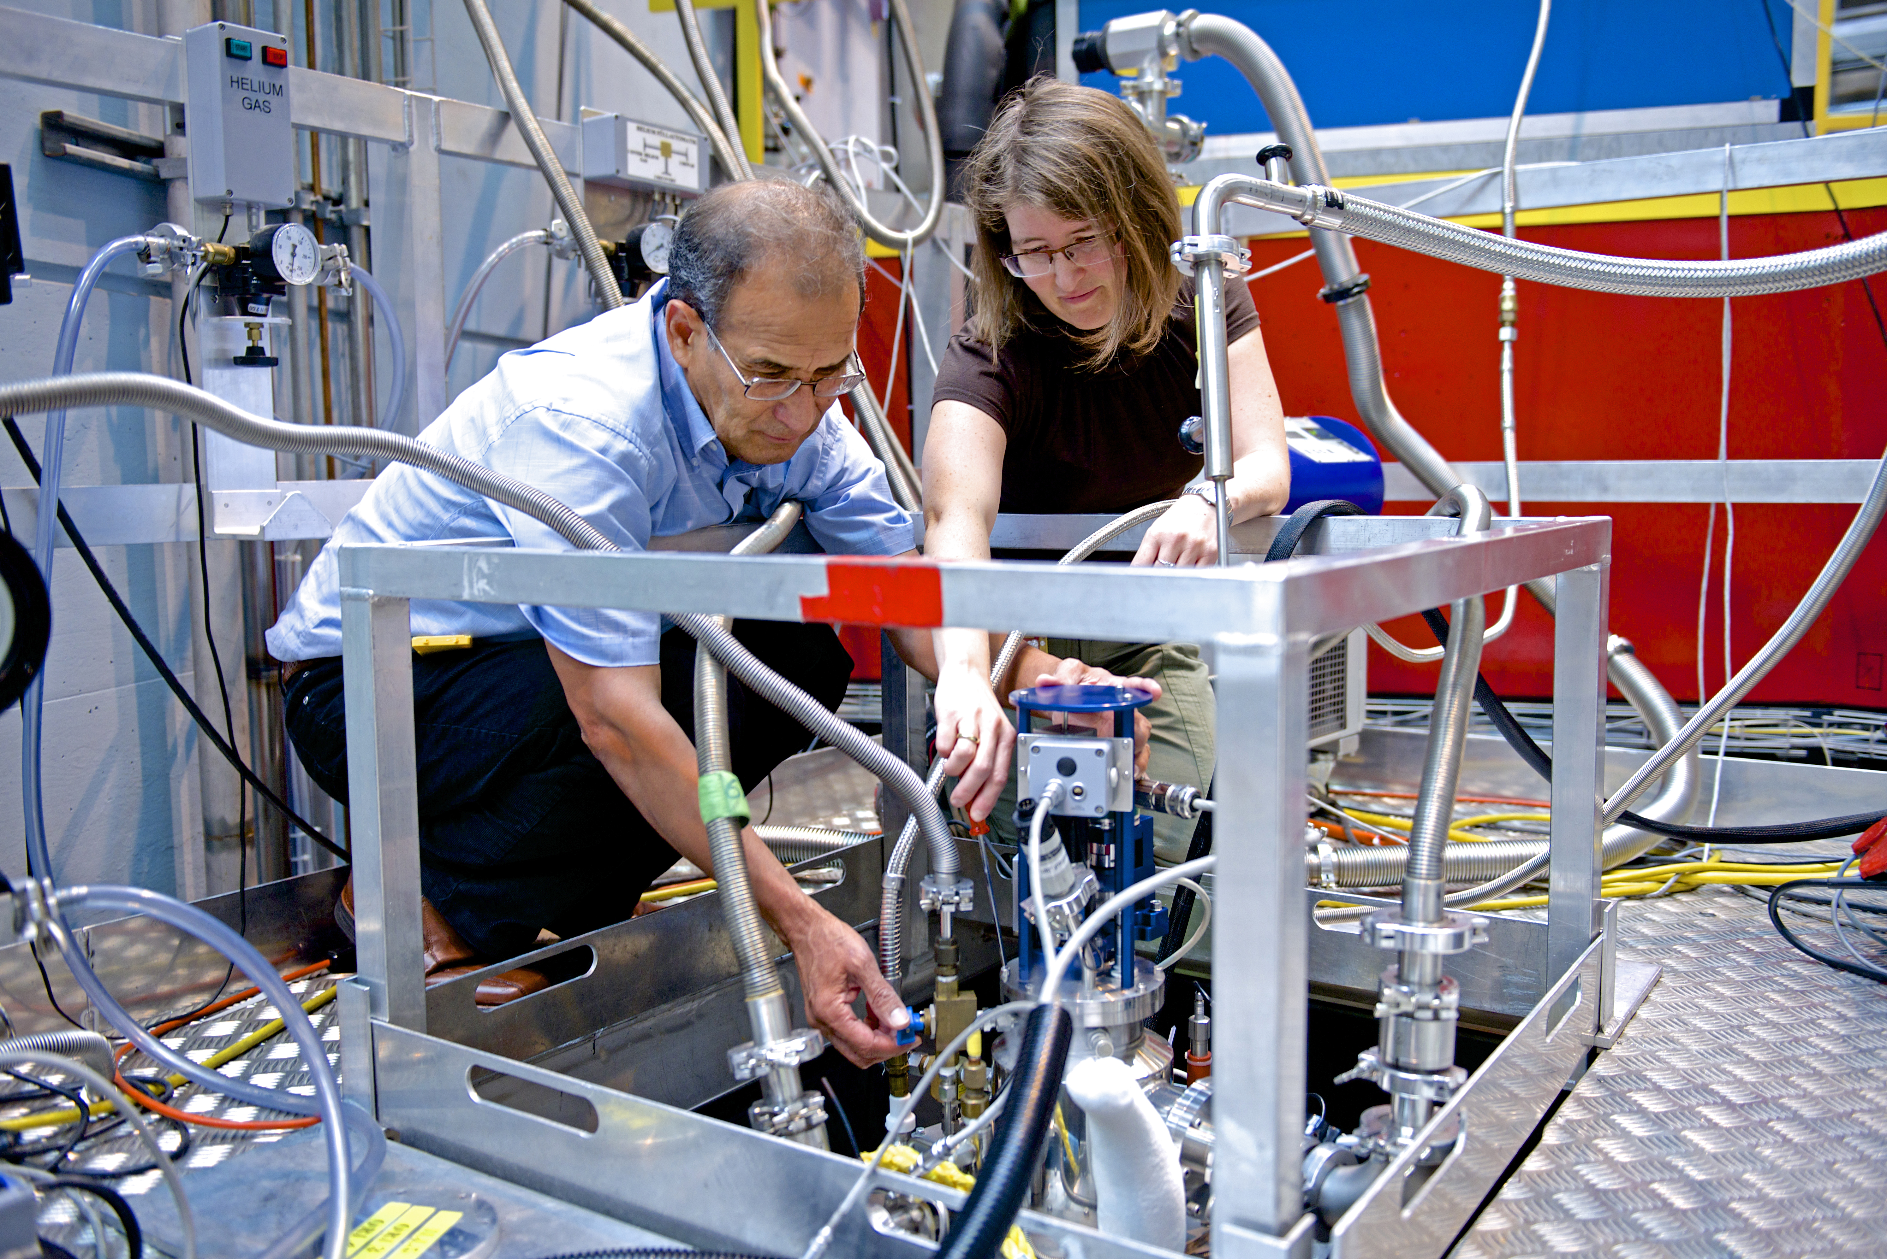
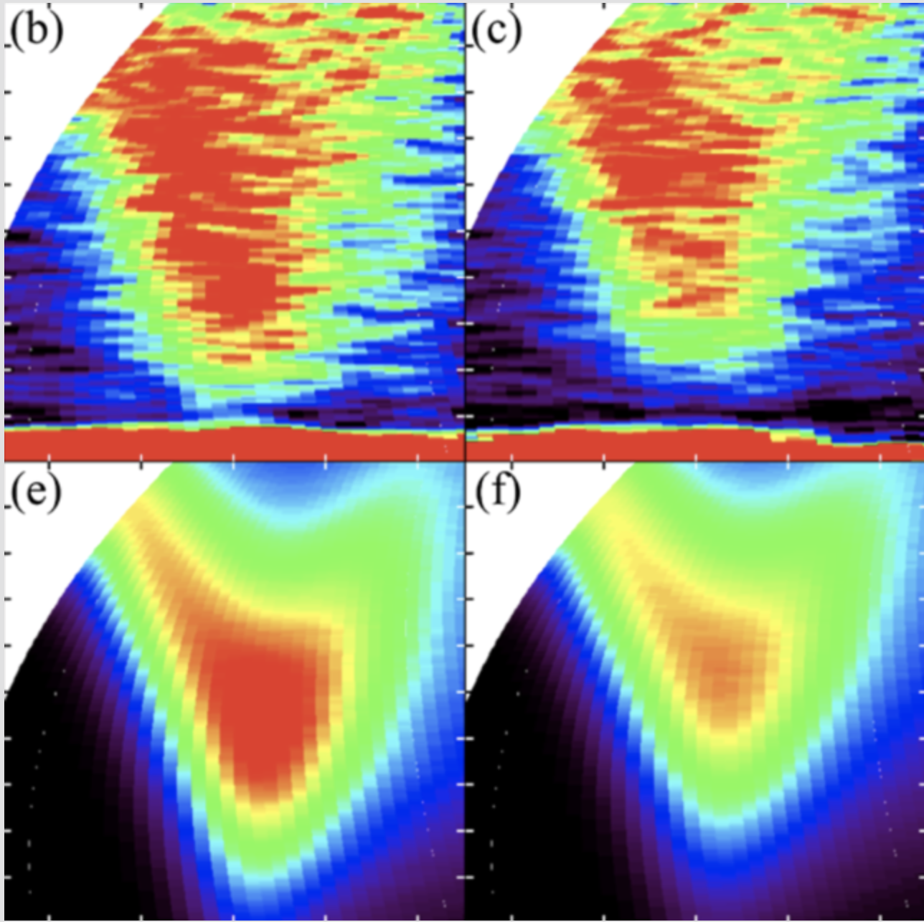
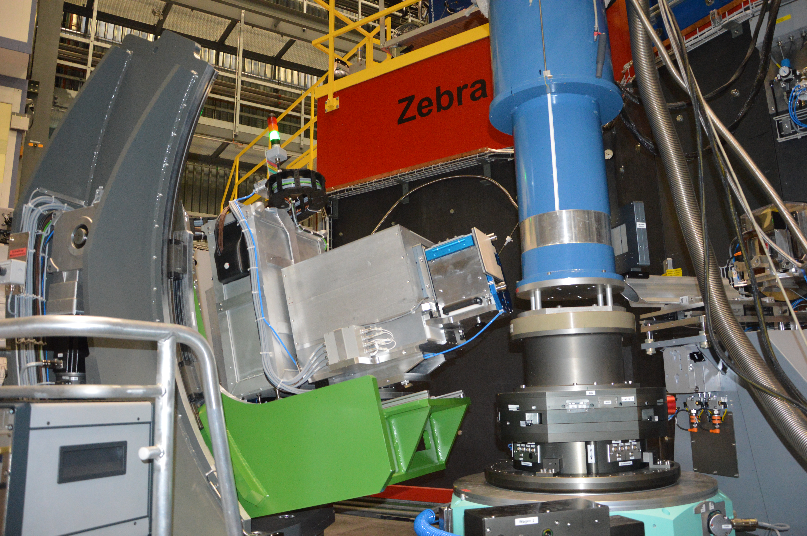
SINQ 2019: - state-of-the-art user facility guide upgrade program ongoing - 18 instruments
- 120-150 publications per year
User Office

Slide 4
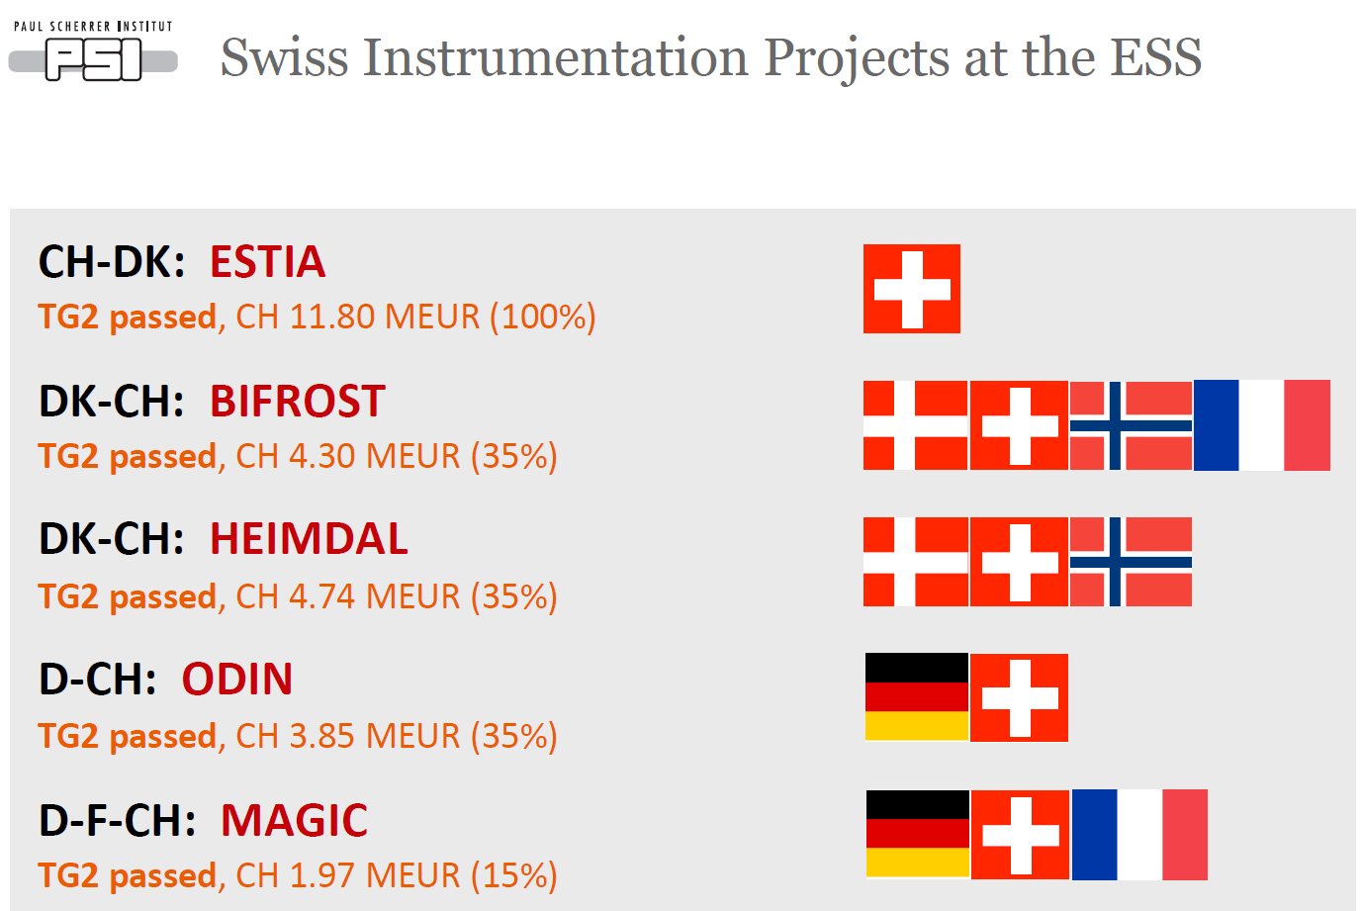



Still, only instrument progressed this far, all papers with ESS ok
But there is big progresss with the other instruments ☺
Plus Zurich University of Applied Science ZHAW : Machine Protection, plus:

Slide 5
Switzerland: Projects and Budget
Contributions to ESS-NSS (+):
Project | Partner | Sub-Project | CBV (k€) | Status
ESTIA | PSI | ESTIA (100%) - Phase I | 530 | Completed. call-off received
ESTIA | PSI | ESTIA (100%) - Phases II-IV | 11’270 | 1st call-off received
ODIN | PSI | ODIN (35%) – Phase I | 87 | Work Completed
ODIN | PSI | ODIN (35%) – Phase II-IV | 4’142 | MoU final, TA (almost) ready, IKA in progress
HEIMDAL | PSI | HEIMDAL (35%) – Phase I | 3 | Work Completed
HEIMDAL | PSI | HEIMDAL (35%) – Phase II-IV | 4’744 | MoU signed, IKA and TA in progress
BIFROST | PSI | BIFROST (35%) – Phase I | 9 | Work Completed
BIFROST | PSI | BIFROST (35%) – Phase II-IV | 3’601 | MoU (signed), IKA and TA in progress
MAGIC | PSI | MAGIC (15%) – Phase I | 98 | Work Completed
MAGIC | PSI | MAGIC (15%) – Phase II-IV | 2’243 | MoU well advanced, TA and IKA in progress
Exp. Ctrl. S/W | PSI | NIK4#1 | 749 | 1st call-off received
Data Curation | PSI | NIK4#4 | 654 | 1-4 call-offs received
Data Analysis | PSI | NIK4#5 | 471 | 1st call-off received
Dig. Controller Boards | PSI | NIK14.4#6 | 4005 | 1-6 call-offs received
TOTAL |  |  | 32’606 | Committed (PSI IK contr.)

Slide 6
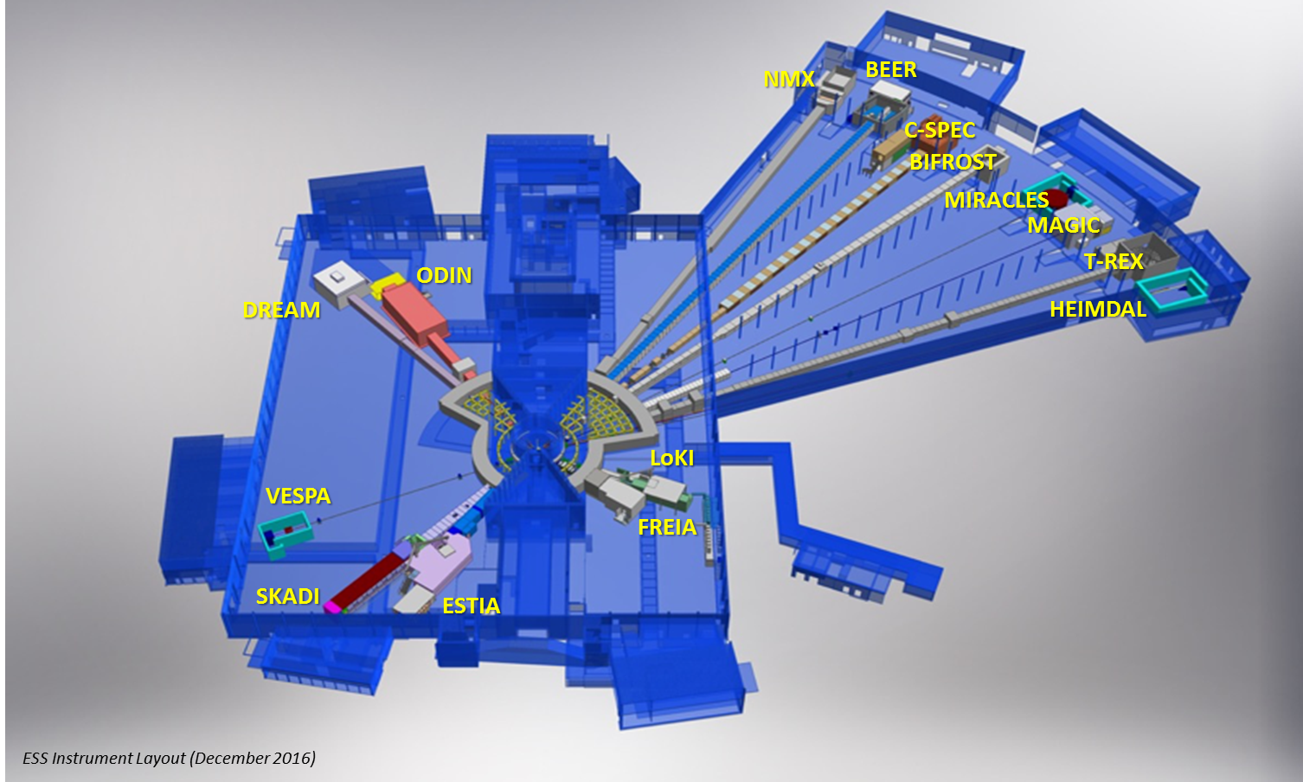
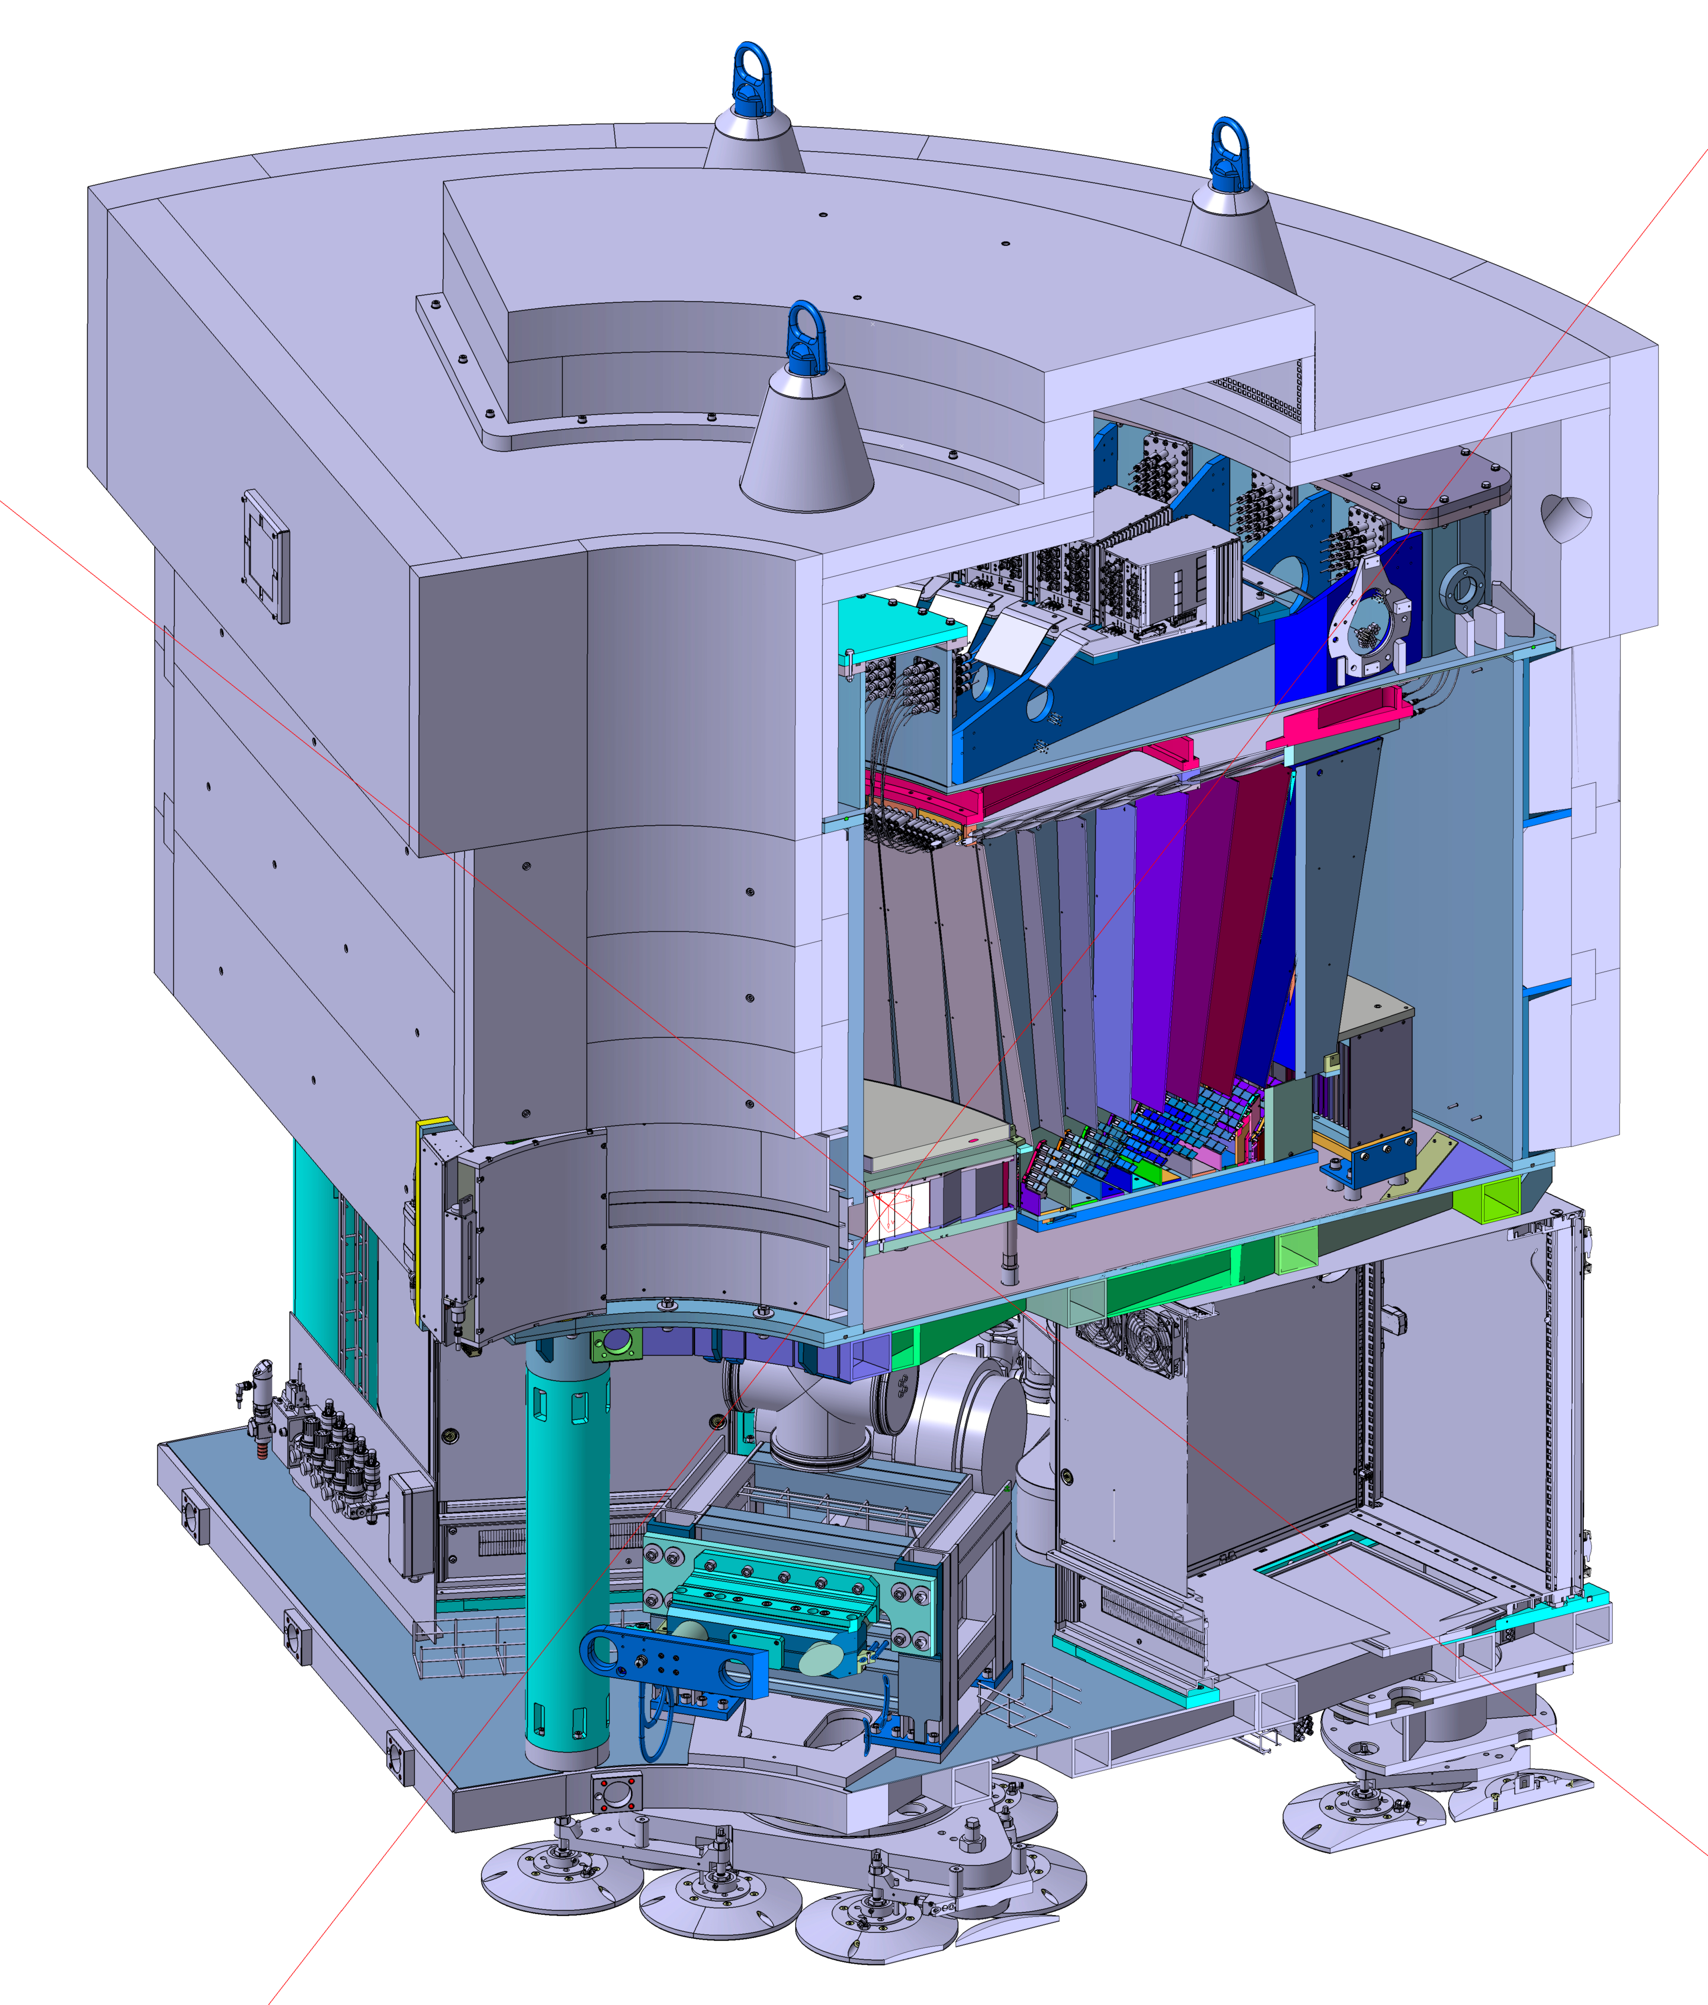
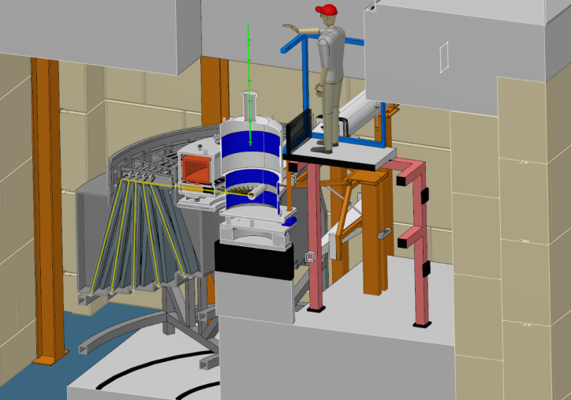
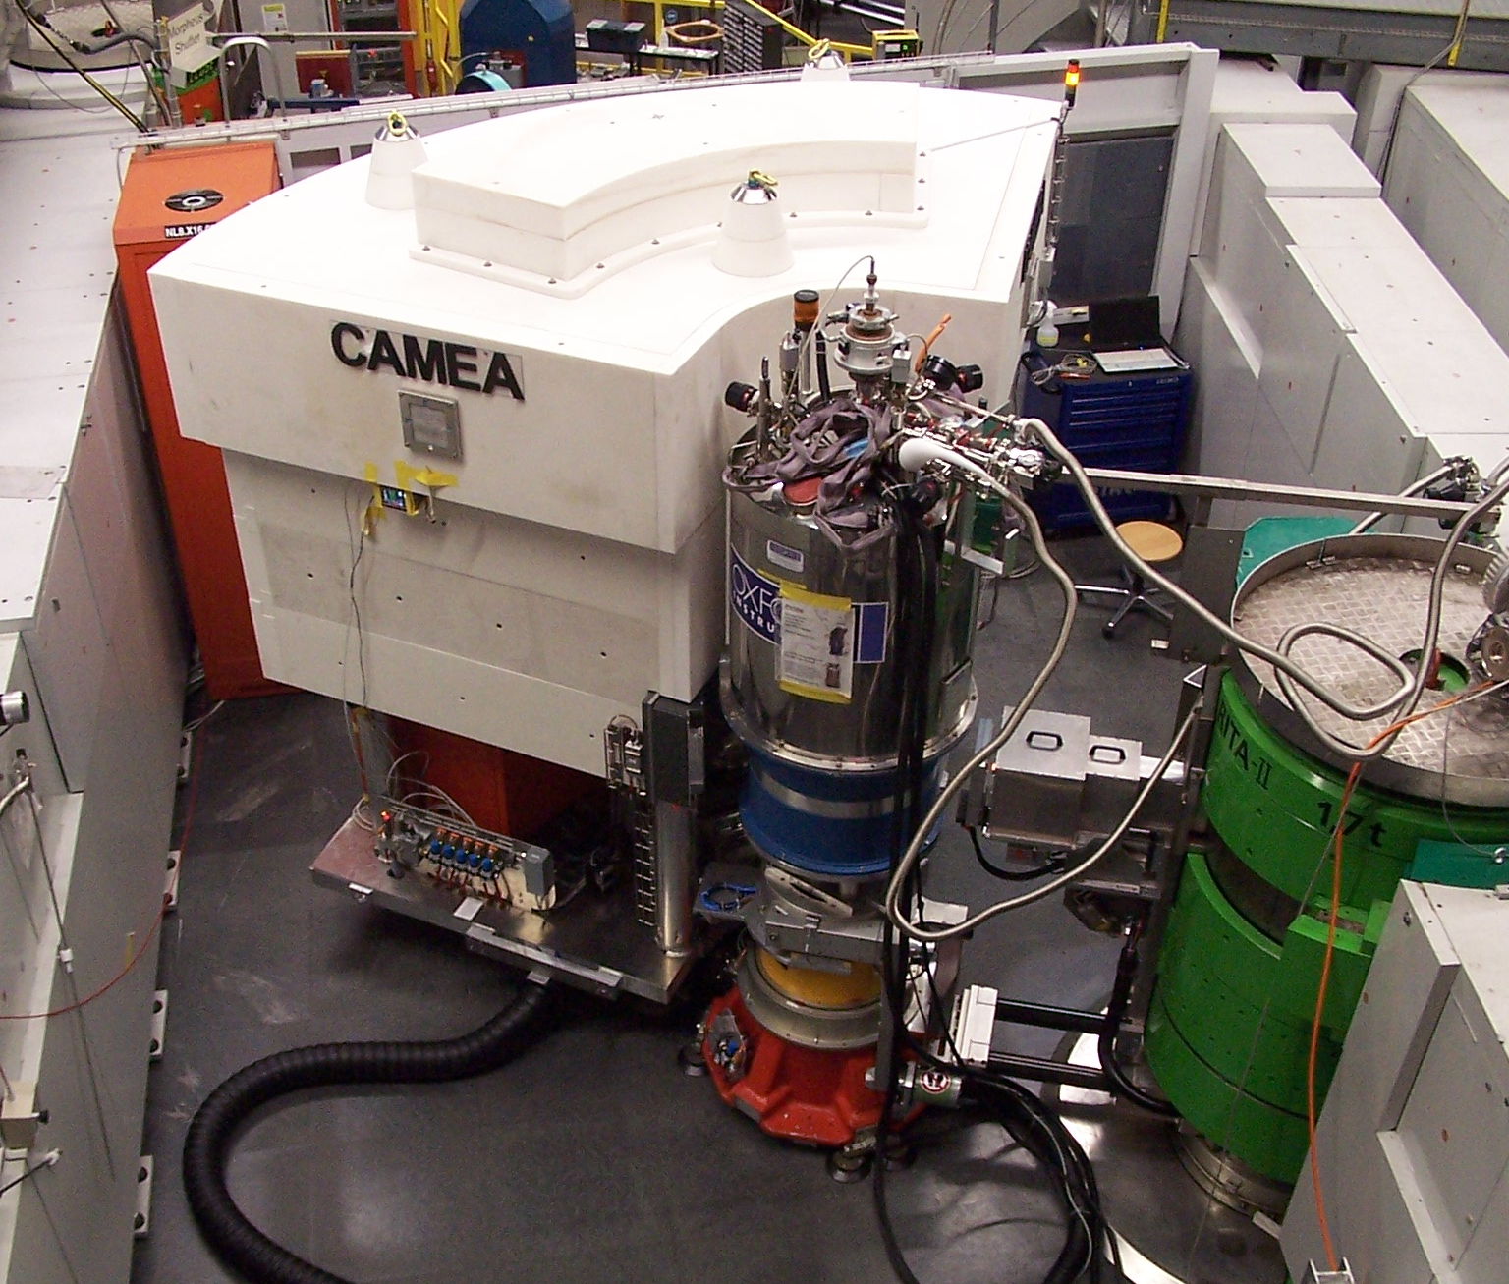
Benefits of IKC
Synergy, e.g. CAMEA - BIFROST

Slide 7

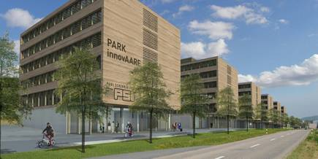


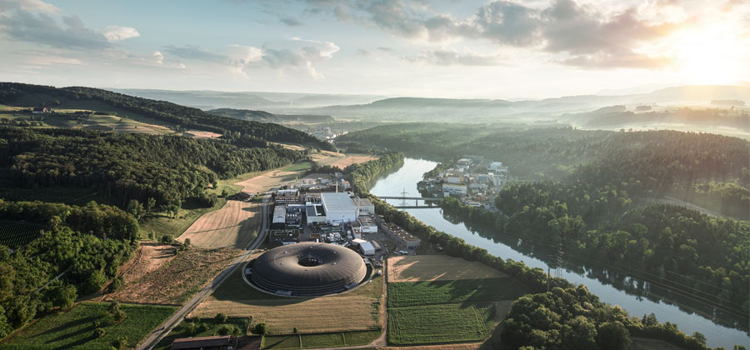
Aare Valley - Silicon Valley Light
KMU - Kleine und Mittlere Unternehmen
Small and Medium Enterprises
99 % of all companies in CH
2/3 of all jobs in CH
often specialized high tech industry

Slide 8







VDL Enabling Technologies Group Switzerland AG

Slide 9



Challenges associated with IKC
Delays
problem with terms of employment
Financial risks for institutes, universities and SMEs
Cutting edge technology
Legal boundary conditions
Contracts
Secondment
VAT

