Slide 1
Mantid Workshop
Events Filtering

Slide 2
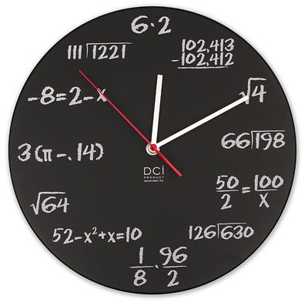
Quick Tutorial on Events
Event specifies “when” and “where”
Time-of-flight – time for the neutron to travel from
moderator to the detector
Pulse time – when the proton pulse happened in
absolute time
Pixel id – integer identifier for the detector pixel

Slide 3
Just in Time Histogramming
30
24
6
8
16
2
4

Slide 4
What is an Event To Mantid
RawEvent
16 byte
tof (double)
pulsetime (int64)
WeightedEvent
24 byte
tof (double)
pulsetime (int64)
weight (float)
errorSquared (float)
WeightedEventNoTime
16 byte
tof (double)
weight (float)
errorSquared (float)

Slide 5
Basic Filtering Algorithms
LoadEventNexus – allow TOF min, max filtering also start stop of run
FilterByTime – basic filtering
FilterBadPulses – Based on specific log value
FilterByLogValue – Based on arbitrary log value

Slide 6
Filter Events (Fast Sample Environment)
Event
TOF
L2
Detector
L1
Sample
TOF + Pulse T = abs T @ Detector
Sample T = abs T @ sample
Need Event T @ sample for filtering
Source

Slide 7
Filter Events (Fast Sample Environment)
Event
TOF
L2
Detector
L1
Elastic adjustment
Event T @ Detector * L1 / (L1 + L2)
Source
Sample

Slide 8
Specific Algorithms
GenerateEventsFilter
FilterEvents

