Slide 1
CEA: Status of CEA Activities on the SRF cavities and cryomodules
P. Bosland – 10th SRF Collaboration meeting
LASA – 25 June 2019

Slide 2
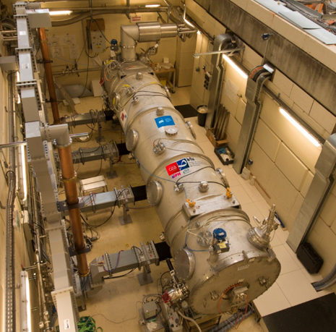
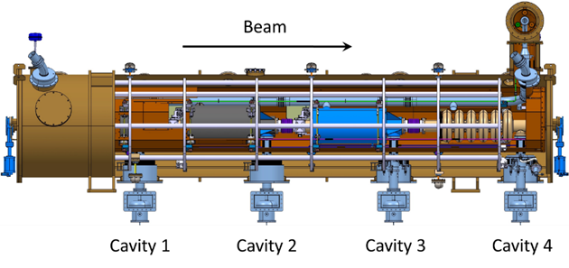
Tests of the refurbished M-ECCTD Preliminary results
Main differences with ESS conditions:
LHe at 1 bar
LN2 thermal shield cooling
1 RF power source: 1,1MW max, 14Hz, 3.6ms RF pulse length
Possibility to run with RF power:
Each cavity separately
Cav 1 + cav 2 or cav3 + cav4 <= not yet tested
Cavity vacuum pumping
Refurbished cavities and power couplers
MB01 LASA
MP04
MP01
MP02

Slide 3
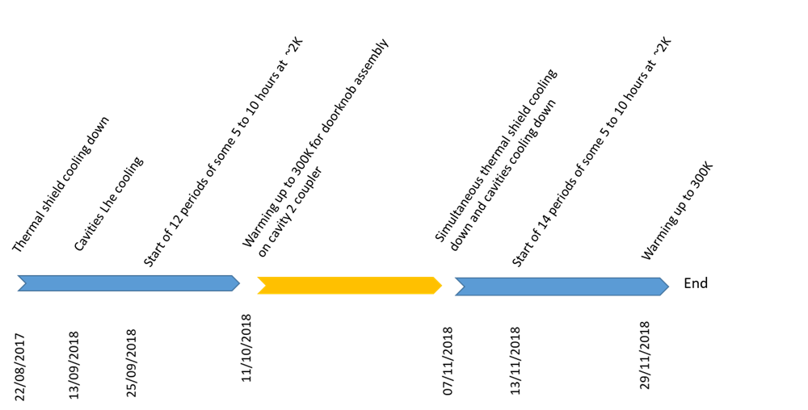
Short summary of the 2nd series of tests 13 Sept. to 7 Dec. 2018
Main objectives: complementary to tests in 2017
RF power measurements
checks of improvements in assembly procedures (alignment, cryo load, …)
Cavity RF dissipations: cryogenic measurements

Slide 4
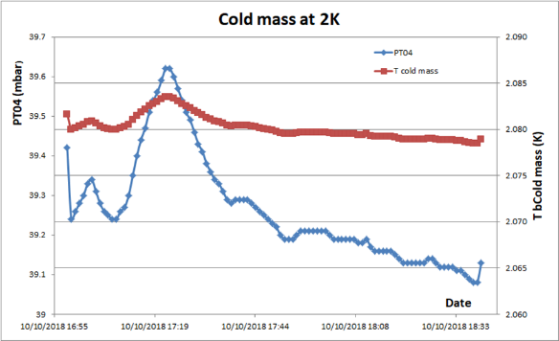
Cryogenic measurements
Remarks:
Instabilities due to the diphasic helium and the Hampson heat exchanger
Problem of helium gauge that is blind above 92% corresponding to the bottom of the diphasic pipe
That caused:
Difficulties to get stable levels for periods longer than ~1 hour
Brake of the burst discs
But we could perform RF measurement at high power and reliable static heat load measurements at 2K & 4K and RF heat load of cav1 at the ESS nominal field
Measured static heat losses at 2K:
19.5 to 19.7 W.
Measured static heat losses at 4,2K:
20,4W
(calculated 19,6W in the same condition!)

Slide 5
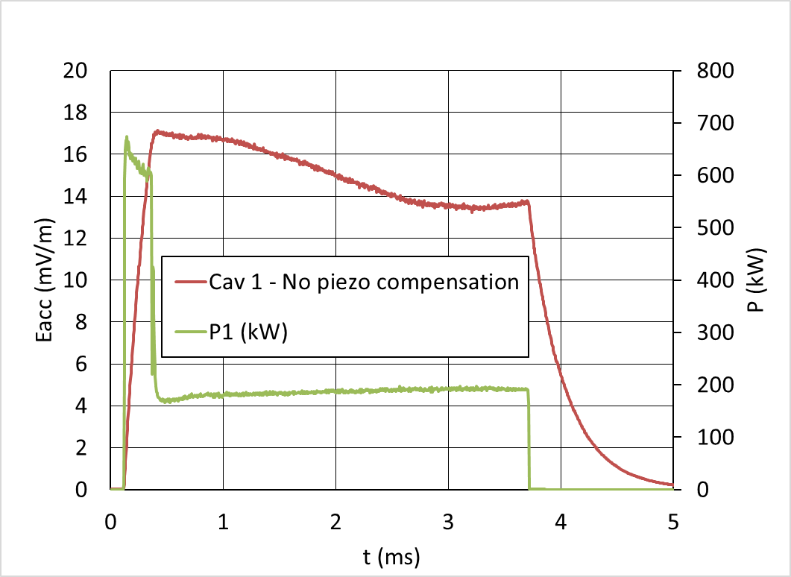
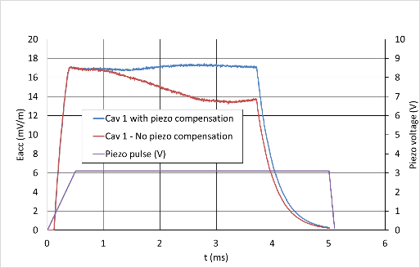
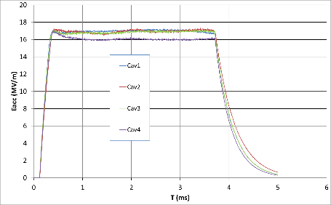
Main Results on RF measurements
2,86ms
Cav1 without piezo compensation
Pulse of the piezo allowing compensation of Lorentz detuning on Cav1
The 4 cavities tested separately at the nominal field (or close to for cav4)
Cav1 and Cav2 tested together with piezo compensation
These results are the validation of the cavity package technology

Slide 6
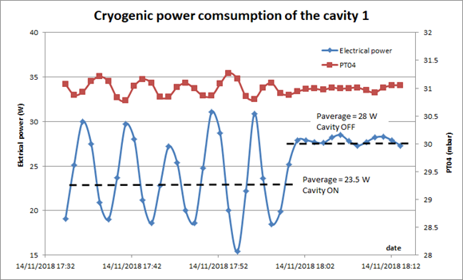
Cavity RF dissipation measurements
Measured RF dissipation of the cavity MB01 at ESS nominal field: 4.5 W
(requirements : < 5W)
Electrical heaters power and helium bath pressure variations at the stop of the RF power in the cavity MB01.
Other measurements that were performed were not reliable enough.

Slide 7
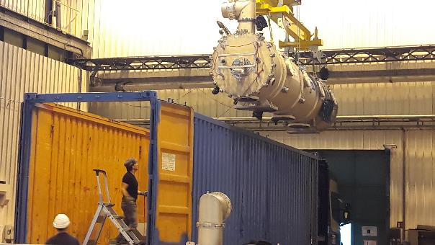
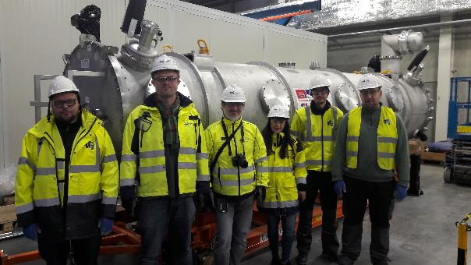
Shipment to Lund
CEA
ESS
Next tests in ESS test stand TS2 in preparation

Slide 8
Cryomodules of the series

Slide 9
Delivery of Components
Vacuum vessels | Contract awarded to ACPP. The first unit is delivered.
Power couplers | Contract awarded to PMB, the 8 couplers of the series have delivered. Two are back at PMB for analysis and two are under conditionning.
Thermal shieldings | Contract awarded to SDMS, 13 first units delivered
Spaceframe | Contract awarded to SDMS, 12 first units delivered
Cold Tuning Systems (mechanical part) | Contract awarded to YVON BOYER. 6 first pre series delivered
Motors for cold tuning systems | Contract awarded to TSA (PHYTRON), 122 motors received
Cryogenic heat exchanger | Contract awarded to SDMS, two first units delivered.
Magnetic shielding | Contract awarded to MECA MAGNETIC, first 3 shields delivered.
MLI | Contract awarded to SODITECH, one MLI delivered for CM01
Internal instrumentation | Contract awarded to SODITECH, first lot delivered.
Intercavity bellows, cold-warm transitions | Contract awarded to SDMS, one set delivered.
Cavity supporting systems (tie rods) | Contract awarded to SPG. One set delivered.
Cryogenic circuits, diphasic tubes, tubes for rupture disks, coupler bells | Cryogenic circuits awarded to CRYODIFFUSION : 1 delivered Di-phasic tubes awarded to SDMS, 1 delivered Ti bellows: 36 delivered
Cryogenic valves CV01 and CV02 | Contract awarded to VELAN. all units delivered
Level sensors | Contract awarded to CRYOFORUM, all the components received
Temperature sensors | Contract awarded to CRYOFORUM, all batches delivered delivered
Safety valves | Contract awarded to LESER. All delivered
Controlled safety valves | Contract awarded to Velan. Kick off meeting done.
Rupture disks | Contract awarded to BS&S. Kick off meeting done.
RF cables | Contract awarded to HABIA. First batch for 10 CM received.
RF feedthroughs | Contract awarded to MDC Vacuum. All the components are received (2x32 feedthrough)
Pressure transmitters | Contract signed in Feb 19
Screws for clean room assembly | Several contracts awarded
Vacuum components | All item ordered HV90 purge valves: all delivered. Standard pumps and gauges awarded to Pfeiffer RGA and baratron gauges: awarded to MKS.
Vacuum pumping groups | Contract awarded to 40-30. Three pumping groups have been commissioned at CEA.
Cryomodule assembly | Contract awarded to B&S. Training has started.
Main difficulties:
Couplers of the series: production stopped
2 first pairs of the series did not pass acceptance tests
Possible issue on TiN coating Investigation in progress by PMB
New series of tests at high RF power on the 2nd pair in Saclay
Delivery of the next pair scheduled beginning of August (TBC!)

Slide 10
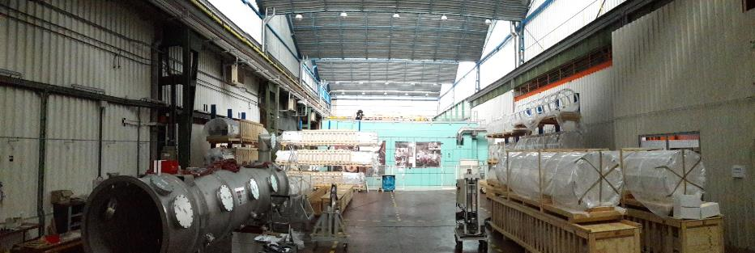
Delivery of Components
We need more storage areas !
 | MAX | DATE
BMAG | 10 | avr-21
BOUCH.JUMPER | 10 | déc-20
CAV.HB | 18 | oct-21
CAV.MB | 10 | févr-20
CAV.PROTO.HB | 4 | juin-19
CIRCUITS.CRYO | 8 | avr-21
CLOCHES.CPLR | 10 | déc-20
CPLR.BOX | 23 | août-22
CPLR.H | 34 | nov-21
CPLR.HCOND | 10 | sept-20
CPLR.M | 12 | oct-19
CPLR.MCOND | 16 | févr-20
ECHANG.TH | 13 | déc-20
ECRAN.TH | 23 | oct-20
ENC.V | 11 | déc-20
INSTRU | 14 | oct-20
SAF.meca | 73 | janv-21
SAF.mot | 139 | mai-19
SOUF.TITANE | 93 | juin-19
SOUF3.TR2 | 14 | mars-21
SPCFR | 30 | avr-20
SUPER.ISO | 23 | juin-20
TUBE.DIPHA | 9 | août-21
TUBES.DISC.RUPT | 7 | oct-21
VAN.VAT | 62 | déc-18
A new building for storage is to be built

Slide 11
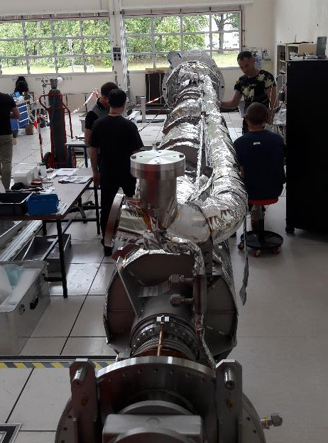
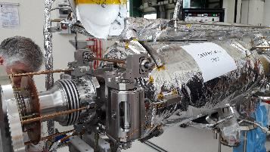
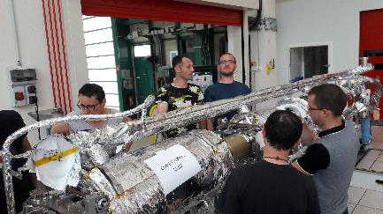
CM01 Assembly under the responsibility of CEA with B&S team
7 B&S persons on site at present:
Project leader
Clean room operators (3 persons)
Component storage – logistic
Welder + operator
Surveyor + operator
Cavity string on MAF1 workstation
At the clean room exit
Ti tubes weld
Issue solved
Cavity vacuum refilling
Tuners assembly => tuning of the cavities
Mag shield assembly
Cavity axis alignment report
Cryo piping + MLI
Instrumentation (T sensors, heaters, etc.)

Slide 12
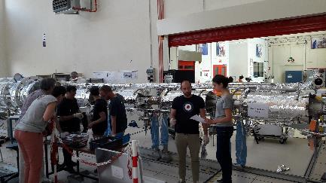
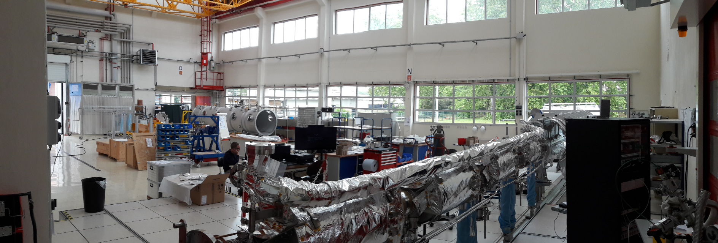
CM01 will be installed in the CEA test stand beginning of August

Slide 13
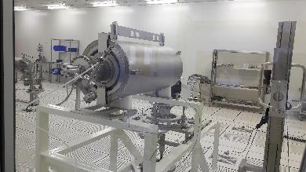
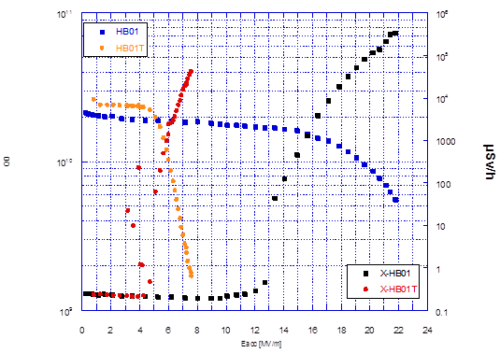
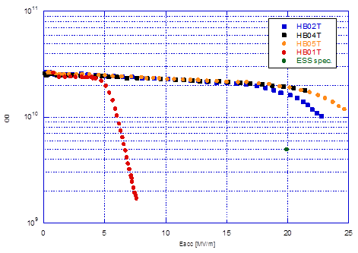
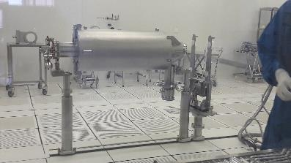
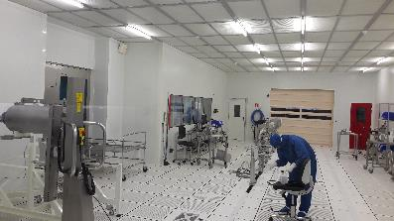
H-ECCTD Assembly under the responsibility of B&S team under the supervision of CEA
5 Hbeta prototype cavities manufactured by RI and final treatment before test in VC made by ZANON.
Shipped to CEA and tested in CEA before cryomodule assembly
HB01 before and after tank weld
The 4 Hbeta prototype cav tested after tank integration
HB02, HB04, HB05 already assembled with their couplers in clean room
HB01 will be reprocessed by ZANON (on the 8th of July)
25/06/2019

Slide 14
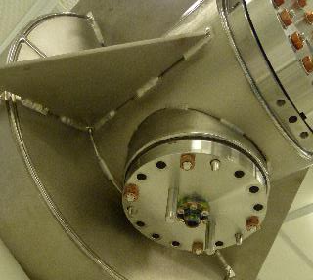
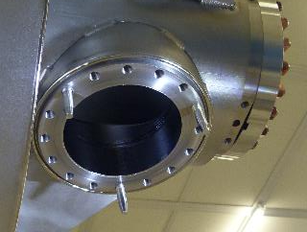
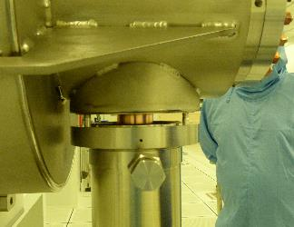
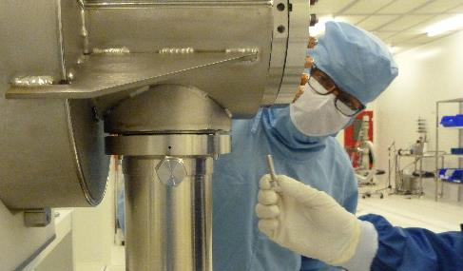
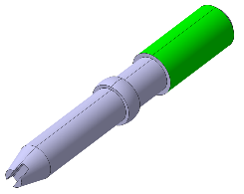
Issues for coupler assembly on Mbeta cavities of CM01
Coupler to cavity assembly in clean room:
mounting the last screws on the coupler flange was impossible during one operation. Unscrewing coupler flange replacing allowed to screw correctly.
This issue is understood by the too large holes of the cavity flange (9mm instead of standard 8.2mm) and some tolerances on the assembly tool used for pre alignment of the coupler on the cavity flange
A new procedure tested during the assembly of the H-beta cavities of the H-ECCTD using a pin for pre alignment

Slide 15
Frequencies
Fmax = 702.950 MHz with
Atm pressure
No clamp
T=20°C
Pi mode measured in clean room in the conditions:
M001: not done
M002: not done
M003: 702.994 MHz > Fmax
M005: 702.991 MHz > Fmax
HB02T: 703.047 MHz > Fmax
HB04T: 703.106 MHz > Fmax
HB05T: 703.034 MHz > Fmax
LHe tank integration in RI different from ZANON procedure
Hbeta prototype tank is also ≠ from Hbeta series ☹ !!!

Slide 16
Request for a shorter Ghe exhaust pipe of the helium tank
Shorter GHe exhaust of the helium tank would be helpful for the CM assembly (see Vincent presentation)
At present an extra length is required on the interfaces documentation. CM01 experience of Ti welds leads us to ask if it is possible for Hbeta cavities to be sent with a nominal length to CEA.
(Too late for Mbeta ?)

Slide 17
Thank you
Commissariat à l’énergie atomique et aux énergies alternatives
Centre de Saclay | 91191 Gif-sur-Yvette Cedex
T. +33 (0)1 69 08 76 11 | F. +33 (0)1 69 08 30 24
Etablissement public à caractère industriel et commercial | RCS Paris B 775 685 019

