Slide 1


WP4
Status of Series Double-Spoke cavities
Guillaume OLRY
on behalf of the ESS IPNO team

Slide 2
Outline
  Fabrication @ ZANON
  Status of the cavity production
  DSPK08 repair
  Preparation @ IPNO
  Chemical etching
  Heat treatment

Slide 3
Fabrication [1]
29 cavities ordered to ZANON SpA in January 2017
First pre-series 4 cavities have been delivered in June 2018.
Delivery rate: 2 cavities / month → all cavities @ IPNO before end of 2019.
As of today:
@IPNO
16 cavities already delivered (4 pre-series + 12 series).
  7 cavities tested @ 2K and officially accepted (=no leak @ 2K) by IPNO.
  2 cavities (almost) ready for testing in VC.
  1 cavity has been rejected (=leak located on the helium vessel)
  6 cavities in the queue of the preparation process waiting for their first chemical etching (=bottleneck)
@ZANON
2 cavities ready for shipping.
3 naked cavities completed (=RF tuning done). Integration of their helium vessel is in progress.
2 cavities will be tuned today.

Slide 4
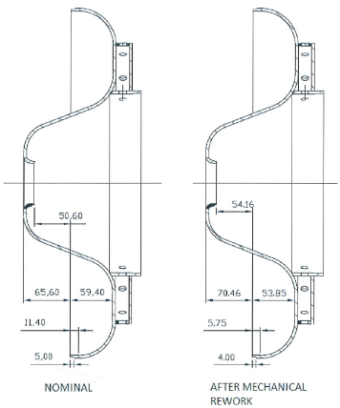
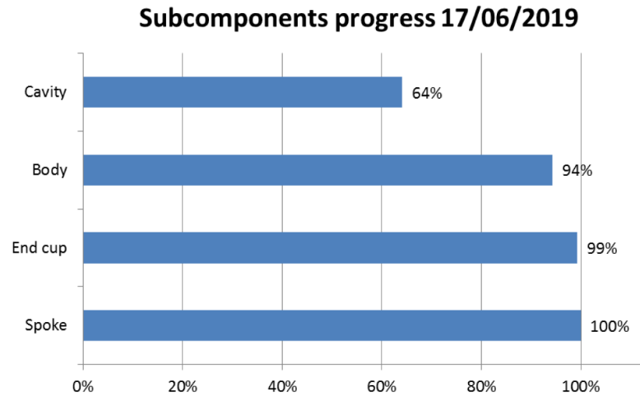
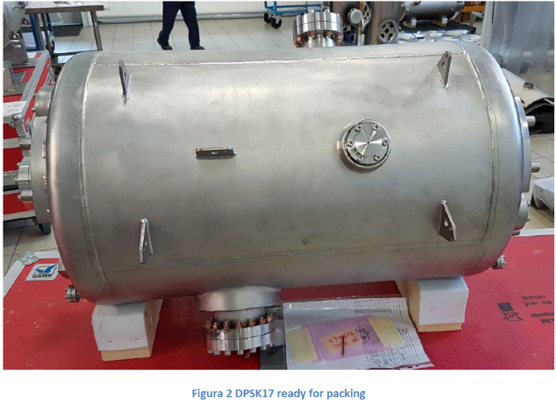
Fabrication [2]
@ZANON [...]
100% spoke bars produced: ready for integration into the remaining cavity bodies.
99% of the end-cups produced. 1 has a NC (=chamfer too small → paired with a dedicated cavity body)
2 cavity bodies waiting for final trimming after coupler port welding operation.
18 cavities fully dressed.

Slide 5
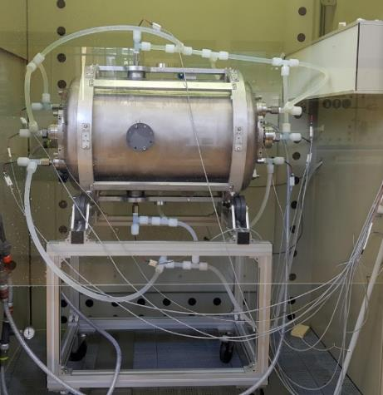

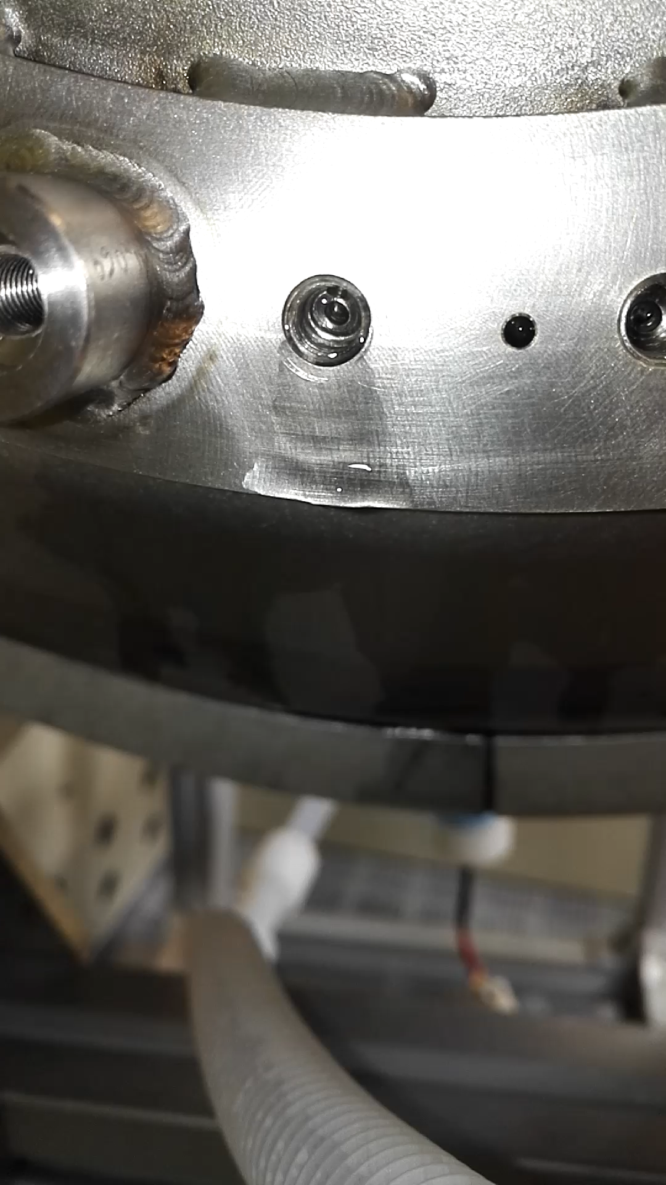
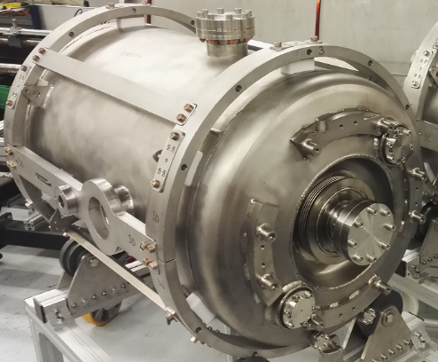
DSPK08: leak [1]
Cavity has successfully passed all leak checks at ZANON before packing & shipping
Delivered on March 13.
Being prepared for the first chemical etching (in horizontal position) one month later.
Leak detected before starting the process: leak from the helium vessel towards the outside (NB: the cavity is chilled with cold water flowing into the helium vessel).
4 blocks with fixing studs (for the tuning system) and threaded holes (for the magn. shield)

Slide 6
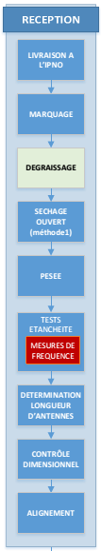
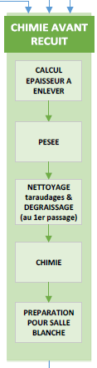
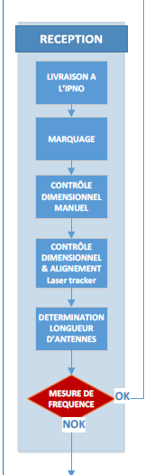
DSPK08: leak [2]
Why the leak has not been detected after the delivery ?
→ We decided to skip the leak checks after the delivery...to save time
V1.4
April 2018
V1.8
March 2019
V1.8
March 2019
No US degreasing
No drying
No weighing
No leak check
Pros & cons have been evaluated → no change. Keep v1.8

Slide 7
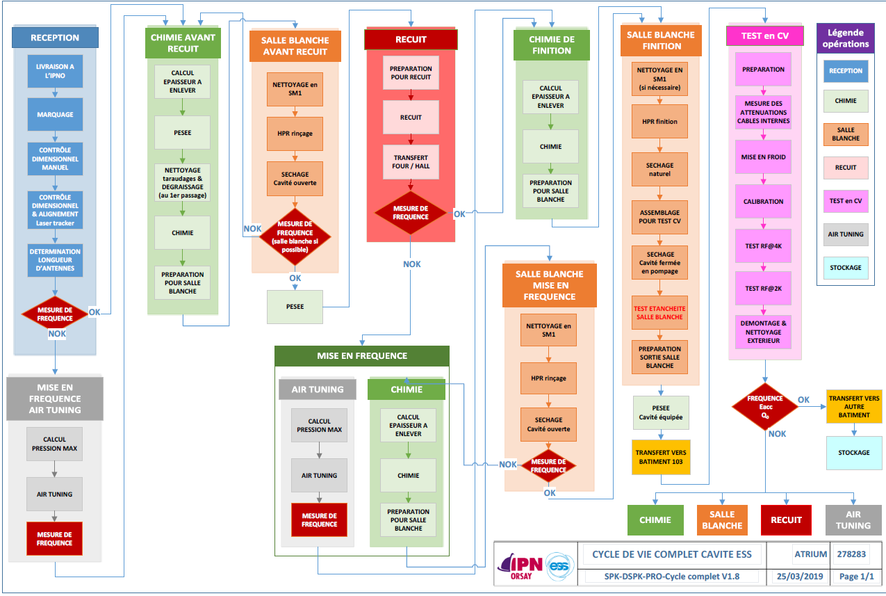
Life cycle of a cavity

Slide 8
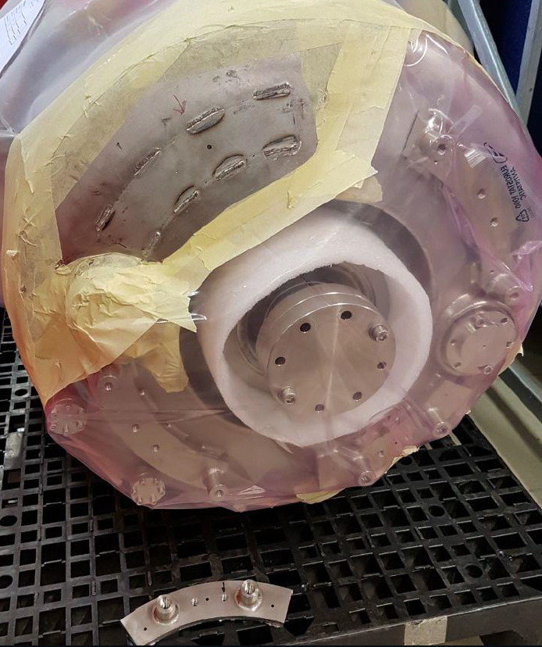
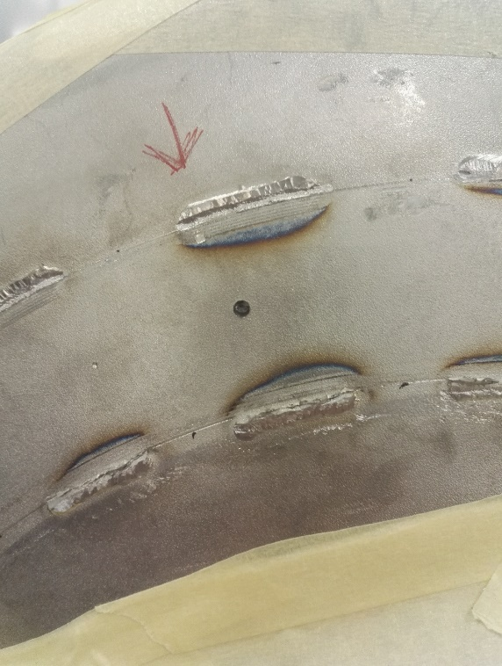
DSPK08: repair
Cavity sent back to ZANON for analysis and (possible) repair
The block has been removed...
...and there is a hole (surprise!).
ZANON doesn’t have an explanation for the hole been drilled AFTER the welding of the block
We think that the US degreasing before the BCP process may have removed metal fillings and traces of grease which revealed the leak
Repair is feasible:
  Meas the frequency all along the process
  Bore a conical hole
  Insert and weld a patch
  Check the tightness
  Weld again the block

Slide 9
Outline
  Fabrication @ ZANON
  Status of the cavity production
  DSPK08 repair
  Preparation @ IPNO
  Status of the cavity preparation ...while tracking the frequency
  Vertical test results

Slide 10
Cavity preparation
Tracking of the frequency
Target @ delivery : 351.383 < f < 351.667 MHz
Δf is barely controlled now → impact of te end-cups forming process (spinning)
Δf is quite controlled now → welder C only
Δf depends on the tooling set-up (clamping by hands!)
Cavities delivered within the specs

Slide 11
Cavity preparation
BCP etching
8 cavities fully processed and 1 nearly finished
Heavy BCP: time needed per cavity is about 2 weeks (incl. HPR in clean room)
Cavity # | Heavy BCP |  | Flash BCP |  | « Tuning » BCP
 | Horiz. pos. | Vert. pos. | Horiz. pos. | Vert. pos. | Horiz. pos. | Vert. pos.
DSPK05 | 2 | 1 |  | 1 | (TBD)
DSPK06 | 2 | 1 | 1 |  | 1
DSPK03 | 1 | 1 |  | 1
DSPK04 | 1 |  | 1 |  | 1
DSPK02 | 1 |  | 1
DSPK01 | 1 | 2 | 1
DSPK07 | 1 | 1 |  | 1
DSPK09 | 1 | 1 | 1
DSPK10 | 1 | (TBD) | (TBD)
Nb thickness removed:
> 1100 µm in H & > 600µm in V
→ ~15 k€ vanished!

Slide 12
Cavity preparation
Heat treatment
Cavity # | Freq shift [kHz]
DSPK05 | -30
DSPK06 | +39
DSPK03 | -14
DSPK04 | -22
DSPK02 | +27
DSPK01 | -4
DSPK07 | +20
DSPK09 | -26
DSPK10 | +29
9 cavities heat treated with a highly reliable process but...
...positive and negative variation of the frequency without explanation...
... But the spread is limited to a few tens of kHz
Freq shift is transparent (+/- 25kHz has been integrated into the target frequency).
Final flash BCP may compensate a few kHz of discrepancy (~-10 to +5 kHz).

Slide 13
Cavity preparation
Data file

Slide 14
Summary
 | Operations | Frequency shift (kHz)
ZANON | After EB welding of the end-cups | -131
 | After the leak check (naked cavity) | -44
 | After the tank integration | -199
 | After the final machining | -20
 | Before shipment (incl final leak check) | -40
IPNO | Chemical etching (200µm) | -132 to +116
 | Heat treatment | (-30 à +39)
 | Cooldown | +618
-435 kHz
(Mean value over 14 series cavities)
No impact
Mean value over 7 series cavities

Slide 15
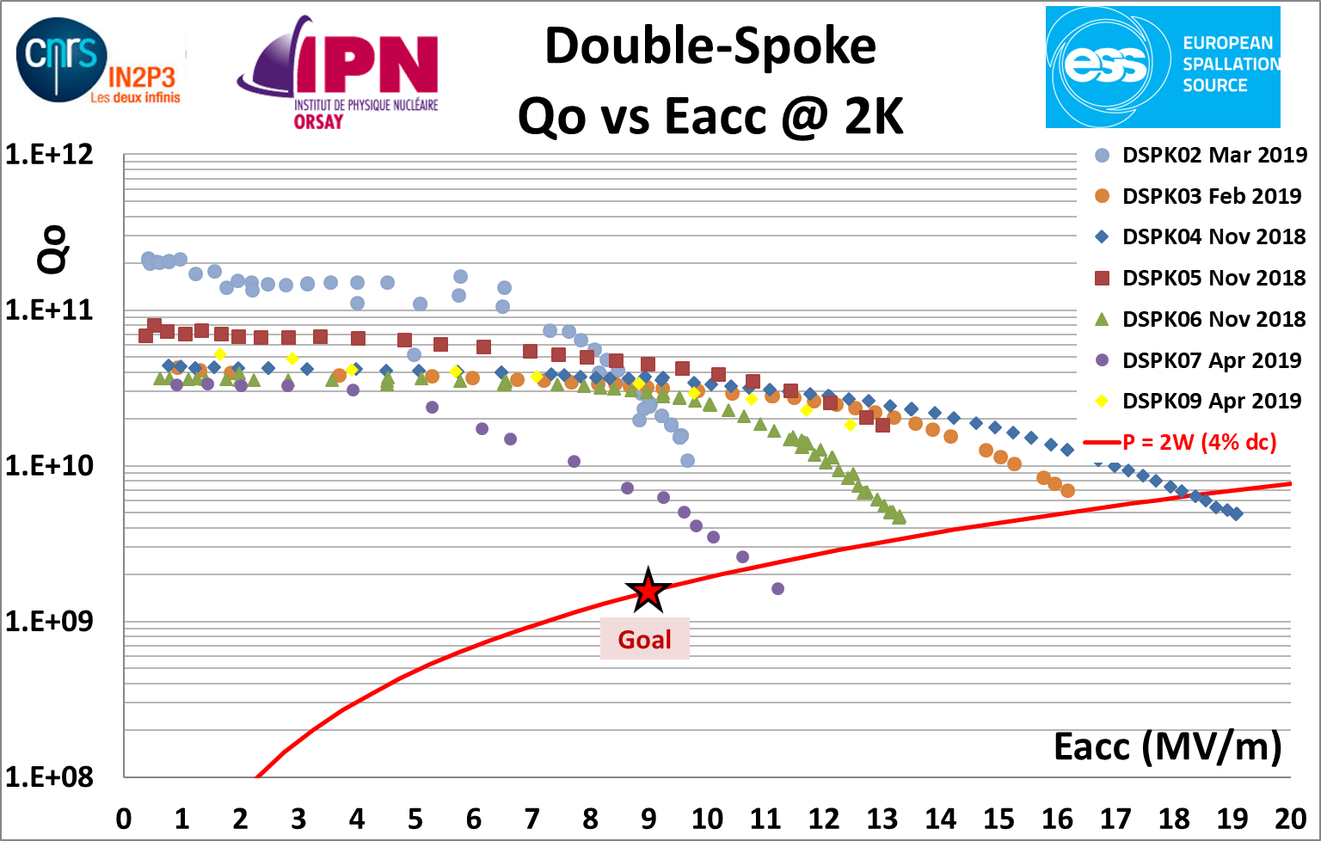
Vertical tests [1]
7 cavities tested @ 2K
2 cavities within the specs (ie. Eacc > 9MV/m, Qo> 1.5 10E+09 and 352.089 MHz < Freq < 352.175 MHz)
1 cavity with thermal quench limitation at 19MV/m. For all other ones, limitation comes from field emission.

Slide 16
Vertical tests [2]
→ Initial goal: 2 cavities tested every month ... We do not meet this goal.
Few events (problems/changes/iterations...)
Furnace
None
BCP etching
Modification of the piping to ease the manipulation of the cavities → the etching rate changed! → need to perform new BCP treatment for 2 cavities.
Pump of the chiller used for the acid out of order (3 weeks lost)
DSPK08 ready for BCP etching but a leak was found (2 weeks lost)
Delivery of the fresh acid was delayed 2 times (3 weeks lost in total)
One operator quitted last summer : nobody found up to now. Fresh news: internal move from one person to the dosimetry service of IPNO
Clean room
One trip of the UPW production unit (2 weeks lost)
Failure of one main filter unit (2 weeks lost)
Vertical cryostat
Leak of a cryo valve (4 weeks lost)

Slide 17
Status of today

Slide 18
Status of today [...]
2 cavities ready for cryomodule assembly

Slide 19
Thank you for your attention

