Slide 1

Paolo Michelato
LASA - Status of cavity documentation, fabrication, inspection and NCRs
Laura Monaco INFN – LASA
10° ESS SRF Collaboration Meeting, 25 - 26 June 2019

Slide 2
Overview
The external QC
  Subcomponents, Al1, Al2, Al3 at the cavity producer
  Al4 for cavity qualification
  Al5 for cavity handover to ESS
Flow and managing of documents/info
  Alfresco (INFN DMS) collaboration with LNS
  DataBase collaboration with LNS
NCRs
  Any deviation from the “standard cycle”
  If relevant to interfaces or cavity performances need an ESS approval
Fast Communication and Tracking of info
  RT tracking system between INFN and cavity producer for exchange of info (BCP adjustment, etc.) and promptly reaction to NCR

Slide 3
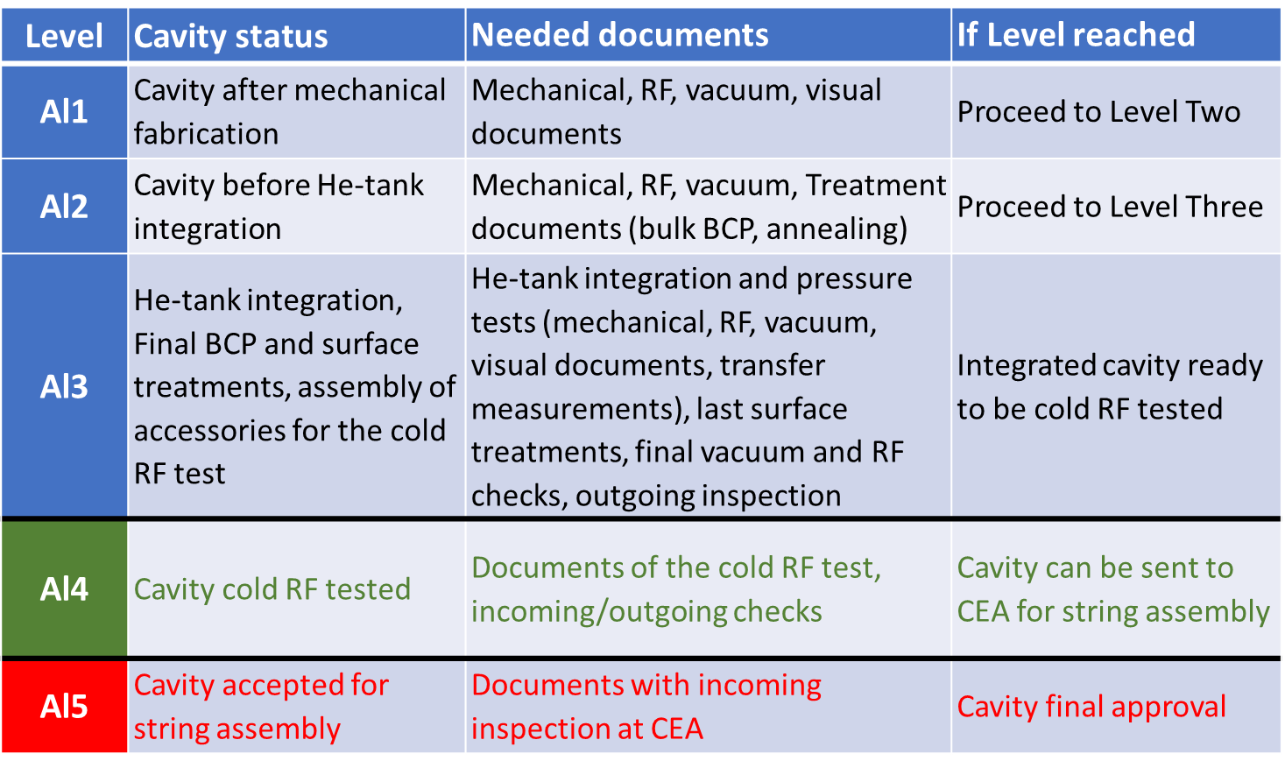
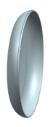
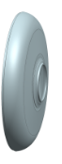
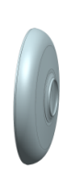
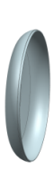

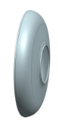
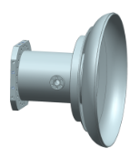
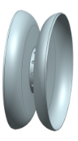
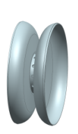
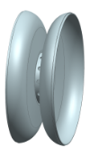
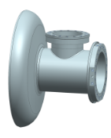
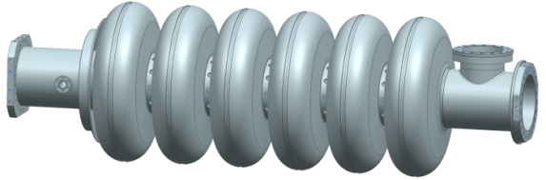
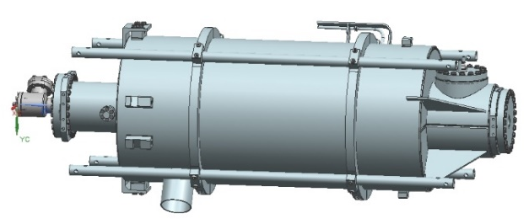
The QC: The Acceptance Levels
EC
PC
IC
PC
EC
EGP
PD
ID
CD
EGC
Mxxx
Mxxx

Slide 4
The QC: The flow of documents

Slide 5

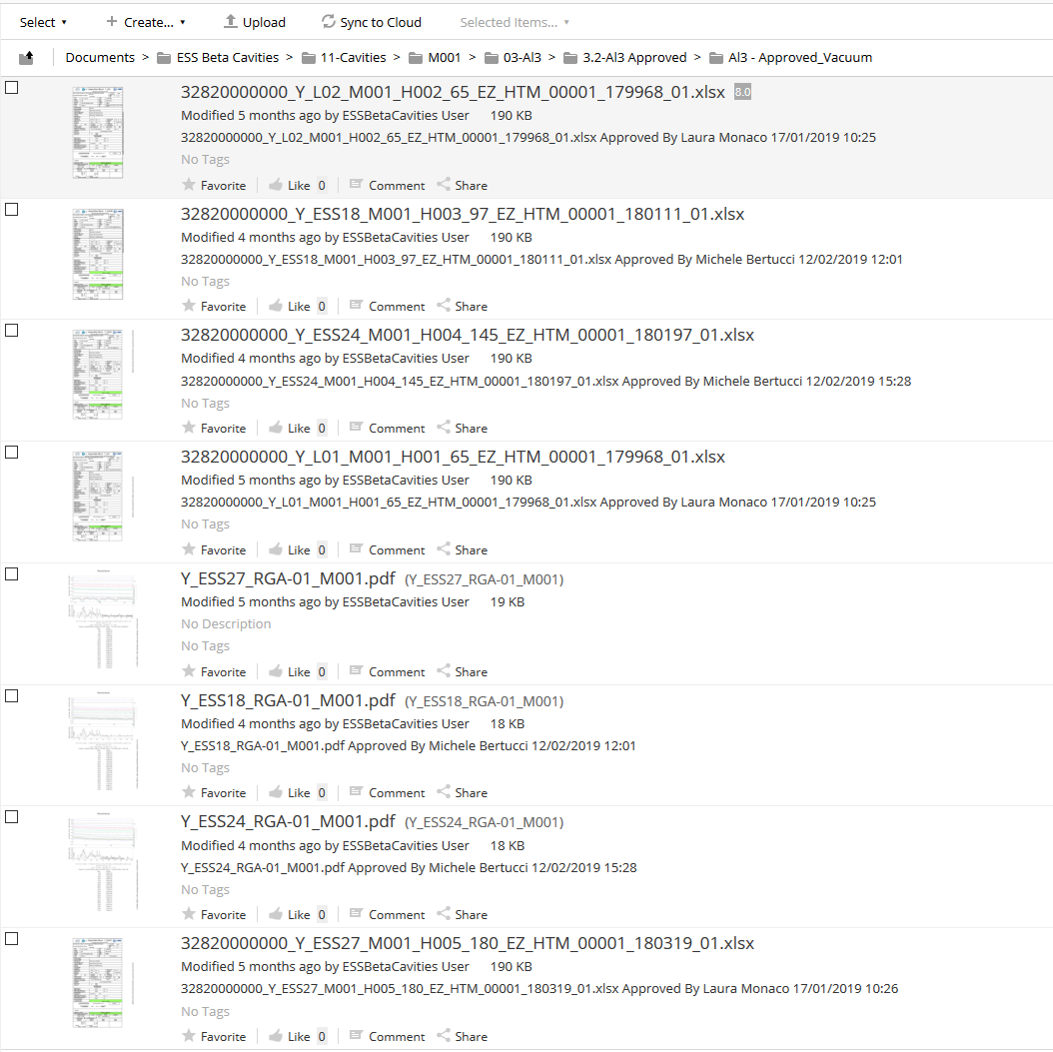
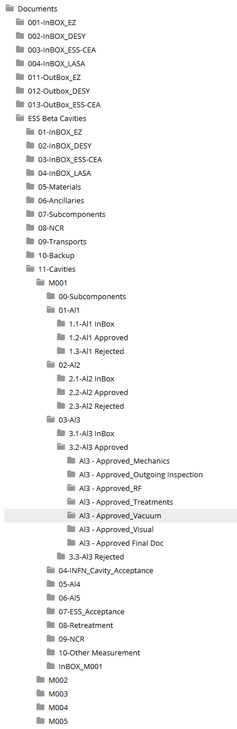
The QC: how we manage (doc flow and status)
Input/output:
INFN
EZ
DESY
CEA
ESS

Slide 6
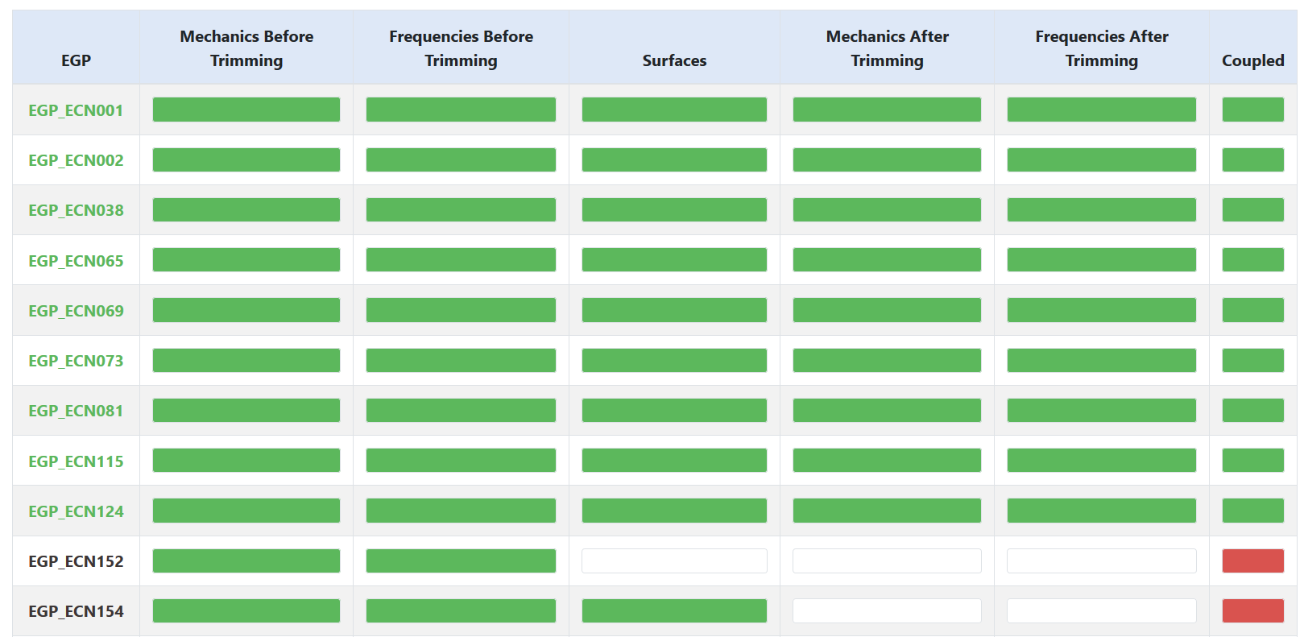
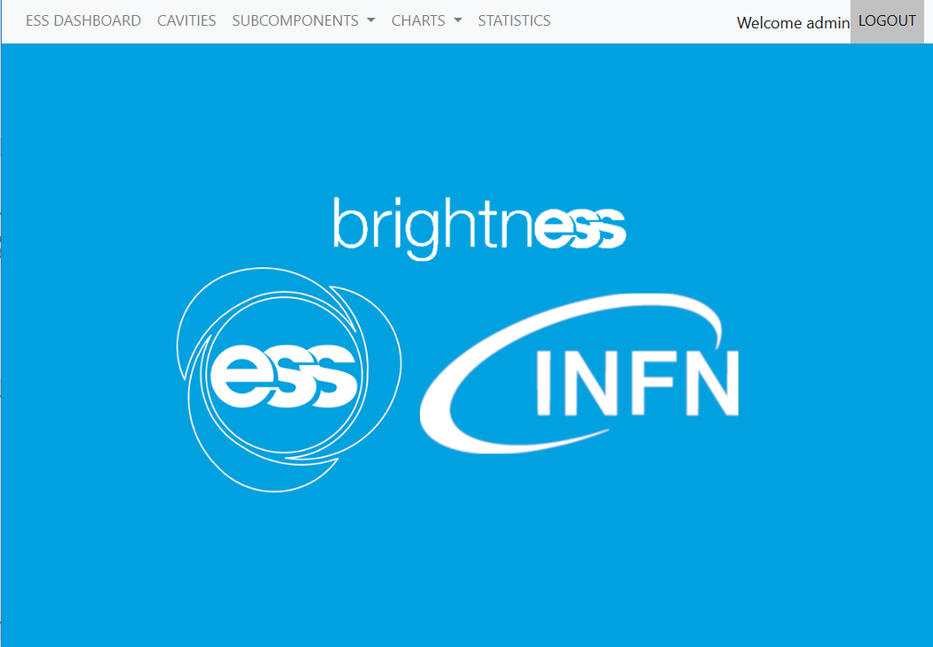
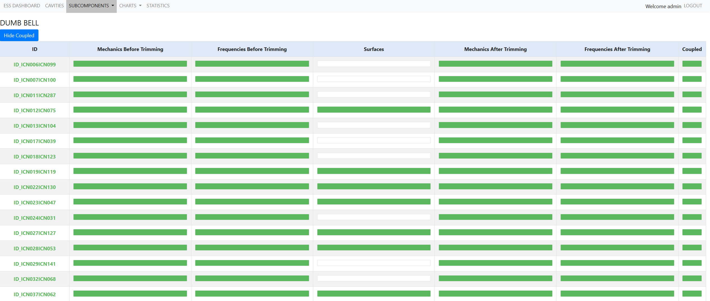
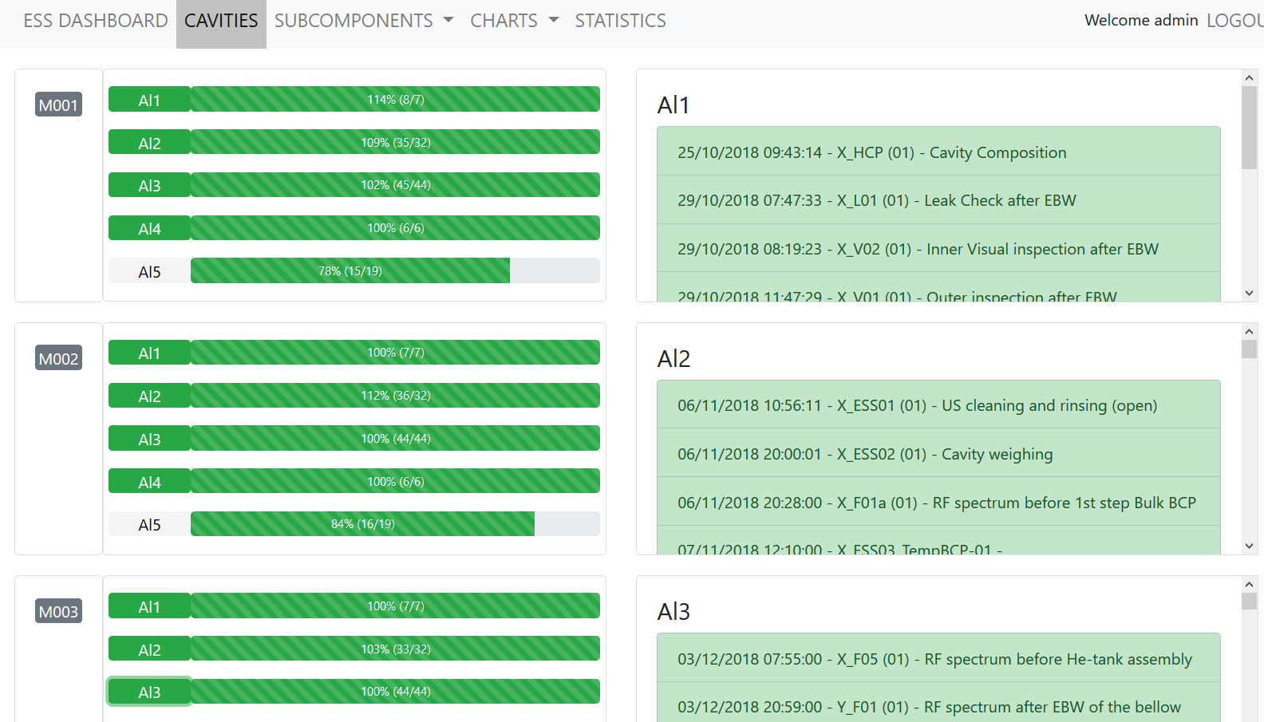
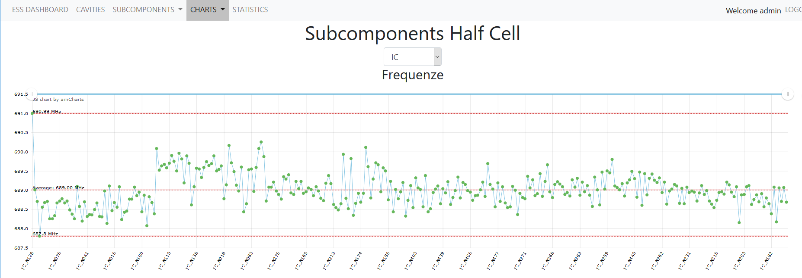
The QC: how we manage docs status and production data
DashBoard Tool
Subcomponents Doc Status
Cavities
Subcomponents Analysis

Slide 7
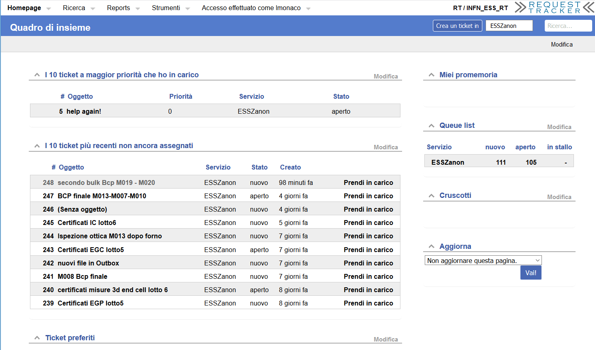
Fast communication (ticketing system)
Used for:
Tracking all events (and discussion) related to the cavity production (INFN-EZ)
Prompt feedback to cavity production (BCP, RF issue, etc.)
Fast and tracked communication of NCR (deviation from the standard cycle)

Slide 8

Number of documents for Subcomponents & Al1-Al3
Subcomponents Documents
Mechanical, RF, 3D surface
  IC, PC, EC (after deep drawing)
  ID, TD, EGP, EGC (before trimming)
  ID, PD, CD, EGP, EGC (after trimming)
For one cavity in total we have 52 docs + (3D docs)
  Measurements can be repeated for cross-check or for after subcomponents reworking (INFN request)
Cavities Documents (Al1)
Mechanical production of the cavity:
  Mechanical, RF, Leak check, inner and outer visual inspection
In total 7 documents
  For “special cavities” we reached up to 13 docs
EC
PC
IC
PC
EC
EGP
PD
ID
CD
EGC
Mxxx
Mxxx

Slide 9
Number of documents for Subcomponents & Al1-Al3
Cavities Documents (Al2)
Surface treatments of the cavity and tuning
  Bulk BCP (+ US cleaning and rinsing, HPR, etc.), Annealing, Mechanical, RF, Leak checks
In total 32 documents
  For “special cavities” we reached up to 54 docs
Cavities Documents (Al3)
Cavity Integration:
  RF, Leak check, Pressure test, Mechanical, Transfer Measurements
Cavity final treatments:
  Final BCP, 12h HPR, assembly of accessories
Cavity Certificate of Conformity (EZ)
In total 44 documents
  For “special cavities” we reached up to 68 docs
EC
PC
IC
PC
EC
EGP
PD
ID
CD
EGC
Mxxx
Mxxx

Slide 10
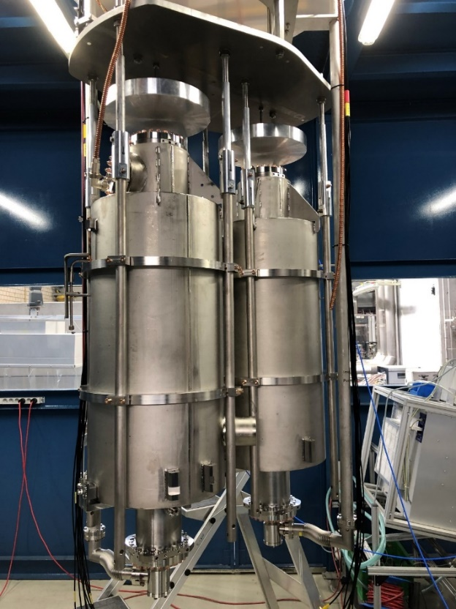
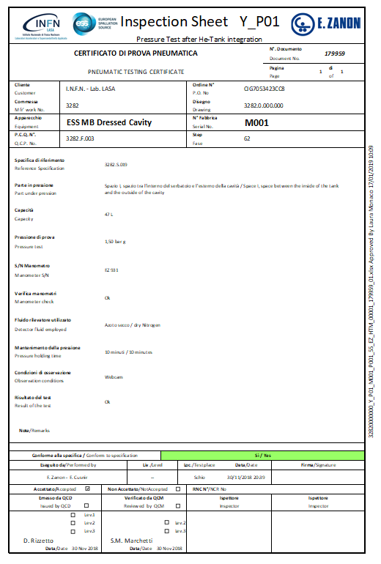
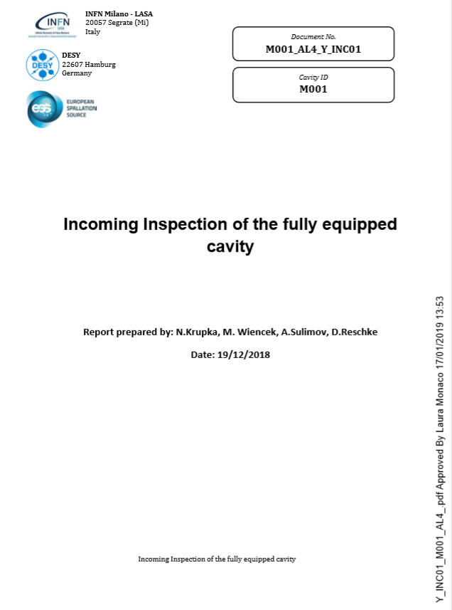
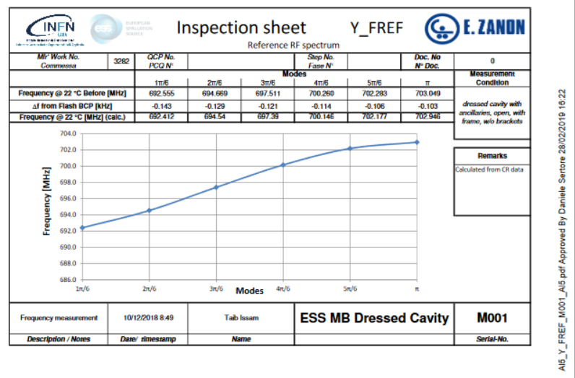
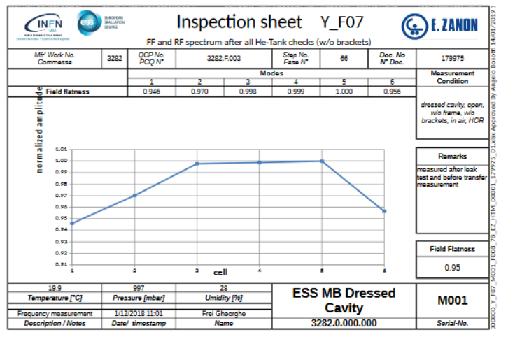
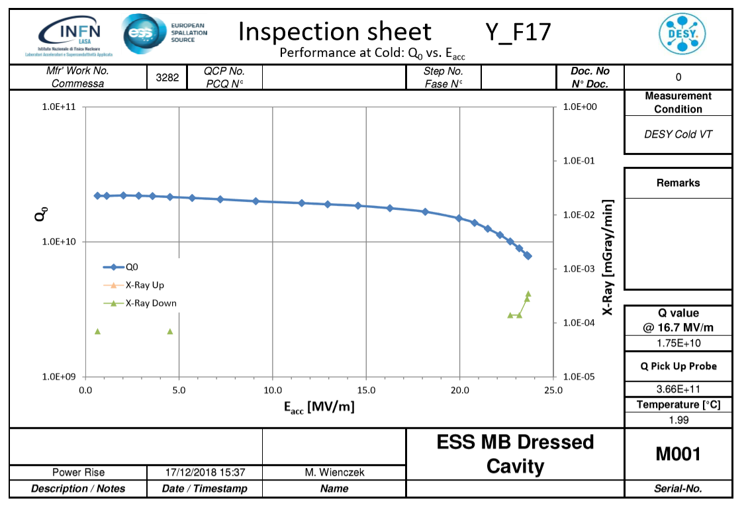
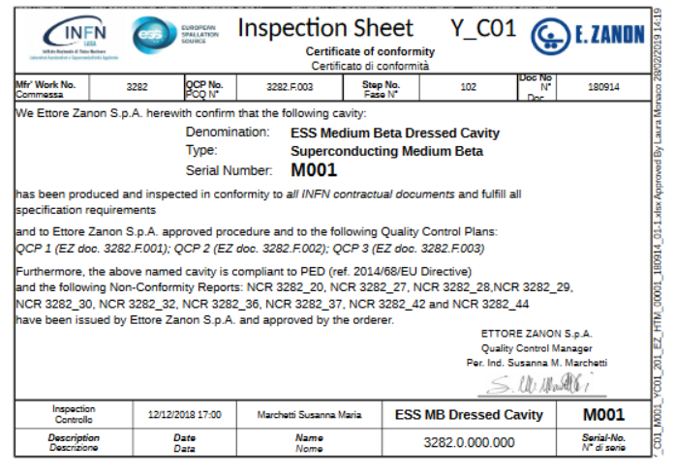
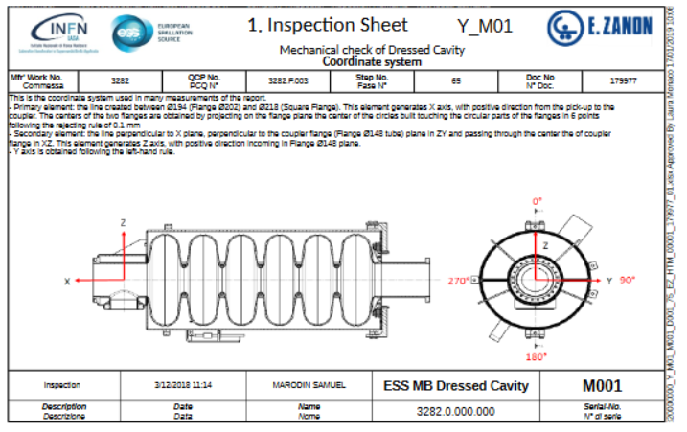
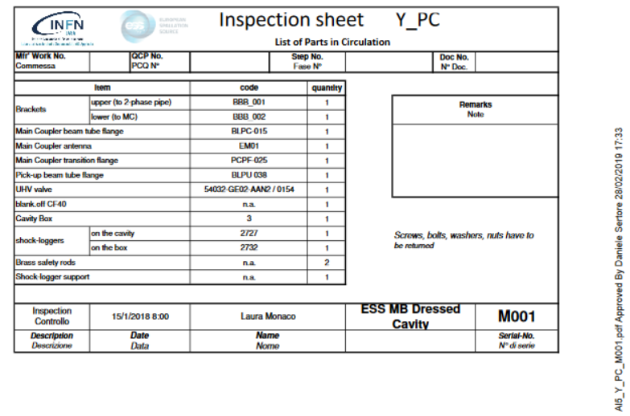
Number of documents for Al4-Al5
Cavities Documents (Al4)
Cavity qualification (performances at cold)
  Incoming/outgoing, RF spectrum before and after transport, Q0 vs Eacc and HOM at cold
In total 6 documents
Cavities Documents (Al5)
Cavity Handover to ESS (CEA):
  Outgoing/incoming, RF spectrum
  before and after transport
  Docs taken from previous Als
In total 19 documents
Collection of Al5 Docs

Slide 11
NCRs (Non Conformity Reports)
NCRs subcomponents & cavity production (including also interfaces requirements)
96: Total number of NCRs emitted by EZ
  Approval INFN only -> if no impact on interfaces
  Approval INFN only after the ESS approval -> if related to interfaces
NCRs related to interfaces
20: Total number of NCRs emitted by INFN
  ESS approval -> if related to interfaces
NCRs doc management
Alfresco is not used for the NCRs flow (acceptance, etc.)
  Alfresco will be used only for the storing of NCRs (once closed)

Slide 12
Actual Document Status
Today status:
Subcomponents (all HCs deep-drawn & measured):
  IC, PC, EC: 1045
  ID, PD, CD, EGP, EGC: 779
Cavities:
  Al1: 150 (21 cav)
  Al2: 440 (12 cav)
  Al3: 378 (9 cav)
  Al4: 24 (4 cav)
  Al5: 62 (4 cav + the on-going)

