Slide 1
10th srf collaboration meeting @ LASA 25-26 JUNE 2019 - CAVITY interfaces - Vincent Hennion
Notes:
Bonjour,
Franck Peauger,
Je suis Ingénieur RF accélérateurs au SACM
Je suis au CEA depuis janvier 2006

Slide 2
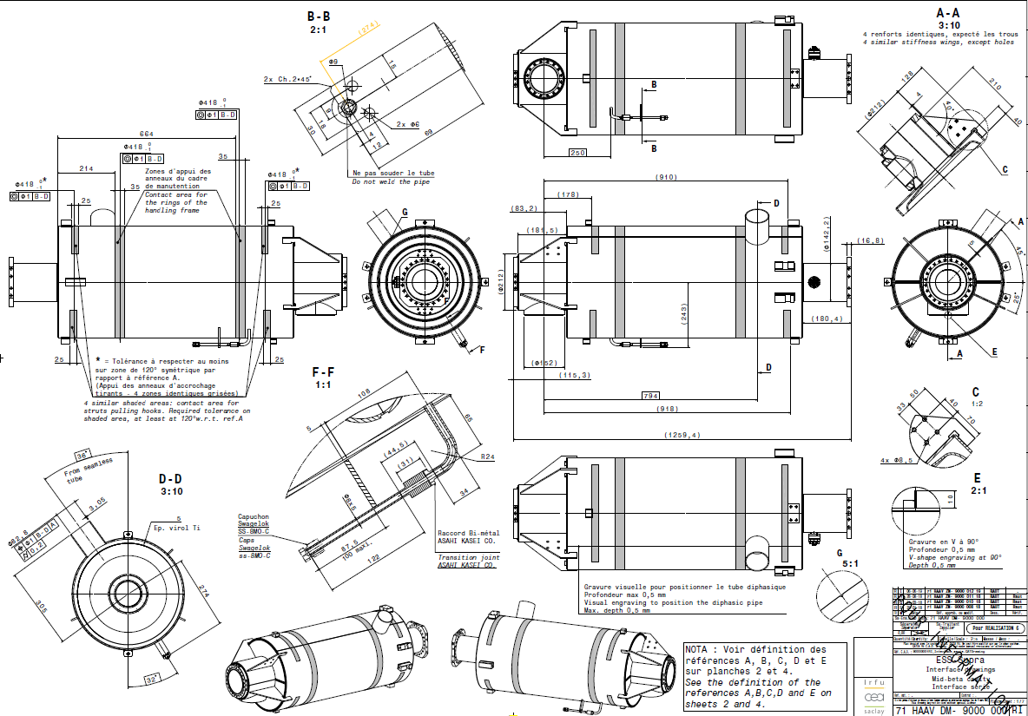
interfaces Drawing sheet n°1
relaxation
engraving
For H-Beta only

Slide 3
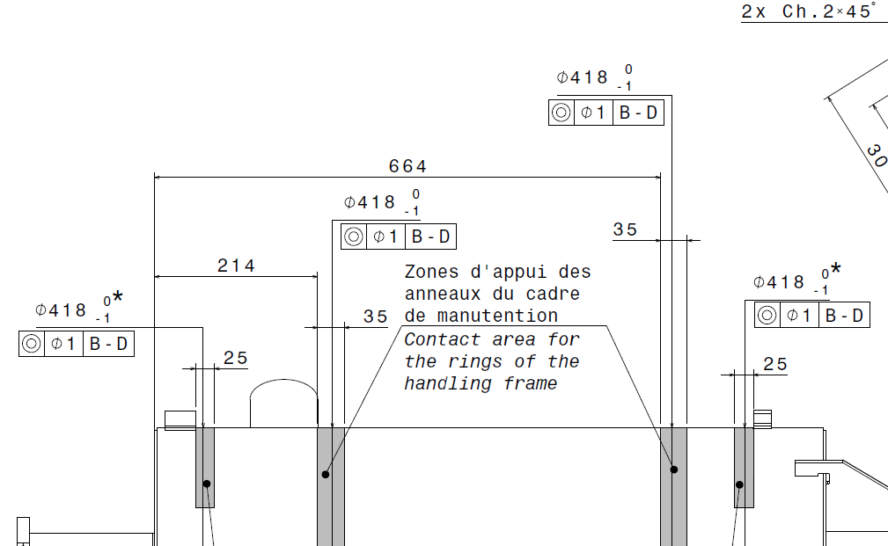
Zoom on the relaxation

Slide 4
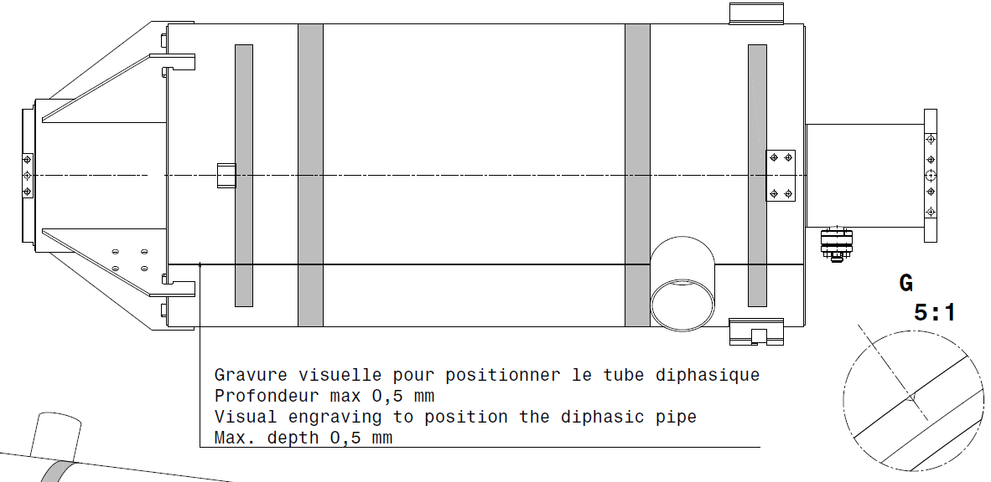
Zoom on the engraving

Slide 5
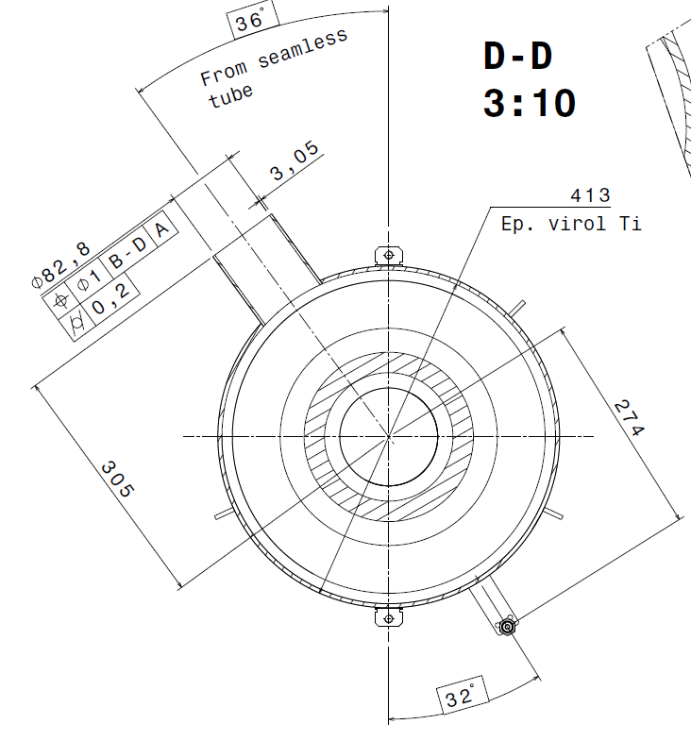
He outlet length only for High Beta cavities
255

Slide 6
Torque of the M8
M8 screws and studs will be tight at 25N.m
Max torque to be applied: 27N.m
Applicable for all type of cavities (including CEA on the string)
The goal is to ensure the riquired tightness while preventing from damaging the NbTi thread

Slide 7
Thank you
Commissariat à l’énergie atomique et aux énergies alternatives
Centre de Saclay | 91191 Gif-sur-Yvette Cedex
T. +33 (0)1 69 08 76 11 | F. +33 (0)1 69 08 30 24
Etablissement public à caractère industriel et commercial | RCS Paris B 775 685 019

