Slide 1
Design Basis (KFM) for PBW Port block and vessel
Mikael Möller
Structural Engineer, Analysis Section
www.europeanspallationsource.se
2019-07-04

Slide 2
The KFM.

Slide 3
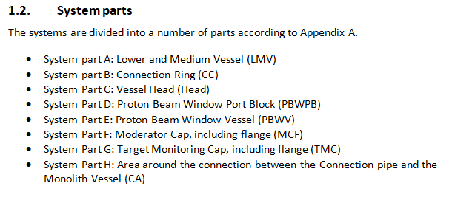
System parts.

Slide 4
Objectives of the KFM.
The KFM shall provide all the information that is needed to conduct structural verification of the component. In short, it includes:
Applicable code framework.
Defining loads to be considered, and giving references to documents where the loads are specified.
Defining load combinations.

Slide 5
Applicable code framework.
The code framework for safety classified components (MQC1-3) is RCC-MRx.
For non-classified components, EN 13445 applies.
Initially, the components were MQC3 and hence the design and analysis were conducted according to RCC-MRx.
Subsequently, it was changed to MQC4 and the manufacturing will be according to EN 13445. Demonstration of complience to EN 13445 in the analysis parts will be done by a delta-analysis.

Slide 6
Load classification.
Loads to consider are classified into different levels of operating conditions with respect to their probability of occurence. Different levels = different evaluation criteria.
In RCC-MRx we have:
SF1 = Normal operating conditions
SF2 = Normal operating conditions incidents
SF3 = Emergency conditions
SF4 = Highly improbable conditions
(The SSM terminology is H1-H4).

Slide 7
Load classification.
In EN 13445 we have:
Normal operating conditions
Exceptional operating conditions
It is defined in RCC-MRx that the following translations are applicable
SF1 & SF2 = EN 13445 normal
SF3 & SF4 = EN 13445 exceptional.

Slide 8
Loads to consider (RCC-MRx classification).
The following loads need consideration from a radiological release point of view:
Design pressure = 1 bar(g) / vaccum at 80C
Operating pressure = vacuum at 50C
SF1 nozzle loads
SF2 nozzle loads
SF2 maintenance loads
SF2 seismic event
SF2 beam trips
SF3 nozzle loads
SF3 target vessel break, release of inventory = 2 bar(g)
SF4 nozzle loads
Dead weight (goes without saying)

Slide 9
Loads to consider (RCC-MRx classification).
The following loads need no consideration from a radiological release point of view:
SF3 seismic event. However, from econimical and availability reasons, ESS decided that it shall be included in the requirements anyway.
SF4 seismic event. However, it shall be analyzed anyway so that ESS are informed about the consequences of such an event.

Slide 10
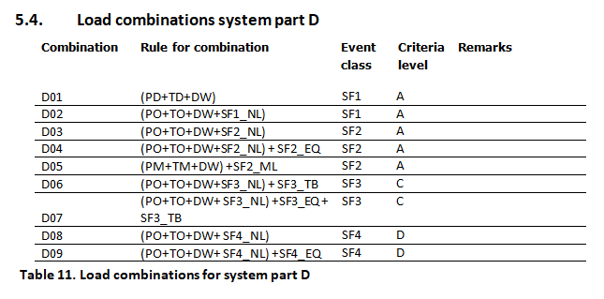
Load combinations.
And so finally we have the specified load combinations to address.

Slide 11
Load combinations.
As an example: combination D7 in SF3.
Pressure at temperature + DW are present in all combinations.
The rest = seismic event triggers a target vessel break, and the nozzle loads include dynamic contributions from seismic.

Slide 12
Questions & objections.

