Slide 1
Power Deposition at the Port Block
Miguel Magán

Slide 2
Aims and Requirements
Obtain a representative power deposition map for the PB.
Realistic: Avoid oversimplification which Will lead to needless design complications.
Reliable: Ensure goodness of the model and solutions used.
Easy to use, import and update for the FEM analyst.

Slide 3
Tools and methods
Code of choice: MCNP6.2 with ENDF-B/VII libraries, with the Target Station V3.1 model as a base start.
Other tools: SuperMC to create MCNP model, CATIA to perform previous simplifications, Paraview to visualize results.
Simplification: Blanking out (Zero importance) of targets, for reasons that we Will see.

Slide 4
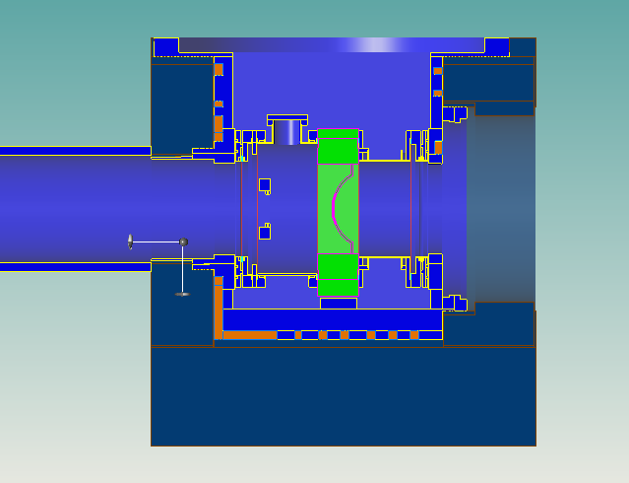
Geometry modelling
Bolt holes, chamfers, etc. Were removed to créate a simplified model.
Void cells: Created by complement to existing cells, to avoid relying on SuperMC methods for void modelling.
PBW is integrated into this model, as it has a major influence. CP is added later.

Slide 5
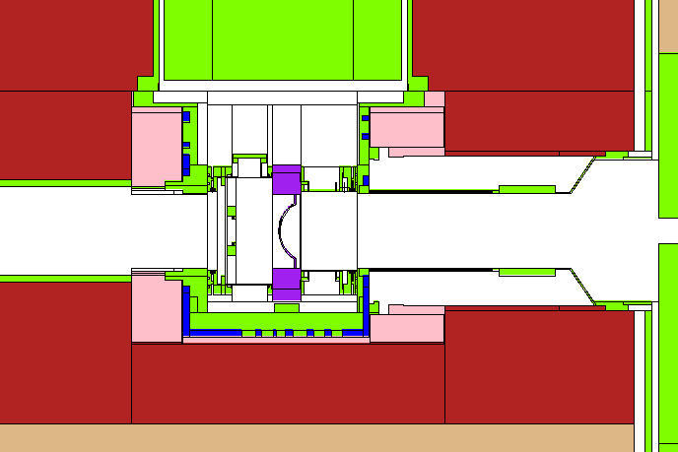
Standalone model creation
With all that information, a standalone model containing just the Port Block “in a box” was created. This allows us to check and manually fix flaws. A cloud source was run, and eventually the model had no geometry failures in 1E8 source particles.
The connecting pipe was later added with the bellow represented as a bounding boc with reduced density.

Slide 6
Target blankout
Computationally speaking, particles hitting the target are very costly, as the spallation process are slow to calculate and have minimal probabilities to reach the área of interest.
On top of that, these particles are actually an overwhelming majority.
Thus, we decided to compare a full model with one where all particles hitting the target are lost.
Location | Inner C. pipe [W] | C. Pipe cooling | C. Pipe cover | Bellow (convolutions) | Expan. pipe
Full model | 372,8 | 139,3 | 144,4 | 44,6 | 101,7
0 imp target model | 372,2 | 140,5 | 143,1 | 44,8 | 105

Slide 7
Model setup
Design beam at 5.2MW
Full array of particles (importantly, electrons!)
Electron knock-on generation sampling at 0.1.
Photon induced secondary electrons can not be sampled!! (see art39260 in Release Notes)
Type 3 TMESH tallies used for spatial distribution. For the connecting pipe, heat was normalized per weight.
+F6 tallies were used to track total heat.
We aim for total heat uncertainty below 1% and mesh uncertainty below 10% in the “hot” regions.

Slide 8
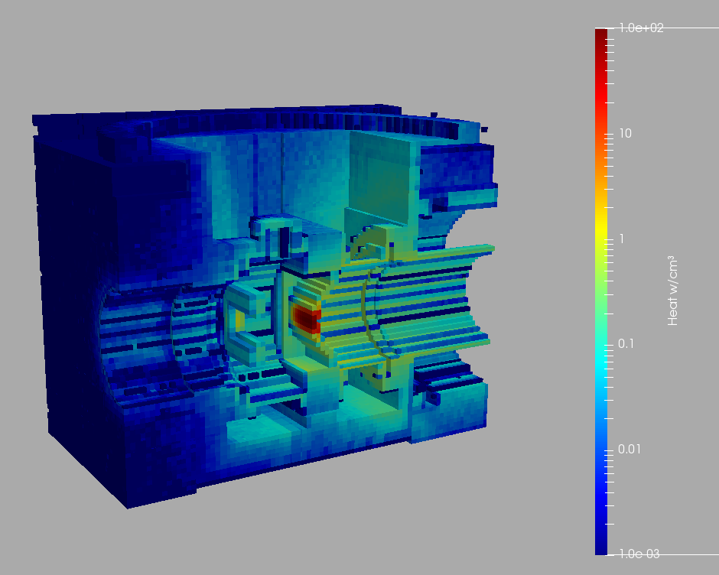
Result overview
Total PB Heat: 2.3kW.
PBW result is not used in this work, (nor in the PBW, actually).
The result in the C. Pipe is replaced by a tailored cylindrical tally.

Slide 9
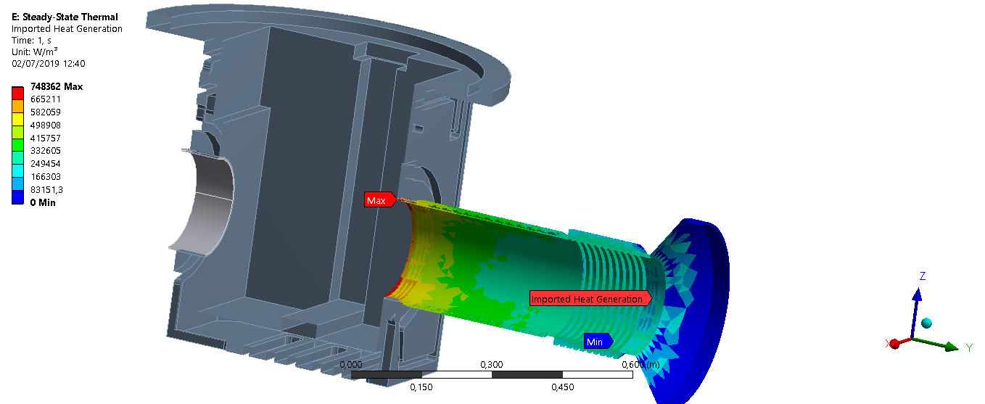
Result overview
Total PB Heat: 2.3kW.
PBW result is not used in this work, (nor in the PBW, actually)

Slide 10
Personalizar esta plantilla
Comentarios e instrucciones de edición de plantilla

