Slide 1
Ion Source and LEBT
Transition from Installation to Testing and Commissioning
Alejandro Garcia Sosa
European Spallation Source
Lessons Learned - August 28, 2019

Slide 2
Outline
Issues
  ISRC Coils
  Grounding
  LEBT Solenoids
  LEBT Chopper
  IRIS
  ISRC Repeller
  Magnetron
Conclusions
Top 3 issues

Slide 3
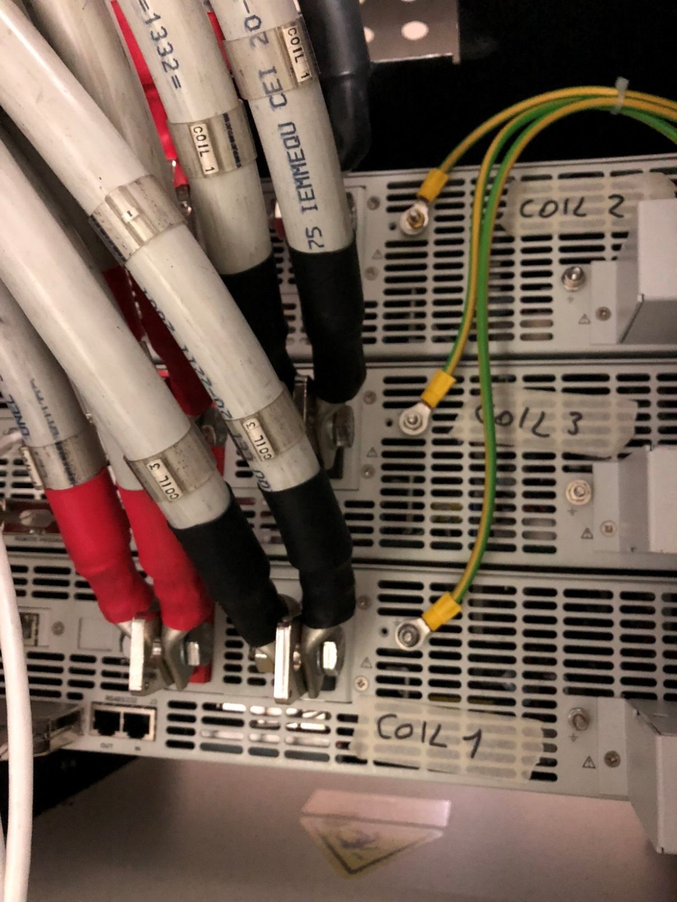
ISRC Coils
Wrong connections
Found out when readouts from coils 1 and 3 were linked

Slide 4
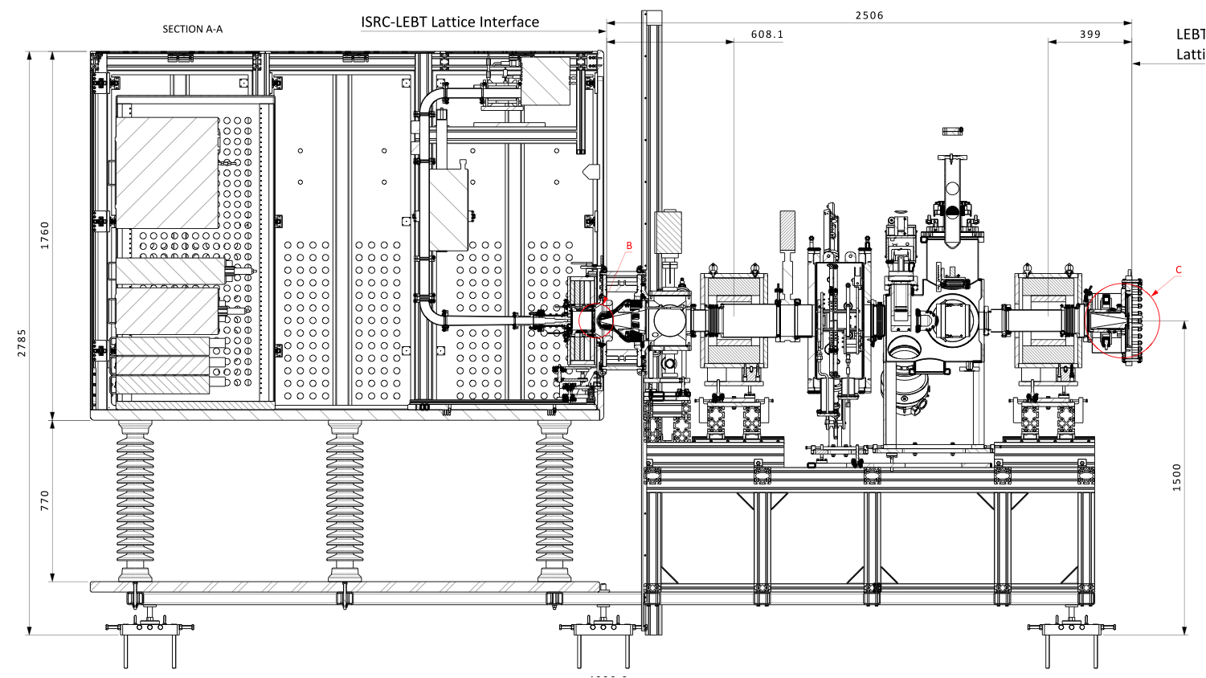
Issues: Grounding
Electronics rack
Electrical Panel

Slide 5
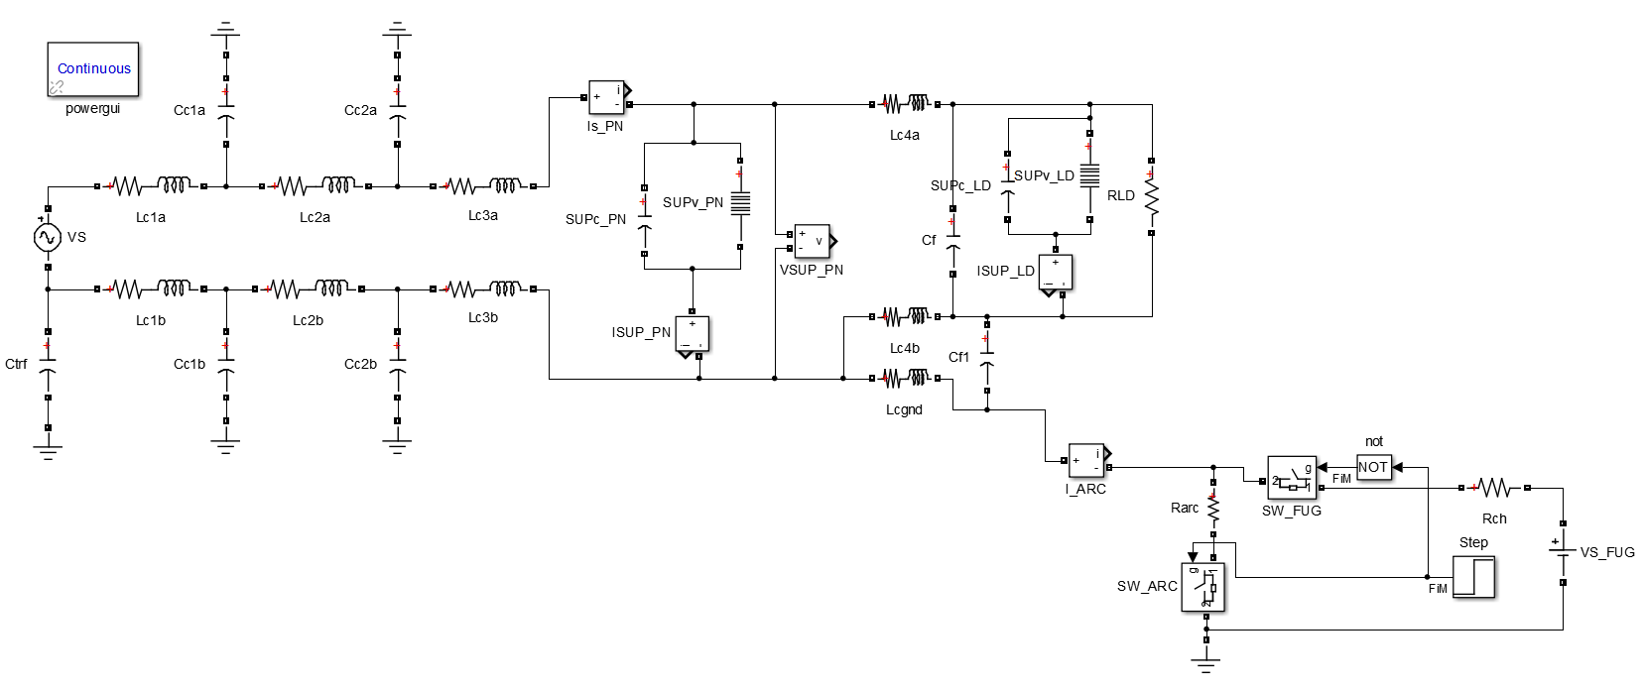
Single-phase Model of HV platform Power Distribution
Phase and Neutral LV cable to Electronics rack
Power Supply w/ internal Surge Suppressor
FUG HV Power Supply (100 kV DC)
Spark generator
Isolation transformer
Phase and Neutral HV cables
Electrical Panel Surge Suppressor
Grounding wire to platform
HV platform

Slide 6
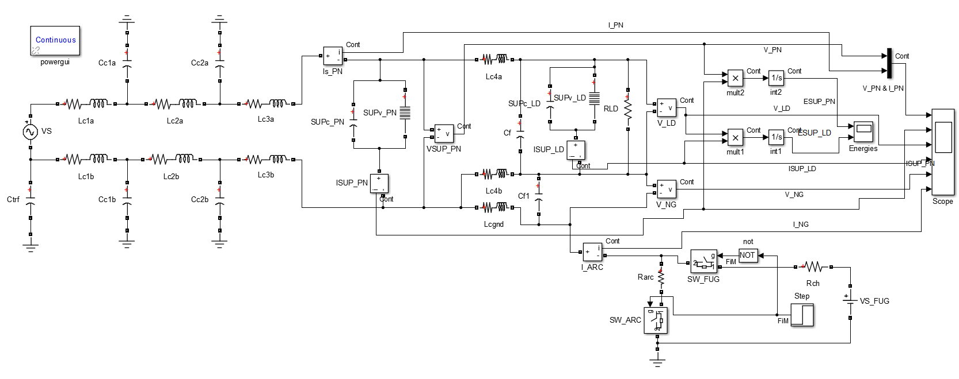
Single-phase Model of HV platform Power Distribution
(Simulation model, including sensors and energy estimators)

Slide 7
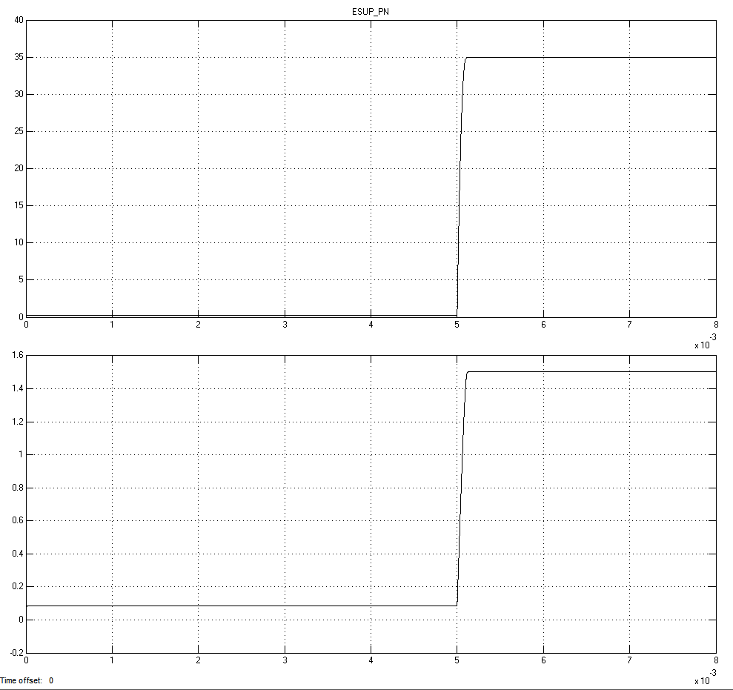
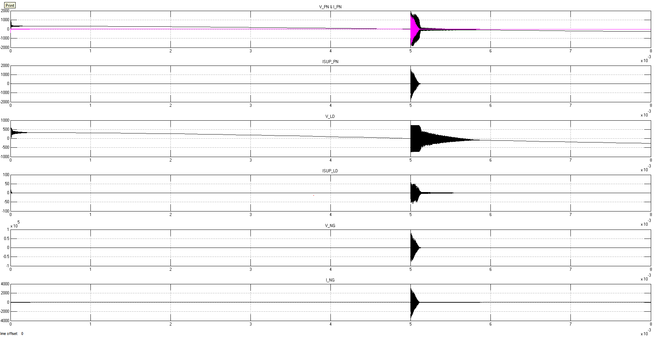
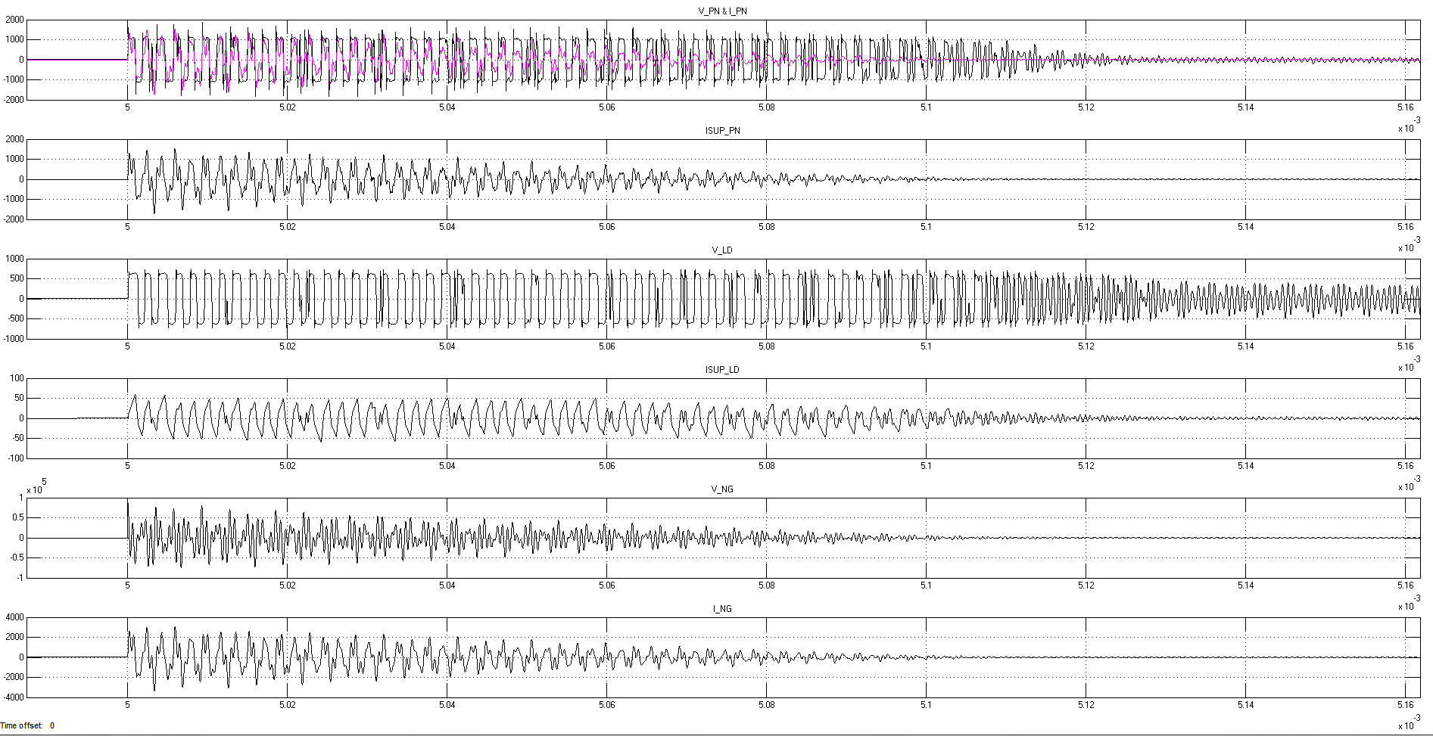
Current HV cables:- 20m long cable
Electrical Panel
Zoom at arcing instant
Electronics rack

Slide 8
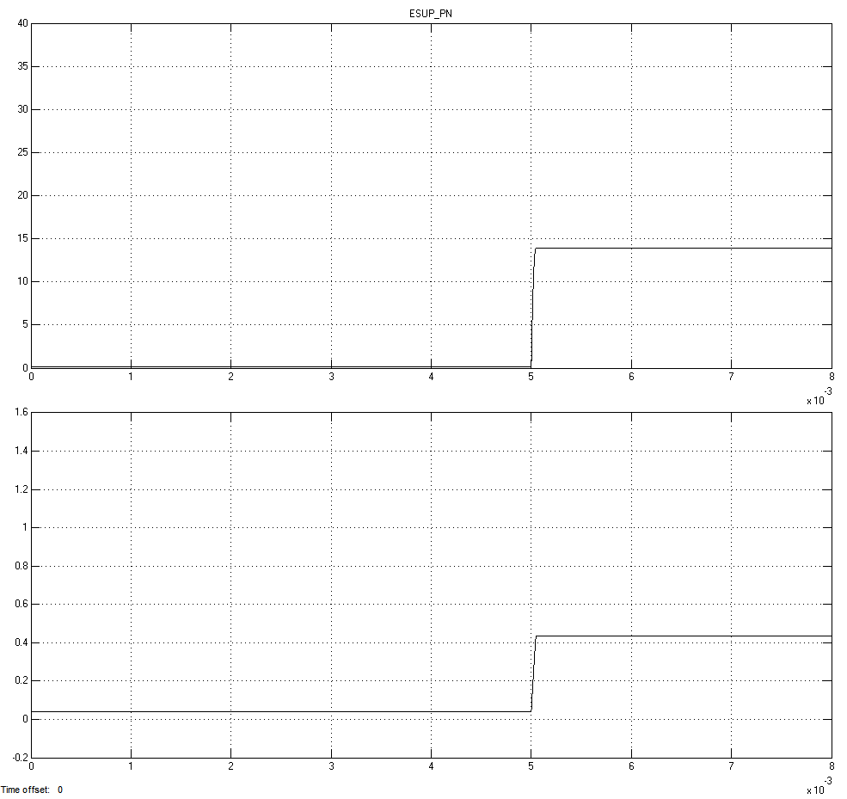
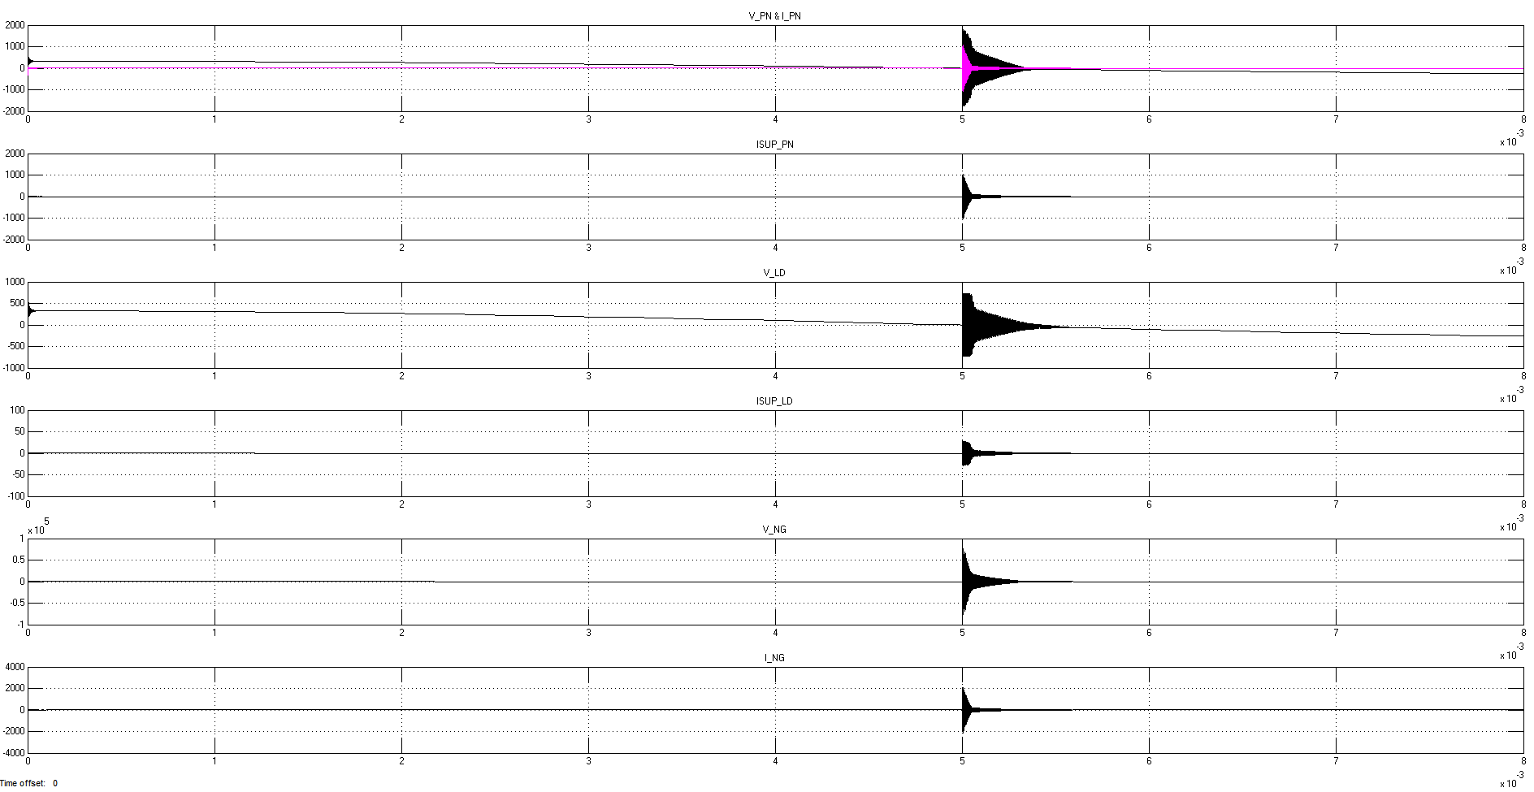
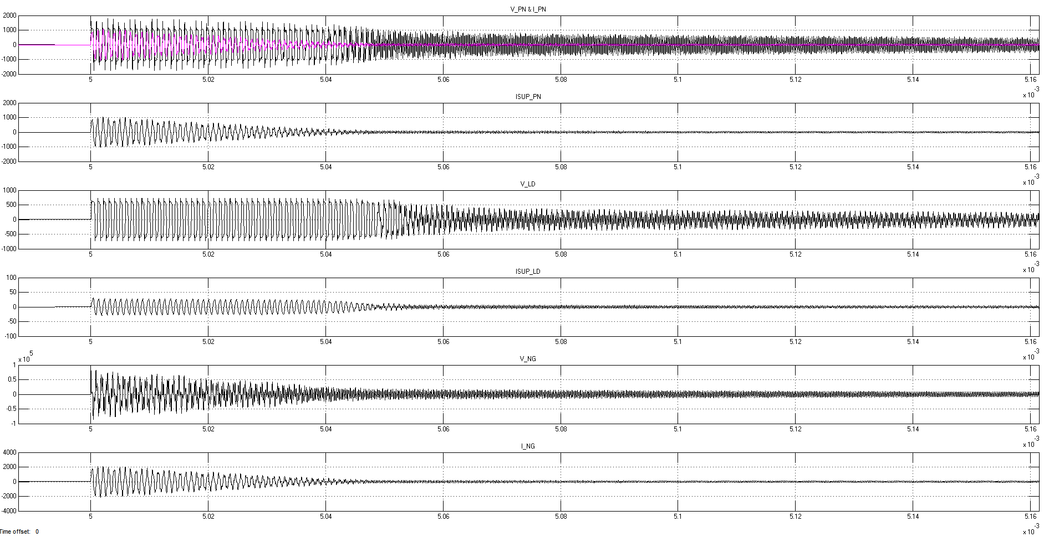
Shorten HV cables only:- 5m long cable
Electrical Panel
Zoom at arcing instant
Electronics rack

Slide 9
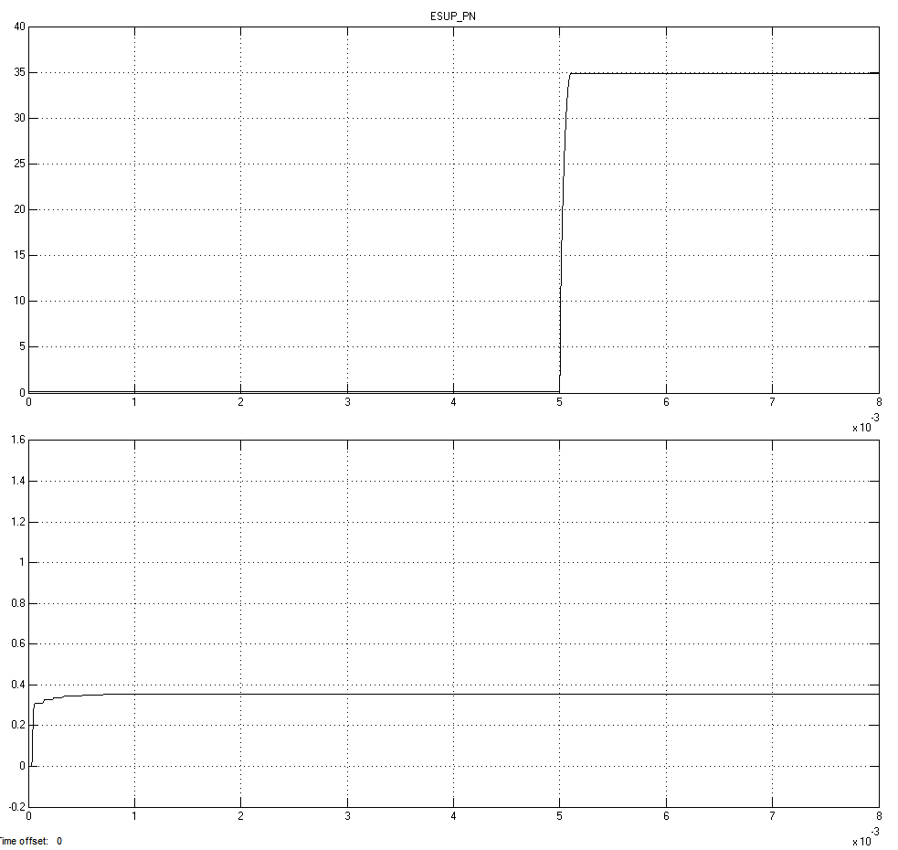
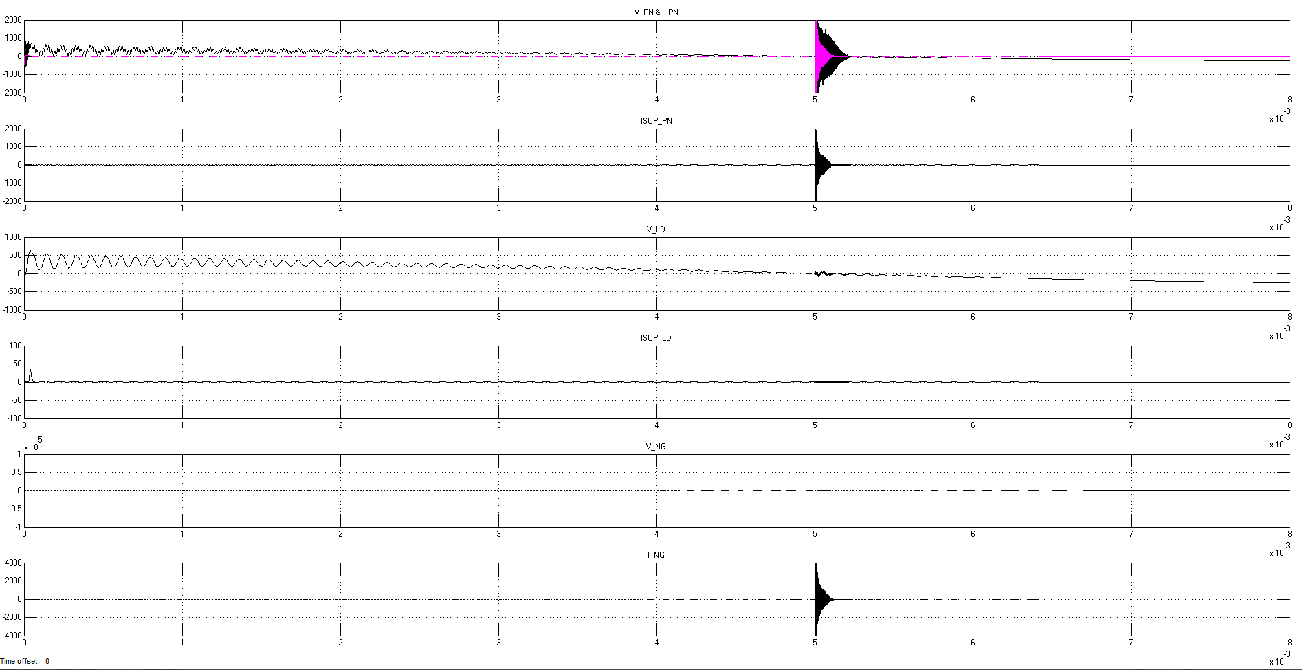
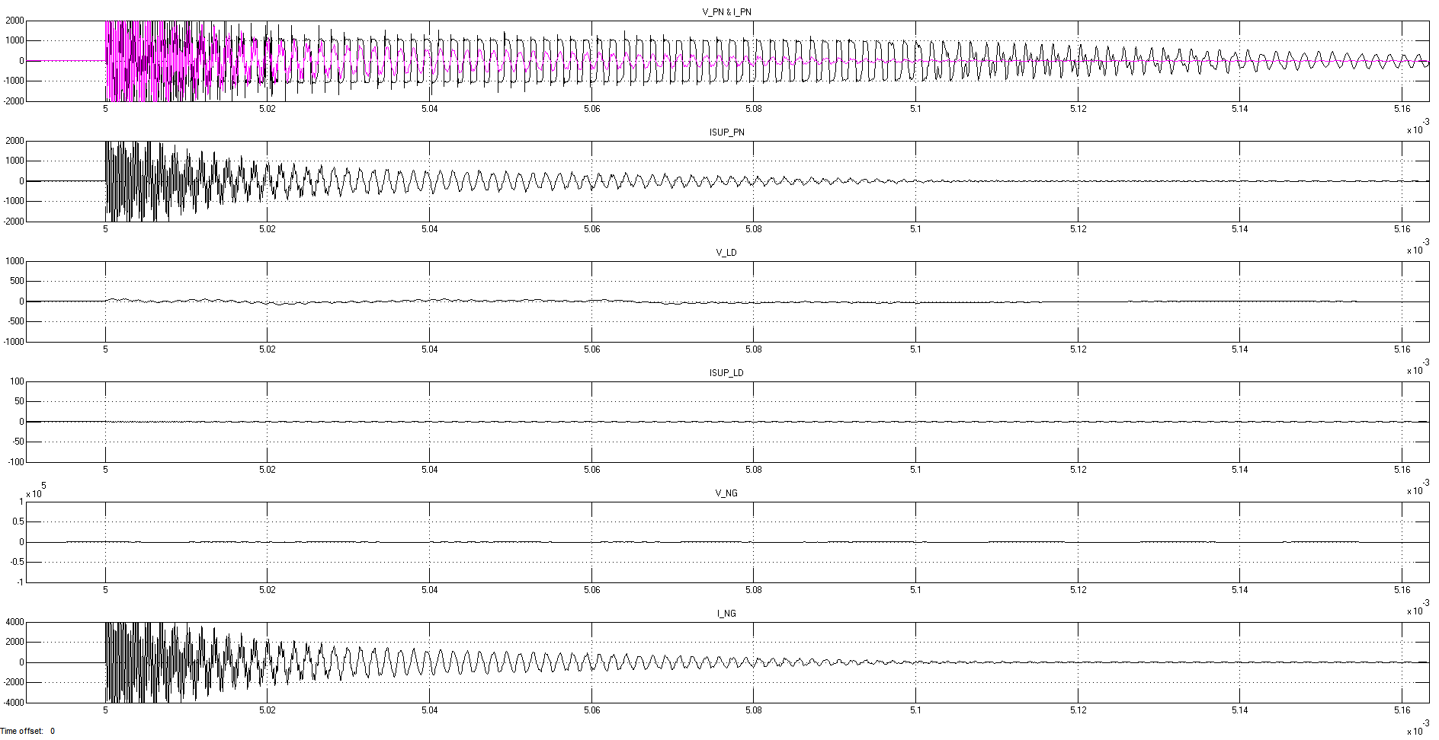
Current HV cables (20m long) + Foil on GND link + EMC filter
Electrical Panel
Zoom at arcing instant
Electronics rack

Slide 10
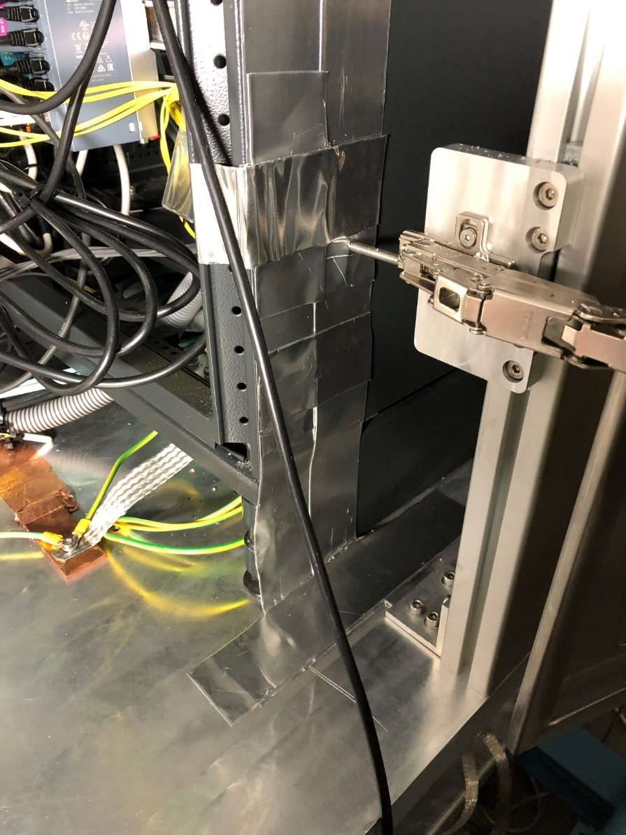
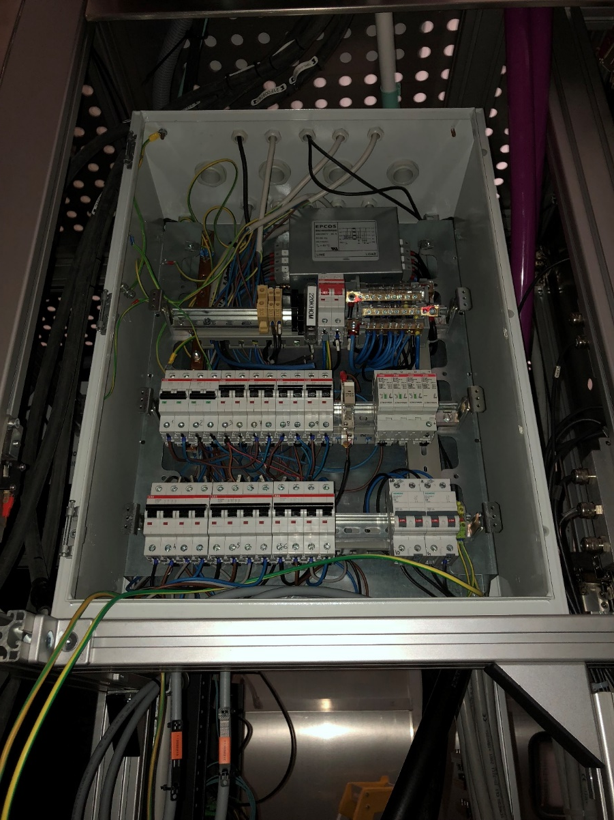
EMC grounding

Slide 11
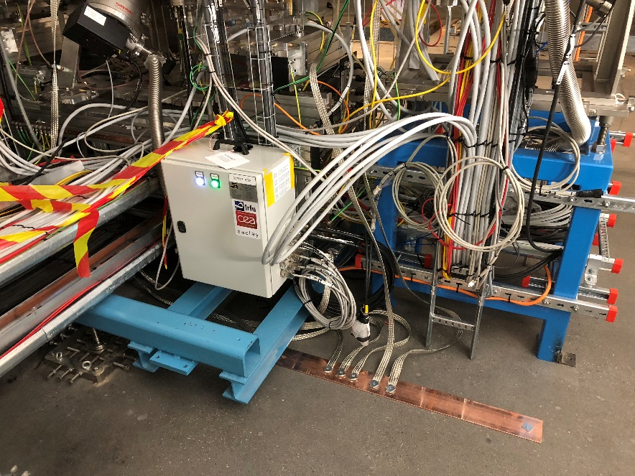
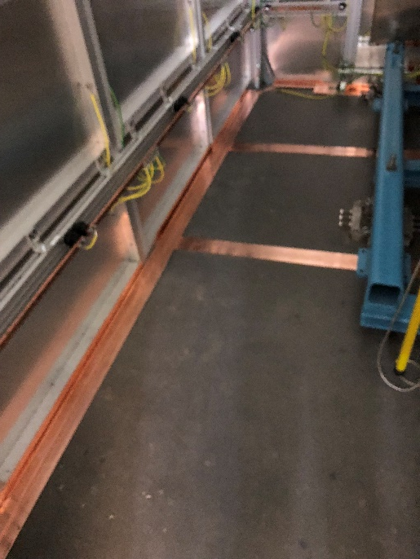
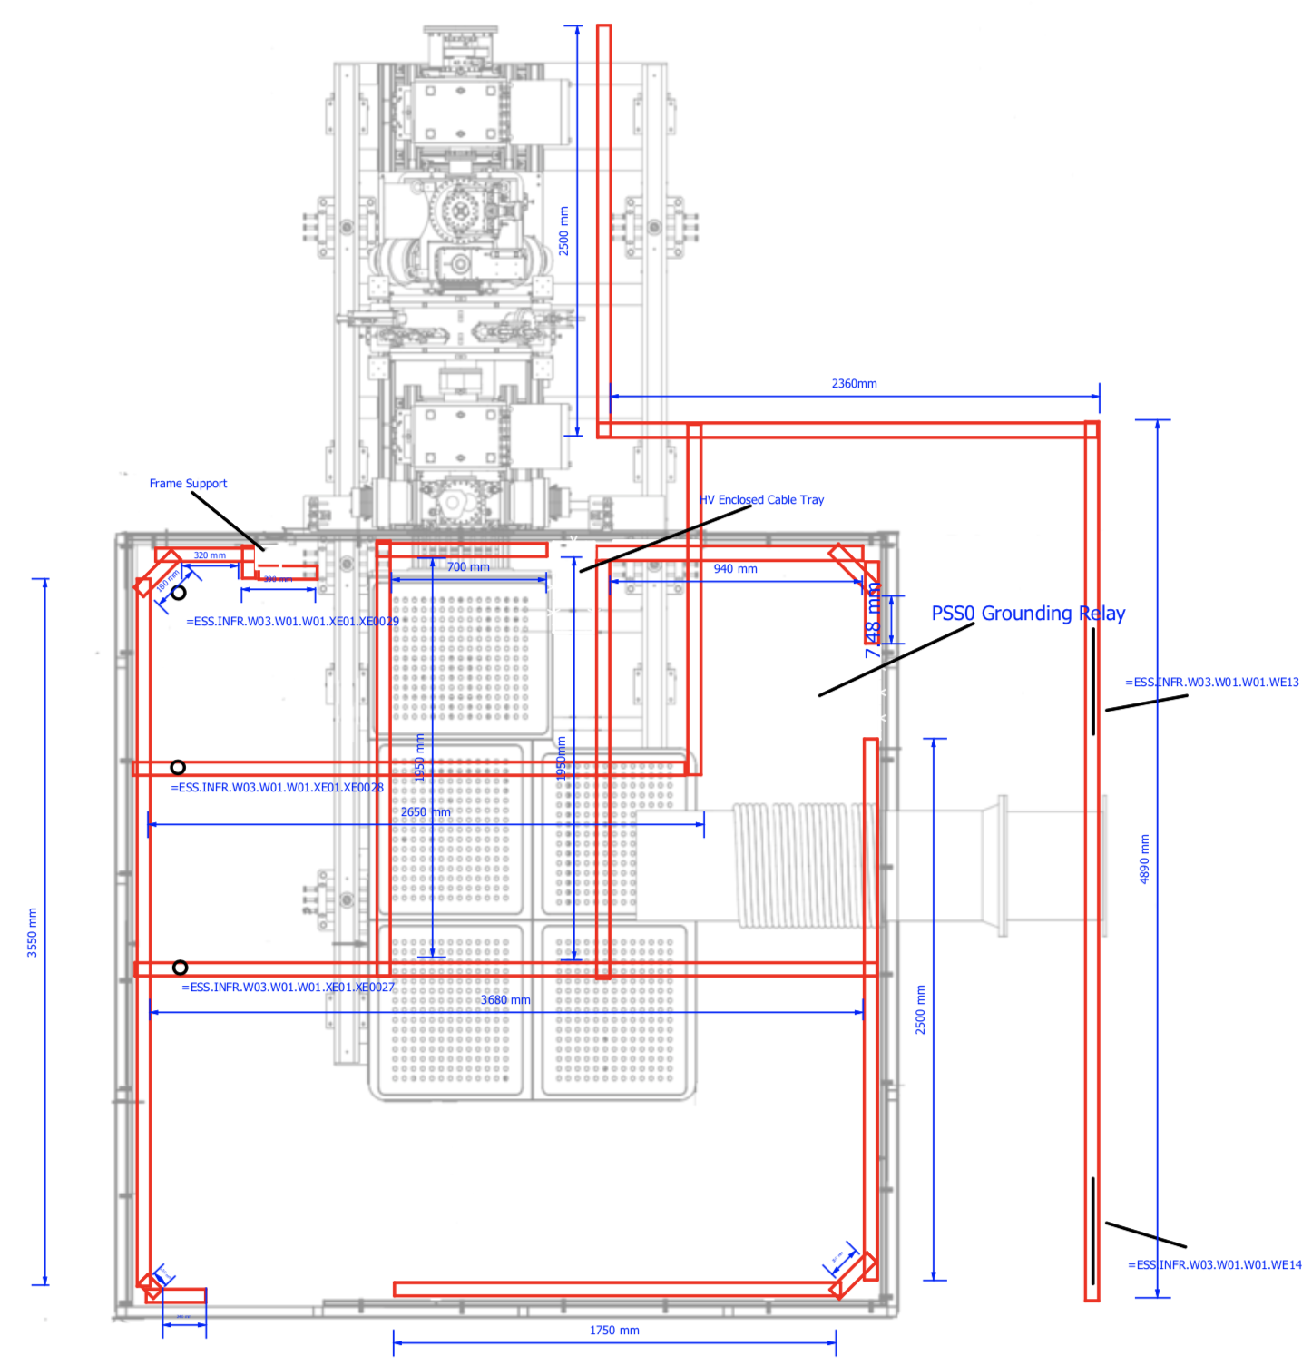
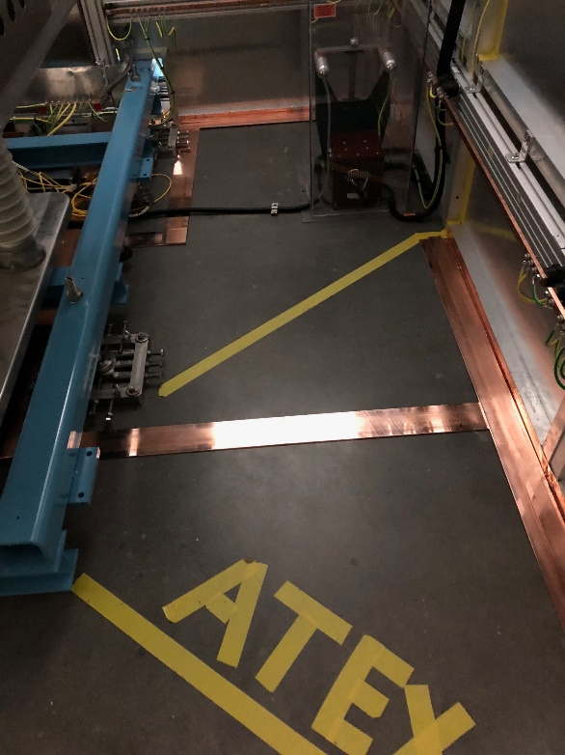
Racks
FEB090
Tunnel
Enclosed Cable tray for
Isolation transformer cables.
Pad
Enclosed Cable tray for
HV power supply cables
HV Power Supply
Isolation Transformer
Pad
Pad
Pad
Pads provide access to
the mesh beneath the concrete

Slide 12
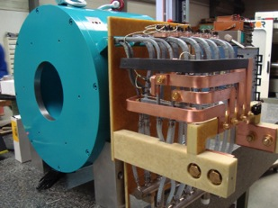
Issues: LEBT Solenoids
LEBT Solenoids have an issue in the connectors of the cooling circuit that make them prone to leak
Corrector magnets use single polarity PS. Polarity is switched using relays that have their own set of issues
Polarities of H1 V1 were swapped.
Sol 1 and 2 had opposite polarities

Slide 13
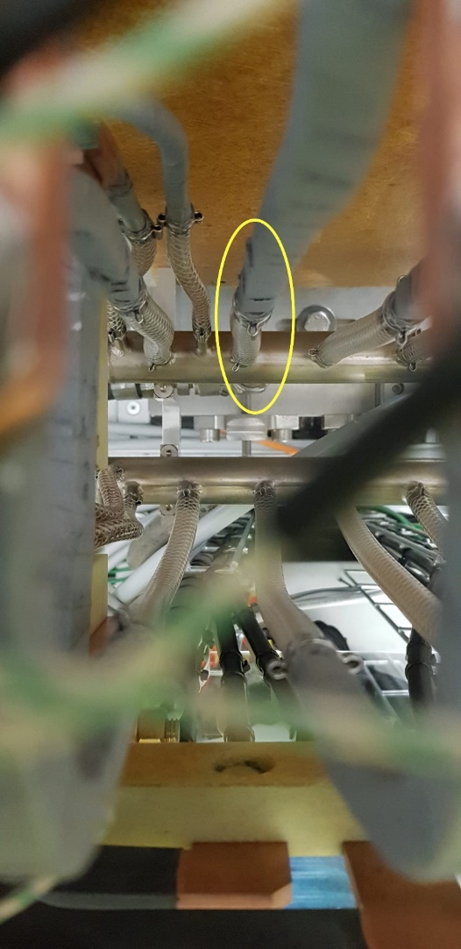
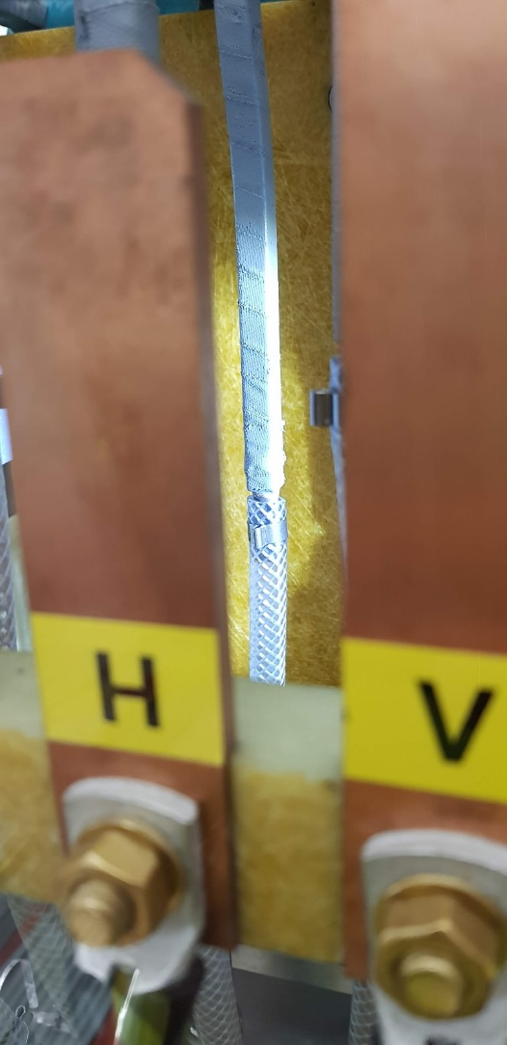
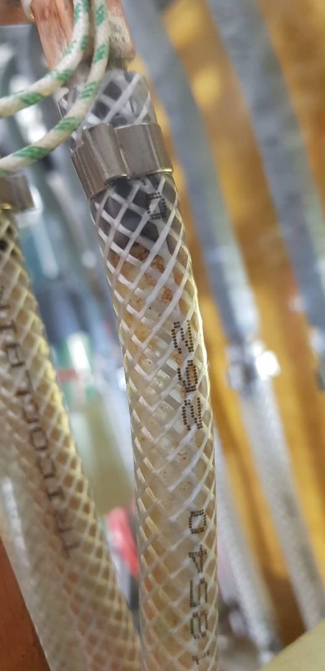
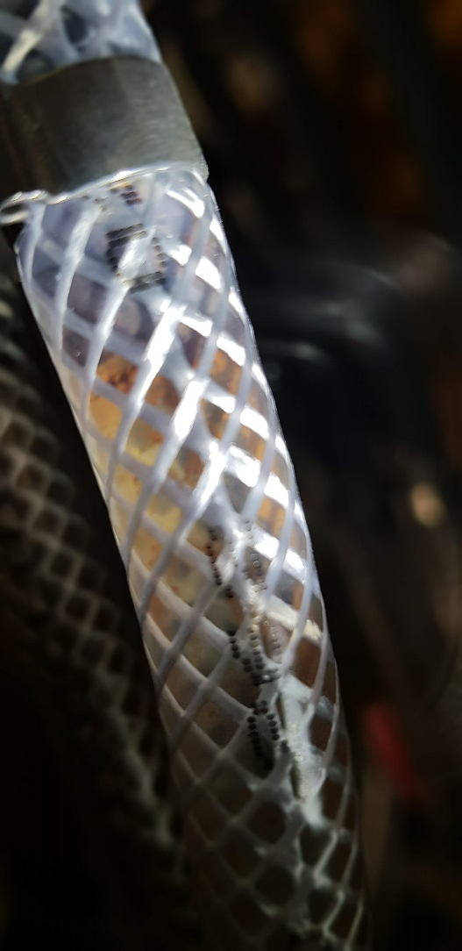
LEBT Solenoid 2 water leak
LEBT Sol 2 water leak
Hard to access given this design
Water cleanliness issues already apparent

Slide 14
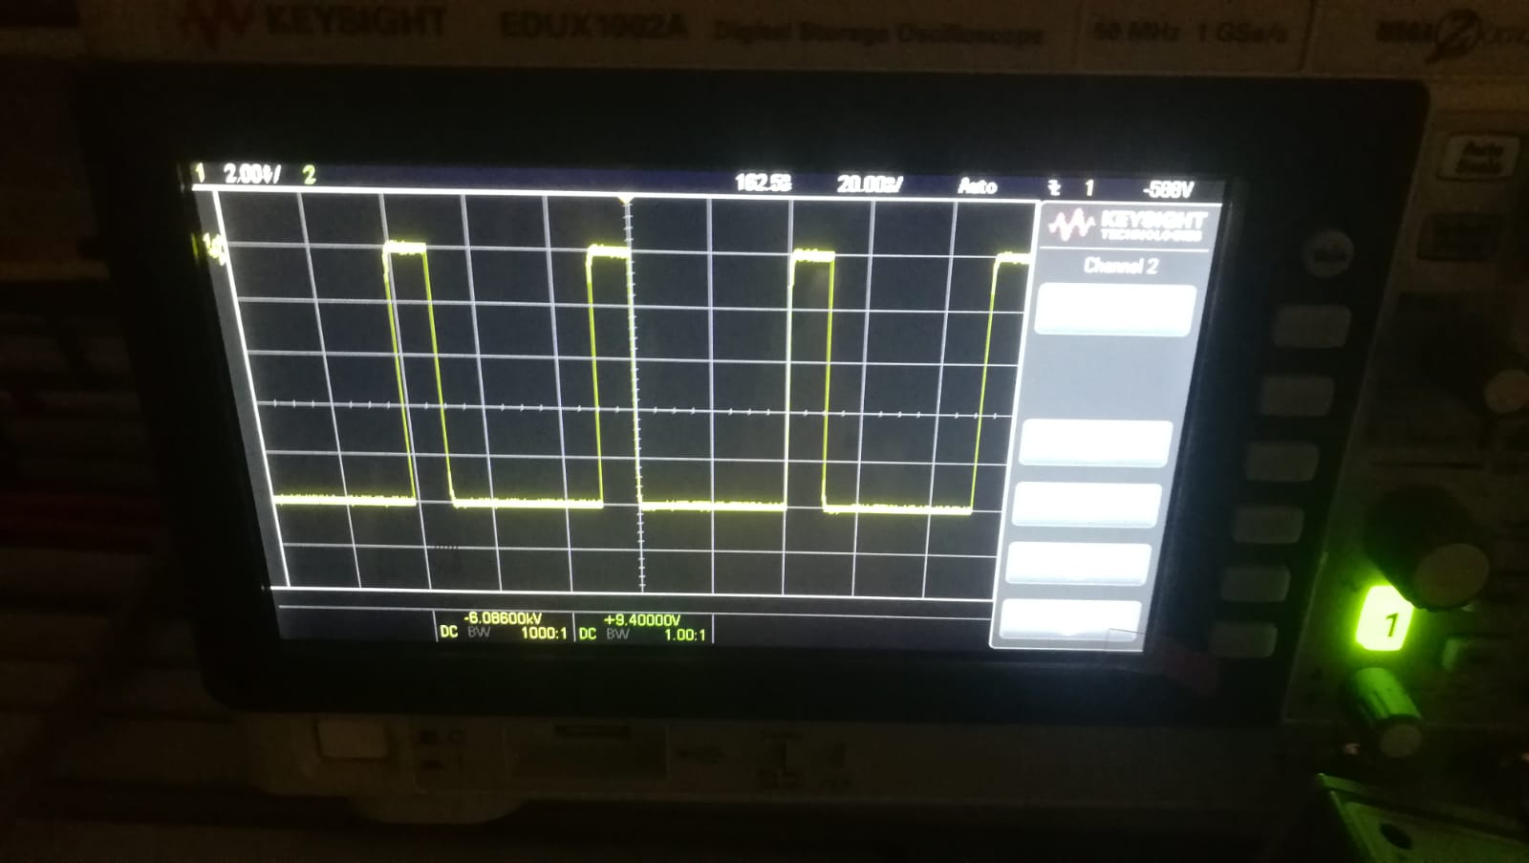
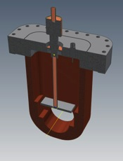
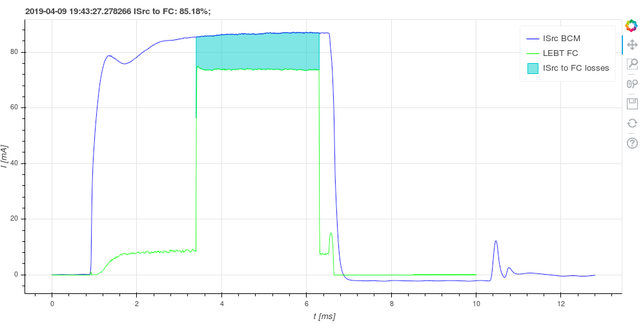
Issues: LEBT Chopper
Commissioning of the chopper started on March 5
Issues reaching the nominal voltage during testing

Slide 15
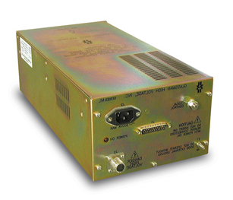

HV Switch
HTS 151-03 GSM Behlke
HVS module
20 meters
27Ω
27Ω
1nF
HV module
HV Power Supply
ML12N25 Glassman
RF 35
Caburn Feedthrough
TTL
Fast Beam Stop
Chopper Enable
Voltage Reference
Interface
V / I Monitor
Fast/Slow Alarm
Fault
Reshasped
LV module

Slide 16
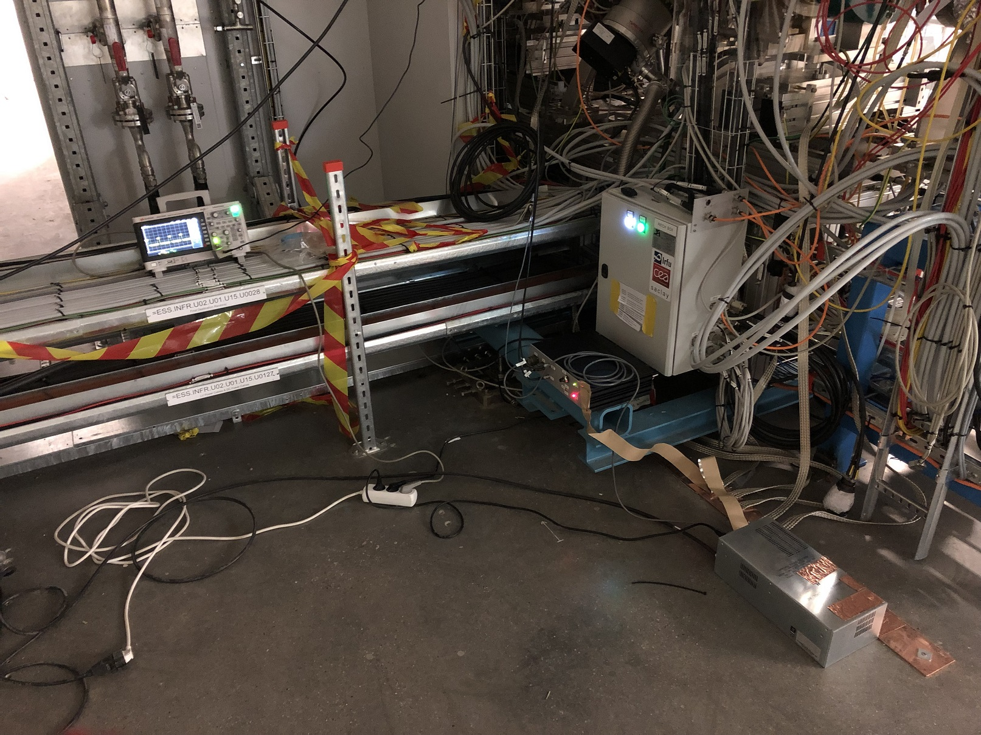
Chopper testing setup
Not enough power outlets in the tunnel!
Installation setup by IK-partner does not fit our reality and needs!

Slide 17
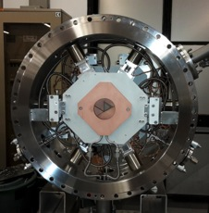
Issues: IRIS
IRIS could never be tested on site by IK or ESS
Need to transfer the controls standard from Geobrick to Beckhoff (EtherCAT)
Need to remove the IRIS for disassembly and debugging.

Slide 18

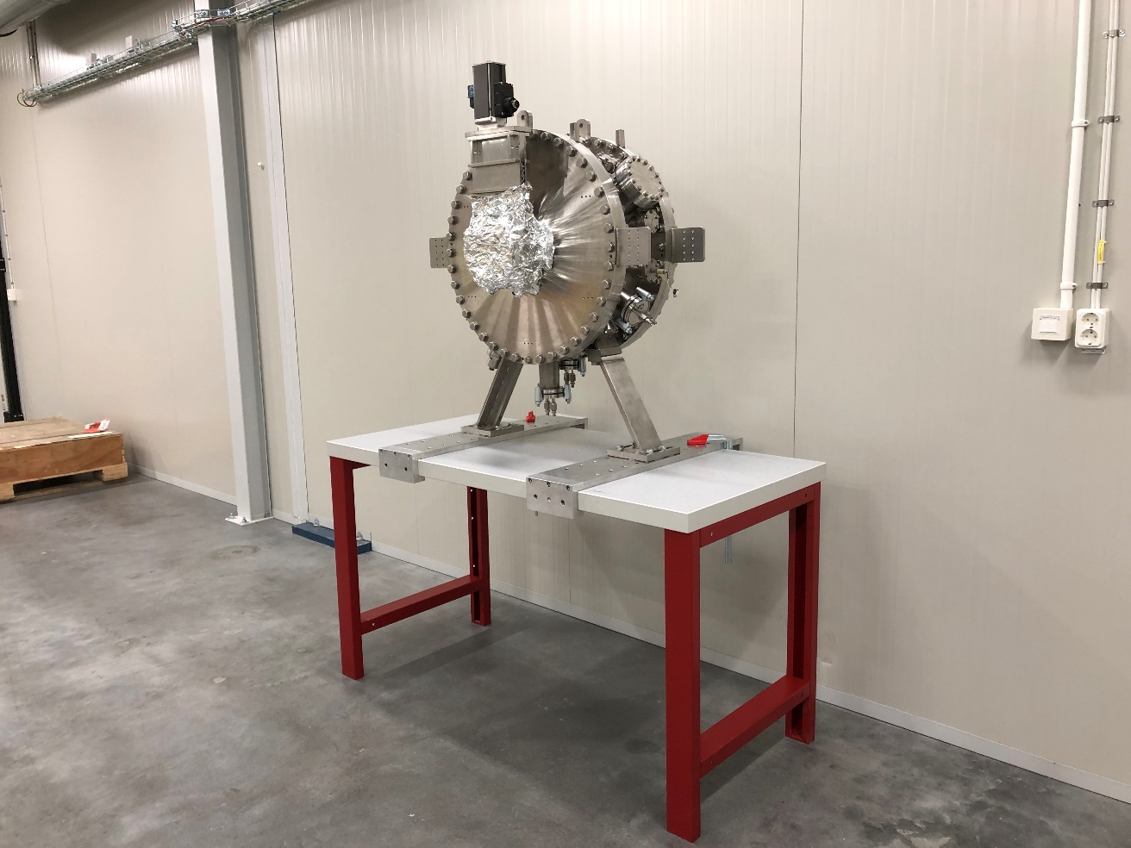
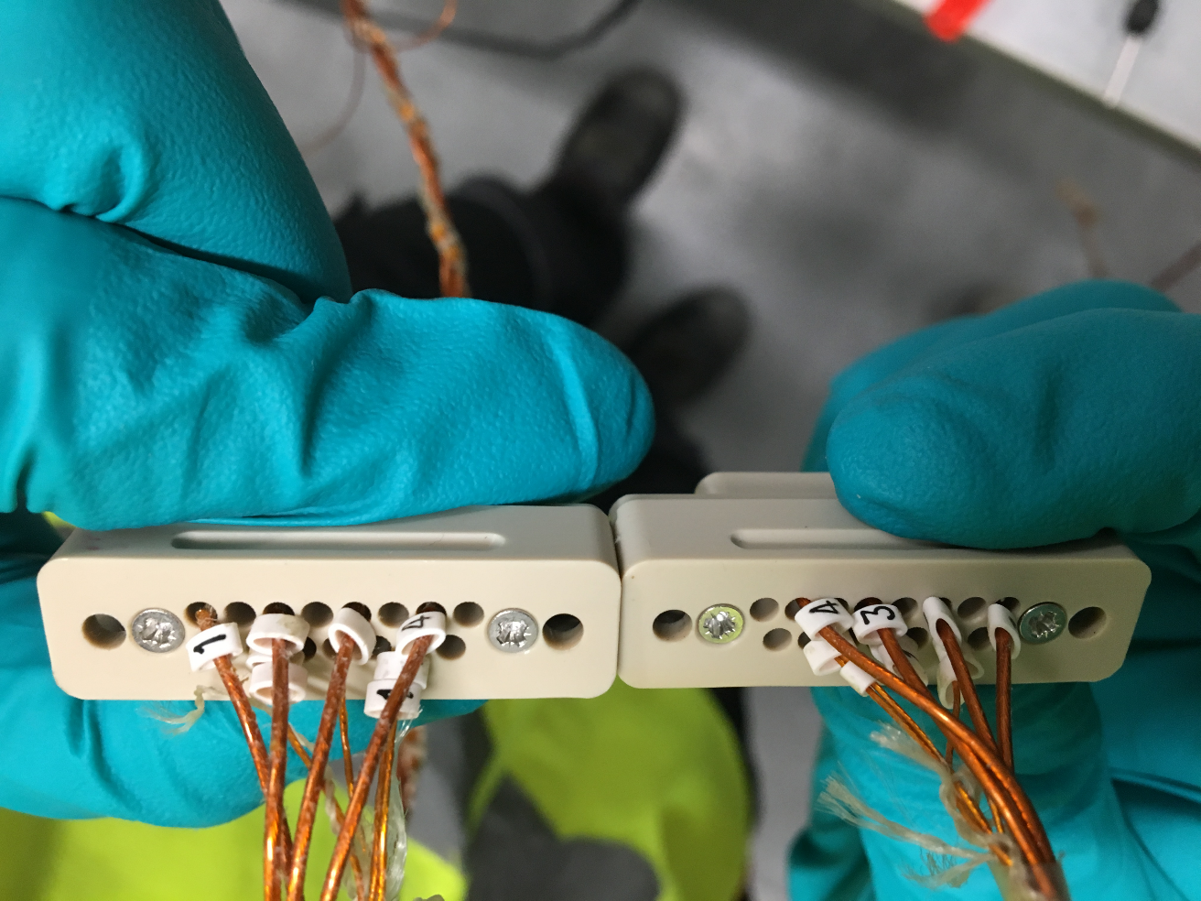
Issues: IRIS
Wrong pinout in connector #6
Some pins are crimped, some are soldered

Slide 19
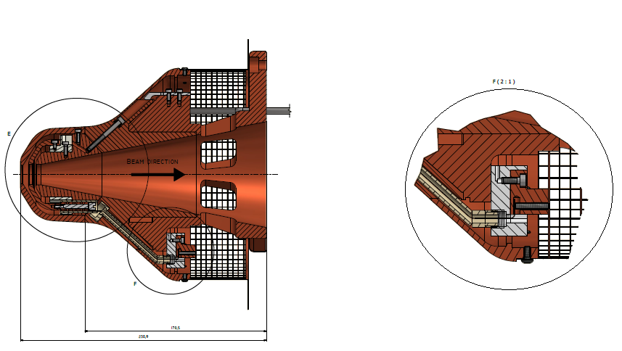
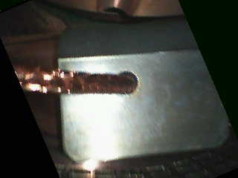
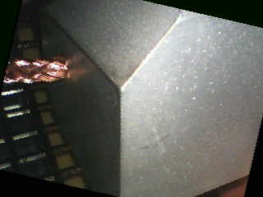
ISRC Repeller
Repeller failed due to a resistive connection
Surprise! Actual parts installed do not match drawings!

Slide 20
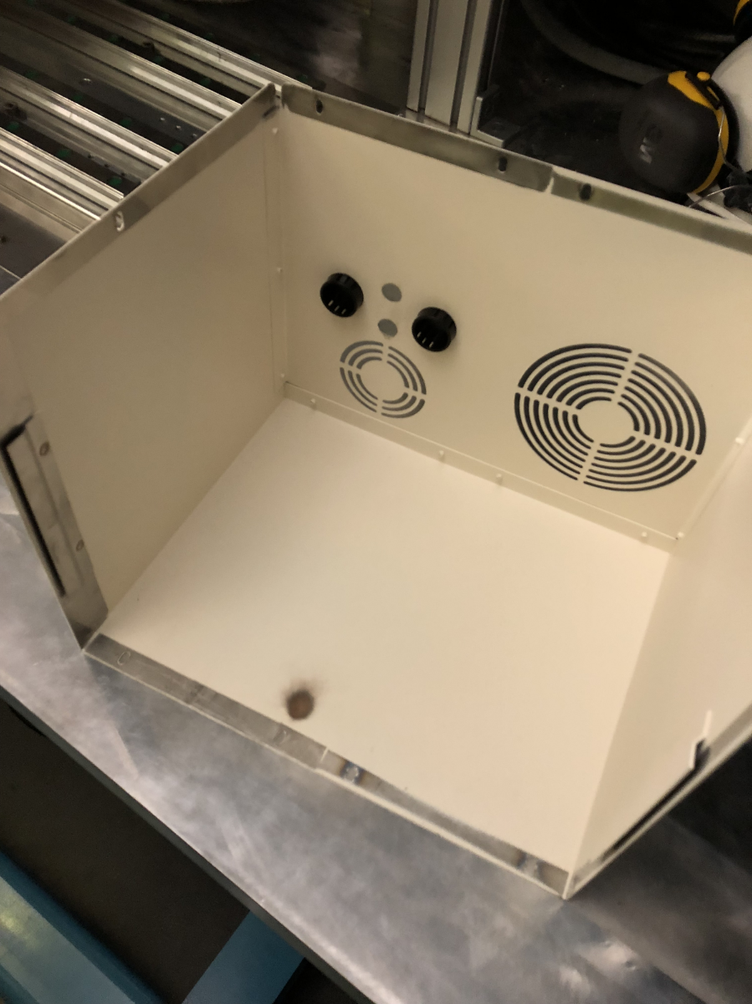
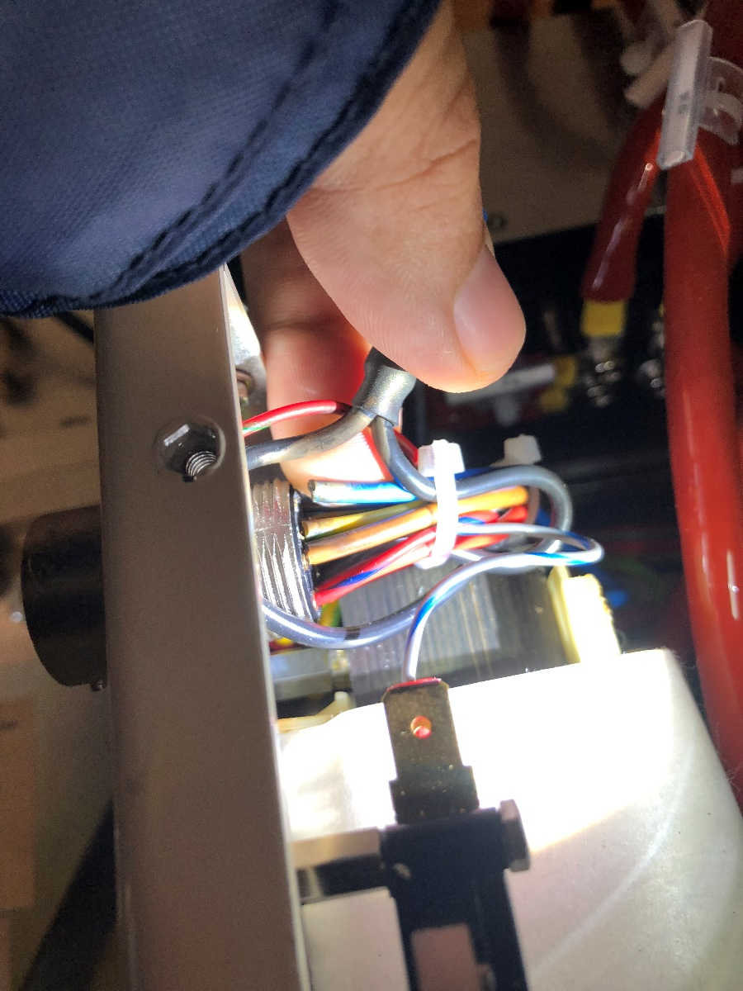
Magnetron issues
Fault: Over-voltage
Major operation just to access the issue: Traced to a burned cable

Slide 21
Conclusions
Extensive debugging and troubleshooting of all systems
This could be avoided by allocating sufficient time for local and integrated tests of each system
This had a significant impact on the time available for testing and commissioning of the ISRC & LEBT
Lack of spares

Slide 22
Top 3 Issues that we need to improve
 | Issue | Comments
1. | Compartmentalized nature of work at ESS | Should work together at one team, one machine.
2. | Excessive bureaucracy and volatile rules | Creates confusion and adds delay
3. | Lack a comprehensive acceptance test and review of components from IK-partners | Issues are known but accountability and IK-agreement follow-up still an issue

Slide 23
Thank you!
Questions?

Slide 24
BACKUP SLIDES

Slide 25
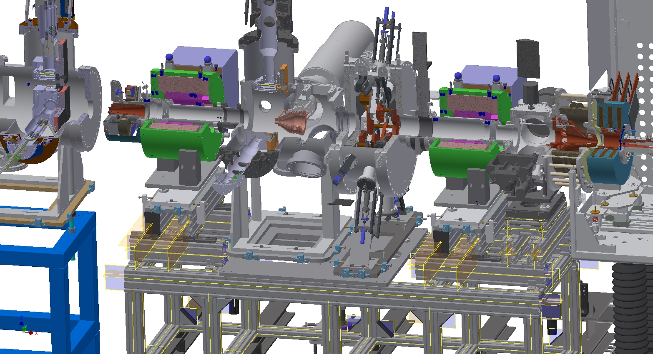
3D Model

Slide 26
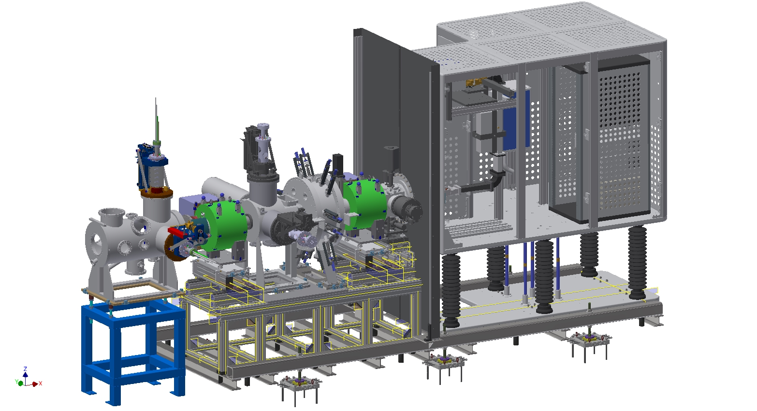
3D Model

Slide 27
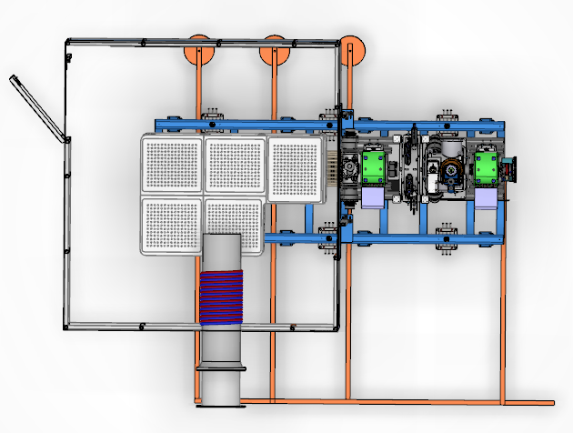
Top view of ISRC & LEBT
PSS0 Entry
Connection to grounding
mesh in the floor
Connection to
wall grounding
Ion source
water cooling

Slide 28
Ion Source + LEBT
Installation and Commissioning timeline
December 2017 – LEBT and source shipped from Catania to Lund
January 2018 to May 2018 – Installations in the tunnel
July 2018 – Safety Readiness Review
September 2018 – Start of commissioning
November 2018 to January 2019 – Sparks from the High Voltage cause damages to a few power supplies, new work with grounding required
February 2019 – Commissioning restarts
July 2019 – End of commissioning and start of RFQ installations

Slide 29
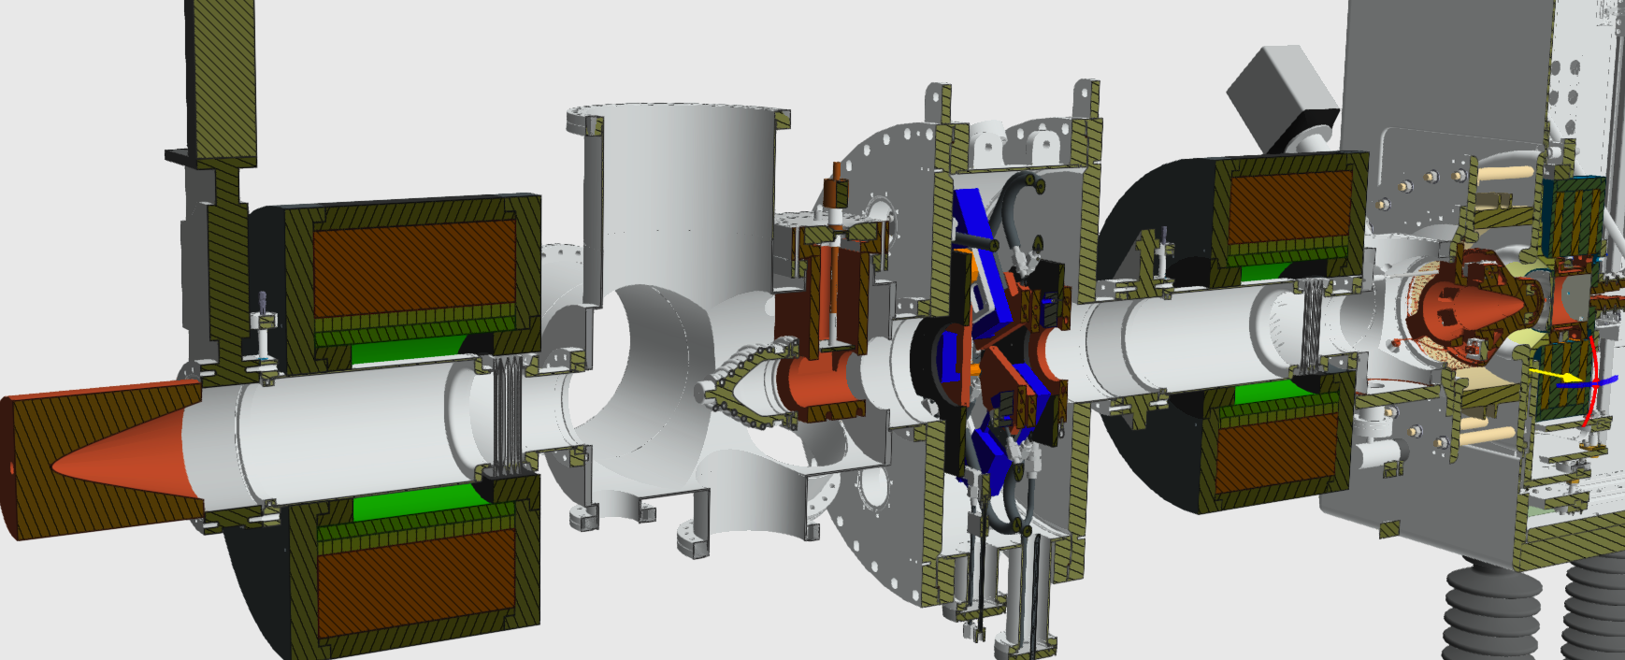
LEBT-RFQ lattice interface

Slide 30
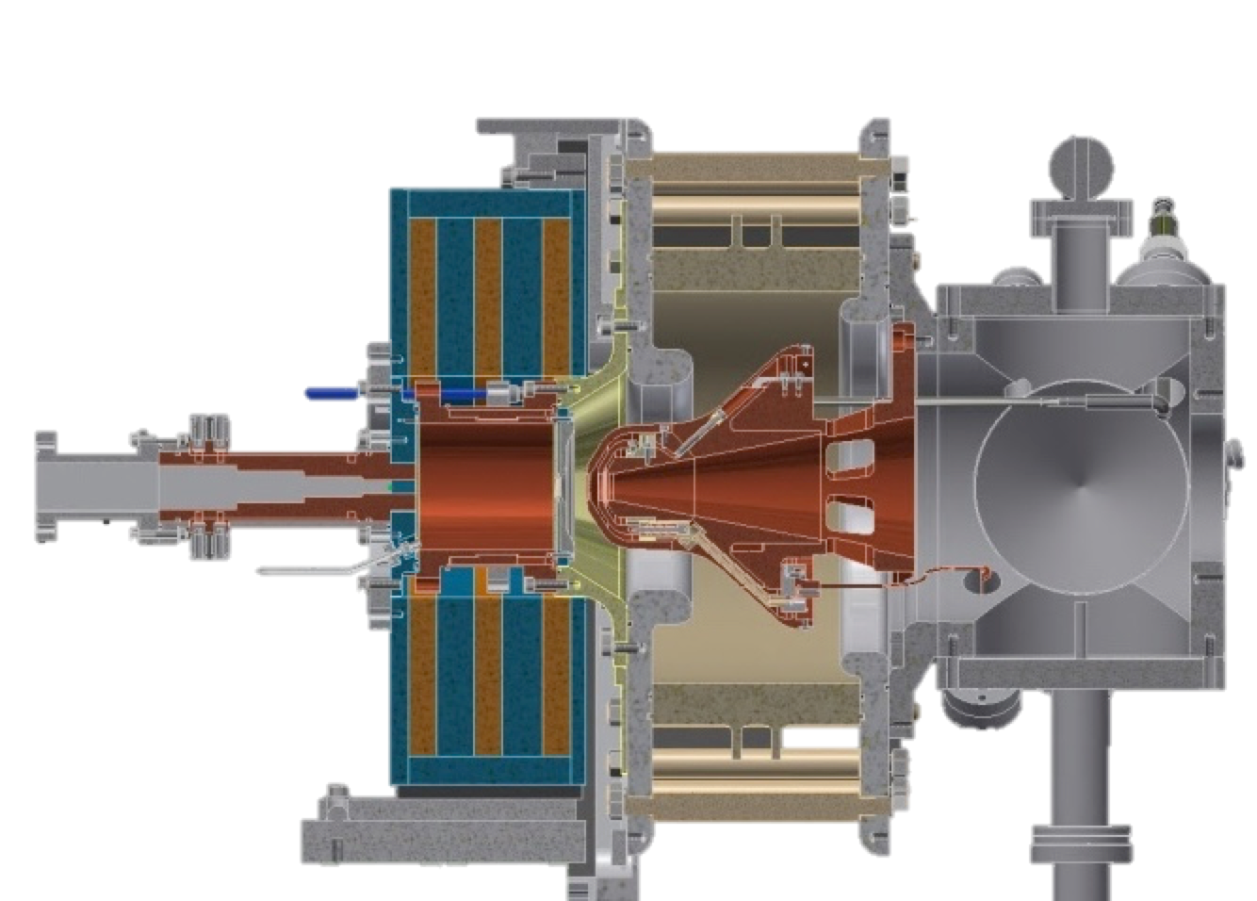
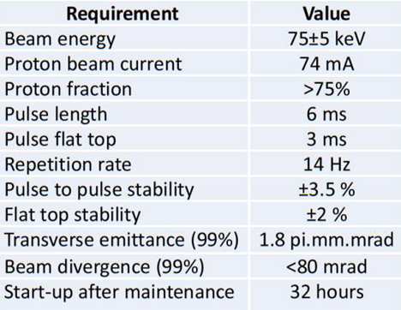
Ion Source
Microwave Discharge Ion Source (MDIS)
High voltage insulator
Extraction electrodes
Plasma chamber
Waveguide
Gas injection
Pumping ports
50 cm
3 Solenoids
30
Notes:
The Ion Source of ESS is a Microwave Discharge Ion Source. These sources produce high currents of singly charged ions with low emittance. A stepped matching transformer is used to allow smooth transition between the waveguide and plasma chamber impedances. An extraction system with a repeller electrode is employed to limit the back-streaming electrons. Microwave Discharge sources differ from ECR sources in the sense that they operate slightly off-resonance and the plasma is not completely confined by the magnetic field. Also, ECR sources have an additional hexapole field surrounding the plasma chamber to further confine the plasma and obtain ions of high charge states.

Slide 31
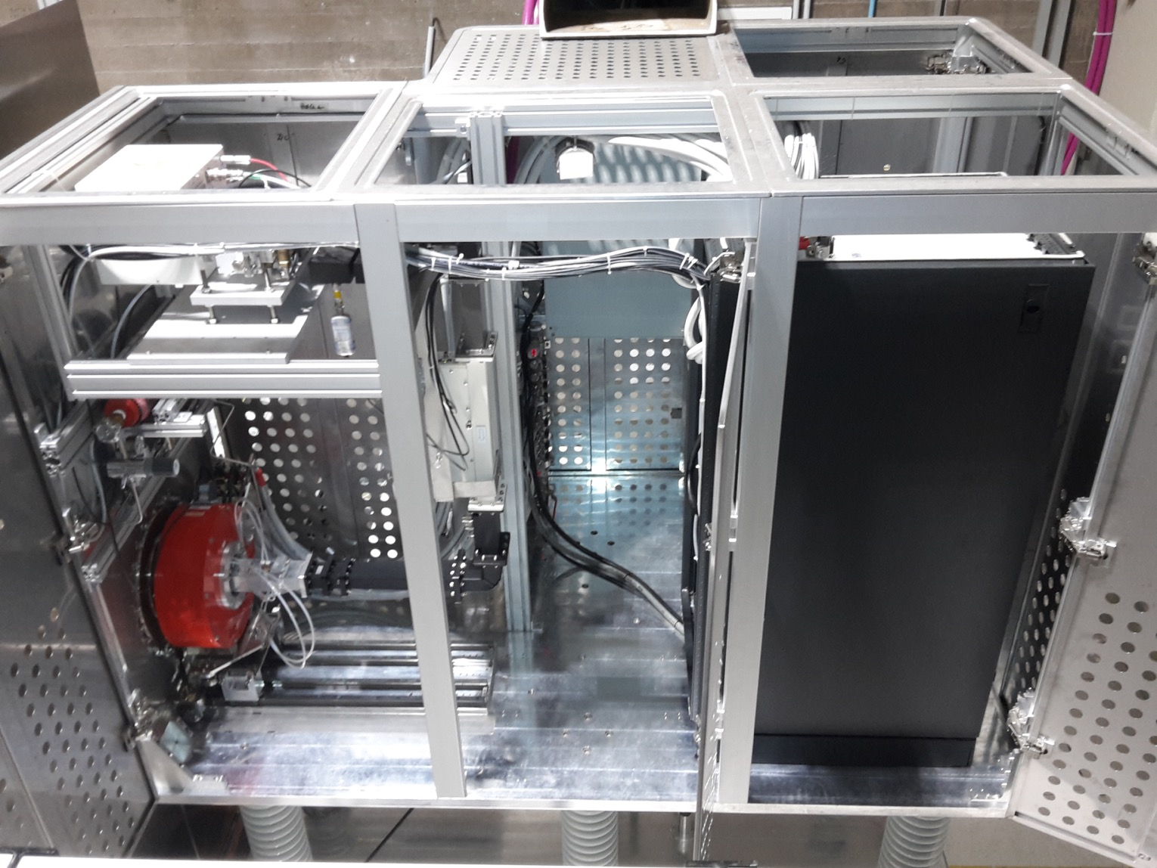
The ion source sits inside a 75 kV high voltage platform
Magnetron head
Electrical panel
Waveguide
Electronics rack
Ceramic insulators
3 Solenoids
Notes:
The ion source sits inside a high-voltage platform biased at 75 kV DC during operation. This setup provides the voltage difference to ground that allows the extraction of protons from the source plasma. In this picture you can see the HV platform with all its doors open and the ceiling panels removed. You can also see the high-voltage insulators, the electronics rack, the electrical panel, the magnetron head, the waveguide and the coils of the Ion source with the plasma chamber inside.

Slide 32
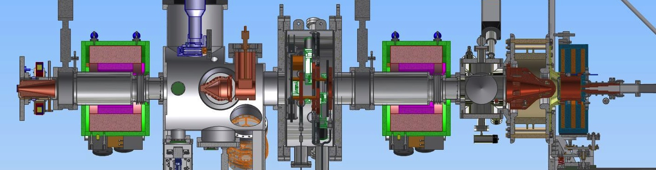
The Low Energy Beam Transport (LEBT) matches the beam to the RFQ input
Ion Source
– creates the H⁺ beam
Solenoid
– focuses the beam
Iris
– controls the current
Chopper and collimator
– controls the pulse length
Notes:
The LEBT matches the beam to the entrance of the RFQ. In the LEBT, immediately after the ion source and extraction electrodes, we have a small tank with vacuum ports for turbopumps, vacuum gauges and a Residual Gas Analyzer (RGA). We have two solenoids for beam focusing, the iris, which is a moveable aperture to control the beam current, and also a diagnostics tank where the Chopper is. The chopper discards the tails of the beam pulse into the collimator, just before the entrance of the RFQ.

Slide 33

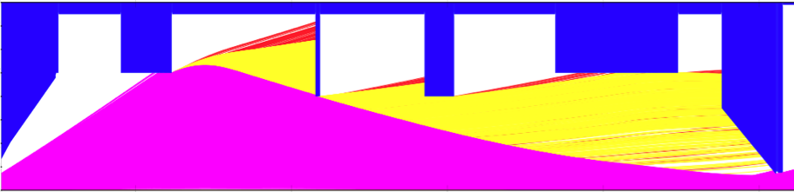
Using simulations, we can simulate the beam transport through the LEBT
H₂⁺
H₃⁺
H⁺
Notes:
Using IBSimu we can simulate the beam transport through the LEBT. Here we can see a very divergent beam scraping at the 1st solenoid, the blade of the IRIS, the chopper and then the 2nd solenoid, arriving to the collimator with a beam that has a very high proton ratio, while other species like H2+ and H3+ are left behind.

