Slide 1
Overall ISrc and LEBT Beam Commissioning Experiences
Ryoichi Miyamoto (AD/BPOD/BD)
Beam Commissioning Coordinator
2019-08-20
Lessons Learned from Testing and Commissioning of the Ion Source and LEBT

Slide 2
Disclaimers
After the beam commissioning, I have been going through logs and studies and trying to summarize:
Useful machine info
Machine performance
We are still analyzing data too.
I try to present these results in another forum but not today.
Today's focus is on how we worked and how we can improve. I focus to high-level subjects:
Planning
Administrative matters
Organizational matters
...

Slide 3
Planning and coordination - Positives
Dependencies among subsystems and tuning activities were well understood.
This helped replanning while many subsystems were not available.
We were very careful to avoid beam induced damages.
Participating the test in Catania (Sept 2017) was extremely helpful.

Slide 4
Planning and coordination - What could be improved
Jira plan got behind the reality.
The reality got hard to predict and so separated from the plan.
The plan was too straight-lined and too detailed, and hard to be fixed.
Coordination ended up in a short-term basis.
Too busy for other works.
Could have clarified better midterm goals, i.e., "What we're doing now.".
ISrc+LEBT is a special and the situation will be clearer in the following phases.
Should have spent more effort on supervising preparations of each activity.
Some critical activities, e.g., shielding verification, were well prepared.
Should formulate better for transferring expertise and transition to operations, with OP.
"Being careful" has limits in protecting components from the beam.
Could sort out how to use communication tools: jira, confluence, logbook, meetings, and etc.

Slide 5
Main massages for everyone - Positives
We managed most subsystems up and running and sustained beam time for ~2 months.
We convinced ourselves that we have enough expertise in house.
We could react against "situations", e.g., fixing subsystems.
We were not bad at improvising, e.g., developing a script on the fly, adjusting the team.
We accumulated a lot of experiences.

Slide 6
Main massages for everyone - What could be improved
We had a lot of situations and made too much improvising.
A lot of room for improvements in terms of preparation (but this is natural).
Mismatch in framework (theory) vs reality:
We should have paid much more attention to technical details of the machine during preparation.
Many details were missing or not good enough for "end users" (Beam Physics and Operations). Communication should be improved and they should be involved more during preparations.
Too much emphasis on established operations.
We should rather have a strategy to develop an operations team.
We should formulate how to transfer expertise of subsystems (hand-over).
As usual difference in opinions between management vs field.
Prioritization
Authorities

Slide 7
Timeline
Date | Event
2018-09-19 | Started beam commissioning and had 1st beam.
2018-10-02 | Started the source repeller repair and 1st round of EMC grounding work.
2018-11-28 | Solenoid 1 power supply damaged (one for Solenoid 2 switched to 1).
2018-12-11 | Extracted beam for ~2 min and damaged power supplies of 3 coils.
2018-12-12 | Started 2nd round of EMC grounding work.
2019-02-08 | Effectively started beam commissioning (with only solenoid 1).
2019-03-08 | Both solenoids became available.
2019-03-19 | Started to cover longer hours.
2019-04-05 | Chopper became available.
2019-04-25 | EMU became available.
2019-04-29 | Started the scheduled water pipe works for NC linac installation.
2019-06-11 | Started the extended period (back to normal hours).
2019-07-01 | Scheduled to start commissioning tank dismantling.

Slide 8
Original plan
For the following phases, I change the structure so that the plan can accommodate nested sequence better.

Slide 9
Planning: initial vs final configurations
ACCT
FC
EMU (H)
EMU (V)
NPM (H)
NPM (V)
Dpl
BCM
EMU (V)
NPM (H)
NPM (V)
FC
HV
Repeller
Chamber
Repeller
N₂ injection
Iris
Chopper
Collimator
Beam stop
Solenoid 1
(Steerer 1H)
(Steerer 1V)
Solenoid 2
(Steerer 2H)
(Steerer 2V)

Slide 10
Planning: initial vs final configurations
ACCT
FC
EMU (H)
EMU (V)
NPM (H)
NPM (V)
Dpl
BCM
EMU (V)
NPM (H)
NPM (V)
FC
HV
Repeller
Chamber
Repeller
N₂ injection
Iris
Chopper
Collimator
Beam stop
Solenoid 1
(Steerer 1H)
(Steerer 1V)
Solenoid 2
(Steerer 2H)
(Steerer 2V)

Slide 11
Hindsight views during the start-up
State of the machine was quite limited at the start-up.
We also spent very little time to get familiarized to interfaces in control room, even for the interlocks.
With no MPS, protection from a beam induced damage was up to physicists (and limited availability of subsystems made it hard).
To my view, beam physics should be involved to the decision making process of start-up, unless we predefine minimal conditions to start.
Could we get clarifications on responsibilities and authorities for this period?
Especially for those of the line-managers.
My personal idea is to have a committee to advice or approve major status changes of systems and subsystems and the line-managers are in it.

Slide 12
Technical issues and reviews
Long-known technical issues:
(EMC grounding?)
Solenoid field quality
Chopper design and polarity
Iris vacuum compatibility
Doppler limitation due to its location
None of these were clearly highlighted in IRR, TRR, nor SRR.
Even if we don't have resource to fix it, we need regular occasions to highlight an issue.
We should have a beam readiness review to highlight issues and check details of subsystems.
Preferably independent from SRR, since the focuses are very different. For example the chopper issue was removed from the presentation since it has no safety/protection function at this phase.
Pros and cons for internal and external.

Slide 13
Hand-over and subsystems states
"Usable": Experts besides the owner, e.g., beam physicists, know how to use the subsystem.
"Operational": Operators can use it (with minimal supports).
Testing is completed, including protection functions.
High-level controls (archiving, limits, alarms, configuration restoration, and etc) are set-up.
For a beam line device, set points are defined in save&restore.
For a diagnostics, required types of processed data are available.
For a diagnostics, allowed machine configurations are defined in save&restore.
Manual is available.
Operators go through through practical trainings.
...
To my view, most of beam line subsystem is not operational.
To my view, a subsystem can be handed over to operations, only after becoming operational in above sense.
We should provide a guidance to the system owner for the "high-level control" part. (Marc's new role?) We could also form a team in the transition period.
For the next beam commissioning phase, should we focus more to establish "operational" statuses of subsystems, including ISrc and LEBT ones?
Management could define high-level goals and priority.

Slide 14
Manpower
We didn't have enough people to clean-up issues in parallel to maintain the control room activities.
Some people had multiple roles in "vertical" direction.
Not only for hardware and controls, follow-ups of beam studies and data analyses are also still ongoing.
The situation remains similar in the next phase.
We should carefully assess how we maintain multiple shifts in the following phases. (Do we have an analysis of how we did in late March and April?)

Slide 15
Trying to map functions to roles. - Should we modify the structure a little?
Linac configuration committee?
Approve or advice transitions of states of systems and subsystems.
SRR vs ARR. This committee could own ARR.
=> Line-mangers of stakeholders?
ITC manager
Ciprian => Ciprian
Beam commissioning coordinator
Ryoichi
Control room coordinator
Supervise infra and software.
Supervise high-level integrations of subsystems.
=> Marc
Run coordinator?
Day-to-day coordination, especially between an intervention and beam time, i.e., "chasing people".
Run daily meetings.
Could be a short term, 1 week to 1 month.
Alex, Marc, Ryoichi => Ciprian? Rotate in AD? BPOD?
Shift leader
"Operator"
Acquiring expertise of subsystems.
Co-develop manuals.
Support beam time.
Alex, Marc, Ryoichi, shift leaders (to some extent), Natalia for NPM => Enough new shift leaders and operators?
System experts
Linac, BD
Studier
BP

Slide 16
Diagnostics status (1)
Common
All types of diagnostics, except for Dpl, were usable and provided good quality signals for characterizations.
One remaining issue is the discrepancy of the LEBT BCM and commissioning tank FC.
High-level Control part should be cleaned-up.
Need to think how to manage large unarchived data of Dpl, NPM, and EMU.
FC
Not far from the operational state.
Implementation of region of interest was not what we wanted.
No PV for the decimated signal.
BCM
PVs for processed parameters, such as average and min/max in a region of interest, won't be available for the next phase.
The average ISrc current is by far the most important PV, which tags the ISrc setting. The points of FC and BCM highlight importance of regular communication on user requirements in detail.

Slide 17
Diagnostics status (2)
NPM
Required to be configured tens of times, causing to lose multiple shifts in total.
Should save more PVs related to conversions to physical units.
EMU
PV names should be cleaned up.
Timing should be checked.
The whole chain is extremely manual.
One OPI for motor and HV.
Another OPI for setting up a scan and display the raw image.
Save more than 10-20 PVs via a jupyter script.
Another script for post-process.
The OPI has a button to save data to an ascii file, but the region of interest wasn't taken into account for this function.
All data from Catania has this issue.
Dpl
Cyrille managed to took some data, but the device even didn't have a chance to be used by physicists.
Has a design issue of looking at the RFQ side.

Slide 18
Example of framework and ownership issue - PV names
PVs | Descriptions
ISrc-010:ISS-Magtr:ForwdPwrS ISrc-010:ISS-Magtr:PulsHLvlS | Magnetron forward power when triggered internally for conditioning Magnetron forward power
LEBT-010:Vac-VGC-30000:PrsR ISrc-010:Vac-VVMC-01100:FlwSPS | Vacuum pressure level in Permanent Tank H2 flow rate
LEBT-010:PBI-FC-001:AMC31-AOI11-SizeR LEBT-010:PBI-FC-001:MCU08-PositionR | Size of region of interest in bits, after decimation Status IN vs OUT
ISrc-010:PBI-BCM-001:AI4 ISrc-010:PBI-BCM-001:AI4-ArrayData ISrc-010:PBI-BCM-001:AI4-IPCH-RBV | Raw pulse waveform Decimated pulse waveform Integrated charge per pulse
LEBT-010:PBI-NPM-002:VCAM-COM LEBT-010:PBI-NPM-002:VCAM-BSZ | Vertical position from a NPM of Permanent Tank Vertical RMS size from a NPM of Permanent Tank
LNS-ISRC-010:PBI-EMH-FC:CurrR LEBT-010:PBI-EMU-002:Mtr.RBV LEBT-010:PBI-EMU-001:Mtr.RBV LNS-ISRC-010:PBI-EMH:PS.NPTS | Raw pulse waveform from EMUH-FC EMUH motor position EMUV motor position Number of angle scan steps of EMUH
Either guideline or horizontal communication seems lacking.
Could OP and BP be a stakeholder of high-level PVs?

Slide 19
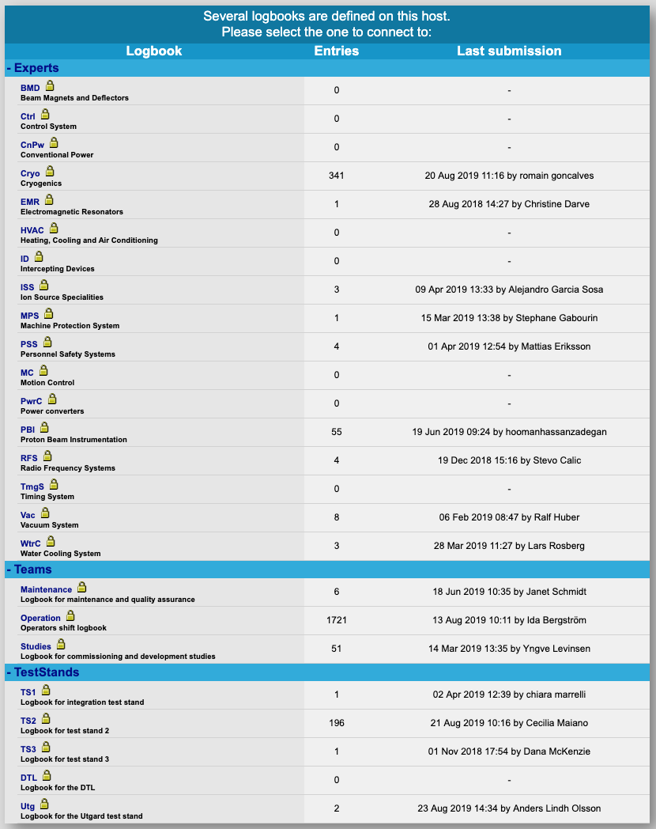
Framework vs user requirement issue - Logbook
Only OP, Cryo, and TS2 have more than 100 entries, followed by BD with 55 entries.
Similar situation with the CSS folder structure.
All OPIs are in the temporary "Non-approved" folder.

Slide 20
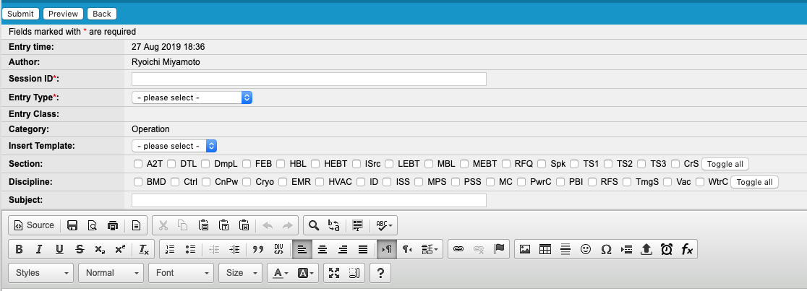
Framework vs user requirement issue - Logbook (2)
In addition, we can also tag with sections and disciplines.

Slide 21
Other misc software issues
What I open on the main console when starting the ISrc:
OPI
ISrc
LEBT
Interlock
BCM
Browser
Magnetron forward power
Magnetron reflected power
Jupyter
PV saver
PV viewer (for current waveforms)
Logbook
Confluence
Remote desktop (almost background)
RGA
What I open on another console, because they are too heavy:
OPI
FC
NPM
(Save&restore)
Issues with 14 Hz
FC OPI too heavy.
Enormous lag in NPM image display.
Need to tackle from both sides of checking the infra and making the signals more efficient.
Each OPI window is too large.
Lack of communication and approval process between the user and developer.
This demonstrates we need some clean-ups of "platforms" and also somewhat formulated training.
Save&restore
Too heavy to use on the main console.
CSS "perspective" very confusing and caused a lot of wasted time.
Structure was hard to understand (simply due to my lack of knowledge of git?)
Like logbook, this was also temporary. We need to come back the requirements.
I propose to use it as a part of handing-over process and thus to introduce some administrative control.

Slide 22
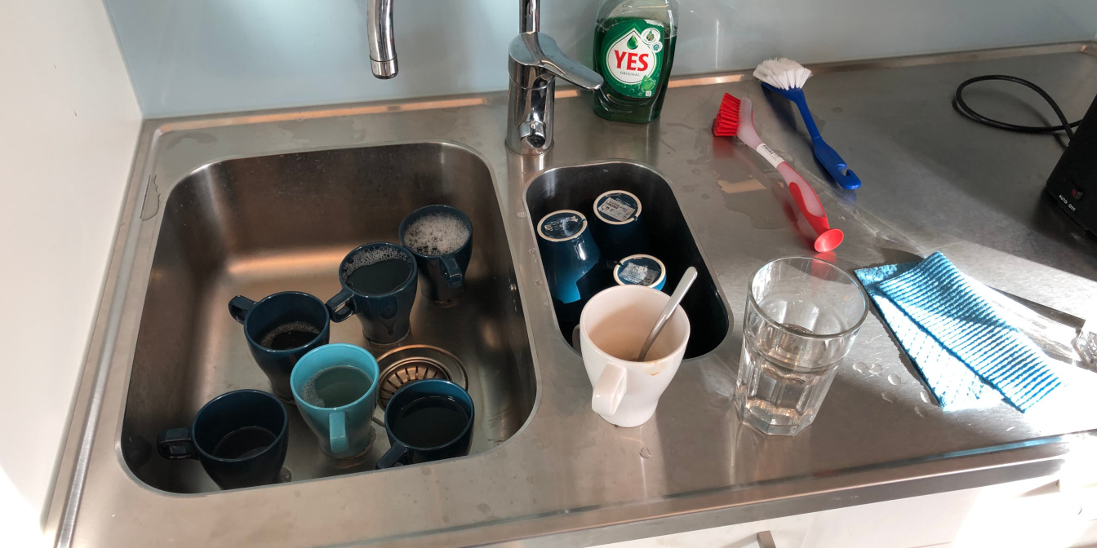
Environment and discipline in LCR
The room was dusty, toilets were not often clean, and there was a report on smell.
It happened several times that a work affecting the machine, controls, and or control room is conducted with no communication to LCR.
Having no children, I enjoyed to feel like being a "father" and cleaning a dozen cups everyday.
It happened many many times that people left a console with an active session and windows open. There was once an unattended terminal logged into an IOC.
BD console is the champion for this.
Should we introduce a training for accessing the control room?

Slide 23
Obsolete

Slide 24
ISrc and LEBT subsystems
Solenoids
Indication or larger tilt and false nonlinearity in field vs current reality. And, no follow-up and no mentioning on this in any reviews.
Solenoid polarities were not defined (thus not known). We did field measurements and found Bz < 0, which were later verified with beam based measurement.
Steerers
Measurement only at the highest current.
Bipolar power supply not reliable.
Response was so slow to prevent scanning.
Iris: We never managed to make it work.
LEBT repeller: It was available only in Sept, 2018. Due to focuses on short-terms we didn't fixed it but later realized its importance for the LEBT output current measurement with a BCM.
This was the only major regret in terms of coordination.
Initial divergence error
Not clear whether we can use the permanent tank diagnostics in the next phase, due the layout issue.

Slide 25
Tentative categories for ISrc-LEBT lessons learned
Status and issues (technical), applies to
Subsystems
Integrations
Software
Performance (beam physics)
Operation and control room (environment)
Preparations and executions (technical), applies to
Subsystems
Integrations
Software
Performance (beam physics)
Operation and control room (environment)
Interface issues
Whatever issues related to interfaces
Planning/coordination
Issues related to the coordination and planning
Meetings
Planner/coordinator should check how their plan/coordination went
Administration matters
Paper works (work order, ...)
Documentation
Handover
Reviews
Organizational matters
Resource and manpower
Prioritization
Roles, responsibilities, and authorities

Slide 26
Beam commissioning prerequisites and mandates - An idea for revisions
Old prerequisites and mandates
All subsystems are hardware commissioned and handed over to operations before beam commissioning.
Beam commissioning includes verifications of subsystems with beam.
Beam commissioning aims to optimize beam parameters.
Beam commissioning checks operational properties of the machine, e.g., recovery time, stability, and etc.
New prerequisites and mandates
Subset of subsystems are hardware commissioned and handed over to operations before beam commissioning.
The minimum required subset should be agreed among stakeholders.
Hardware commissioning continues in parallel to beam commissioning.
Beam commissioning includes verifications of subsystems with beam.
Beam commissioning aims to optimize beam parameters.
Beam commissioning not only checks operational properties of the machine but includes thorough handing over of subsystems.

