Slide 1
Lessons Learned: Software and Machine Studies, AD perspective
Natalia Milas (BP)
Lessons Learned from Testing and Commissioning of The Ion Source and LEBT
28.08.2019

Slide 2
Software – Part 1

Slide 3
Background info:
Specialized software (Phase Scan, Trajectory correction, Matching, etc) is under the Beam Physics Section responsibilities.
Operator screens, motion control, display screes are NOT under our scope but we do use it a lot.
Specialized Software: OpenXAL (Java based library for GUI, Applications and Services)
EPICS is the connection we use to talk to the machine and OpenXAL uses it as well
For the Applications to be successful there is a direct link to how well the machine is working and performing (Diagnostics in place and working, network, etc)

Slide 4
What did we have for the LEBT Commissioning
Lattice file for the LEBT with the main EPICS channels and diagnostics
A launcher (from SNS)
A configurator APP (to set the lattice file and some other common variables for OpenXAL)
A Scanner App (multi dimensional App, functional boundary conditions)
A LEBT viewer App (Access to main equipment from the LEBT, live model and comparison to diagnostics readings)
Services:
  Direct connection from the App to the LogBook allowed to create an entry from with multiple figures and text.
  Direct connection to a confluence page with a basics “user guide” to for each App.
Almost all the time the only people using the
App was the developer only

Slide 5
Problems we faced
No time for Application debug previous to commissioning, GUI and code bugs had to be fixed on-the-fly and multiple times in the LCR during commissioning.
The Java interface and GUI (and the fact that myself and Yngve are not Java born developers) made the addition of features requested or the bug fixing work slow.
OpenXAL was one huge big blob (core, services , apps). Once a bug was fixed or a new featured added we had to make a full release of the code, the ask Benjamin to install in the workstations and notify Operations about it.
Diagnostics were not ready or reported “wrong readings” rendering some apps not that useful.
People developing the GUIs were also commissioning the machine. No dedicated developer was available full time.
No clear way to save data: format and storage place. No easy was to retrieve it as well.
Timing issues (timestamps, getting data from the same pulse)
Scripts took over the commissioning

Slide 6
How to move forward (from our side)
GUI vs Scripts: for the commissioning phase we decided to start with scripts
  Fast
  Easier to get ready
  Simpler to modify/add features/fix bugs
  Commissioning and development are easier to do at the same time
Once a script is well established and there is the need (and time) -> move to a dedicated GUI
  We start with a fully developed script
  App developed interleaved between commissioning periods
  We would like here to request some Java support in order for us to structure better the Java code. Someone that could either help us write and structure and/or review the logic.
We (Juan) separated the release of OpenXAL core and the applications making updates a lot easier and simpler. We still have some protocol to follow before releasing.

Slide 7
Analysis
 | Issue | Comments
1. | Organizational (Lack of manpower) | Same people developing the code heavily involved in commissioning
2. | Preparations | No time, before commissioning, to test with equipment (connection, units) also no debugging time
3. | Planning | There was a disconnection between when Software and instrumentation were ready

Slide 8
Machine Studies – Part 2

Slide 9
Example: Corrector scan and model comparison
Machine Study Planning:
  Work to be performed:
    Move corrector setting from -20 A to +20 A and difference solenoid settings
    Observe centroid motion on the NPMs (depending which correctors we scan)
    Compare the result with the model
  Why do this:
    Understand the machine
    Validate the model
    Validate instrumentation

Slide 10
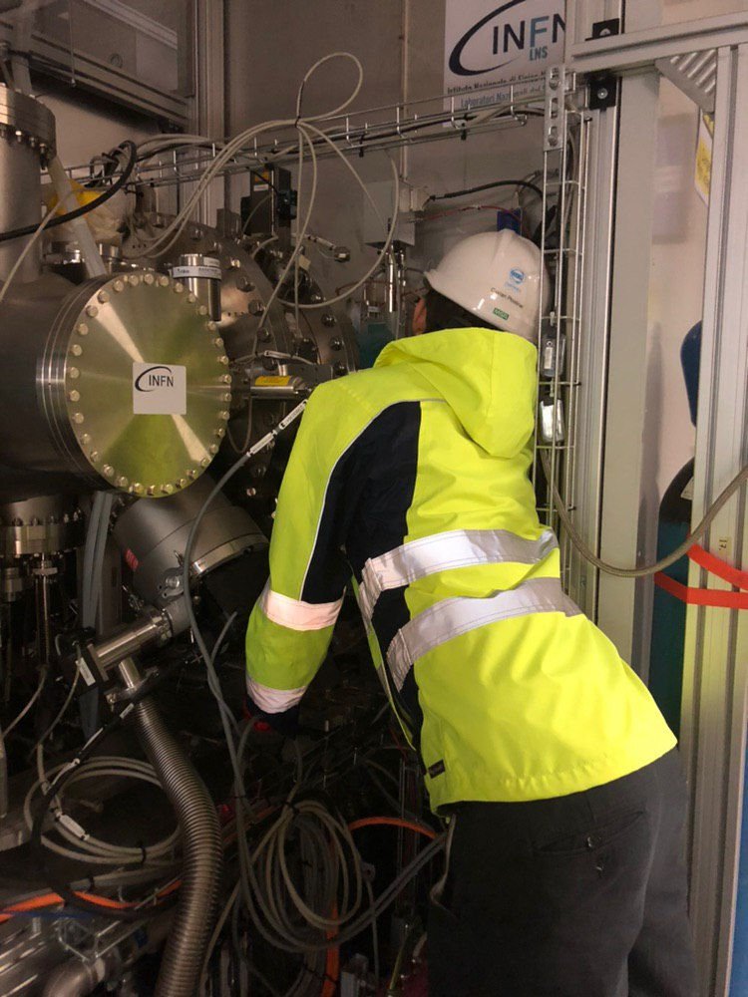
Issues
Magnet Polarity/Conversion:
  Commissioning officially started in February 8th -> Polarity checks ran throughout until end of April (2 solenoids and 2 pairs of correctors)
  There was no clear definition of which polarity to use for the solenoids
  No indication of correct polarity on the equipment
  Solenoid polarity was very hard to measure once installed and correctors polarity was inconclusive.
  For the correctors we have one single measurement of the field at 120 A (max of the power supply) but we continuously operate around 10-15 A
Preparations and Execution
What happens when physicist are desperate

Slide 11
Issues
Diagnostics:
  Main elements for the measurements: NPMs and BCMs
  NPM horizontal reading still with wrong polarity.
  NPM setup, before every measurement was quite lengthy and very often we did it wrong or could not get it going
  PV with super complicated names which are very often used.
    LEBT-010:PBI-BCM-001:AI5-IPCH-RBV : current waveform in the BCM
    LEBT-010:PBI-NPM-001:HCAM-COM: NPM1, horizontal centroid position (from fit), scalar
    LEBT-010:PBI-NPM-002:VCAM-BSZ: NPM1, vertical bema size (from fit), scalar
Preparations and Execution
Organisational

Slide 12
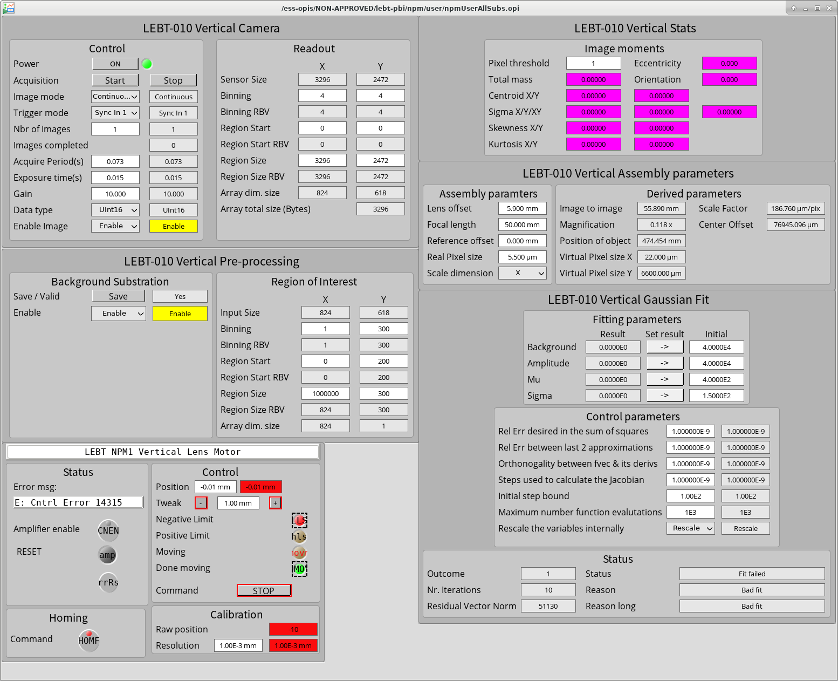
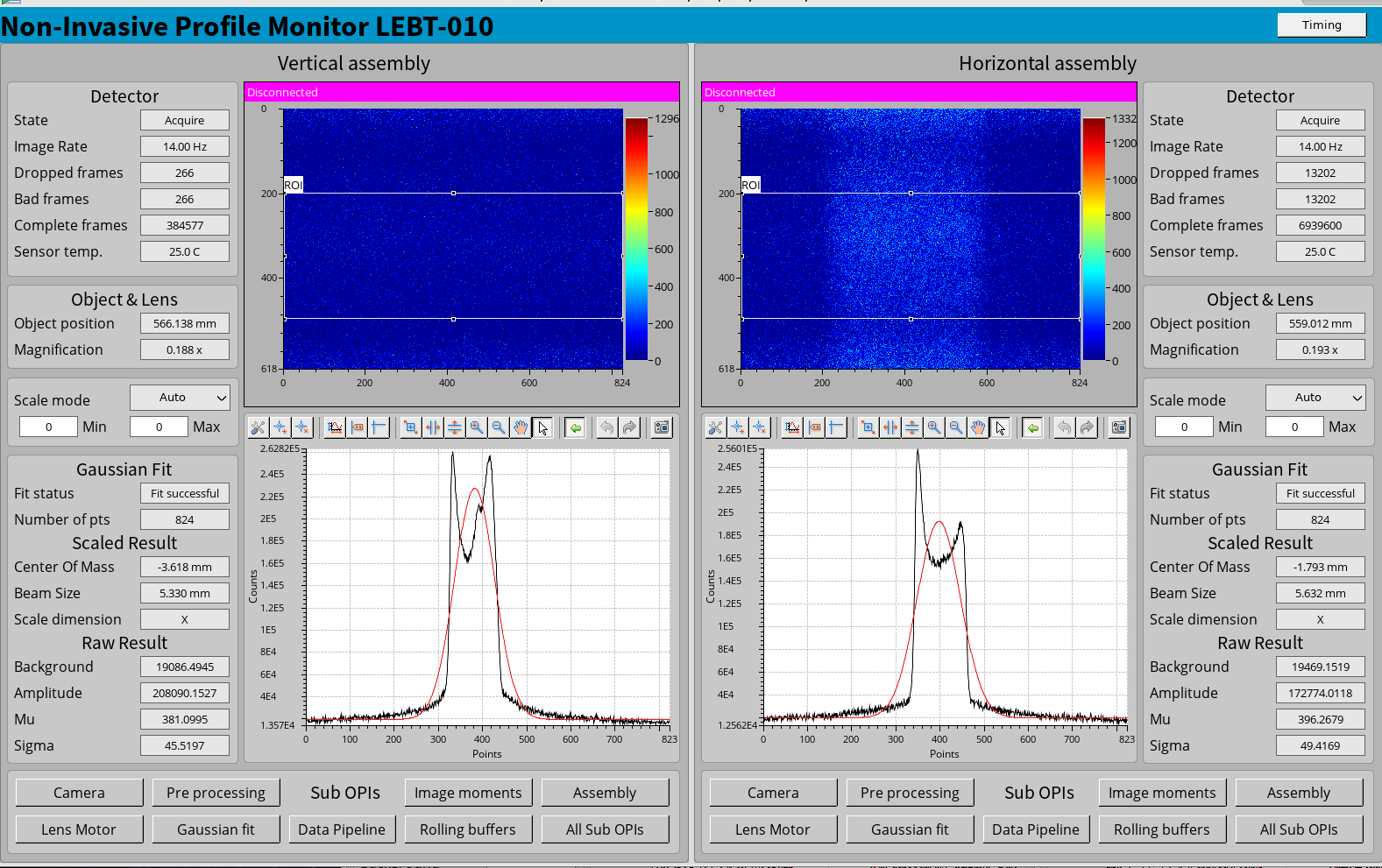
Another bunch of windows to check for
Binning and Background Subtraction

Slide 13
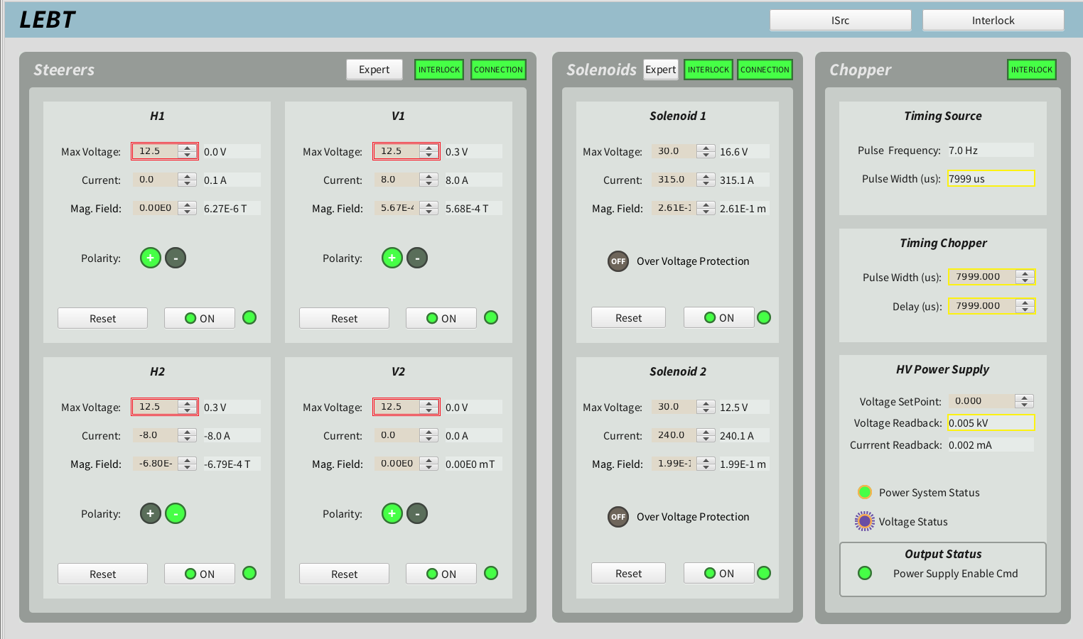
Issues
Software/Control
  Lots of PVS with wrong names at start (quite some work to redo the names)
  Lots of PVS that are not configured correctly (connected to Archiver issues)
  Correctors have an unipolar power supply -> made correctors scan painful and awfully lengthy
  Patch: sequence in EPICS to switch polarity -> still slow (since it the bottleneck was hardware) but a bit better
  At start we only had current PV -> Add filed PV with the correct calibration
  As for many other elements in the machine: screens have way more information or controls than needed -> you have to set max Voltage and then current in the correctors.
  In particular for the correctors: save a restore usually did not bring them back (partially because of the slow response)
  Difficulties with our Scanner Application -> outsourced scans to scripts
Preparations and Execution
Organisational
Planning and Coordination

Slide 14
What worked
The dynamics between ICS, Beam Dynamics, diagnostics and Linac groups was quite nice.
Fast fixes and patches (for the correctors control for example)
Support was always available
Interfaces
  One of the things that worked really well during commissioning for this example case

Slide 15
What can we do for the next phase
Magnets:
  Check polarity in advance
  Beam Physics should get more involved in some aspects
  Go into more details what is coming from the IK, maybe request extra measurements if time is still available
  Check with the IK partners while disassembly or assembly here at ESS that cable for magnets has correct polarity marks
  Have equipment at had for polarity checks (gaussmeter for example, maybe more?)
Diagnostics:
  Check in advance the conventions for axis direction for ESS (right-hand rule) and have diagnostics to respect those
  Have a self config routine/file
  Have a dedicated time for diagnostics commissioning
Controls/Software
  Simplified operation controls
  Scripts over fully functional GUIs for commissioning

Slide 16
Analysis
 | Issue | Comments
1. | Preparation and Execution | Obstacles and unanticipated circunstances
2. | Planning and coordination | Communication
3. | Organizational | Prioritization

Slide 17
Open Issues
Data saving:
  Storage (NextCloud was a solution for now but, should we keep it?)
  Formats (HDF5 should be enforced? Common header for all saved data to allow future search/reatrieval?)
  Data retrieval (how? At which level? Who should be involved?)
Diagnostics integration:
  We need a dedicated time for diagnostics debug and tests
  Review how this data is saved ( issues with PVs not being saved, or saved at wrong intervals, etc)
Data in general
  Wrong data stored (solenoids and corrects with wrong polarity, positions with wrong sign)
  Archiver cannot support big waveforms
EPICS:
  PVs ownership
  PV correct definitions -> impacs how PV is archived, alarms, etc.
Timing:
  Lots of PVs with wrong timestamp at start
  EPICS doesn’t make it easy to get data synchronously
  How to get easily request data from the same pulse?
OpenXAL
  Java coding support

Slide 18
Thanks!
Questions?

