Slide 1
Lessons learned from the Ion source and LEBT Test stand commissioning: PSS0
Stuart Birch
On behalf of Protection Systems Group
Lessons Learned
2019-08-28

Slide 2
Contents
Lessons learned
Positives
Negatives
Conclusions

Slide 3
PSS0
First Personnel Safety System at ESS.
The Ion Source and LEBT was not in the original scope of the protection systems group.
The purpose of PSS0 was primarily to restrict access to the PSS0 controlled areas during operation and to ensure that personnel where protected from being harmed by exposure to high voltage during access

Slide 4
Lessons learned (positives)
The PSG team delivered a well structured set of personnel safety system documentation.
Excellent system delivery
Design,
Installation,
Verification and commissioning

Slide 5
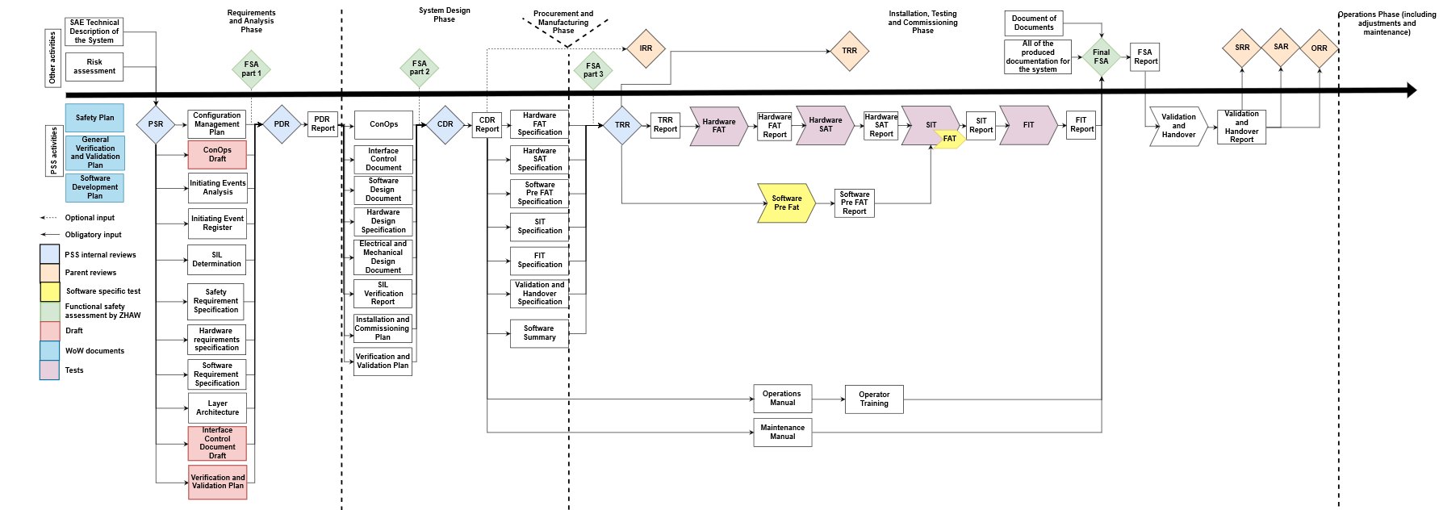
Documentation/ Development Flow

Slide 6
Lessons learned – Negatives - Documentation
PSS0 Documentation:
To produce documents for a PSS system takes a large amount of time and resource. It was the first PSS at ESS and we underestimated the true impact of producing documents.
Document approval too many reviewers and approvers so it took considerable time to get documents finally approved
We spent too much time revising the documents and changing after comments from reviewers.

Slide 7
Lessons learned – Negatives - Analysis
PSS0 Analysis
At the start of the process there was a lack of hazard and risk assessment information. So it was difficult to obtain a real set of PSS0 overall safety requirements.
This was addressed very late during the Ion Source and LEBT design process
It is really important that the hazard and risk assessments are carried out as early as possible!!

Slide 8
Lessons learned – Negatives – Design and Installation
PSS0 Design
Hardware no real issues.
Software planning and design and simulation took longer than anticipated.
PSS0 Installation
Installation was slow. Required improved communication and planning with CF and AD stakeholders
in PSS0 case, late delivery of mains power and Safety fence cost the PSS team a considerable amount of installation downtime.

Slide 9
Lessons learned – Negatives - Verification
PSS0 Verification and Validation
Cyber security and software management.
Lacked information on how we introduce new software and firmware to the systems.
Interface devices.
The PSG team felt that the systems that we interfaced with had not been fully commissioned or commissioning had been rushed, HV power supply etc etc. Final integration tests were delayed. This leads to partial PSS commissioning.
Procedures
Ensure that all stakeholder operational procedure documentation is completed and approved well before operation starts. (key handling, alarm handling, system re-set etc. etc.)
SRR
ESS as a facility was not ready for SRR.

Slide 10
Lessons learned – Conclusion
PSG
Planning and resources
Documentation
Software design
Software simulation.
Installation with stakeholders
Improve communication with our stakeholders particularly agreeing interfaces early.
Three for our Stakeholders
Complete hazard and risk assessments earlier.
Improve delivery of commissioned stakeholder interface systems.
Have operational procedures documented as soon as possible

Slide 11
Lessons learned
Thank you!
Questions

