Slide 1
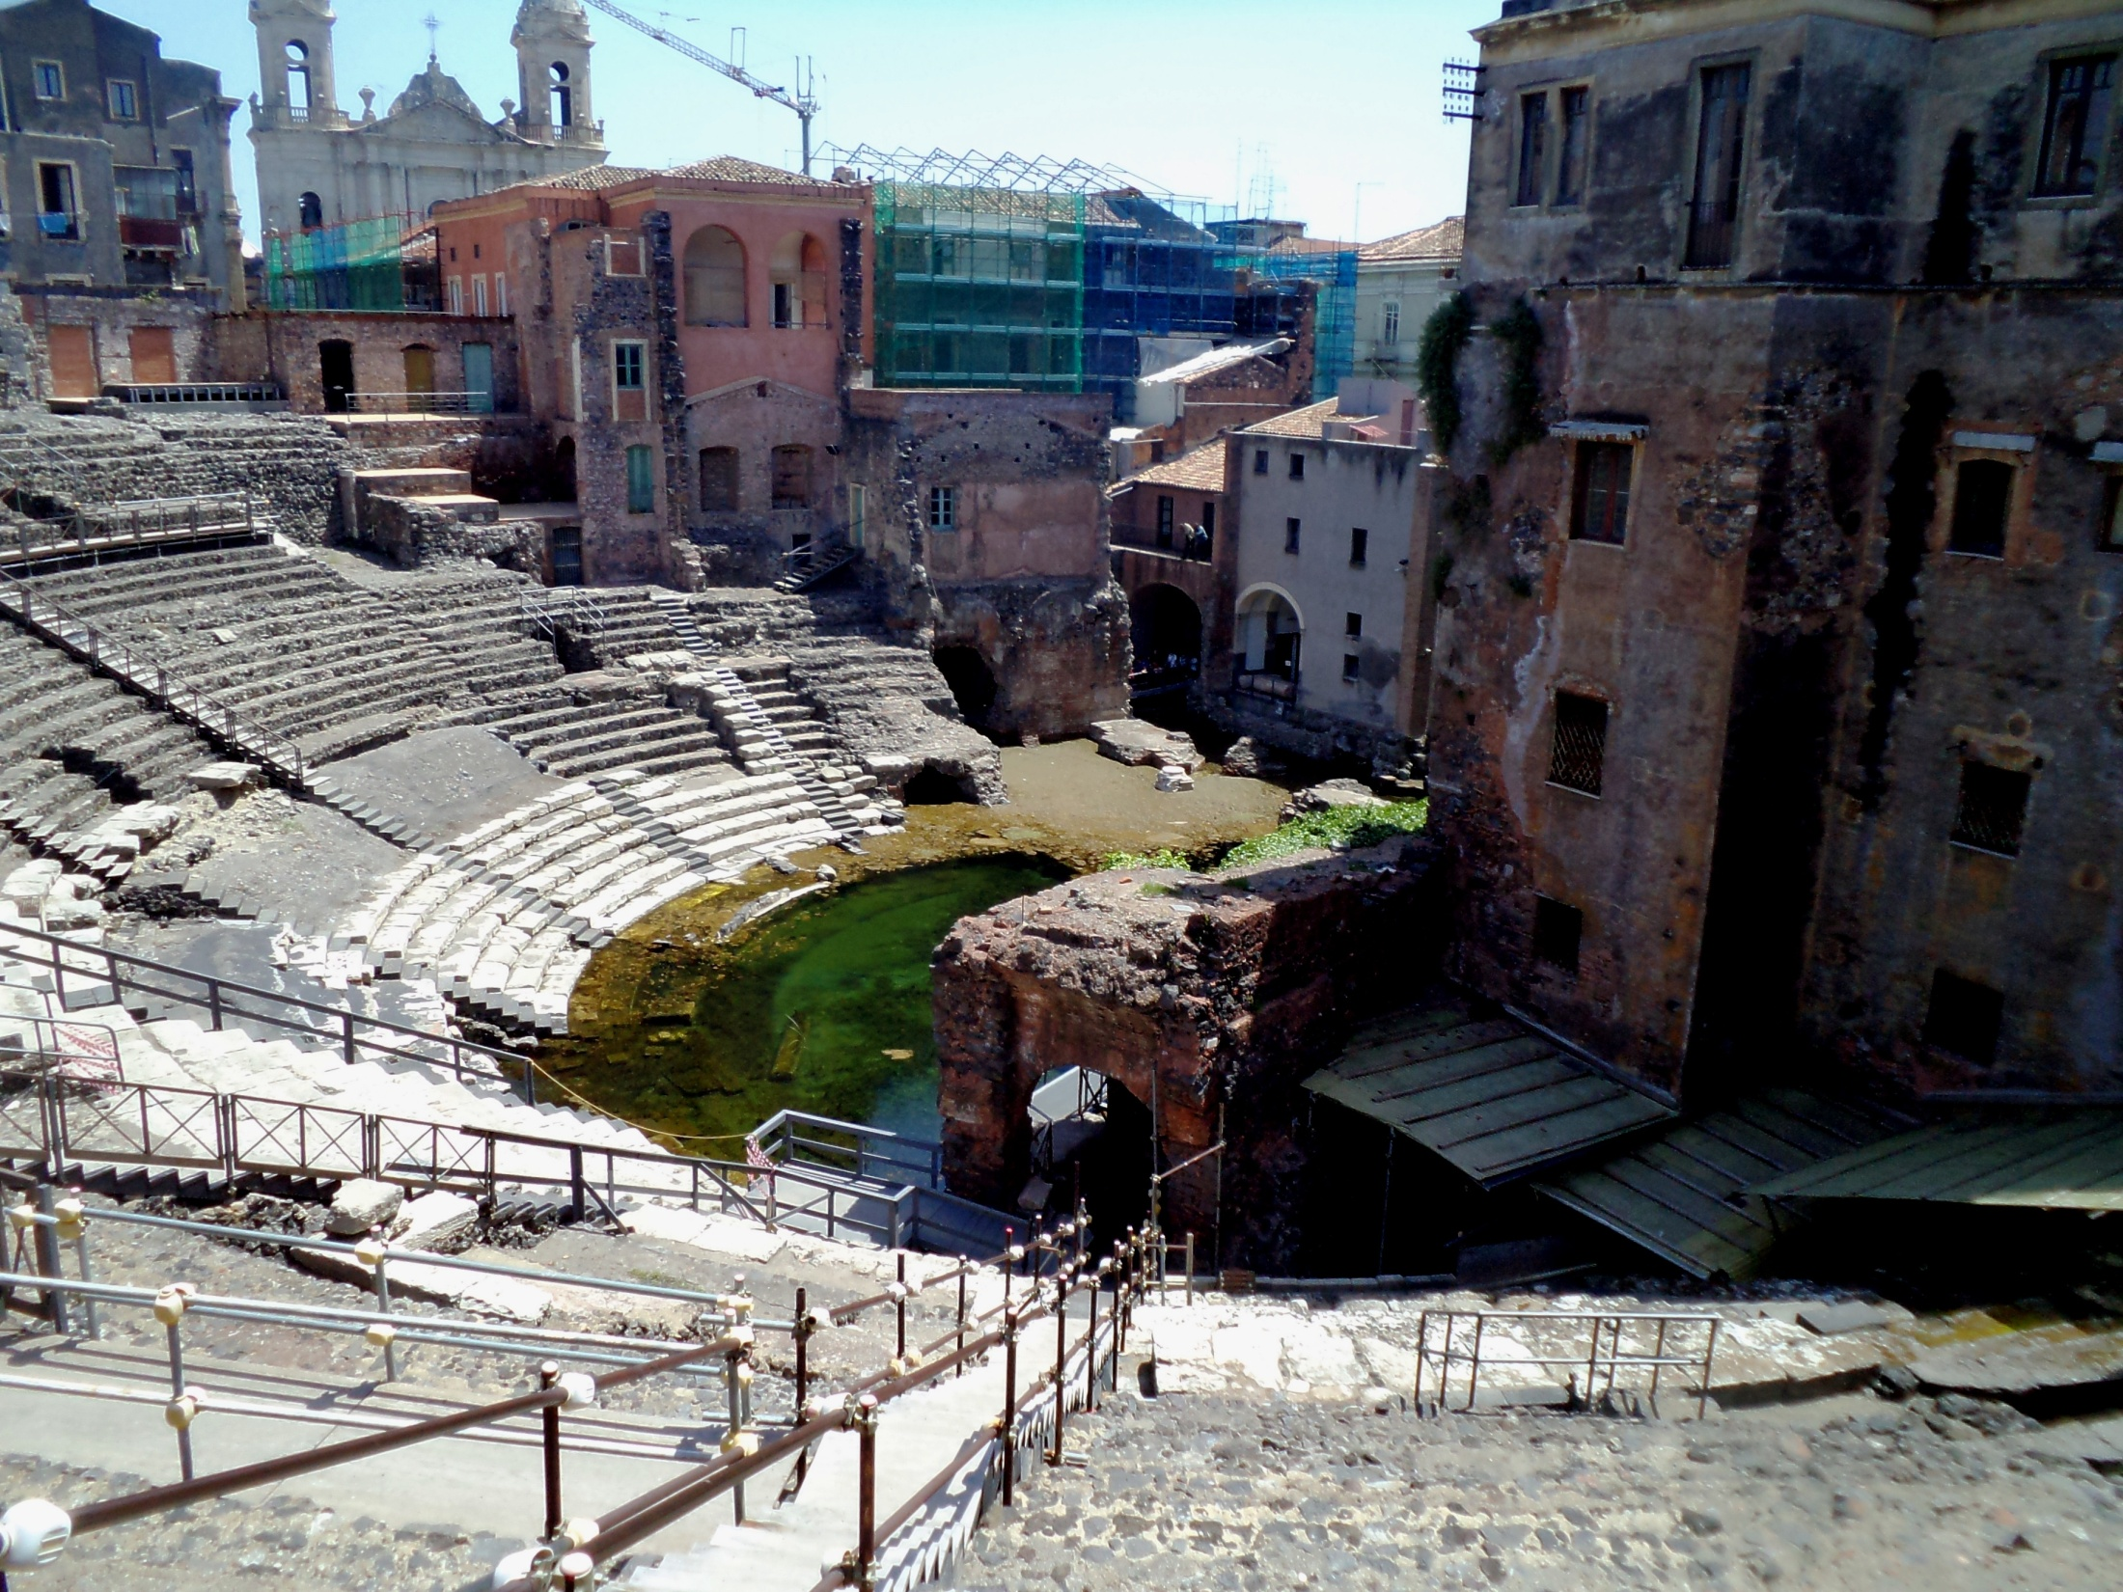
The SPL Short Cryo-module:
Status Report
V.Parma,
CERN, TE-MSC
On bahalf of the
Cryomodule development team
2nd Open Collaboration Meeting on Superconduting Linacs for High Power Proton Beams (SLHiPP-1), 3-4 May 2012, INFN-Catania

Slide 2
The actors on stage...
ESS/CERN Fellow
System/Component/Activity | Person(s) in charge | Lab
Cavities/He vessel/tuner construction | O.Brunner, O.Capatina, Th.Renaglia, F.Pillon, N.Valverde, M.Esposito, I.Aviles, G.Devanz | CERN CEA-Saclay
SRF, magnetic shielding, Clean-Room activities, RF test stations (SM18) | E.Ciapala, T.Junginger, K.Shirm, J.Chambrillon, O.Brunner | CERN
RF Coupler | E.Montesinos, G.Devanz | CERN CEA Saclay
Vacuum systems | G.Vandoni | CERN
Cryogenics, (cryo infrastructure SM18) | U.Wagner, (O.Pirotte) | CERN
Survey and alignment | P.Bestman | CERN
Cryo-module conceptual design | R.Bonomi, D.Caparros, O.Capatina, P.Coelho, V.Parma,Th.Renaglia, A.Vande Craen, L.R.Williams | CERN
Cryo-module detailed design & Integration & Cryostat assembly tooling | Ph.Dambre, P.Duthil, P.Duchesne, S.Rousselot, D.Reynet | CNRS/IPNO-Orsay
SPL Machine architecture | F.Gerigk | CERN
ESS Cryomodule developments | Ch.Darve | ESS, Lund
Cryo-module Technical Coordination | V.Parma | CERN
ESS/CERN Fellow
ESS/CERN Fellow
ESS/CERN Fellow

Slide 3
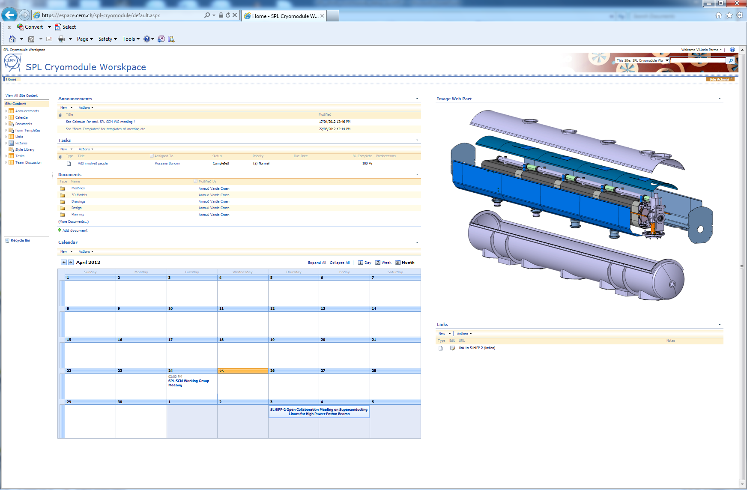
SPL Cryomodule Workspace
https://espace.cern.ch/spl-cryomodule/default.aspx

Slide 4
Short cryomodule: schematic layout
Connection to cryo distribution line
End
Module
Cryo fill line (Y), top left
Technical Service
Module
Phase sep.
Now suppressed
Inter-cavity support
CW transition
Cavity additional support
RF coupler, bottom left side
Now suppressed
1.7% Slope (adjustable 0-2%)

Slide 5
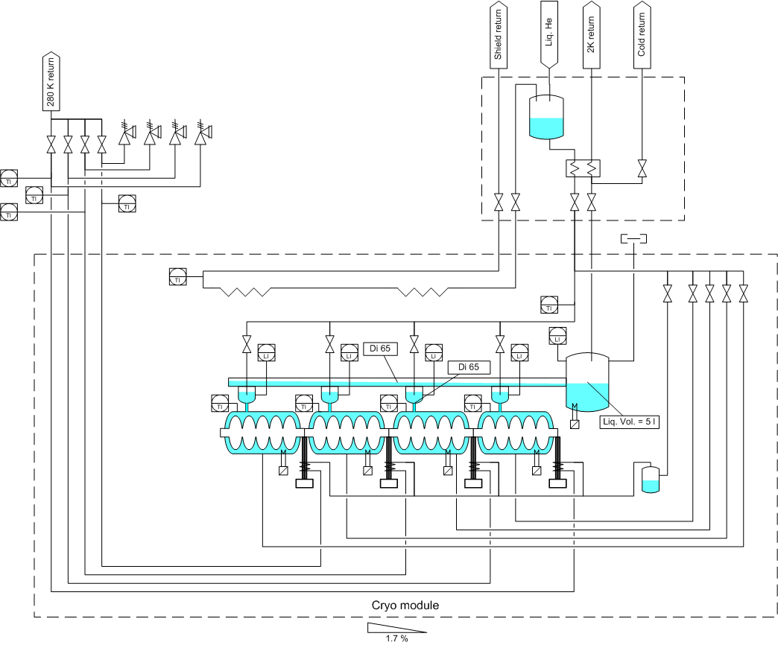
Cryogenic Scheme Short Cryomodule
Additional valves/level gauges
to test feasibility of 2 K supply scheme
Cool down valves;
tests should show if necessary
E’
C
E
XB
C3
X
Y
C1
L
Z
C2

Slide 6
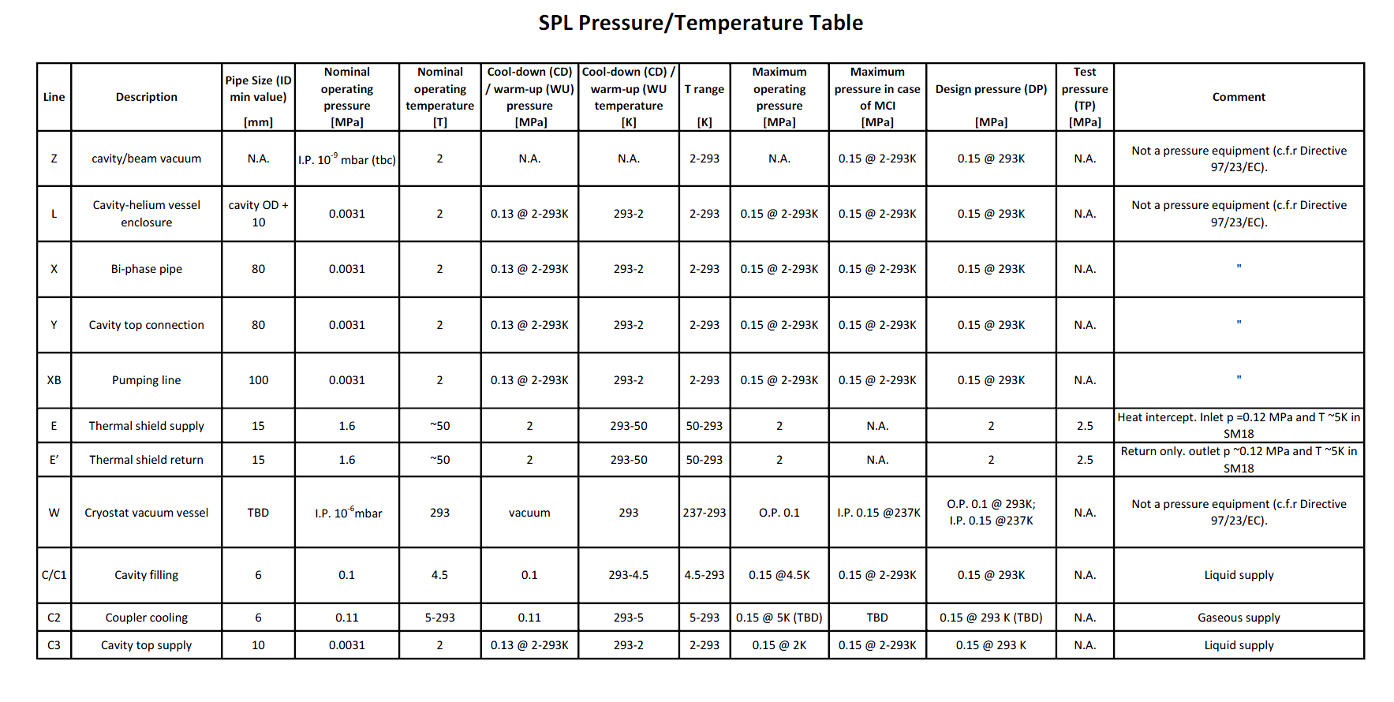
Pipe sizes and T, p operating conditions

Slide 7
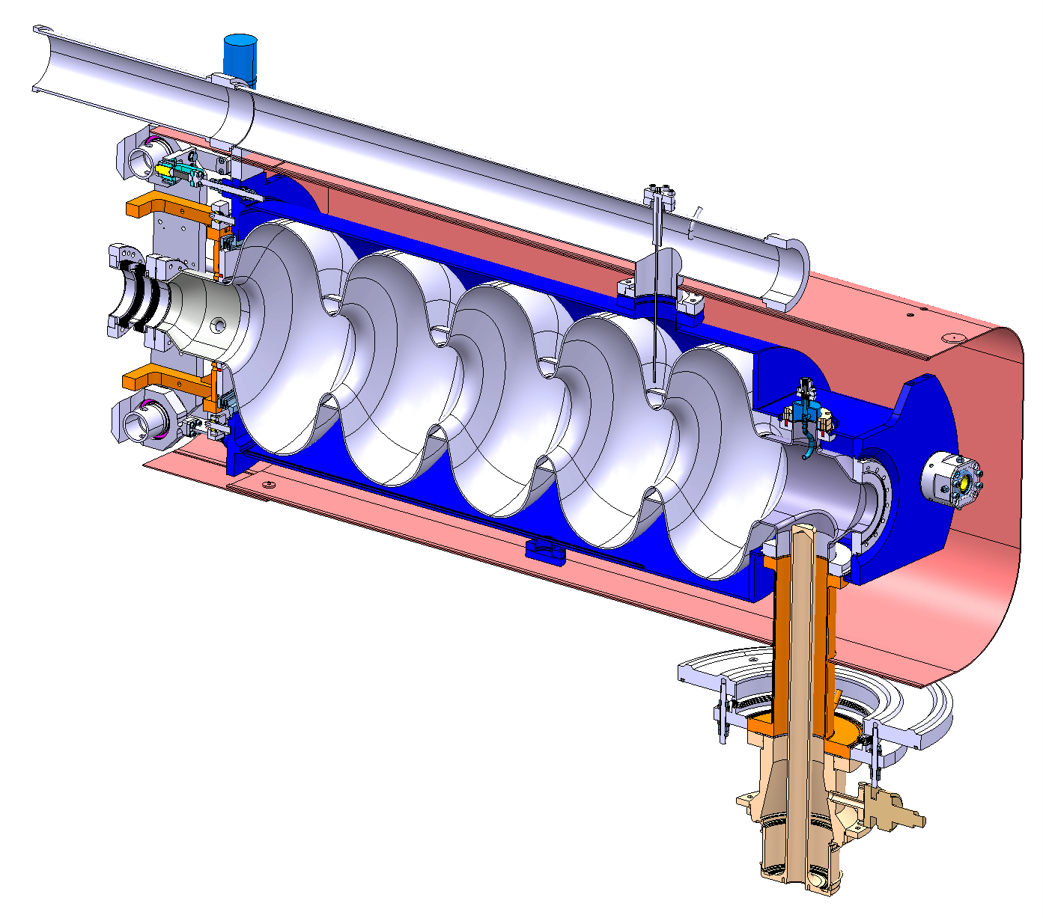
Bi-phase helium tube
SS CF UHV DN100
Helium Tank
Bellows
CEA’s tuner
Bulk Niobium 5Cells cavity
Magnetic shielding
(old design)
Hom Coupler
Inter-cavity support
Double walled tube
RF Power Coupler

Slide 8
Actively cooled double walled tube
Helium gas cooling 5-300 K
Thermally efficient
No intermediate T heat intercepts
See Rossana Bonomi’s presentation

Slide 9
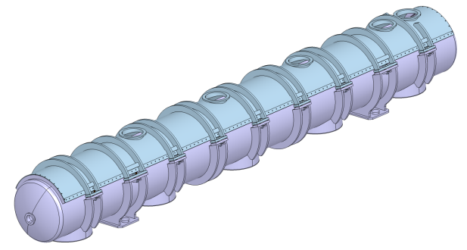
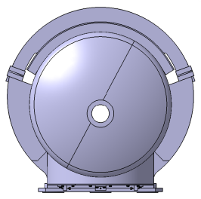
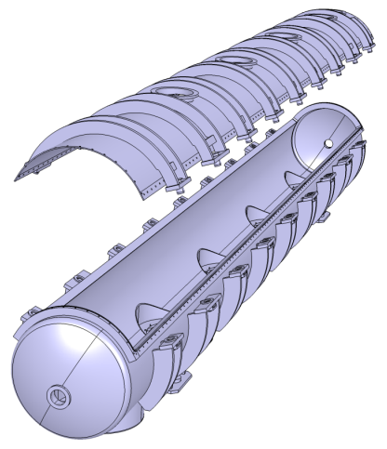
Vacuum vessel with removable top
General concept and dimensions (not latest design)
1054
1021
7400
SSS
Transport,dressing and alignment frame
More in P.Duthil’s presentation
(views S.Rousselot, IPN-Orsay)

Slide 10
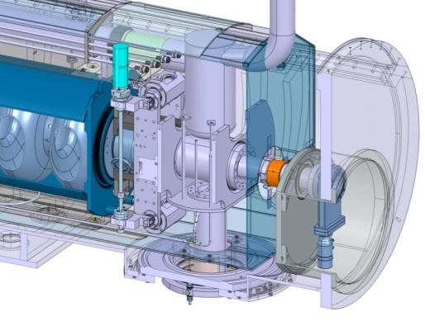
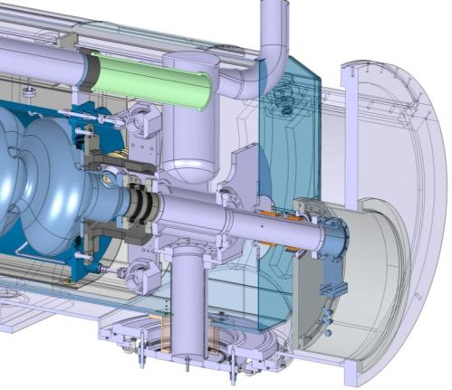
Technical Service module: features
Ph.Separator pot
4.5 K vapor generator
reservoir
(with elect.heater)
Last cavity
IC support
CWT 50 K heat intercept
standard
support
DN80 gate valve (single valve)
More in P.Duthil’s presentation
(views S.Rousselot, IPN-Orsay)

Slide 11
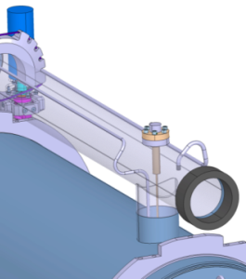
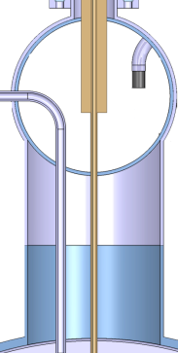
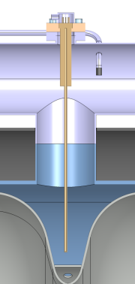

Cooling, Filling, level gauges
(views IPN-Orsay)
filling line
Filling line shifted from the cavity bath
Z
Y
X
INLET
OUTLET
Z
Z
X
Y
Y
X

Slide 12
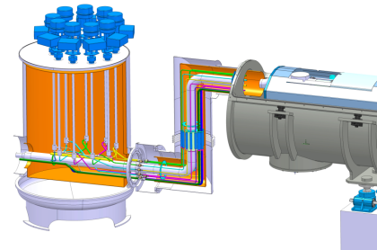
Valves Box
(S.Rousselot, IPN-Orsay)

Slide 13
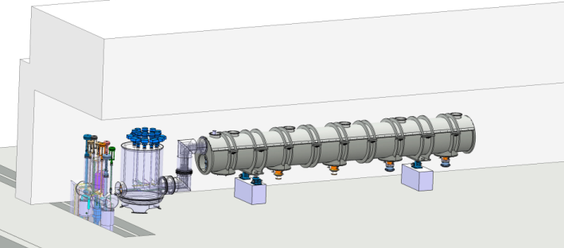
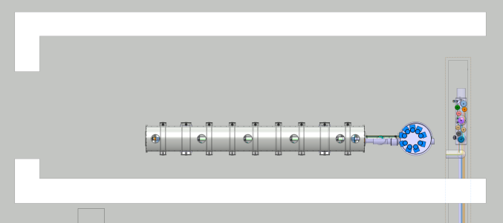
RF Bunker integration study (CERN, SM18)
Valve Box
Distribution line
Flexible Link
(allows ±2% tilt)
(views: IPN-Orsay
and TE-CRG CERN)

Slide 14
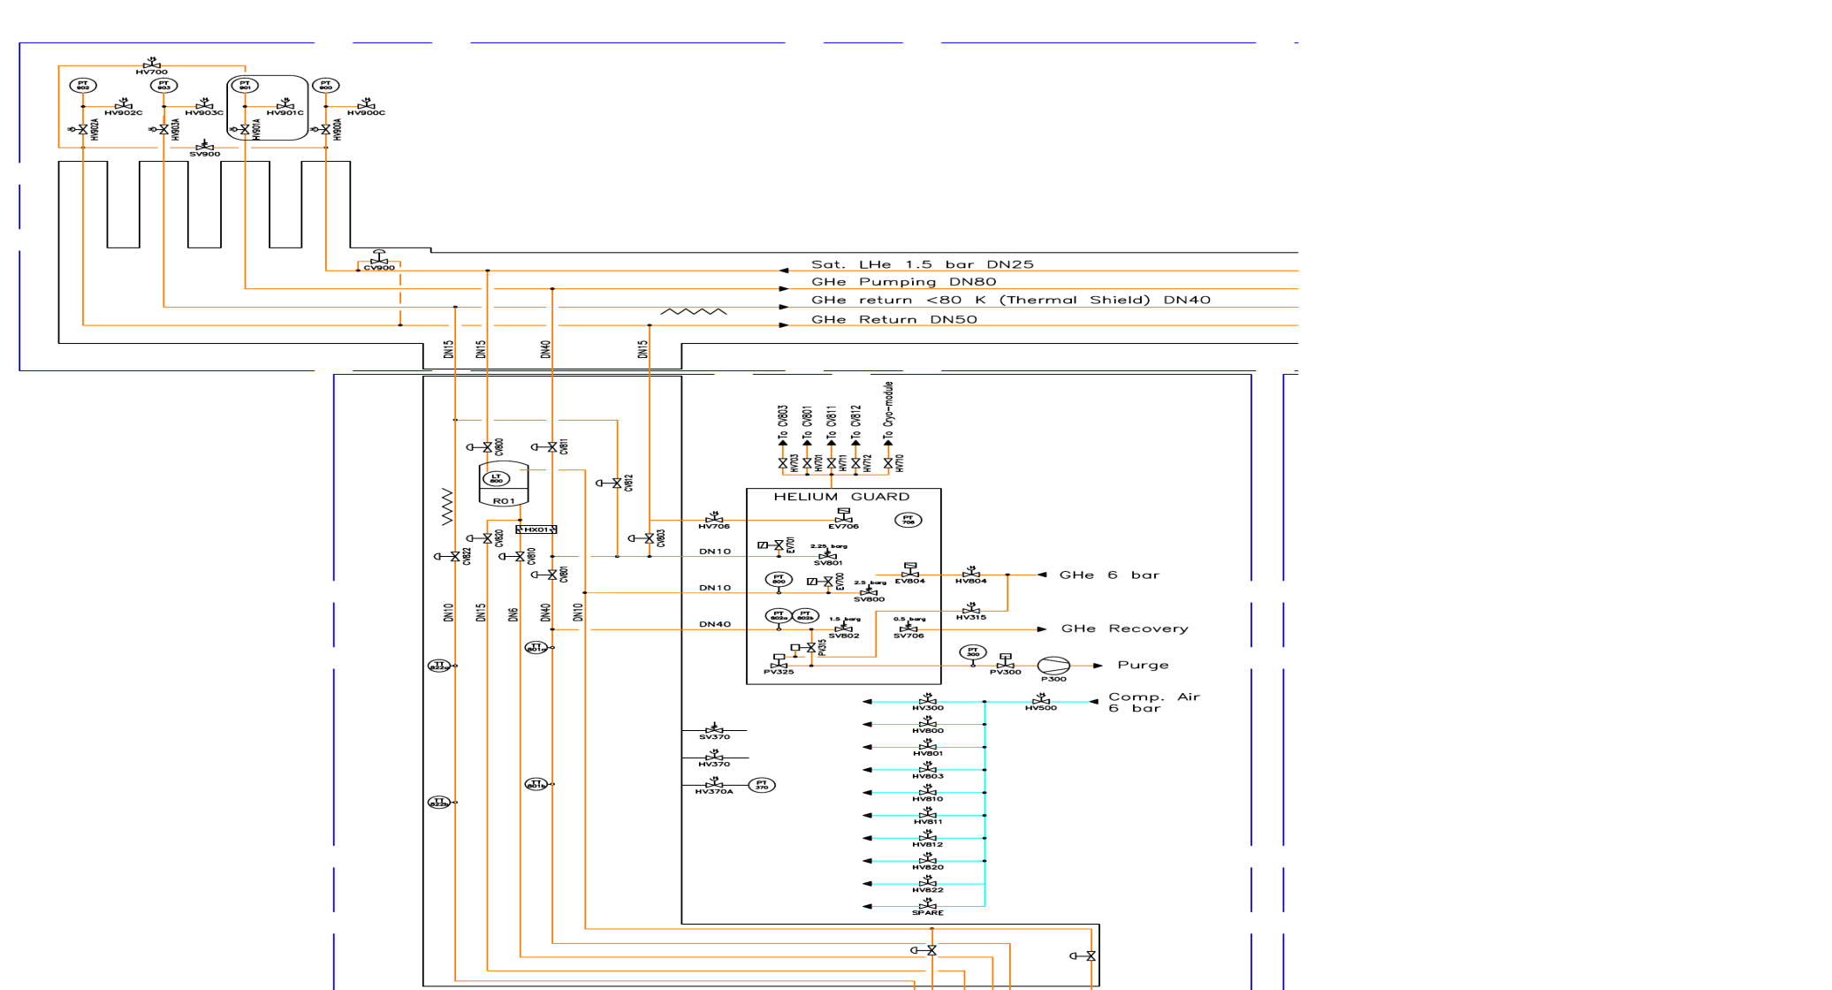
SM18 SPL CRYOGENIC PID
4K LHe I
4K GHe
2K LHe II
GHe Pumping
GHe return (70K)
4K GHe
From He Guard
280K return
Vacuum barrier
Ti
SPL Valve Box
Thermal shield
Ti
From He Guard
TT
Cavity supply lines
Pi
Li
Li
Li
Li
LT
Cooling down lines
Couplers Cooling
(IPN-Orsay
and TE-CRG CERN)
TT
TT
TT
TT
Ti
Ti
Ti
Ti
Ti
TT
TT
TT
TT
TT
SPL Cryomodule
(Adjustable slop : 0 to 2%)
11/04/2012

Slide 15
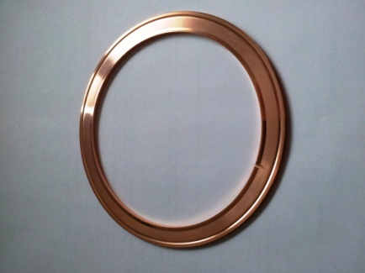

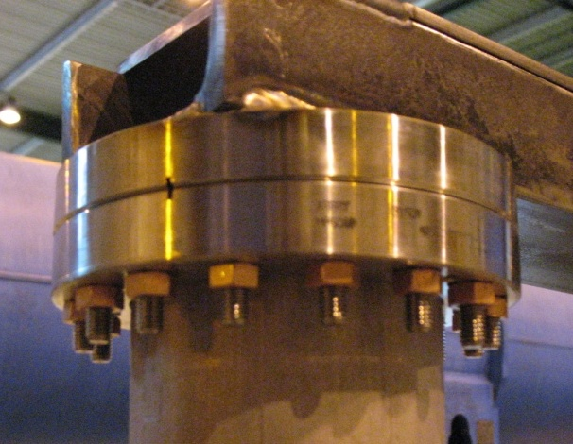
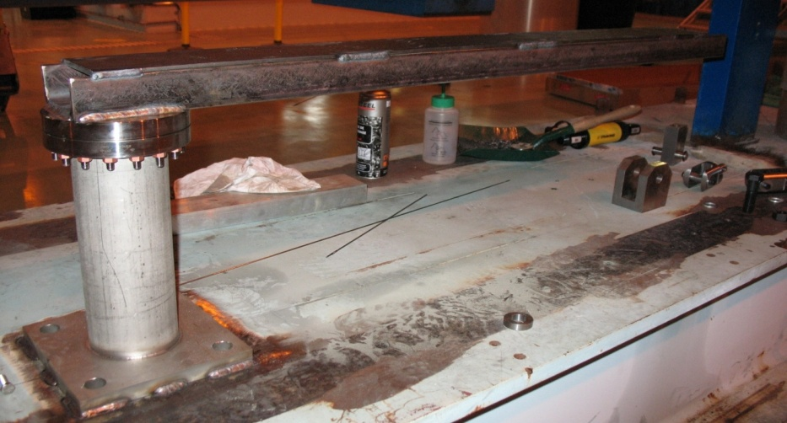
Supporting system Mock up I
Tube : same inertia as double walled tube
Real flanges
Force at end of beam (bending on flange)
Aimed at validating CF top flange (with RF gasket) assembly:
  Mounting procedure (studs quality, torques, etc.)
  Leak tightness under mechanical loading of CF top flange with RF gasket
RF Cu gasket
Schematic view
F
See P.Azevedo’s presentation

Slide 16
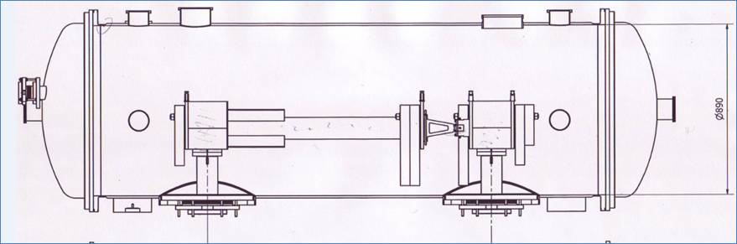
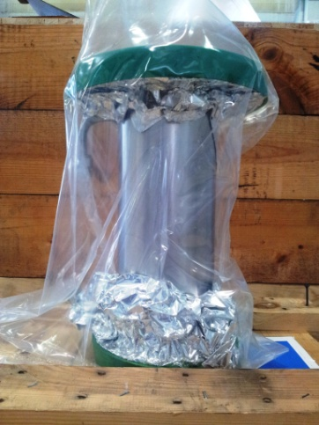
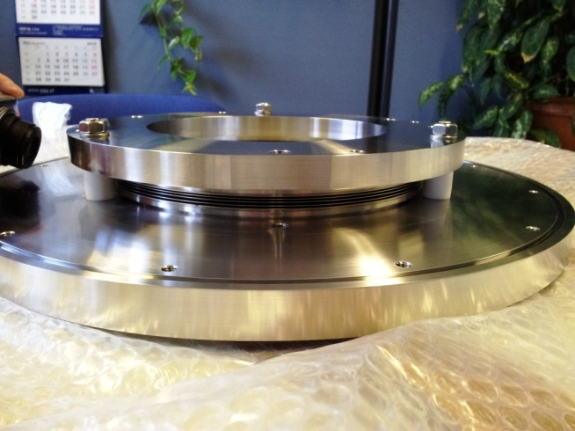
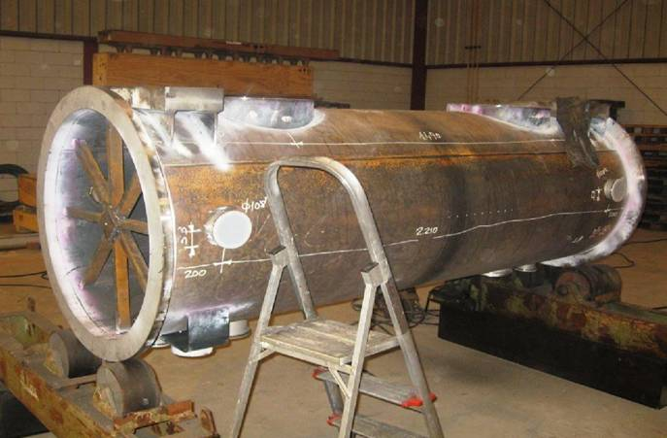
Supporting system Mock up II
Mechanically representative mock up of 1 cavity
Real prototypes of double-walled tube and interface to vacuum vessel
LN2 cooled cavity and double-walled tube
Aimed at validating:
  Cavity supporting system (double walled tube and inter-cavity supports)
  Assembly/realignment of cavities via vessel interface
  Thermal contraction movements
  Active controlled cooling of double-walled tube
  Alignment measuring devices (optical Wire Position Monitor)
See P.Azevedo’s presentation

Slide 17
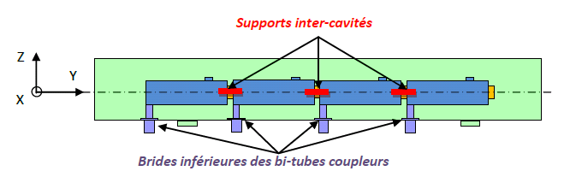
Optical Wire Position Monitor (OWPM)
Cavity position monitoring specs:
Static position or slow movements: absolute movements (x,y,z) of each of 4 cavities during steady state operation and cool-down/warm-ups (300-2 K)
Vertical range: 0-2mm
Precision: <0.05mm
Resolution : <0.01mm
Possibly vibration measures (0-1kHz)
Stretched wire
Opto-coupler sensors
Last cavity support

Slide 18
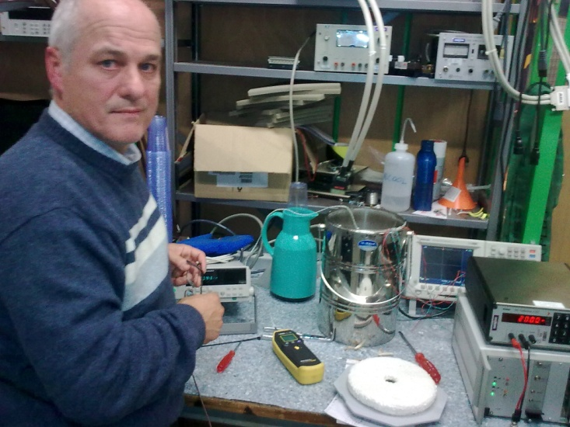
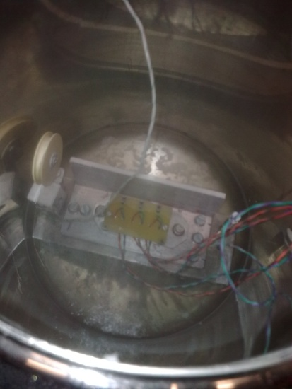
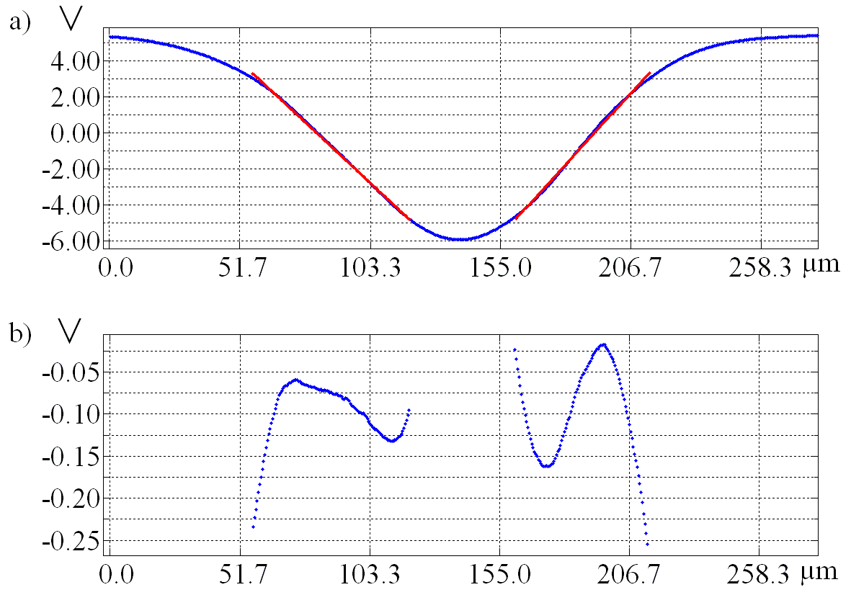
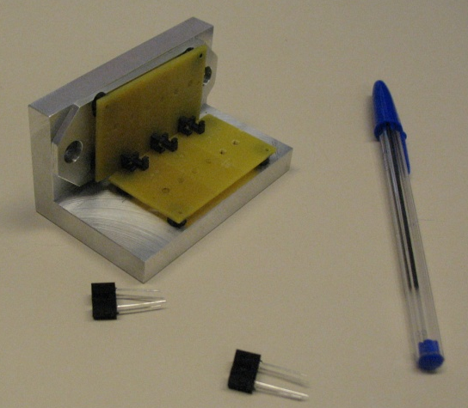
Photo-interrupter as displacement measurement devices:
R&D in progress
Operating tests in LN2
Multiple interrupters examples
Typical response and linearity curves (TJ0006 sensor, 1 mm wire)
(courtesy: J.C.Perez)

Slide 19
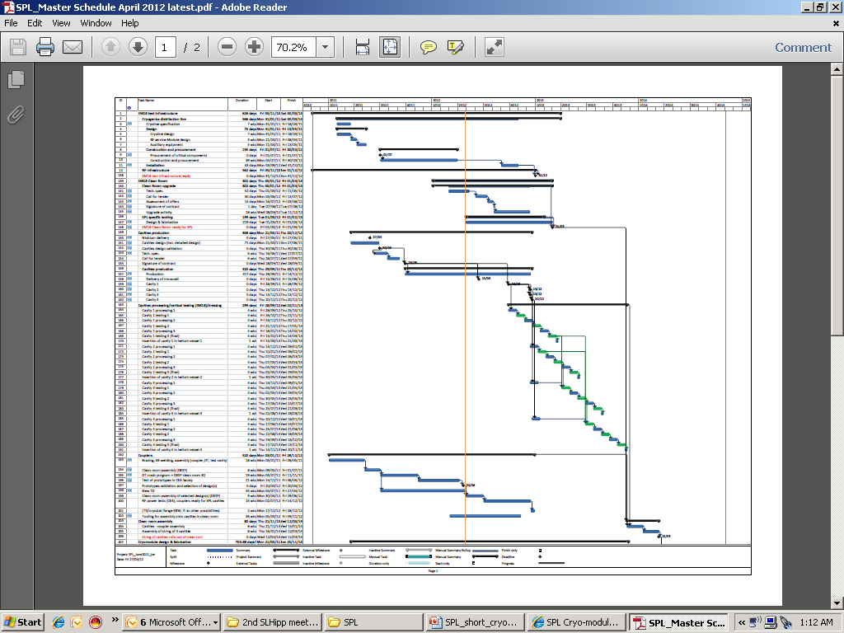
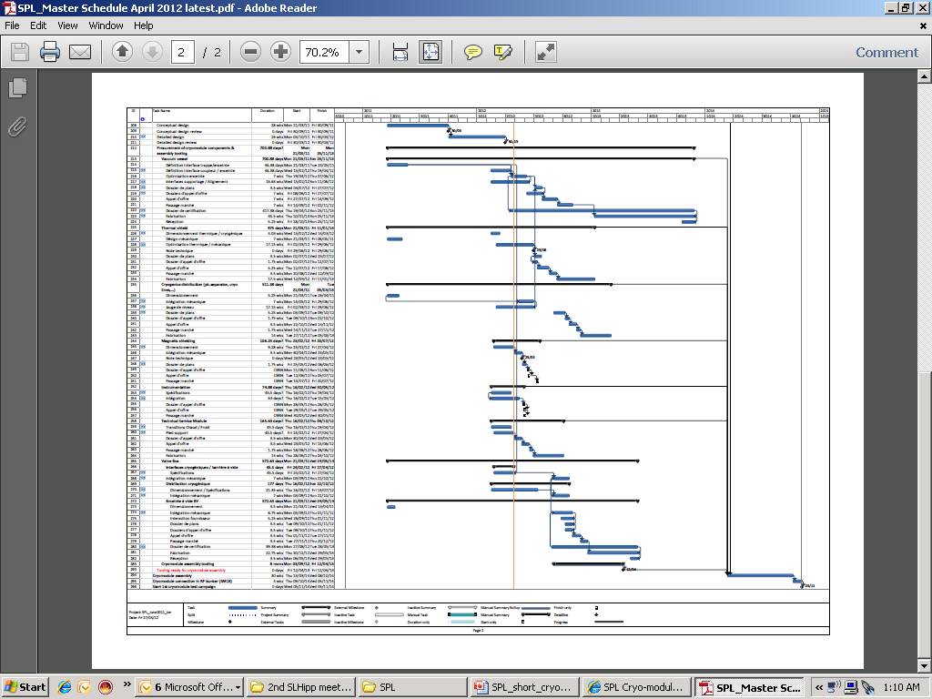
Master Schedule

Slide 20
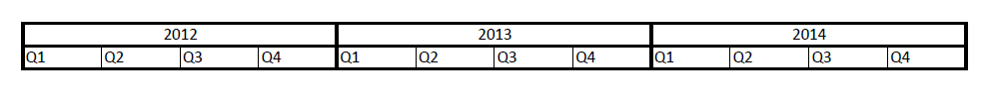
Master Schedule...readable
Preparation of SM18 infrastructure (cryogenics, RF, clean-room)
Cavities production
Cavities processing/RF testing
RF couplers
Clean room assembly of string
Cryomodule (& assy tooling) design
Cryomodule fabrication
Cryomodule assembly
Start cryomodule
RF testing

Slide 21
Summary
Most of the technical choices for the Short Cryomodule are now frozen
Mock-ups of the supporting system are starting to give first results. More results to come in the coming months (see P.Azevedo’s presentation)
Modifications implemented recently :
  Instrumentation (T gauges, heaters) moved to insulation vacuum
  Vapour generation for coupler tube cooling via active heater (not by static heat load)
  Single warm gate valves (cold valves removed) and re-entrant closing ends
The mechanical optimization of the vacuum vessel design with opening top lid is underway. The choice of the sealing is still to be made (see P.Duthil’s presentation). A study committed to industry is probably one of the next steps to assess the construction feasibiliy.
Preliminary Heat Loads estimated are available (see R.Bonomi’s presentation)
Further work:
  Improve design of magnetic shielding (present design not ideal)
  Cryogenic risk analysis (need for no. & size of burst disks)
  Define cool down and warm up requirements and constraints, and elaborate a procedure for cooling down the cold magnetic shield
  Check compatibility with SM18 cryogenic infrastructure (thermal shield cooling, 4.5 K vapor generation)
  Develop a thermo-hydraulic model to analyze the robustness of the 2 K He level controls (RF transients)
  Integration of HOM with active cooling
  Integration of instrumentation for prototype
  …
A project oriented working group is now in place (~monthly meetings). Next meeting at CERN on 14th May. For more information: https://espace.cern.ch/spl-cryomodule/default.aspx
Goal for 2012: finalize the detailed design of long lead items (vac.vessel) and launch tendering phase

Slide 22
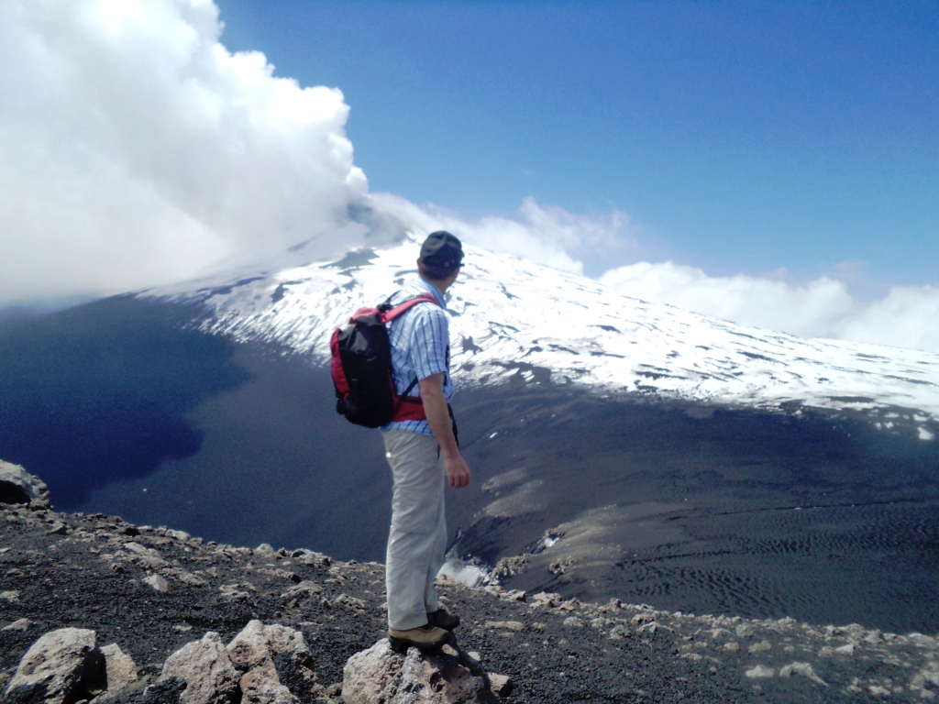
Thank you for your attention

Slide 23
Spare slides

Slide 24
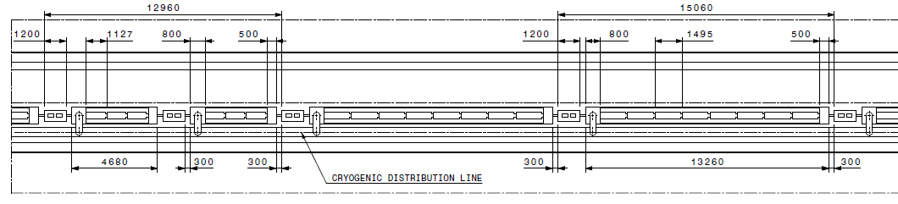
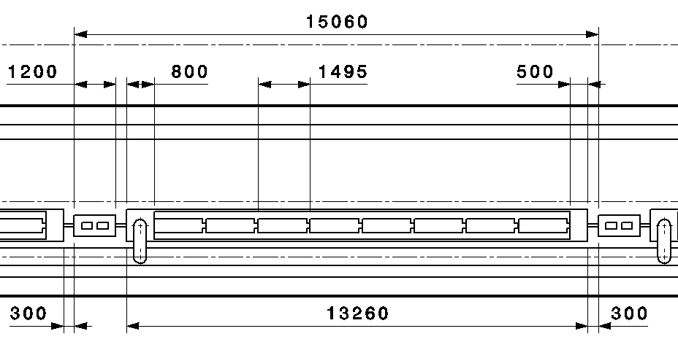
A possible SPL architecture
«segmented» with warm quads and a cryo distribution line:
warm quads
β =0.65 cryomodule (3 cavities)
β =1 cryomodule (8 cavities)
Short Cryomodule designed possibly
to be compatible with a full-lenght
8 cavity cryomodule:
Mechanical design
Cryogenics (Heat loads,
T and p profiles)
4 cavities less
(from workshop on SPL vacuum and cryogenic sectorisation http://indico.cern.ch/conferenceDisplay.py?confId=68499)

Slide 25
