Slide 1





ESS Cryomodule Development
Christine Darve – ESS
and
on behalf of CEA/IPNO WP4 and 5
2nd Open Collaboration Meeting on Superconducting Linacs for High Power Proton Beams (SLHiPP-2)
2012-05-03 and 04, Catania, Sicilia

Slide 2
Headlines
Few milestones since SLHiPP-1 (December 2011)
Cryomodule Requirements and Functions
Cryomodule Status
Elliptical Cavity Cryomodule Technology Demonstrator

Slide 3
Headlines
Few milestones since SLHiPP-1 (December 2011)
Cryomodule Requirements and Functions
Cryomodule Status
Elliptical Cavity Cryomodule Technology Demonstrator

Slide 4
Few milestones since SLHiPP- 1 (December 2011)
  Design requirements
  Use a segmented cryomodule configuration with warm corrector magnets ; Preliminary cold linac heat load estimate
  Cern meeting - Feb 1st
  SPL / ESS design configurations and infrastructures
  Technical Advisory Committee – Feb 16th
  Endorse technical choices, lower technical risk
  SNS, CEA and IPNO input
  Technical solution, Cost and schedule
  French/Swedish agreement, April 25th
  → Official support for ECCTD
  IPNO/CEA developments
  → On-going configuration study

Slide 5
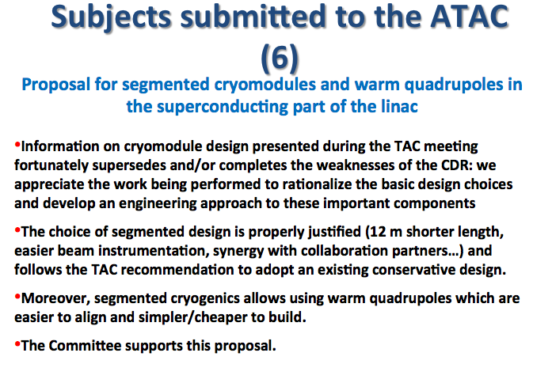
TAC 4 - Recommendations

Slide 6
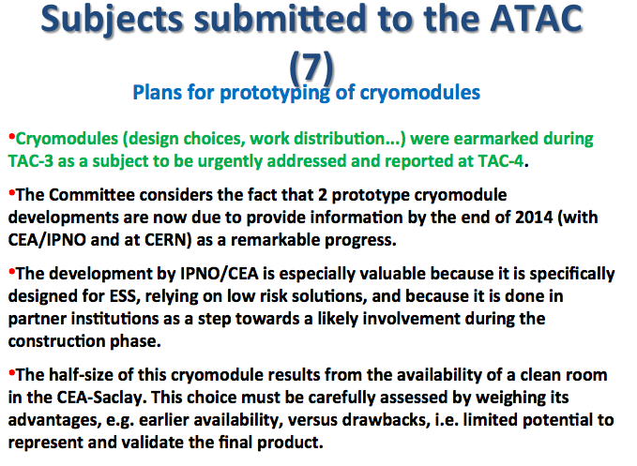
TAC 4 - Recommendations

Slide 7
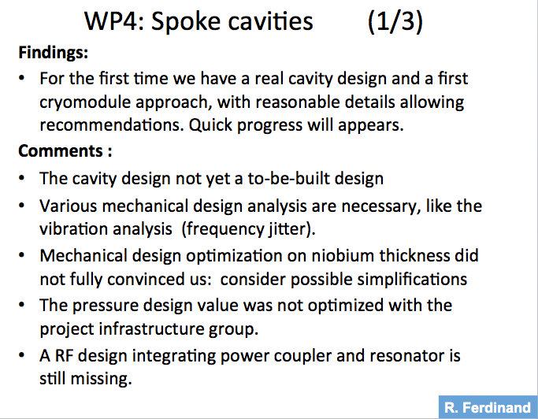
TAC 4 - Recommendations

Slide 8
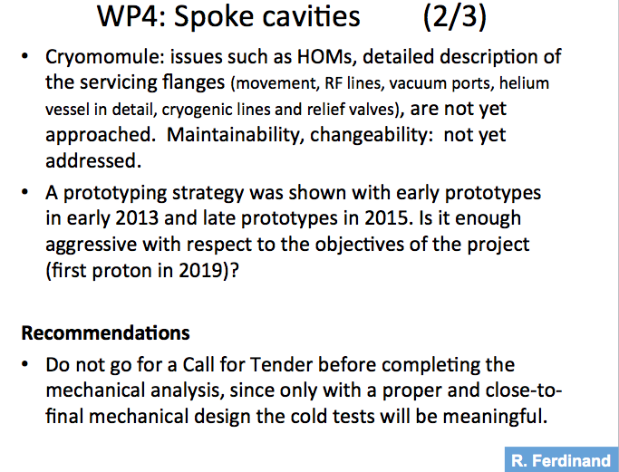
TAC 4 - Recommendations

Slide 9
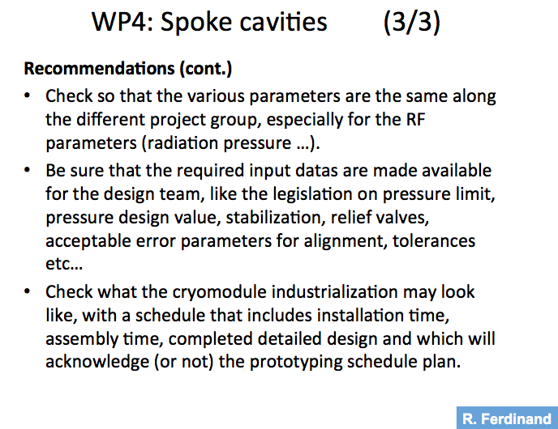
TAC 4 - Recommendations

Slide 10
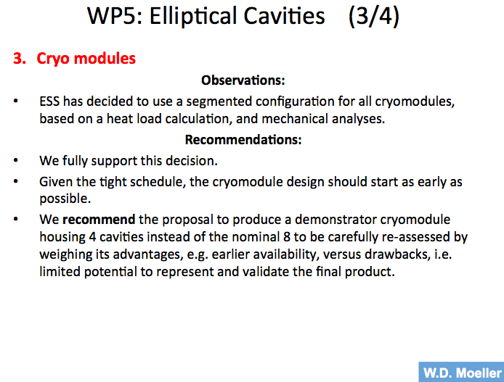
TAC 4 - Recommendations

Slide 11
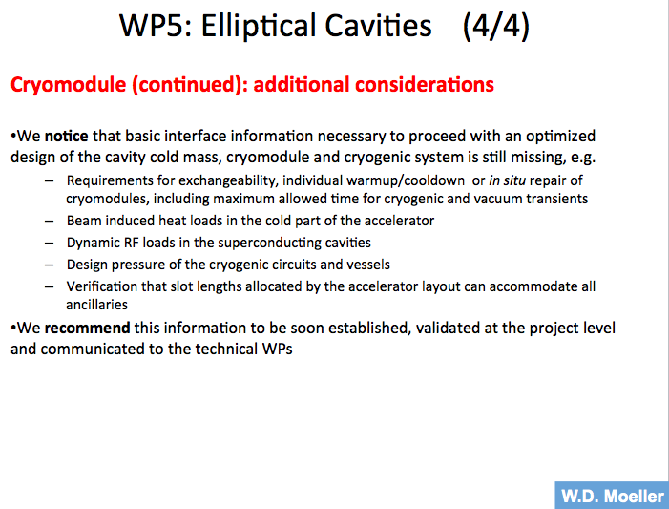
TAC 4 - Recommendations

Slide 12
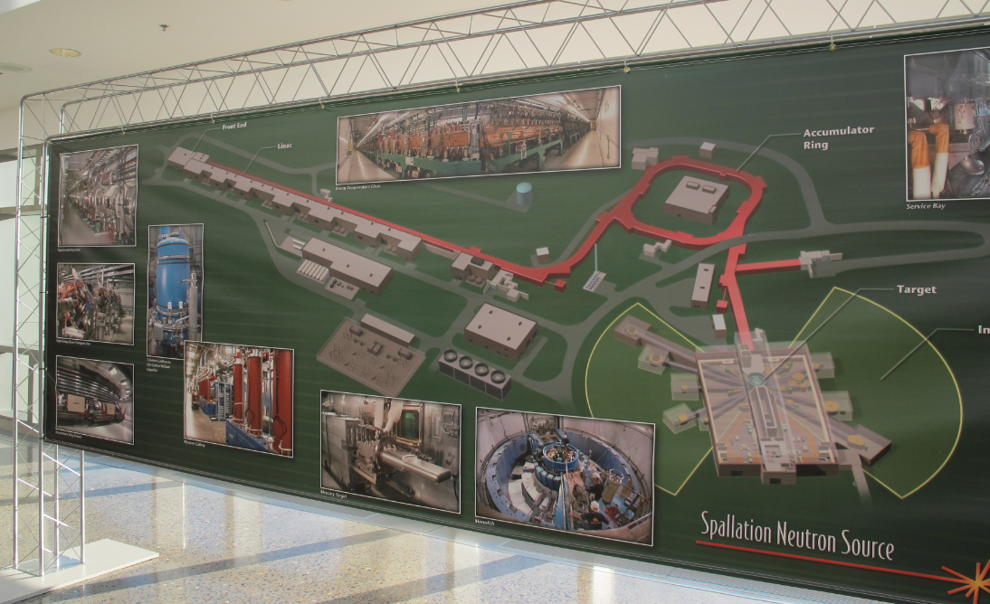
SNS Visit

Slide 13
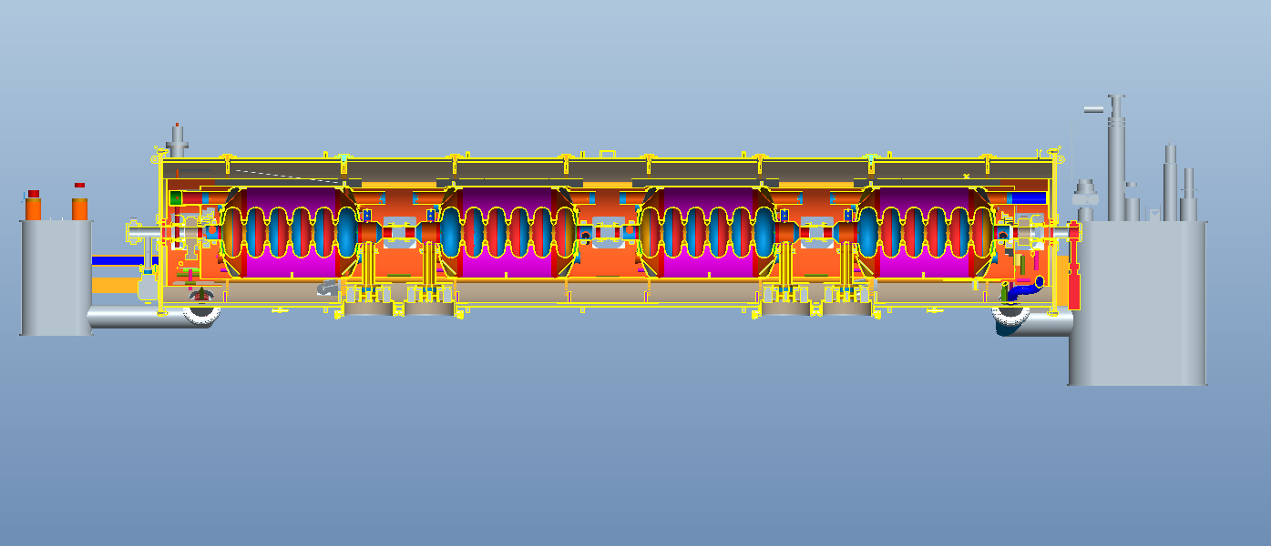
SNS 3 D model
Courtesy of Matt Howell
CM engineer – Mechanical calculations

Slide 14
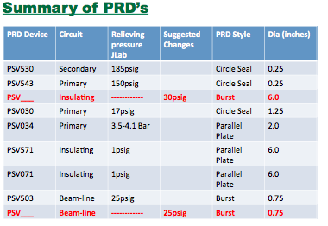
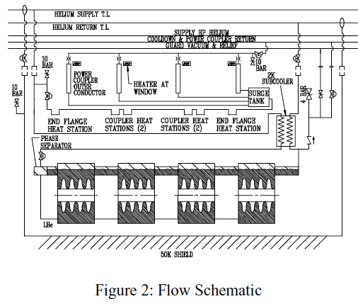
Pressure definition
Courtesy of Matt Howell
CM engineer – Mechanical calculations

Slide 15
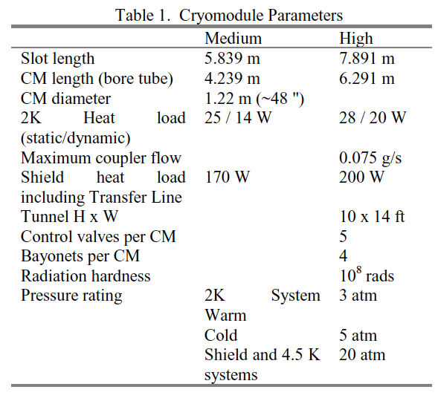
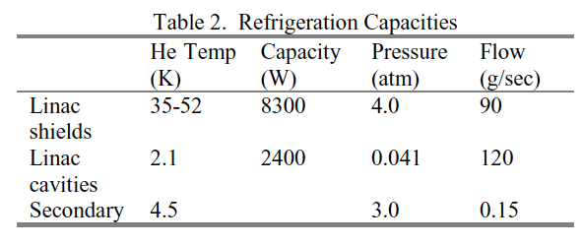
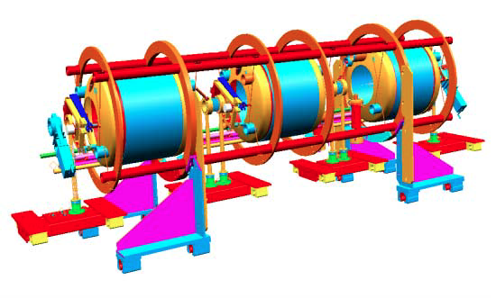
SNS parameters
Medium beta Cryomodule

Slide 16
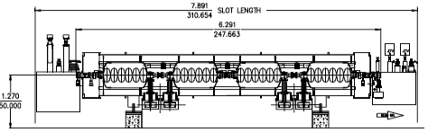
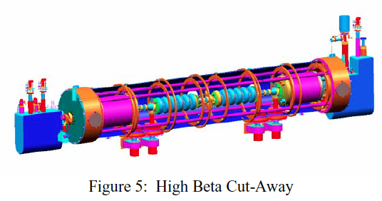
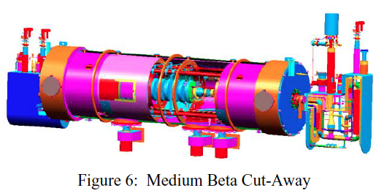
SNS design – high beta
Key operating elements
Operate at 805 MHz.
Accelerating gradient,: Epeak of 27.5 MV/m
Design quality factor Q0 = 6x109 at 2.1 K.
Power dissipation per cavity at 7% duty cycle is 2 W (Mb) and 3.5 W (Hb)
Thickness = 4 mm niobium
Stiffening rings at 80 mm to minimize microphonics.

Slide 17
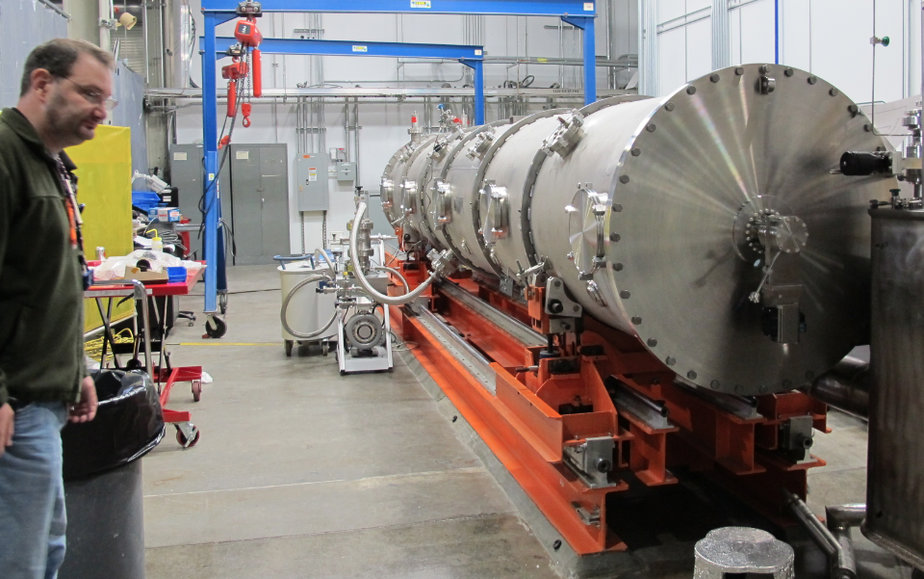
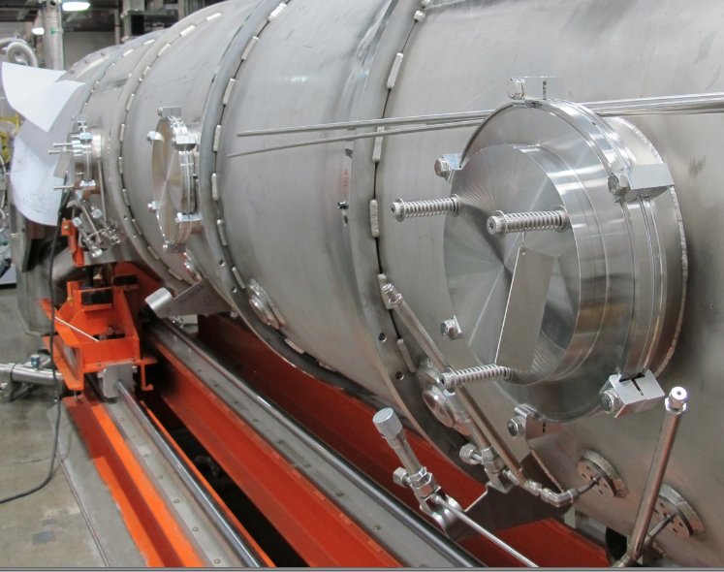
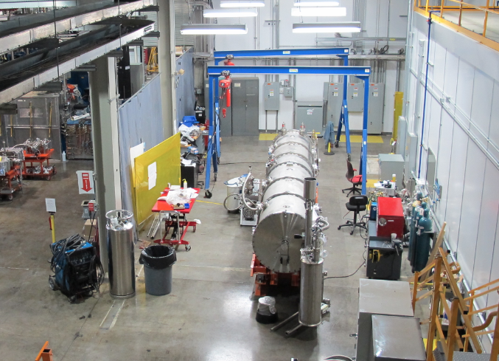
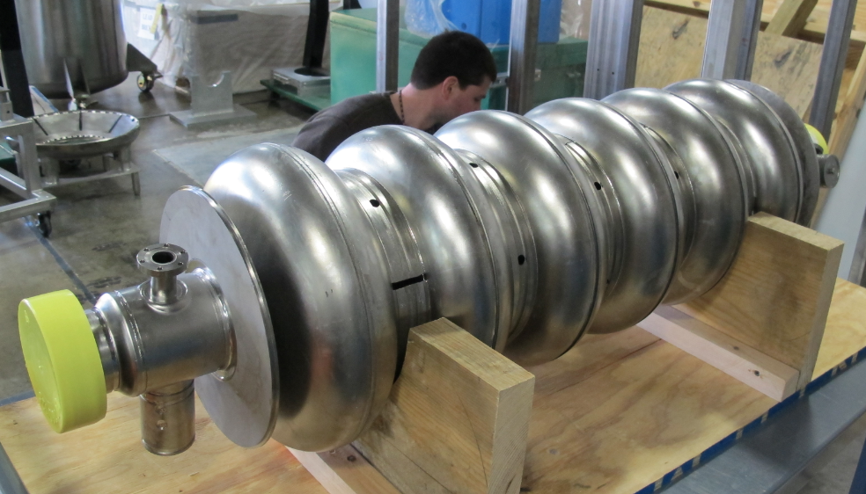
Update of the SNS – Prototype test

Slide 18
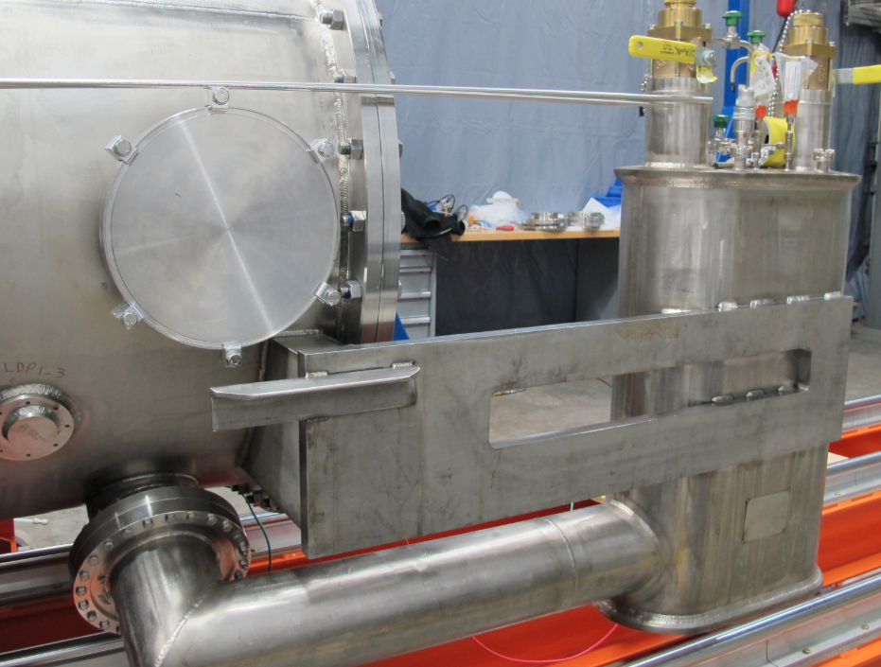
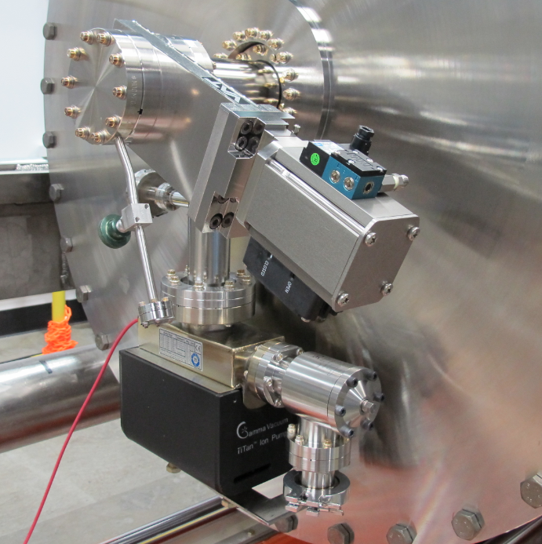
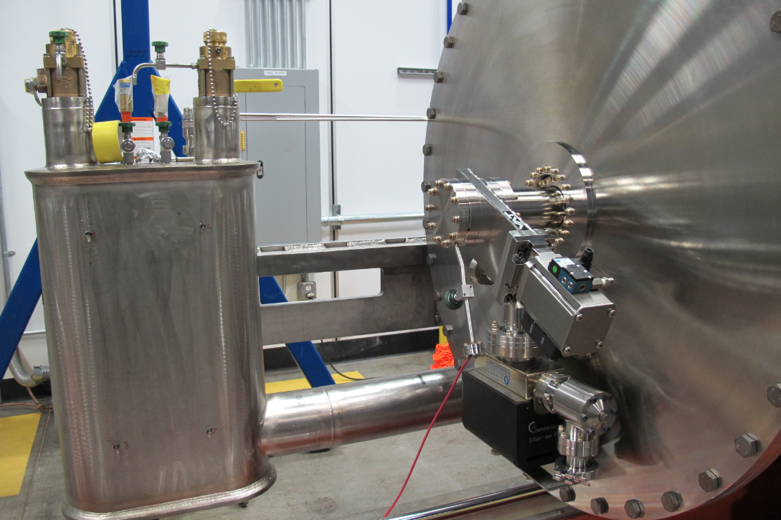
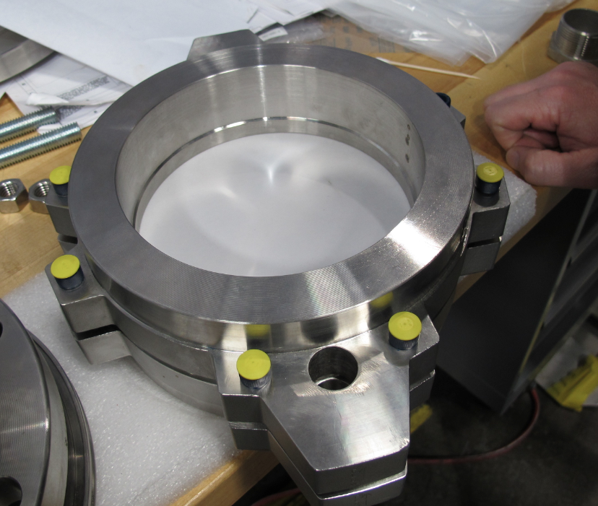
SNS prototype

Slide 19
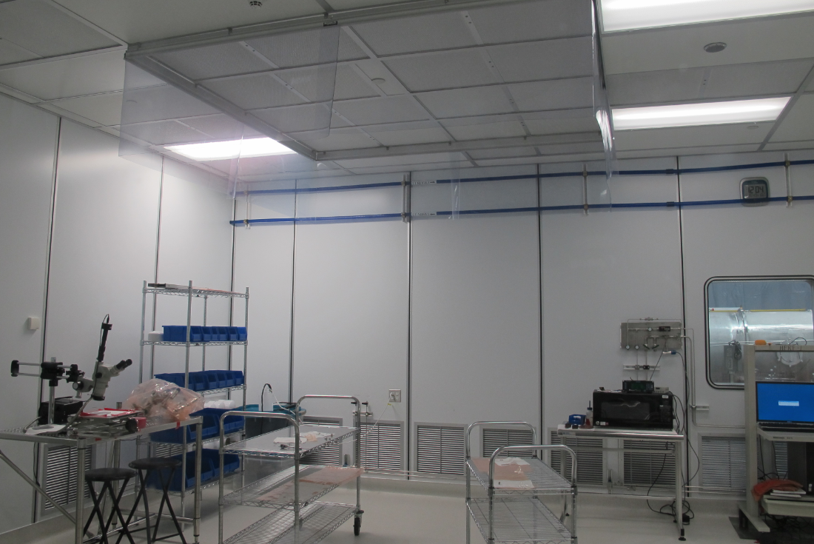
Clean-room

Slide 20
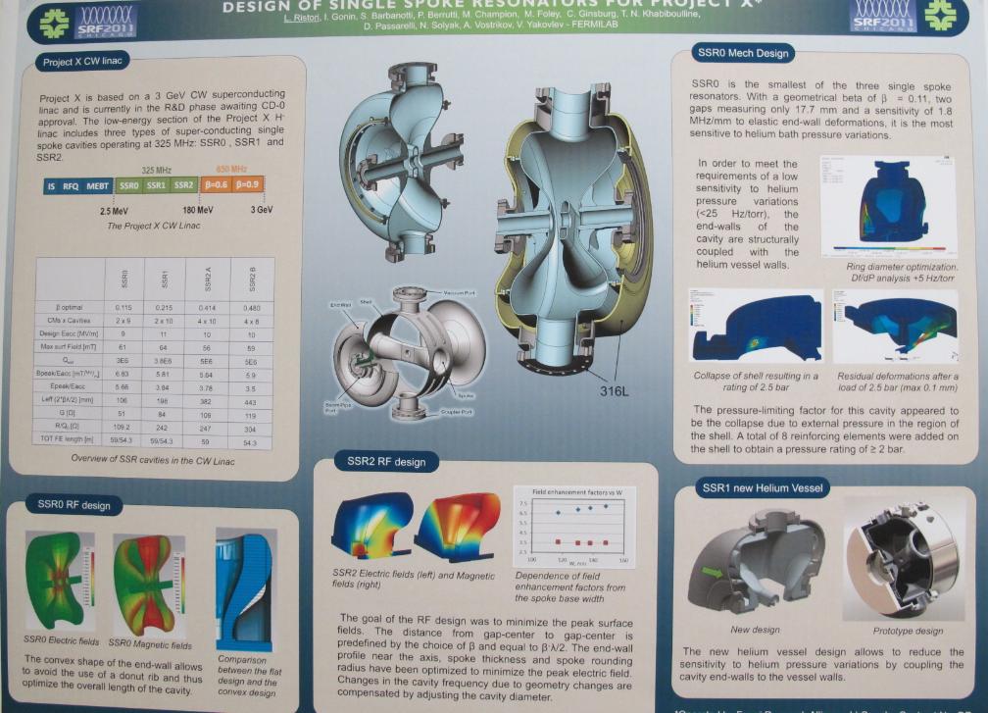
FNAL - Spoke

Slide 21
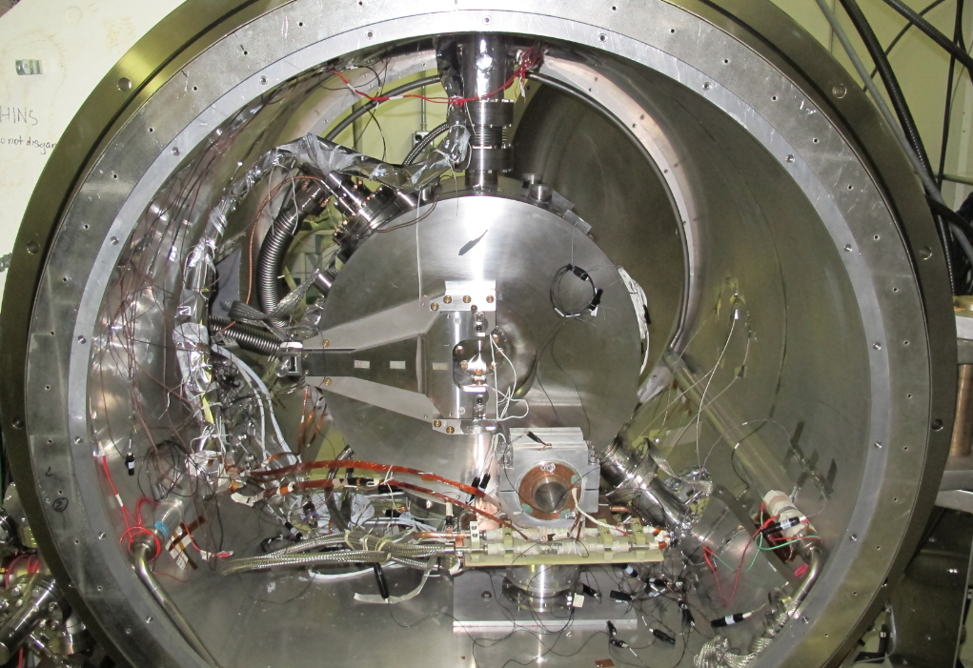
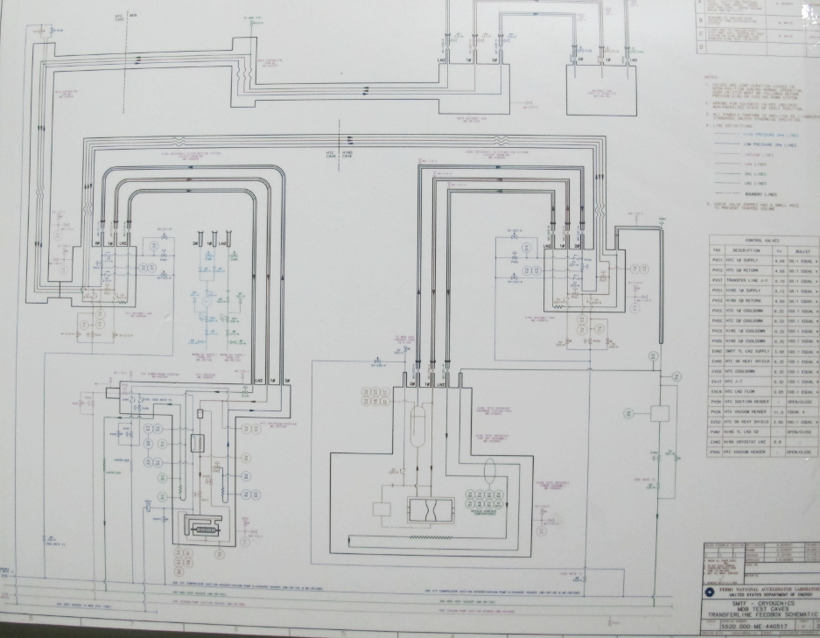
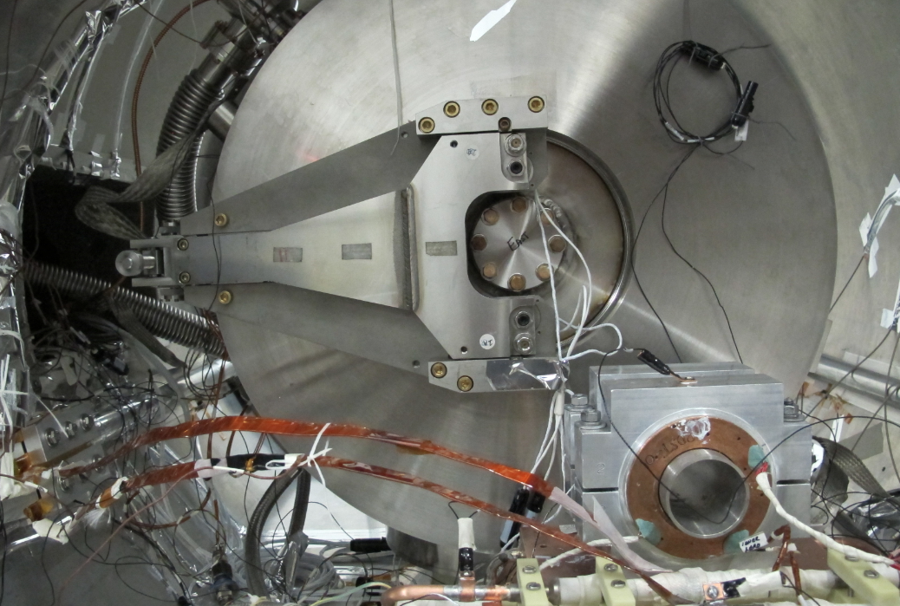
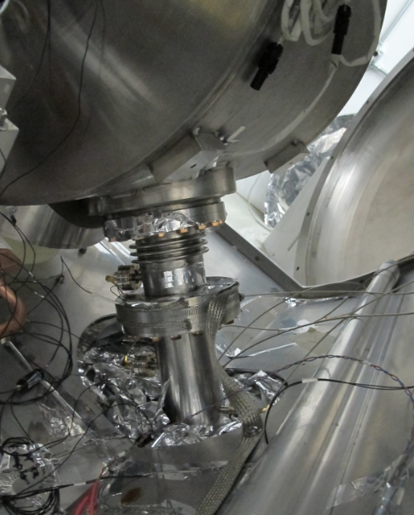
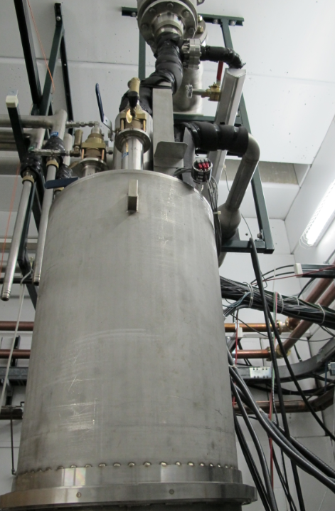
MDB - Spoke Cavity test - HINS

Slide 22
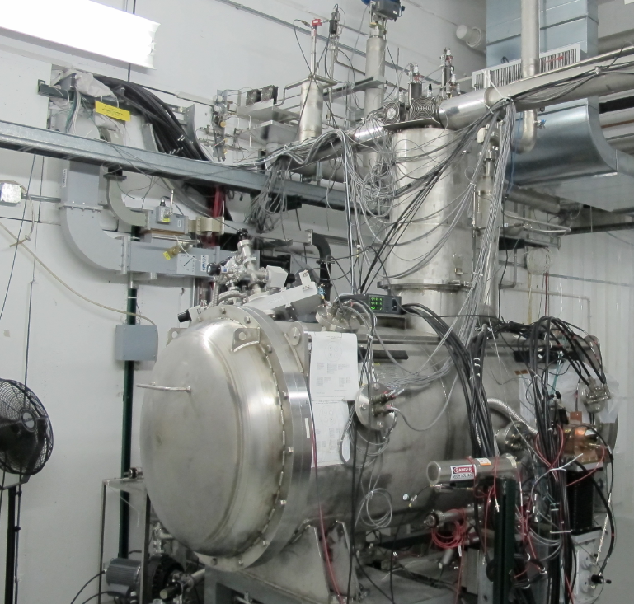
MDB - HTS

Slide 23
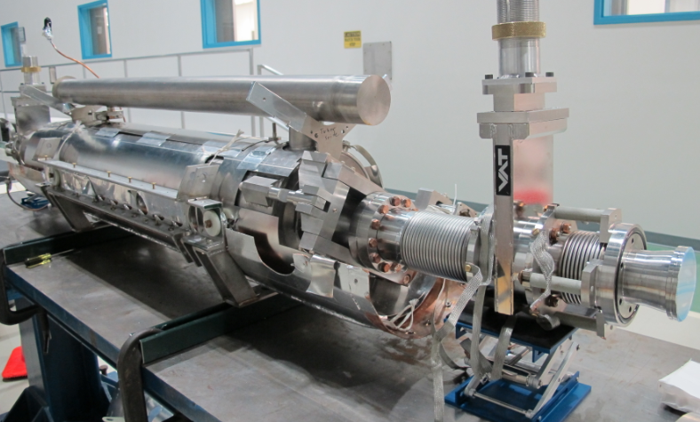
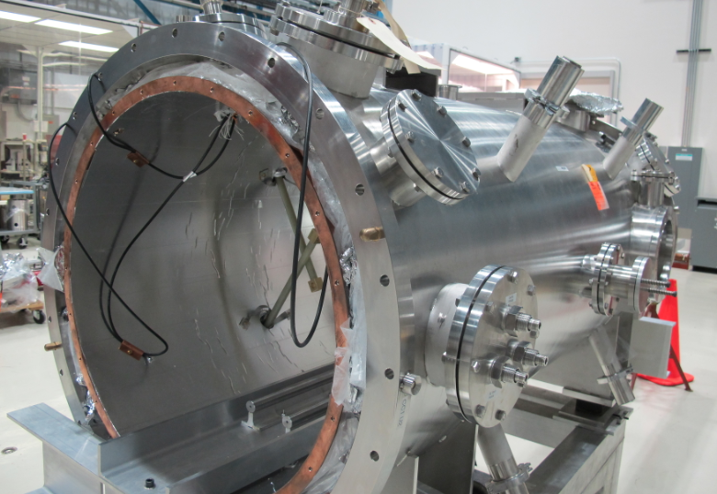
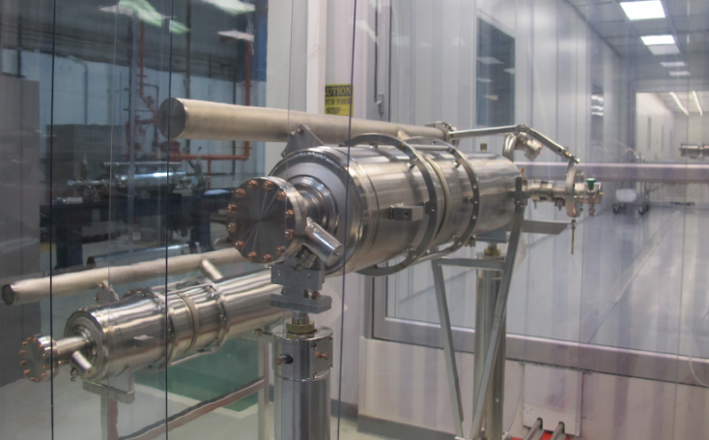
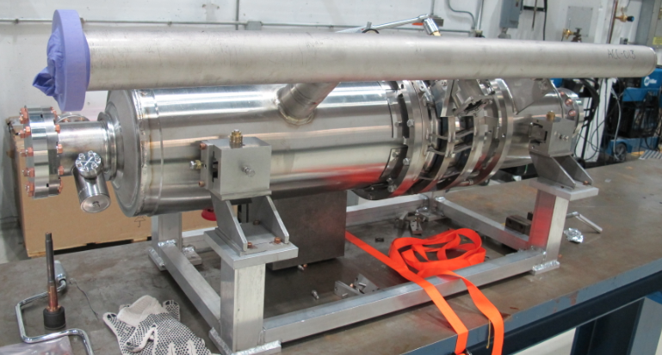
MP9 assembly hall and Clean-Room

Slide 24
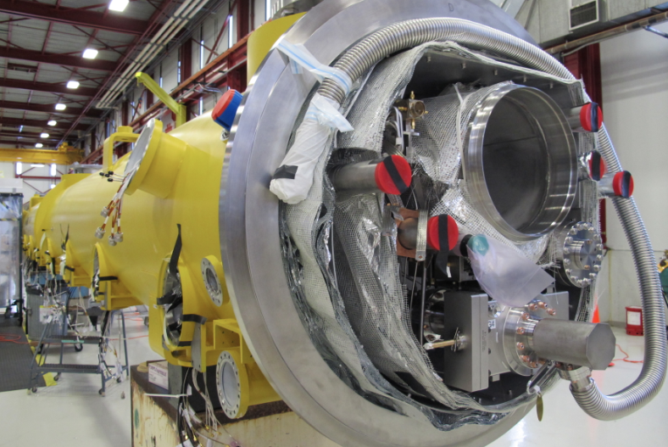
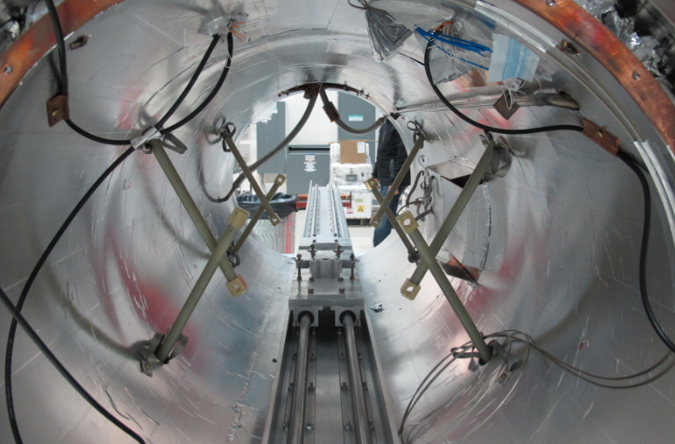
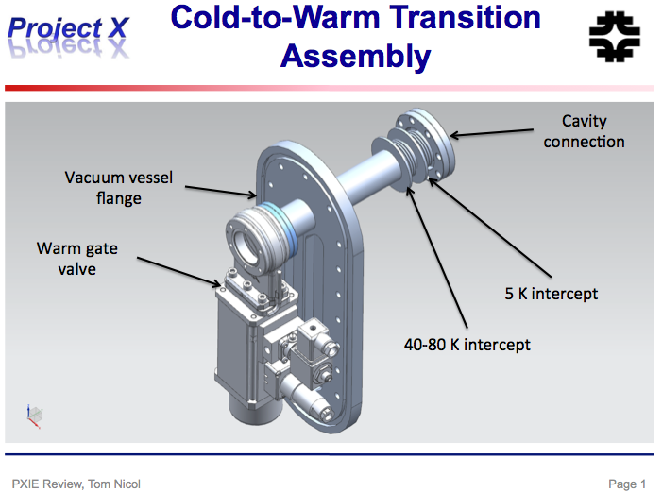
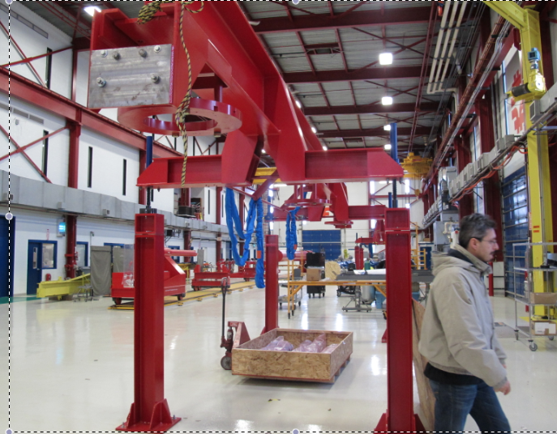
MP9 and ICB

Slide 25
Headlines
Few milestones since SLHiPP-1 (December 2011)
Cryomodule Requirements and Functions
Cryomodule Status
Elliptical Cavity Cryomodule Technology Demonstrator

Slide 26
Cryomodule Requirements and Functions
Main functions
The two main functions of the cryomodules are to :
  1) provide the positioning and alignment of the cavity package w.r.t. the beam axis,
  2) reduce the thermal losses to the cavity package while it transfers energy from the RF system to the cavity package.
Functional requirements
  Capacity to transfer energy from RF system to the beam,
  Capacity to confine the protons longitudinally,
  Capacity to steer the protons longitudinally,
Notes:
Contains 4 SC elliptical cavity package (ECP), cooled at 2 K, 1.8 bar – check the use of saturated conditions)
Positions the ECP according to a reference axis (this axis being aligned with the beam axis in the test area),
Limit the heat losses to the ECP (e.g. thermal shielding, MLI, insulating vacuum)
Contains diagnostic instrument (e.g. sensors and valves to monitor and control the ECCTD operation).
Designs requirements shall comply with the ESS codes and standard (e.g. MAWP, Nb vessel)

Slide 27
Cryomodule constraints
Contains several SC cavity package (CP)
Positions the CP according to a reference axis
Limits the heat losses to the CP,
Limits the residual magnetic field to the CP,
Separates the beam vacuum and the insulation vacuum,
Contains diagnostic instrument for operation,
Protect personal and equipment:
  Protect active components from overpressure → MAWP; functional analysis
  ALARA
Provide control and monitor
  fail-safe emergency scenarios
  → QA; Reliability, Availability, Maintainability, and Interchangeability
  Designs requirements shall comply with the ESS codes and standards
Notes:
Contains 4 SC elliptical cavity package (ECP), cooled at 2 K, 1.8 bar – check the use of saturated conditions)
Positions the ECP according to a reference axis (this axis being aligned with the beam axis in the test area),
Limit the heat losses to the ECP (e.g. thermal shielding, MLI, insulating vacuum)
Contains diagnostic instrument (e.g. sensors and valves to monitor and control the ECCTD operation).
Designs requirements shall comply with the ESS codes and standard (e.g. MAWP, Nb vessel)

Slide 28
e.g. Elliptical Cavity Cryomodule Requirements
If we assume a SNS-like cryomodule design, the cryogenic heat loads shall not exceed those of the SNS.
  Static heat loads by cryomodule at 2 K, Qs_CM < 100 W (tbc)
  Dynamic heat loads by cryomodule at 2 K, Qd_CM < 40 W
  Beam Loss < 1 W/m,
  Alignment (Oz is the reference axis that would coincide to the beam axis in case of perfect alignment):
  Magnetic shielding: residual field
  Insulating vacuum at operating temperature
Notes:
(tbc) heat load to be crossed checked with coupler values and co

Slide 29
Headlines
Few milestones since SLHiPP-1 (December 2011)
Cryomodule Requirements and Functions
Cryomodule Status
Elliptical Cavity Cryomodule Technology Demonstrator

Slide 30
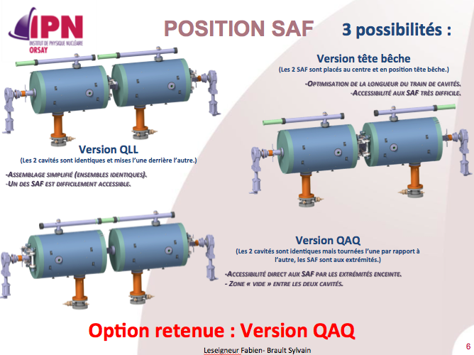
Spoke Cryomodule (IPNO)

Slide 31
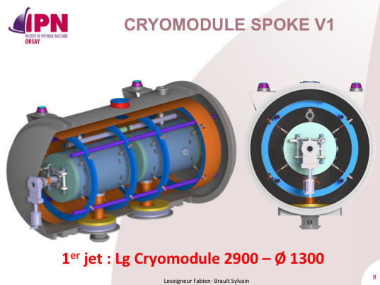
Courtesy of Denis Reynet
Spoke Cryomodule (IPNO)

Slide 32
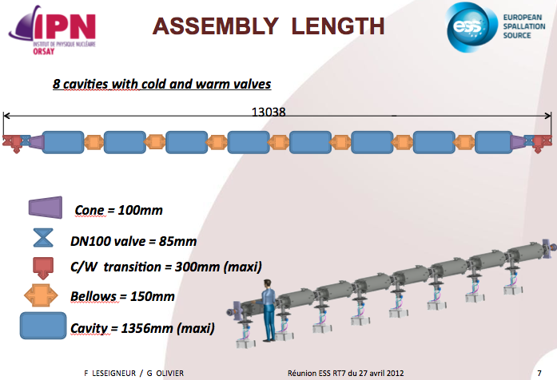
Elliptical Cryomodule (IPNO)

Slide 33
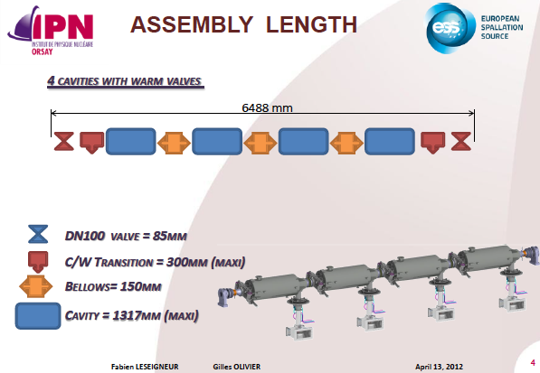
Beta =0.86

Slide 34
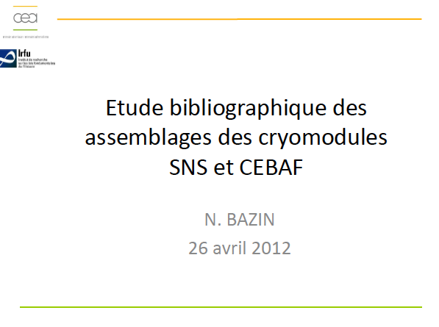
Studies of the Supporting Systems
VERSION SNS / CEBAF
VERSION XFEL / TESLA
VERSION LHC

Slide 35
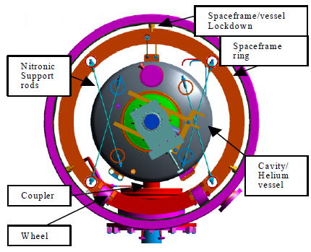
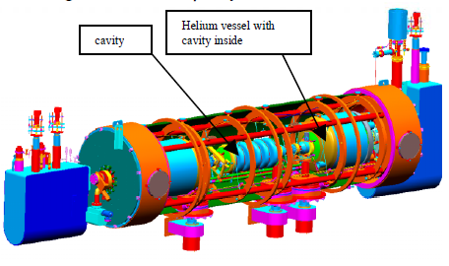
SNS
- Thermal shield inside the Space frame
2 magnetic shielding inside and outside the space frame
Stainless steel rod
Axial stoppers
Courtesy of IPNO / F. Leseigner – G. Olivier

Slide 36
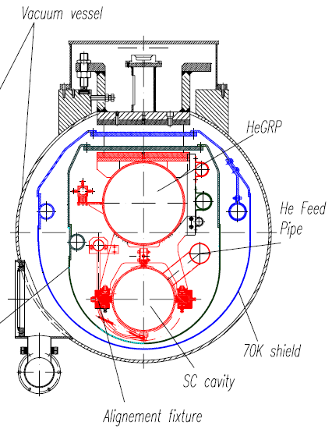
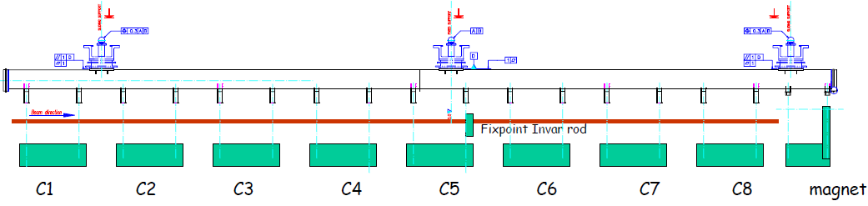
XFEL
2 thermal shield at 4 and 70K
Composite support post (type LHC)
Cavities hanging from the He bi-phasic tube (back bone)
Support et positionnement des cavités par des patins à aiguilles.
Invar bar to limit the thermal contraction
FPC bar to limit the thermal 90°
Courtesy of IPNO / F. Leseigner – G. Olivier

Slide 37
LHC accelerator
Superconducting magnets
  1,250 ton of NbTi superconducting materials
  7,600 km of superconducting “Rutherford” cables
  9,600 magnets (incl.1,232 dipoles, 392 quadruples)
Superfluid helium cryogenics (< 2 K) and vacuum techniques
  Pressurized and saturated superfluid helium, in two-phase flow
  Cryostats and thermal insulation
  Efficient and large capacity helium refrigerators
  Cryogen storage and management (120 ton of helium)
Two Phase He II
heat exchanger
Pressurized He II bath containing magnet
Notes:
Field reproducibility/precision ~ 10-3
Field homogeneity ~ 10-4

Slide 38

LHC accelerator
24 km of magnets colder than the outer space

Slide 39



Slide 40


Slide 41


Slide 42


Slide 43


Slide 44
Headlines
Few milestones since SLHiPP-1 (December 2011)
Cryomodule Requirements and Functions
Cryomodule Status
Elliptical Cavity Cryomodule Technology Demonstrator

Slide 45
Elliptical Cavity Cryomodule Technology Demonstrator (ECCTD)
The Elliptical Cavity Cryomodule Technology Demonstrator (ECCTD) contains:
  Four Elliptical Cavity Packages, ECP
  The supporting and mechanical systems that interface the ECP in the test area.
  The vacuum vessel, thermal and magnetic shieldings that insulate the ECP from the ambient condition,
  The cryogenic systems (distribution boxes and hydraulic circuits) that interface the ECP with the cryogenic distribution system in the test area,
  The instrumentation (diagnostics) and the safety devices

Slide 46

Cryomodule Prototype Requirements
Scope : Validate the technologies used to assemble and operate the 4 ESS-type cavities installed in a cryostat
→ A Technology Demonstrator to validate the following points:
Installation of the cryomodule: e.g. cleaning, tooling, procedures, QA;
The performance of the RF design:
e.g. characterize the cavity RF signature; validate RF results obtained invertical cryostat;
The performance of the thermal design:
eg. cool-down rate, operating conditions; heat loads; cooling scheme efficiency;
The performance of the vacuum design: e.g. leak tightness, bake-out;
The performance of the mechanical design: e.g. MAWP, stability, alignment;
The safe operation of the cryomodules:
e.g. process variables, control loops, operating modes, relieving system and interlock;
Training: e.g. to assemble, to operate.

Slide 47







CEA Infrastructures
+ 1 new cleanroom

Slide 48



Cryomodule Components developed by CEA

Slide 49

8 cavity packages per cryomodule
Spring 2020

Slide 50
Motivation
The ESS high-beta design calls for 8 cavity package/cryomodule in 14 cryomodules [CDR]
The elliptical cryomodule technical demonstrator contains 4 cavities per cryomodule. Constraints:
  Availability of niobium for cavities
  Clean room and test stand availability
A risk assessment performed in March:
  Suggested the need for a pre-series 8 cavity cryomodule to follow the 4 cavity technology demonstrator
  Highlighted multiple schedule risks associated with 8 cavity cryomodules production
Accelerator Division has begun examining the advantages of a 4 cavity cryomodule for series production.

Slide 51

8 Cavity cryomodule
Advantages
  Limit the cooling capacity → Cost
  Simplify the cooling scheme → Cost
Disadvantages
  Need a production alpha version → Schedule
  Limited clean room availability → Schedule
  Large RF testing facility needs to be found or built → Cost
  New (uncertain) alignment system to design → Design
  Less flexibility in lattice design

Slide 52

4 Cavity Cryomodule
Advantages
  Technology Demonstrator is the alpha version → Schedule
  Re-use more clean rooms → Schedule and cost
  Re-use the SNS design → Design
  Similar assembly and hardware for medium beta → Design
  More places to test (RF + cryo) → Schedule and cost
  Isolate cavity in case of failure → ESS program
  Only one standard cryostat for all elliptical cavities → Design
  More flexibility for lattice design (FODO) → ESS program
Disadvantages
  Additional test to plan → cost
  May add up to 21 meters to the cold linac → cost
  Additional segmentation and components (valve boxes, connecting pipe) → cost
  Higher high load → cost (negligible)

Slide 53

4+4 Cavity cryomodule
Advantages
  Possibility to re-use more clean room → Schedule and cost
Disadvantages
  Need a production alpha version → Schedule
  Add extra 12 meters to the cold linac → Cost
  Add additional segmentation and components (valve boxes, connecting pipe) → Cost
  Less flexibility in Lattice design → Design
  Large testing facility required → Cost
  Weakness of the mechanical design (e.g. capture end force) → Design

Slide 57

4 cavity packages per cryomodule

Slide 58
Conclusions
Key Collaborations:
New support : CEA future cleanroom and IPNO engineering expertise
Keep supporting ESS-CERN joint collaboration
Cryomodule Requirements and Functions:
Document to be completed asap
Cryomodule Status (Spoke, Elliptical)
Fast Progress by IPNO (Spoke, Elliptical)
Elliptical Cavity Cryomodule Technology Demonstrator
The next milestone..
Notes:
----- Meeting Notes (2/6/12 14:24) -----
Risk too much to
Overall set-up
Cern meeting - change design of CDR --> planing ready and requirements ready - facility
CEA
Construction
Assembly
Test
Associated infrastructures.

Slide 59
EXTRA slides

Slide 60

Spoke resonators – Summary
Sebastien Bousson - IPNO
Overall dimension of the cavity
Cavity β | 0.50
Cavity length | 780 mm
Cavity diameter | 480 mm
frequency | 351.8 MHz
Cavity RF parameters
R/Q | 426 Ω
G | 130 Ω
Q_{o} at 4K (with R_{res} = 10 nΩ) | 2.6 10⁹
Q_{o} at 2K (with R_{res} = 10 nΩ) | 1.2 10¹⁰
E_{pk} / E_{acc} | 4.43
B_{pk} / E_{acc} | 7.08 mT/(MV/m)
Peak fields @ Eacc =8 MV/m
E_{pk} = 35 MV/m
The « One » Risk of the ESS ?
B_{pk} = 57 mT
Cover the energy range: ~ 50 MeV to ~ 190 MeV
Nominal power: 250 kW
Capacitive coupling
Maximum reflection coefficient: S₁₁ < -30 dB
Window cooling capabilities
Relatively simple design for reliability & cost
Max outer diameter: 100 mm
2011-12-09, SLHiPP-1, Christine Darve

Slide 61

Elliptical cavities – Summary
Guillaume Devanz - CEA
5-cell cavities, bulk niobium
frequence = 704.42 MHz
operating temperature 2K
Two beta families
beta | Eacc VT (MV/m) | Eacc Linac (MV/m)
0.65 | 17 | 15
0.86 | 20 | 18
β g=0.86 |  | unit
Frequency | 704.42 | MHz
Nr of cells | 5 (sym.)
Cell to cell coupling | 1.8 | %
π and 4π/5 mode separation | 1.2 | MHz
Epk/Eacc | 2.2
Bpk/Eacc | 4.3 | mT/(MV/m)
Max. r/Q | 477 @ β=0.92 | Ω
G | 241 | Ω
Low field Qo | 3e10
Qo at nominal Eacc | 6e9
Cavity string building block : fully dressed cavity
2011-12-09, SLHiPP-1, Christine Darve

Slide 62







Elliptical cavities – Views
He vessel and tuner integration
Guillaume Devanz/CEA
Stainless steel vessel option
Titanium tank
NbTi flanges, Al Hex seals
(single bellows)
Derived from CARE-HIPPI β = 0.5 cavity
Titanium vessel option
New Saclay piezo tuner for SPL cavities
Derived from SPL Ti tank design

