Slide 1
ESS RF System Design
Stephen Molloy
RF Group
ESS Accelerator Division
SLHiPP2
4-May-2012

Slide 2
Outline
Overview of the ESS RF system
System behaviour
System layout
Modulator workshop
Risk & reliability

Slide 3
System Overview

Slide 4
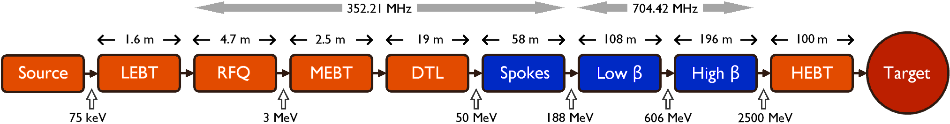
RF System Overview
NB: Lattice updates will have altered this.
Superconducting linac

Slide 5
RF System Main Components
The RF system for the ESS linac is defined as the system that:
  converts AC line power to RF power at either 352 or 704 MHz
  supplies this power to the cavity couplers
Main components
  Modulator
    Converts conventional AC power into pulse power
    ESS requires 90 modulators
  RF Power Amplifiers
    Converts the modulator’s pulsed power to RF at 352 or 704 MHz
    Typically klystrons
      Require ~180 klystrons
      1 MW peak power per klystron (40 kW average)
  RF Distribution
    Transports the RF from power amplifiers to cavity coupler couplers
    Typically waveguides with other components (circulators, directional couplers, etc…)
  Low Level RF Control
    Regulates RF amplitude to 0.5% and phase to 0.5 degrees
    Requires both feedback and adaptive feed-forward algorithms

Slide 6
General Requirements

Slide 7
System Requirements

Slide 8
Example Specifications

Slide 9
Behaviour

Slide 10
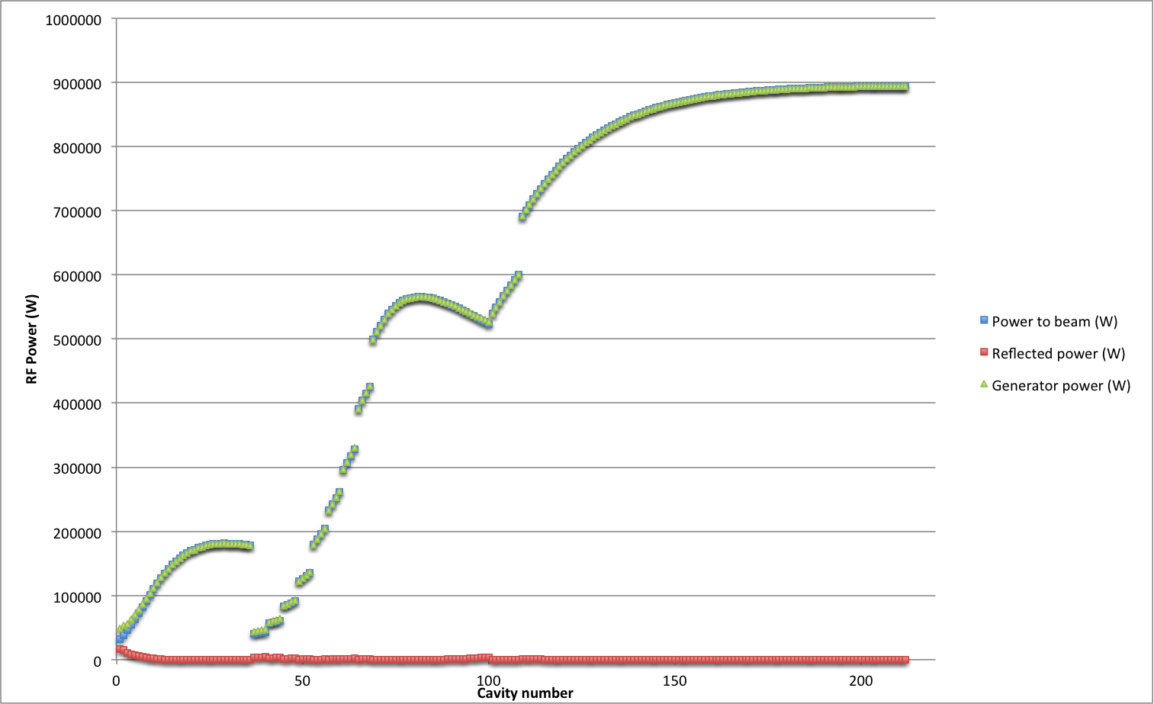
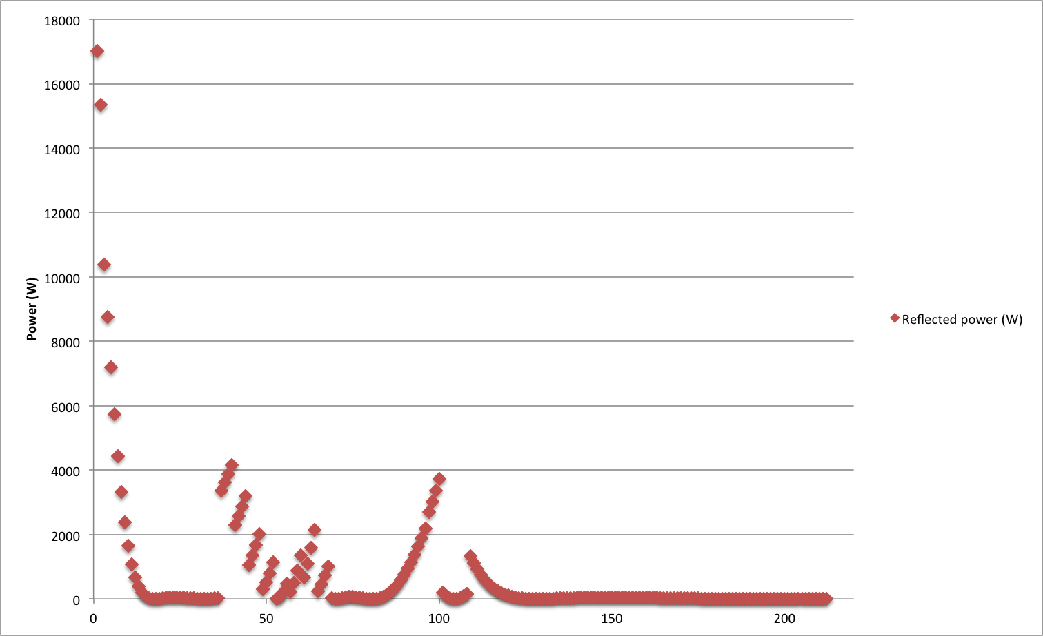
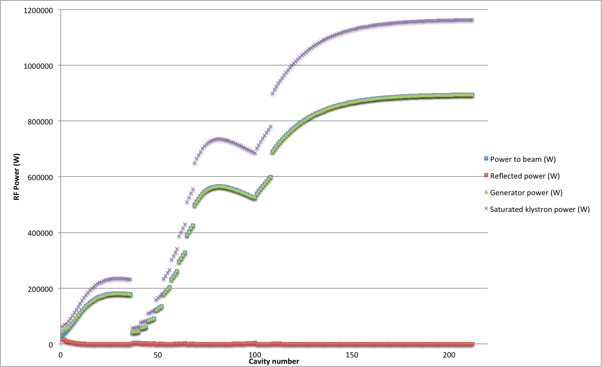
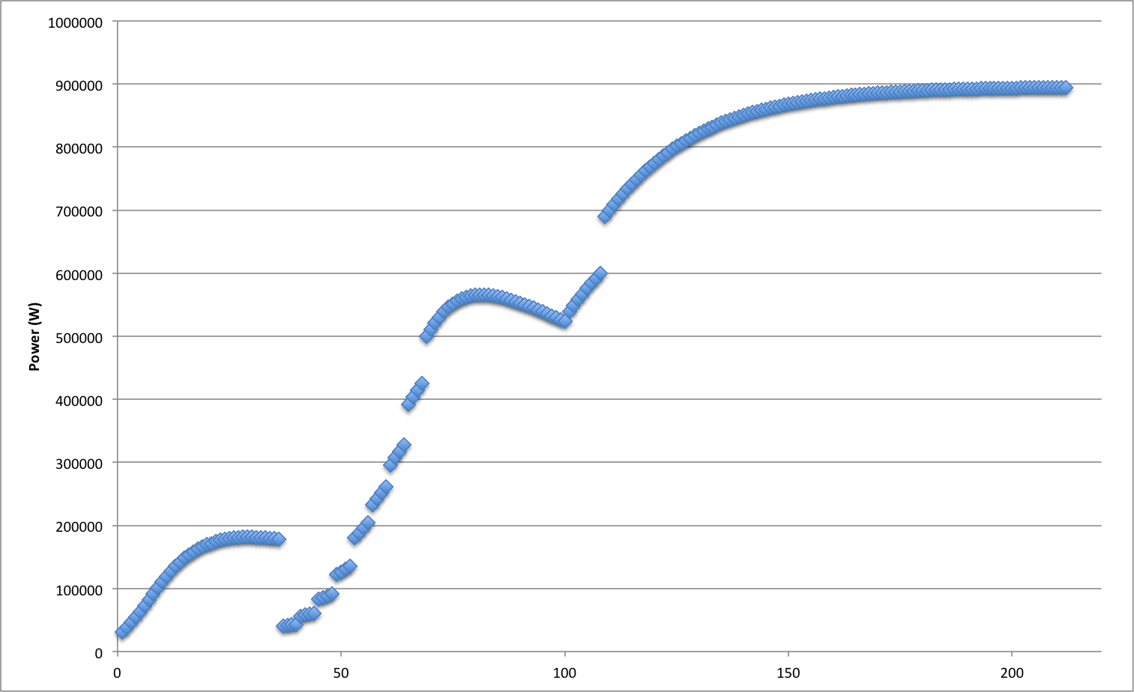
Large-scale system response
Steady-state reflected power (i.e. during beam-time) is governed by the R/Q drop at the ends of each section.
Drives requirements of the circulators, loads, etc.
Required saturated klystron power assuming 25% overhead + 5% losses.
Drives the scale of the klystron/modulator systems, cooling requirements, etc.
Single coupler design (i.e. Q_{L}) for each section, but each cavity detuned to minimise the reflected power.

Slide 11
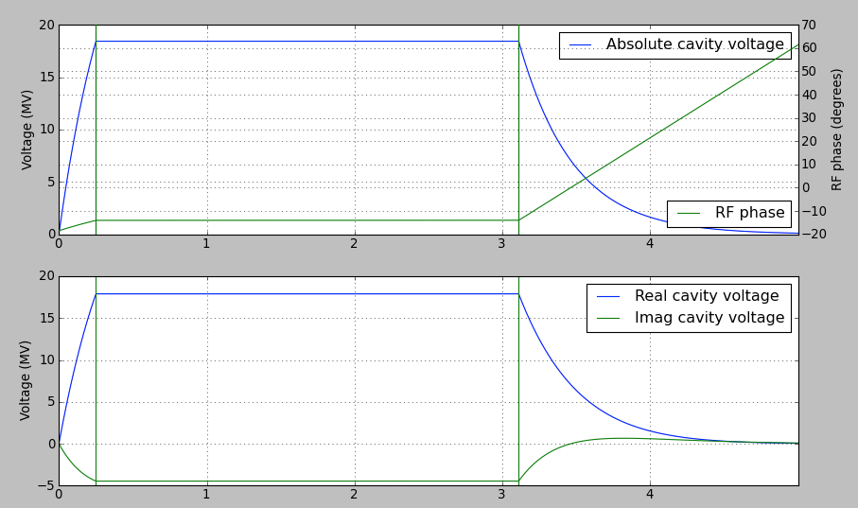
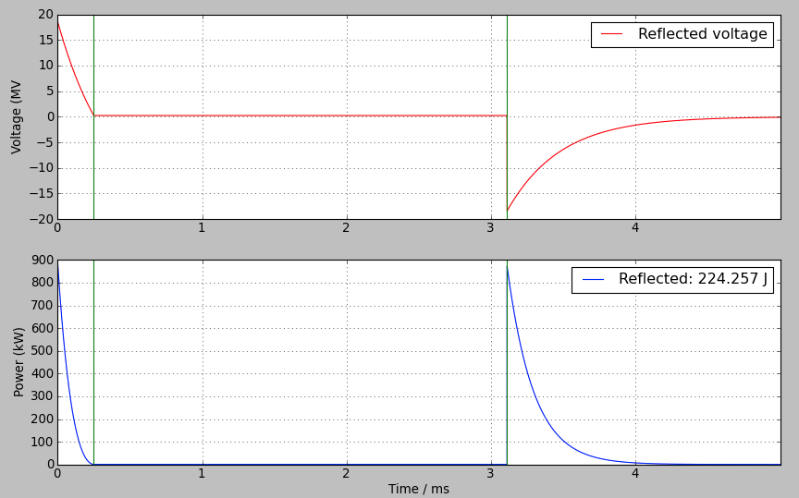
Temporal response
Total reflected energy per pulse under nominal conditions. Dictates the load requirements.

Slide 12
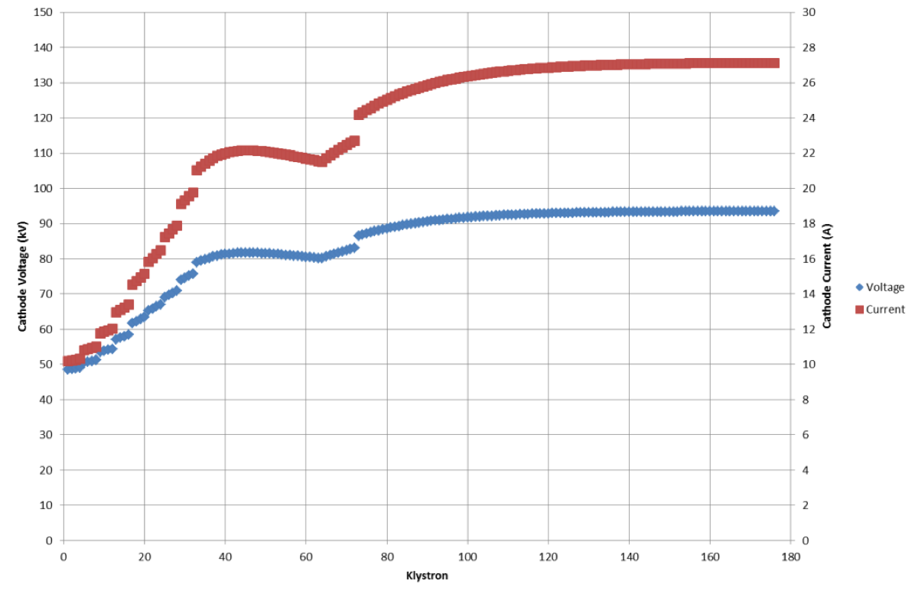
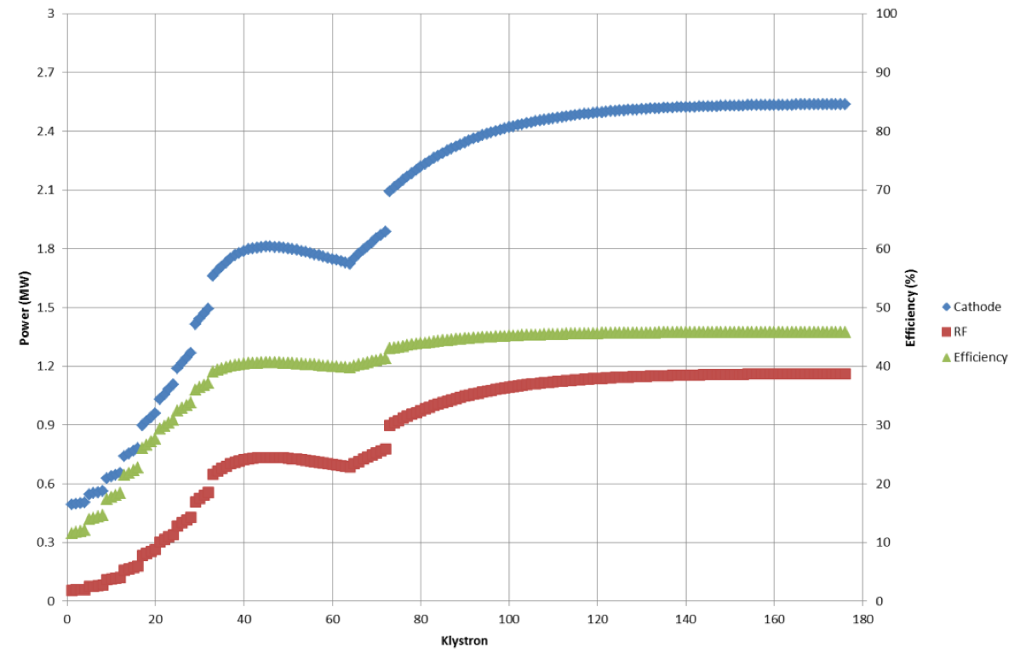
Efficiency of the overall RF system

Slide 13
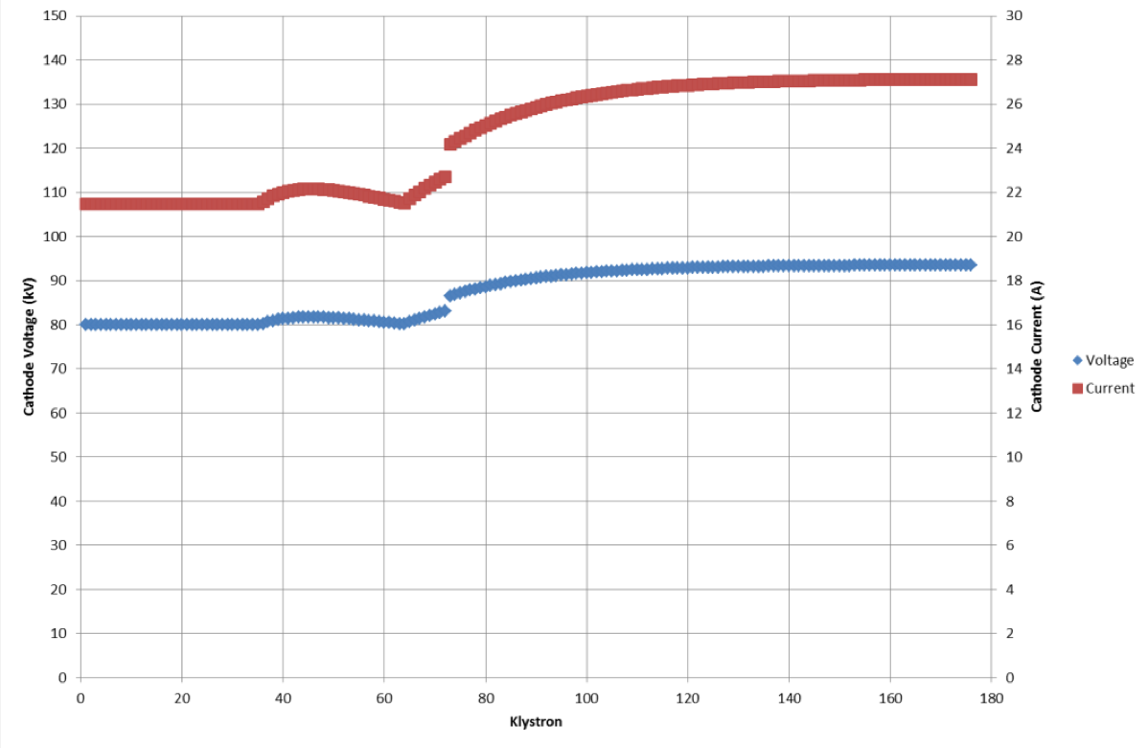
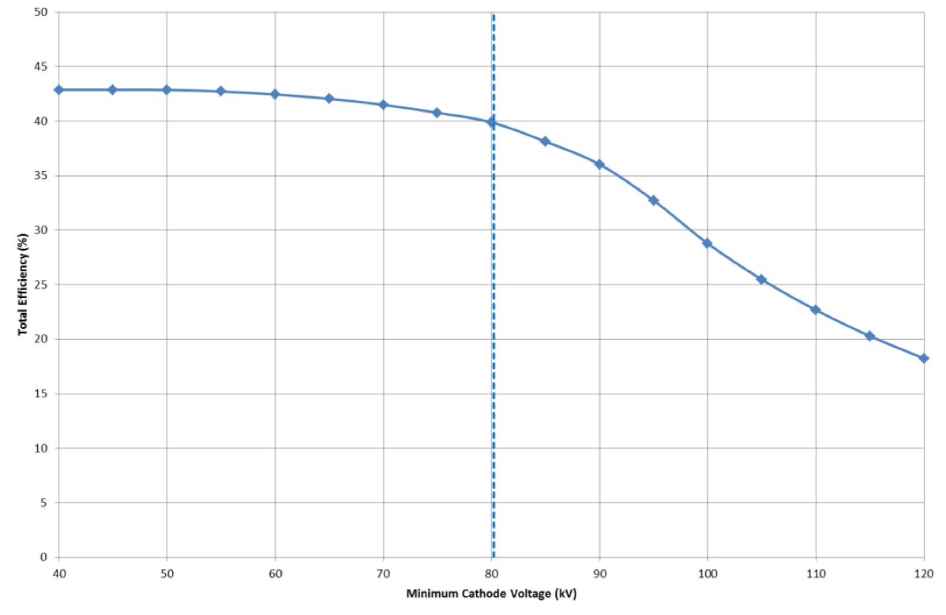
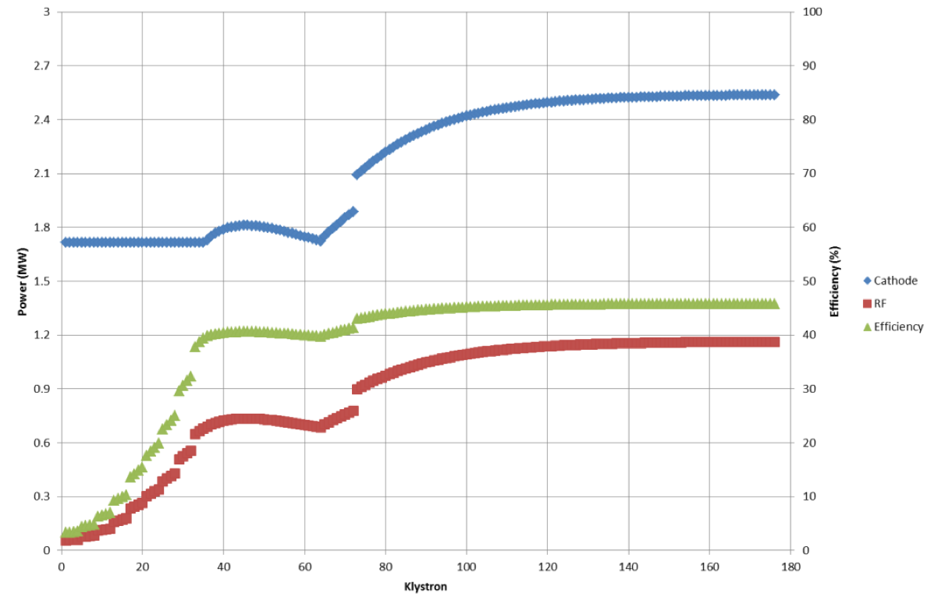
Efficiency of the overall RF system

Slide 14
Layout

Slide 15
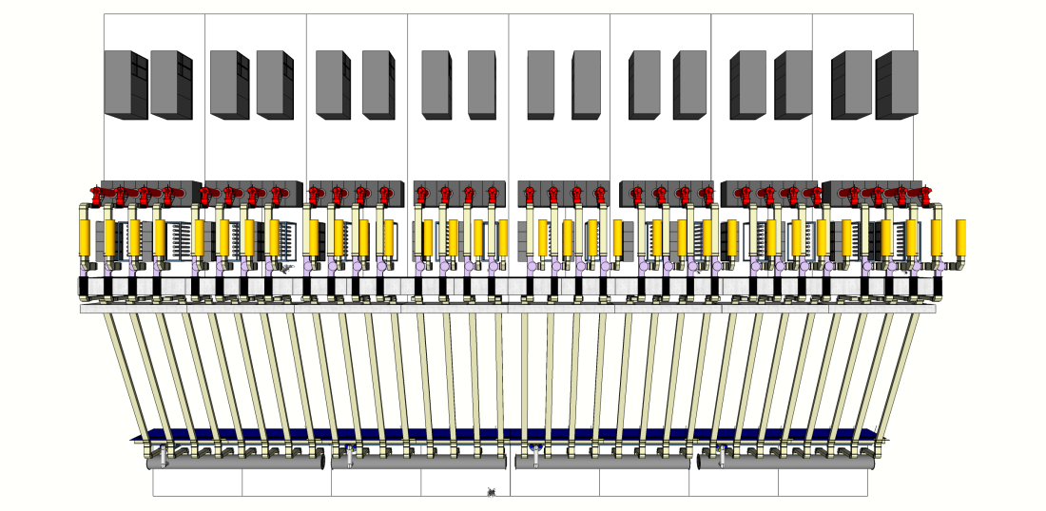
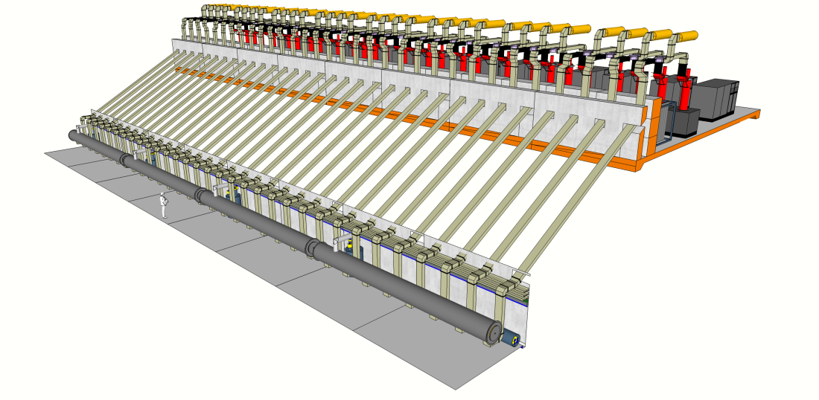
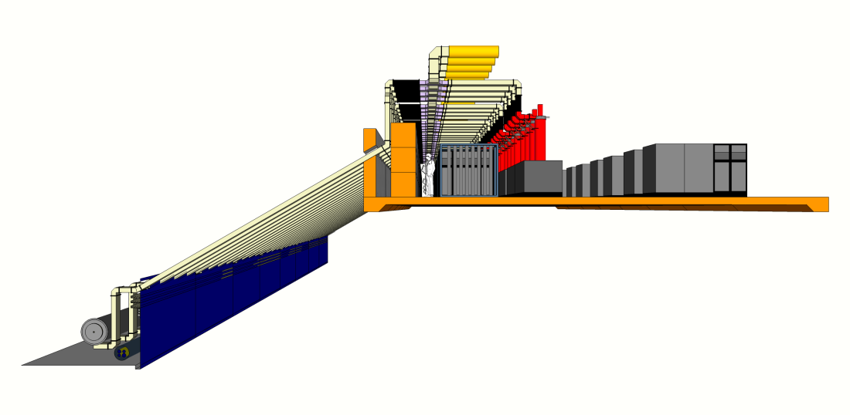
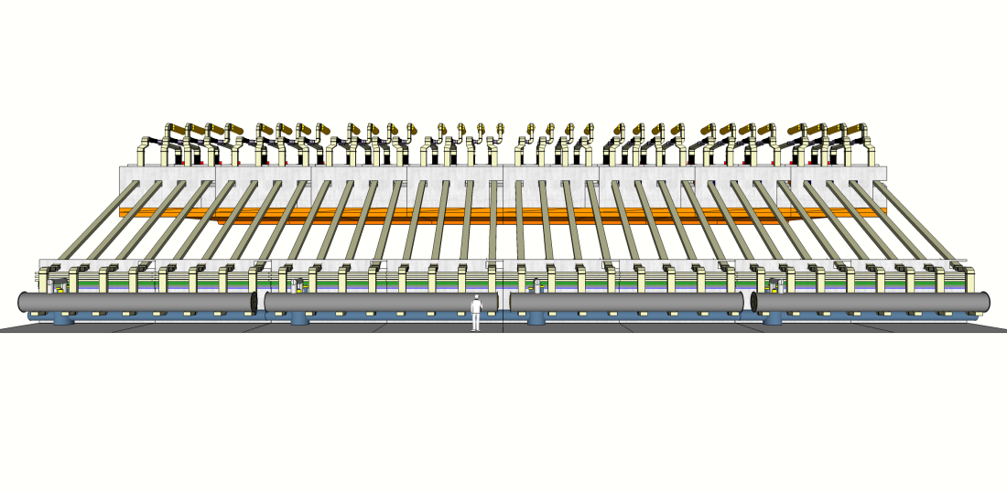
Gallery/Linac integration:
Chute Concept

Slide 16
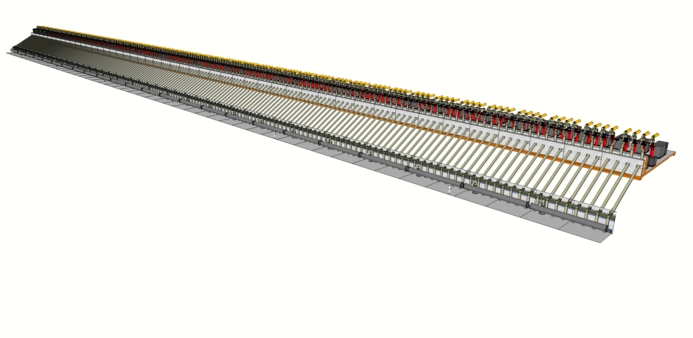
Gallery/Linac integration:
Chute Concept

Slide 17
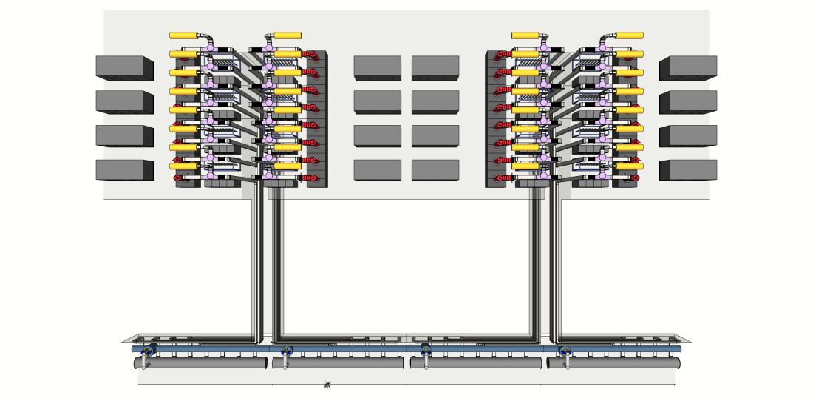
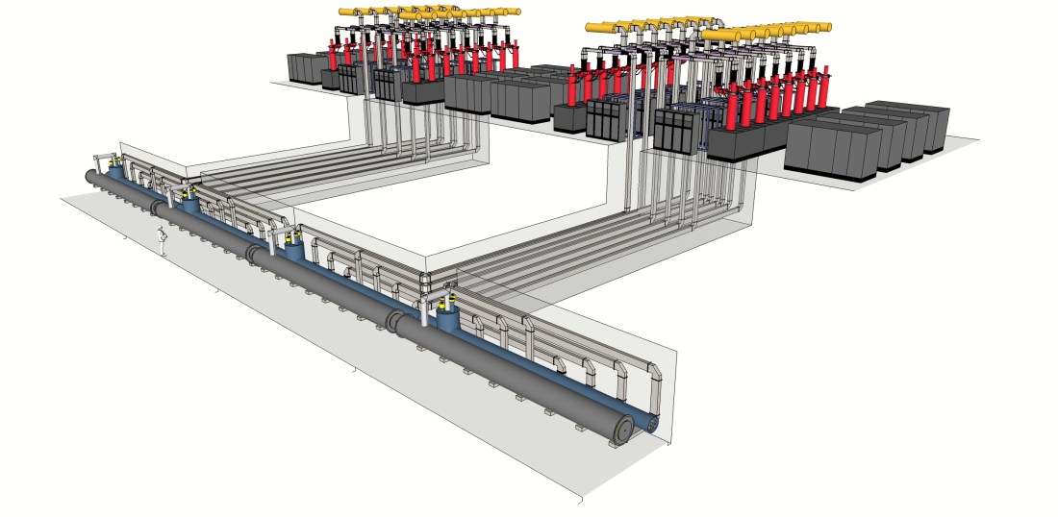
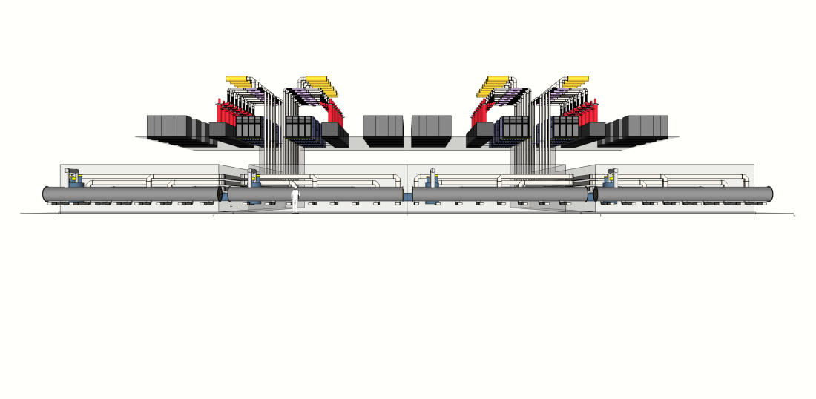
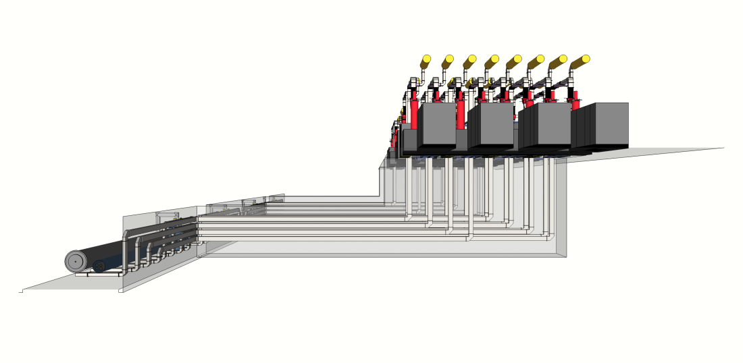
Gallery/Linac integration:
Stub Concept

Slide 18
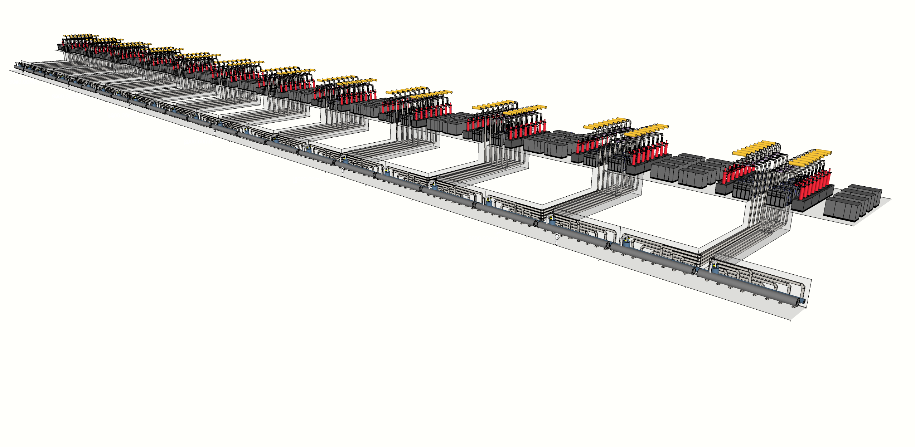
Gallery/Linac integration:
Stub Concept
Benefits:
Fewer (larger) penetrations.
Wide penetrations allow 90 degree bend.
No line of sight from tunnel to gallery.
Freedom to alter cryomodule positions

Slide 19
Modulator workshop

Slide 20
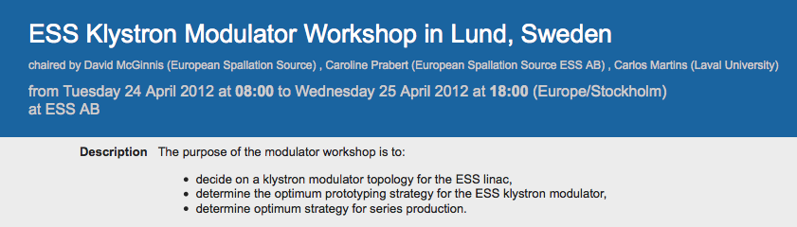
“Intense” Discussions
Presentations by invited experts
    CERN, DESY, FNAL, LANL, RRCAT, SLAC, SNS
Attendance included manufacturers
      No presentations, but strong participation in discussions
Draft strategy emerged from the meeting
    ESS will write the technical specifications
        Does *not* impose a topology
    Call for tender for production of multiple prototypes
    Limited call for tender for series production
        Possibility for multiple vendors to be successful

Slide 21
Risk & Reliability

Slide 22
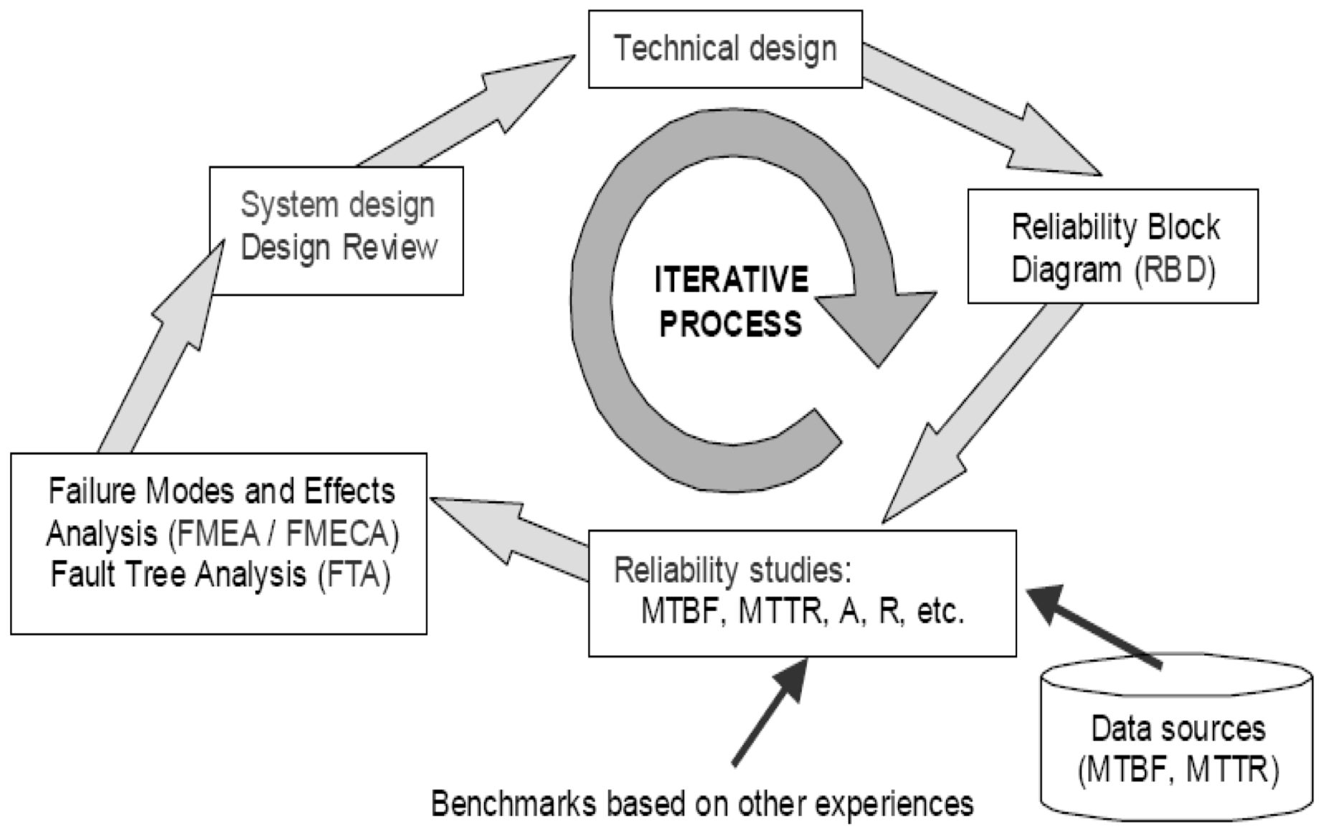
95% availability
MTBF & MTTR of klystrons is likely to dominate the machine availability

Slide 23
Power dist <i>
RBD
Transformer
R_{ti}=0.99999969
RF Source 1
RF Source 2
RF Source 3
RF Source 4
RF Source <i>
RBD
Modulator
R_{mi}=0.9999
Klystron
Klystron
R_{ki}=0.9995
R_{ki}=0.9995
LLRF
LLRF
R_{mi}=0.9999
R_{mi}=0.9999
Circulator/load
Circulator/load
R_{ci}=0.9995
R_{ci}=0.9995

