Slide 1
PSS1 overview and concepts of operations
PSS1 Preliminary Design Review
2019-09-18
Morteza Mansouri
Lead Integrator Engineer for Safety Critical Systems
On behalf of ICS Protection Systems Group
www.europeanspallationsource.se
19-09-18

Slide 2
Content
NCL and PSS1 controlled area layout
PSS1 principles of operation
PSS1 overview; safety interlock system and access control system
PSS1 layer architecture
PSS1 modes of operation
PSS1 key exchange system
Some open questions
Summary

Slide 3
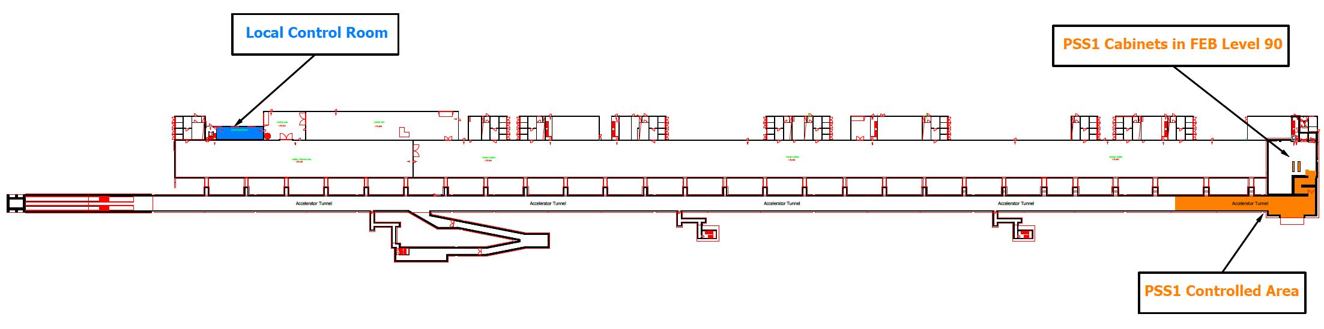
NCL layout

Slide 4
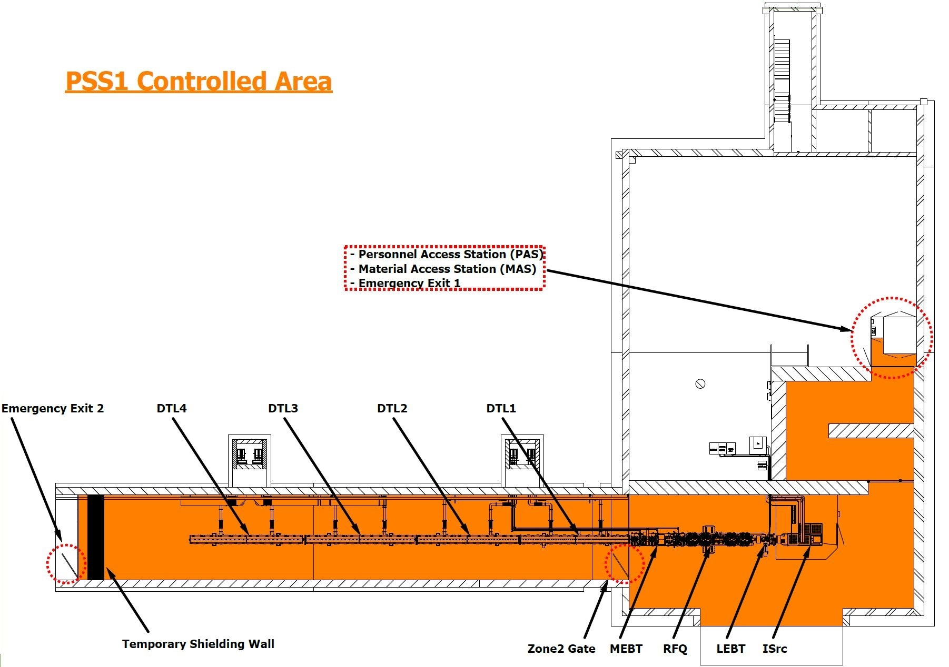
PSS1 controlled area layout
The purpose of PSS1 is primarily to restrict access to NCL area and to ensure that personnel are protected from being harmed by exposure to ionising radiation in the NCL, generated by the proton beam and high-power Radio Frequency (RF) systems. This is achieved by allowing access to the NCL area in the accelerator tunnel (hereafter referred to as “PSS1 controlled area”) only during safe state of the area.

Slide 5
PSS1 principles of operation
Prior to energizing the SAE (i.e. enabling ISrc HV PS, beam operation and RF systems):
  Trained operators shall carry out a formalised search in the PSS1 controlled area;
  The access door and emergency exit doors of the PSS1 controlled area shall be locked (the emergency exit doors can be opened from inside the PSS1 controlled area).
Prior to granting access to PSS1 controlled area:
  The SAE shall be turned off through the control system.
  The mains incoming power to the SAE shall be disconnected.
  The mains incoming power to the SAE shall be secured against re-connection.
Stakeholder Associated Equipment (SAE) are the equipment in NCL that PSS1 interlocks in order to mitigate their associated hazard(s) within PSS1 controlled area. In case of PSS1, the SAE are RFQ and DTLs’ modulators, LLRF of NCL RF systems, ISrc Magnetron power supply and ISrc HV PS.
Access to PSS1 controlled area shall be registered and controlled:
  Entry and exit to PSS1 controlled area shall be registered (e.g. log the entry/exit).
  Entry to PSS1 controlled are shall be provided upon identification of the person.

Slide 6
PSS1 overview
PSS1 consists of two subsystems:
Safety Interlock System: The safety interlock system consists of sensors, logic solvers and actuators that remove the permits to power the proton beam and RF systems under conditions leading to ionising radiation hazards, or electrical hazard.
Access Control System: The PSS1 access control system controls the access to the PSS1 controlled area (registered and controlled access). It consists of a Personnel Access Station (PAS) and a Material Access Station (MAS).
Notes:
Safety interlock system:
If the PSS1 Main key in the key exchange system (Appendix 4) is removed, the proton beam is switched off by removing the power to the designated Stakeholder Associated Equipment (SAE), which are the ISrc High Voltage Power Supply (HVPS) and the RFQ modulator. The RF power to the MEBT bunchers and DTLs is also switched off by removing power to the MEBT bunchers Solid State Amplifiers (SSA) and the DTL modulators respectively.
Lock access doors to PSS1 controlled area prior to enabling the power to the designated SAE as described in 3.3.1.1. This function is derived from Worker Radiation Safety Function (WRSF) 94 in ‎[2].
If an intrusion into PSS1 controlled area is detected by the safety position monitoring switches at any access or emergency exit door of PSS1 controlled area, the proton beam is switched off by removing the power to the designated SAE, which are the ISrc magnetron Power Supply (PS), the ISrc HVPS and the RFQ modulator. The RF power to the MEBT bunchers and DTLs is also switched off by removing power to the MEBT bunchers SSA and the DTL modulators. This function is derived from WRSF 95 in ‎[2].
The PSS1 controlled area is equipped with emergency switch-off pushbuttons. Pressing any of the emergency switch-off pushbuttons in the PSS1 controlled area immediately switches off the proton beam and the RF power by removing the power to the designated SAE as described in 3.3.1.3.
If PSS1 receives a high radiation alarm or a fault signal from any of the Area Mixed-Field Monitors (AMM), the proton beam and the RF power are immediately switched off by removing the power to the designated SAE, as described in 3.3.1.3, in order to protect personnel working in the vicinity of the PSS1 controlled area. This function is derived from WRSF 141 in ‎[2]. Appendix 2 details the location of the AMM around the PSS1 controlled area.
The RF systems for RFQ and DTLs will need to be tested in the klystron gallery whilst access to PSS1 controlled area is allowed. Only if a dedicated removable part of the RF Distribution System (RFDS) is removed, the power to the RFQ and DTL modulators is enabled by PSS1. The PSS1 monitors the position of the removable RF waveguide and ensures this part is removed prior to enabling power to the respective RF system.
The RF systems for MEBT will need to be tested in the klystron gallery whilst access to the PSS1 controlled area is allowed. Only if the RF switch on the RF coaxial cable is closed, the power to the MEBT bunchers SSA is enabled by PSS1. The PSS1 monitors the position of the RF switch on the RF coaxial cable and ensures it is closed prior to enabling power to the respective RF system.

Slide 7
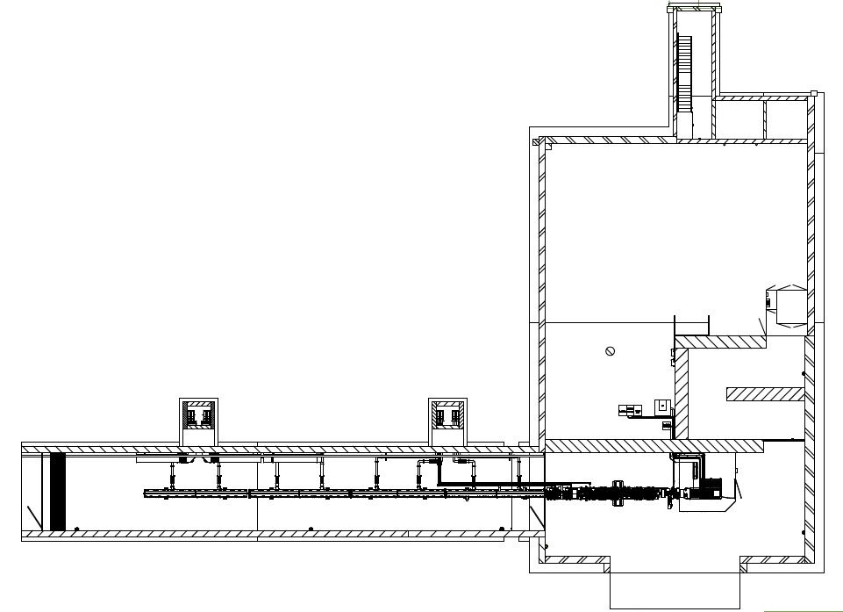
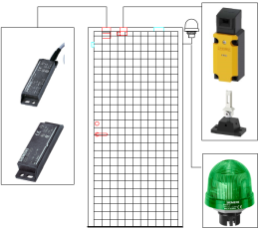
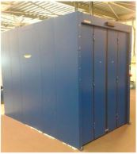

PSS 1 safety interlock system; monitoring doors positions
Monitor the position of the access stations and emergency exit doors by using safety position monitoring switches;
Locking the access stations and emergency exit doors to prevent access to PSS1 controlled area prior to energising the SAE.
Installing emergency switch-off pushbuttons inside PSS1 controlled areas, in order to provide means to manually switch off beam and RF power in case of emergency.
+
Emergency exit doors
PAS
MAS

Slide 8
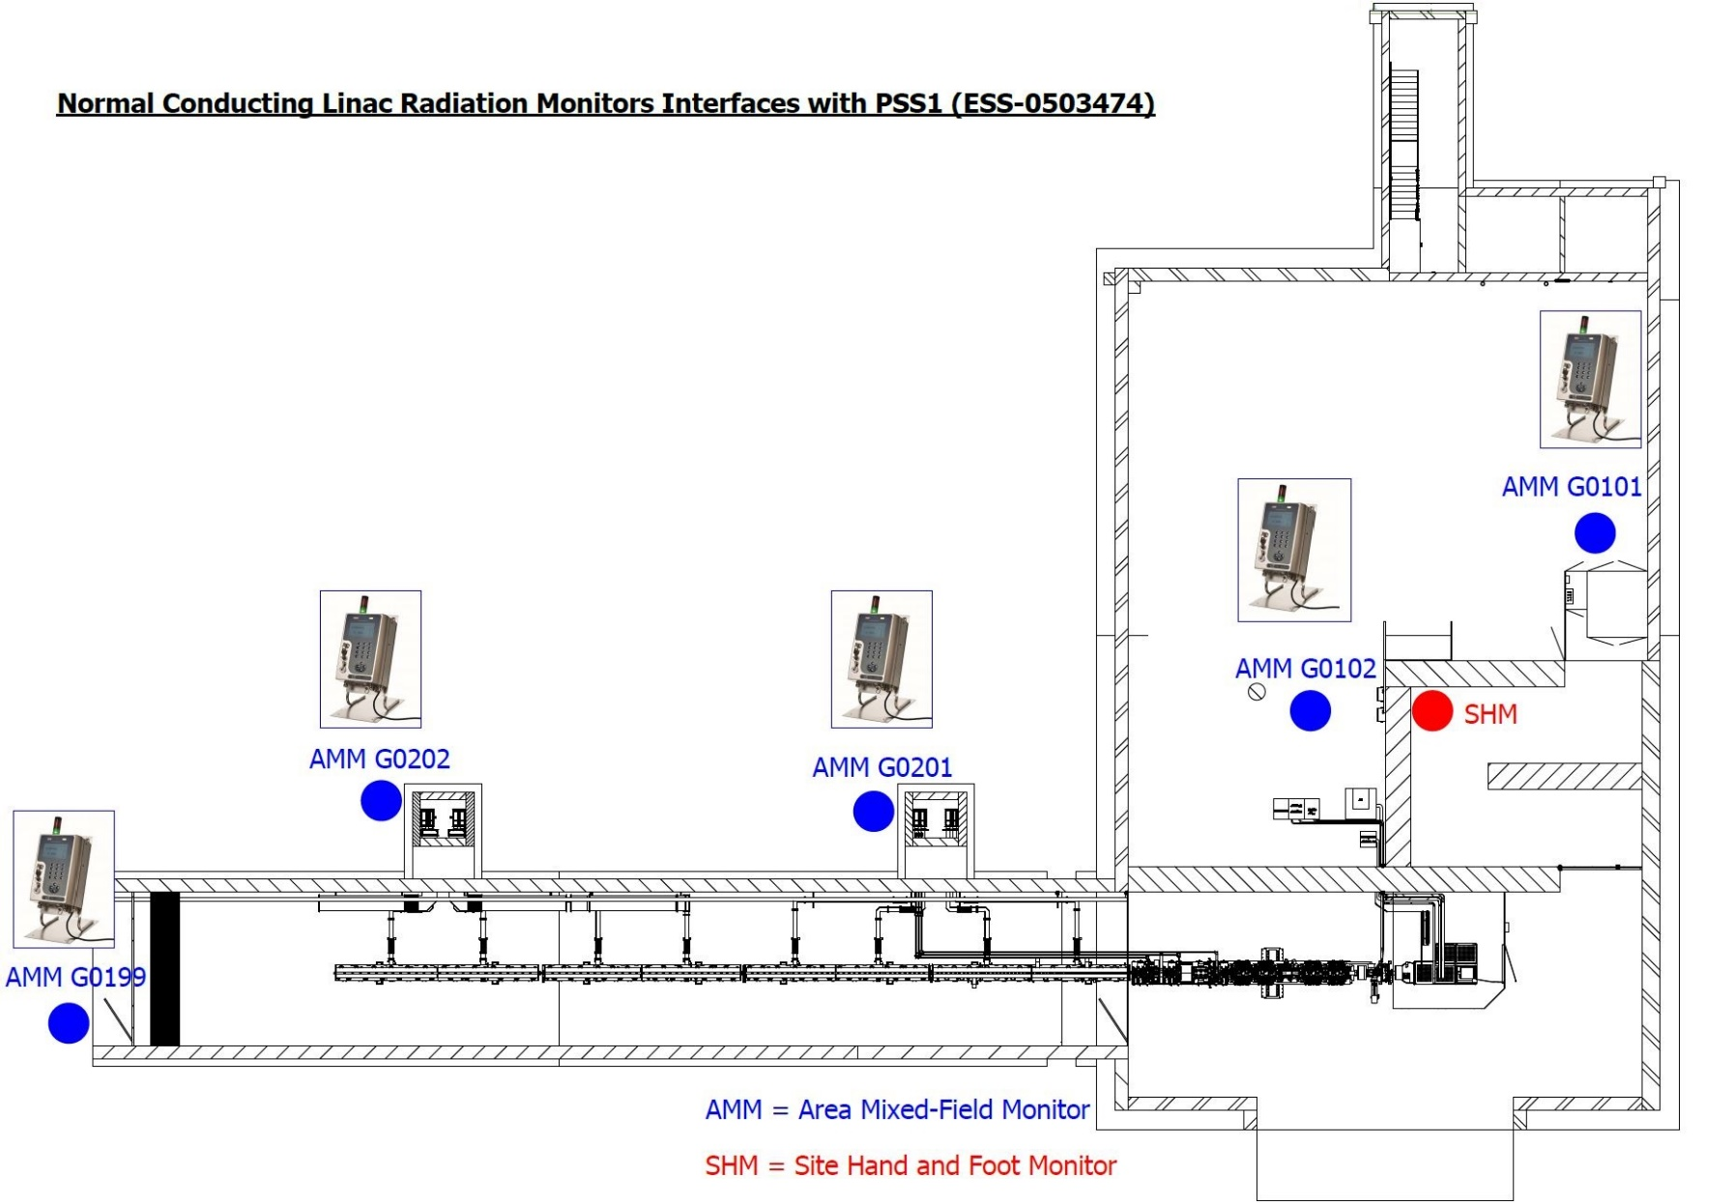
PSS 1 safety interlock system; interfaces with REMS
PSS1 receives two signals from each of these radiation monitors:
High radiation alarm (defining the thresholds is in the responsibility of the RP group)
Radiation monitor fault (the conditions that generate this signal can be configured in the radiation monitor by the RP group.)
PSS1 treats both signals the same way, i.e. upon receiving any of these signals, PSS1 switches off all the SAE.

Slide 9
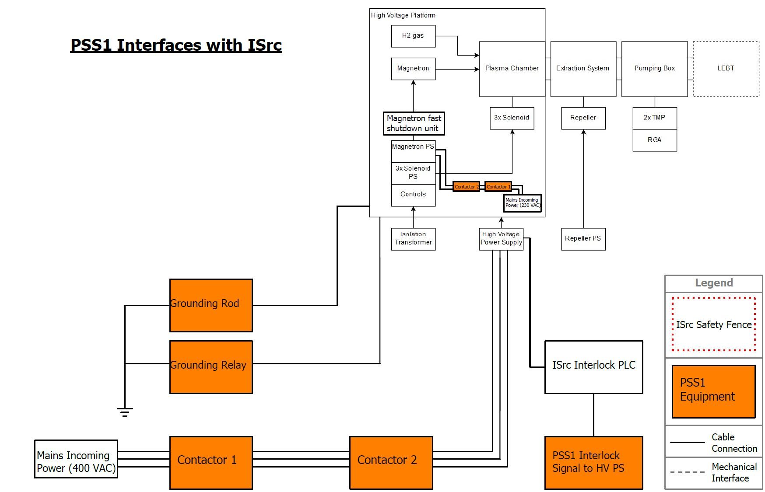
PSS 1 safety interlock system; interfaces with ISrc

Slide 10
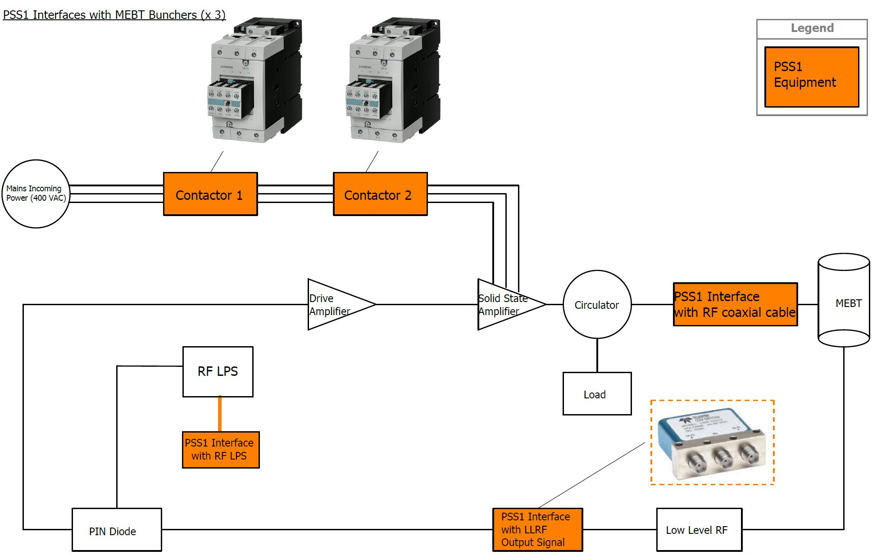
PSS 1 safety interlock system; interfaces with MEBT

Slide 11
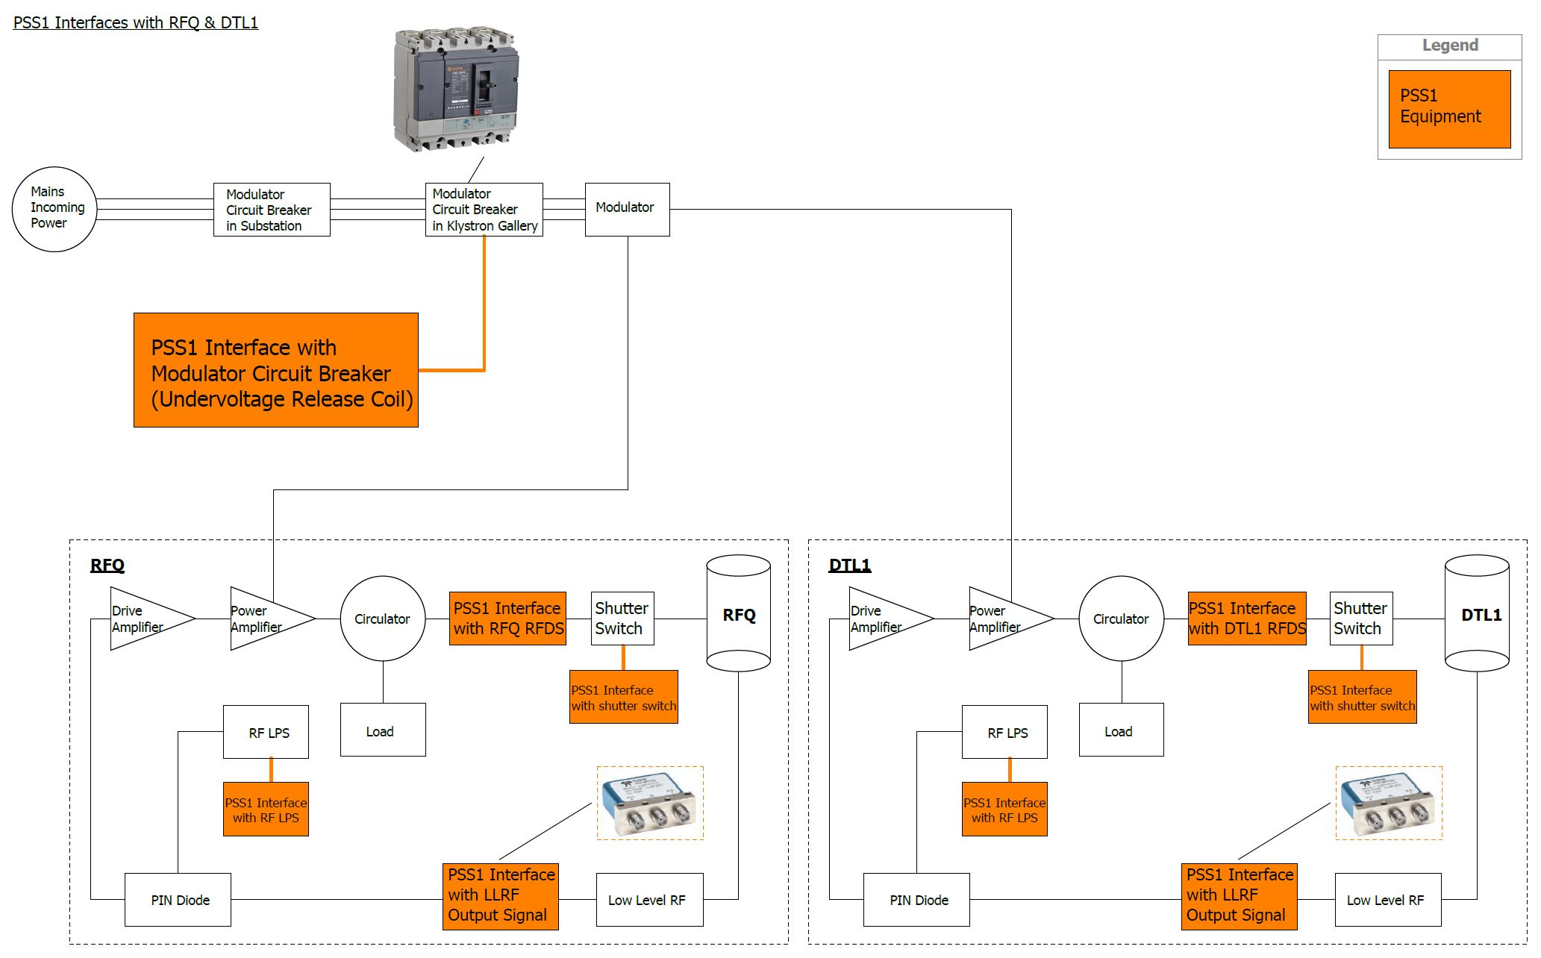
PSS 1 safety interlock system; interfaces with RFQ & DTL1

Slide 12

PSS 1 safety interlock system; interfaces with DTL2 & DTL3

Slide 13
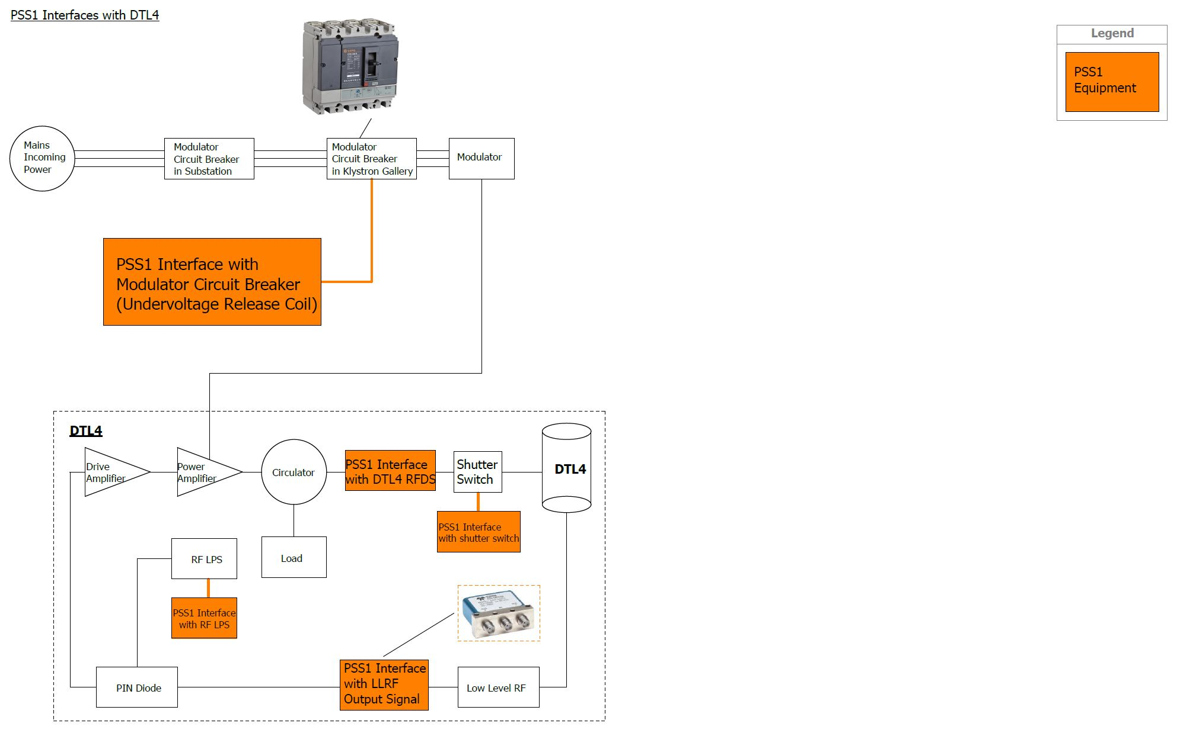
PSS 1 safety interlock system; interfaces with DTL4

Slide 14
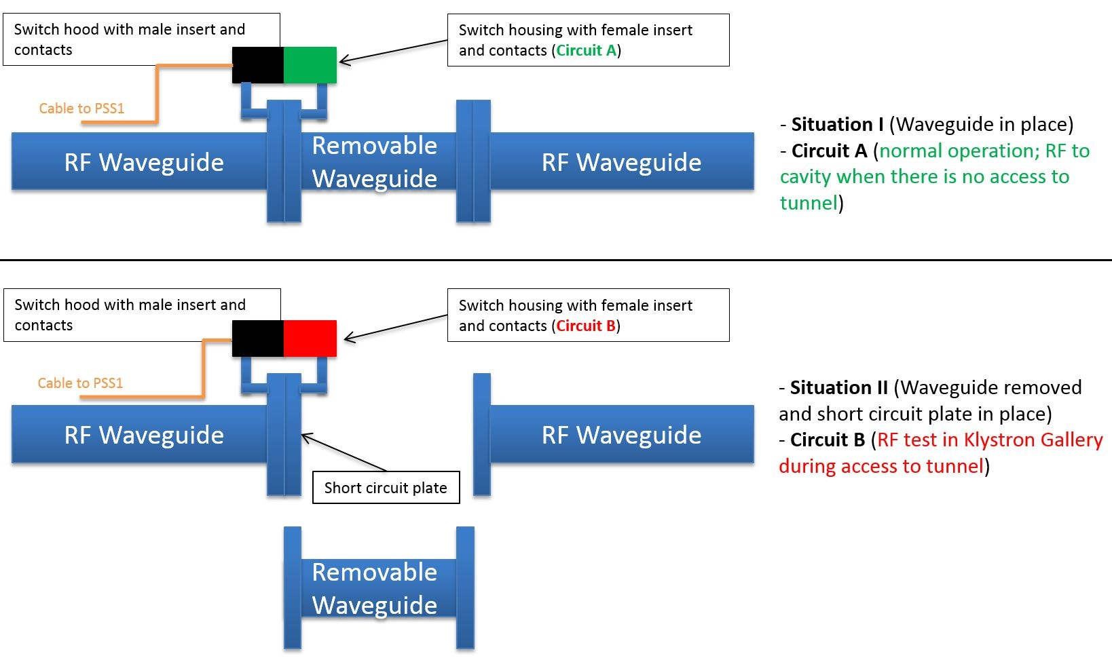
PSS 1 safety interlock system; interfaces with RFDS

Slide 15
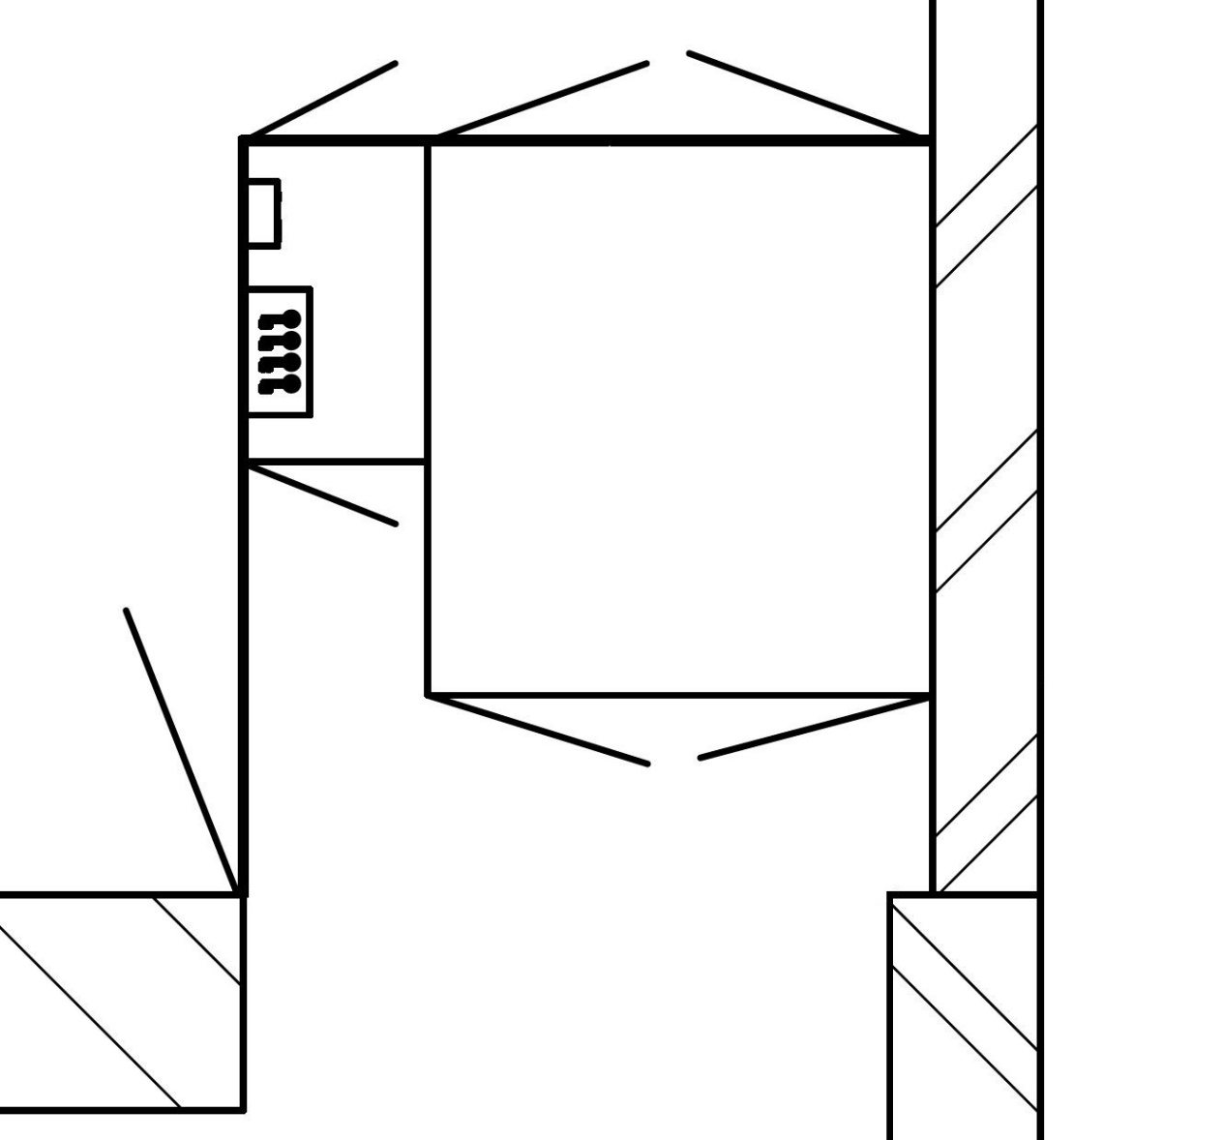
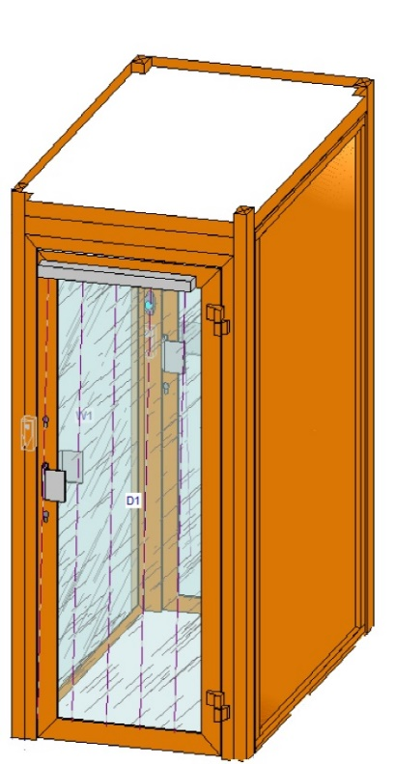
PSS1 Access Control System; PAS
The PAS ensures single person entry and exit to the PSS1 controlled area.
Door 1 and Door 2 of PAS cannot be open at the same time.
Entry and exit to the PSS1 controlled area are granted by swiping the person’s ESS Identification (ID) card with entering the Personal Identification Number (PIN) that is registered in the ESS Access Management System (AMS) database(s). Upon swiping the card and entering the PIN, the AMS verifies if the person is authorised to access the PSS1 controlled area. The verification includes, but is not limited to personal identification, safety training and person’s annual effective dose level.
Inside the PAS, a key exchange system is used to limit the number of people allowed to enter PSS1 controlled area in specific access modes.
A pressure floor mat (with a marked area, which provides standing space to only one person) is installed to ensure that only one person is present inside the PAS at a time.
The person shall verify that they are carrying an Electronic Personal Dosimeter (EPD) to be able to proceed with access to PSS1 controlled area
For communication between the PAS and LCR, intercom and video surveillance systems are installed inside and outside the PAS.

Slide 16
PSS1 Access Control System; MAS
The MAS is intended for transporting large-sized equipment into/out of the PSS1 controlled area, and it is installed next to the PAS.
The MAS in the FEB is a double-gated access system consisting of two doors and an enclosed area between them.
Door 1 connects the MAS with the FEB, and Door 2 connects the MAS with the PSS1 controlled area.
Door 1 and Door 2 of MAS cannot be open at the same time.
The MAS is equipped with a motion detection system to ensure that no person uses it to enter or exit the PSS1 controlled area. For this purpose, motion detectors with high resolution capable of covering the whole MAS volume are used.

Slide 17
Overview of PSS1 interface with ACS/AMS
PSS1 controlled area
ACS: Access Card System
AMS: Access Management System
CR: Card Reader
DB: Database
EPD: Electronic Personal Dosimeter
PAS: Personnel Access Station
PLC: Programmable Logic Controller
PSS1: Personnel Safety System for Normal Conducting Linac (NCL)
S4: Local controller unit for Stanley system
CR2
Door 2
PSS1 PLC
PAS
DB1
DB1
DB2
DB2
EPD dumb reader
Search (0/1)
CR controller
ACS
(S4 unit)
AMS
RA (0/1)
OP (0/1)
Door 1
RP survey (0/1)
Alarm? (0/1)
Manual transfer of data
(frequency?)
CR1
Entry/Exit cycle completed
DBn
DBn
System to issue EPD

Slide 18
Layer Architecture of Personnel Safety System 1
ESS Local Control Room
PSS Engineering Workstation
PSS Engineering WS
(TIA portal)
PSS1
GUIs (CSS)
PSS1
HMI (WinCC)
Machine for GUI (CSS)
and IOC Developing
High Performance
Data Network
EPICS
PSS1
EPICS IOC
EPICS
Archiver
PSS1
Gateway PLC
Fast Beam
Interlock System
Machine Protection
Personnel Safety Systems
PSS1 PLC
ISrc
PLC
RF LPS
PLC
Temporary
Remote
I/O
Remote
I/O
Remote
I/O
Remote
I/O
Remote
I/O
Remote
I/O
Remote
I/O
Remote
I/O
Remote
I/O
Remote
I/O
Remote
I/O
Fieldbus
Device signals
Search Buttons
Message Display & Annuciator Devices
Key exchange units
Radiation Monitors
E-Switch OFF Buttons
Door Switches
PAS & MAS
AMS Interface Unit
SAE Interface Relays & Contactors
Template: ESS-0505806
Notes:
Single train PLC system, redundancy and diversity in position monitoring of the doors, redundancy in actuators, etc.
PSS1 supervision; HMI and OPI
Gateway PLC for communication with EPICS.
Date archiving (EPICS archiver).

Slide 19
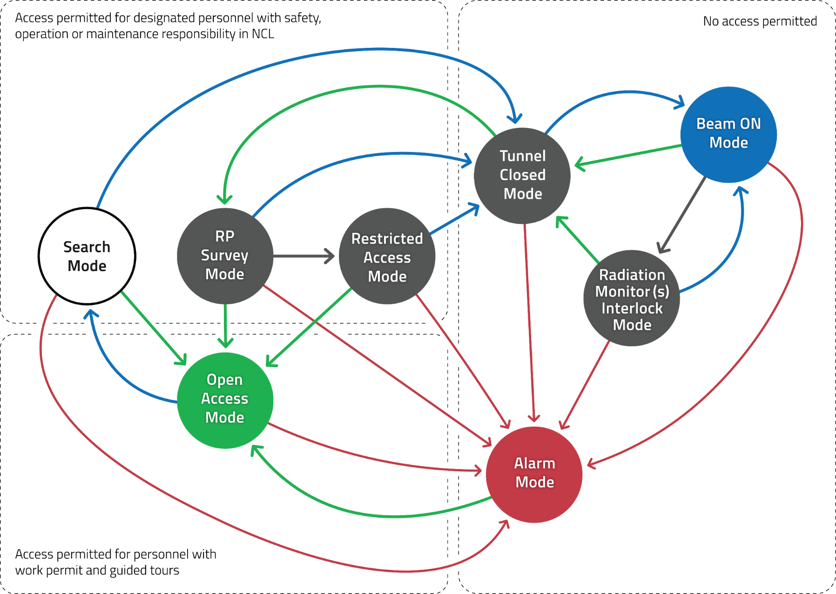
PSS1 modes of operation
Mode | Number of persons allowed in the PSS1 controlled area
Search | 3 (2 to conduct search, and 1 person for training purposes)
RP Survey | 3 (2 to conduct RP survey, and 1 person for training purposes)
Restricted access | 4 (at the same time)
Open access | 30 (at the same time)

Slide 20
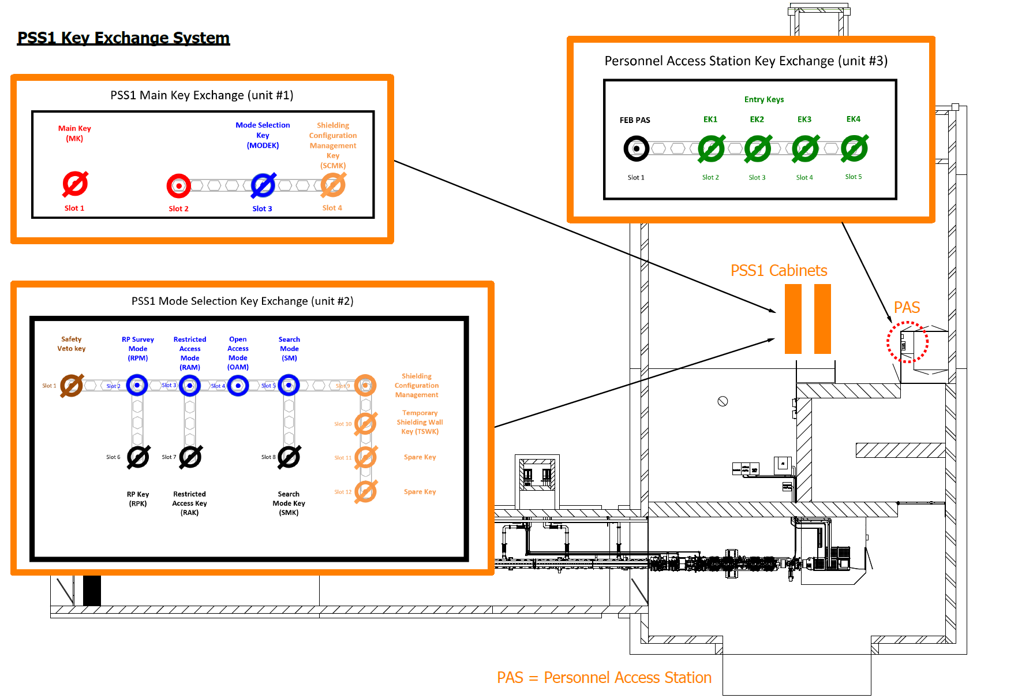
PSS1 Key Exchange system; layout
  The PSS1 key exchange system (Trapped Key Interlock Switches) is used to ensure that a predetermined sequence of events takes place or that hazards have been removed before personnel become exposed to them.
  This system ensures that the access process to PSS1 controlled areas is followed and cannot be circumvented or short cut.
  PSS1 will use modular key exchange units which are used to exchange one or more keys for a number of other keys.
  The unit will contain stainless steel mechanical lock modules with uniquely coded keys.

Slide 21

PSS1 Key Exchange system; operation
PSS1 Main Key Exchange (unit #1)
Main Key
(MK)
Mode Selection Key
(MODEK)
Shielding Configuration Management Key
(SCMK)
Slot 1
Slot 2
Slot 3
Slot 4

Slide 22
PSS1 Key Exchange system; operation
PSS1 Mode Selection Key Exchange (unit #2)
Safety Veto key
RP Survey Mode
(RPM)
Restricted Access Mode (RAM)
Open Access Mode
(OAM)
Search
Mode
(SM)
Shielding Configuration Management
Slot 1
Slot 2
Slot 3
Slot 4
Slot 5
Slot 9
Temporary Shielding Wall Key (TSWK)
Slot 10
Slot 6
Slot 7
Slot 8
Slot 11
Spare Key
RP Key
(RPK)
Restricted Access Key
(RAK)
Search Mode Key
(SMK)
Slot 12
Spare Key

Slide 23
PSS1 Key Exchange system; operation
Personnel Access Station Key Exchange (unit #3)
Entry Keys
FEB PAS
EK1
EK2
EK3
EK4
Slot 1
Slot 2
Slot 3
Slot 4
Slot 5

Slide 24
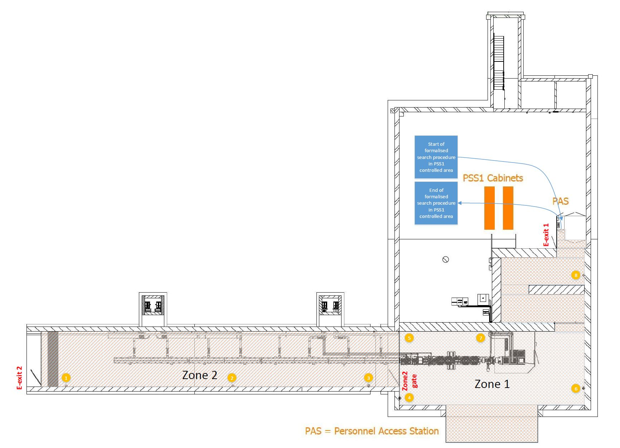
PSS1 formalised search

Slide 25
Other features foreseen for PSS1
Message displays (e.g. light panels) will be installed at the PAS and emergency exits of PSS1 controlled area that provide personnel with information such as the current state of PSS1, access mode to PSS1 controlled area, etc.
Public Address (PA) system to broadcast messages (e.g. evacuation, search) in the PSS1 controlled area. A microphone connected to PA system can be provided in the LCR.
Blue fluorescent lights in PSS1 controlled area; the blue lights are controlled by PSS1 alerting the personnel that SAE are energized.
*Red fluorescent lights in tunnel (including PSS1 controlled area); the red lights are NOT controlled by PSS1, but will be controlled by Accelerator ODH detection system in order to alert personnel in case of ODH.

Slide 26
PSS1 interfaces with removable shielding blocks
Does/should PSS1 interface with NCL removable shielding blocks (e.g. using key exchange system)?
Temporary Shielding Wall → Yes, already agreed, and incorporated into PSS1 ConOps.
Stubs 100 and 110 → ?
Penetrations in the Front End Building (FEB) → ?
Drop hatch → ?
Alignment penetrations → ?
Inner wall of FEB chicane → ?
Shielding of public areas → ?

Slide 27
Some other open questions
Video Surveillance at PAS and MAS:
  Should a video surveillance for PAS and MAS area be installed? (from PSS team perspective, yes).
  Should this video be available in LCR? Or anywhere else?
  Role of operators in the LCR to use the video surveillance needs to be defined.
Emergency switch-off pushbuttons inside PSS1 controlled area:
  Should these pushbuttons turn off the electrical power in PSS1 controlled area for e.g. the equipment on the ISrc HV platform?
  The design of PSS1 emergency switch-off pushbuttons has foreseen space to share contacts with electrical safety system.
As per PSS1 ConOps document (ESS-0100563 Rev. 4 section 6.1.8), the first intervention into PSS1 controlled area after PSS1 transitions into Alarm mode shall be done by a trained person who is authorised by the shift leader. Procedures on the intervention (who does what) need to be defined.

Slide 28
Summary
See more details in Concepts of Operations for PSS1 (ESS-0100563)

Slide 29
Thank you!

Slide 30
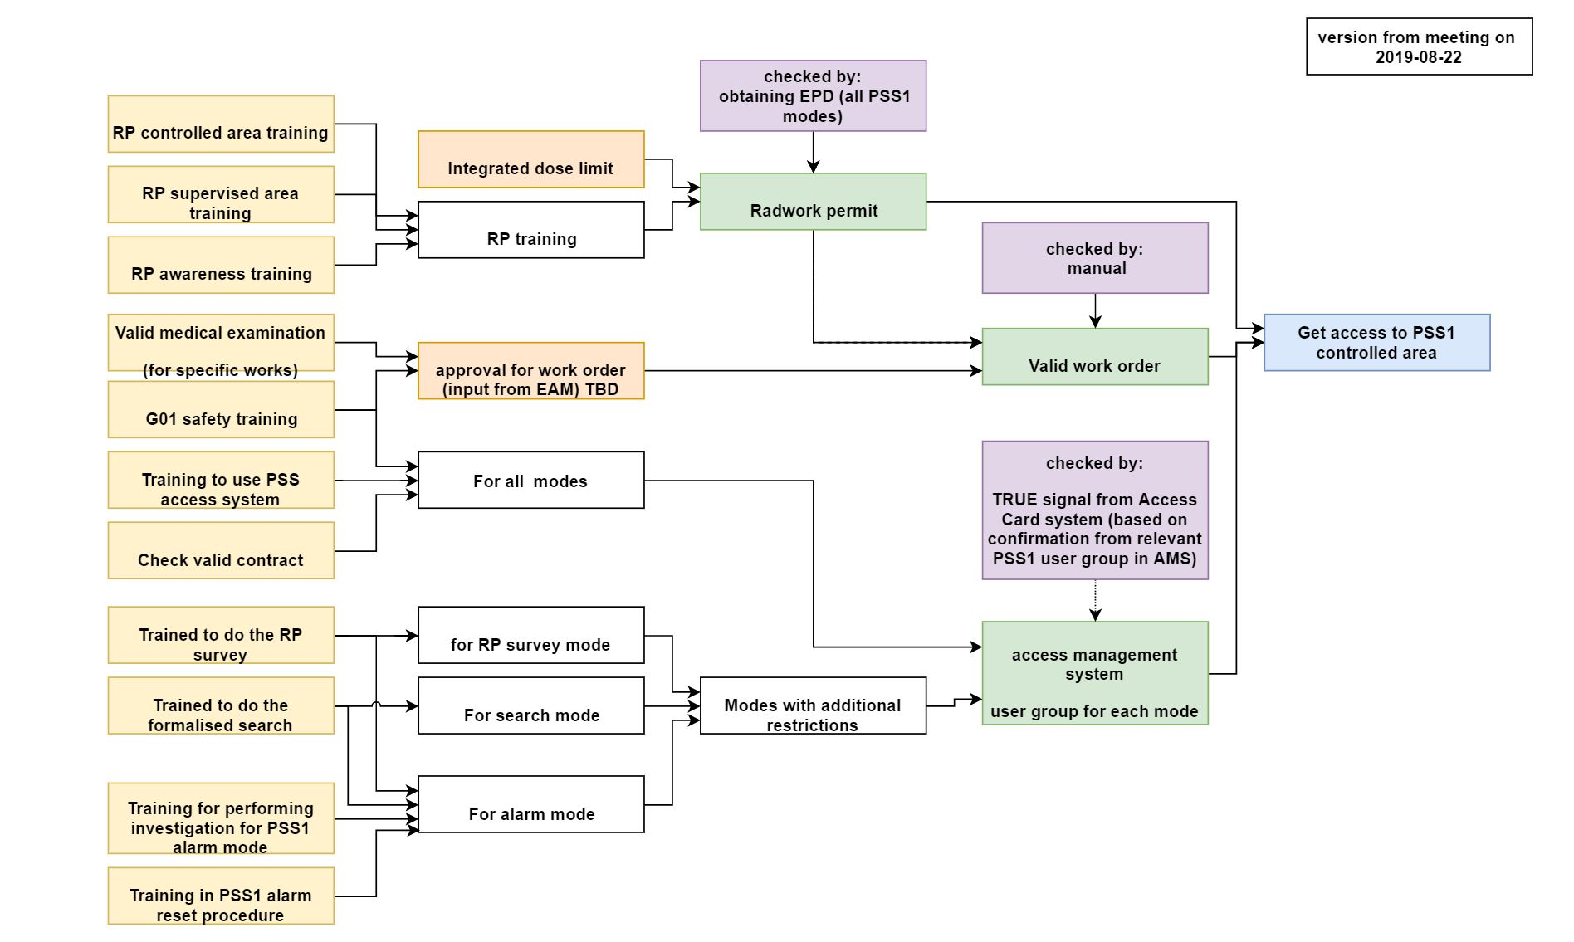
Flow chart for PSS1 access criteria
By working group for defining PSS1 access criteria
https://confluence.esss.lu.se/pages/viewpage.action?pageId=316605111

Slide 31




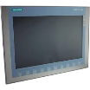


Development and production network for PSS
(Current setup)
PSS-TS2-GW-PLC
172.21.120.32/30
Remote I/Os
Safety PLC
Gateway
PLC
NTP
Offline deployment
HMI
Archiver
TS2
PSS-TS2-PLC
(172.16.54.0/26)
PSS-ACC-GW-FW
172.21.120.32/30
ChannelAccess-PS
(172.16.116.0/24)
Remote I/Os
Safety PLC
Firewall
Gateway
PLC
PSS-ACC-FW-PLC
172.21.120.32/30
HMI
PSS-Midzone
(172.16.45.0/25)
Accelerator
PSS-ACC-PLC
(172.16.53.192/26)
Johan Christensson

