Slide 1
NCL Commissioning – Current Status and Plans
Ciprian Plostinar
Testing and Commissioning Manager
European Spallation Source ERIC
29 January 2020

Slide 2
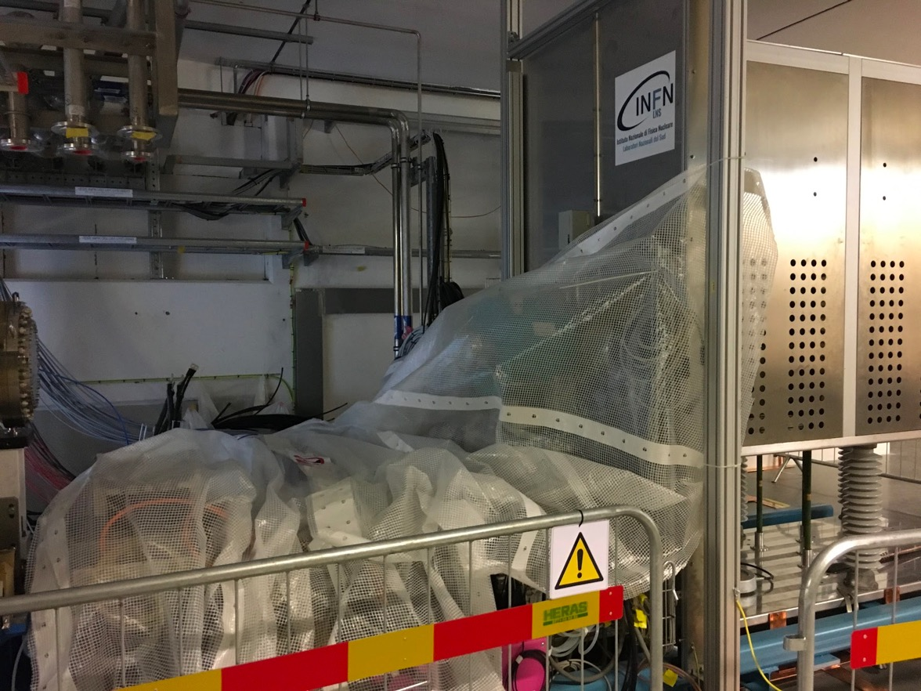
Ion Source and LEBT
See Alex’s talk

Slide 3
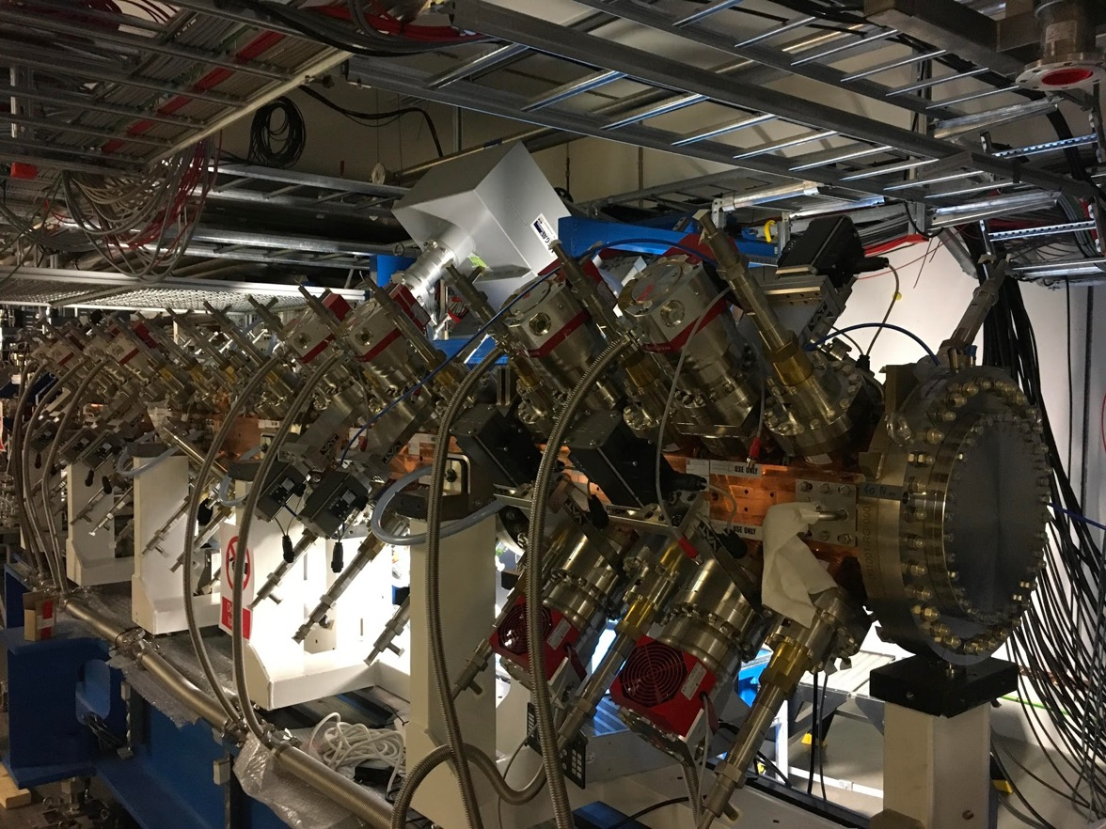
RFQ
See most talks this afternoon

Slide 4
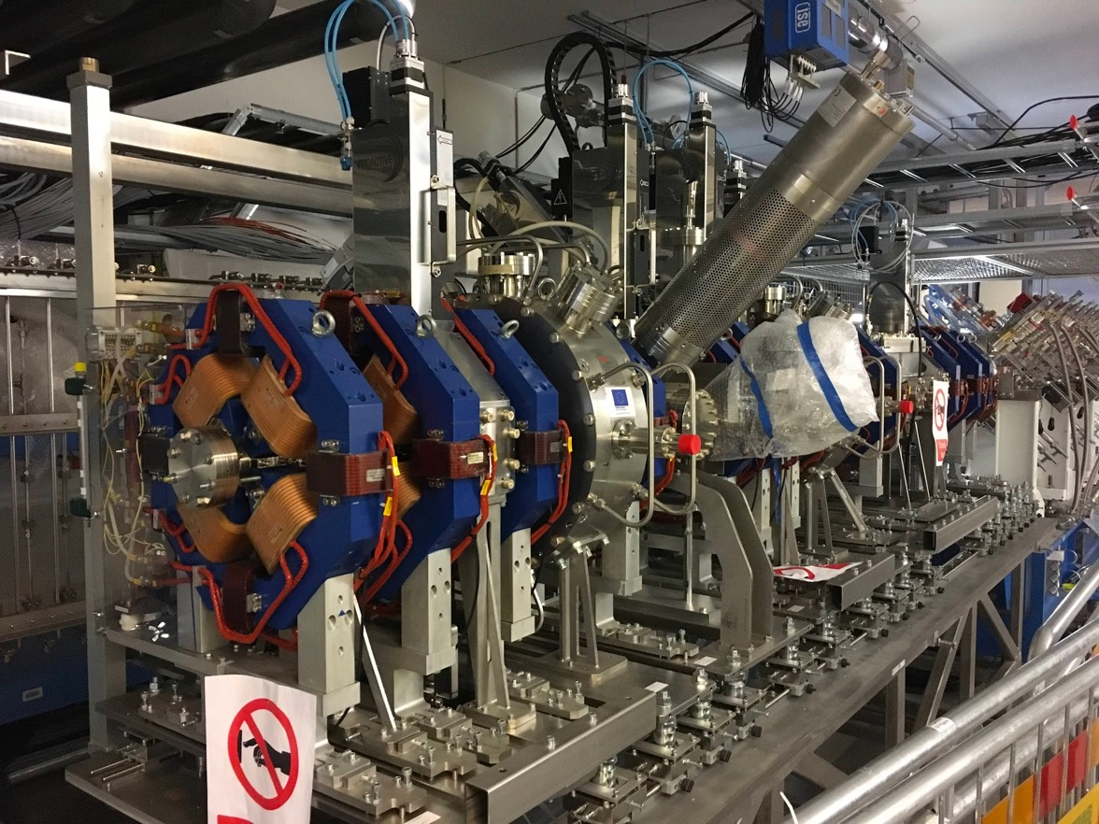
MEBT
See talks tomorrow

Slide 5
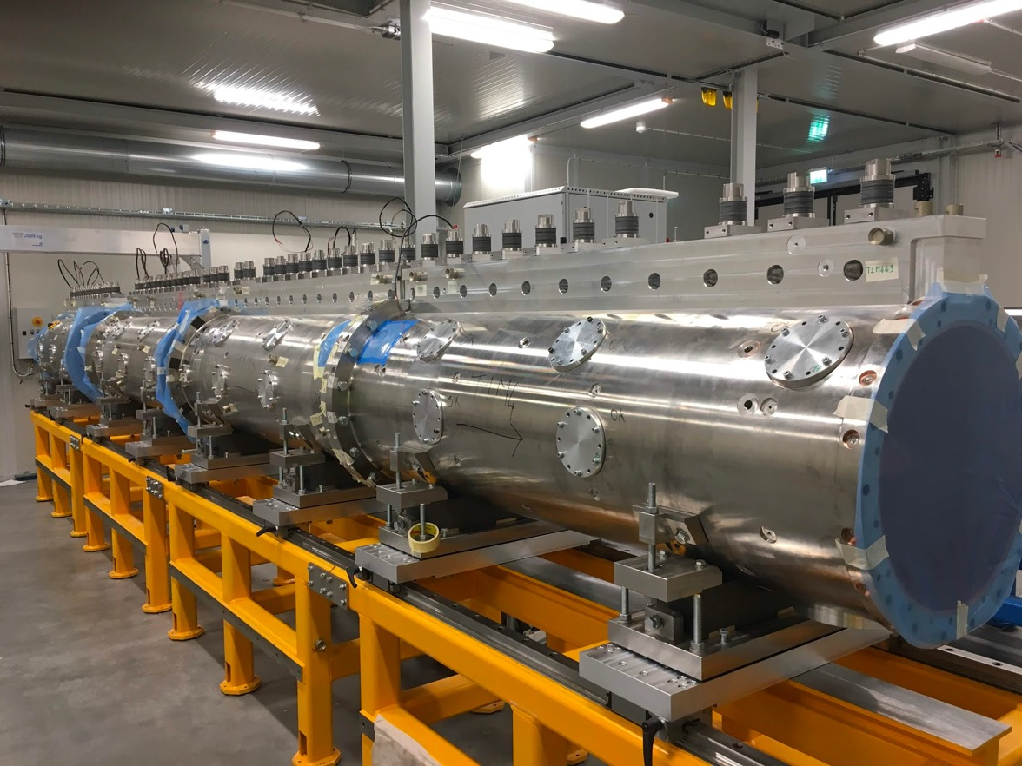
DTL1

Slide 6
Where are we today?
RFQ Conditioning – Status of Major Systems
 | JAN | FEB | MAR | APR | MAY | JUN | JUL | AUG | SEP | OCT | NOV | DEC
RFQ Installed, Local Testing Completed
RFQ Infrastructure
RFQ Integrated Testing
RFQ Skid Operational
NCL Shielding Completed
RFQ RF System Operational
PSS/MPS Validated
REMS
Licence
PRL

Slide 7
RFQ Timeline
PSS1 Validated
RFQ Ready for Integrated Testing
Infrastructure Ready
Today
Licence Available
RFQ RF System Ready
Aug
Sep
Oct
Nov
Dec
2020
Feb
Mar
Apr
May
Jun
Jul
2020
RFQ TRR1
RFQ TRR2 (For RF Conditioning)
RFQ SAR
RFQ Assembly
6 wks
Aug 26 - Oct 4
RFQ Local Testing
9 wks
Oct 7 - Dec 6
RFQ Integrated Testing
8 wks
Mar 2 - Apr 24
PSS Validation
4 wks
May 4 - May 29
RFQ RF Conditioning
6 wks
Jun 1 - Jul 10
Timeline based on data from the integrated plan (not everything is fixed).
RFQ Integrated Testing Plans – Currently being detailed, durations will most likely change
RFQ TRR – Framework and scope under development

Slide 8
ISrc – DTL1
LEBT
RFQ - MEBT
DTL1

Slide 9
SRR 2 Split
SRR2A and SRR2B
Early conditioning of the RFQ, early beam to the MEBT FC Two PSS1 validations, two RF conditioning windows Two SRRs
SRR2A: ISrc LEBT RFQ MEBT up to the FC Buncher cavities not powered SRR2B: ISrc to DTL1 including all required RF power | Advantages Early start of beam commissioning LEBT, RFQ and MEBT validation with beam Disadvantages: Requires an additional SRR and extra validations/reviews Considerations: We need a strong integrated plan to commit to a start date (T0) Do we have any hidden drivers?

Slide 10
SRR2 Timeline
Start of RFQ Conditioning
SRR2A
Start of Beam Commissioning
SRR2B
Jan
Feb
Mar
Apr
May
Jun
Jul
Aug
Sep
Oct
Nov
Dec
2020
RFQ Conditioning
6 wks
SRR2A Follow-Up
2 wks
Beam Commissioning to the MEBT FC
9 wks
PSS1 Re-Validation
3 wks
DTL1 and MEBT Bunchers Conditioning
6 wks
SRR2B Follow-Up
2 wks
Beam Commissioning to the DTL1 FC
6 wks

Slide 11
SRR2
Some Considerations
Heavy work over the summer holiday.
Experience from SRR1 and TS2 SRR shows that the follow-up is much longer than 2 weeks. Detailed SRR preparation is required.
Commissioning for low-current.
This option removes the DTL1 and MEBT RF systems from the critical path, but puts pressure on infrastructure, integration work for the LEBT, MEBT and DTL1.

Slide 12
SRR2A: Beam to the MEBT FC
See Ryoichi’s talk
Minimum Requirements:
RFQ Conditioned
LEBT Chopper System, LEBT Collimator, LEBT Iris and LEBT BCM
MEBT Infrastructure Completed
MPS Validated
MEBT Magnets, MEBT FC, MEBT BPMs, MEBT BCMs
Timing System
Option1+ (Valuable additions)
MEBT Chopper
Optional, but valuable: nBLM, WSs
These systems need to be deployed such that we’re ready to take data when high power RF system commissioning begins.
Potential measurements:
LEBT Recommissioning
RFQ transmission and acceleration efficiency (only low energy beam)
ToF energy measurements out of the RFQ
MEBT tuning to transport the beam to the FC
With Option1+ we can test and commission all devices that have a protection function.

Slide 13
2018 Commissioning Workshop Recommendations
https://indico.esss.lu.se/event/1118/
Management
Sort out shift work, overtime issues, legal requirements, etc.
High-level priority setting
In-kind relations
Support from other institutes is very valuable at this stage
Commissioning
Have a plan B
Get beam through the machine as soon as possible
Run stability tests for as long as possible
Coordination and Communication
Have a clear progress matrix for each system taken from the detailed project plan
Drive things by pre-agreed check lists.
Testing
Have a clear integrated test and verification plan

Slide 14
2018 Commissioning Workshop Recommendations
https://indico.esss.lu.se/event/1118/
Databases, configurations
Before starting commissioning, naming service, FBS, databases and other document repositories must be in place and in good shape
An inventory and asset traceability system is needed
Global configuration, authority
Global naming convention for saved set points, and procedure to set/change this.
Establish clear authority on interlocks, MPS settings, etc.
Keep the balance between taking some risks (component damage -> cost) and the cost of beam being down
Safety
Safety of personnel is paramount

Slide 15
Lessons Learned and Moving Forward
In August 2019, a workshop was held at ESS to understand the lessons learned during the testing and commissioning of the Ion Source and the LEBT.
Ion Source and LEBT, Transition from Installation to Testing and Commissioning - Alejandro Garcia Sosa
Overall Beam Commissioning Experience - Ryoichi Miyamoto
BI: Diagnostics Deployment - Elena Donegani
Lessons from Integration - Saeed Haghtalab
Software and Machine Studies, ICS perspective - Emanuele Laface
Software and Machine Studies, AD perspective - Natalia Milas
Control Room Experience and Operational Perspective - Marcos Munoz
Personnel Safety Systems - Stuart Birch
Safety and Radiation Protection - Helen Boyer
https://indico.esss.lu.se/event/1280/

Slide 16
Lessons Learned and Moving Forward
 | Summary | Description
NCLPR-234 | LL28 - Control Systems Verification Plans | Verification plans for the control systems and parent systems should be reviewed and agreed upon before executing stand-alone control system tests (e.g. network connectivity), before control system integration tests with controlled equipment (e.g. power supply connectivity and control), and before commissioning with beam. The verification plans/test specifications should include the test method descriptions and the pass/fail criteria. The test method identification is needed for estimating and allocating adequate resources to the testing activities (see Lesson Learned 32).
NCLPR-235 | LL29 - Integration Diagrams | Integration trees in system aggregation diagrams should be created during the planning phase for the control system integration.
NCLPR-236 | LL30 - Concepts of Operations Descriptions | Concepts of Operations Descriptions should be available for the main systems/functions. This helps to clarify the expectations of stakeholders and improves the analysis of requirements, which is for example very useful for the control system development. It also drives the elaboration of procedures, rules, workflows, etc, for operational and maintenance activities.
NCLPR-237 | LL31 - Communication | Communication with all relevant stakeholders should be improved and the use of communication tools clarified. Communication and collaboration between AD and ICS should be kept strong throughout the testing and commissioning phase. The recently setup AD-ICS prioritisation forum is a step forward as it reduces the burden on integrators by defining the priorities and schedules at division level.
NCLPR-238 | LL32 - Testing Time | Sufficient time for local and integrated hardware testing should be allowed prior to commissioning with beam.

Slide 17
Lessons Learned and Moving Forward
 | Summary | Description
NCLPR-240 | LL34 - Spares | Provisions of common spare parts, consumables and basic measurement devices for quick checks should be made prior to the testing and commissioning phase to avoid delays in getting those during the testing and commissioning phase.
NCLPR-241 | LL35 - Asset Traceability | Suitable asset traceability should be ensured throughout the testing and commissioning phase using suitable tools, e.g. EAM, CIDL (Configuration Item Documentation List) approach.
NCLPR-242 | LL36 - Reviews | Technical reviews, such as Site Acceptance Test (SAT), Test Readiness Review (TRR) and Safety Readiness Review (SRR), should be held on a timely basis. In addition, a 'Beam Readiness Review' independent of the Safety Readiness Review (SRR) should be held.
NCLPR-243 | LL37 - Authorities and Priorities | Management should clearly define the authorities and priorities during the testing and commissioning phase. A commissioning team with clear roles should be set up. Clear owners should be defined for every system from hardware to software. The communication tools in use should be well defined and communicated.
NCLPR-244 | LL38 - Procedures when Commissioning Safety Systems | Procedures for testing and commissioning components without protection functions in place should be established and reviewed prior to testing and commissioning.
NCLPR-245 | LL39 - Resources | Sufficient resources should be allocated to address identified issues during testing and commissioning.

Slide 18
Lessons Learned and Moving Forward
 | Summary | Description
NCLPR-246 | LL40 - Processes and Convetions | Processes, conventions and deployments should be made clear to all stakeholders prior to the testing and commissioning phase.
NCLPR-247 | LL41 - Transition from Commissioning to Operations | The transition from commissioning to operations should be clearly defined. A procedure for handing over the commissioned systems to the Operations Team should exist and the related formalities for the handover should be followed after the commissioning phase.
NCLPR-248 | LL42 - Communication with IK-Partners | Communication with in-kind partners should take place prior and after delivery of equipment to ensure fully documented configuration and comprehensive Factory Acceptance Test (FAT) and Site Acceptance Test (SAT).
NCLPR-249 | LL43 - Critical Infrastructure | Owner should ensure that the critical infrastructures are available prior to testing and commissioning. The owner should clarify the status to the testing and commissioning team on a regular basis.
NCLPR-250 | LL44 - Testing and Commissioning Planning | A strict, but realistic, plan with wide visibility should be developed prior to testing and commissioning and this plan should be followed by all. The objectives, scopes and deliverables of the plan should be well defined in advance and revised regularly based on the compiled data from the stakeholders.

Slide 19
Lessons Learned and Moving Forward
 | Summary | Description
NCLPR-251 | LL45 - Preparations before commissioning | The testing and commissioning team should be familiar with all relevant hardware details prior to testing and commissioning.
NCLPR-252 | LL46 - Interlocks | Change of interlock logic during commissioning should be made under strict control and there should be a clear procedure for bypassing.
NCLPR-253 | LL47 - Safety Readiness Review | The Safety Readiness Review (SRR) process should be improved to give stakeholders clarity on the level of documentation required as well as sufficient preparation time. Dry runs must be arranged in preparation for the review and the committee should only be called once critical safety systems have been validated.

Slide 20
SRR2A
SRR2B
SRR3
Today
Jun 26
Oct 30
Jun 14
2019
2020
2021
2019
Q2
Q3
Q4
Q1
Q2
Q3
Q4
Q1
Q2
Q3
2021
RFQ TRR
RFQ Assembly
RFQ
RFQ Local Hardware Tests
RFQ Infrastructure Work Completion
RFQ Integrated Hardware Tests
MEBT TRR
MEBT Assembly
MEBT Rafts 1-3 Reassembly
MEBT
MEBT Local Hardware Tests
MEBT Infrastructure Work Completion
MEBT Integrated Hardware Tests
DTL1 TRR
DTL1 Installation
Jul 6
DTL
DTL1 Local Hardware Tests
Jan 6 - Jan 31
DTL1 Infrastructure Work Completion
Jan 6 - Jan 31
Mar 2
DTL1 Integrated Hardware Tests
DTL2 - DTL4 Installation and Testing Window
PSS1 Validation
Jan 4 - Mar 26
RFQ Conditioning
May 4 - May 29
Beam Commissioning (ISrc to MEBT FC)
Jun 1 - Jul 13
PSS1 Re-Validation
Jul 13 - Sep 14
Commissioning
DTL1 and MEBT Bunchers RF Conditioning
Beam Commissioning (ISrc to DTL1 FC)
Mar 29 - Apr 16
Sep 14 - Oct 2
Apr 19 - Jun 25
Oct 5 - Nov 13
PSS1 Re-Validation
Nov 16 - Dec 25
DTL2 - DTL4 RF Conditioning
Beam Commissioning (ISrc to DTL4)
Jun 28 - Sep 24

