Slide 1
Ion Source and LEBT
Commissioning Results + Current Status
Alejandro Garcia Sosa
European Spallation Source
ESS Accelerator Testing and Commissioning Workshop - 29-30 January 2020

Slide 2
Outline
Introduction
Commissioning Results
Current Status
Conclusions
Notes:
I’ll give a short introduction of the ESS Ion Source and the LEBT and then I’ll talk about the issues we faced during these months of commissioning, including grounding, LEBT solenoids, the problems commissioning the chopper, and the status of the IRIS.

Slide 3
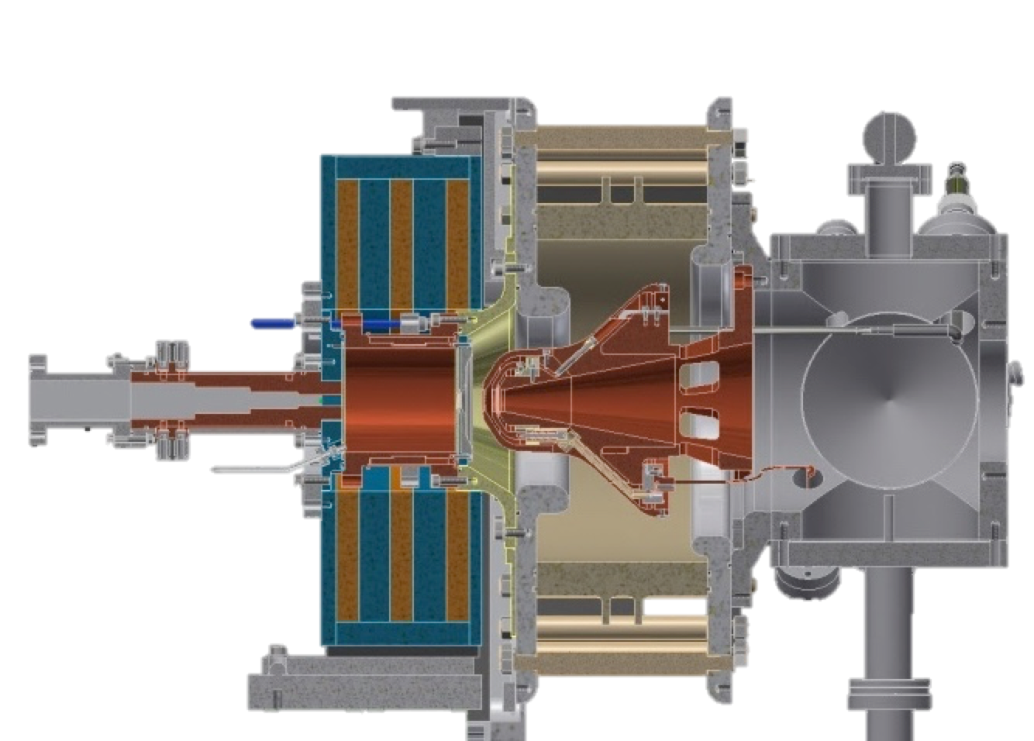
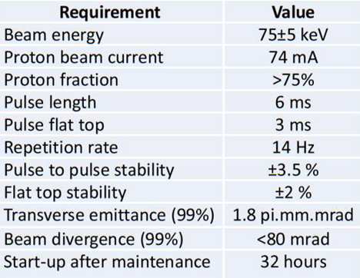
Ion Source
Microwave Discharge Ion Source (MDIS)
High voltage insulator
Extraction electrodes
Plasma chamber
Waveguide
Gas injection
Pumping ports
50 cm
3 Solenoids
3
Notes:
The Ion Source of ESS is a Microwave Discharge Ion Source. These sources produce high currents of singly charged ions with low emittance. A stepped matching transformer is used to allow a smooth transition between the waveguide and plasma chamber impedances. An extraction system with a repeller electrode is employed to limit the back-streaming electrons. Microwave Discharge sources differ from ECR sources in the sense that they operate slightly off-resonance and the plasma is not completely confined by the magnetic field. Also, ECR sources have an additional hexapole field surrounding the plasma chamber to further confine the plasma and obtain ions of high charge states.

Slide 4
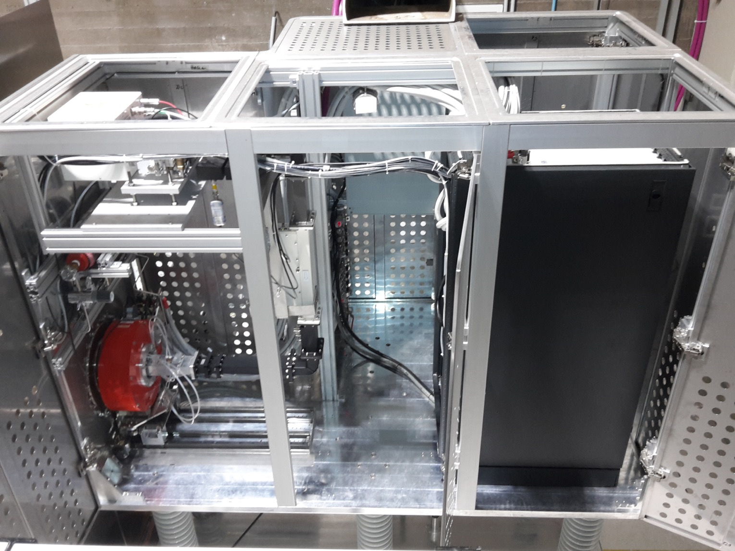
The ISrc sits inside a 75 kV DC high voltage platform
Magnetron head
Electrical panel
Waveguide
Electronics rack
Ceramic insulators
3 Solenoids
Notes:
The ion source sits inside a high-voltage platform biased at 75 kV DC during operation. This setup provides the voltage difference to ground that allows the extraction of protons from the source plasma. In this picture you can see the HV platform with all its doors open and the ceiling panels removed. You can also see the high-voltage insulators, the electronics rack, the electrical panel, the magnetron head, the waveguide and the coils of the Ion source with the plasma chamber inside.

Slide 5
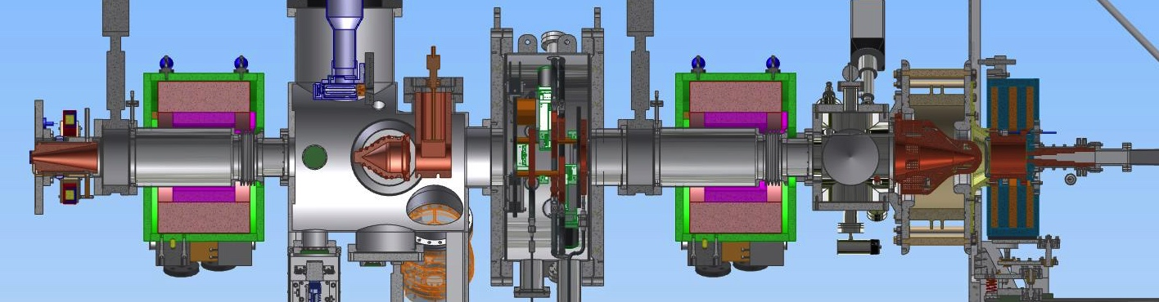
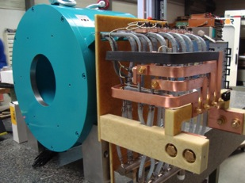
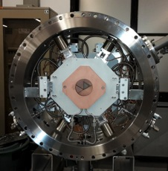
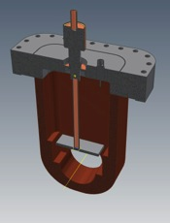
The Low Energy Beam Transport (LEBT) matches the beam to the RFQ input
Ion Source
– creates the H⁺ beam
Solenoid
– focuses the beam
Iris
– controls the current
Chopper and collimator
– controls the pulse length
Notes:
The LEBT matches the beam to the entrance of the RFQ. In the LEBT, immediately after the ion source and extraction electrodes, we have a small tank with vacuum ports for turbopumps, vacuum gauges and a Residual Gas Analyzer (RGA). We have two solenoids for beam focusing, the iris, which is a moveable aperture to control the beam current, and also a diagnostics tank where the Chopper is. The chopper discards the tails of the beam pulse into the collimator, just before the entrance of the RFQ.

Slide 6
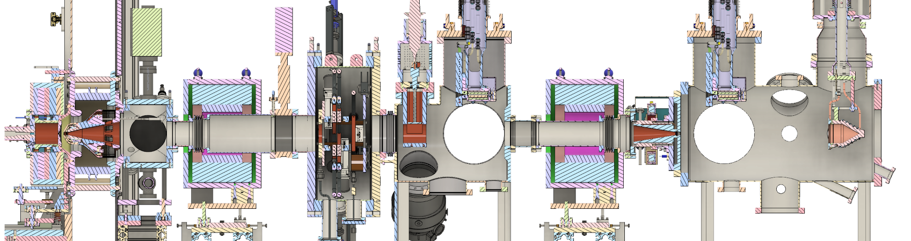
LEBT at the start of commissioning
ACCT
FC
EMU (H)
EMU (V)
NPM (H)
NPM (V)
Dpl
BCM
EMU (V)
NPM (H)
NPM (V)
FC
HV
Chamber
Repeller
N₂ injection
Iris
Chopper
Collimator
Repeller
Beam stop
Solenoid 1
(Steerer 1H)
(Steerer 1V)
Solenoid 2
(Steerer 2H)
(Steerer 2V)
Notes:
This was the LEBT at the start of beam commissioning. We started the commissioning round in Sept 2018 with a barely functional LEBT. No steerers tested, no Iris, no chopper. The only diagnostics available were the BCMs and the FC which was not completely validated.

Slide 7
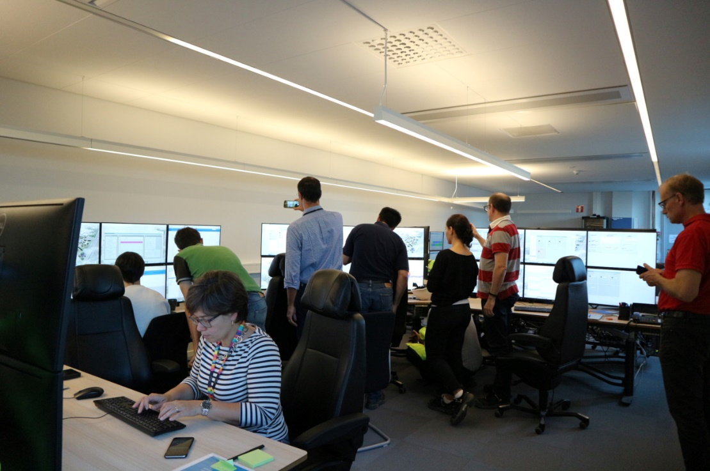
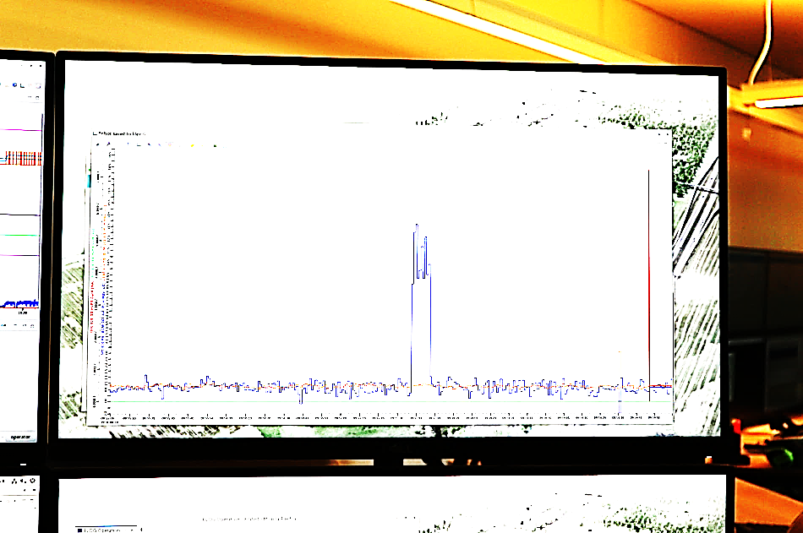
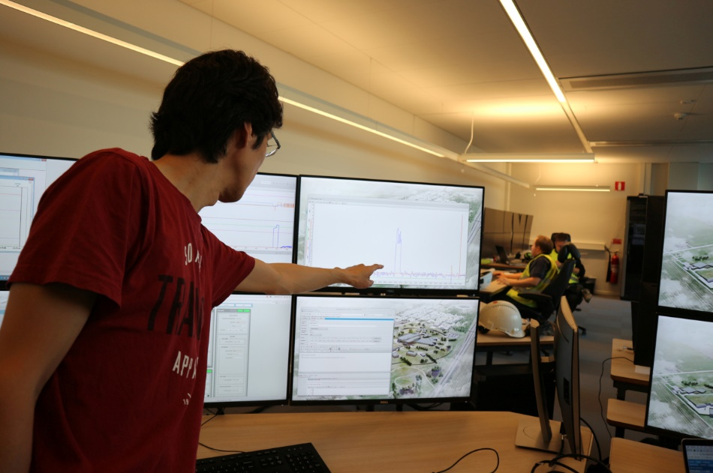
First beam at ESS, 2018-09-19
Logbook message ID 69, 2018-09-19 10:31
Ryoichi on behalf of ISrc team.
"THE" screenshot of the first beam! Blue trace is the integrated charge per pulse in micro-C. 12 micro-C and 2 ms gives 6 mA. We had the beam for about 10 s.
Notes:
Nevertheless, we were able to produce the first beam pulses on Sept 19, 2018. We had 6 mA of beam for about 10 seconds.

Slide 8
Commissioning Timeline
Date | Event
2017-12-14 | Source and LEBT delivered to ESS.
2018-07-18 | Safety readiness review completed.
2018-09-19 | Started beam commissioning and had 1st beam.
2018-10-02 | Started the source repeller repair and 1st round of EMC grounding work.
2018-11-28 | Solenoid 1 power supply damaged (PS from Sol 2 switched to Sol 1).
2018-12-11 | Extracted beam for ~2 min and damaged power supplies of 3 coils.
2018-12-12 | Started 2nd round of EMC grounding work.
2019-02-08 | Effectively started beam commissioning (with just 1 solenoid).
2019-03-08 | Both solenoids became available.
2019-03-19 | Started to cover longer hours.
2019-04-05 | Chopper became available.
2019-04-25 | EMU became available.
2019-04-26 | Planned last day of source and LEBT commissioning.
2019-04-29 | Started the scheduled water pickling works for NC linac installation.
2019-06-11 | Started the extended period (back to normal hours).
2019-07-03 | Source and LEBT commissioning ended.
Notes:
And here’s the commissioning timeline.

Slide 9
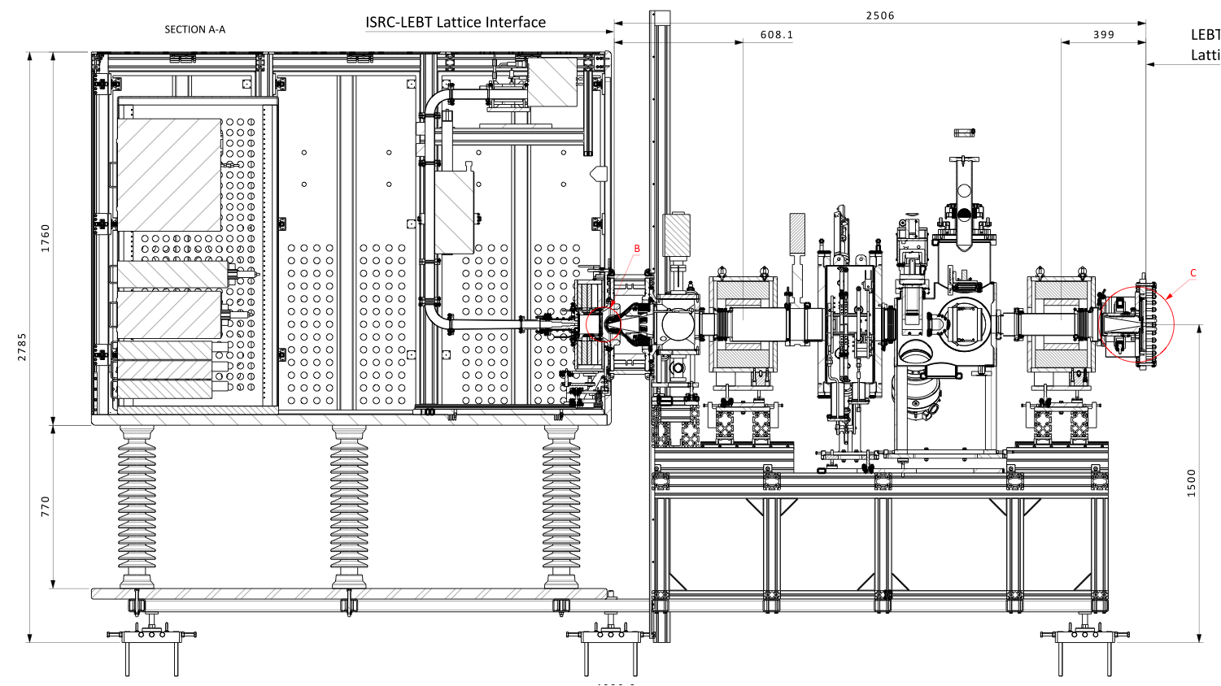
Issues: Grounding
Electronics rack
Electrical Panel
Notes:
Ever since we started beam commissioning, we had issues with electric discharges taking out fuses and damaging electronics inside the platform. This turned out to be a major showstopper for the commissioning that took 5 months to overcome. Specifically, we had breakers trip on the electric panel of the platform, which sits here. We also tripped the breakers on the back of some power supplies in the electronics rack that is over here. The Magnetron PS could be recovered resetting manually after a spark, but we had one instance where the 3 coil power supplies were damaged at once. Since we only had 1 spare, we were left waiting for 2 new power supplies to arrive.

Slide 10
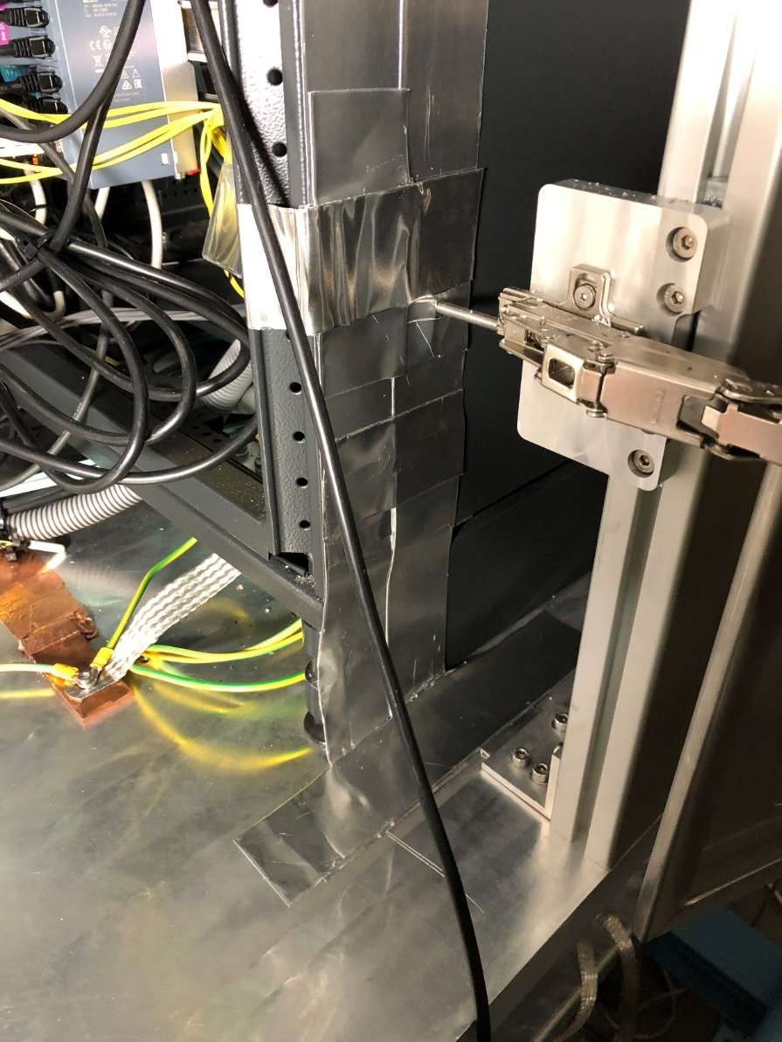
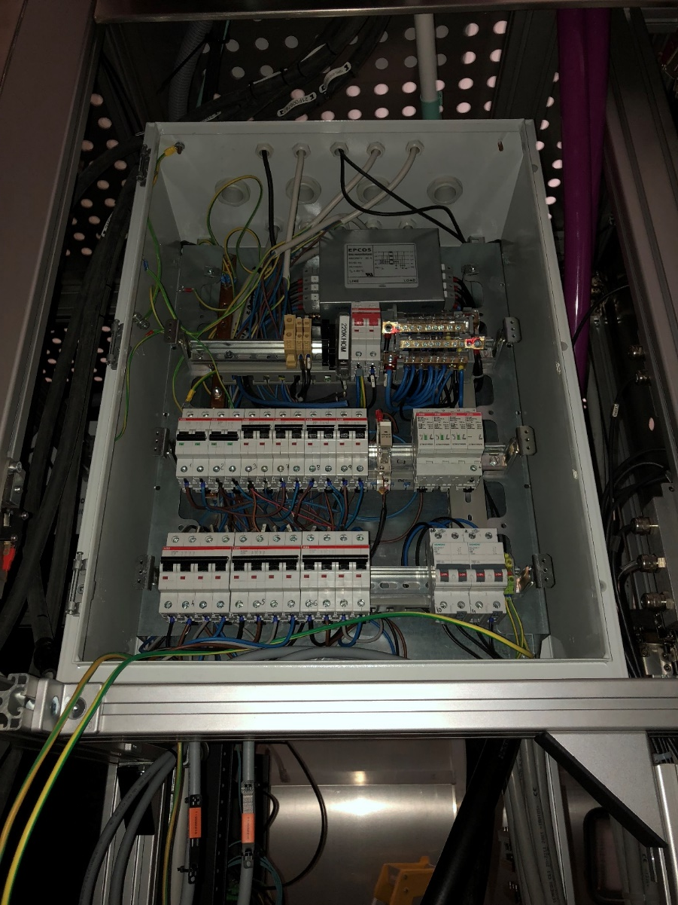
Issues: Grounding
Notes:
The grounding system of the Ion Source is comprised of a network of 10 cm wide flat copper bars that are interconnected and grant access to the grounding mesh beneath the concrete floor through connections to the nearest pads and to the copper bar on the wall. The electronics of the racks were grounded using aluminium foil and flat braids. The electric panel of the platform was completely rearranged, installing a new surge suppressor and an EMC filter.

Slide 11
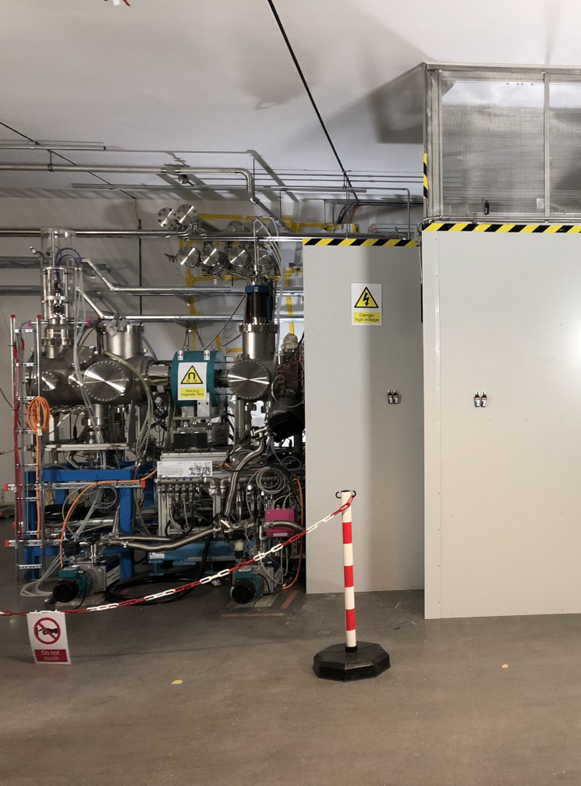
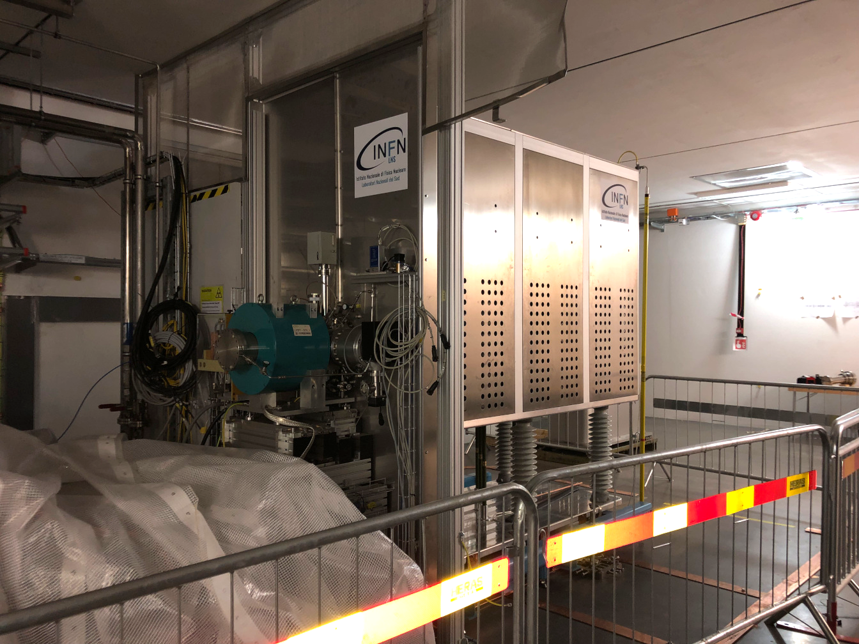
ISrc+LEBT beam commissioning
From 2018-Sep-19 to 2019-Jul-03
Most of LEBT was then disassembled for
  RFQ bead-pull
  Repairs and upgrades: Repeller (RFQ interface), iris, chopper, diagnostics...

Slide 12
ISrc and LEBT commissioning activities
(In Lund)
Commission systems with beam.
  Establish stable operation of source.
  ... (diagnostics, control, ...)
Study source behavior (against 5 knobs).
Correct beam trajectory.
Study matching to RFQ.
  Matching to the RFQ is ultimately optimized by scanning the 2 solenoids and maximizing the transmission through the RFQ.
Prepare "candidates" for the nominal setting.
  We don't know beam loss and matching condition of the RFQ.
Establish adjustment capabilities of pulse length and current with the chopper and iris.
(Check stabilities.)
(Transfer expertise to the operation team.)

Slide 13
Beam time achieved from Feb-8 to Jul-3, 2019
Stable operation achieved after the grounding issue was solved
435 h of total beam time
88 shifts
Double shifts March and April
Gap due to water pickling activities in the tunnel pipes

Slide 14
Stable source operation achieved after EMI issue was fixed
~174 hours of beam time in April.
  "Shifted working hours" to cover 08:00 to 24:00.

Slide 15
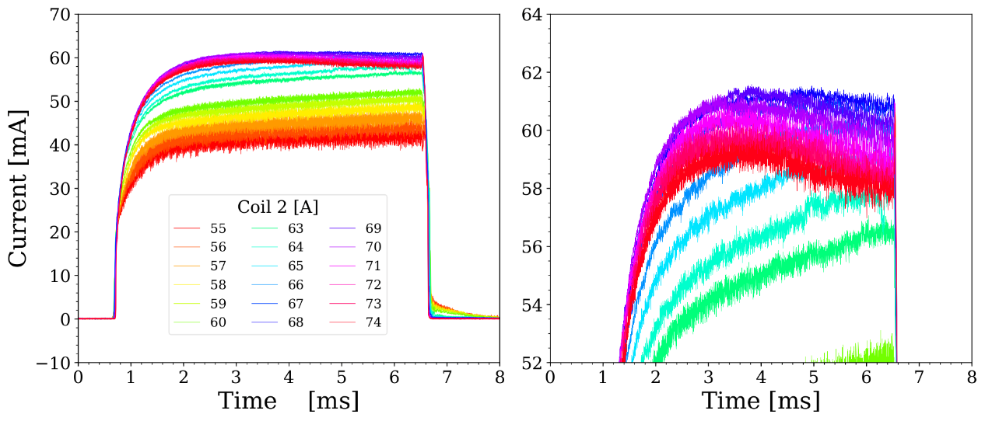
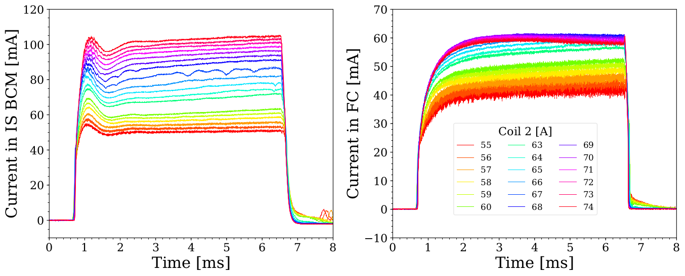
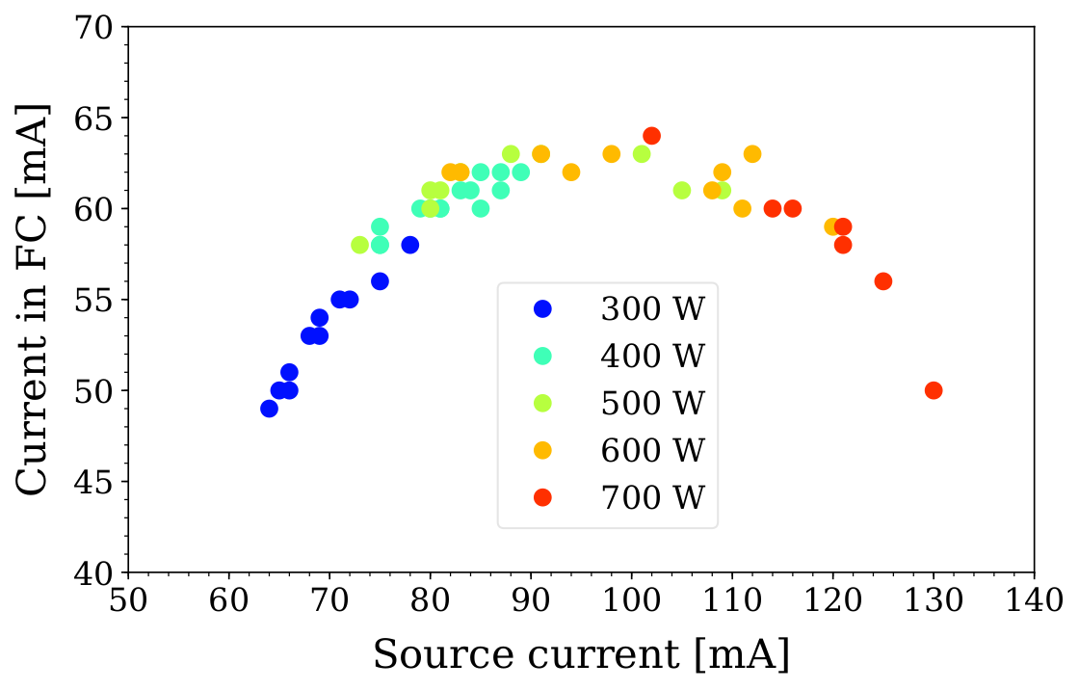
Source characterization
The source proved to be very flexible and provided a wide operation range.
We can easily establish a new set point in a systematic manner (coil2 scan).
The source beam characteristic is dictated by the extracted current.
  Seems no special source configuration with a high brightness.

Slide 16
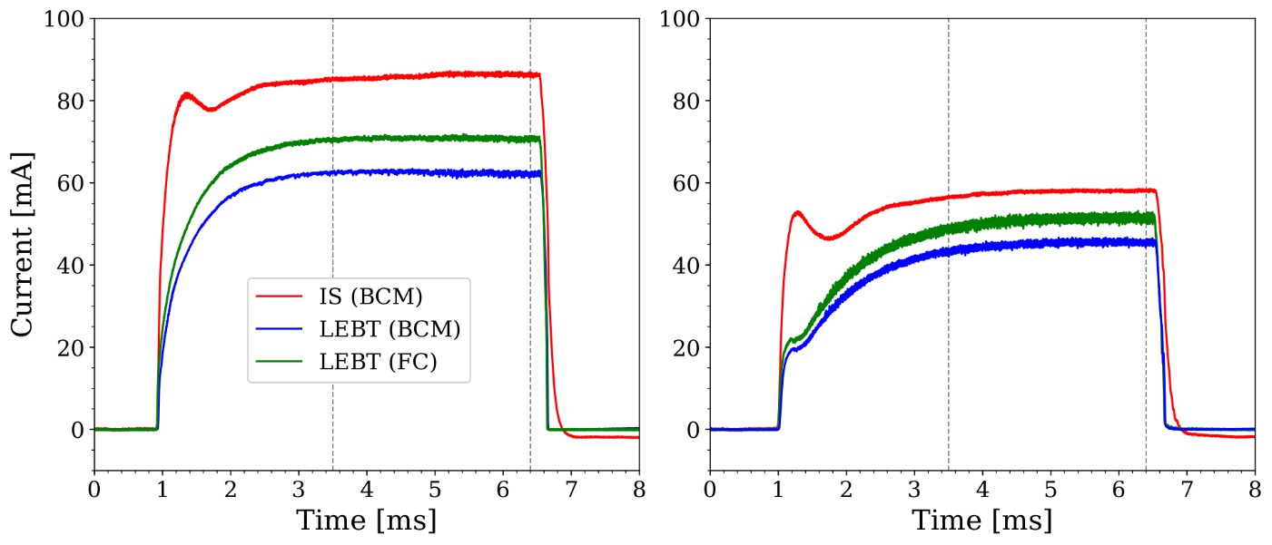
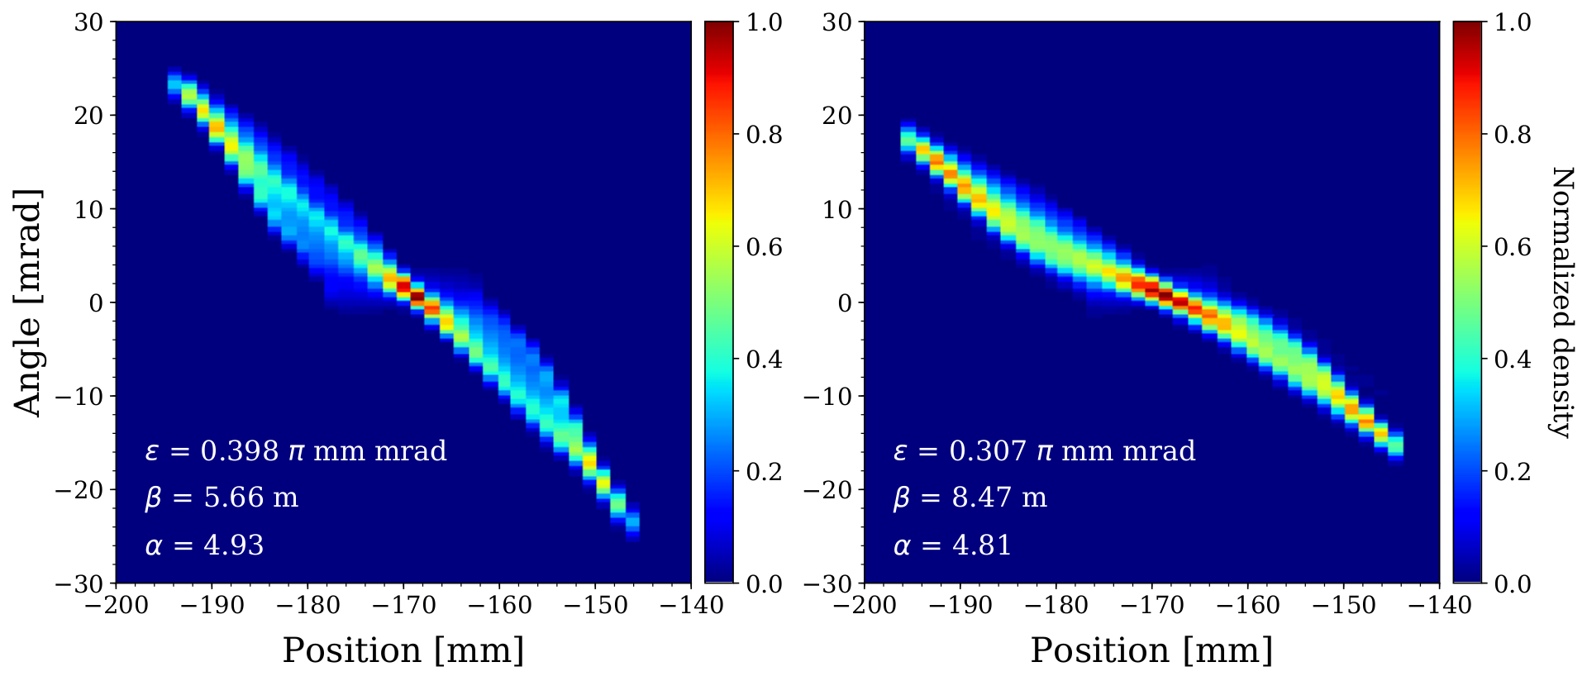
Ranges of current and emittance
~85 mA extracted
~60 mA extracted
Off site commissioning had 0.2-0.3 π mm mrad for ~85 mA extraction ???
No positive impact seen by N₂ injection.
Large initial divergence?
Large discrepancy between the FC and BCM (even with good transmission).
Emitt after sol1

Slide 17
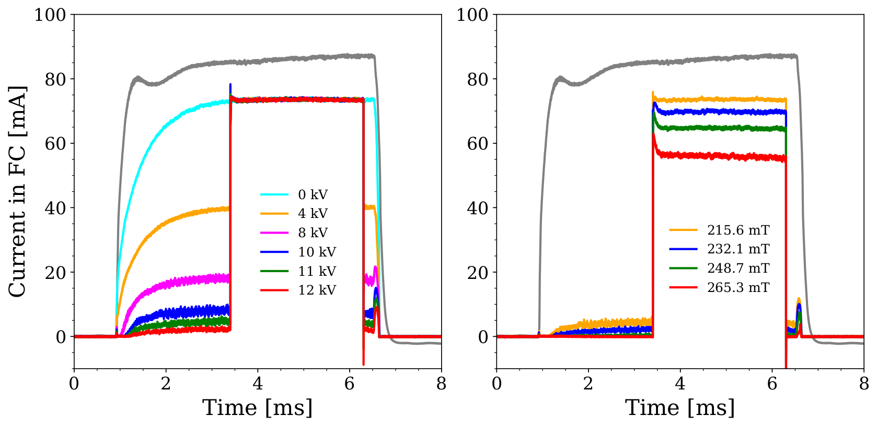
Chopper and iris issues
11 kV, vs sol2
We couldn't move the iris blades before the commissioning was over.
Chopper electrode was originally designed for positive bias, but the bias was swapped.
  To avoid drawing electrons which would affect space charge neutralization.
  Because the field is nonlinear, the swap degraded the efficiency.
  Chopper and iris have to be tested from scratch in the beginning of the next phase.
  Less straightforward with the RFQ connected.

Slide 18
Commissioning Results
Commissioning and Validation of FC, NPMs, BCMs and EMU
Emittance meas:
  Quad Scan (NPM)
  Single shot of beam waist (NPM)
  EMU
Chopper Tests
Transported the beam successfully to the end of the LEBT with 85% transmission in some configurations.
Beam trajectory studies.
  Estimate for divergence and Solenoid error
ISRC Characterization

Slide 19
Current Status
IRIS Repair
Fiducialization of Diagnostics Tank and associated devices (FC, EMU2, Doppler…)
Designing new fence around the HV Platform.
Installing permanent H2 monitor in the platform.
Reassembly to start next week.
Notes:
So the commissioning of beam diagnostics is work in progress, with the EMU, the second pair of NPMs at the commissioning tank and the Doppler monitor next in line. I highlight here in red that measuring the emittance at the entrance of the RFQ is the single most important measurement of this commissioning, and that’s where we are focusing all our efforts.

Slide 20
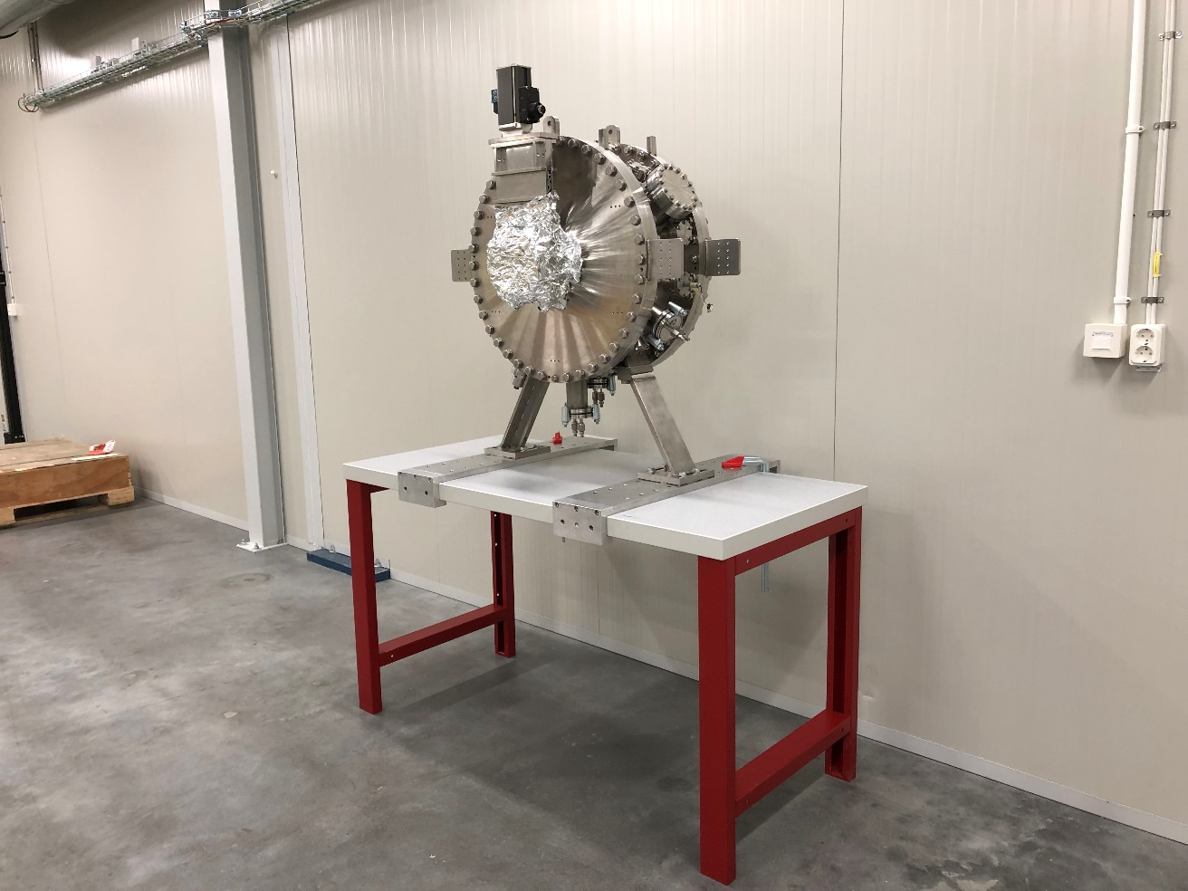
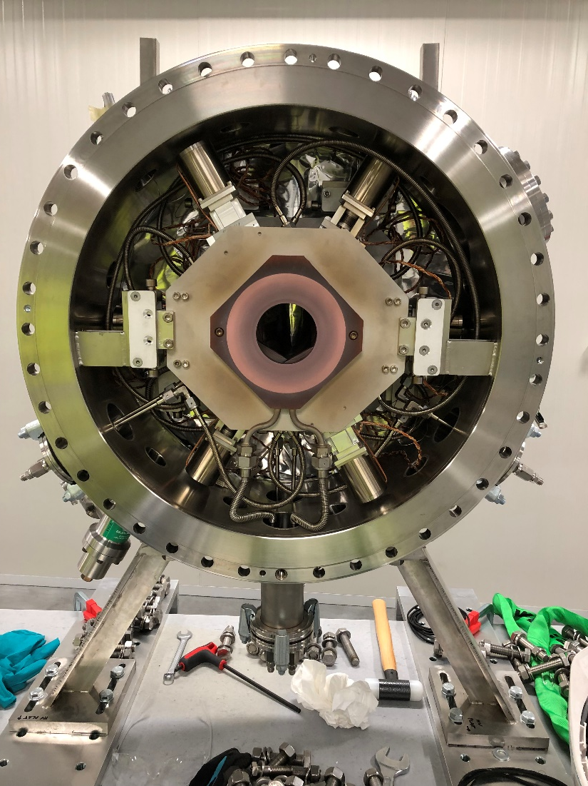
Issues: IRIS
Fixing connectors and pins
Geo Brick → EtherCAT
Thermocouple wires

Slide 21
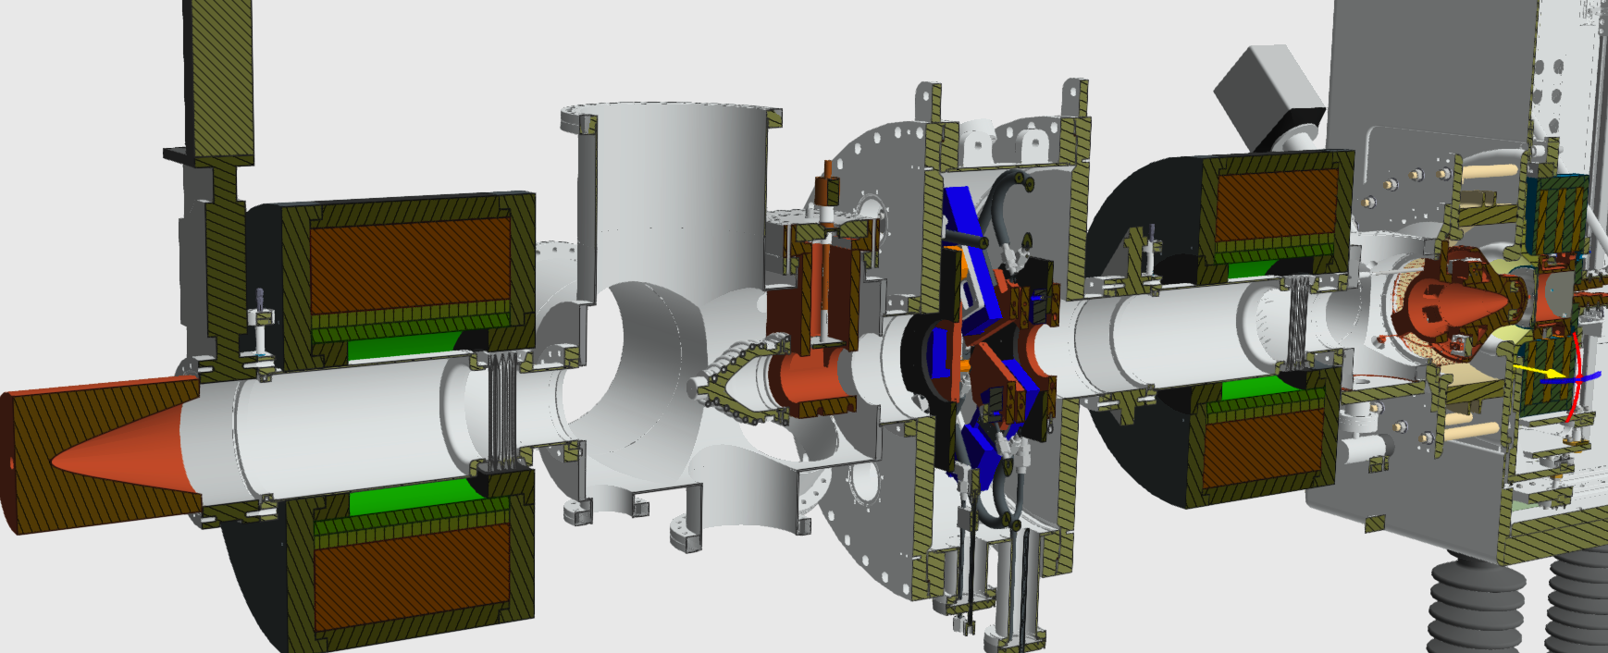
LEBT Reassembly
Notes:
At the moment, we only have the LEBT installed up to Solenoid 1. The reassembly will start by installing the gate valve to the Iris and installing that section first on the beam line, followed by the diagnostics tank. The diagnostics tank and all its devices have been fiducialized, as the survey and alignment team and BI were missing that information. Once the diagnostics tank is in place, the reassembly continues with the installation of Solenoid 2 and the collimator, finishing with the connection to the RFQ.

Slide 22
Conclusions
Overall
  A lot of progress in all areas of the accelerator.
  NC linac commissioning is planned for this year.
Ion source and LEBT
  Spent nearly 5 months to overcome the EMI issue. Afterwards, stable operation was achieved for the source.
  Understanding of the ion source behavior has improved a lot.
  Issues present with beam quality and trajectory.
  Couldn't establish adjustments of the pulse width and current with the chopper and iris.
  Resource limitation of the controls team was and will be a major issue. Already talking about the bare minimum configuration for the next phase.
Notes:
To conclude, I’d like to say that a lot of progress is made in all areas of the accelerator. Commissioning of the NC Linac is planned for this year, and that may even include DTL 1 tank. What we learned from the first round of beam commissioning is that unforeseen events can have a major impact on the schedule, we understand much better now the ion source and LEBT, but there are still issues with beam quality and trajectory, and we could not use the Iris and the Chopper effectively to adjust the pulse width and beam current. We still suffer from very limited resources, especially in the controls team, and this will continue to be a bottleneck as we are discussing bare minimum configuration for the next round.

Slide 23
Acknowledgements
Beam commissioning leader:
  Ryoichi Miyamoto
Beam Physics section:
  Mamad Eshraqi
  Natalia Milas
  Yngve Levinsen
  Ciprian Plostinar
  Emelie Nilsson
  Björn Gålander
Operations section:
  Lali Tchelidze
  Marc Muñoz
Beam Instrumentation Section:
  Cyrille Thomas
  Elena Donegani
  Clement Derrez
  Roxana Tarkeshian
  Rafael Baron
  Slava Grishin
  Edvard Bergman
Integrated Control System:
  Saeed Haghtalab
  Antoni Simelio
  Joao Paulo Martins
  Thomas Fay
  Emanuele Laface
  Juan F. Esteban Müller

Slide 24
Thank you!
Questions?

Slide 25
BACKUP SLIDES

Slide 26
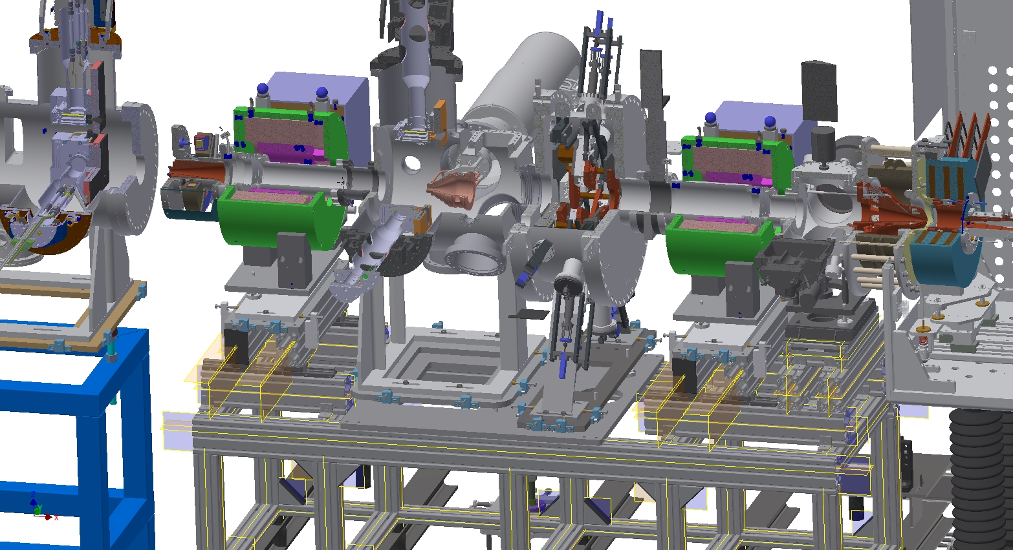
3D Model

Slide 27
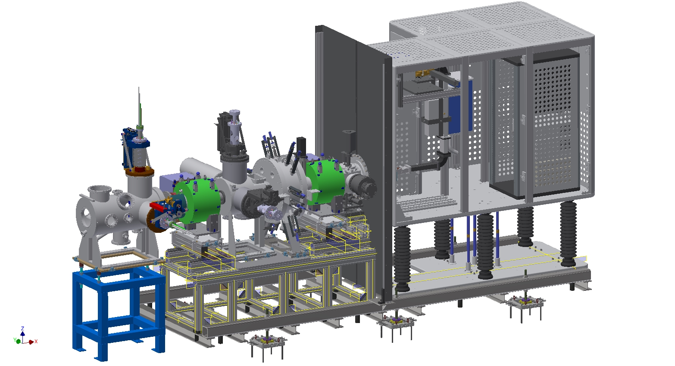
3D Model

Slide 28
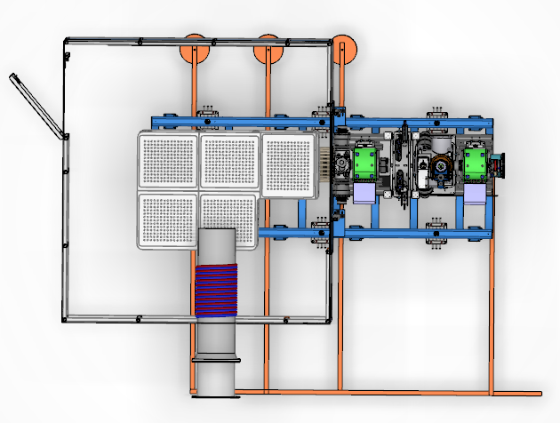
Top view of ISRC & LEBT
PSS0 Entry
Connection to grounding
mesh in the floor
Connection to
wall grounding
Ion source
water cooling

Slide 29
Ion Source + LEBT
Installation and Commissioning timeline
December 2017 – LEBT and source shipped from Catania to Lund
January 2018 to May 2018 – Installations in the tunnel
July 2018 – Safety Readiness Review
September 2018 – Start of commissioning
November 2018 to January 2019 – Sparks from the High Voltage cause damages to a few power supplies, new work with grounding required
February 2019 – Commissioning restarts
April 2019 – End of commissioning and start of RFQ installations

Slide 30
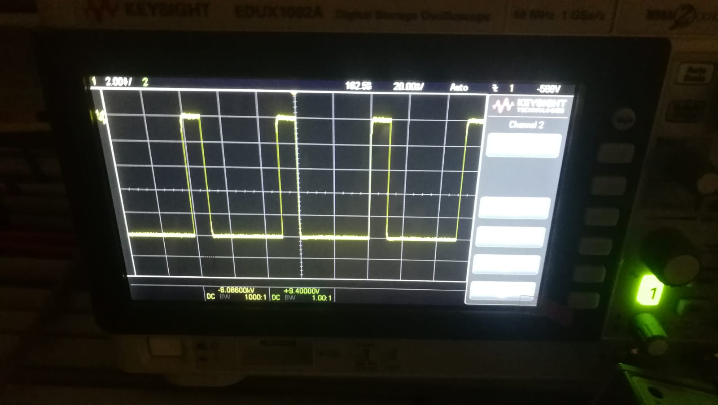
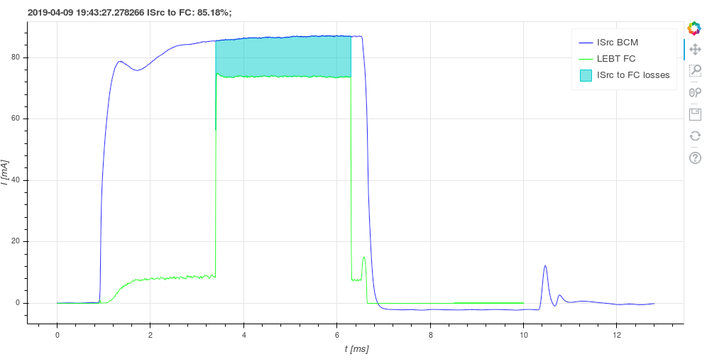
Issues: LEBT Chopper
Commissioning of the chopper started on March 5
Issues reaching the nominal voltage during testing
Debugging the system
Local test successful!
Remote control test ongoing
Notes:
The commissioning of the LEBT chopper started just last month. We installed the different electronic modules and the power supply, and during testing we observed issues reaching the nominal voltage of -10 kV. We are still debugging the system to find the cause of the problem.

Slide 31
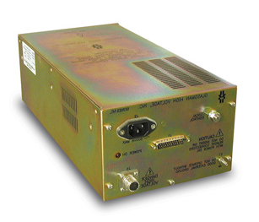

HV Switch
HTS 151-03 GSM Behlke
HVS module
20 meters
27Ω
27Ω
1nF
HV module
HV Power Supply
ML12N25 Glassman
RF 35
Caburn Feedthrough
TTL
Fast Beam Stop
Chopper Enable
Voltage Reference
Interface
V / I Monitor
Fast/Slow Alarm
Fault
Reshasped
LV module
Notes:
The power supply of the chopper is connected to a HV switch which is controlled by a low voltage module. We are using a negative polarity chopper because, when using a positive bias, the chopper electrode picks up electrons from secondary emission or from the residual gas and it drains more current from the power supply, which is an issue for holding the voltage properly.

