Slide 1
NCL Beam Commissioning - Coordination/Plan/Steps -
Ryoichi Miyamoto (Beam Commissioning Coordinator)
2020-01-29~30
ESS Accelerator Testing and Commissioning Workshop

Slide 2
Outline
Introduction
Beam commissioning aspects
Coordination matters in light of experiences from ISrc and LEBT
NCL beam commissioning plan
Situation and objectives
Steps for the upcoming stage
ISrc restart
RFQ injection preparation
Probe beam threading to MEBT FC
Low current tuning (MEBT linear optics)
Summary and outlook

Slide 3
Introduction

Slide 4
Beam commissioning aspects (definitions)
Subsystems (components) verifications with beam
Overlap with testing team.
Verify magnets, LLRF, diagnostics, protections, shielding, ...
Occupy 50-75% of time, from experiences of other machines.
Tuning beam parameters
Mandate of beam physicists.
Low current (centroid) tuning: steering, RF setting, ...
High current (phase space) tuning: matching, loss mitigation, ...
If all the subsystems work perfectly, tuning activities could be short.
Preparations to operations
Overlap with operations team.
Handing over subsystems and setting, training operators, ...
Power ramp-up?
Availability improvement?

Slide 5
How we did ISrc-LEBT beam commissioning? - Subsystems verifications with beam
For many subsystems, verifications were left in incomplete state.
Preparations can improve.
A lot of improvising tests.
Need more inputs from owners, especially what to do in a control room.
Improve communication among stakeholders, on interfaces and especially on conventions.
Don’t forget the “colorful” polarity errors in solenoids, steerers, and NPM.
Note priority was given for collecting measurement data, because of:
Initial issues and time limit
Commissioning tank available only for that stage
Was/is the whole chain from testing to handing-over clear?
Reports?
The previous workshop pointed out the issue of a single person in charge of multiple aspects.

Slide 6
How we did ISrc-LEBT beam commissioning? - Tuning beam parameters
Missing critical components meant:
Spent a large fraction of time on unplanned improvising measurements.
The original straight-line plan failed abysmally.
The brainstorming during planning was vital.
For the upcoming stage for RFQ and MEBT, we already plan for the minimal machine state and there is much less flexibility for this to happen.
Unexpected characteristics of beam also led to a lot of unplanned improvising measurements.
Large trajectory error
Large emittance
(Polarity errors)
Scripting with jupyter saved the day.
How improvising measurements fit to the engineering handbook?
Reports?
The same situation as the subsystems verifications.

Slide 7
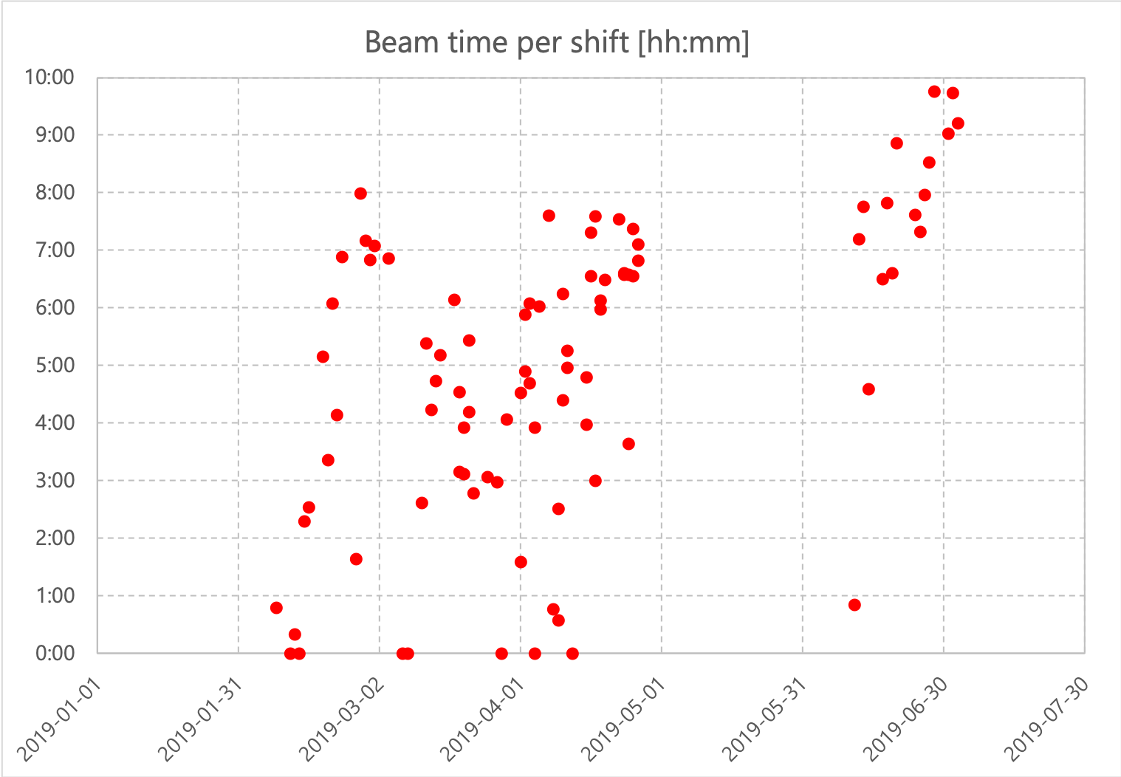
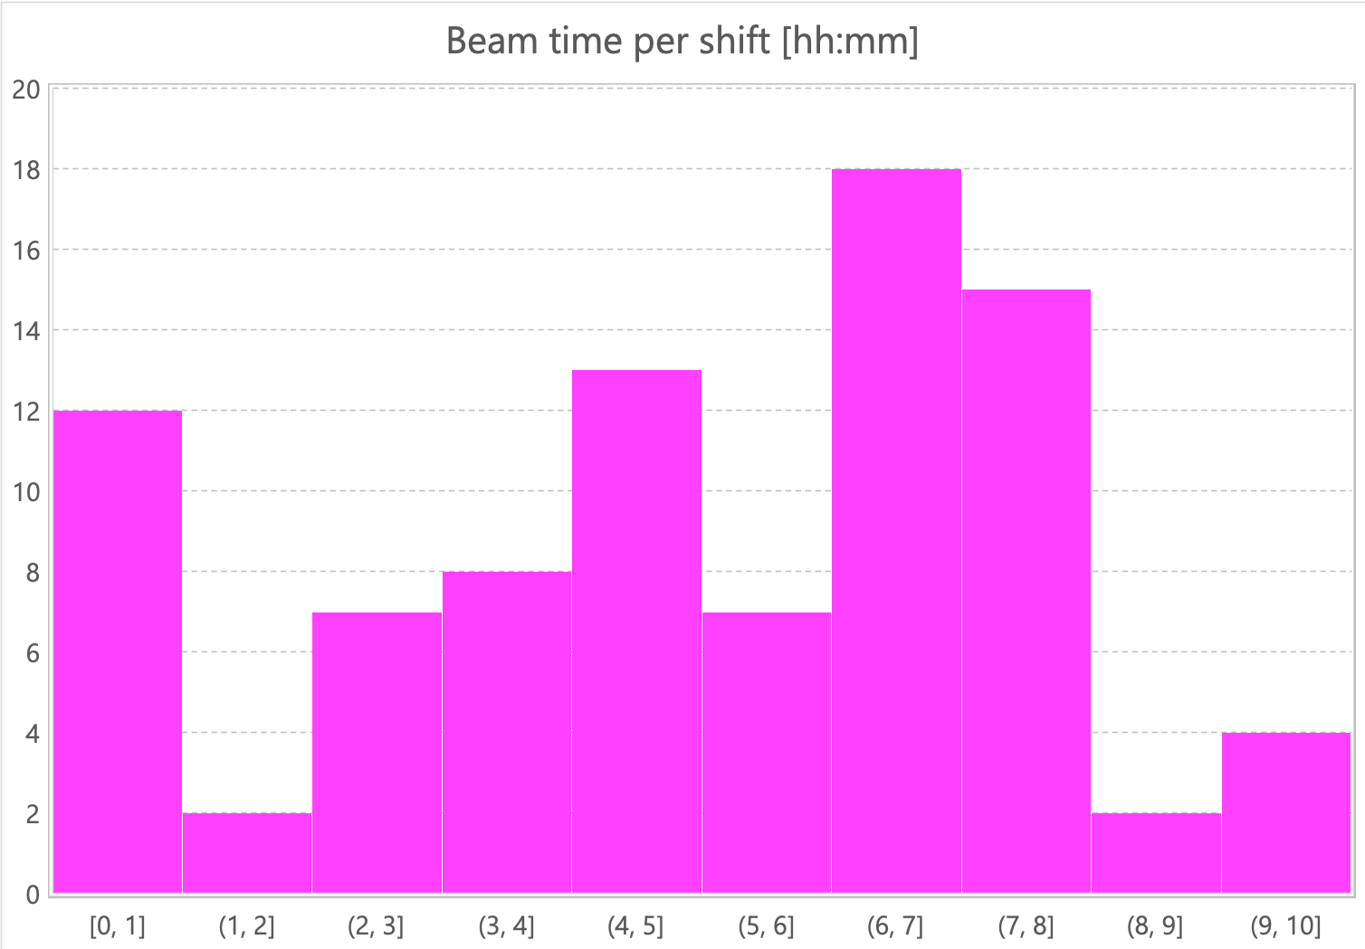
Some statistics from ISrc-LEBT commissioning
The first beam was achieved on 2018-09-19, but the effective duration was ~3.5 months from 2019-02-08 to 2019-07-03, minus ~1.5 month for water piping works.
For 1 month out of ~3.5 months, 2nd solenoid was missing.
In ~3.5 months, we had 88 shifts scheduled to have beam.
The average beam availability per shift over those 88 shifts was 4:56, but improved to 7:54 after 2019-06-12.
Now counting the ratio between the verifications vs tuning....
We’ll see the case for the NCL commissioning.
Could use some help/inputs from operations and RAMI folks.

Slide 8
NCL beam commissioning plan

Slide 9
Situation for the upcoming commissioning
Technical homework from the ISrc and LEBT beam commissioning
Beam mode production (short term)
Timing system
Iris
New LEBT chopper
Beam quality (long term)
Large emittance (initial divergence?)
Large trajectory error (initial divergence and solenoids)
Missing Bunchers and DTL1
Diagnostics
Available
ISrc+LEBT: FC, BCMs
RFQ+MEBT: FC, BCMs, BPMs, FBPM, nBLMs
Missing (likely)
ISrc+LEBT: Dpl, NPMs, EMUs
RFQ+MEBT: FBCM, WSs, NPMs, LBM, EMUs, collimators

Slide 10
NCL beam commissioning goals at each stage
Stage 1A: ISrc-MEBT
The main focus is subsystems verifications:
(Restart ISrc)
Make RFQ work
Establish Beam mode production (timing, choppers, and iris)
Verify MPS
Tuning is limited to low current and transverse plane in MEBT.
Stage 1B: ISrc-DTL1
The main focus remains to be subsystems verifications:
Make DTL1 work
Verify all the subsystems up to DTL (?)
Tuning is likely to be limited to low current due to the time limit.
Stage 2: ISrc-DTL4
Verify all the subsystems up to DTL4.
Identify the current limit up to DTL4.
Stability test (?).

Slide 11
NCL configurations for stages
Stage 1A/B
MEBT FC
DTL2 FC
RFQ
MEBT
DTL1
DTL2
DTL3
DTL4
DTL5
DTL2-4 not installed.
DTL2 FC is placed right after DTL1 with shielding.
Temporary shield wall at DTL5.
Temp shield wall
Stage 2
MEBT FC
DTL2 FC
DTL4 FC
RFQ
MEBT
DTL1
DTL2
DTL3
DTL4
DTL5
MEBT and DTL2 FCs are at their nominal locations.
DTL4 FC is placed in shielding.
Temp shield wall

Slide 12
Beam modes and stops during NCL commissioning
Mode | I [mA] | T [µs] | f [Hz] | IT [µC]
Probe | 6 | 5 | 1 | 0.03
Fast commissioning | 6 | 5 | 14 | 0.03
RF test | 6 | 50 | 1 | 0.3
Stability test | 6 | 50 | 14 | 0.3
Slow commissioning | 62.5 | 5 | 1 | 0.3125
Fast tuning | 62.5 | 5 | 14 | 0.3125
Slow tuning | 62.5 | 50 | 1 | 3.125
Production | 62.5 | 2860 | 14 | 178.75
Stop | “Max” mode | IT [µC]
LEBT FC | Production* | 178.75*
MEBT FC | Slow tuning | 3.125
DTL1 FC* | Fast tuning? | 0.3125?
DTL2 FC | Fast tuning? | 0.3125?
DTL4 FC | Slow tuning | 3.125

Slide 13
Steps for the upcoming stage

Slide 14
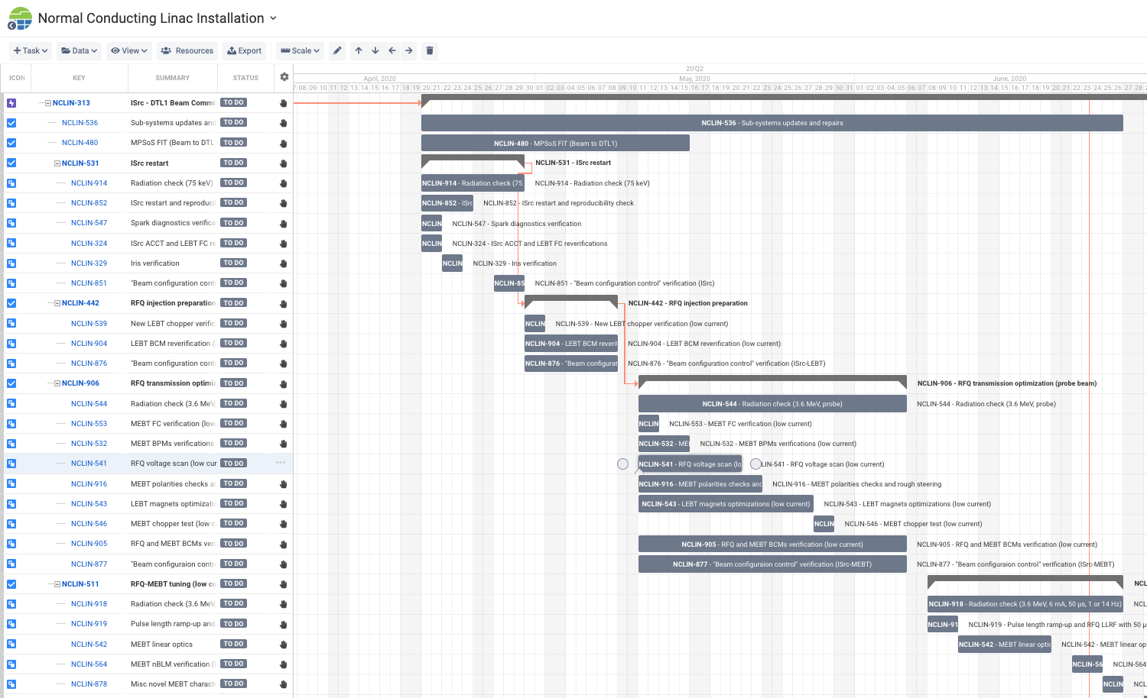
~10 weeks live plan in Jira
Verifications
MEBT tuning
LEBT FC
LEBT
collimator
MEBT FC

Slide 15
Overview
This stage is about verifying all available subsystems.
In remaining time, low current transverse tuning of MEBT is conducted.
High current beam is tried only briefly or not tried at all, unless a profile or emittance diagnostics becomes available.
3 verifications steps:
ISrc restart (beam to LEBT FC)
Check known ISrc settings
Test the iris
RFQ injection preparation (beam to LEBT collimator)
Verify the new LEBT chopper -> establish beam modes production
RFQ transmission optimization with probe (beam to MEBT FC)
Make the RFQ work
Establish stable probe beam transport to the MEBT FC
Verifications of MPS and shielding are done iteratively at each step.

Slide 16
Comments on the Jira plan
Things to do were listed and very rough estimations of durations were added.
No float nor consideration on availability.
Details of each activity will be further developed.
I need much more inputs from the subsystem owners on what to do in the control room.
MPS verification could be especially complicated and require interdisciplinary collaboration.
Activities of the low current (centroid) tuning should be “relatively” straightforward. The key is to prepare adequate tools.
The issue with the straight-line plan vs reality is less like for NCL, due to much less flexibility.
In addition to improvising tests, how do the Jira plan fit to the engineering handbook, i.e., thorough documentation?

Slide 17
Steps 1 & 2 at a glance
ACCT
FC
EMU (H)
EMU (V)
NPM (H)
NPM (V)
Dpl
NPM (H)
NPM (V)
BCM
EMU (V)
NPM (H)
NPM (V)
FC
HV
Repeller
Source
Repeller
N₂ injection
Iris
Chopper
Collimator
Beam stop
Solenoid 1
(Steerer 1H)
(Steerer 1V)
Solenoid 2
(Steerer 2H)
(Steerer 2V)
New timing (supercycle), MPS, and beam modes production must work at this stage.

Slide 18
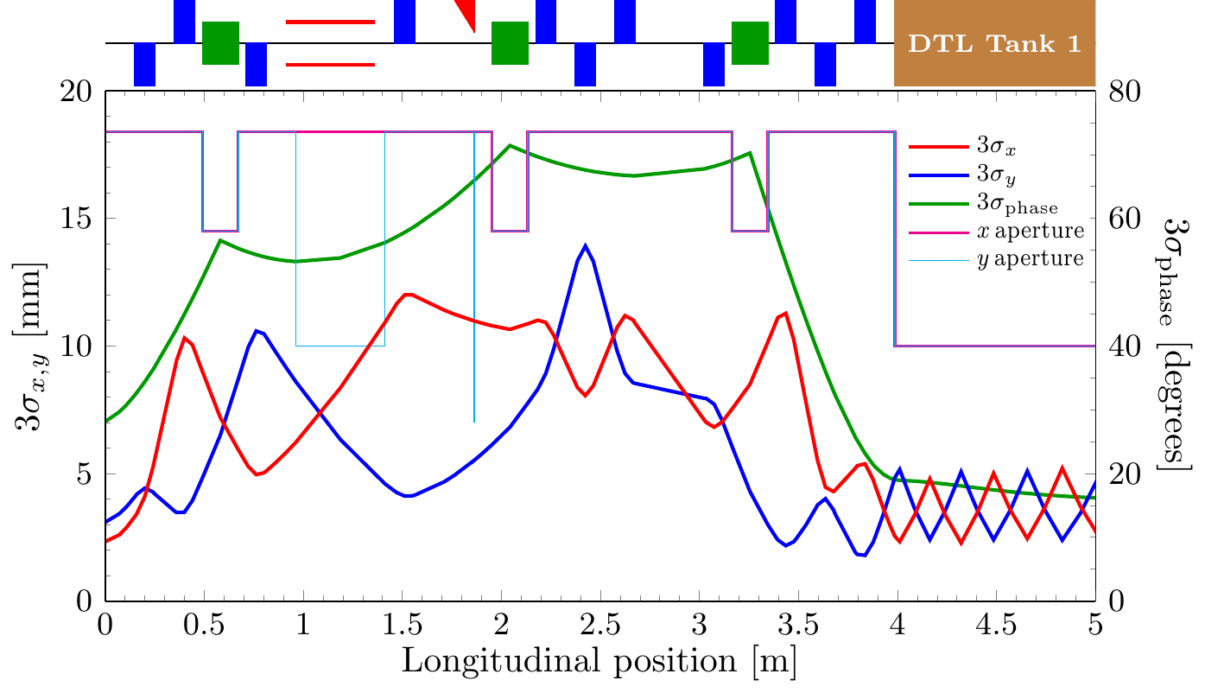
MEBT layout

Slide 19
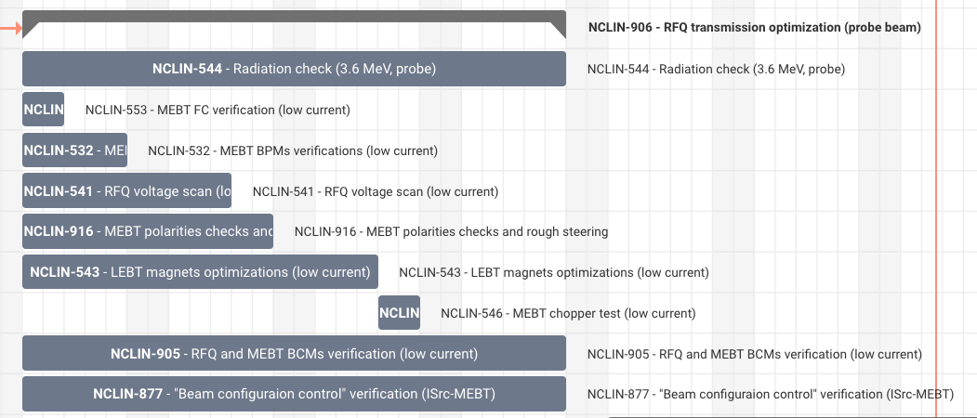
Step 3 at a glance
This is a convoluted step involving:
Iterations among the RFQ voltage scan, MEBT steering, and LEBT solenoids adjustment
Verifications of FC, BCMs, and BPMs.
Verification of MPS.

Slide 20
What we could do with just the probe beam and BPMs
RFQ output energy measurement
Direct measurement with a pair with special electronics
Aperture (limit) scan
Response matrix measurement
Quad gradient
Quad cycling curve
Steerer deflection and nonlinearity
Note the sextupolar component is as strong as ~30% at the border or ROI.
BPM linearity
Beam based alignment
Trajectory correction
Local correction
Especially at the chopper and its dump
Global correction

Slide 21
Summary and outlook

Slide 22
Summary and outlook
The upcoming beam commissioning stage focuses on subsystems verifications with beam for the RFQ and MEBT.
Limited time
Limited components
Homework left from the ISrc-LEBT commissioning
In addition to make the RFQ (first RF accelerating structure), major goals include establishing beam modes production and protection functions.
Tuning activities will be limited low current one for the upcoming stage. It is likely that the stage one after is also limited to low current most of time and proper high current tunings are done when we have up to DTL4.

