Slide 1
Status of infrastructure for RFQ, MEBT and DTL1 (cooling, power, racks, cables, etc.)
Kristofer Falkland

Slide 2
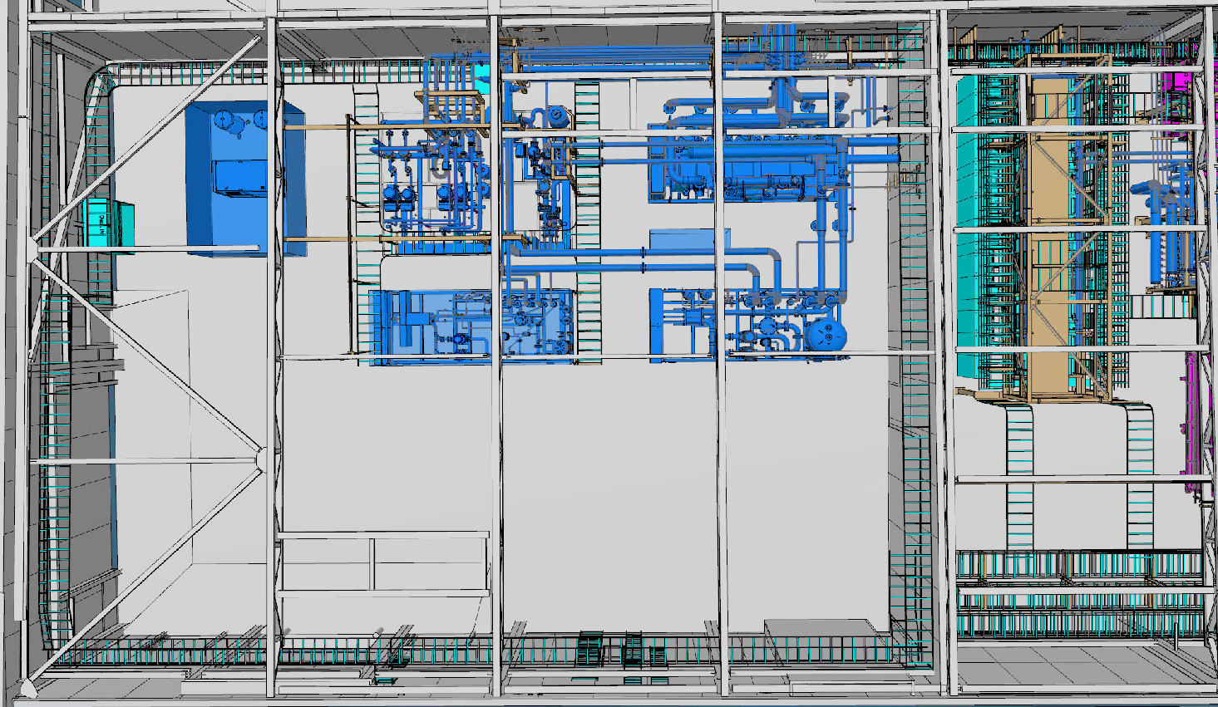
FEB100
Electrical infrastructure
Install power CWS02 (February)
Reconnect CWS03 (April)
Install power CWS04 (May?)
Install N2 Generator support (February)
Water infrastructure
Install CWS02 (April)
Install CWS04 (May?)
Install N2 Generator support (February)
Others
CWS03
RFQ Skid
(CEA)
CWS04
DTL Skid
(INFN)
NCG
N2 generator
CWS01
Ion Source / LEBT / MEBT / DTL FC Skid (GRE)
CWS02 Magnets/RF Couplers
(GRE)

Slide 3
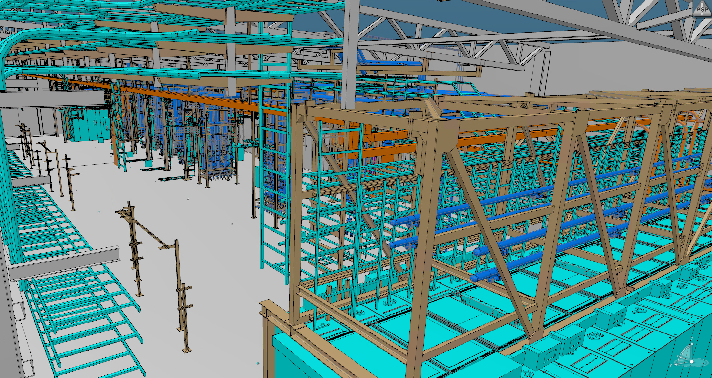
NCG
Electrical infrastructure
Complete Ladders (need components)
EMC (need components)
PSS & BI Conduits (design ongoing)
Cable pulling (95% / 50% / 44 % [73% DTL-1])
Termination A-side (….)
Termination B-side (25% / 0% / 17 % [32%])
Install Modulator/Klystron
Water infrastructure
CWL is ready
P&P of CWM ongoing. (Schedule to be done February)
CWH later
nVent connet cooling of racks (April?)
Hoses (Design ongoing)
Others
Shielding (stub)
PRL early commissioning

Slide 4
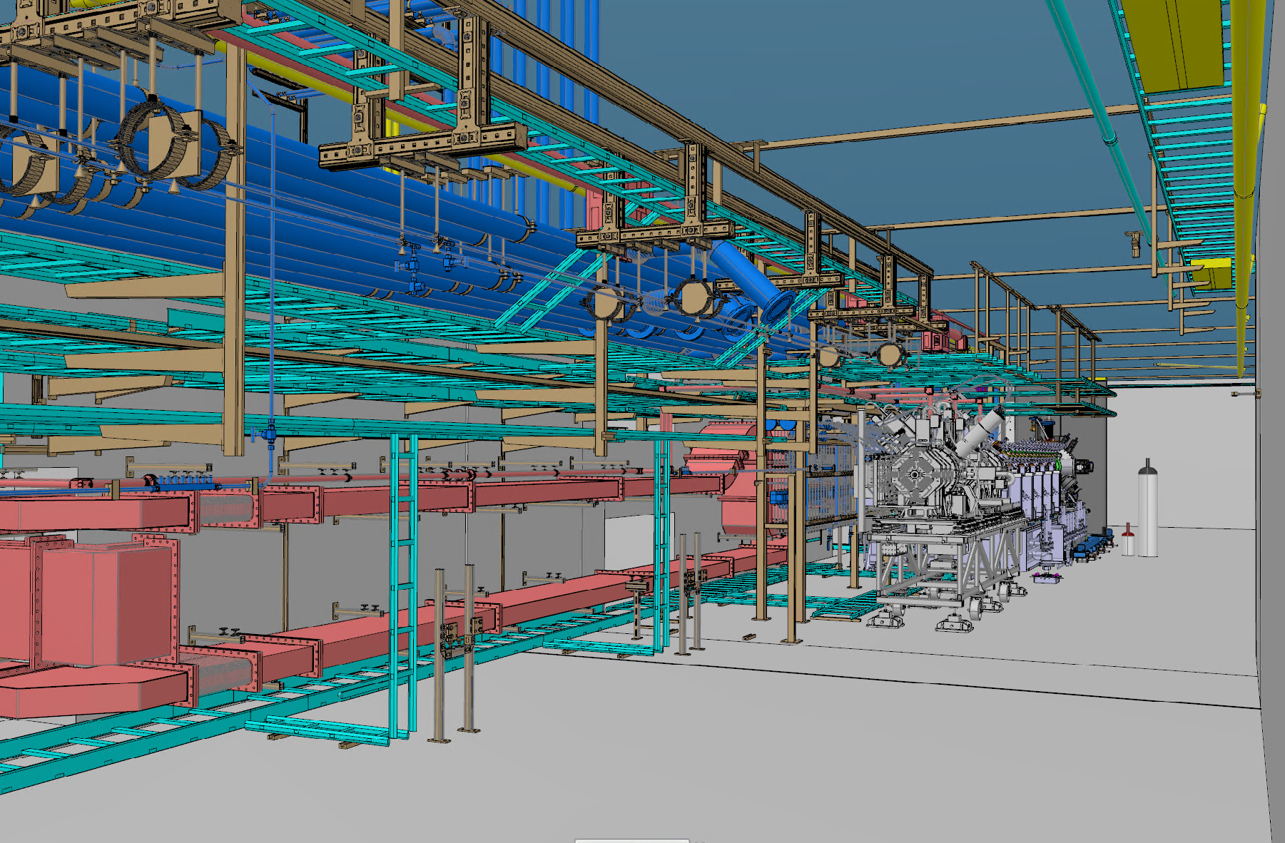
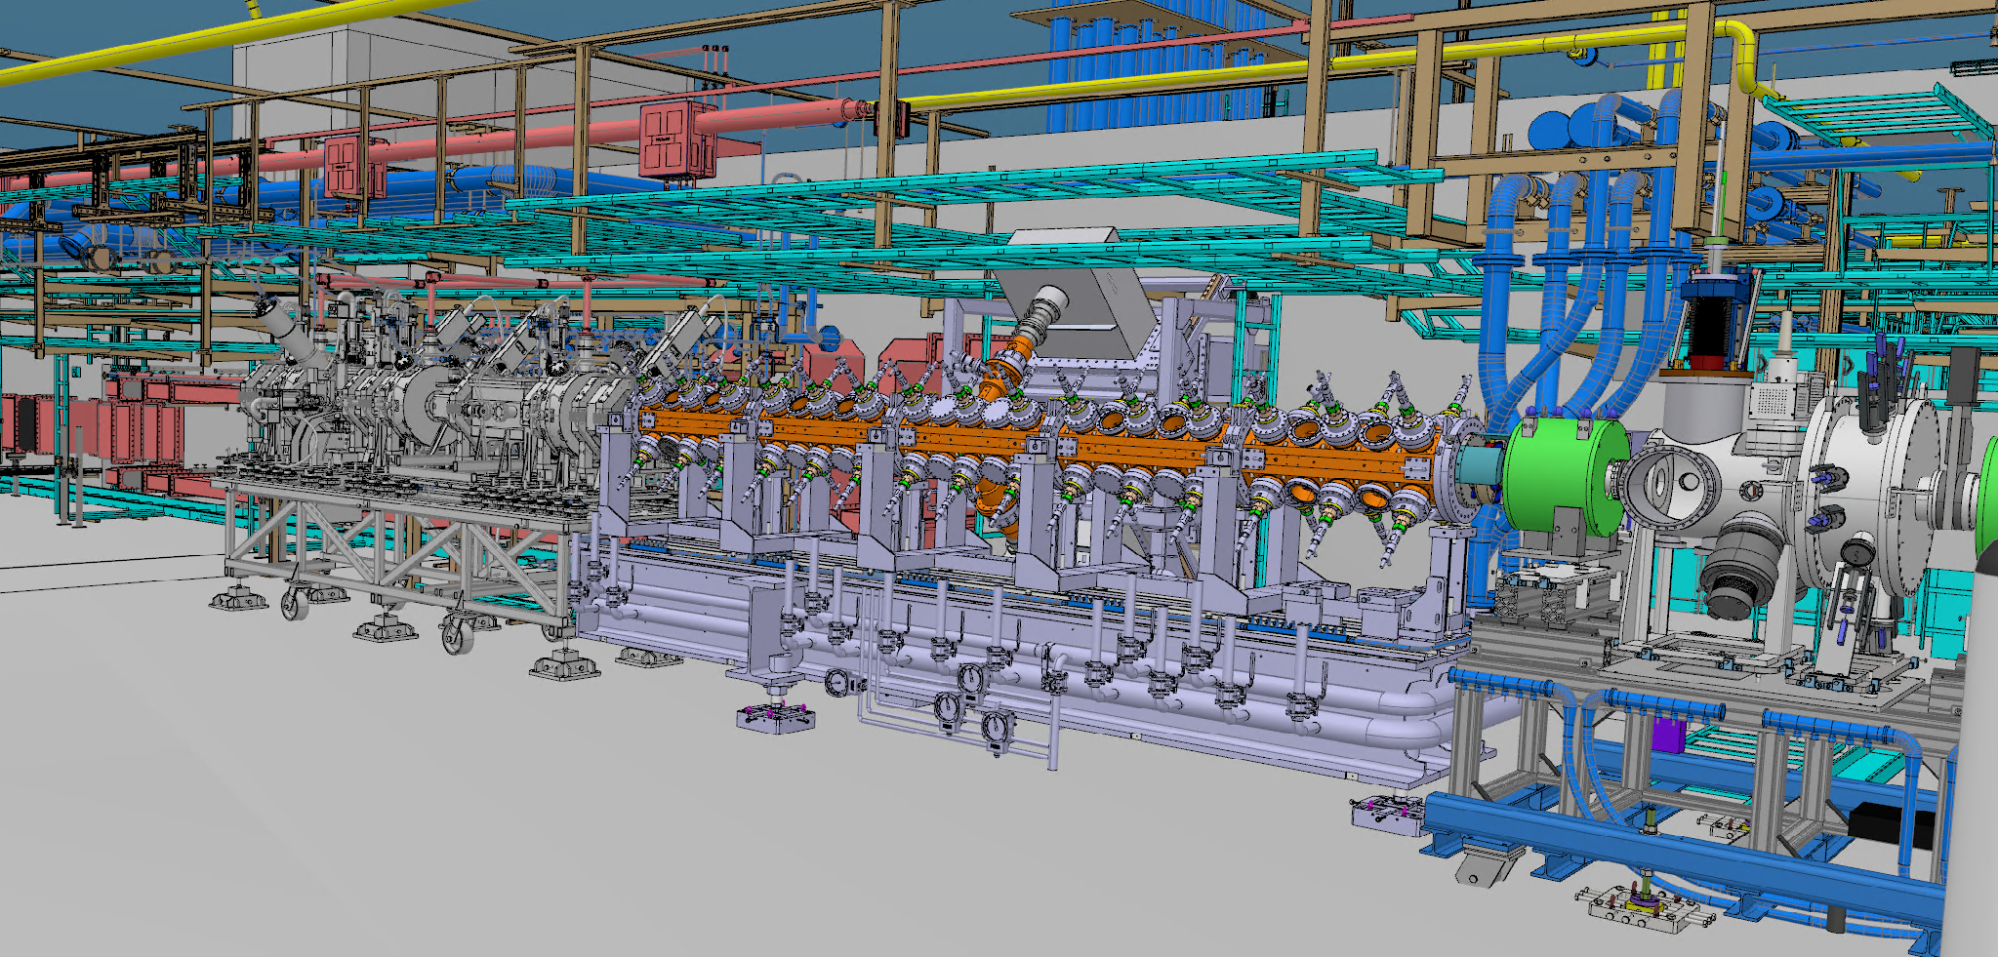
G01
Electrical infrastructure
Complete Ladders (need components)
EMC (need components)
PSS & BI Conduits (design ongoing)
Cable pulling (95% / 50% / 44 % [73% DTL-1])
Termination A-side (….)
Termination B-side (25% / 0% / 17 % [32%])
Water infrastructure
Manifold (MEBT) (ongoing)
Manifold (RFQ+Skid) (end of April)
Manifold (DTL1) (when installing DTL)
IAR (RFQ+MEBT) (februray)
IAR DTL-1 (when installing DTL-1?)
Others
Shielding (TSW, drop hatch)
PRL early commissioning

Slide 5
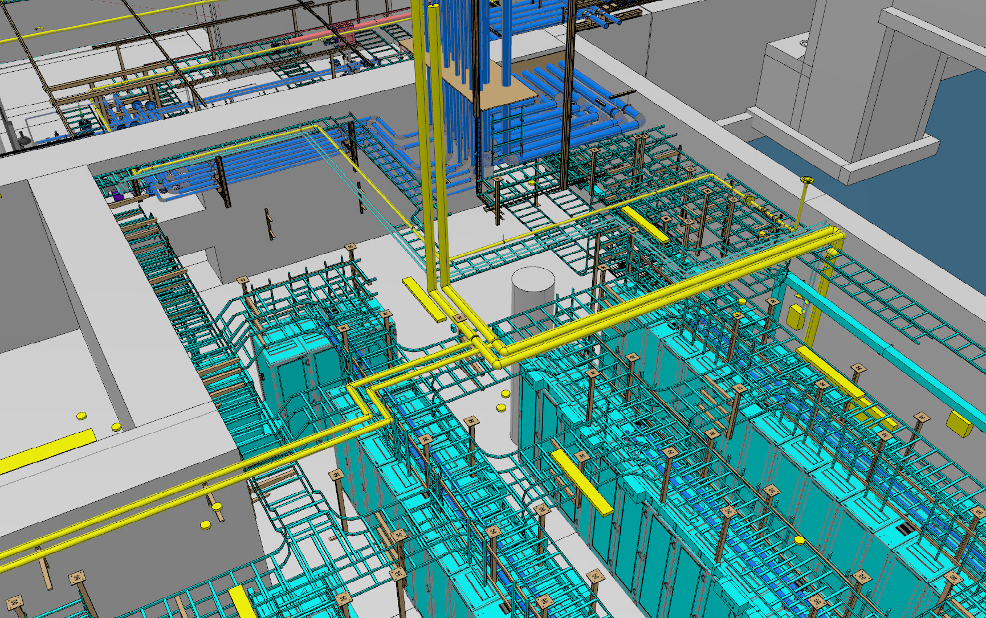
FEB090
Electrical infrastructure
Complete Ladders (design ongoing)
Cable pulling
Finalize PDU/cooling installation (april)
Others
Shielding

Slide 6
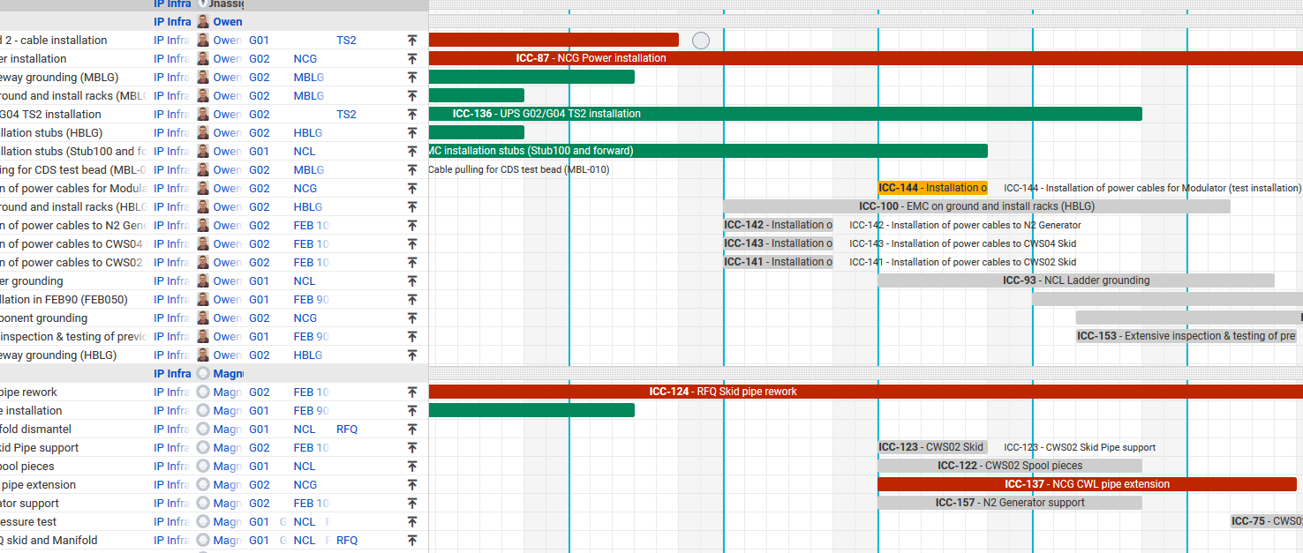
Coordinate it
In a way to try coordinate and visulize all near term installation activities we have a JIRA plan.
Please visit the schedule: https://jira.esss.lu.se/plugins/servlet/softwareplant-bigpicture/gantt.html

