Slide 1
European Spallation Source
Morten Jensen
WP8
European Spallation Source ERIC
29 January 2020

Slide 2
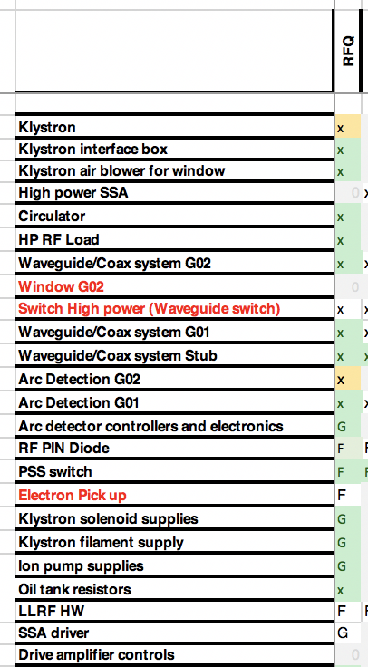
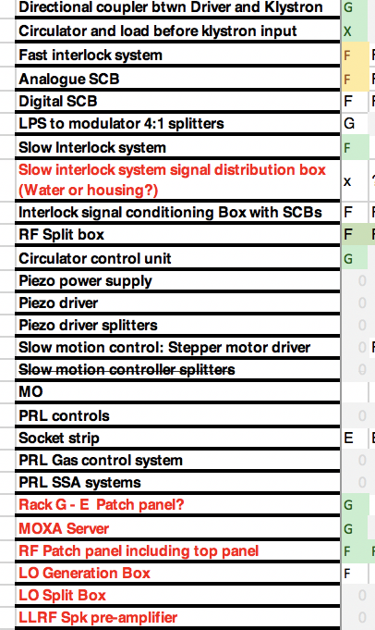
RFQ - Scope
Scope summary of WP8: See ESS-0115056 for overall schematic
Scope includes:
LPS (interlock systems)
LLRF
Klystron and klystron auxiliaries (except modulator)
Waveguide, directional couplers, phase shifter, circulator, loads
Split boxes, e-pickup, PSS switch, tuning controller, couplers etc (3 racks worth)

Slide 3
WP8 Project organisation
Additionally:
Anirban Bhattacharyya
Chiara Marrelli
Chris Amstutz
Inigo De la Fuente
Nils Öst
Engineer tbd
Technican x 3 tbd

Slide 4
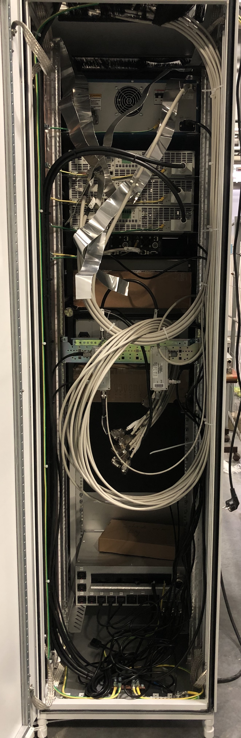
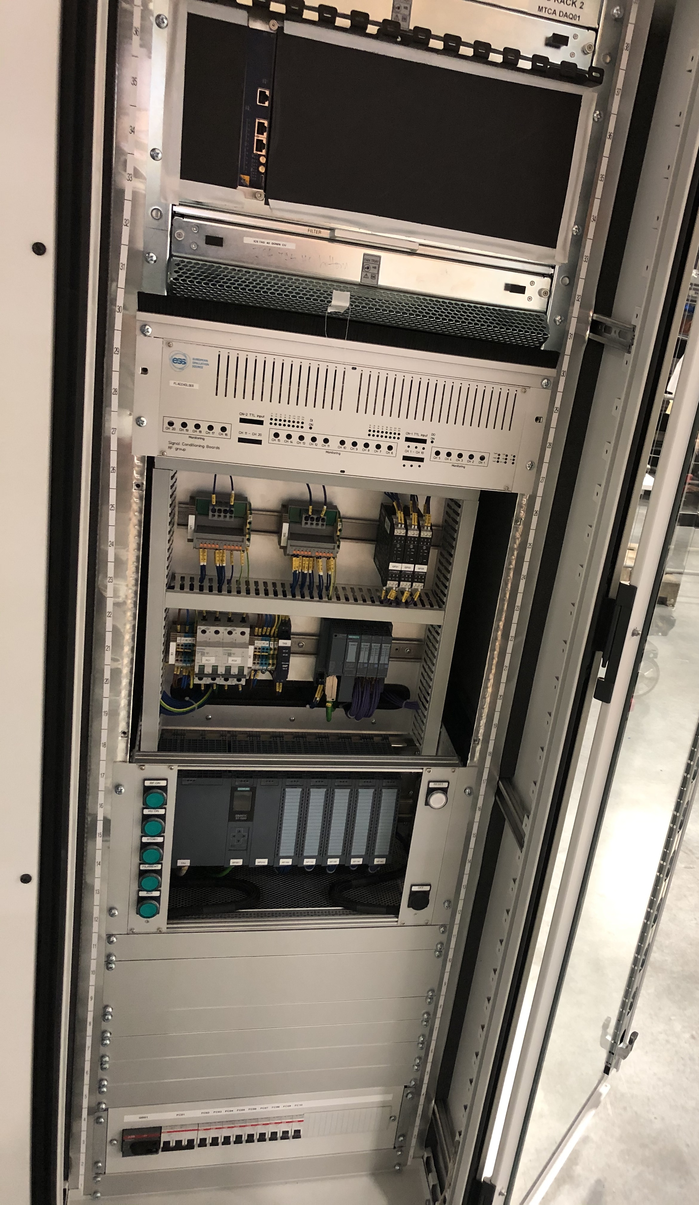
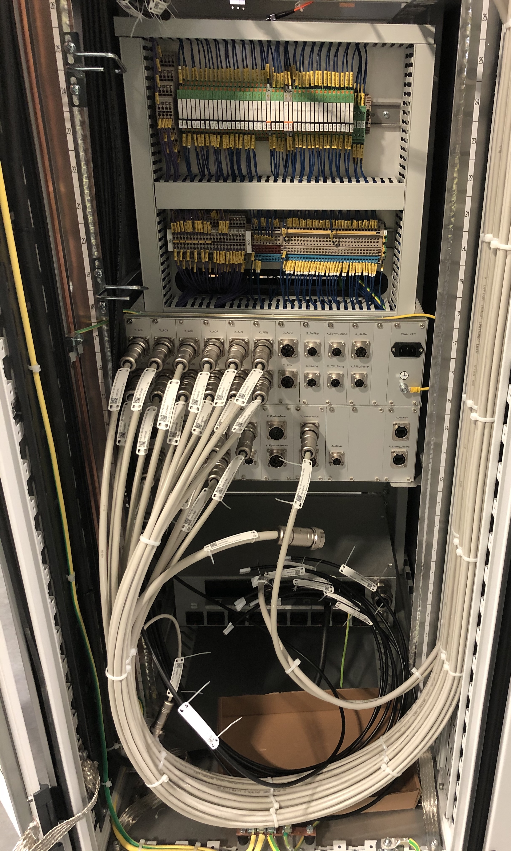
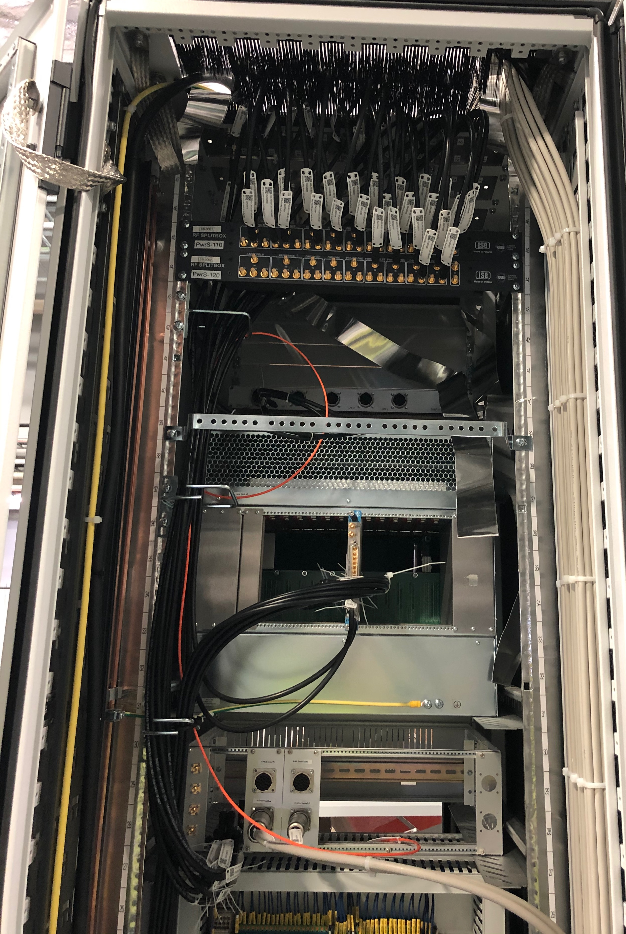
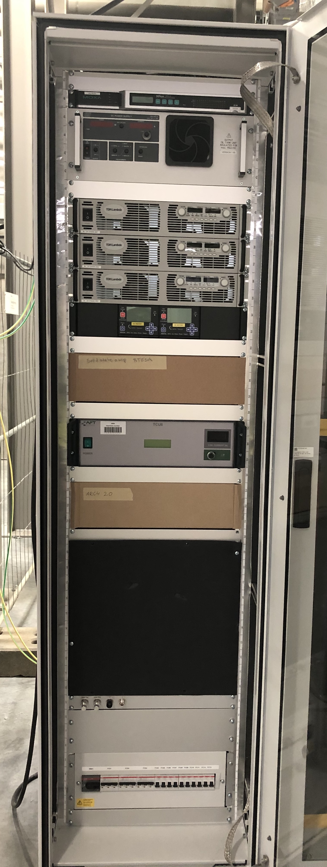
Installation to date
Installation status:
Racks assembled and cabled internally and together in RAA and low power testing has started
Rear
Front
Includes:
Moxa Server
Filament supply
Solenoid supplies
Ion Pump controllers
Drive amp (space)
Circulator control
Arc detection
LLRF
Slow interlock
Fast interlock
Signal conditioning
PDUs
…

Slide 5
Documentation for installation, test and commissining
A long road behind us, a huge task ahead of us
Detailed Incoming inspection, installation and test documentation prepared and being prepared:
  More than 50 recent detailed instructions drafted and in use, eg rack installation, low and high power rack testing, cable termination guides, with step by step assembly and instructions, RFDS installation, torque data sheets etc etc
  Has been ongoing for several years to support IFJPAN with RFDS installation and incoming inspections
  Emphasis on detailing in sufficient detail to allow semi skilled staff and contractors to follow instructions
  Consistency for quality of installation, test procedures and record keeping

Slide 6
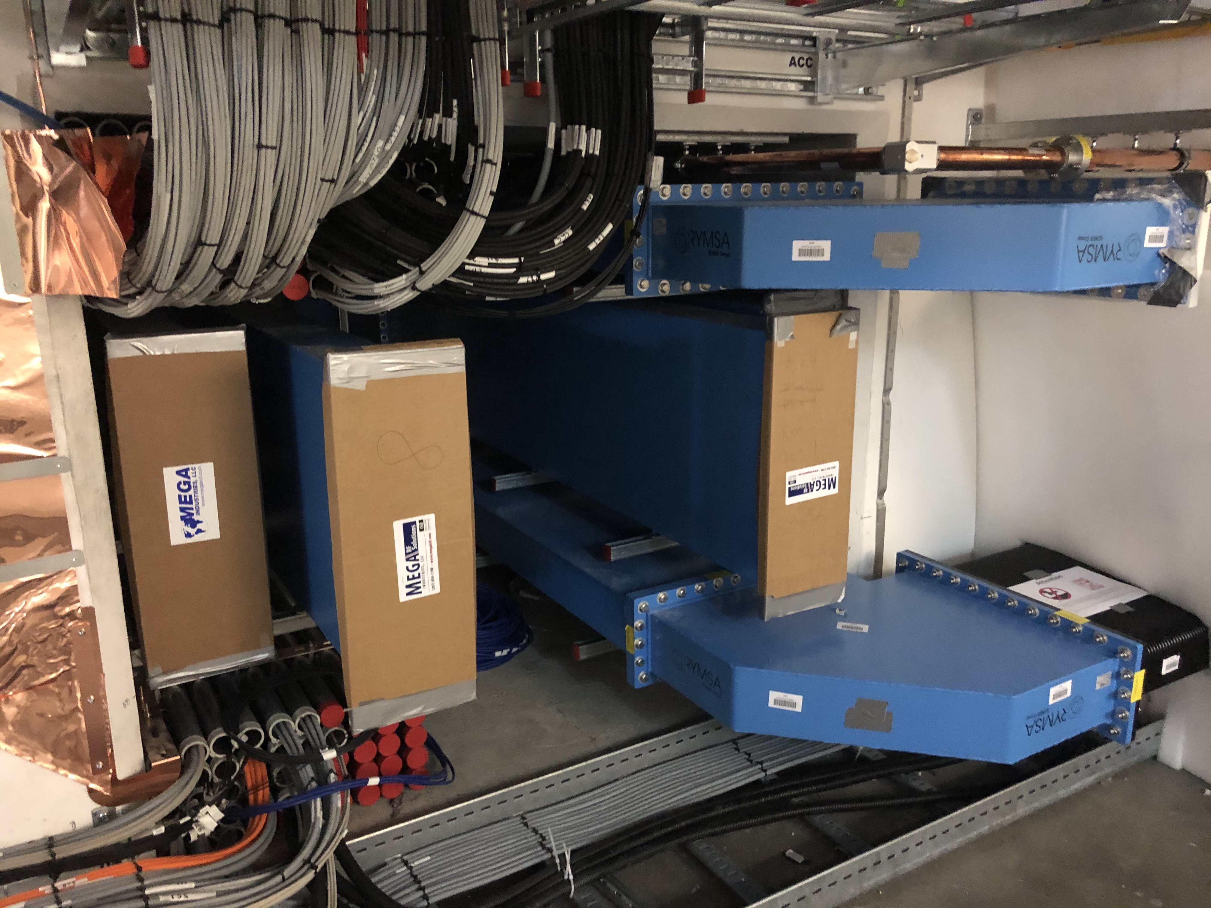
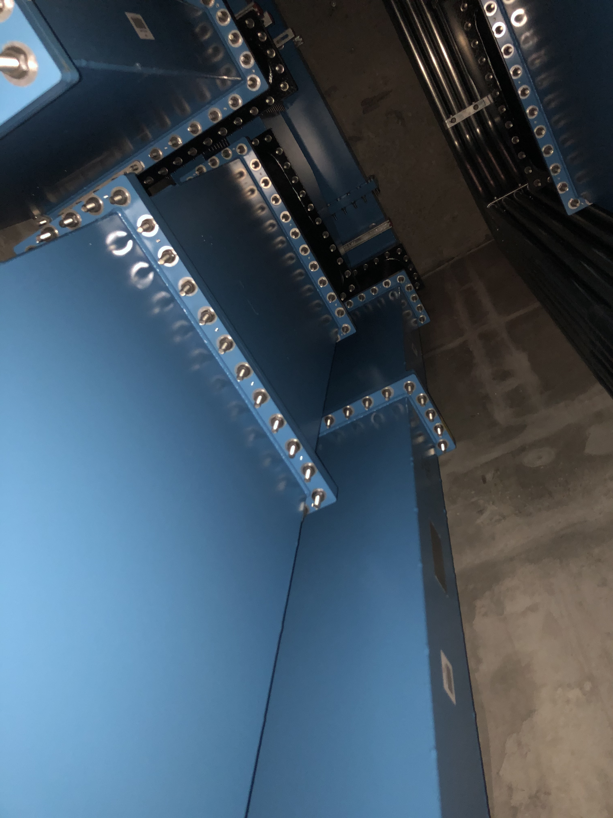
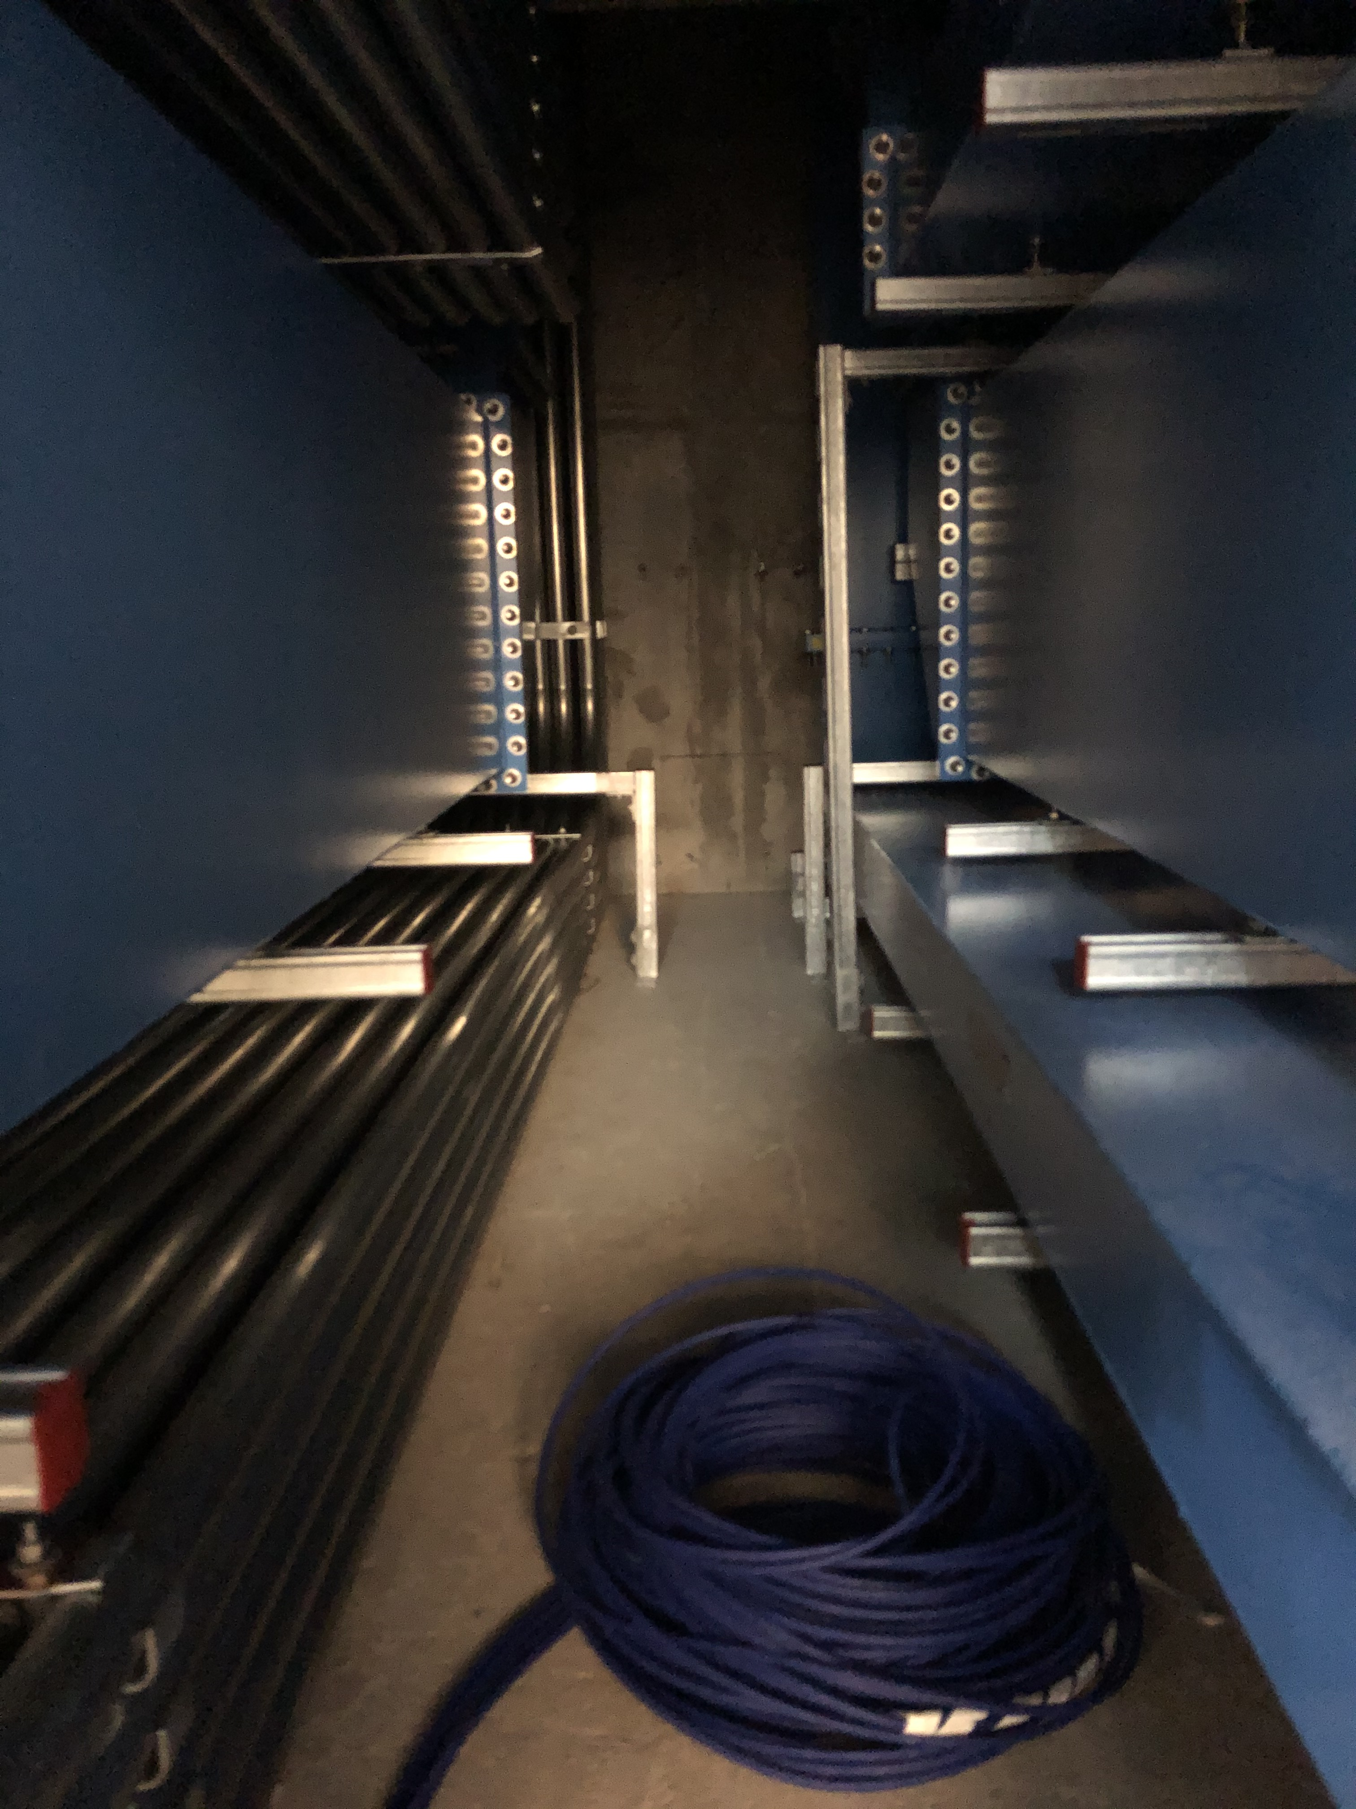
RFDS Installation
Stub 100
All waveguides in the stub are installed
Stub exit in G01
Vertical part in the stub
Horizonal part in the stub

Slide 7
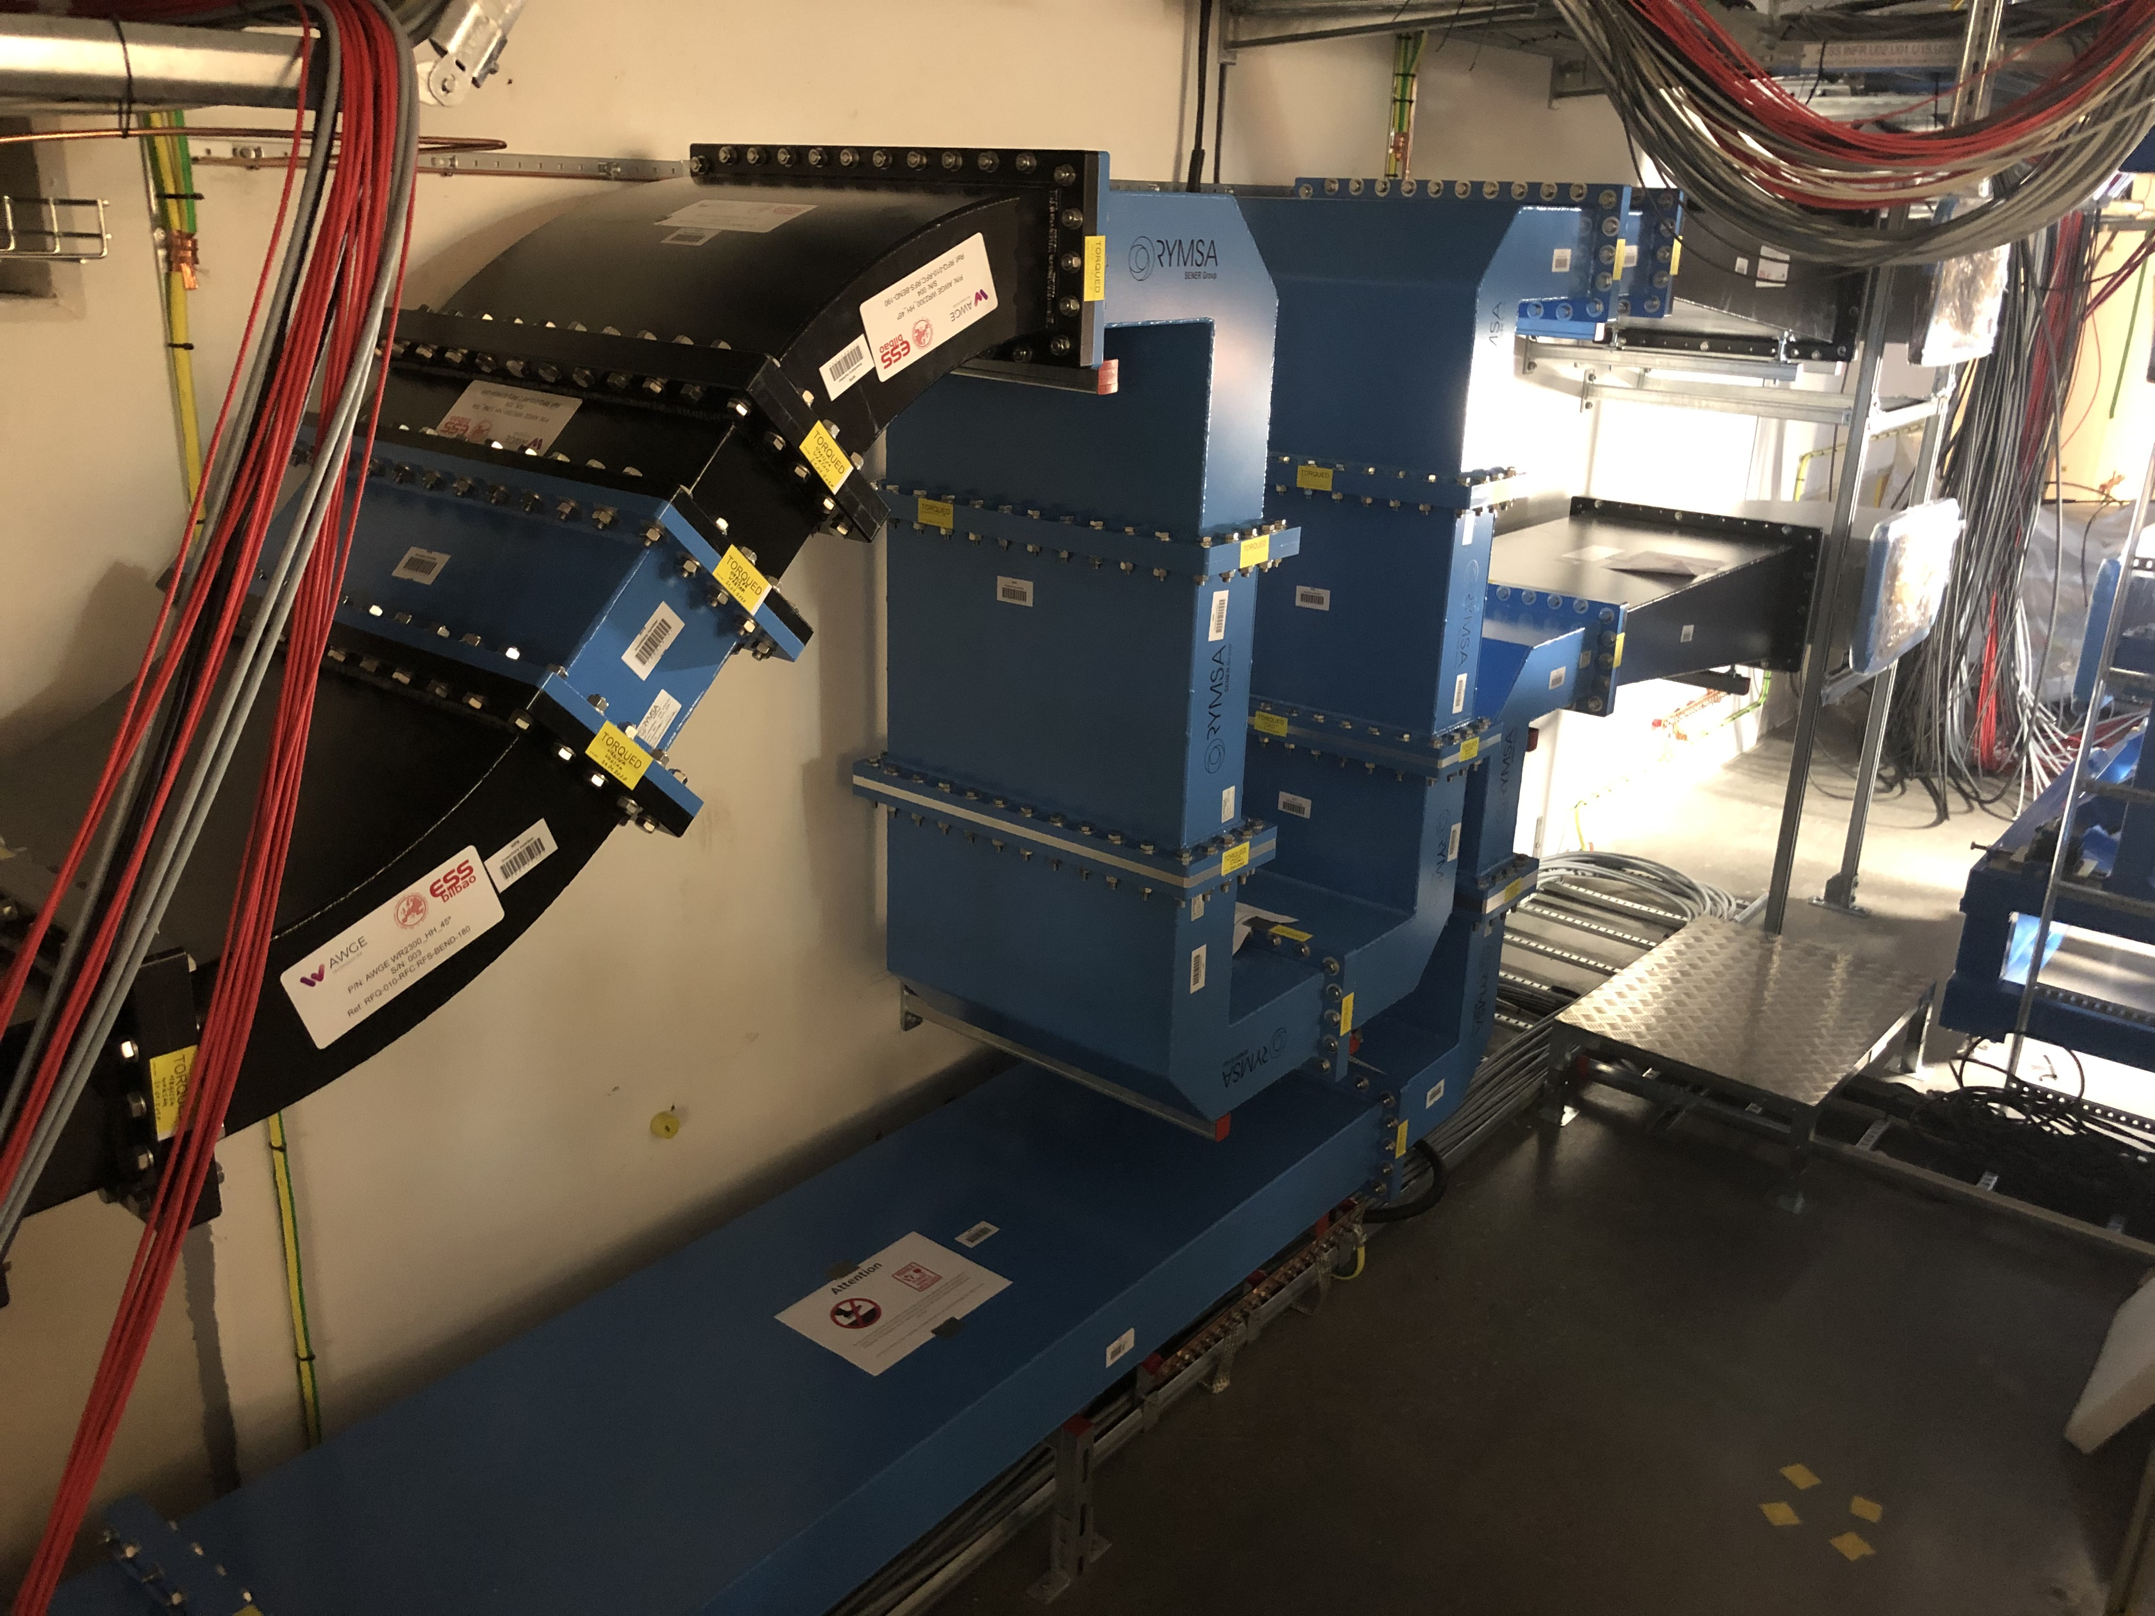
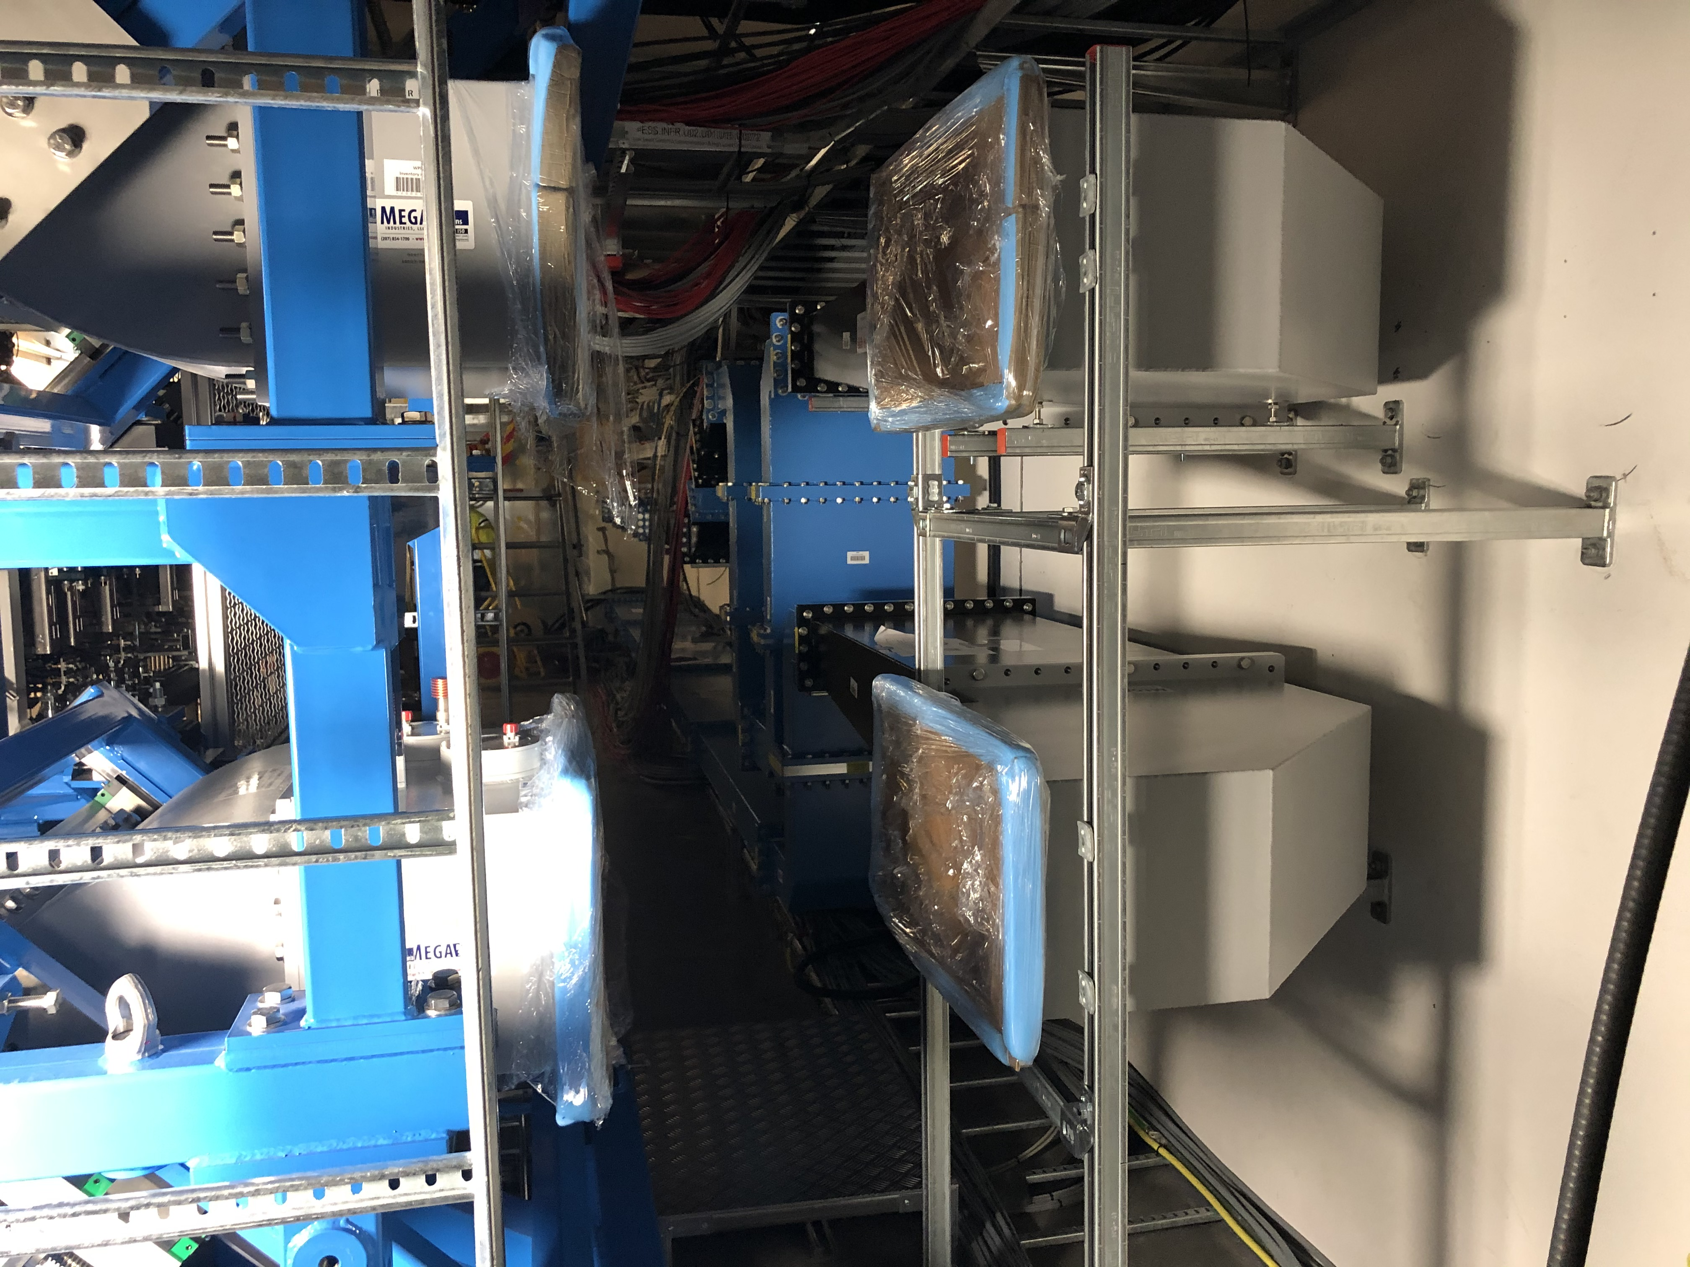
RFDS Installation
G01
Waveguide installed and trial fit to the RFQ carried out
Final connection to RFS (left)

Slide 8
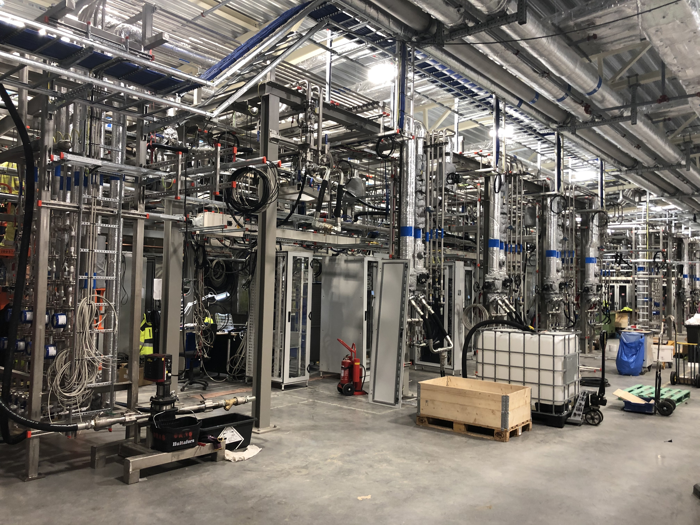
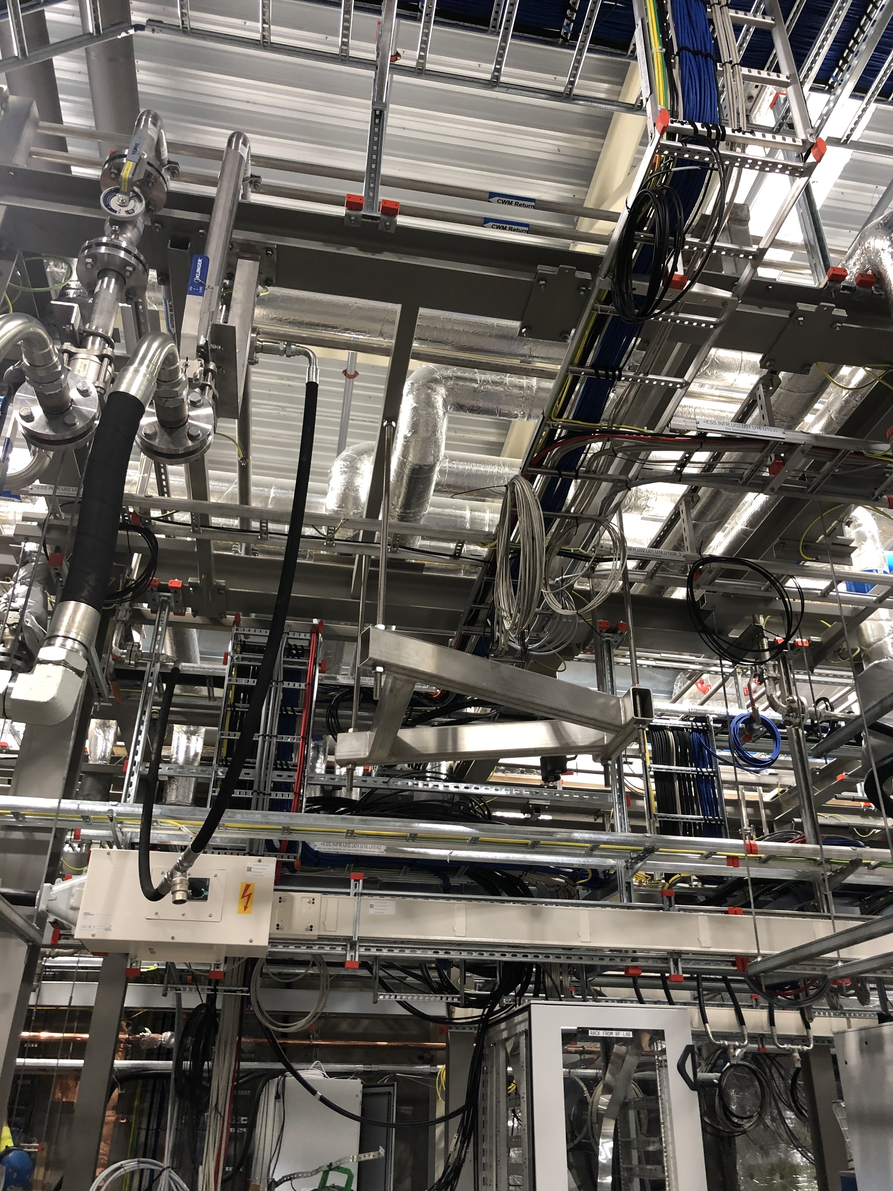
RFDS Installation
G02 installation
Main structure (almost) handed over (last hangers going up this week)
RF installation for RFQ will start this week
Load and circulator hangers in place

Slide 9
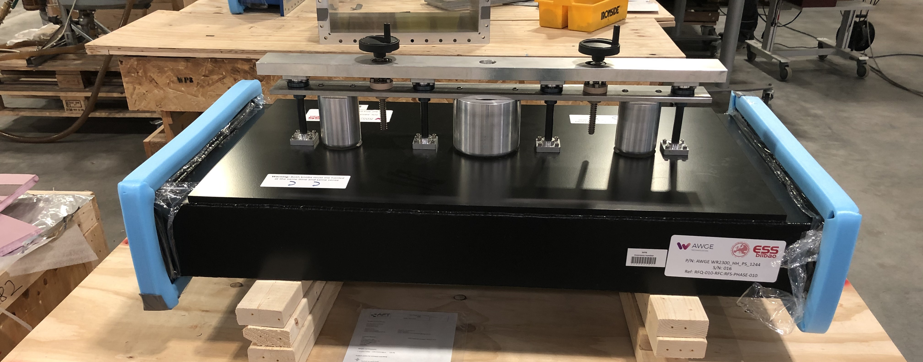
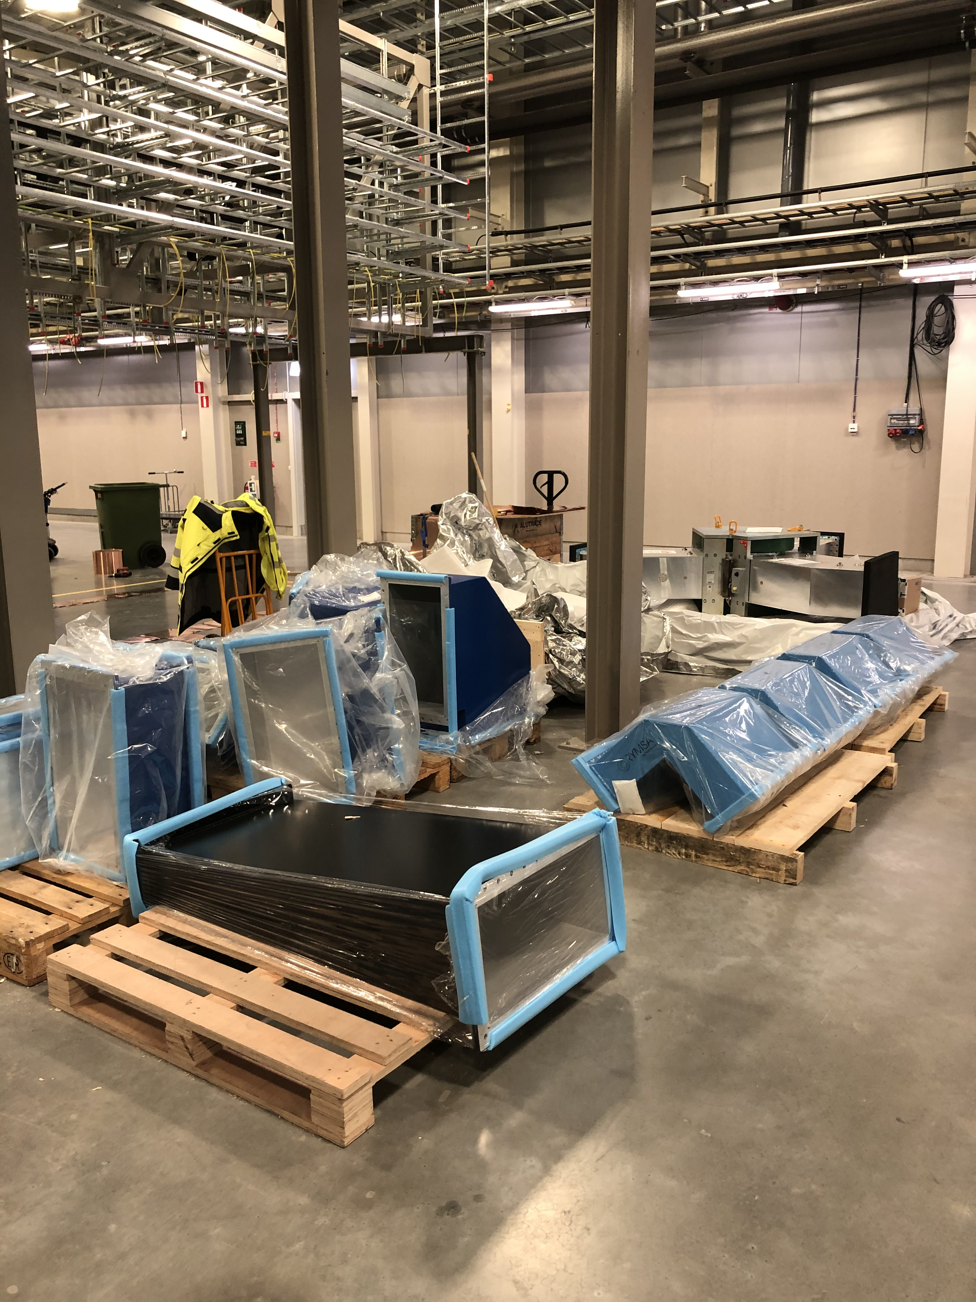
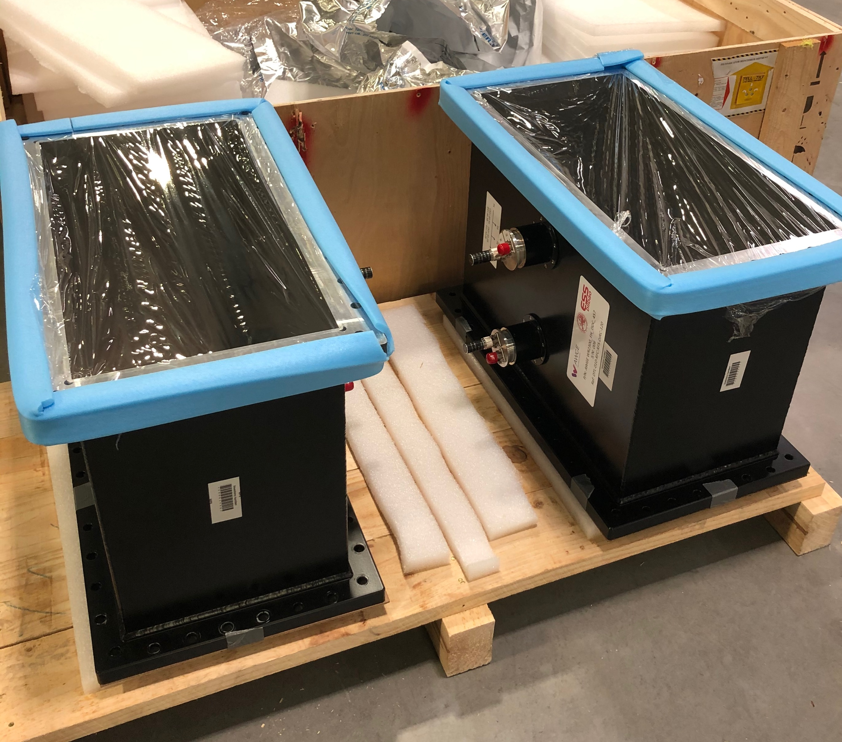
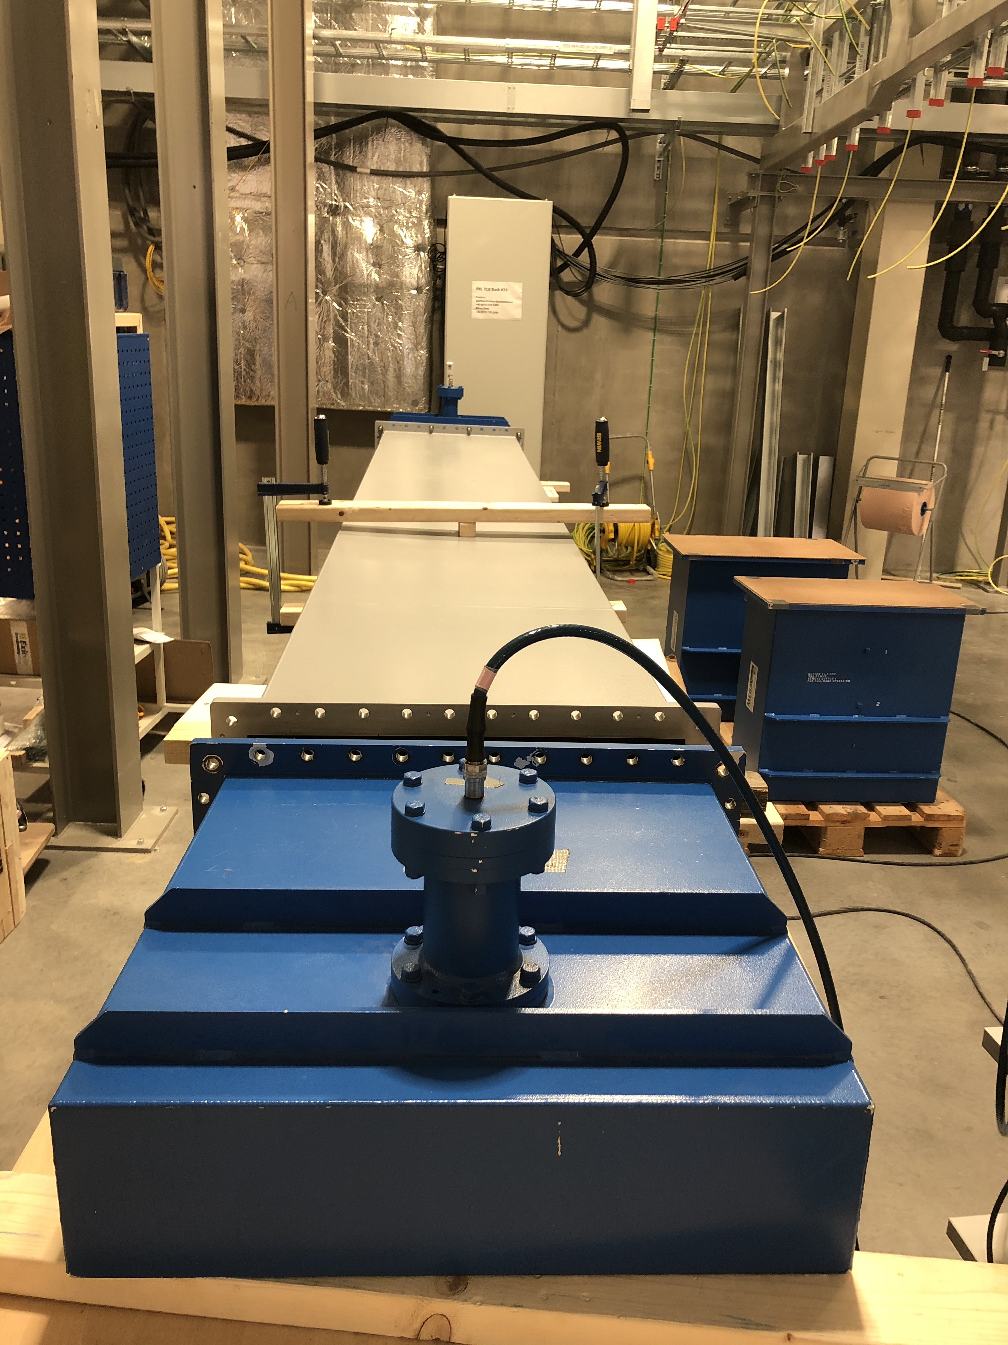
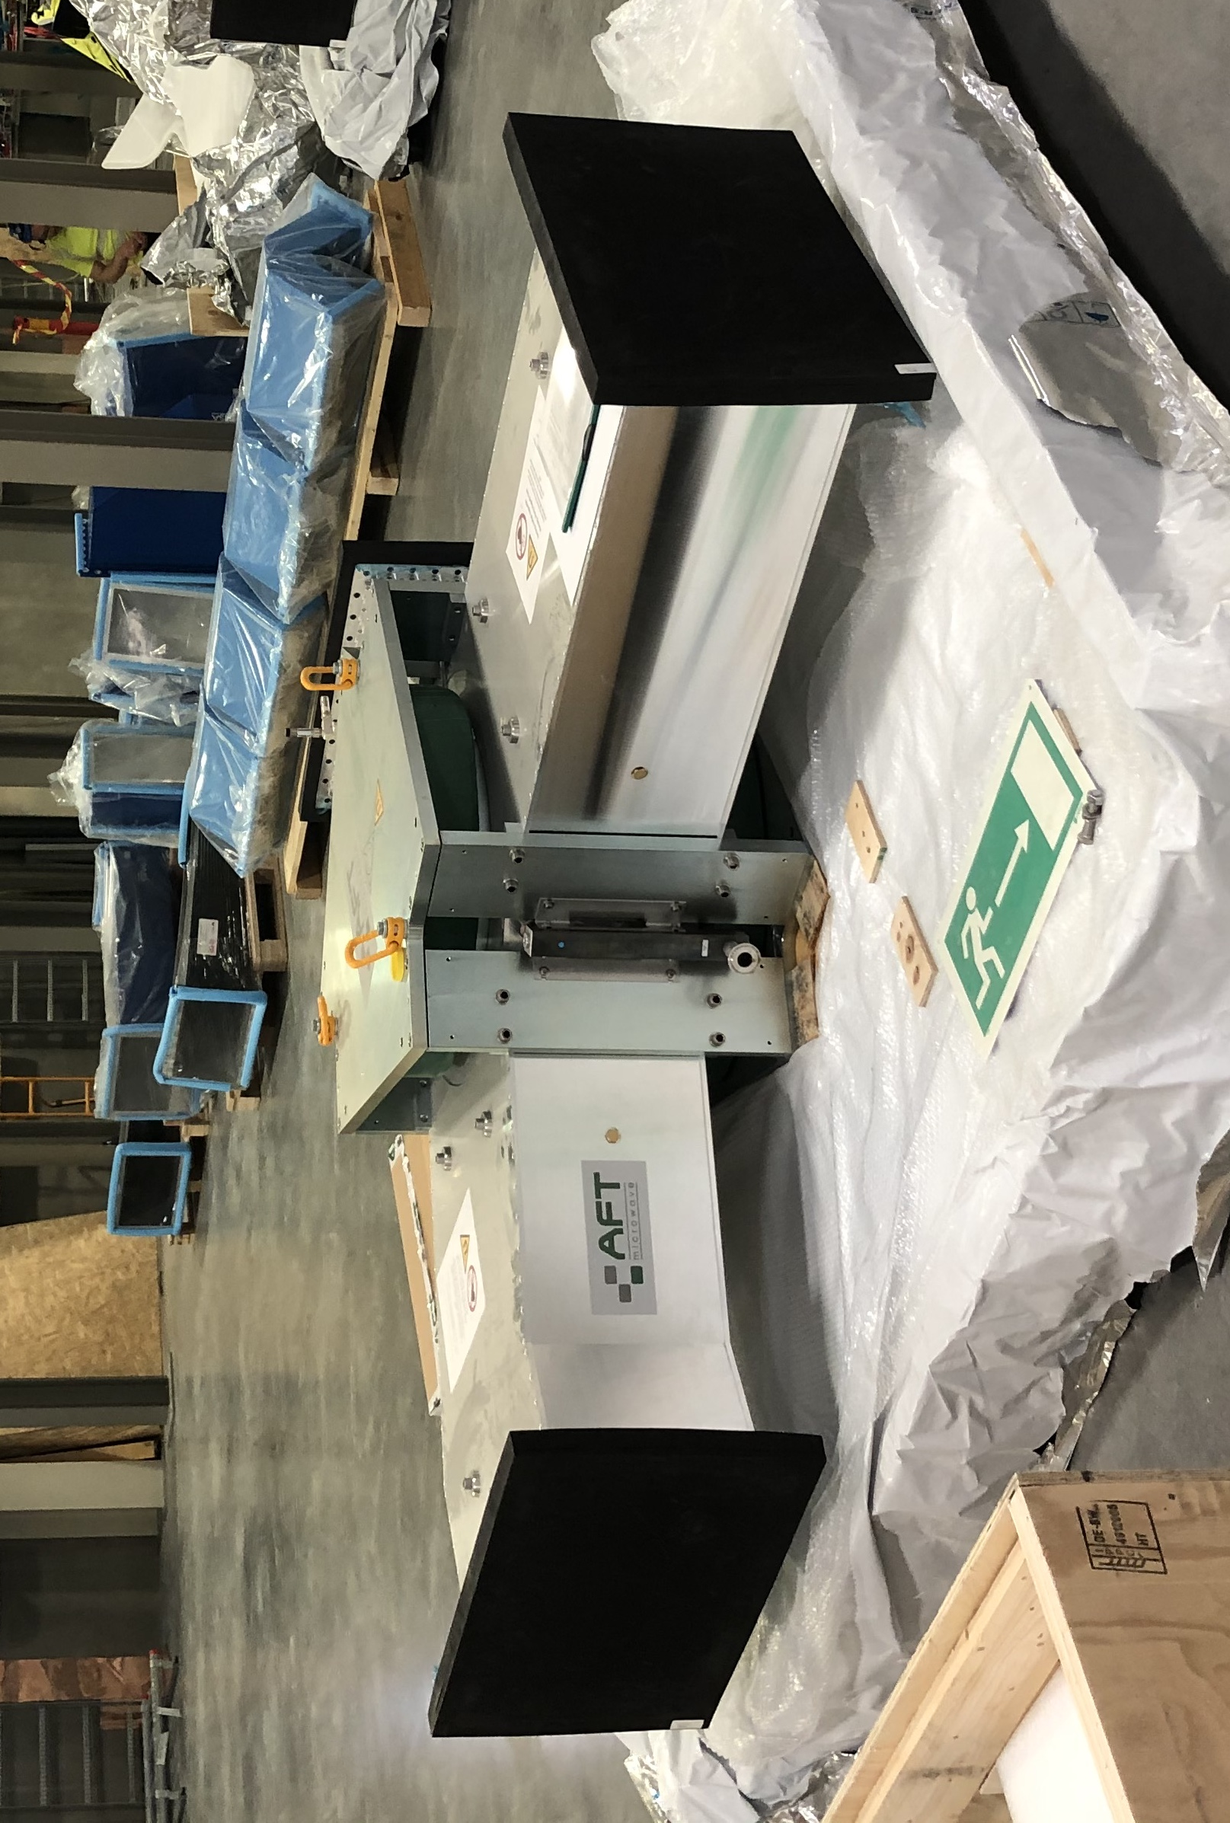
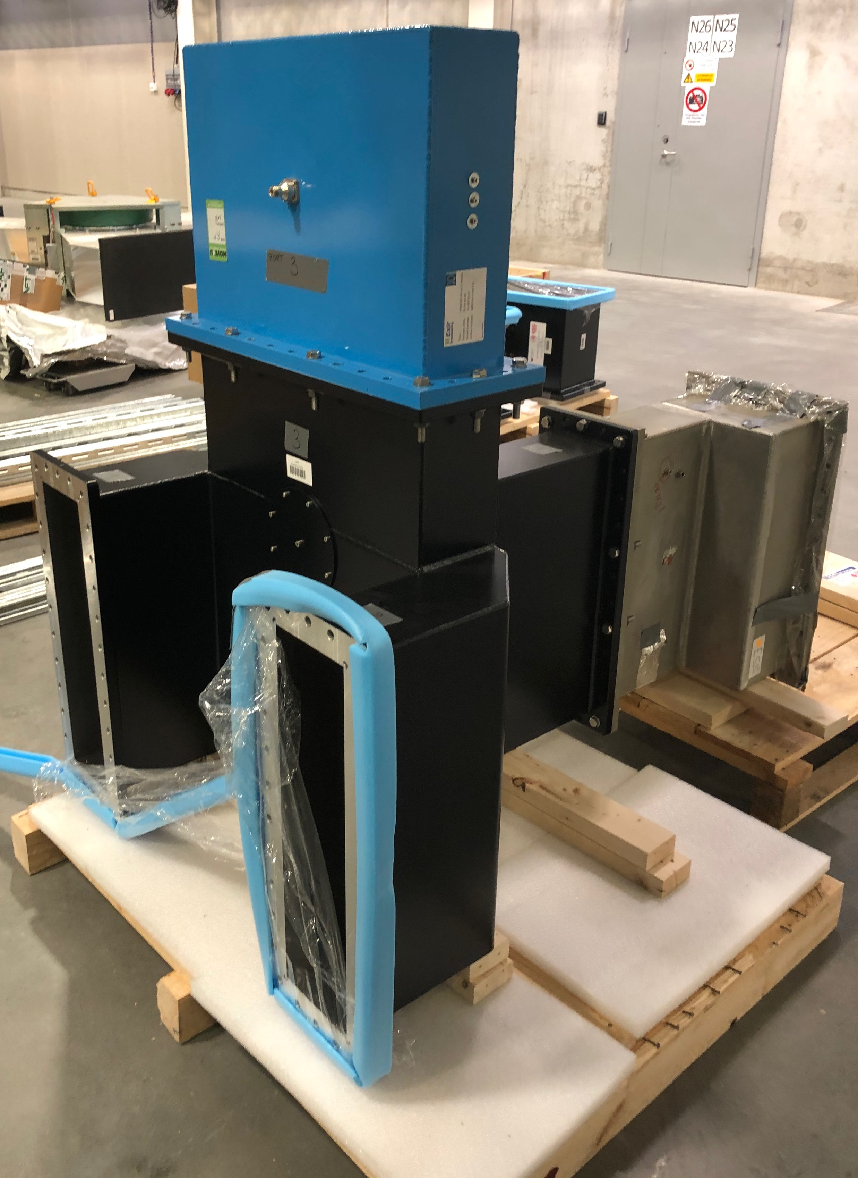
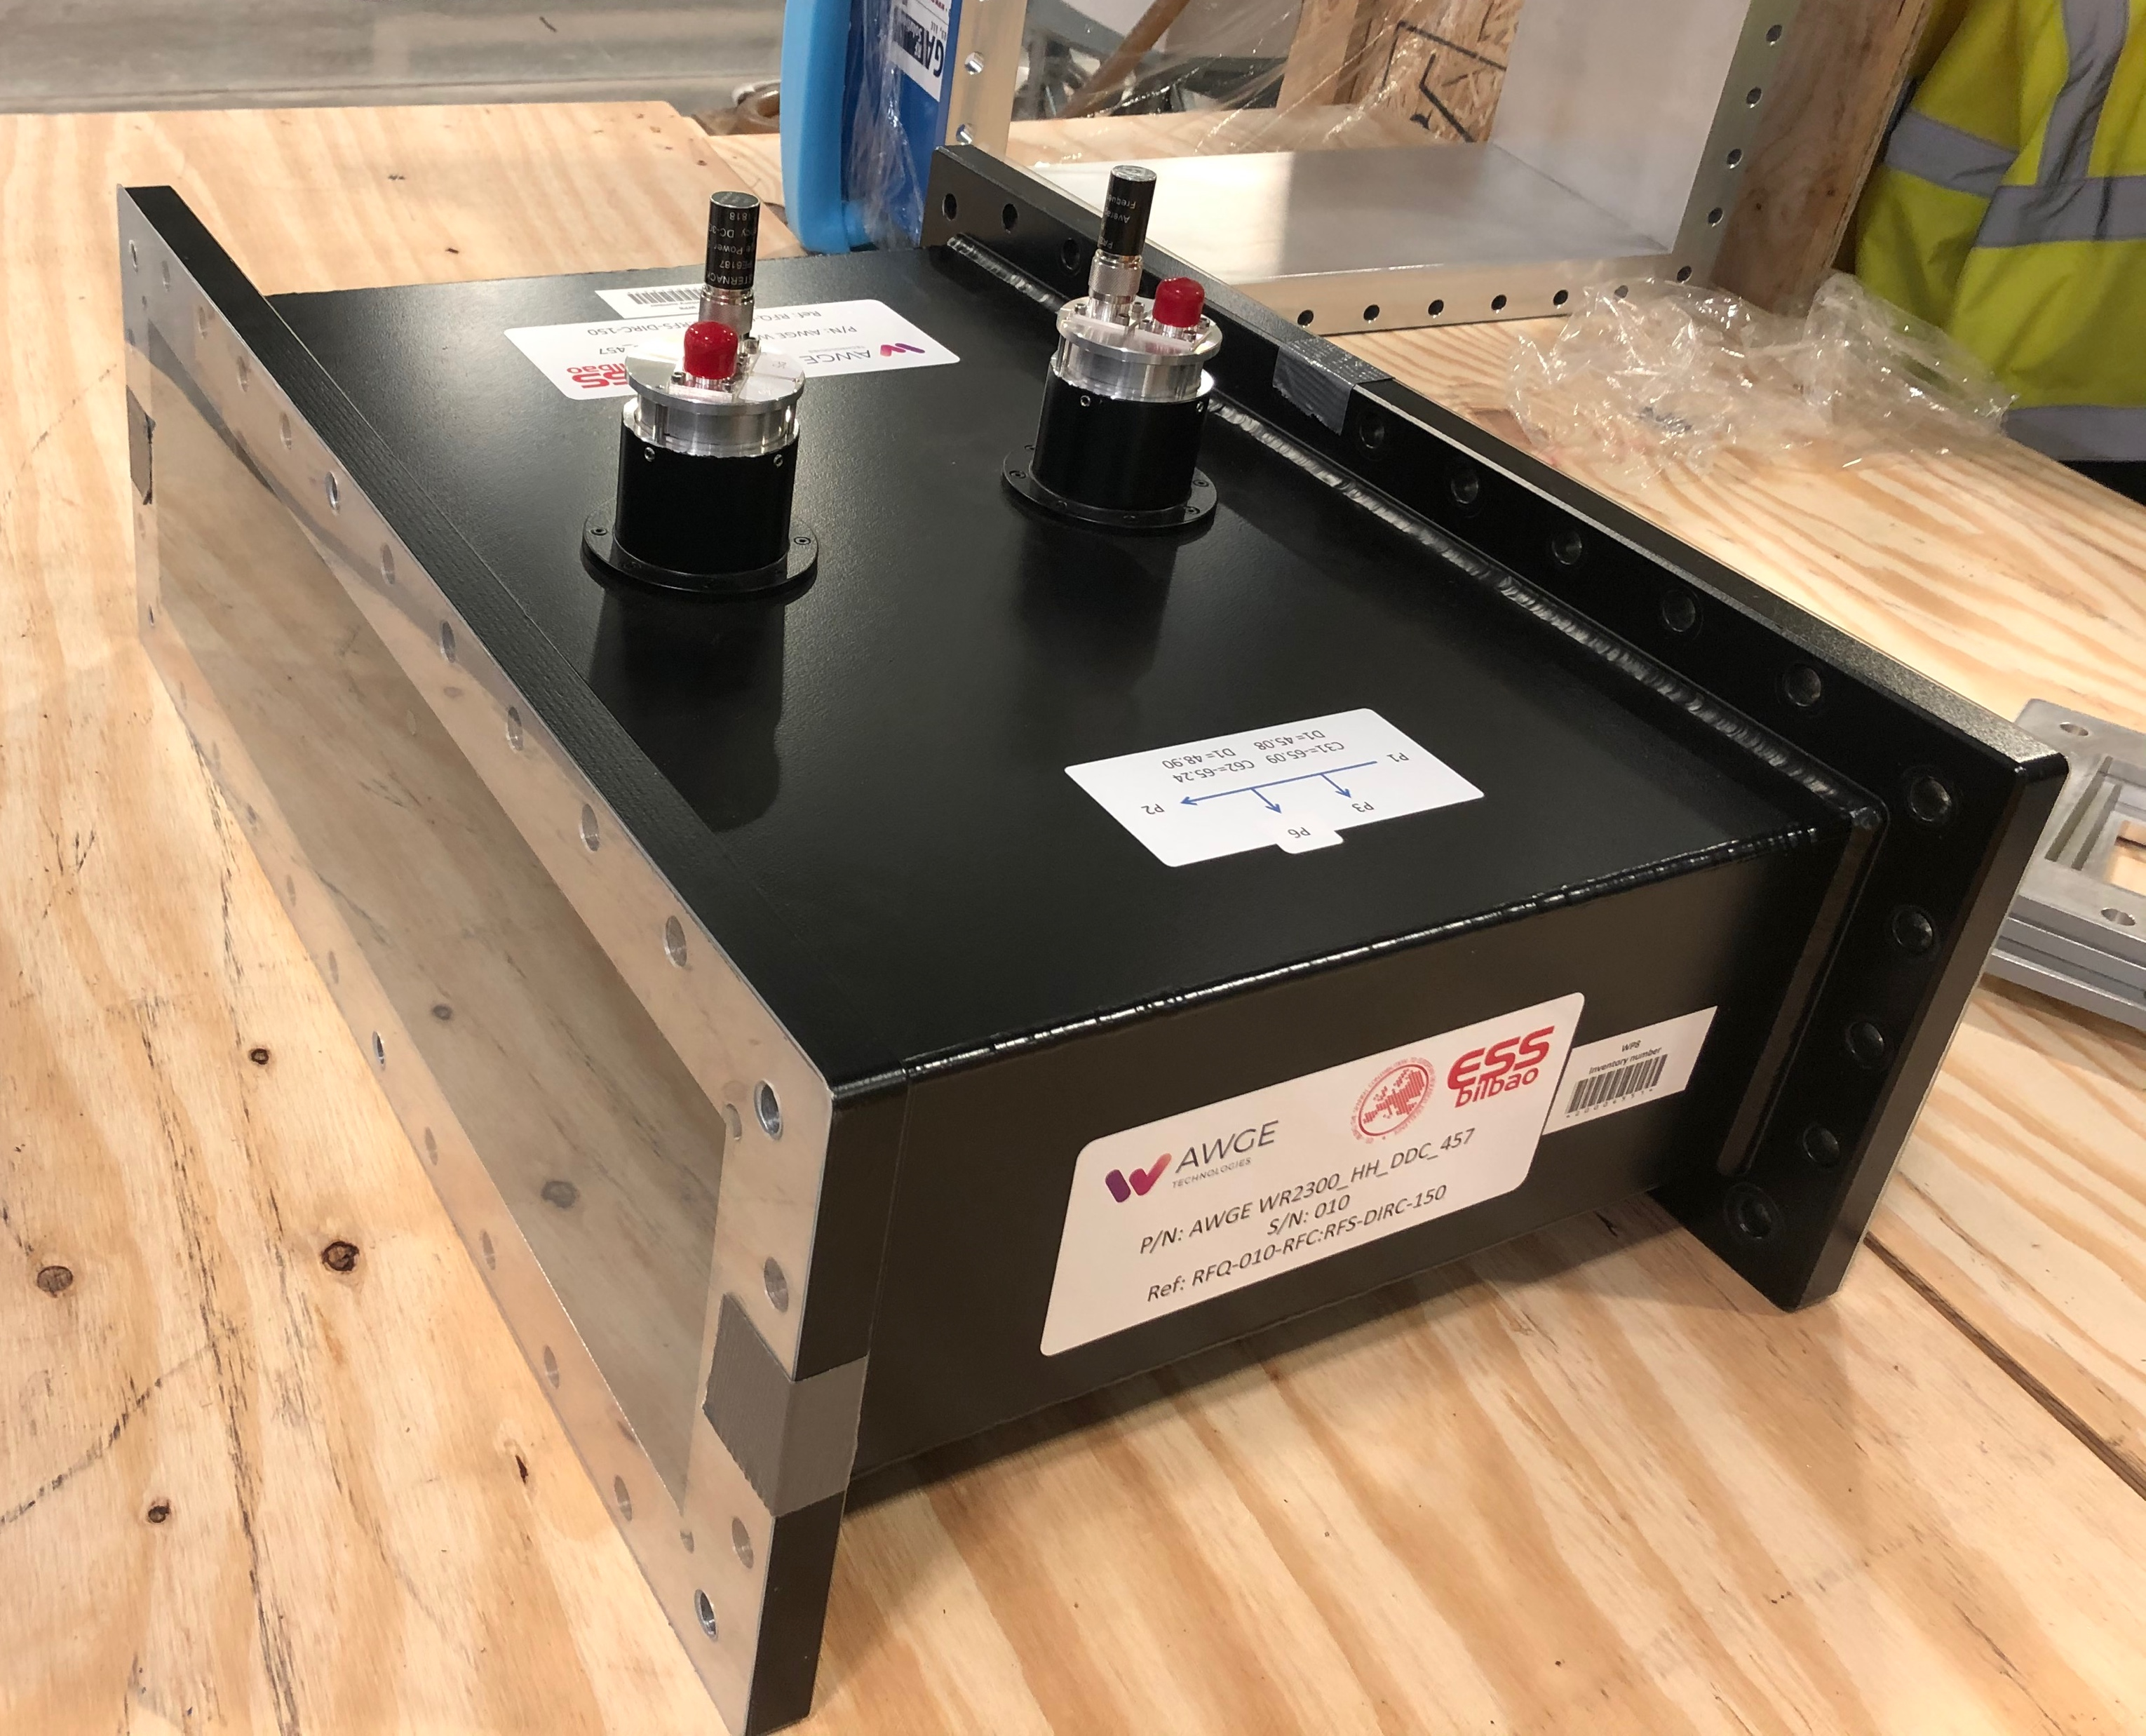
Selection of Special waveguide components
Full and half height directional couplers
‘Perfect’ load for tuning
High power phase shifter
Magic-T
3 MW circulator

Slide 10
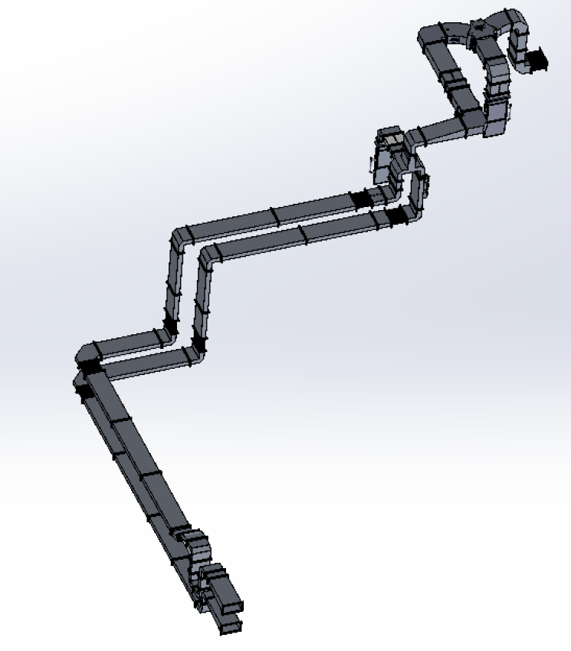
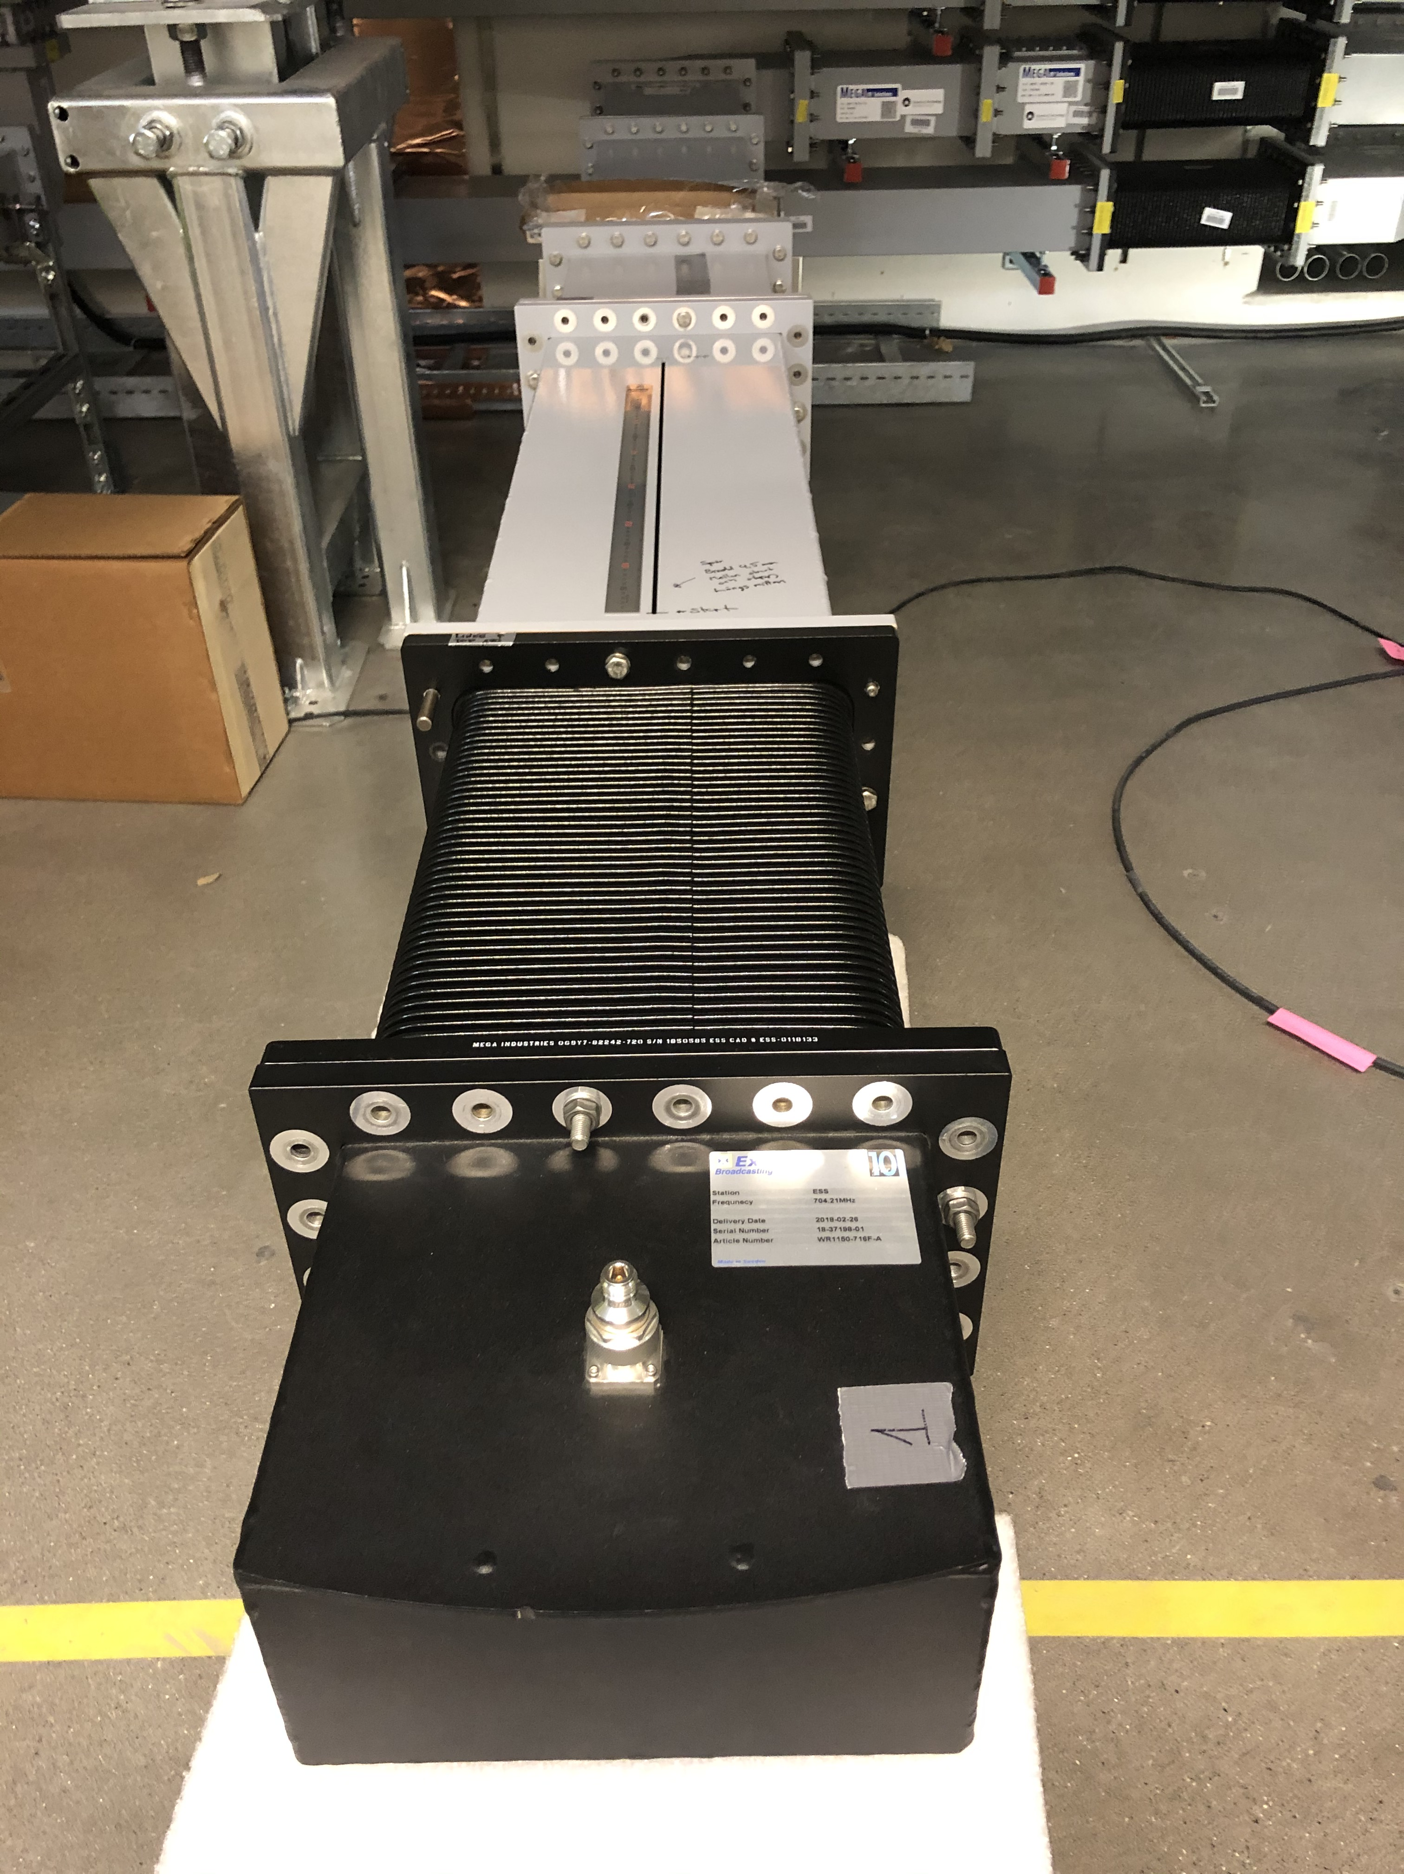
RFDS Testing and Tuning
1: 2: The directional coupler before the cavity (WP8) should be matched looking towards the klystron. match if necessary. Measure from half height to matched full height on the circulator. (Bruno to check with R&S how to do a one port calibration to allow us to go from half height to a full height - needed for half height to full height measurement).
3: Looking back from the cavity the WG should be matched up to circulator P2. Line without phase shifter first, Move to other line, set phase and match. Matching in the tunnel.
G02 installation
Main structure (almost) handed over (last hangers going up this week).
RF installation for RFQ will start this week.
Preliminary measurements of waveguide runs indicate that waveguide runs need to be tuned.
Tuning plan documented:
  Cavity to see matched waveguide
  Directional coupler after circulator (total Pfor/Prefl to be matched)
  Directional coupler for each power coupler to be matched
  Phase of each line to be matched
  Tuning will be with posts as required
Klystron
Slotted waveguide for tuning and post position transposed to fixed waveguide
RFQ

Slide 11
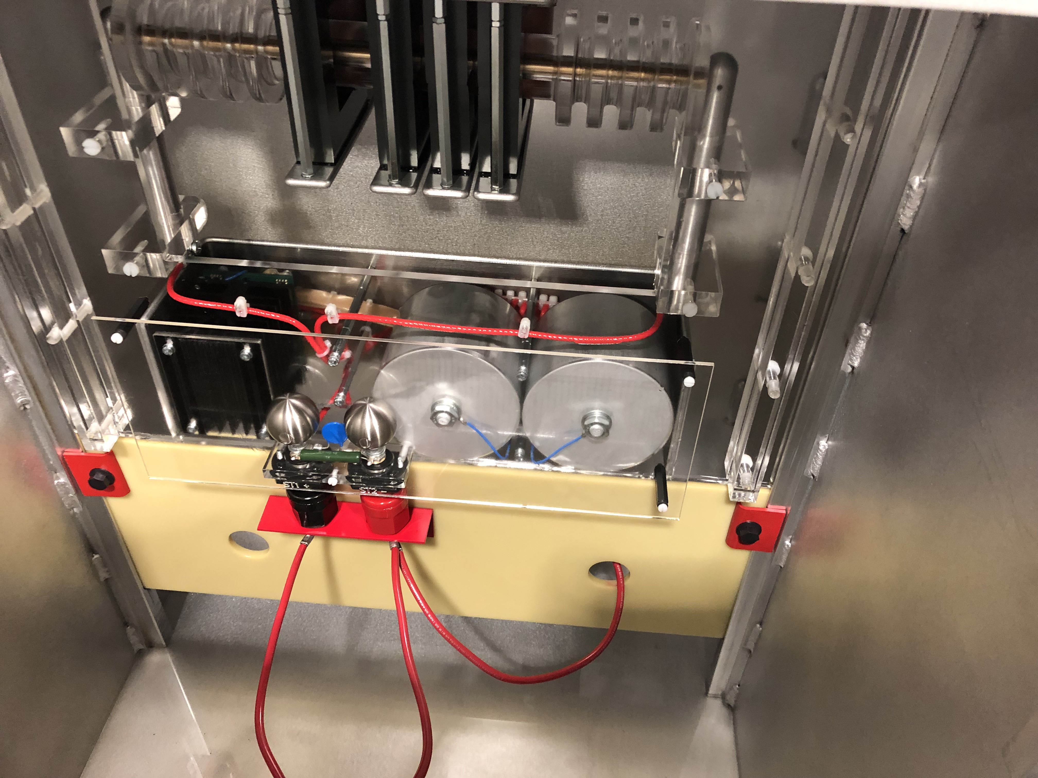
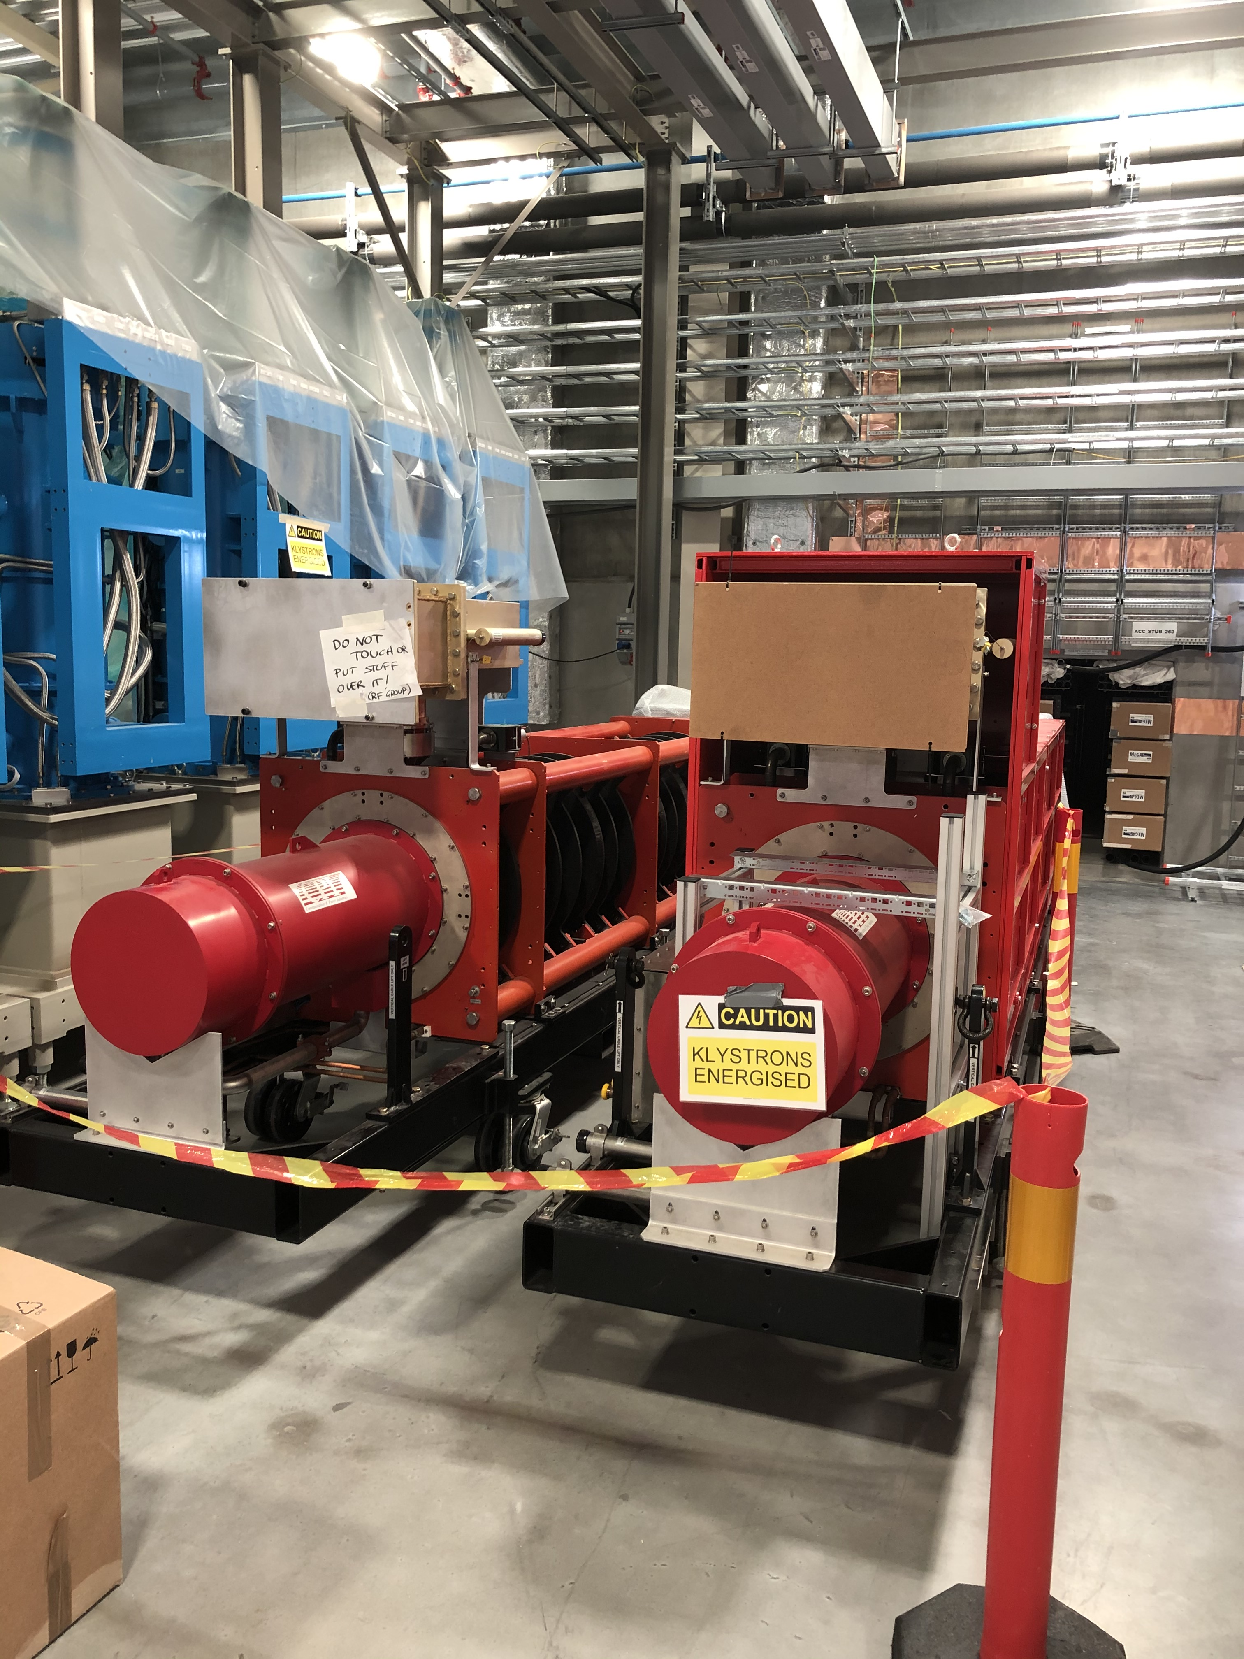
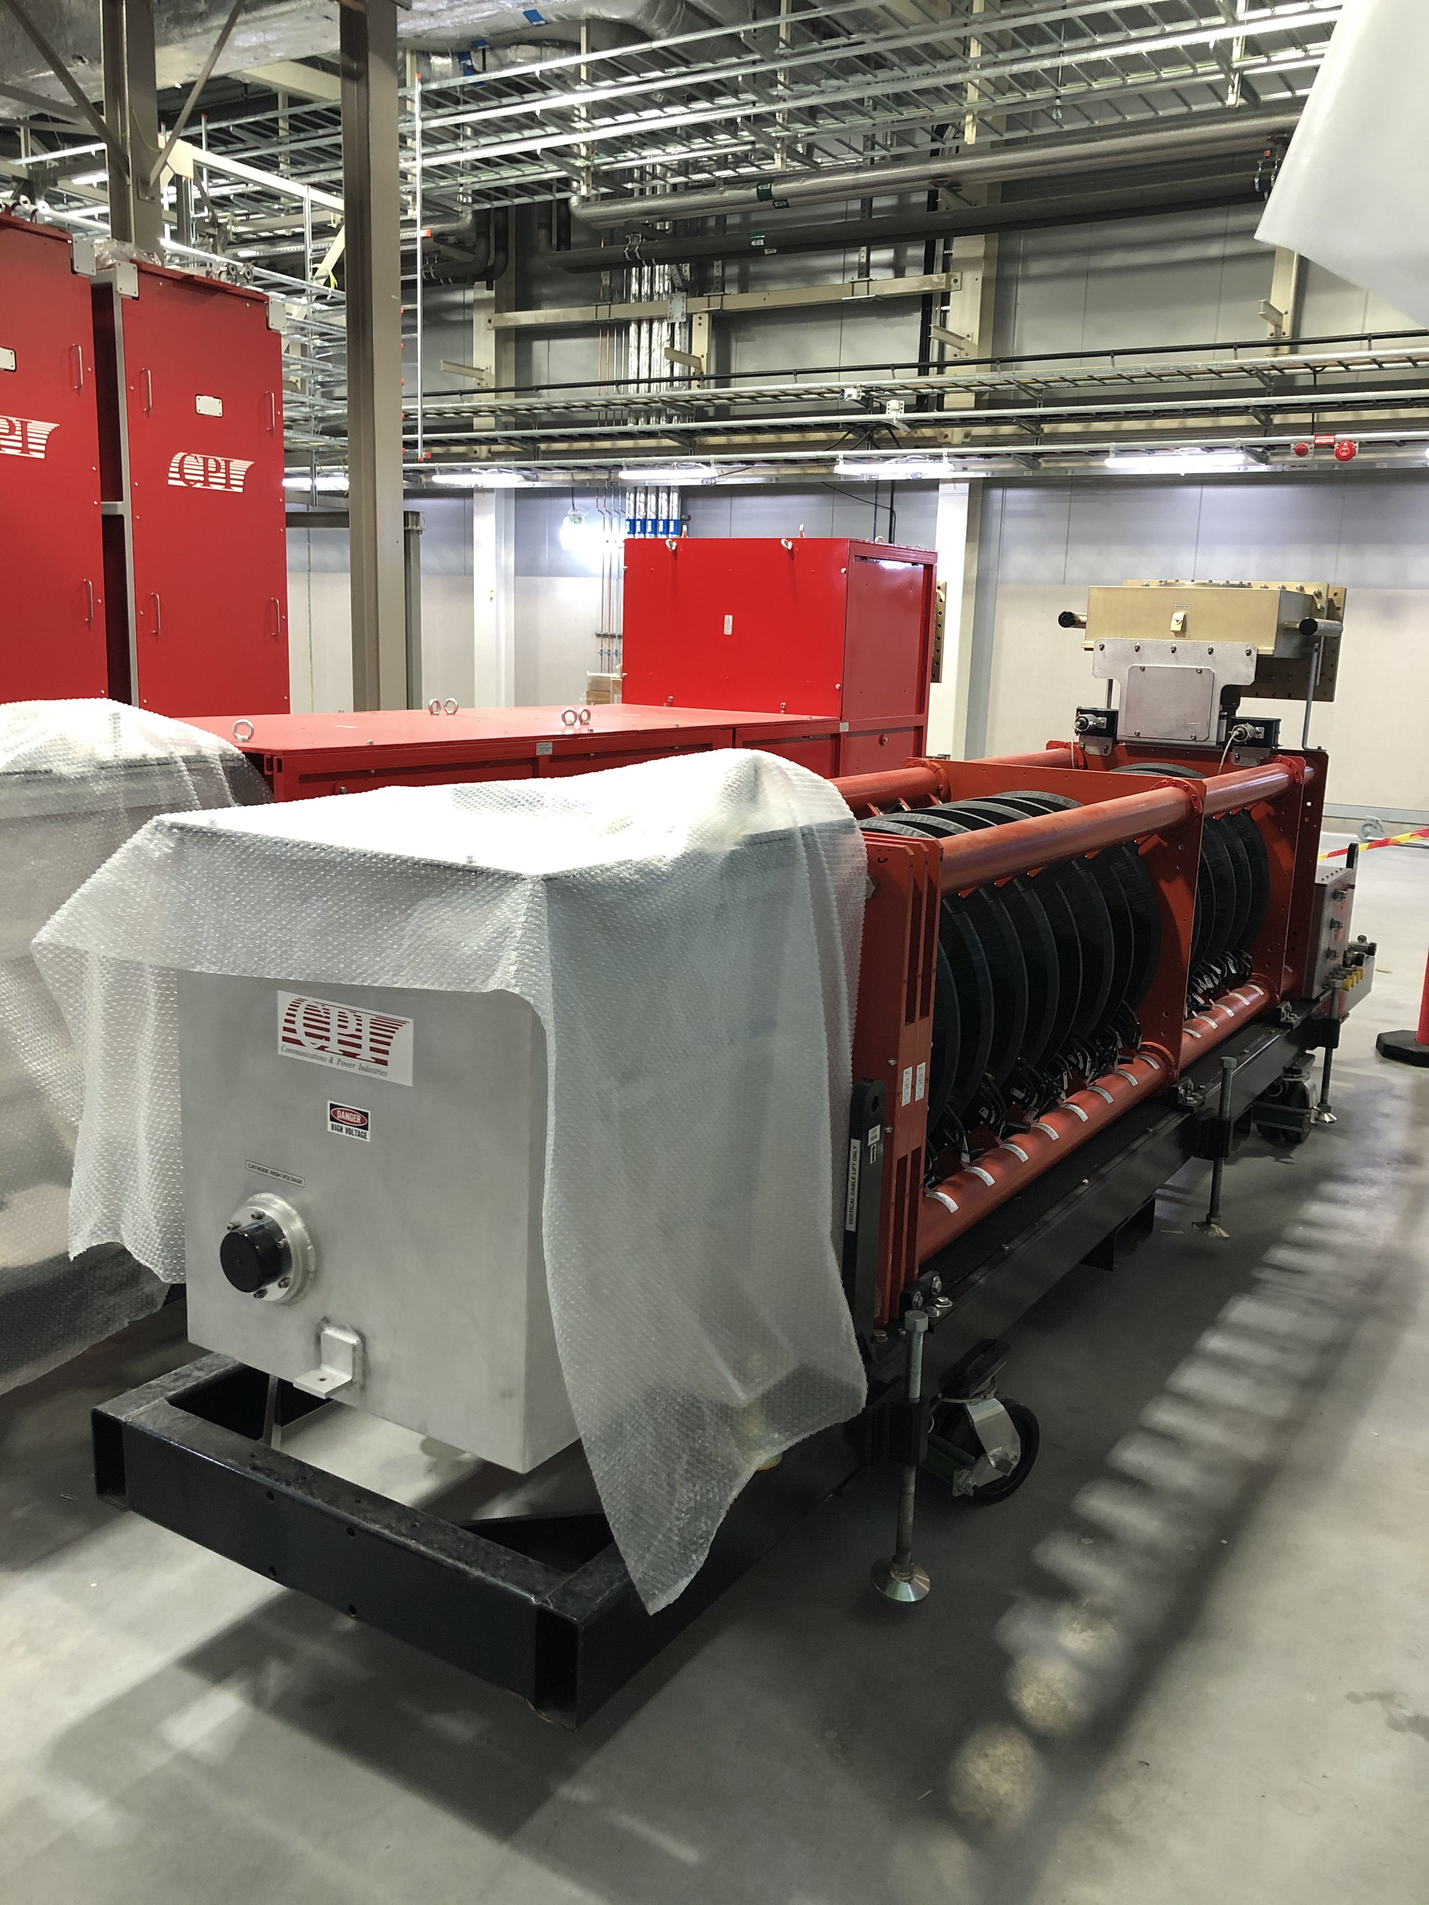
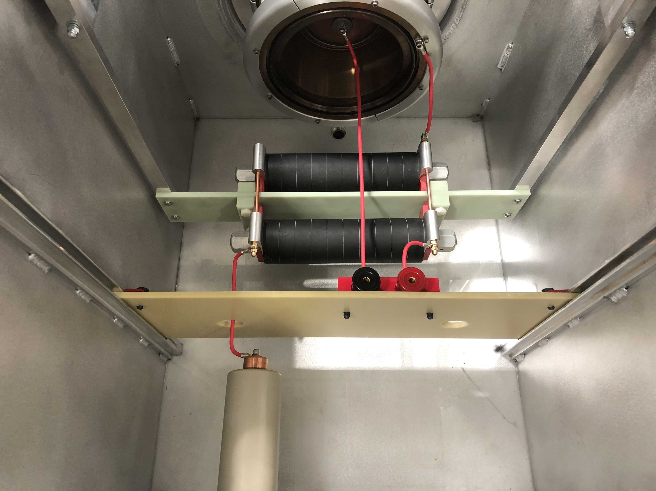
Klystron delivered
Two klystrons delivered
Filament supply fitted in the oil tank
Modified and completed oil tank

Slide 12
Other key and critical subsystems
LLRF – First unit assembled at ESS Bilbao.
PSS switch: Delivered
e-pickup: Due to be delivered soon
SIM: Built in house, lab tested and installed in the rack
  Associated cooling box under construction.
FIM: IOxOS parts available
  Signal conditioning board: tested in the lab, ready for installation
Drive amplifier: delivery from BTESA in February
Arc detectors delivered from Bilbao.
Filament supply, solenoid supplies and ion pump controllers delivered and tested.

Slide 13
PRL status
Installation Status
Main line installed from ion source to dog-leg
Line from dog-leg to A2T installed and connected to ion source
Gas lines installed and being pressure tested
All cables pulled, terminated and inspected (except for 7/8 inch cables)
  routed to temporary racks for commissioning
Beckhoff fiber optics modules for communication between racks delivered
Extension cables for heaters under preparation
TCB OPIs created
TCB IOC ready and tested with TCBs
Installation documentation produced
Commissioning
PRL1 temperature sensors and heating cables operational and tested with feedback loop
To be done: Full temperature stability test for PRL 1 (needed for RFQ)
Main amplifiers under test in Warsaw. Will be moved to final racks when the racks have been delivered
Phase compensation unit – first prototype ready and final unit is in production.
Full testing with full 200 W RF load planned for March.
MBL07 racks??

Slide 14
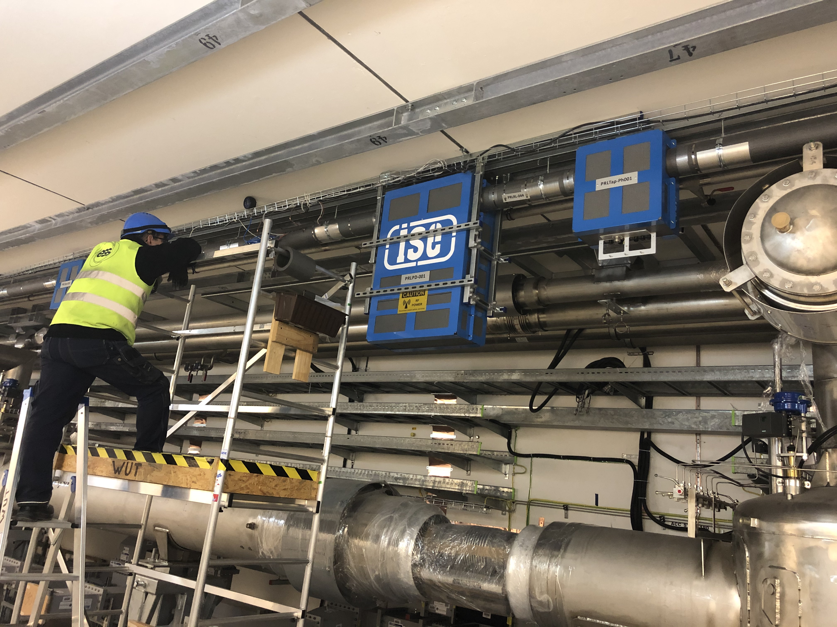
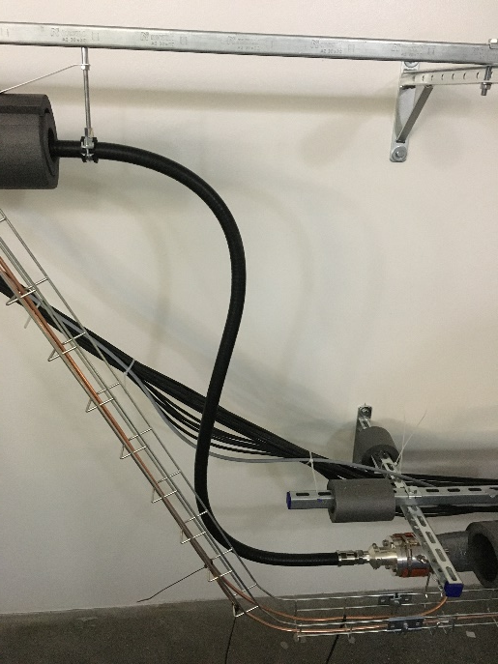
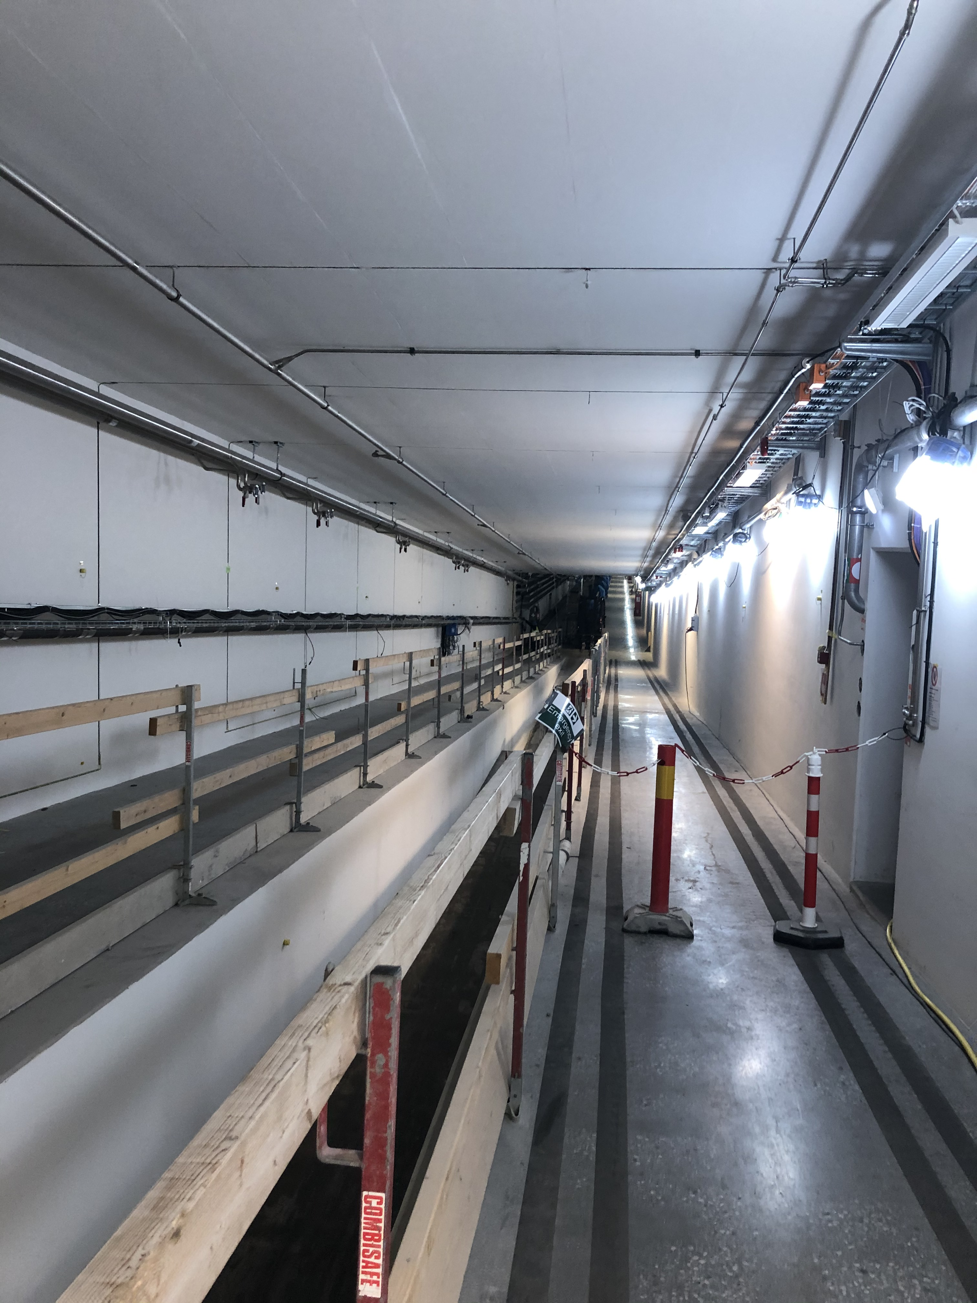
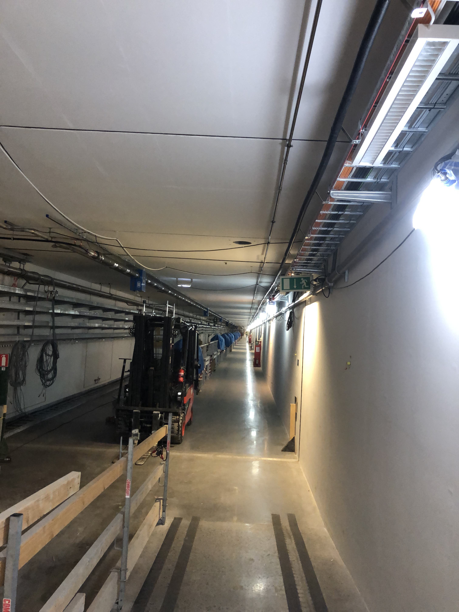
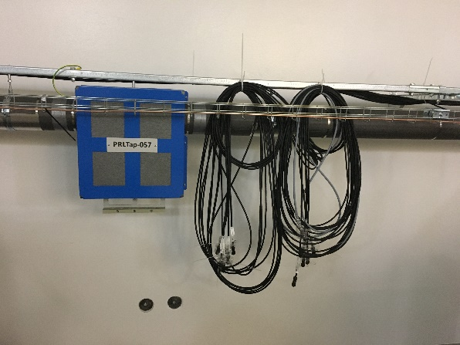
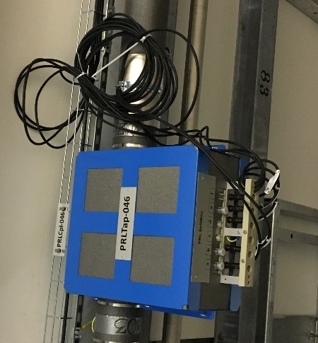
Leaks, remedies and connections
PRL complete from ion source to A2T
Main reference power splitter
Split boxes installed and all cables available

Slide 15
Typical Test Sequence
Incoming inspection for components to be installed
Installation of electronics in racks ESS-1419298
Visual inspection and low power testing of electronics in racks, full interlock checks to HV ready ESS-2025267
RFDS installation and tuning
RF calibration
Klystron installation and connecting to controls and utilities
High Power testing: ESS-2013598
  Klystron conditioning DC
  Klystron conditioning RF
Waveguide flange certification and signoff
X-ray inspection and signoff
LLRF installation and connection to cavities
Tuning control
Open and closed loop operation

Slide 16

Let’s quack this case!

