Slide 1
Status of Beam Instrumentation for IS, LEBT, RFQ and MEBT
PRESENTED BY Tom SHea

Slide 2
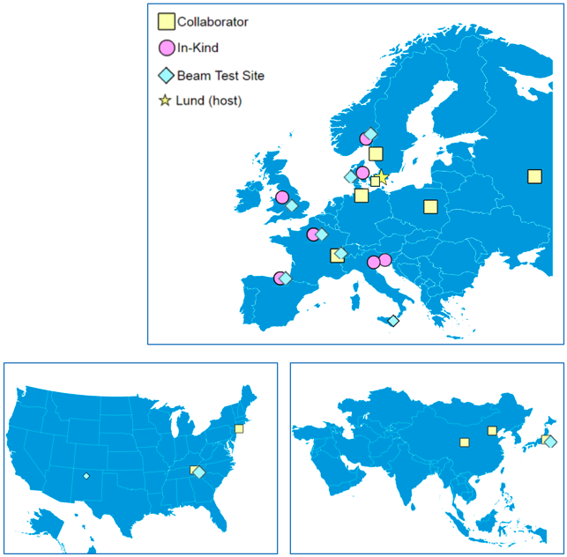
Organization
>20 Partners and Collaborators
Aarhus University
CEA Saclay, Paris
CERN, Geneva
Cockcroft Institute, Daresbury
DESY, Hamburg
Elettra – Sincrotrone Trieste
ESS Bilbao
INFN, Catania
INFN, Legnaro
Lund University
University of Oslo
DTU, Denmark
STFC, Daresbury
WUT, Warsaw
Lodz U. of Technology, Lodz
Chinese ADS
J-PARC, Japan
ORNL, USA
LANL, USA
IHEP, Russia
INR, Moscow
Högskola Väst, Trollhättan
Stony Brook U., New York
BNL, New York
At ESS Lund, the team consists of staff, consultants, students, and matrixed staff
Lead system design and deployment
Cover all technical disciplines
Tom Shea
System Leads
Rafael Baron
Clement Derrez
Elena Donegani
Hooman Hassanzedagen
Irena Dolenc Kittelmann
Roxana Tarkeshian
Cyrille Thomas
Technical Team
All system leads contribute technical expertise
In addition:
Edvard Bergman
Thomas Grandsaert
Slava Grishin
Hinko Kocevar
Mehdi Mohammednezhad
Johan Norin
Kaj Rosengren
Henrique Silva

Slide 3
Proton Beam Instrumentation (PBI)
For the IS, LEBT, RFQ, and MEBT
Beam Accounting
Faraday Cup (FC)
Beam Current (BCM)
Fast Current Monitor (FBCM)
Neutron monitor (nBLM)
Doppler (DPL)
Collimator (Coll)
Centroid Measurement
Position Monitor (BPM)
Fast Position Monitor (FBPM)
Distribution Measurement
Wire Scanner (WS)
Emittance (EMU)
Longitudinal bunch shape (LBM)
Non-invasive Profile, Fluorescence (FPM)

Slide 4
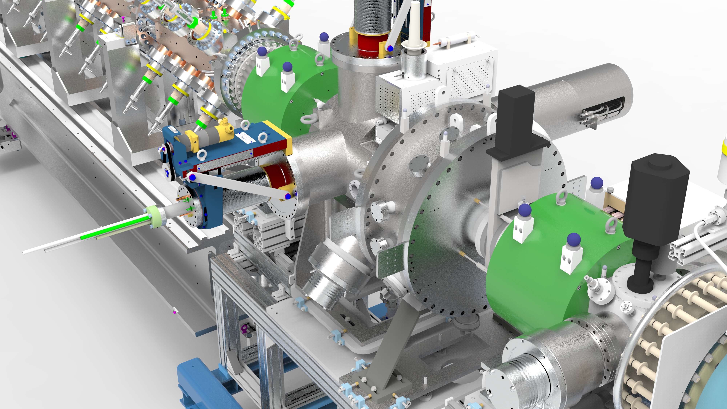
LEBT
LEBT

Slide 5
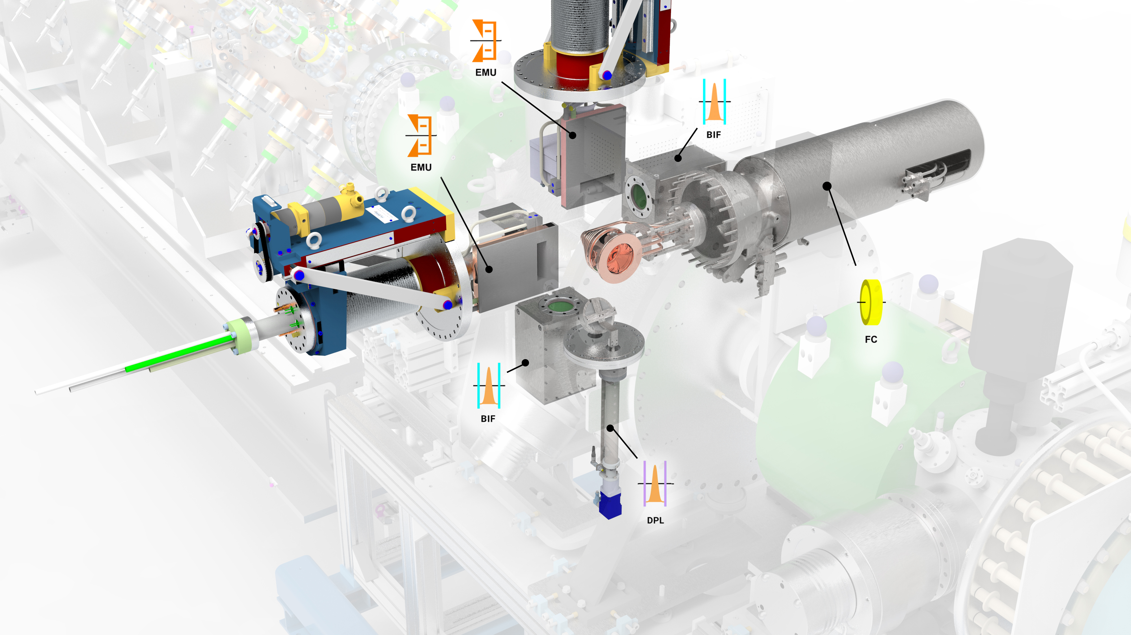
LEBT PBI in Diagnostic Tank
LEBT
Also,
current and voltage measurement in the Ion Source

Slide 6
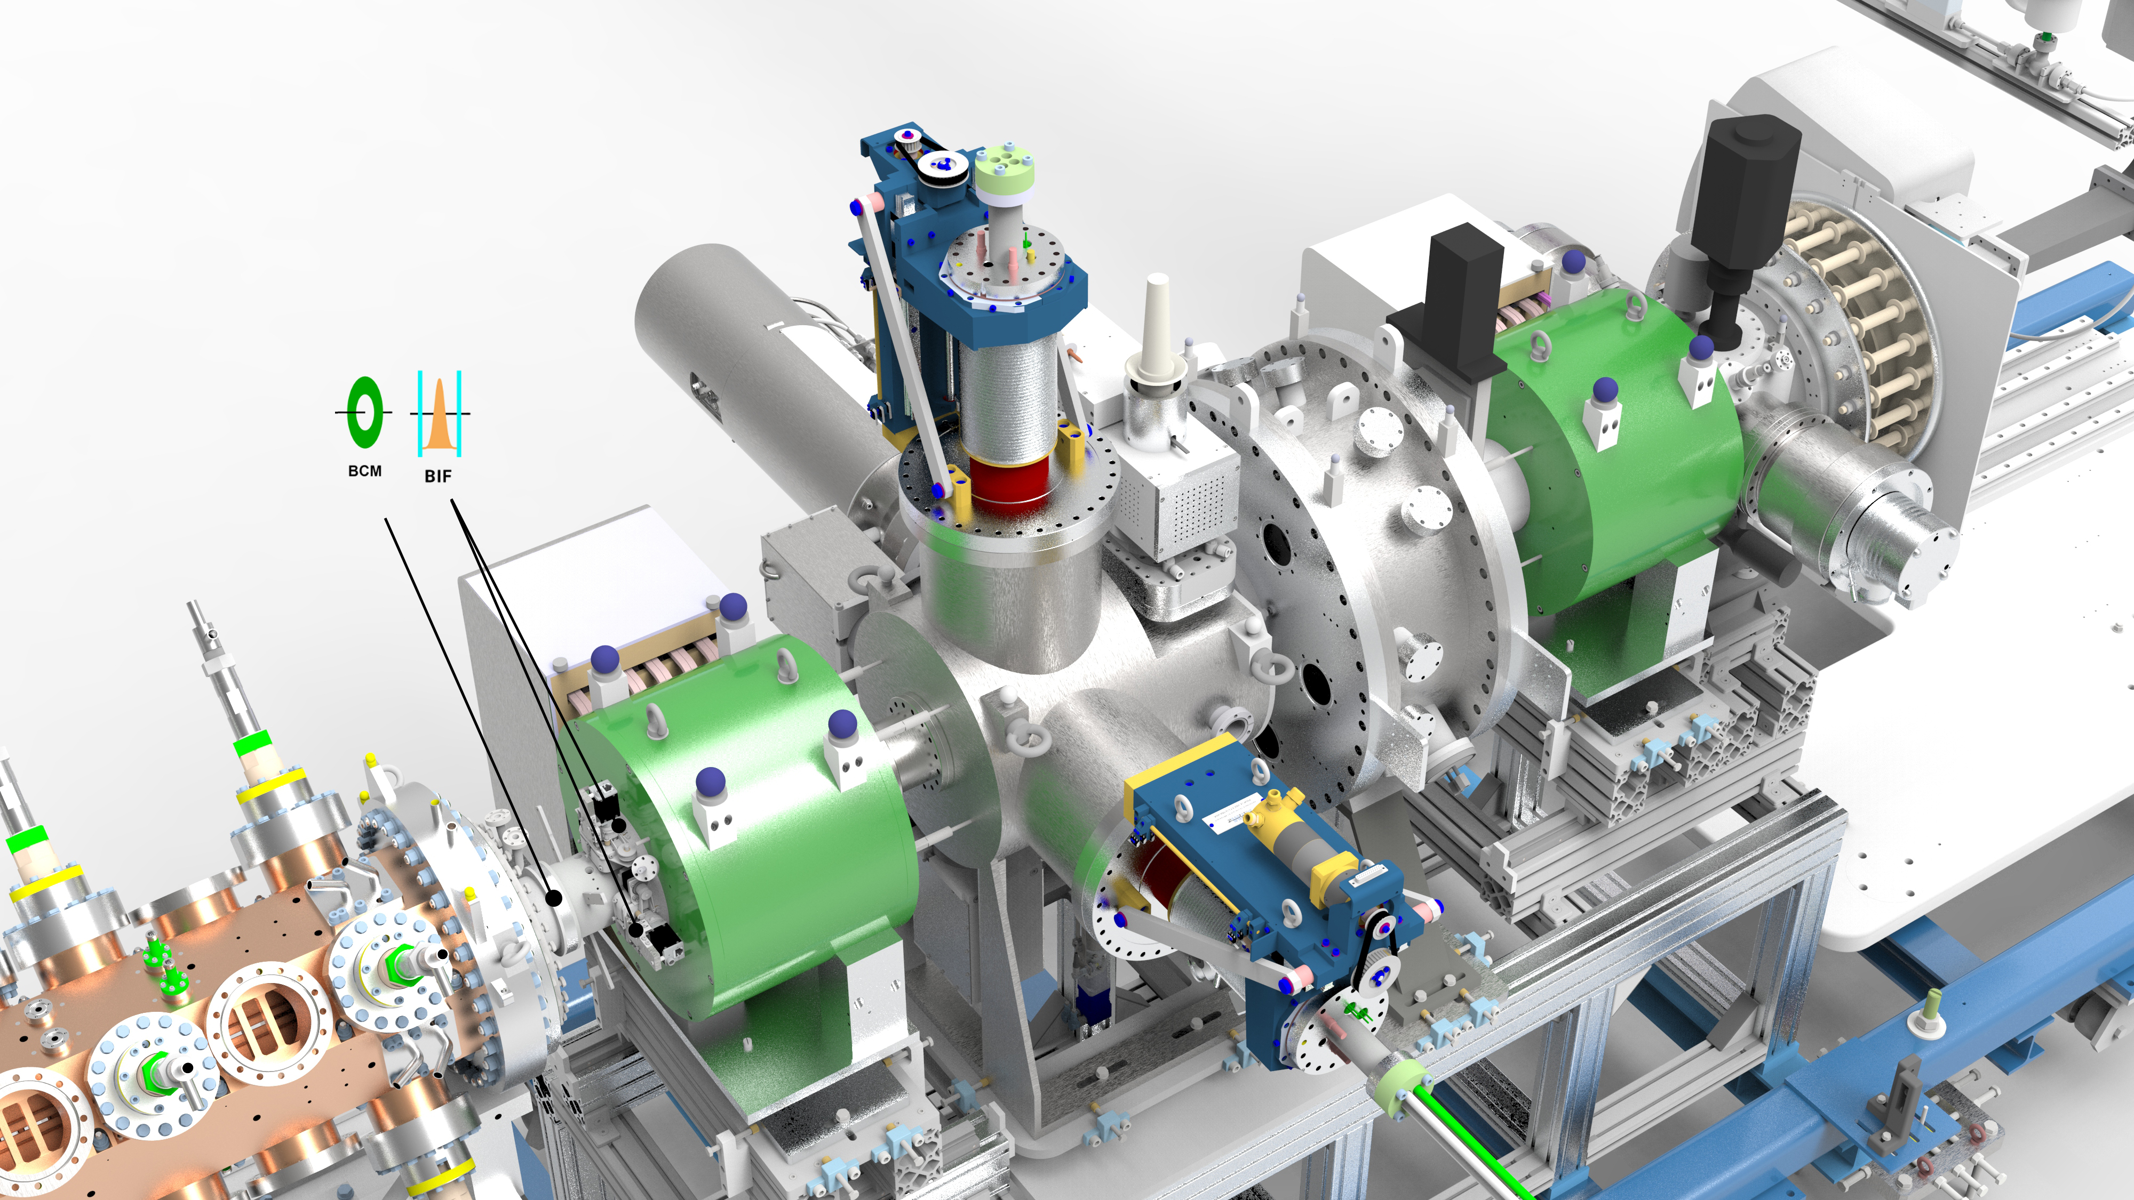
LEBT PBI in Cone
LEBT

Slide 7
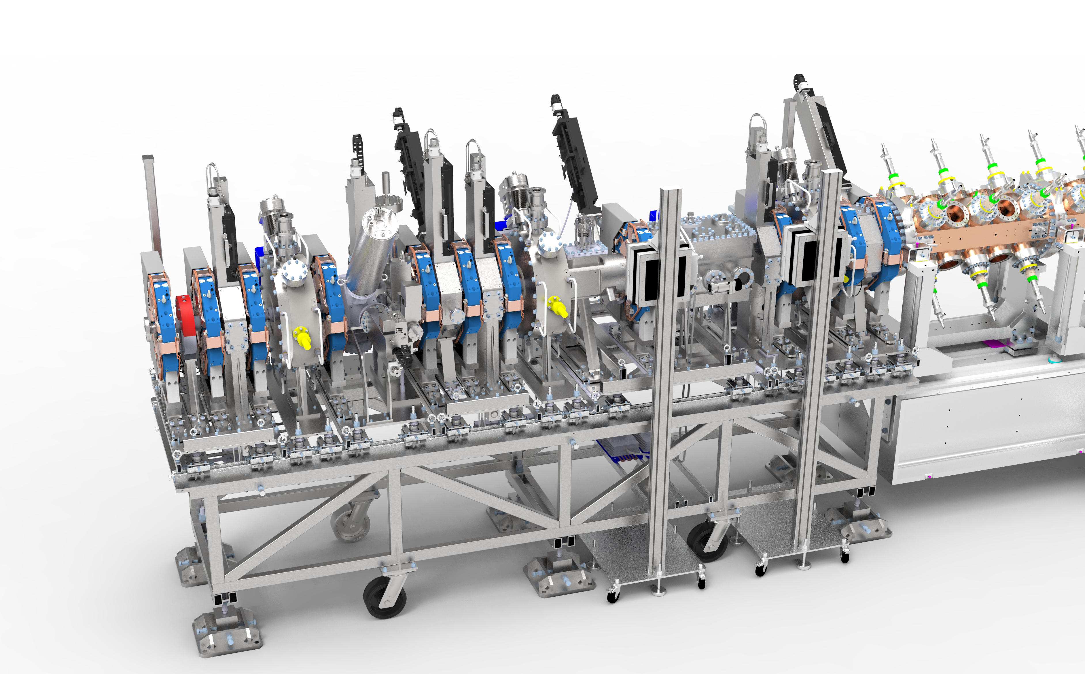
RFQ and MEBT
LEBT

Slide 8
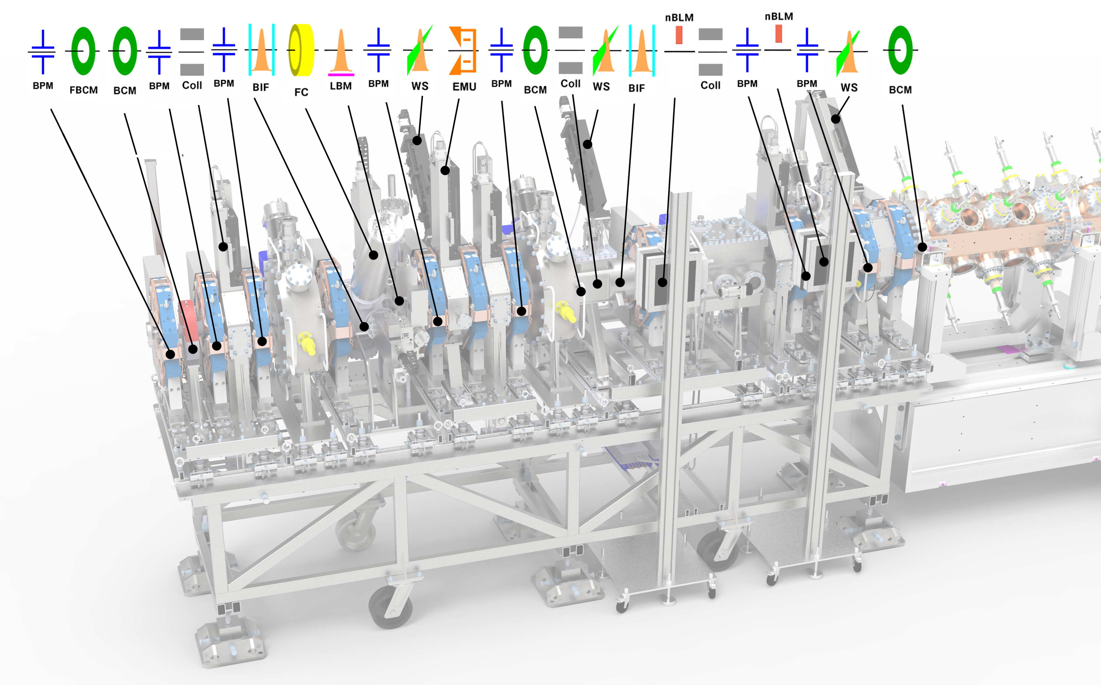
RFQ and MEBT PBI
LEBT

Slide 9
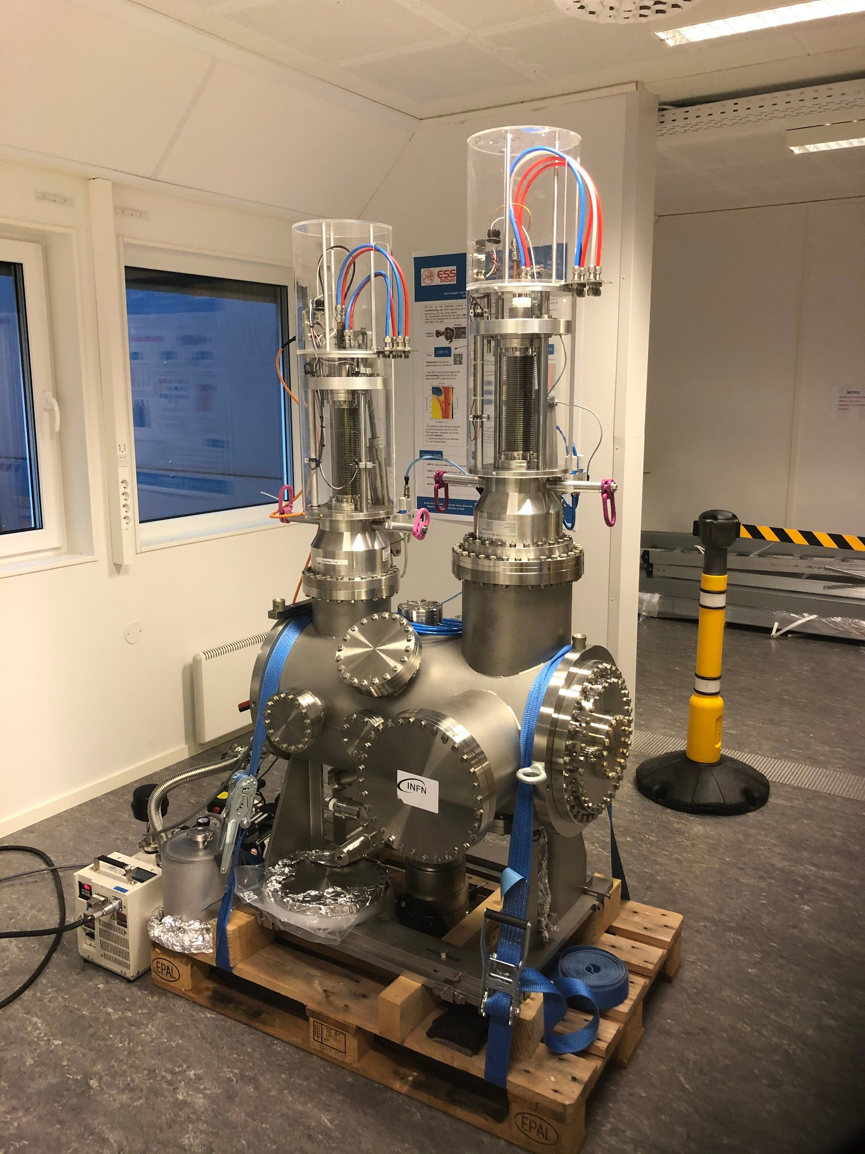
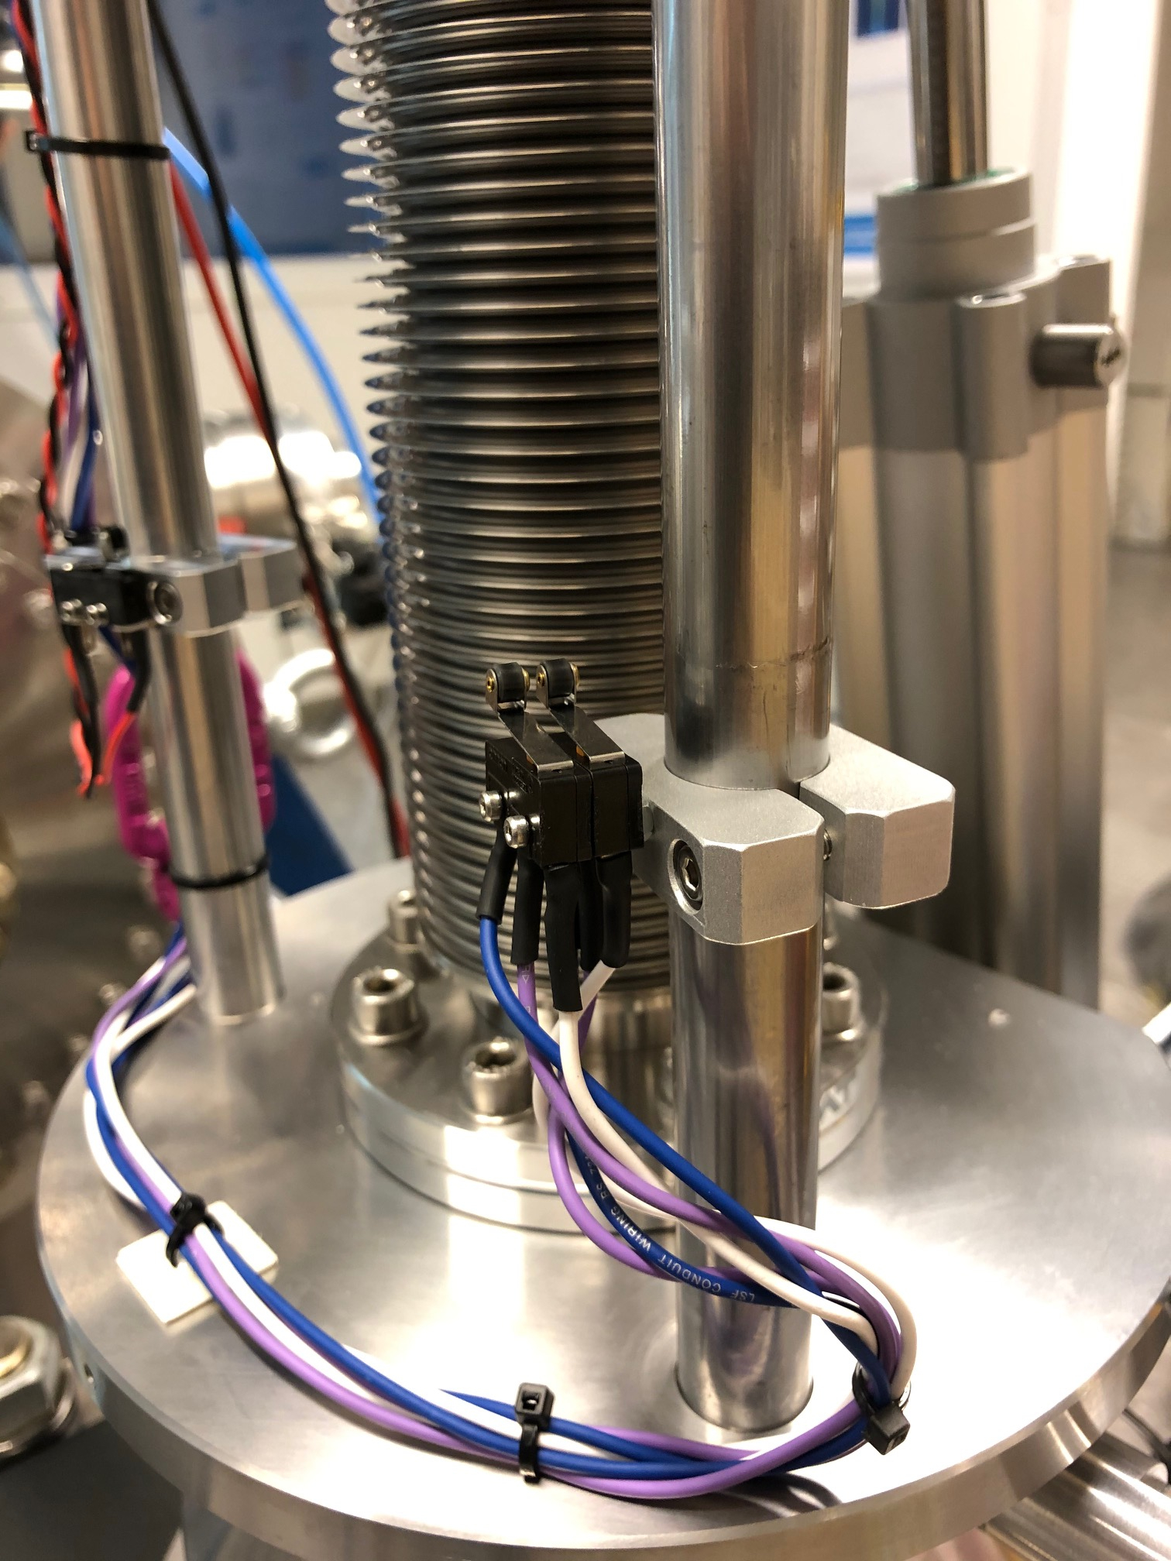
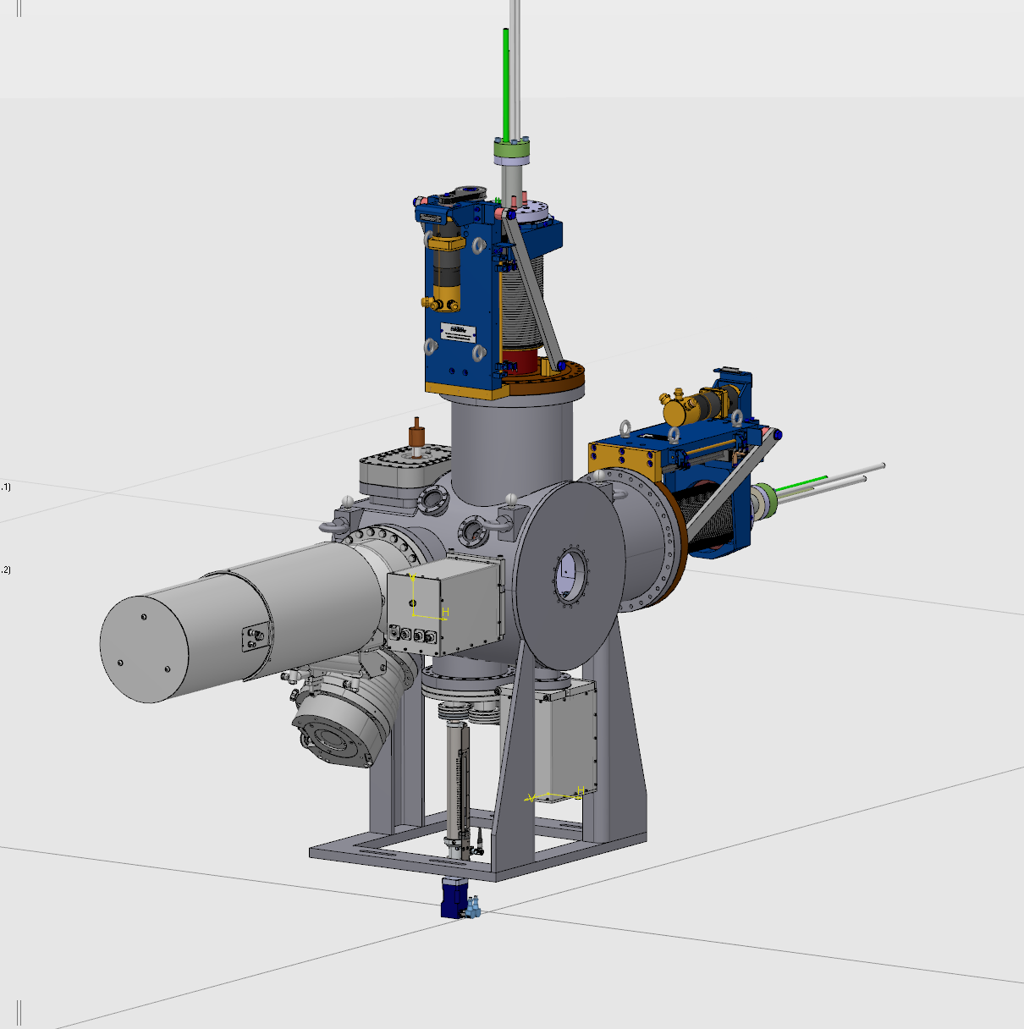
LEBT FC status
  #2 Delivered late: Dec-19 from Pantechnik
  Revised actuator system
  Installed MPS limit switches
TBD:
  Fiducialization, installation, alignment, leak check
  ICS/BD: collisions avoidance (2 EMUs, 1 FC, 1 Doppler)
FC2
FC1
Commissioning
tank

Slide 10
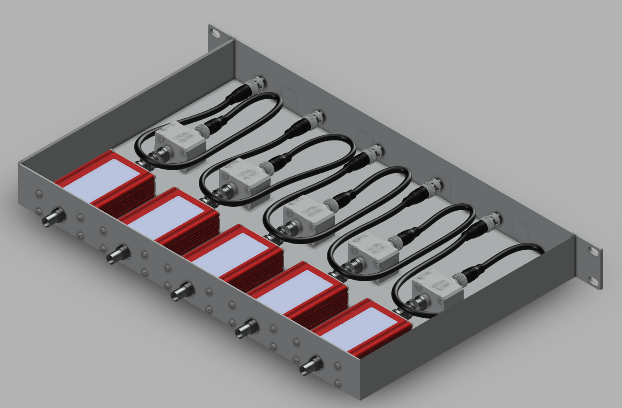
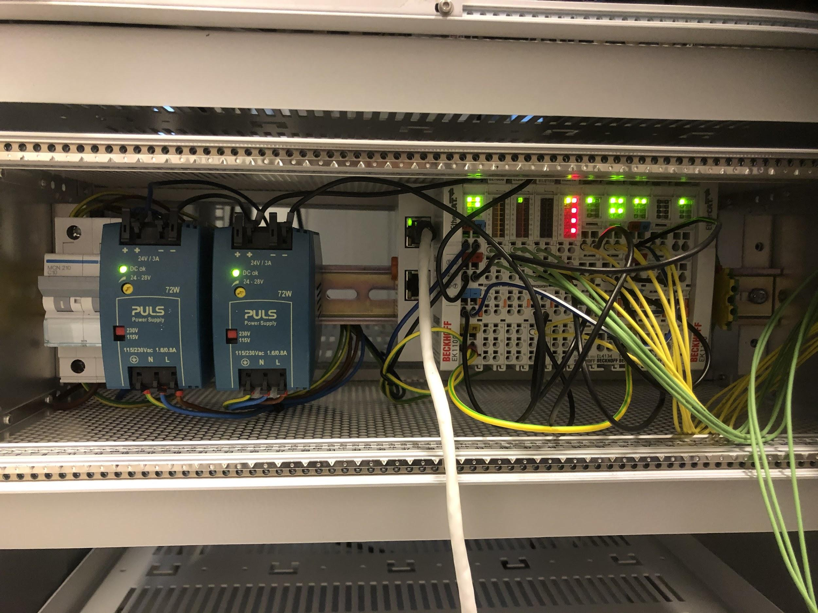
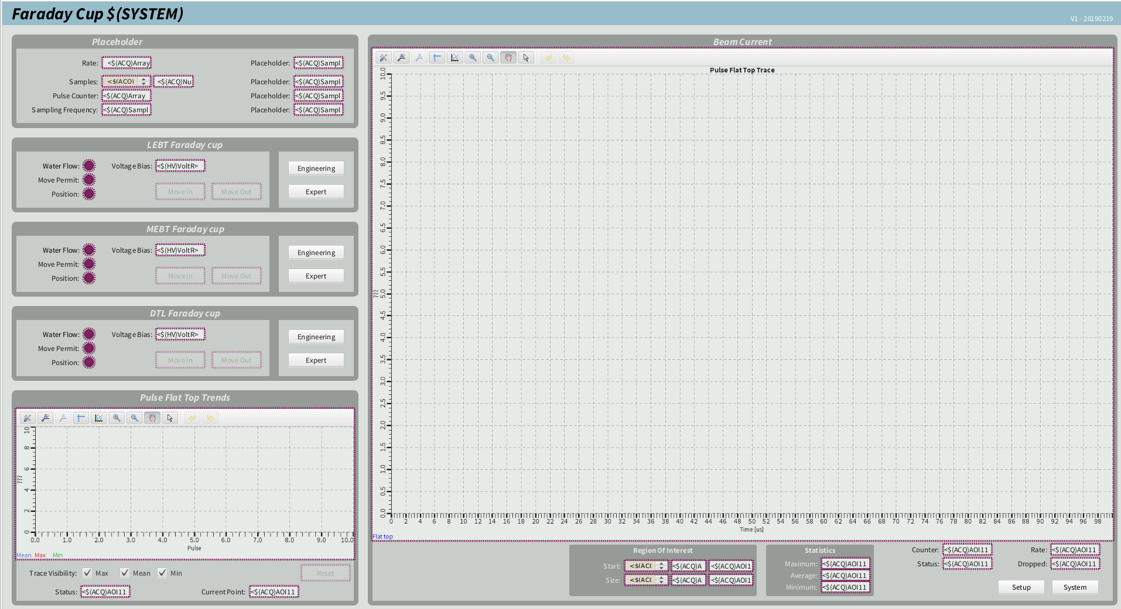
Towards beam on the LEBT, MEBT FC ( … and beyond ...)
Verified w. beam in LEBT; devices being installed; EPICS integrated in lab
  Revised grounding of EtherCAT modules by ICS (motion group), to be prepared for 3 FCs in total
  New Front-end enclosure, including 5 * LEBT FC FE
  Faraday cup .opi to monitor 3 FCs (LEBT, MEBT, DTL2)

Slide 11
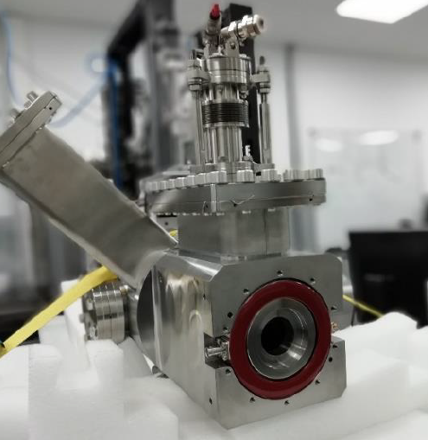
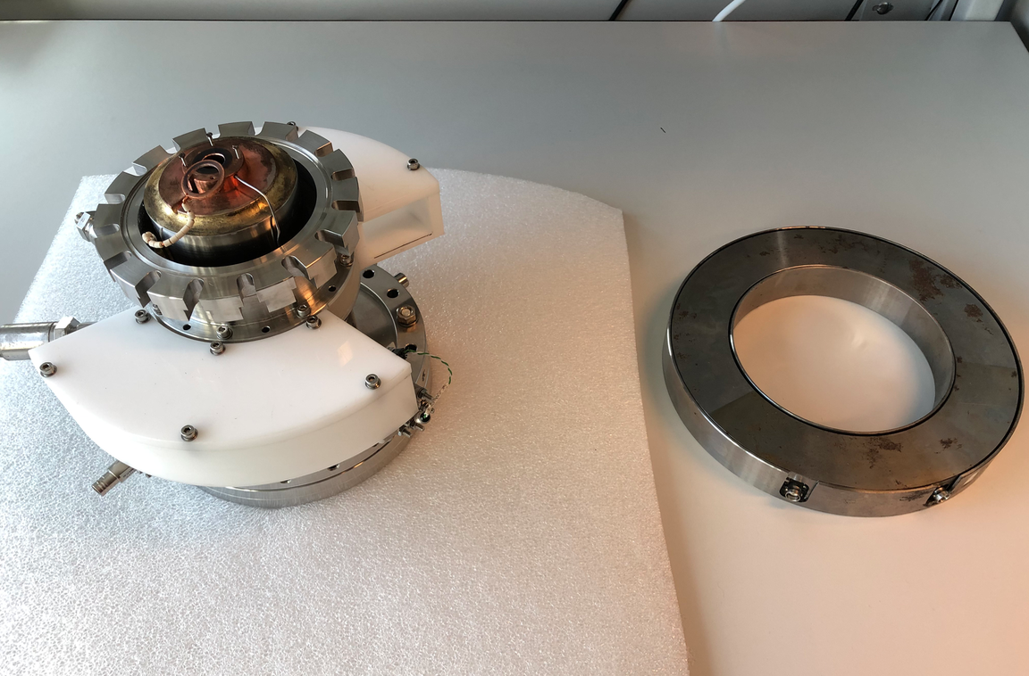
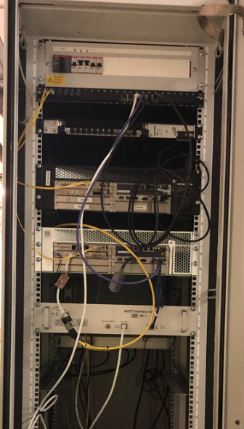
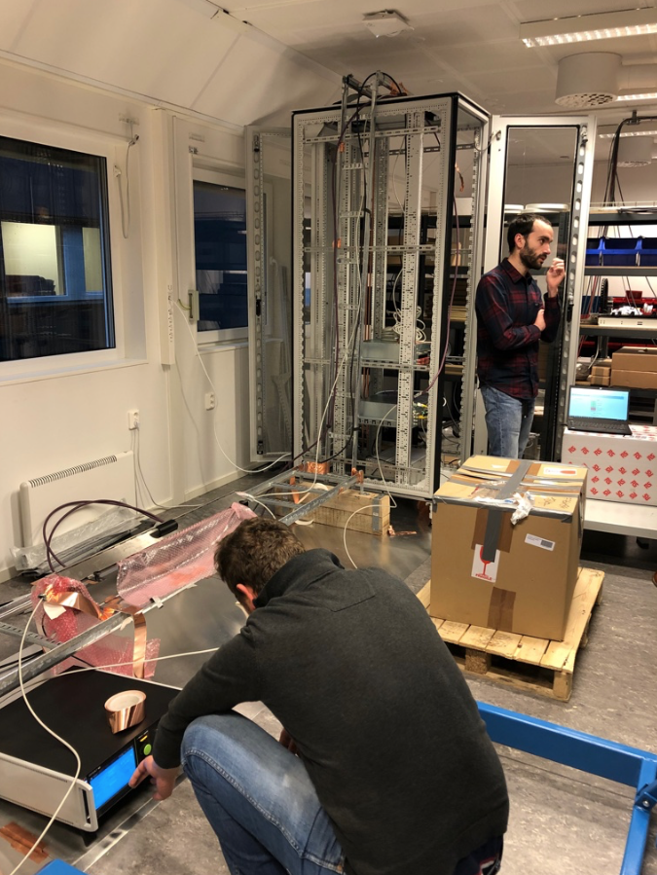
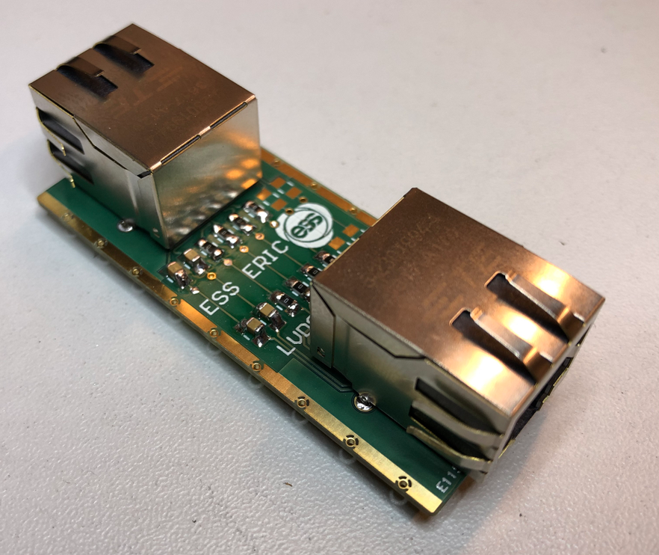
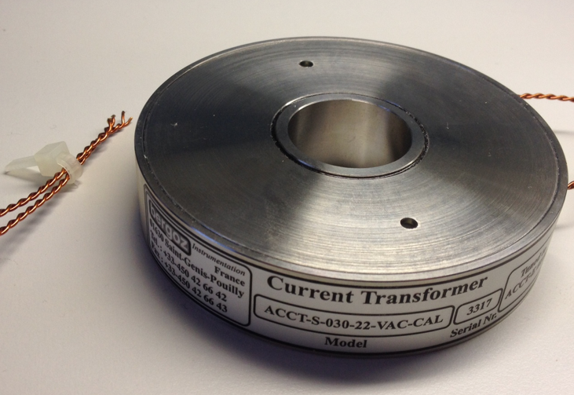
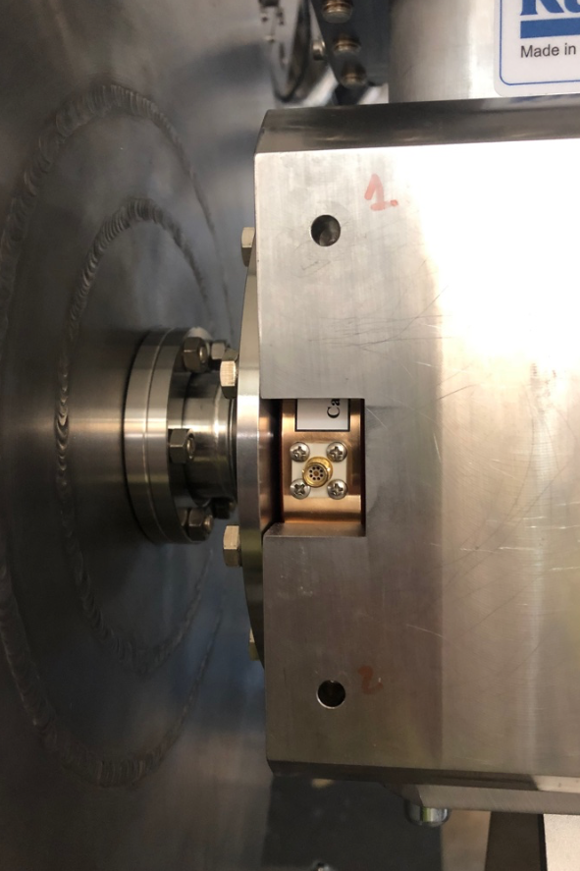
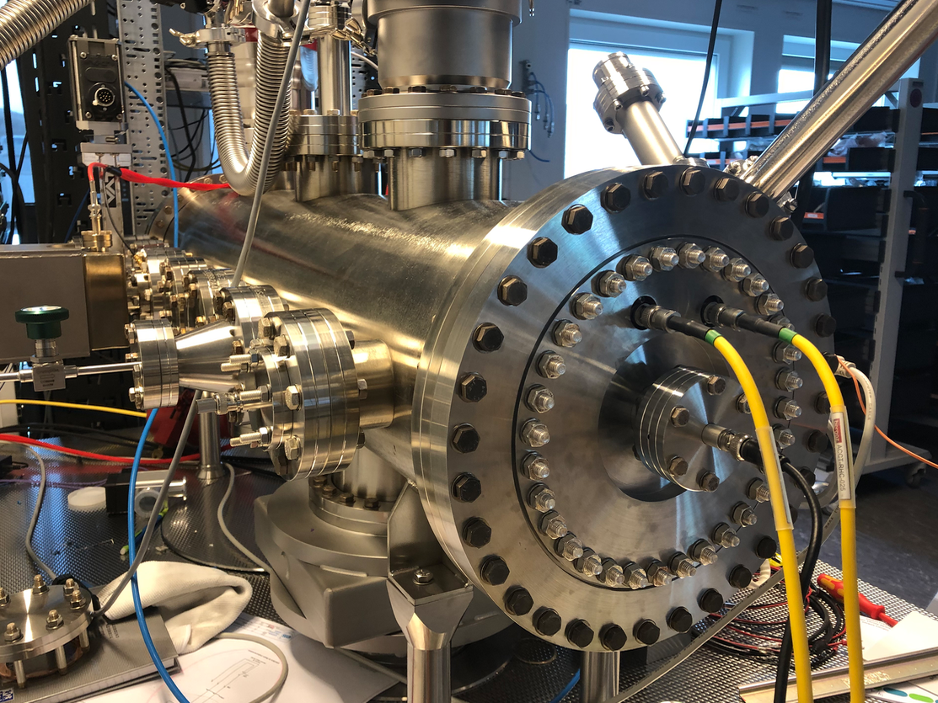
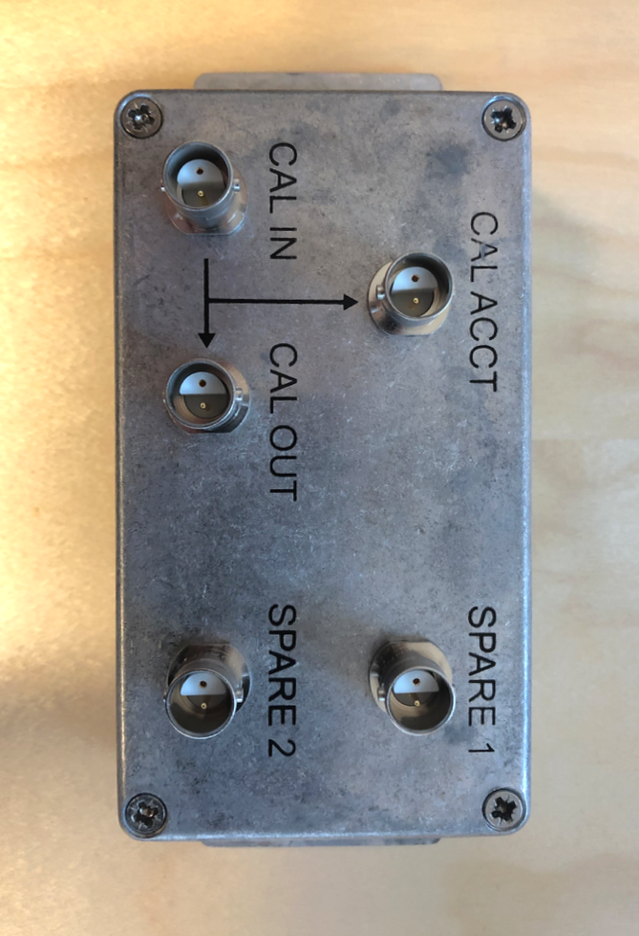
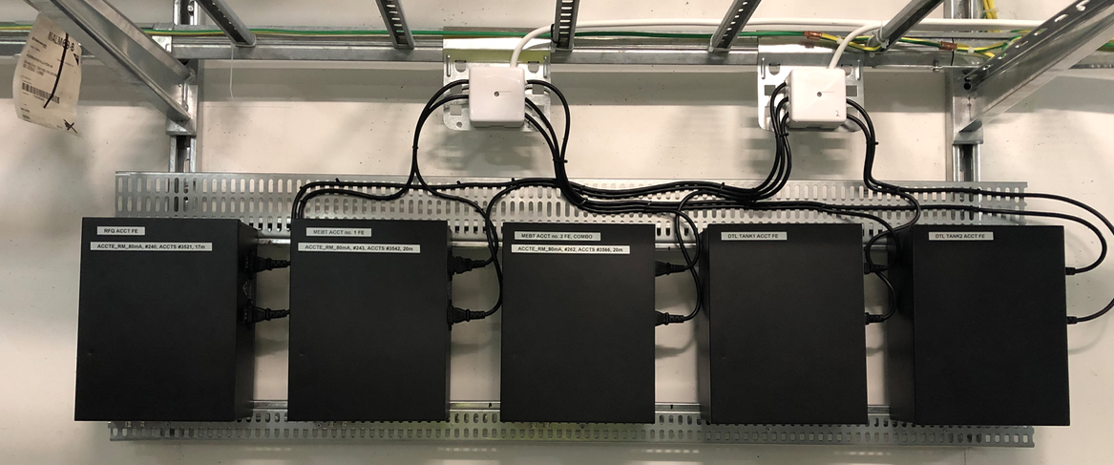
BCM installation
Verified w. beam in LEBT; toroids installed; EPICS integrated in lab
The already-installed BCM electronics in the FEB90 supports 7 ACCT sensors (i.e. from ISRC down to DTL tank 2) + the platform high-voltage measurement
Site installation of the BCM sensors nearly complete
EMC tests on the BCM-FBIS interface
BCM Patch Panel and Patch Boxes are being installed in the BCM rack and in the tunnel
ACCT front end installation in FEB90

Slide 12
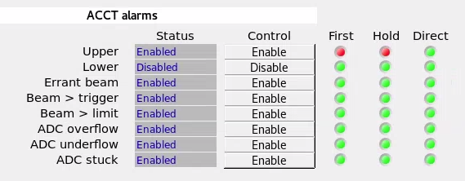
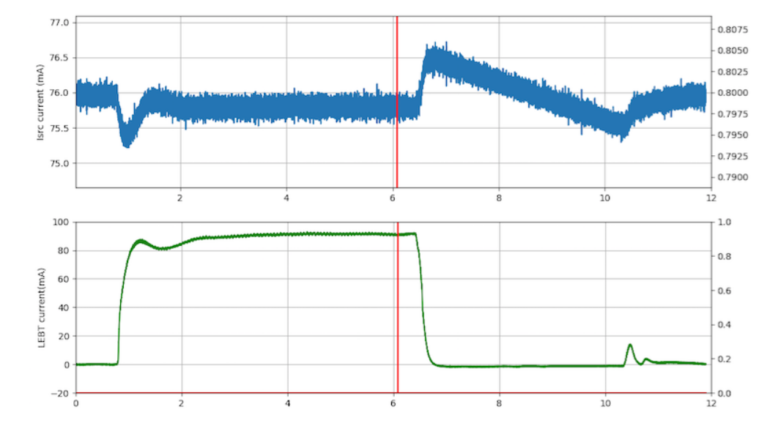
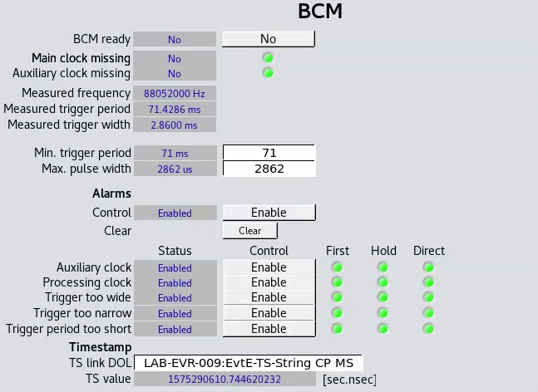
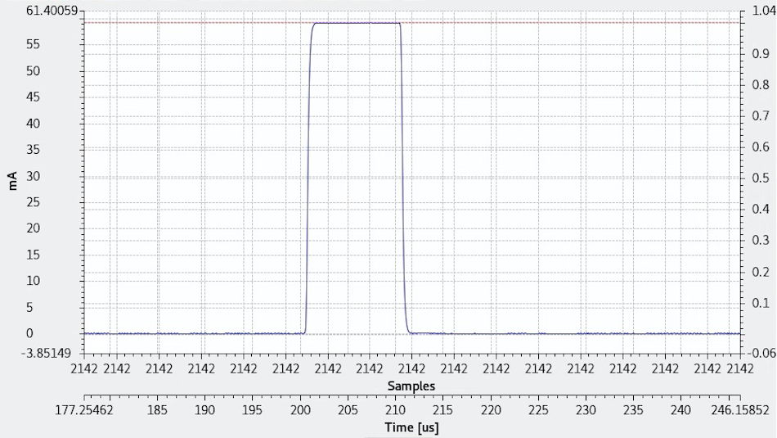
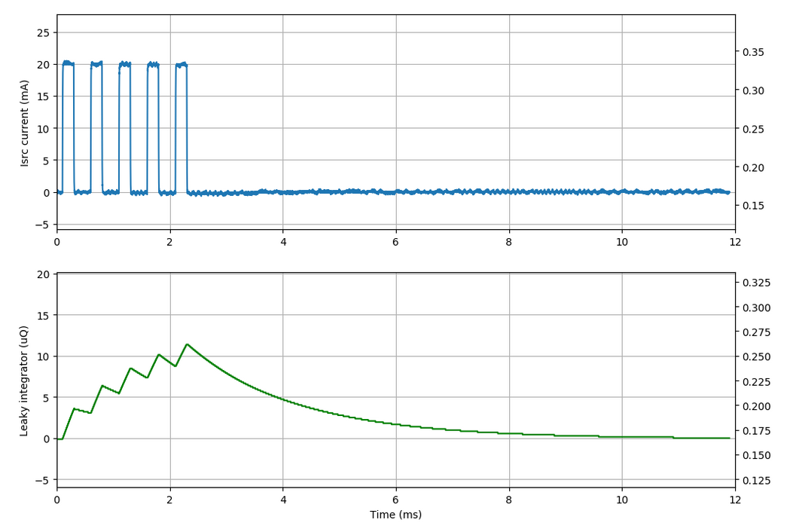
BCM tests
BCM machine protection functions based on a single ACCT are now integrated
A spare BCM channel is being used for measuring the voltage of the ISRC HV platform
~us pulses can be successfully measured with the 1 MHz BCM B.W.
A model-based protection function is implemented in the BCM firmware

Slide 13
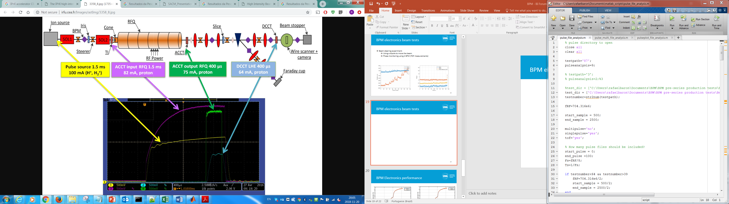
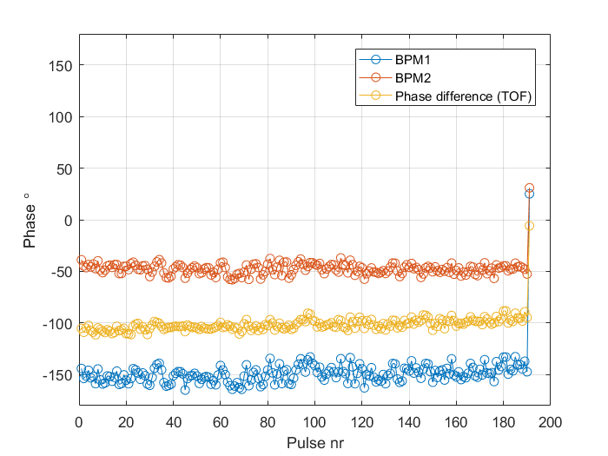
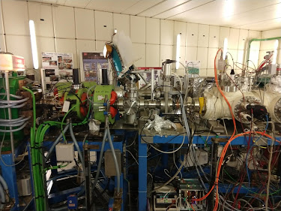
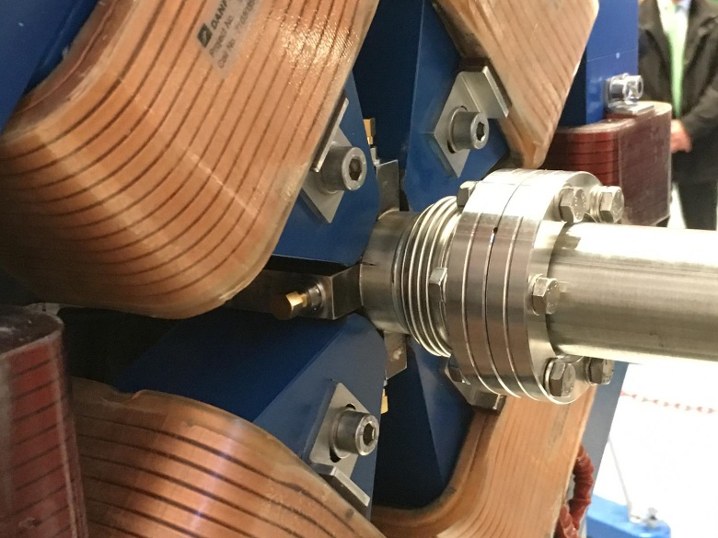
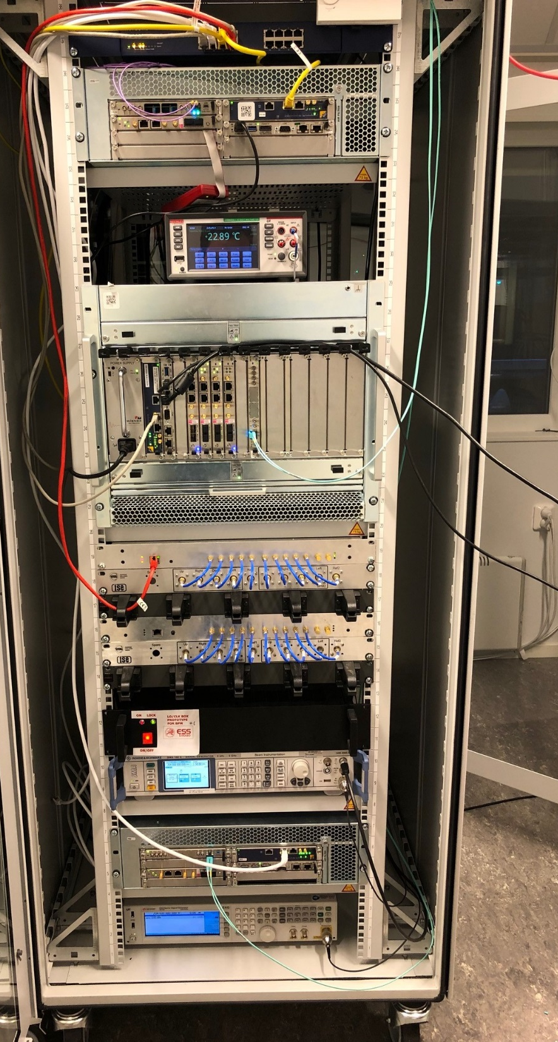
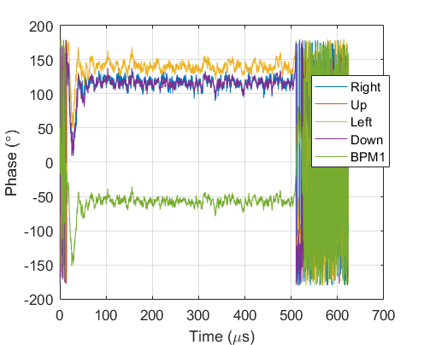
BPM
Verified w. beam at IPHI; MEBT electrodes installed; EPICS integrated in lab
5 m
MEBT BPM inside the quadrupoles
Beam tests at IPHI CEA-Saclay with the MEBT BPM
BPM electronics rack:
3 MeV, 0.4 mA to 50 mA, proton beam, 352.2 MHz RF
Repair of MEBT BPM broken during transportation from Bilbao. Repair done at ESS - Lund.
~5 minutes
Intra pulse phase measurements
Primary functionality:
Position, phase and amplitude
Waveforms and Averages
Data on demand
Position and energy interlocks

Slide 14
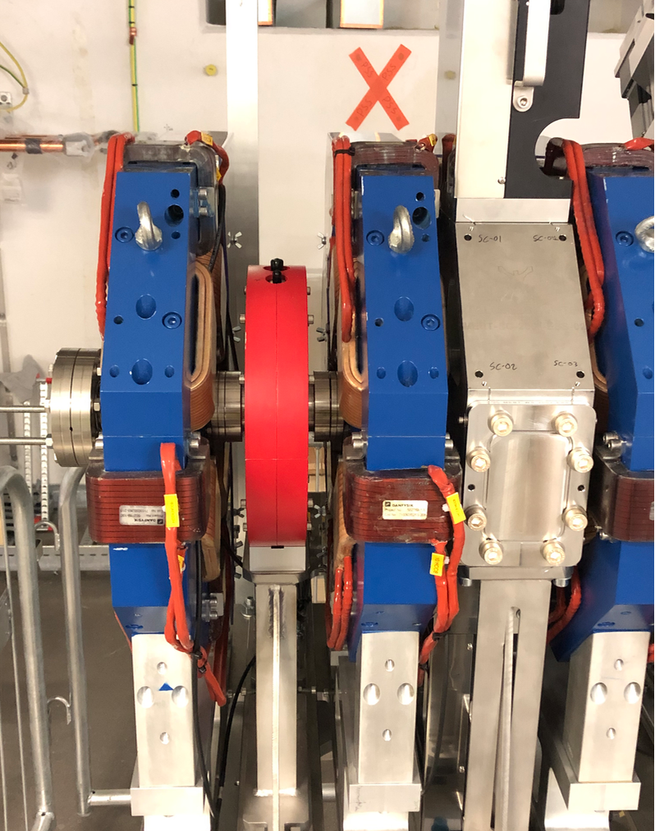
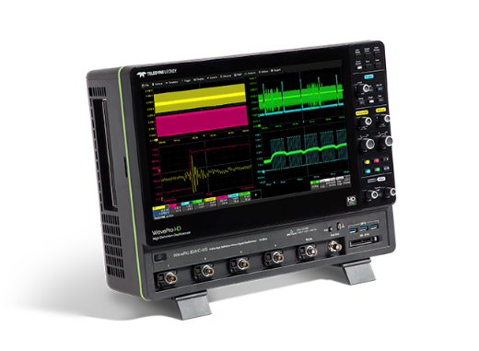
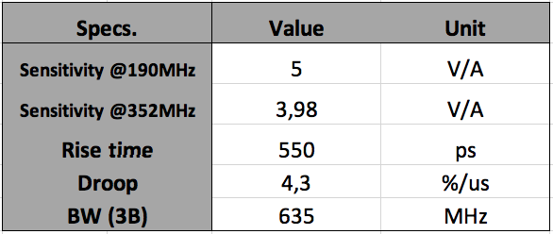
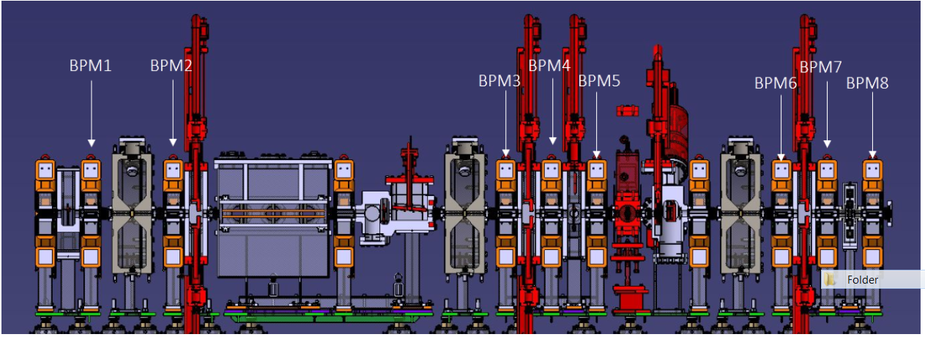
Fast BPM and fast BCM
The fast BCM (i.e. FCT) is integrated in the MEBT. N.B. After FC so used in DTL commissioning run
2 BPM’s are connected through the same cable path for absolute RFQ energy measurements in time domain (3 GHz bandwidth)
A fast oscilloscope (Received; EPICS integration in progress) will measure the fast BCM/BPM signals
BPM3
BPM4
Switch
LNA
Long cables
Measured FCT specifications (by the Bilbao team)
The FCT has a measured B.W. of 635 MHz and can be used for measuring pulse rise/fall time downstream of the MEBT chopper.

Slide 15

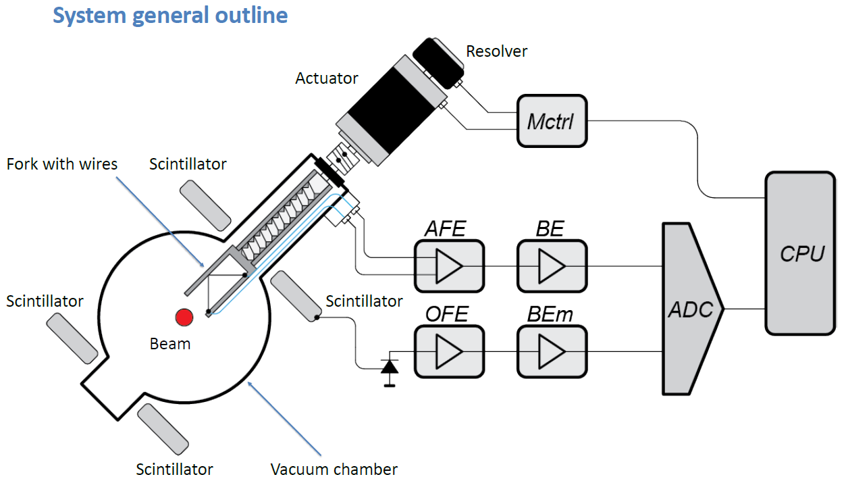
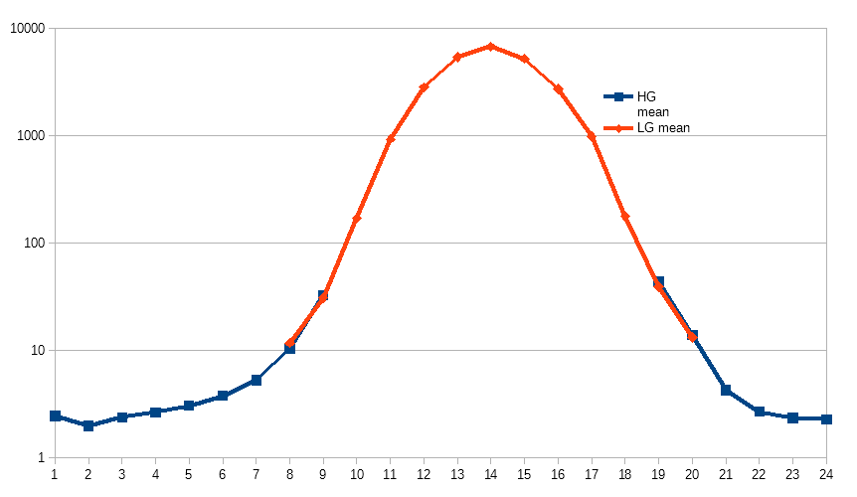
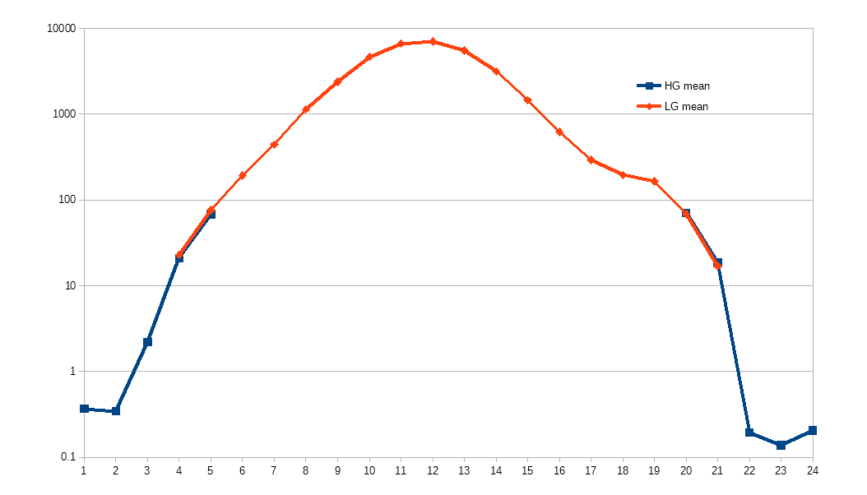
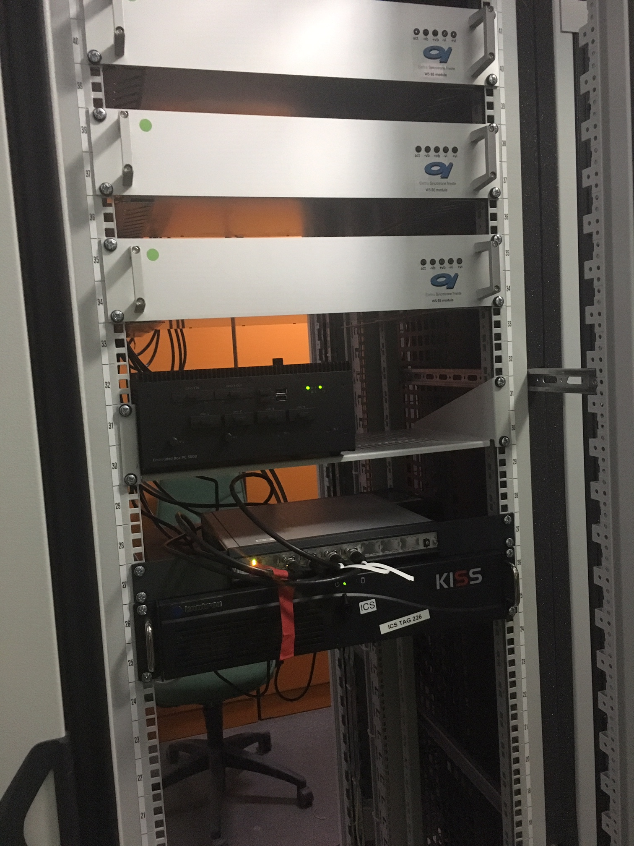
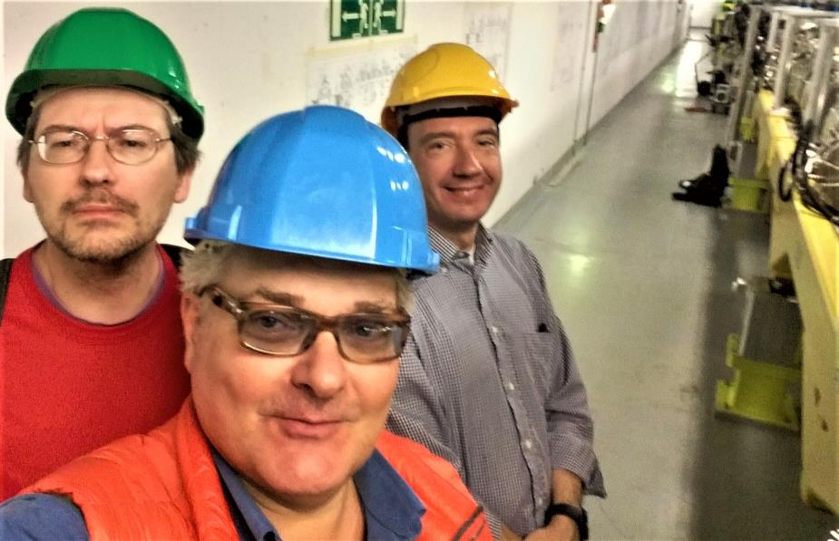
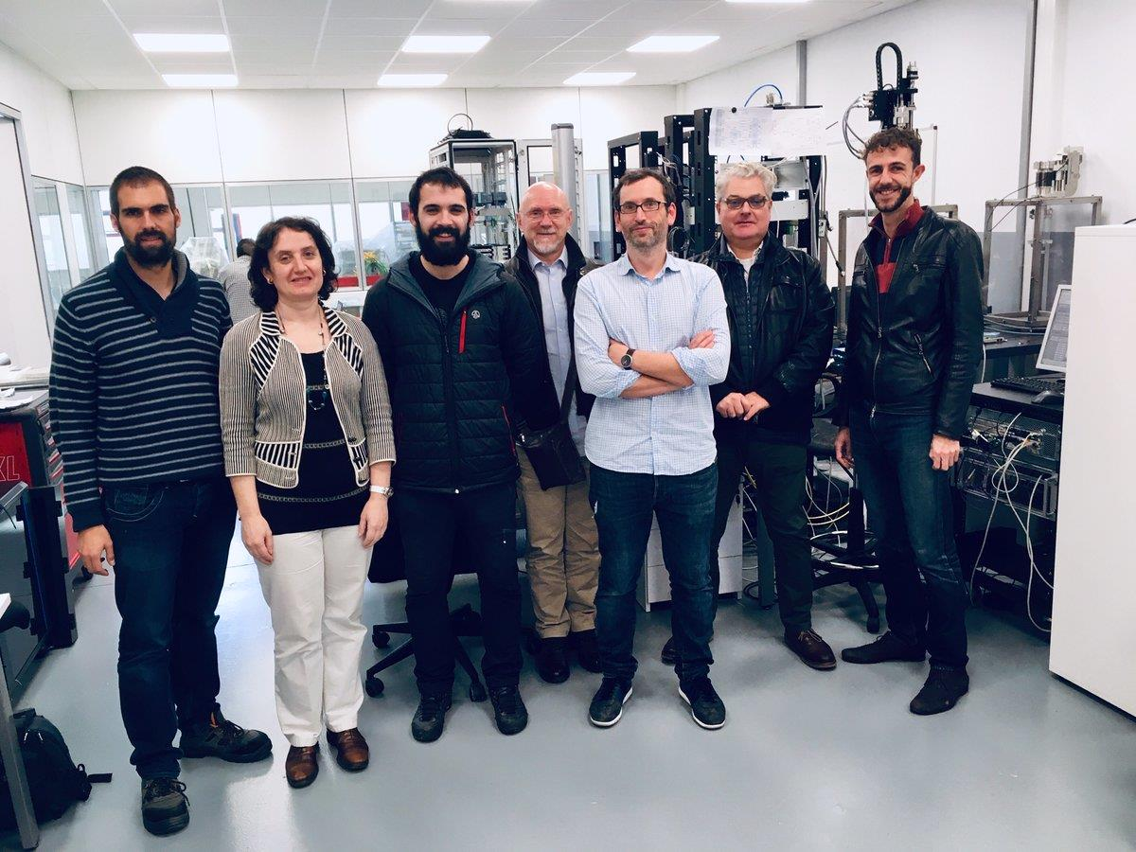
MEBT Wire Scanners
Acquisition verified in beam at Linac 4; All equipment received; init. EPICS integrated
Acquisition system:
  Elettra IK delivery.
  Vertically tested with beam at LINAC4: Horizontal and vertical profile plots above
  HW Received and Verified. MEBT Back Ends installed and Analog Front Ends RFI.
SW: waiting for delivery and verification.
Actuators: WS1 being repaired (bellow) at Proactive, installation planned in March.
Deliver H & V beam transverse profile scan at constant speed and in step by step mode (in tuning modes and below)
Test at CERN
Test at Bilbao
Electronics in FEB90

Slide 16
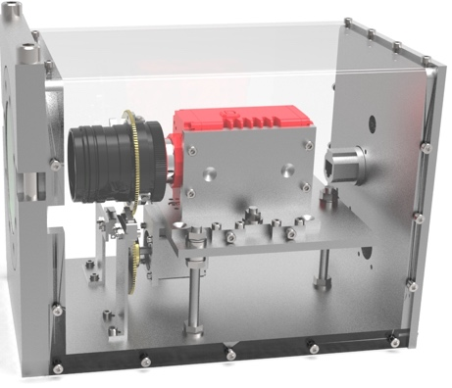
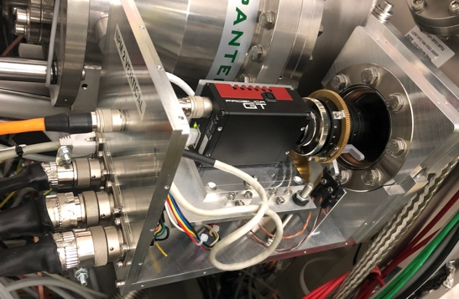
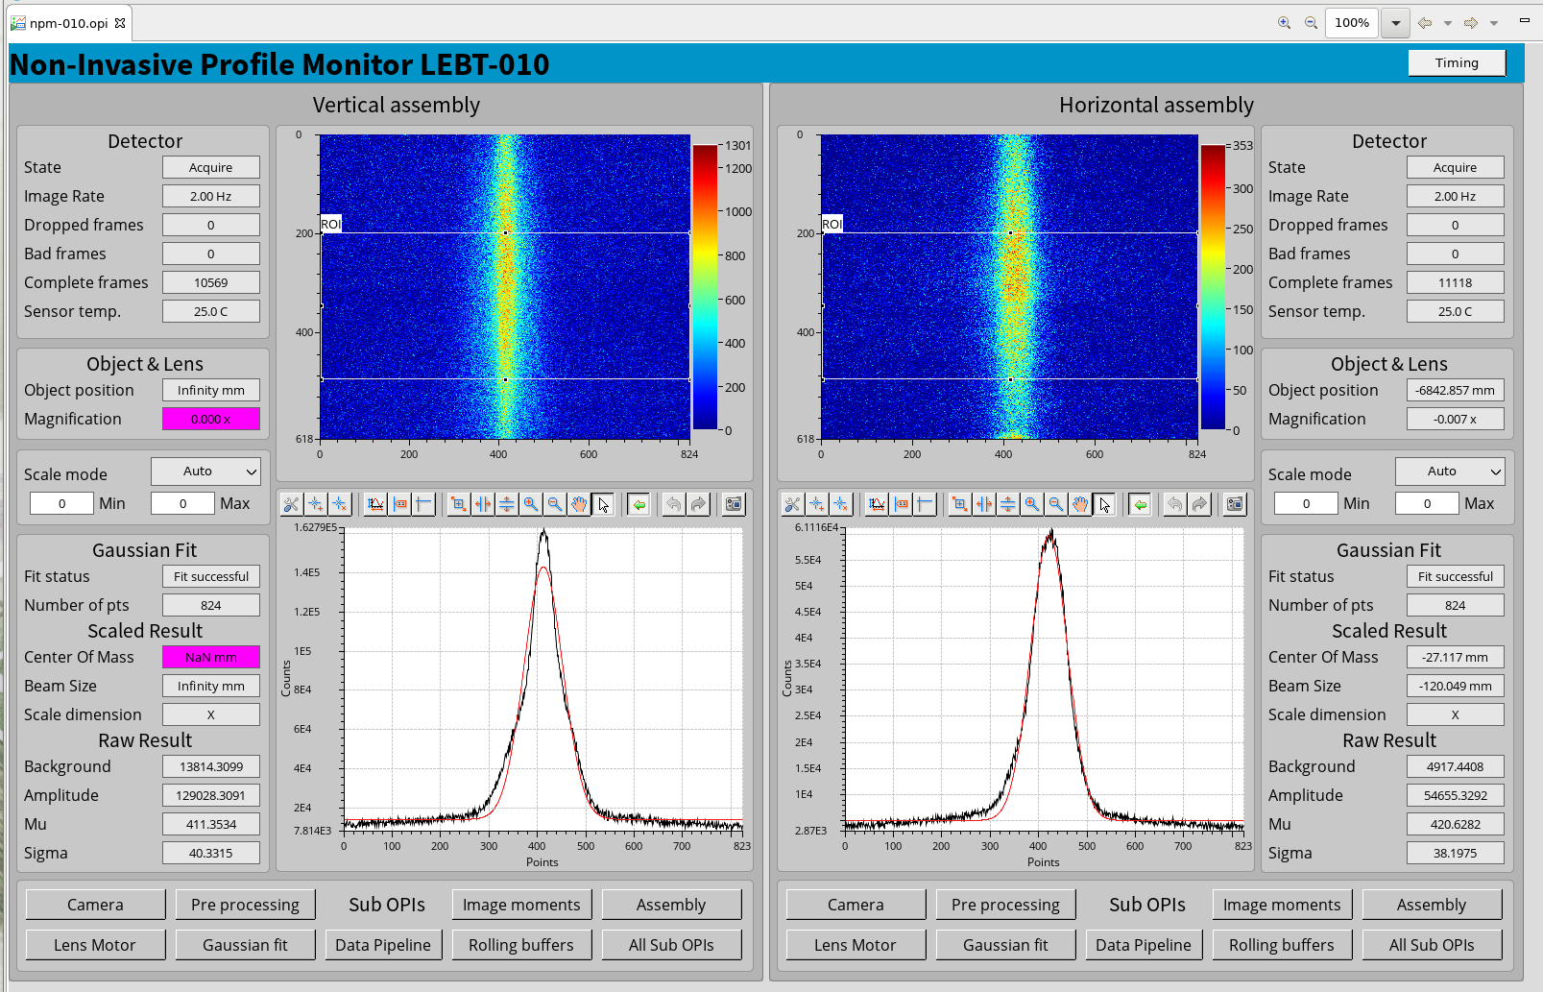
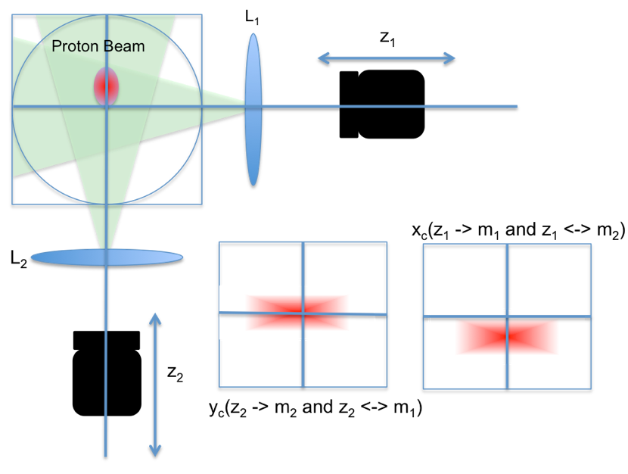
NPM. Fluorescence Profile Monitor
Verified w. beam in LEBT. Photon counting version under construction for profile measurements in MEBT
H⁺ + H₂ -> H⁺ + H₂* + γ
γ
γ
Optical axis
H₂
γ
y_{c} , m_{y}
H⁺
x_{c} m_{x}
FPM @ ESS LEBT
Transverse beam position measurement @ LEBT
16
FPM operation principle

Slide 17
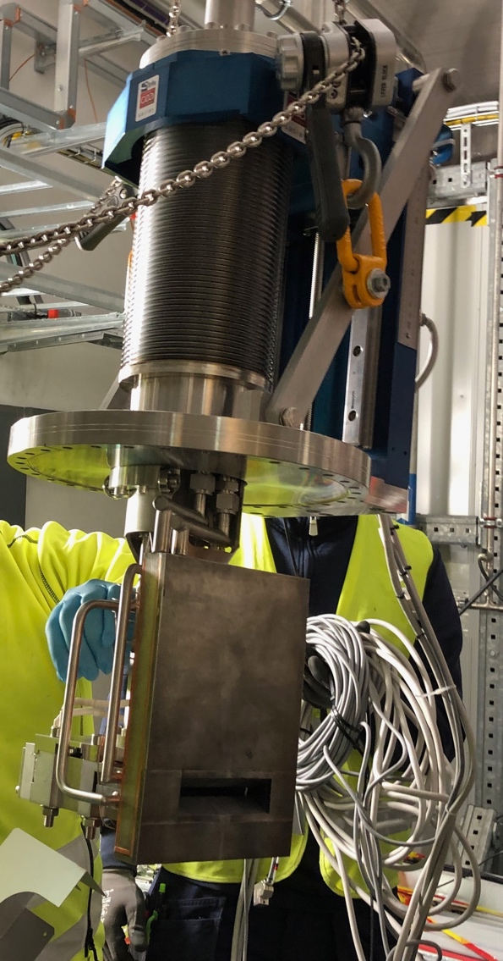
LEBT Emittance Measurement Unit (EMU Allison Scanner)
Verified w. beam in LEBT
AS developed at CEA for ESS LEBT @ 75 keV
Measured emittance at LEBT, 2019

Slide 18

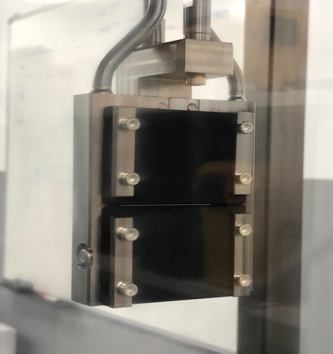
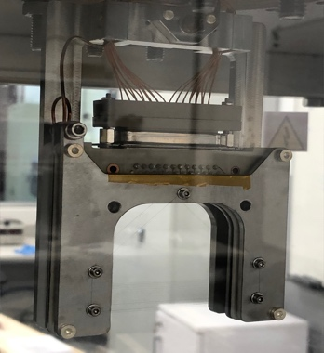



MEBT Emittance Measurement Unit (Slit and Grid)
Equipment received, update nearing completion
  Vertical Integration test at ESSBilbao
  (cross talks, offset and noise in some
  channels observed that may be perturbing the emittance measurement.)
Fully differential outputs
To FMC
Reception tests in Lund on-going
    In-house (ICS) firmware development for IFC1410 + (2x) ADC3117;
    New EPICS data acquisition module based on AreaDetector.
    Next step: develop the EMU IOC to automate the scanning procedure;
24 ch current inputs from grid
200 nA – 200 uA
2 MHz bandwidth

Slide 19


BSM
Requirements and Design
  Will be used to measure average bunch shape.
  Designed and fabricated at INR, Moscow, Russia.
  Same designed adopted for BSM2 (at the end of DTL).
  Improved symmetric λ-type RF deflector designed to fulfil the required 0.5º phase resolution for zero intensity beam (4ps @ 325.2MHz).
  Space charge effects estimated to increase the upper limit of phase resolution to 0.7º
Status
  Equipment received in April 2018.
  Device installed in the MEBT beam line in June 2019.
  Installation of electronics in the racks by INR team planed for May/June (after long haul cable installation, trip also combined with BSM2 pre-installation activities).
  The device comes with LabView based control system. Minimum steps to have the BSM ready for beam require timing and MPS integration.
BSM1 during bench tests at ESS in vacuum lab
BSM1 installation in MEBT
Symmetric RF deflector

Slide 20


nBLM
Verified at Linac 4, equipment received
Requirements and Design
  Particle discrimination
  µs time resolution, latency
  MPS function
  Fast (recoil) and slow (moderated) detectors
  Event-based acquisition
Status and Plans
  FPGA features: event building, data on demand (but restricted to 1 or 2 channels)
  Infrastructure for gas being installed
  System awaits MPS hardware, EPICS software
  Test in upcoming commissioning run to maintain contractual agreements and assure readiness for operations
Test at LINAC4 in Nov. - Dec. 2019
Fast nBLM at DTL1-2 intertank region at LINAC4
Neutrons indicating beam pulse (200μs and 150μs)
Gammas indicating
RF pulse (880μs)

Slide 21


Global functions
Intent: Deploy these initial versions for next commissioning
Remote system management
  IPMI management function integrated with EPICS
  Alarms, archiving of health data
Data on Demand (aka Synchronous Data Service)
  FPGA support for buffered, triggered data acquisition
  Software support with Area Detector
Low-latency multi-gigabit link
  Demonstrated for diferential current

Slide 22


Acceptance to installation to commissioning
Verification with WeTest, etc
EAM Labelling
PBI lab Acceptance
Ready for Installation
Transport to G01/G02 &
Installation
Beam Commissioning
Verification without beam / Cold Check Out
Ready for beam commissioning
Arrival at ESS

Slide 23




Verification and Data Management
Multi-year effort, multi-directorate effort - now dangerously close to ready
Data source
PBI / BP Expert
System Verification Data
System status
Natalia’s talk
Asset management
Expert User
Reformatting to ESS NeXus
EAM
QR Scanning tool
ESS User
Meas01
SciCat
Embedded HDF viewer
Data storage
Cataloguing
Notes:
Test benches produce data from the lab and the tunnel, from single unit acceptance to system verification with beam.
Data is stored in hdf5 format in meas01, files definition can be found in https://confluence.esss.lu.se/display/PBITECH/Systems+status+and+data+files+definition
Beam Diagnostics folders in meas01 are automatically analysed and catalogued by SciCat
A custom field in EAM links assets to their data, visualized in SciCat.
- Lifecycle (not sure exactly what to call this…): a couple of slides: Slava, Clement and Johan provide overview of supply chain management, installation, EAM, verification, WeTest, data management, etc .... System engineering graphic is OK, but also include real example(s), real data.

Slide 24

Schedule Comparison
DTL5
+ Spokes
+ Medium Beta
Source/LEBT
at Catania
RFQ/MEBT/DTL1
To target
Source/
LEBT
split
DTL 2-4
ESS
2017
2018
2019
2020
2021
2022
SNS
2002
2003
2004
2005
2006
1
2
3
4
5
6
7
8
9
MEBT
improve
DTL 1
improve
Elliptical
In years past, the ESS plan appeared too aggressive.
In 2018, it looked achievable and similar to RHIC and SNS.
Now, the pace appears slow
Deployment at scale: superconducting linac devices

Slide 25

Challenges and Mitigations
Challenges:
  ICS resource limitations
  Infrastructure readiness
  Delayed deliveries.
Mitigations:
  Prioritize through Program Forum
  focus on first proton functions
  Data-driven, lean documentation,
  “we must have the data” (C. Saltmarsh c. 1992)
  Self perform
Opportunity:
  Contribute more globally (ex. Chopper, RF systems, EMC, operator screens, accelerator commissioning, even neutron science)
P6 Plan (Milestones, Earned Value)
~2 months
One Program Board (CAP)
~2 weeks
Many Team Boards
2nd sprint
1st Sprint

Slide 26
System Status
Activities prioritized in Accelerator Controls Program Forum
System | Required for SRR2a | Priority of other systems | Design status | Material ordered | HW received up to SRR2a | Integration in the lab | Deployed | Projected readiness For commissioning
BCM | Yes |  |  |  |  | On track | Partly deployed for LEBT
BPM | Yes |  |  |  |  | On track
FC | Yes |  |  |  | FE in construction | On track | Partly deployed for LEBT
WS |  | 1 |  |  | 1 WS unit being repaired | Partially tested Next in priority
EMU |  | 2 | Rework ongoing | Rework ongoing | Additional cable needed |  | Partly deployed for LEBT
FBPM |  | 3
LBM |  | 3
nBLM |  | 3
ICBLM |  | 3 |  |  | N/A
DPL |  | 3 |  |  |  |  | Partly deployed for LEBT
NPM |  | 3 | uTCA/IPC, fiber, drawings, cables |  | MEBT optics needed |  | Partly deployed for LEBT
COLL |  | 3 | Signal part will be target aperture prototype

Slide 27



FC, BCM, BPM nearing deployment
Verifying timing, archiving, operator screens, …

