Slide 1
PSS1 and MPS1 Overview and Status 2020-01-30
ICS Protection Systems Group
www.europeanspallationsource.se
2020-01-30

Slide 2
Let’s Discuss
a

Slide 3
PSS1

Slide 4
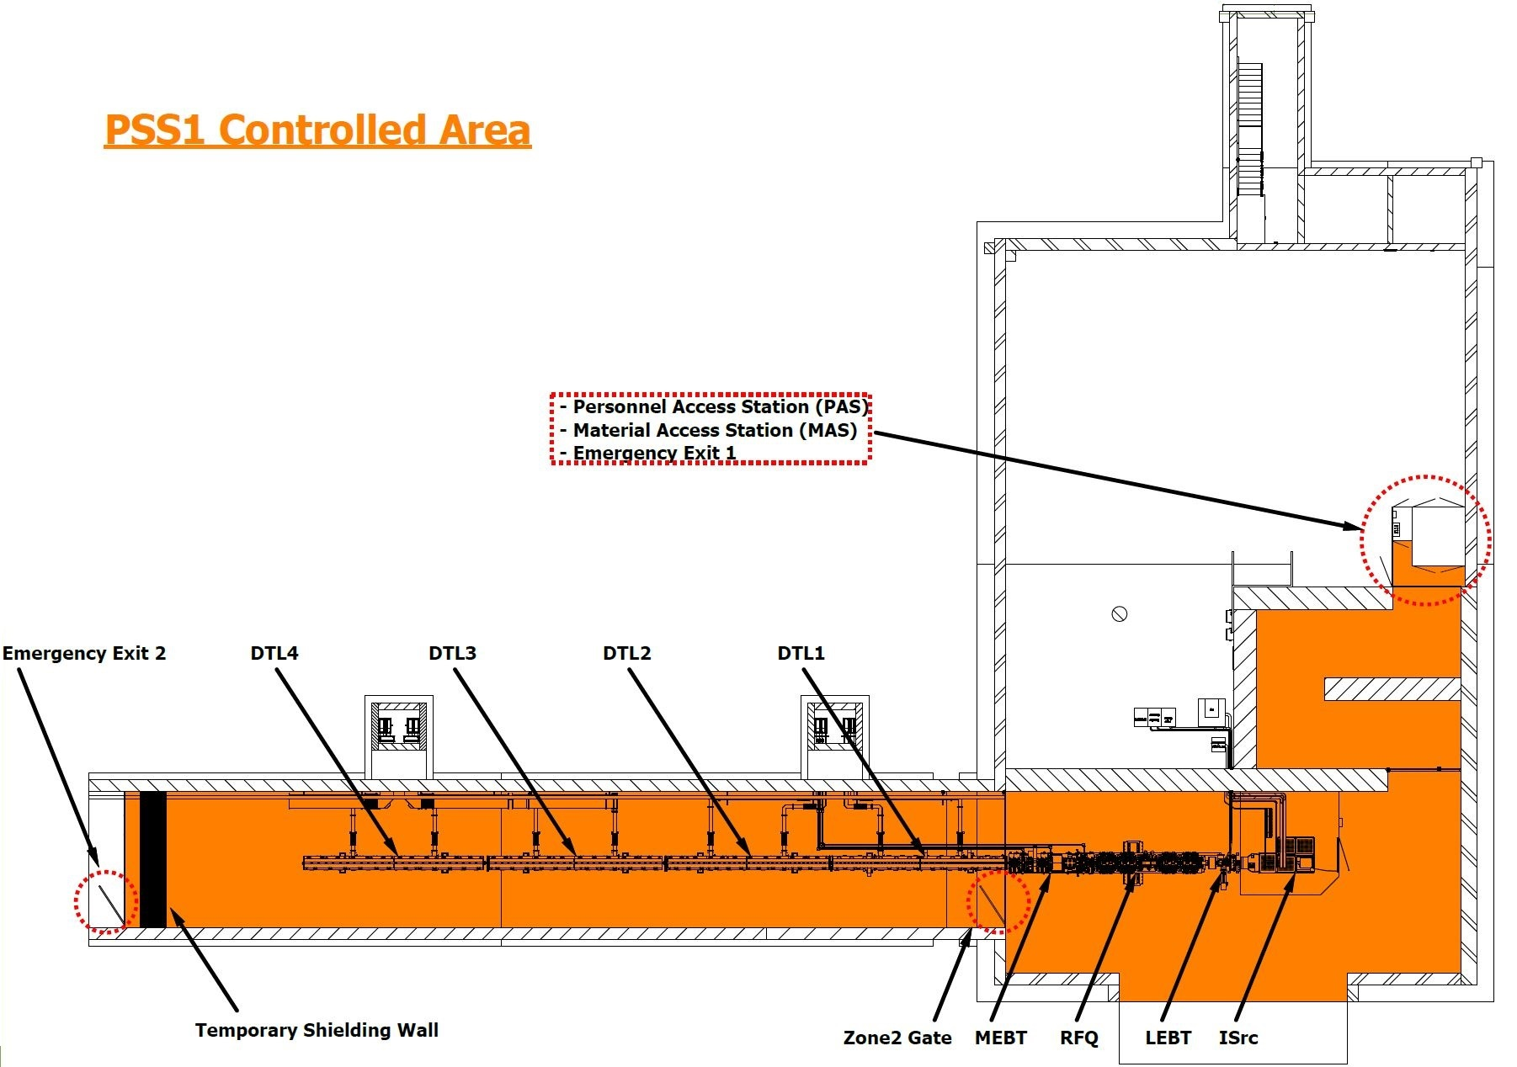
PSS1 brief overview
PSS1 is realised in three phases:
PSS1-a: ISrc up to and including RFQ (required for RFQ RF conditioning) → 2020-05-31
PSS1-b: ISrc up to and including DTL1 (required for DTL1 RF conditioning) → 2020-09-28
PSS1-c: ISrc up to and including DTL4 → 2021-04-05
What should be installed, commissioned and validated for PSS1-a?
PSS1 PAS & MAS (including card readers connected to ESS access control system, intercom, CCTV);
PSS1 fences (e-exits, zone gate);
PSS1 interfaces with TSW;
PSS1 key exchange system;
PSS1 field devices (Emergency switch-off stations, doors switches, lights, etc.) for the whole PSS1 controlled area;
PSS1 interfaces with REMS (x5);
PSS1 interfaces with ISrc;
PSS1 interfaces with RFQ RF system.
To be added for PSS1-b:
PSS1 interfaces with MEBT RF system (x3);
PSS1 interfaces with DTL1 RF system.
To be added for PSS1-c:
PSS1 interfaces with DTL2, DTL3 and DTL4 RF systems.

Slide 5
Current status
PSS1 analysis, overall design and concepts of operation:
Analysis documents are being restructured and optimised based on lessons learned from TS2 PSS functional safety assessment (to be finalised for CDR);
PSS1 Preliminary design approved during PSS1 PDR (ESS-0100563);
Recommendations from PDR are being followed up and implemented to have the overall design finalised for CDR.
PSS1 HW:
Electrical and mechanical design drawings for PSS1 cabinets finalised and issued for construction;
Electrical and mechanical design drawings for PSS1 field devices are being developed (to be ready before CDR);
Requirements document for PAS and MAS are being finalised with the selected vendor.
PSS1 SW:
Functional description of the system is being developed in details (to be ready for CDR);
Software modules are being prepared.
EPICS integration not started yet. (to start mid Feb. 2020)
PSS1 procurement:
PSS1 cabinets, PLC modules and field devices mostly procured and delivered to site.
PAS and MAS contract signed. Delivery expected early April.
PSS1 key exchange system procurement planned for mid February, delivery early April.

Slide 6
Schedule risks
Challenging to keep the limited resources focused on PSS1 while required to provide input/work to other stakeholders such as licensing team, Accelerator PSS (PSS2), Target, NSS, and also On-call service for already handed over systems (TS2 PSS, and ODH detection system for cryoplants).
PAS and MAS delivery (from France)
FAT with support from ESS staff.
PSS1 interfaces with ESS access controlled system (access user groups, databases, etc.)
Out of PSS staff control.
On time delivery of electrical infrastructure (cable containment) for PSS1.
Documents preparation may take longer as a result of incorporating lessons learned from previous system’s functional safety assessment.
Detailed instructions for configuration management of safety critical systems SW is not available and may be late.

Slide 7
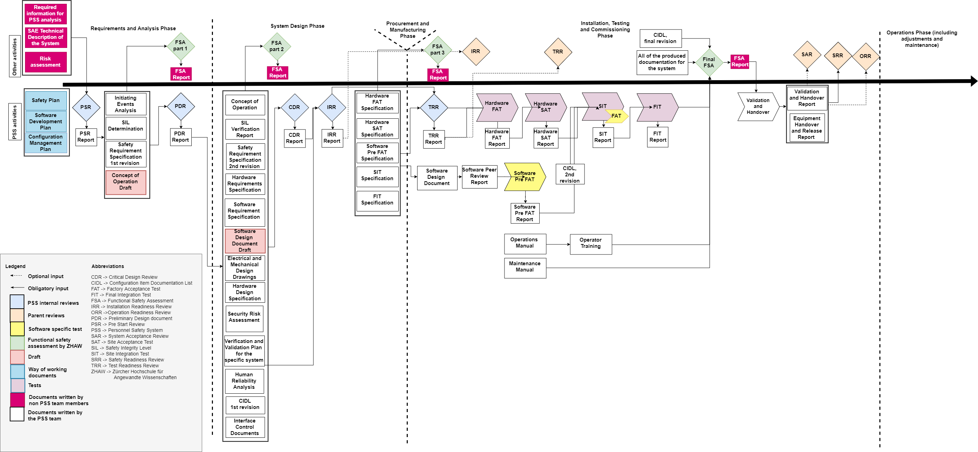
Documentation
2019-08-23
2019-09-18
Planned for
2020-03-13
Performed
prior to any part of
verification/commissioning
PSS1-a
2020-05-31
Performed
prior to any part
of installation
picture courtesy of Paulina Skog [link]

Slide 8
Dependencies
PSS1-a requires:
TSW should be installed before the PSS1 fence downstream the TSW;
RF system (modulator, RF distribution system, RF LPS) for RFQ be installed and energised;
Radiation monitors (x5) installed and energised;
Electrical infrastructure (cable containment) for PSS1 installed;
UPS (nice to have).
PSS1-a is required for:
RFQ RF conditioning;
SRR#2-a; beam to MEBT FC.
PSS1-b requires:
RF system (SSA/modulator, RF distribution system, RF LPS) for MEBT (x3) and DTL 1 be installed and energised.
PSS1-b is required for:
DTL1 RF conditioning;
SRR#2-b; beam to DTL 1.
PSS1-c requires:
RF system (modulator, RF distribution system, RF LPS) for DTL 2,3 and 4 be installed and energised;
PSS1-c is required for:
SRR for beam up to DTL4.

Slide 9
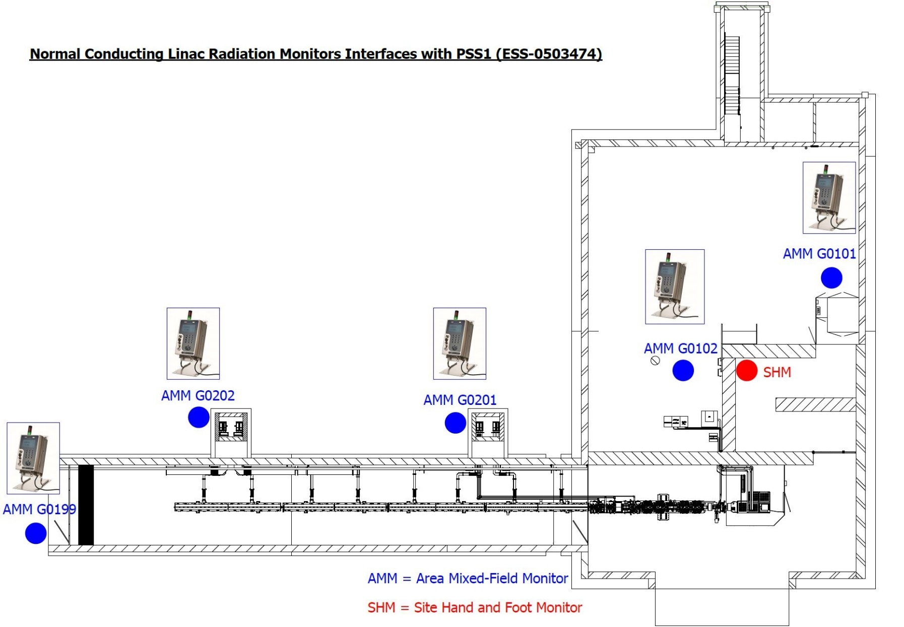
PSS 1 safety interlock system; interfaces with REMS
PSS1 receives two signals from each of these radiation monitors:
High radiation alarm (defining the thresholds is in the responsibility of the RP group)
Radiation monitor fault (the conditions that generate this signal can be configured in the radiation monitor by the RP group.)
PSS1 treats both signals the same way, i.e. upon receiving any of these signals, PSS1 switches off all the SAE.

Slide 10
MPS1

Slide 11
Machine Protection Goals
Enable highly flexible operation of ESS,
Enable & increase proton and neutron beam availability (by preventing and mitigating damage to the machine)
How?
Through the use of:
Interlocks
Data exchange
Through applying a modular design:
Inputs grouped according to equipment type (magnets, vacuum valves, beam current monitors, etc.)
Inputs grouped according to relevance (based on beam destination)

Slide 12
Machine Protection Architecture
Fast Beam Interlock System (FBIS):
collects inputs (RF, Beam Monitoring, Vacuum, etc)
decides if it is safe to operate with beam or not.
interrupts beam operation in case of a fault.
BCM: Beam Current Monitor
BLM: Beam Loss Monitor
nBLM: Neutron BLM
icBLM: Ionisation Chamber – BLM
BPM: Beam Position Monitor
FBIS: Fast Beam Interlock System
FC: Faraday Cup
FSU: Fast Shutdown Unit
Isrc: Ion Source
LPS: Local Protection System
LPSRSM: LPS for Raster Magnets
MPS: Machine Protection System
MPSID: MPS for Insertable Devices
MPSMag: MPS for Magnets
MPSTrg: MPS for Target
MPSVac: MPS for Vacuum
RF: Radio Frequency System

Slide 13
Machine Protection Lifecycle
Test Readiness Review
Operations/ Handover Readiness Review
Developed (FBIS, crates…)
PLC / FBIS (HIL)
Sensors
PLC / FBIS
Sensors
Actuators
Timing
(EPICS)
PLC / FBIS
Sensors
Actuators
Timing
EPICS
FAT
Hardware
SAT
Integrated Systems without Beam
Integrated Systems
with
Beam
Procured (off the shelf)
Local-SIT
SIT
FIT
Production
Software
Development
SST
Safety Readiness Review
FAT: Factory Acceptance Test
SAT: Site Acceptance Test
SIT: Site Integration Test
FIT: Final Integration Test
HIL: Hardware in the Loop
Software Simulation Test using SIMIT (for PLC based systems) and HIL for FBIS.
Independent code review
MP-Readiness Review

Slide 14
Machine Protection for NCL: MPS1
MPS1 is realised in 3 phases:
MPS1-a: ISrc up to and including MEBT FC → 2020-06-22
MPS1-b: ISrc up to and including FC downstream of DTL1 → 2020-10-26
MPS1-c: ISrc up to and including FC downstream DTL4 → 2021-05-10
MPS1a,b,c can be fully validated only with beam.
MPS1a,b,c validation must be done before beam commissioning of other systems can start.

Slide 15
MPS1 Hardware
WP14.5 has to deliver:
Fast Beam Interlock System:
specially developed FPGA based electronics (microTCA based)
collaboration with In-kind Zurich University of Applied Science (ZHAW) and IOxOS
distributed through the facility
fast reaction time (<5 us)
Machine Protection Systems
Siemens PLC based protection systems
Safety CPU and gateway CPU
Distributed I/Os
For MPS1 (NCL):
MPS-Mag (magnets),
MPS-ID (insertable devices),
MPS-Vac (vacuum)

Slide 16
MPS1 Integration Tests - Dependencies
Before allowing for NCL beam operation, the following systems and interfaces need to be tested successfully (integrated testing):
FBIS
MPS PLC systems (3)
Timing System
EPICS
Sensor Systems (vac, mag, IDs, RFLPS, IrSc PLC)
Beam Stop Actuators:
Timing System (TS)
Fast Shutdown Unit (FSU)
Optical switch
HVPS Ion Source
LEBT Chopper
MEBT Chopper
Beam Monitoring Systems
BCM

Slide 17
MPS1 - Overall status
MPS1 analysis, overall design and concepts of operation:
100%
But we decided to execute a major face lift on documentation and presentation of the analysis (ie focus is now on full optimisation/ full traceability of requirements / nothing that would impact the overall schedule).
MPS1 HW:
Electrical and mechanical design for MPS1 PLC based systems: 100%
Electrical design for FBIS installation at ESS site and mechanical design for FBIS: 100%
Electronics design FBIS: 70% (in kind partner responsibility)
MPS1 SW:
PLC based systems SW: 85% (ESS/Lund responsibility)
FBIS firmware (FPGA): 70% (in kind partner responsibility)
FBIS SW (CPU): 20% (shared responsibility between in kind partner and ESS/Lund)
EPICS integration: PLC based systems 85% , FBIS 10% (ESS/Lund responsibility)
MPS1 procurement:
PLC based systems: 100%
FBIS: 70% (in kind partner responsibility)

Slide 18
MPS1 – Documentation Status
Documentation Status:
75% ready
Documentation issues to be solved:
Documents are not yet attached to FBS, but is foreseen to be done before TRR.
Document structure of MP docs may not really be in the proper format to be attached to the FBS (not clear yet what the format should be though either).
All MP related FBS nodes are currently only in a preliminary state.
It is not clear how and when to release the MP FBS nodes.

Slide 19
MPS1- Installation Status
Installation Status:
Electrical interfaces at ESS site have been installed to 90%
HW FBIS at ESS site has been installed to 0%
Installation issues to be solved:
Dependencies on accelerator schedule are clear but not well integrated into detailed plan
‘Big’ milestones exist in P6 and are aligned and checked weekly together with AD.
From infra-project we depend on: final race ways in the tunnel, UPS power,

Slide 20
MPS1 – Testing Status
Testing Status:
FBIS HW and system type tests are done by in kind partners (FAT equivalent)
FBIS HW needs to be re-tested when having arrived at ESS using the HIL (hardware in the loop test stand),
HIL usage is well prepared at ESS site / and ZHAW team will assist in first HIL tests here at ESS
Note: HIL at ZHAW is an exact copy of the HIL at ESS enabling consistent testing
Testing issues to be solved:
Integration test plans are not developed (e.g integration test between FBIS and LEBT Chopper, etc)
Integration tests of MP systems are not properly addressed in the different plans (installation plan and commissioning plans of AD and must be updated asap (ownership of the plan needs to be resolved first)
FIT specifications for FBIS are developed to 0%

Slide 21
Summary
The three PLC based systems that are needed to start commissioning the NCL with beam are well advanced: no severe issues identified.
The Fast Beam Interlock System delivery needs to happen on time but there are several un-resolved issues with the HW and FW-> very challenging schedule for in kind partner. Weekly progress meetings between ESS and ZHAW: this is a risk that is difficult to get under control.
Detailed integrated planning of installation and testing of MP systems together with accelerator and other such as timing system, EPICS, is missing: this is a risk that is currently being addressed and hopefully can be resolved in a short time.

Slide 22
Backup Slides PSS1 Interfaces

Slide 23
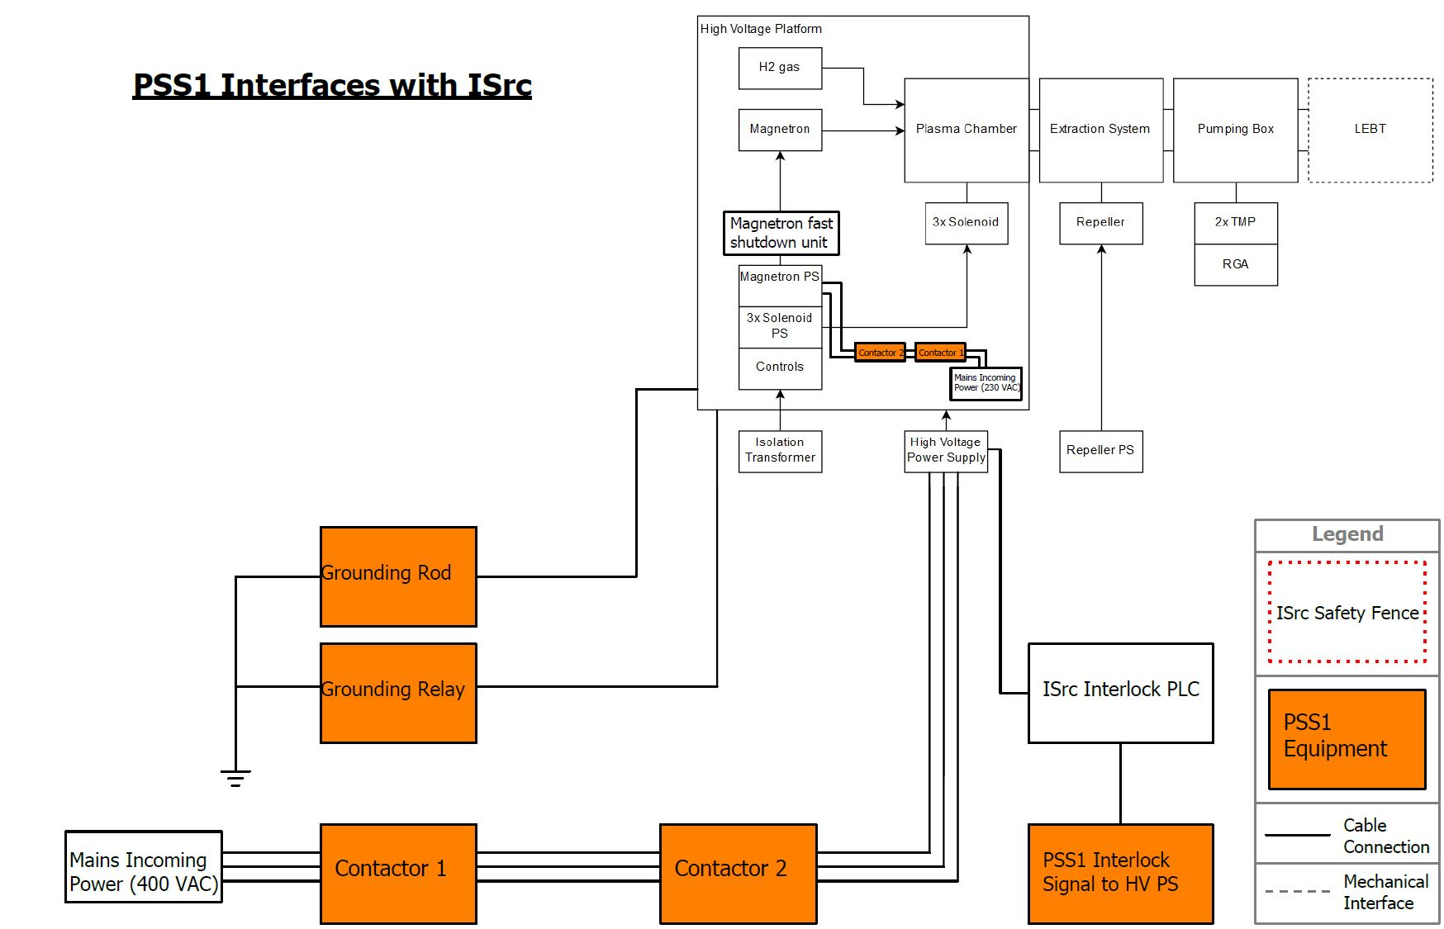
PSS 1 safety interlock system; interfaces with ISrc
PSS1 interfaces with ISrc as below:
ISrc plasma generation (magnetron power supply);
ISrc beam extraction (high voltage power supply);
ISrc high voltage platform (grounding relay).

Slide 24
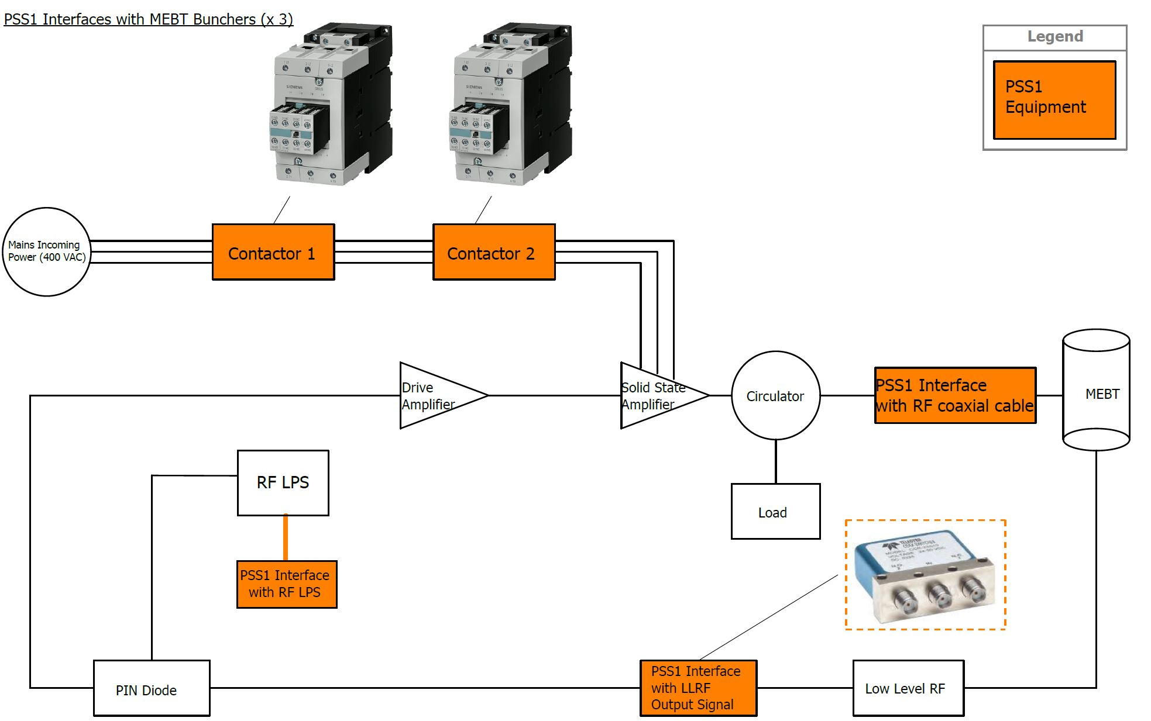
PSS 1 safety interlock system; interfaces with MEBT
PSS1 interfaces with MEBT RF systems as below:
Mains incoming power to Solid State Amplifier;
Output signal from Low Level Radio Frequency (LLRF);
RF distribution system (RF coaxial cable);
RF Local Protection System (LPS) for MEBT.

Slide 25
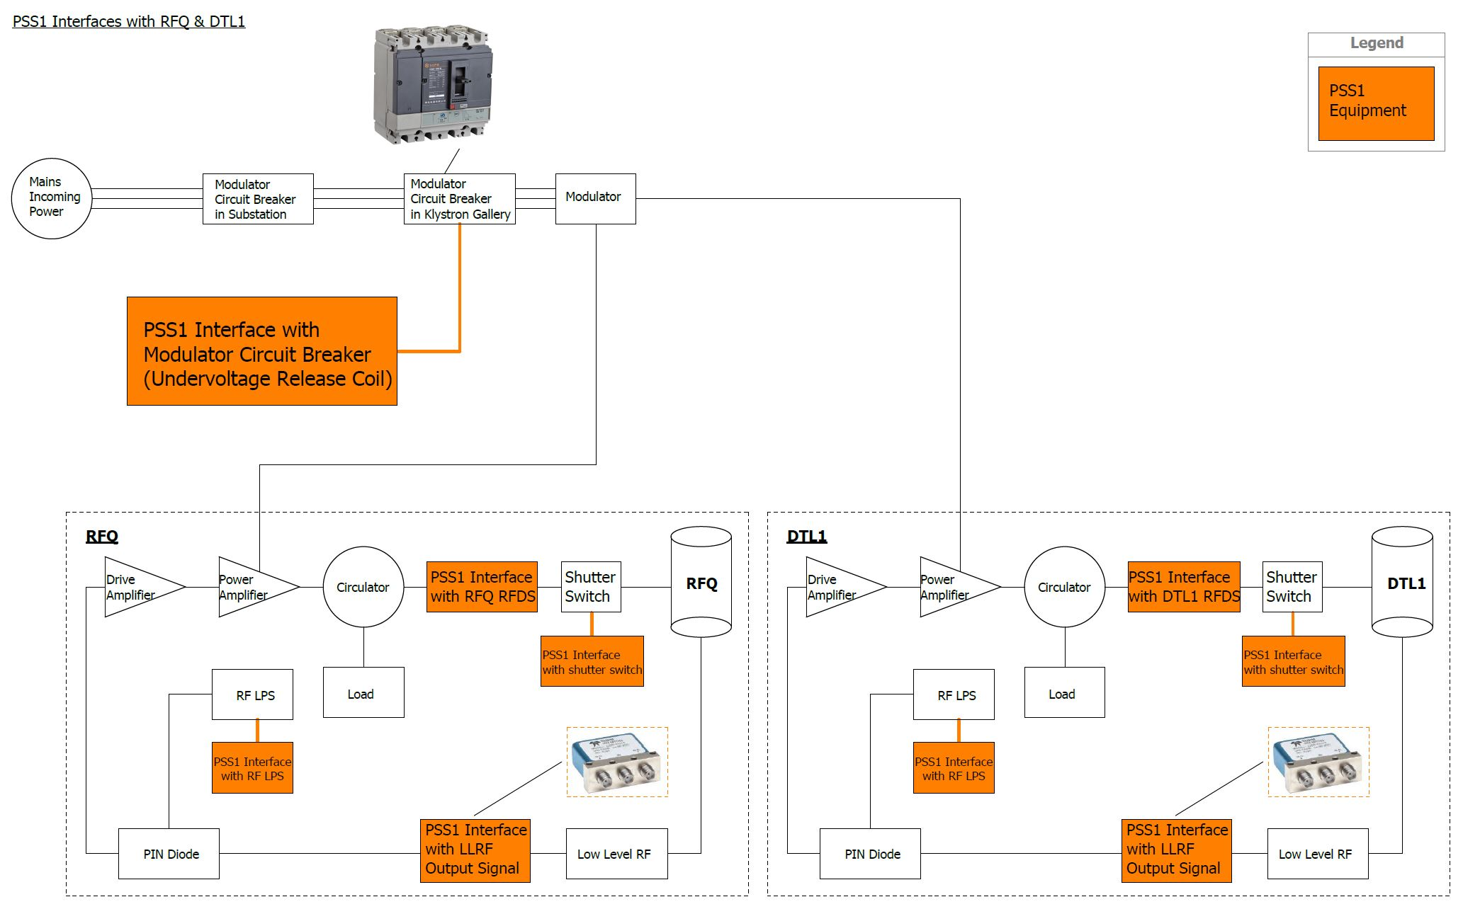
PSS 1 safety interlock system; interfaces with RFQ & DTL1
PSS1 interfaces with RFQ and DTL1 RF systems as below:
Mains incoming power to modulator 1;
Output signal from RFQ and DTL1 LLRF systems;
RF distribution systems for RFQ and DTL1 (RF waveguides);
RF LPS for RFQ and DTL1.

Slide 26
PSS 1 safety interlock system; interfaces with DTL2 & DTL3
PSS1 interfaces with DTL2 and DTL3 RF systems as below:
Mains incoming power to modulator 2;
Output signal from DTL2 and DTL3 LLRF systems;
RF distribution systems for DTL2 and DTL3 (RF waveguides);
RF LPS for DTL2 and DTL3.

Slide 27
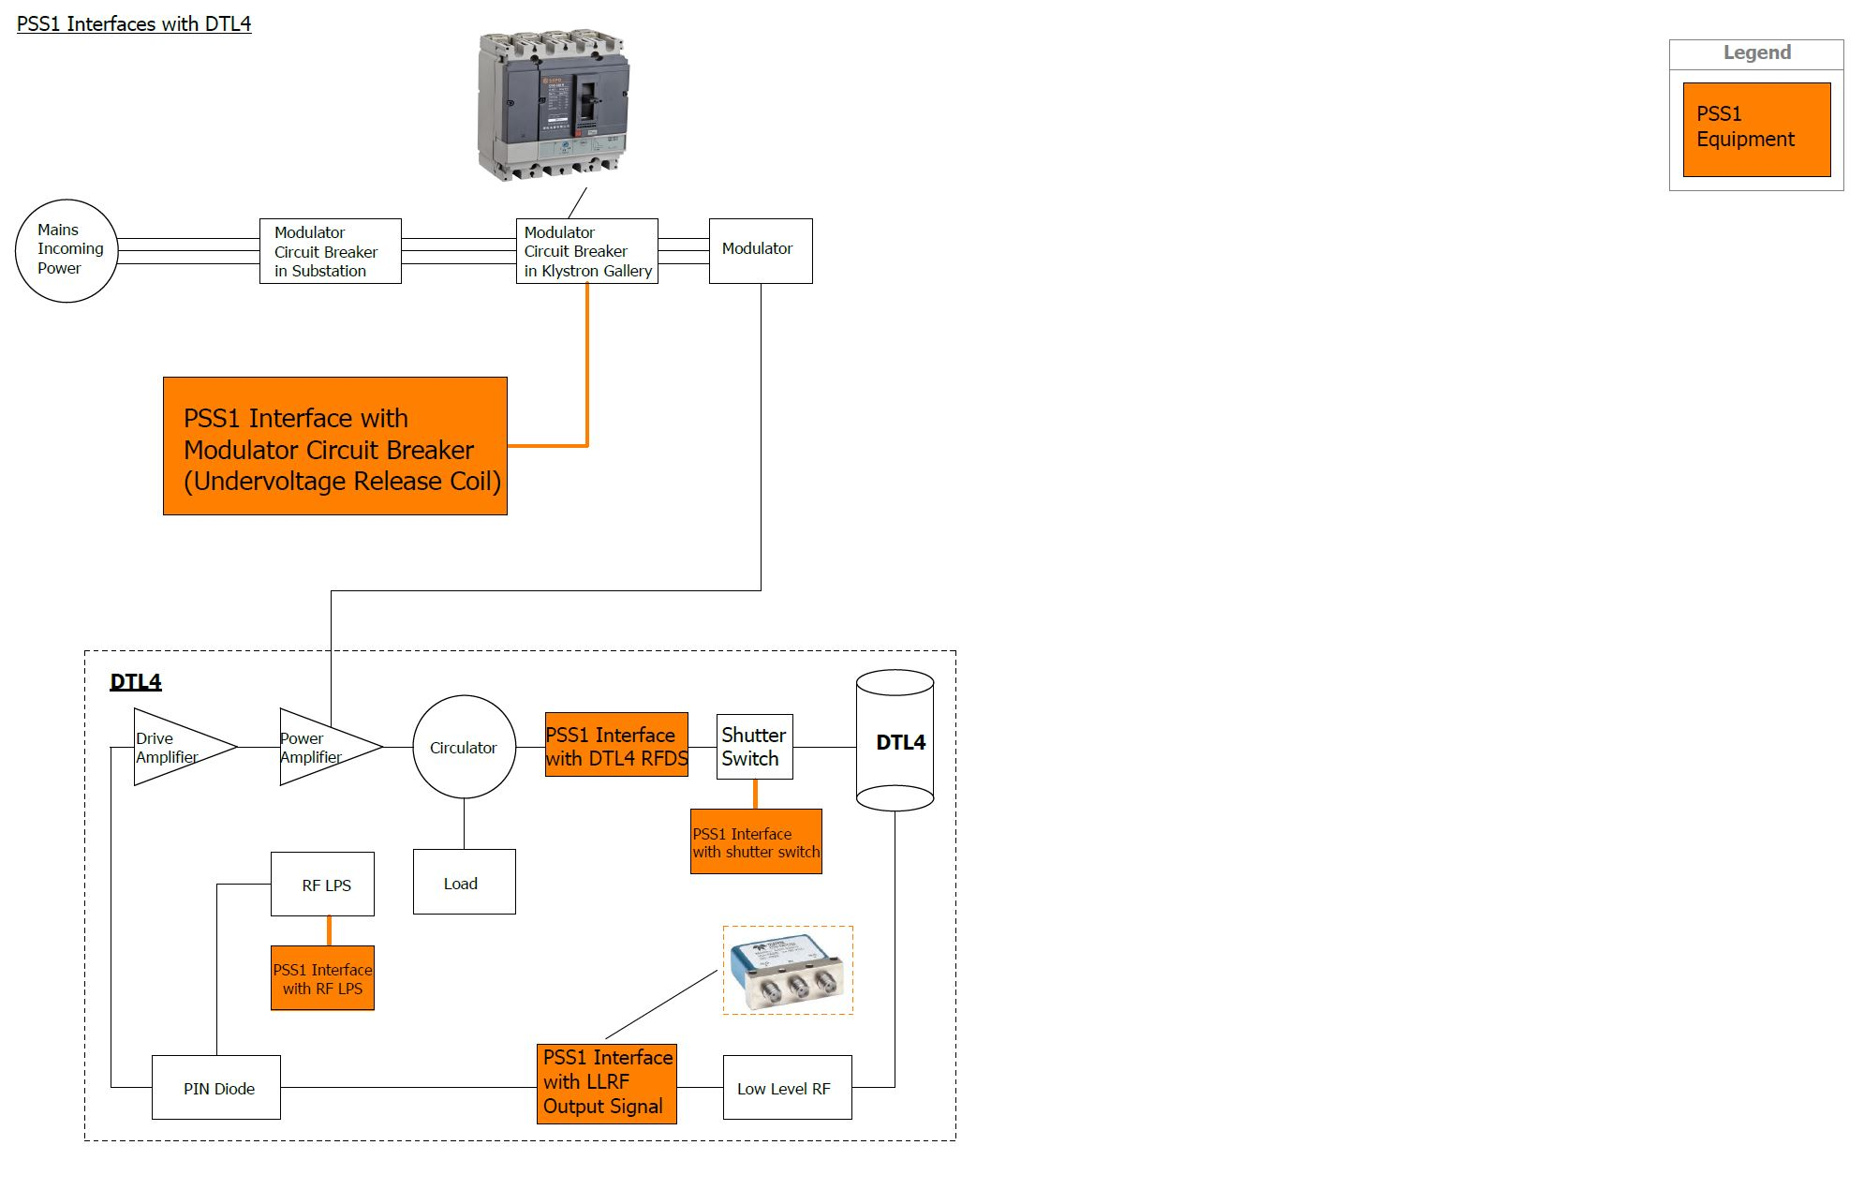
PSS 1 safety interlock system; interfaces with DTL4
PSS1 interfaces with DTL4 RF system as below:
Mains incoming power to modulator 3;
Output signal from DTL4 LLRF system;
RF distribution system for DTL4 (RF waveguide);
RF LPS for DTL4.

