Slide 1
Timing Distribution - NCL
Jerzy Jamroz
Embedded Systems Engineer
Integrated Control System Division
2020-01-30
1

Slide 2
Outline
Installation
Deployment
Validation
Supercycle
Workflow
Conclusions
2

Slide 3
Installation
3

Slide 4
Installation
Timing Distribution (TD) Eplan Drawings
NCL: mid 202002
FBS
Status: released
ESS/Epics names
Status: released
TD-M (Master)
EAM asset codes
Status: subscribed for each card.
Installation
Status: mid 202002 in MBL-070ROW:CNPW-U-017
RF Front End Integration Tests: SAT and SIT
TD-D2X where X belongs to NCL: ESS-1404467
March, April, May 2020
4

Slide 5
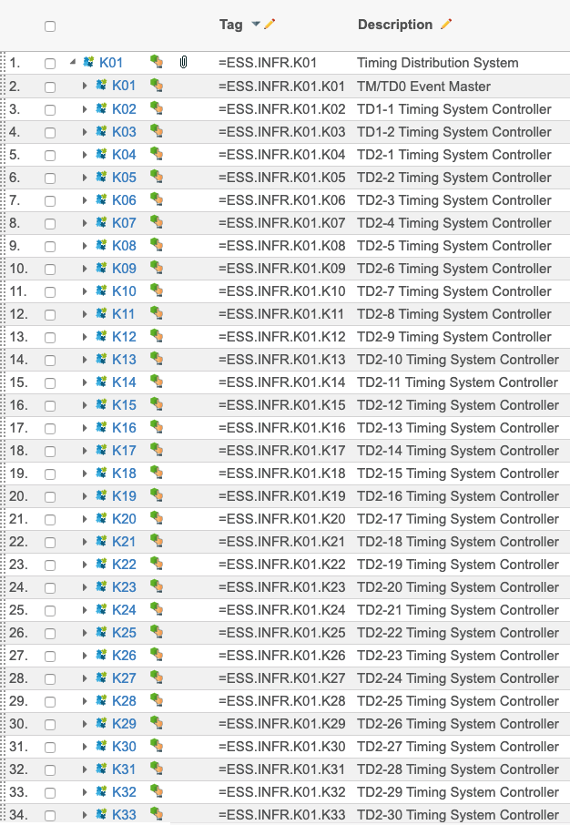
Installation – FBS (Chess)
5

Slide 6
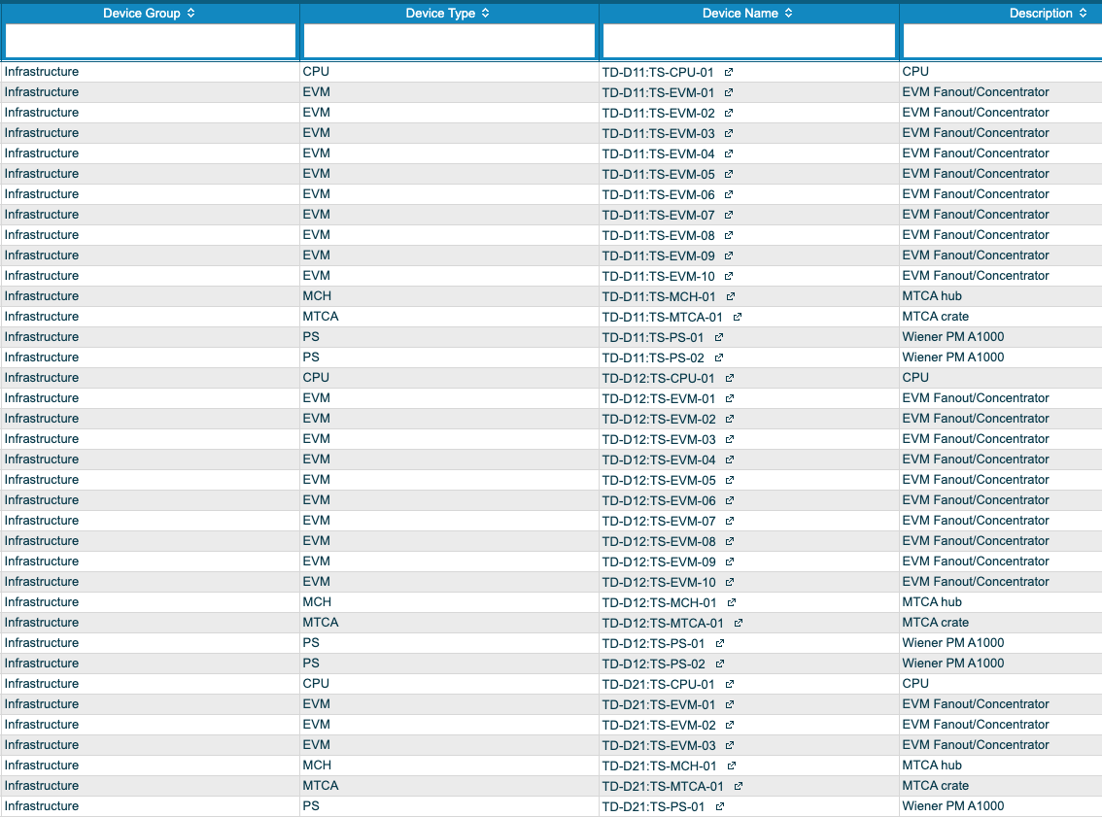
Installation – Epics Names
6

Slide 7
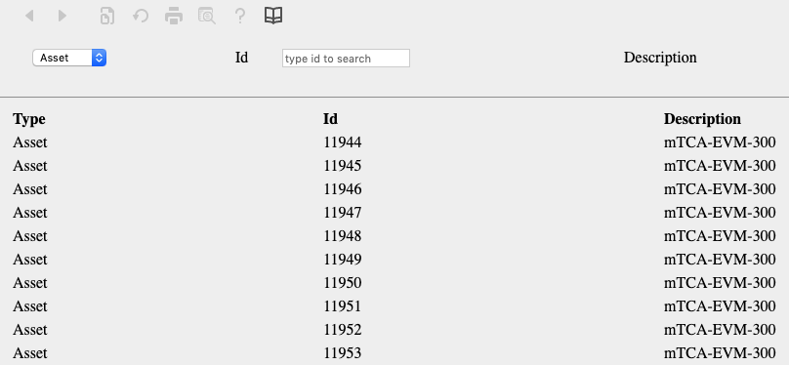
Installation – EAM
7

Slide 8
Deployment
8

Slide 9
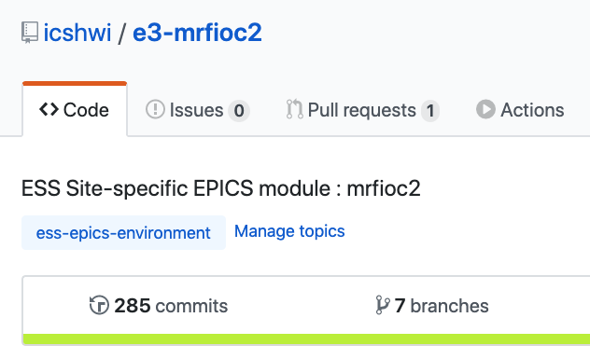
Deployment - IOC
TD-M
NFS Mount
# Maintenance
epicsEnvSet("LOCATION","MBL-070ROW:CNPW-U-017") # Location
epicsEnvSet("FBS","=ESS.INFR.K01.K01") # The parent node of AS
# Naming: AS:DS-ID
epicsEnvSet("AS", "TD-M") # Area Structure
# SCE IOC
epicsEnvSet("DSSCE", "TS-SCE") # Device Structure SCE
epicsEnvSet("PSCE01", "$(AS):$(DSSCE)-01:") # Prefix of the SCE 01
# EVG IOC
epicsEnvSet("DSEVG", "TS-EVG") # Device Structure EVG
epicsEnvSet("PEVG01", "$(AS):$(DSEVG)-01:") # Prefix of the EVG 01
Under revision
9

Slide 10
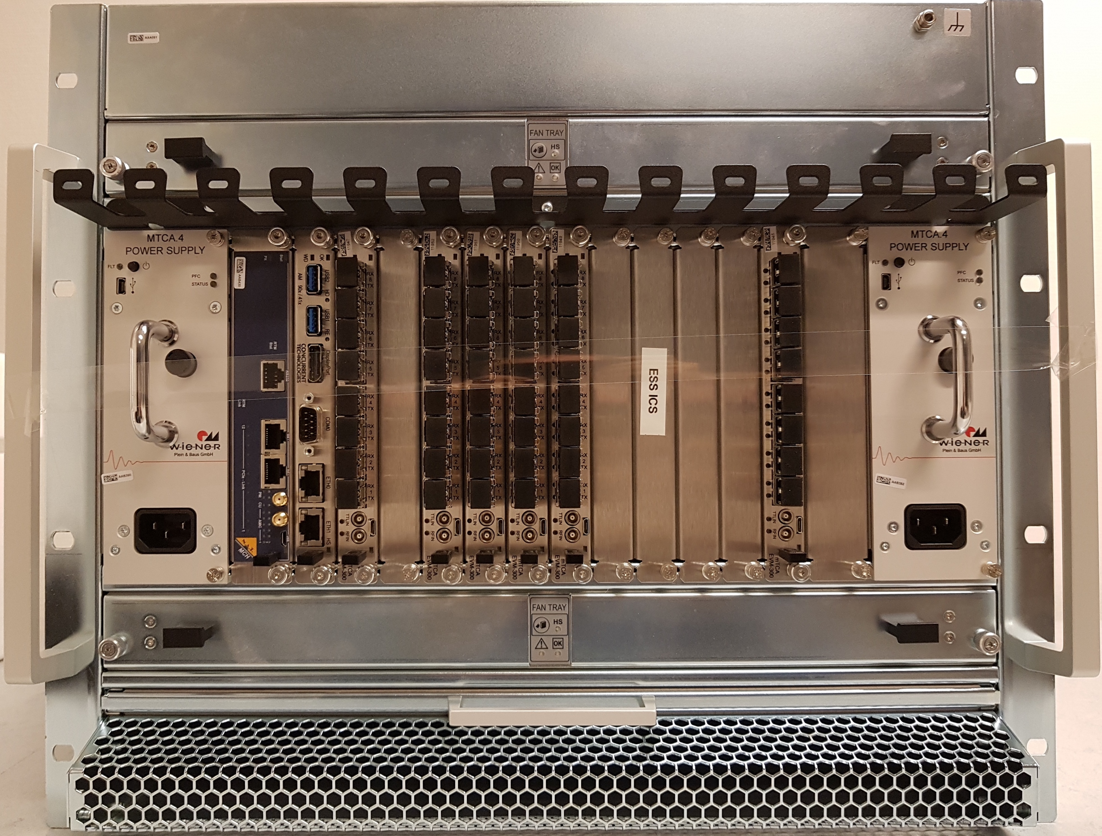
Deployment - Hardware
TD-M
Ready
10

Slide 11
Validation
11

Slide 12
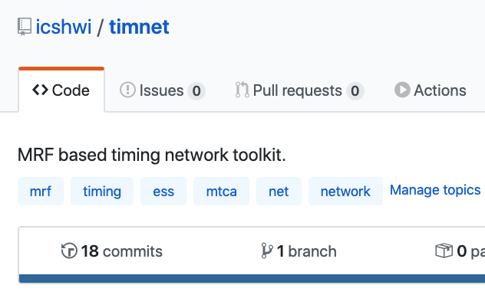
Validation - TD
“timnet” App (Alpha Release)
To expose the timing network topology, parameters and states
Background for an eventual timing network GUI development
Maintenance checks after changes or shutdowns
SAT and SIT purposes
Timing network monitoring
12

Slide 13
Validation - Electronics
“timtest” App (Not Finished)
Stress tests – One week.
Firmware
Image
Status: backlog
State definition for the global ESS state grid
Status: backlog
Plenty of manual tests were done up to now
Under development
13

Slide 14
Supecycle
14

Slide 15
Supercycle
The supercycle performs:
Master Event Sequence Distribution
ION_ST, ION_END, BPULSE_ST, BPULSE_END, 14HZ(always), BPULSE_CM
Data Buffer Distribution
IdCycle, PBCfg, PBDest, PBMod, PBLen, PBEn, PBCurr, TgRast, TgSeg
Specification
Operating frequency: one linac cycle (14 Hz)
Sequential execution
Config
Config
Outlook
EVG
FW
SCE
Logic
User
Interface
15

Slide 16
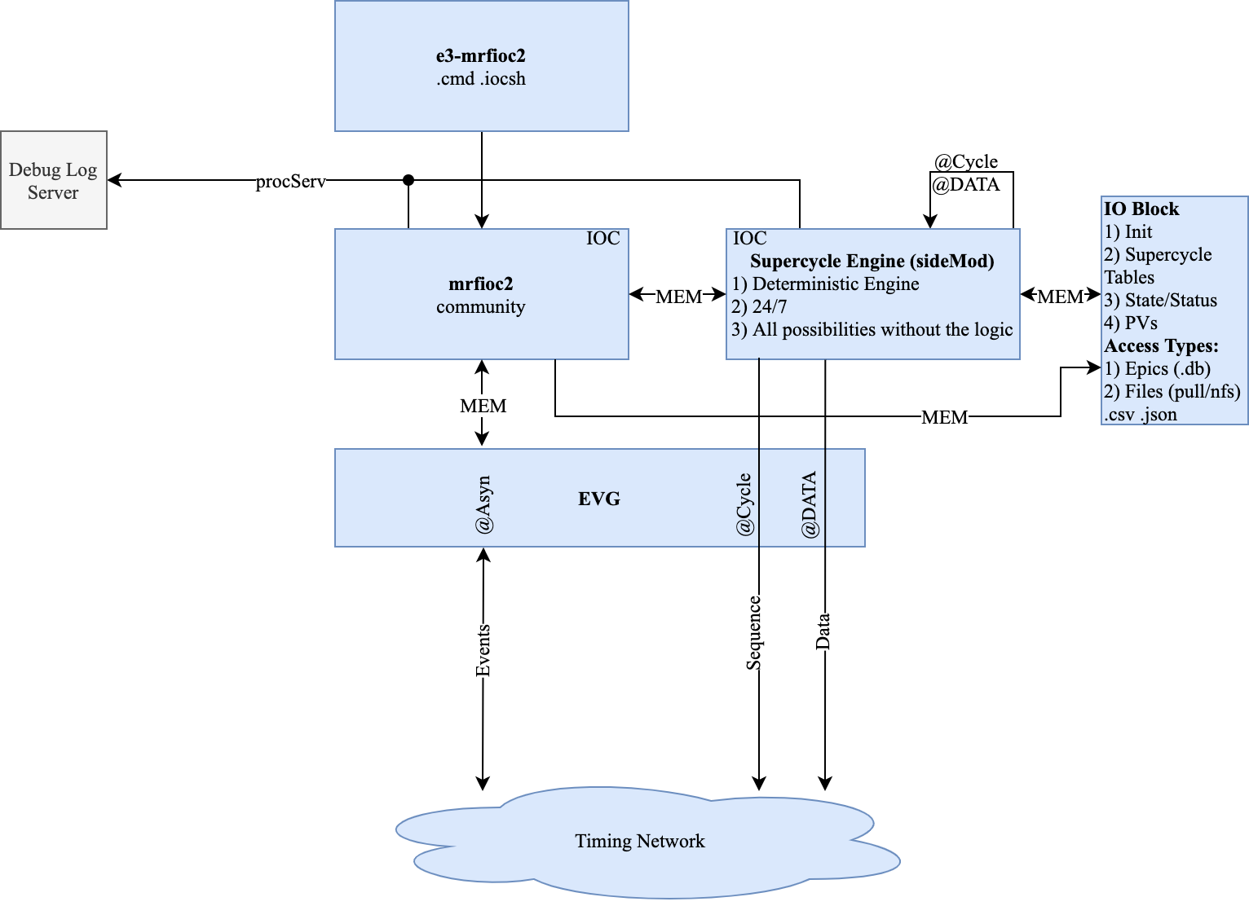
Supercycle Engine (TD-M)
16

Slide 17
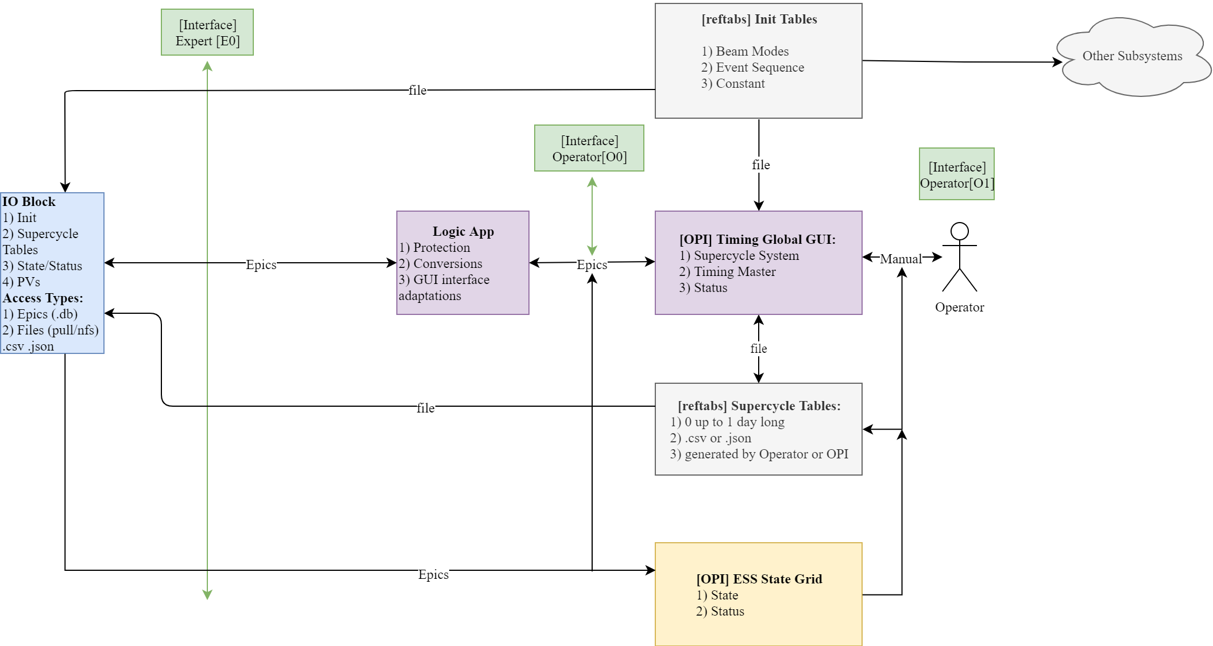
Supercycle Front End - Outlook
17

Slide 18
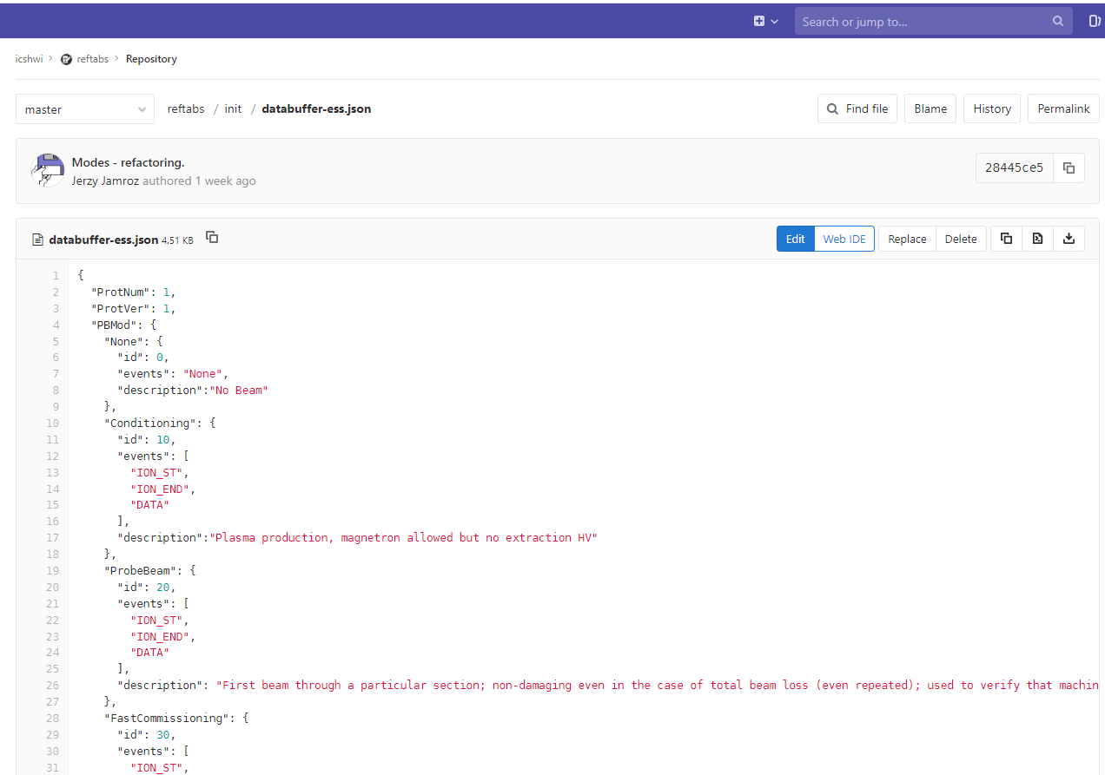
Init (Global)
18

Slide 19
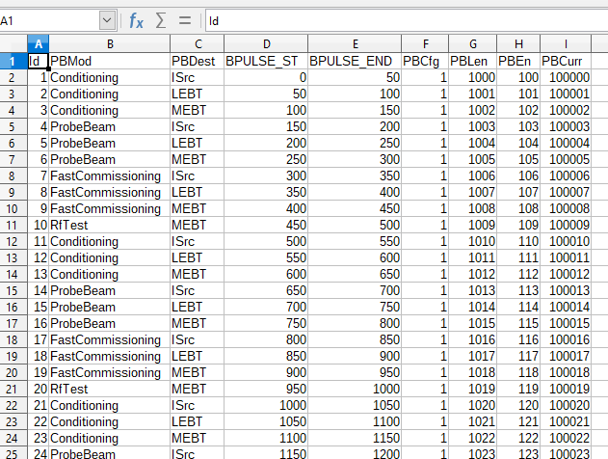
SCTable Example
19

Slide 20
Workflow
20

Slide 21
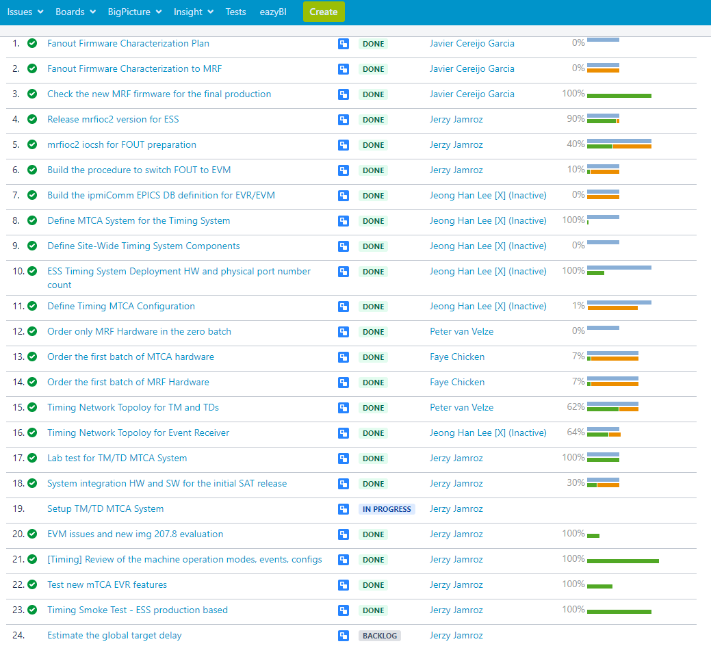
Jira – Mainly ICSHWI-1686
21

Slide 22
Conclusions
22

Slide 23
Conclusions
The installation is the main concern at the moment.
NCL part will validate the workflow and tools.
The supercycle engine will accept any input data (expert access) to the timing system – operators will have the full freedom.
The commisioning experience will be a base for the supercycle front end development (logic and GUI).
„reftabs” repository will serve the settings for other subsystems as well.
23

