Slide 1
Data Management
Test and Commissioning Workshop
Natalia Milas and Clement Derrez

Slide 2
Summary
Types of data:
Calibration, Verification and Commissioning/Conditioning data
Data storage and retrieval
Main Issues
Requirements for the data outside the archiver
Data Flow Example
Current Situation and File Struture
Next steps

Slide 3
Types of data
Calibration, Verification and Commissioning/Conditioning data
Calibration data:
Data from In-kind partners
Measured data from instruments or elements of the machine (connected to an asset_id)
Verification data:
Data measured during acceptance tests, at the in kind or during testes in the tunnel
Data acquired with or without beam (not necessarily at ESS)
Connected to and asset_id (specific equipment) and also a shift_id
Data type:
All kinds of file formats and extensions
Need some kind of connection (cross-reference) to FBS. EAM, etc..
Calibration database -> takes care of some data (partially)
EAM
Labels
System FRUs list
Tests report
Test plan
Laboratory devices
FBS, LBS
Data

Slide 4
Types of data
Calibration, Verification and Commissioning/Conditioning data
Conditioning data:
Measured data from instruments or elements of the machine (connected to an asset_id) and also to a shift_id
Data takes at ESS (more likely)
Usually long time series collection. For example: RF conditioning
Commissioning data:
Data measured during tests, scans or specific measurements in the machine
With beam (most cases)
Not connected to one instrument or equipment in particular
Requires a type (measurement or technique used) and a shift_id identifier

Slide 5
Types of data
Very hard to find out what was the measurement for
even when searching at the logbook
Data Storage and retrieval
Archiver - default solution
Good solution for many cases
Works perfectly fine for scalars and compact arrays
Goodness of data stored depends on how the EPICS channel logged is configured (work in progress)
Data is saved in a non-synchronous fashion
What to do when your needs fall outside those boundaries?
NextCloud (commissioning data and diagnostics data) or other storage solution
Mainly hdf5 but no specific formatting
Relies on the person performing the measurement to store the data in the correct file/folder
??
No metadata except for which
EPICS channels are stored

Slide 6
Main Issues
Decentralized system makes it harder to create solutions that cover many cases: tailored solutions to each specific case demands time and man-power.
A lot of the data has to be reformatted once it arrives at ESS
Even if a lot of stakeholders transforming theirs files to HDF5 the variations are still large across groups/sections
Files have no traceability and no further connections to other systems at ESS (FBS, EAM, etc….)
Questions:
How do we want to organize data?
How and where do we store it?
How to guarantee data traceability?

Slide 7
Requirements for the data beyond the archiver
Wishlist
A predefined format for the data files that fit all users (stakeholders) at ESS
A place to store those files (server)
A way to search some of the file metadata (coming from the pre-defined structure)
File structure enforced at ESS: HDF5
-> Using Nexus of top of HDF5
INFRA group (ICS) is taking care of this part
Calibration data service (also ICS)
Discussions ongoing with DMSC

Slide 8
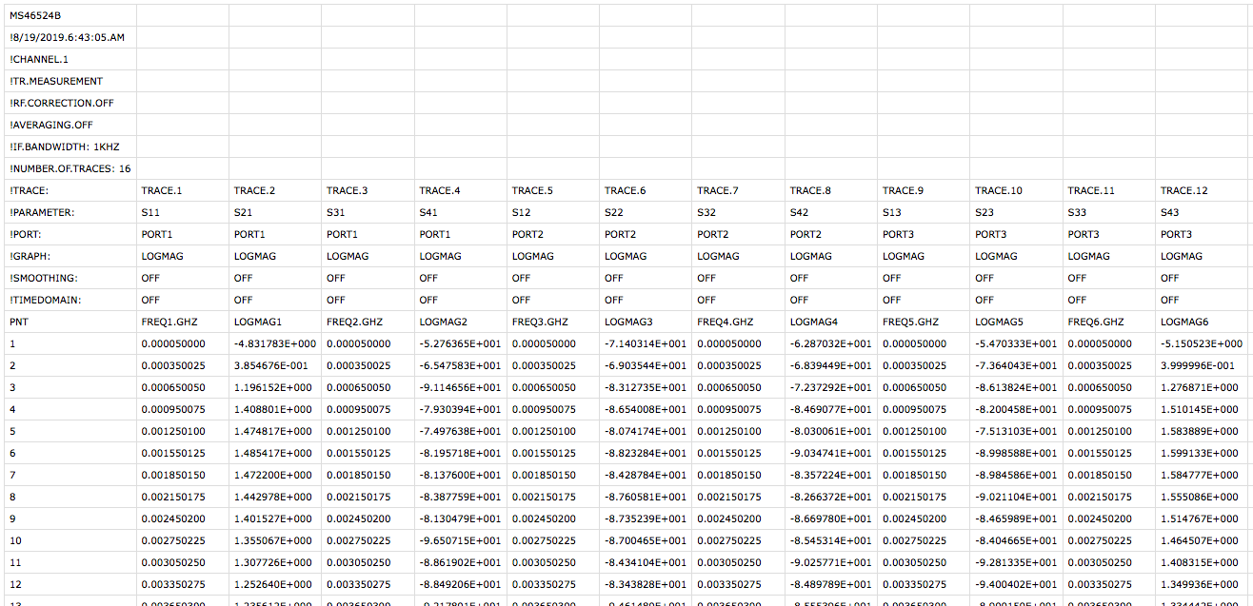
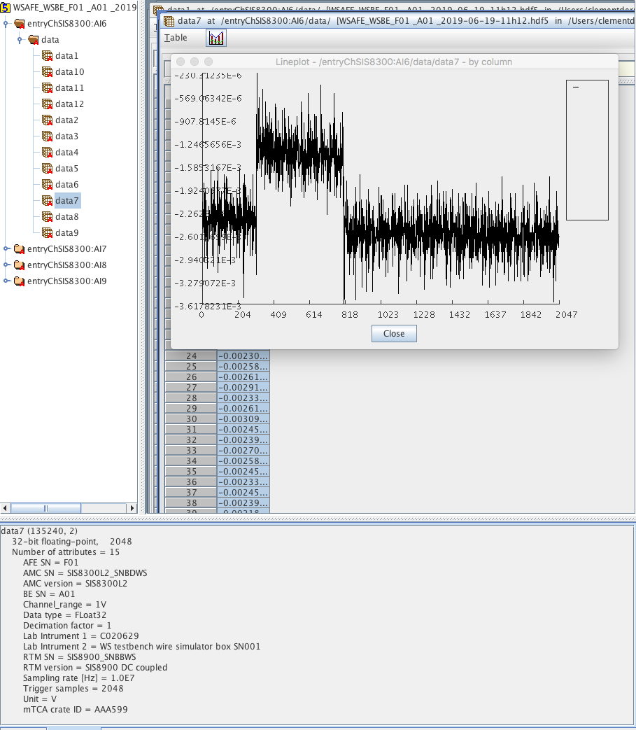
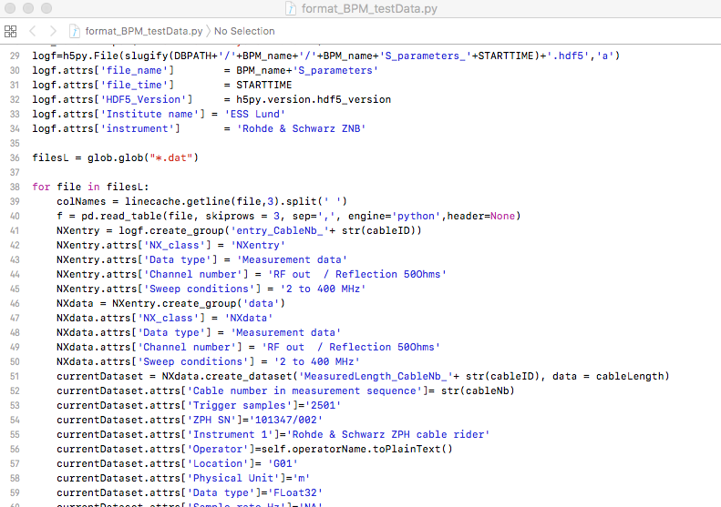
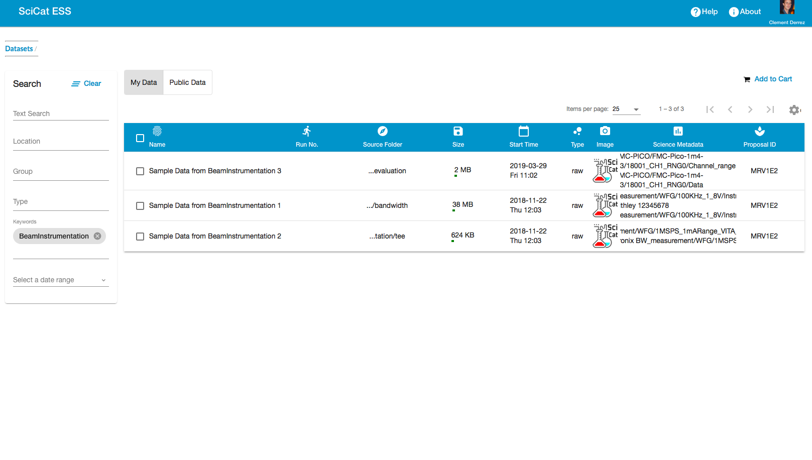
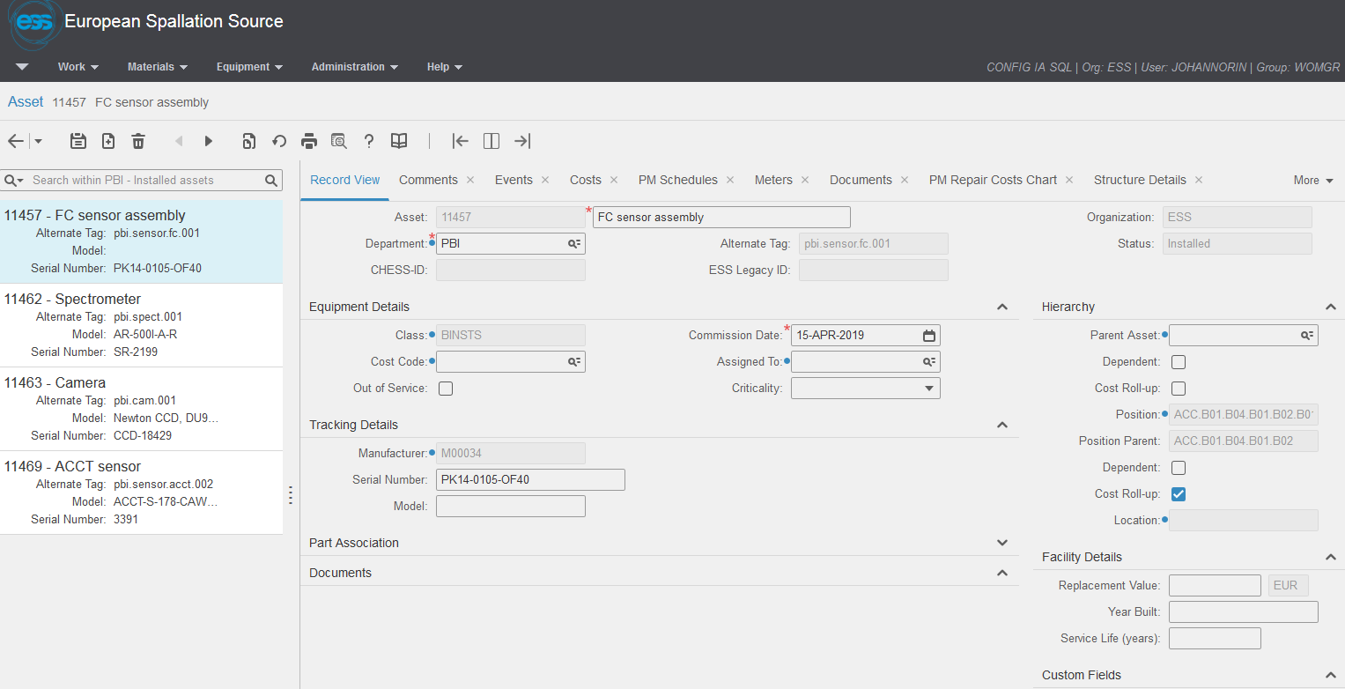
Data Flow
Data source
Data source
ESS User
Data flow
Ext. ESS
In. ESS
Assets management
Expert User
Deployed system
Reformatting to ESS neXus
EAM
QR Scanning tool
ESS User
Calibration database
Meas01
SciCat
Embedded HDF viewer
Data storage
Cataloguing

Slide 9
Current Situation
https://confluence.esss.lu.se/display/BIG/Data+format+proposal
We have been working on a data formatting proposal for ESS:
Use the Nexus structure with minimal changes (for now)
Format that can hold files for many different groups and for many different needs
Define which metadata is important and should be available for searches
Working closely with other people:
LINAC (Alex, Daniel and Rihua)
RF (Rihua, Paolo, Cecilia and Anirban)
Diagnostics (Clement)
Beam Physics (Natalia)
ICS Software (Jan-Ake)
Post-mortem and Data-on-demand (Ricardo)
DMSC (Tobias and Gareth)

Slide 10
Current Situation: File Structure
https://confluence.esss.lu.se/display/BIG/Data+format+proposal
NxEntry: timestamp for start/end of measurement/calibration, asset id, shift id and type
NXUser: name, role affiliation and inkind_id
NXInstrument: here is wehre the description of the equipment used in the measurement comes
NXsource: collection of beam parameters
NXradio_frequency, NXlinac_element, NXbeam_instrumentation, NXmagent and NXlab_instrument
NXData and/or NXLog (for time series)
NXNote: additional notes about the measurement/calibration or verification
NXParameters: process parameters used for data conversion etc.

Slide 11
Next Steps
Long term:
Continue to work together with DMSC to get the cataloguing solution working for all our file. Polish the file formatting and try to enforce its use at ESS (everybody wins)
Short and long term
Final touches on the format still needed and a second round of checks on the new Nexus Classes.
Send new classes and some test files (coming from BI) to DMSC to start the tests with the cataloguing
Probably a few more iterations with DMSC will be needed until we have a system that could be fully tested. But we hope to have it ready for the next commissioning phase
Write a python class for saving those Nexus files according to the defined format.
Agree/Refine the file format
Define and refined NexusClasses
Develop an API for file saving
Created test files
Scan and test solution in Scicat

Slide 12
Thank you!
Questions?

