Slide 1
Automatized RF Conditioning Application
Emmanouil Trachanas
Electrical and Computer Engineer
European Spallation Source
Emmanouil.Trachanas@esss.se
Thomas Fay
Control Systems Engineer
European Spallation Source
thomas.fay@esss.se
Lund, Sweden – January 2020

Slide 2
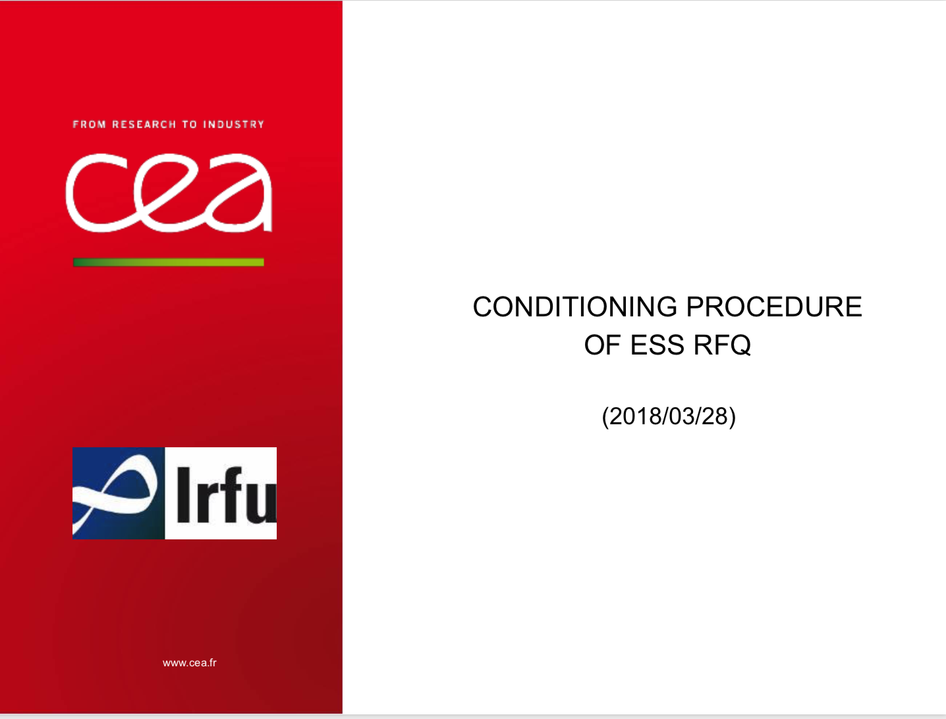
Scope of the project
”Create a EPICS/IOC application implementing the algorithm for the automatized RF conditioning procedures of NCL cavities ”
Grateful to Alexis Gaget
and other colleagues for the
base code and assistance during
integration
Text here

Slide 3
Application Characteristics
Algorithm Implemented on SNL
Code integration and Modification
EPICS modules provided by CEA
OPI created on BOY editor of CS studio
One centralized menu with 2 tabs
Configurable Cycle
Threshold Input
Work with Interlock IOC
Generalized module for flexibility
The application sets the klystron power and its parameters and reads PVs as response and clasifies possible errors with severity (Minor-Major-Critical)
Depending on the fault, power stays the same or decreases. In case of critical fault RF LPS shuts power down until fault is corrected.

Slide 4
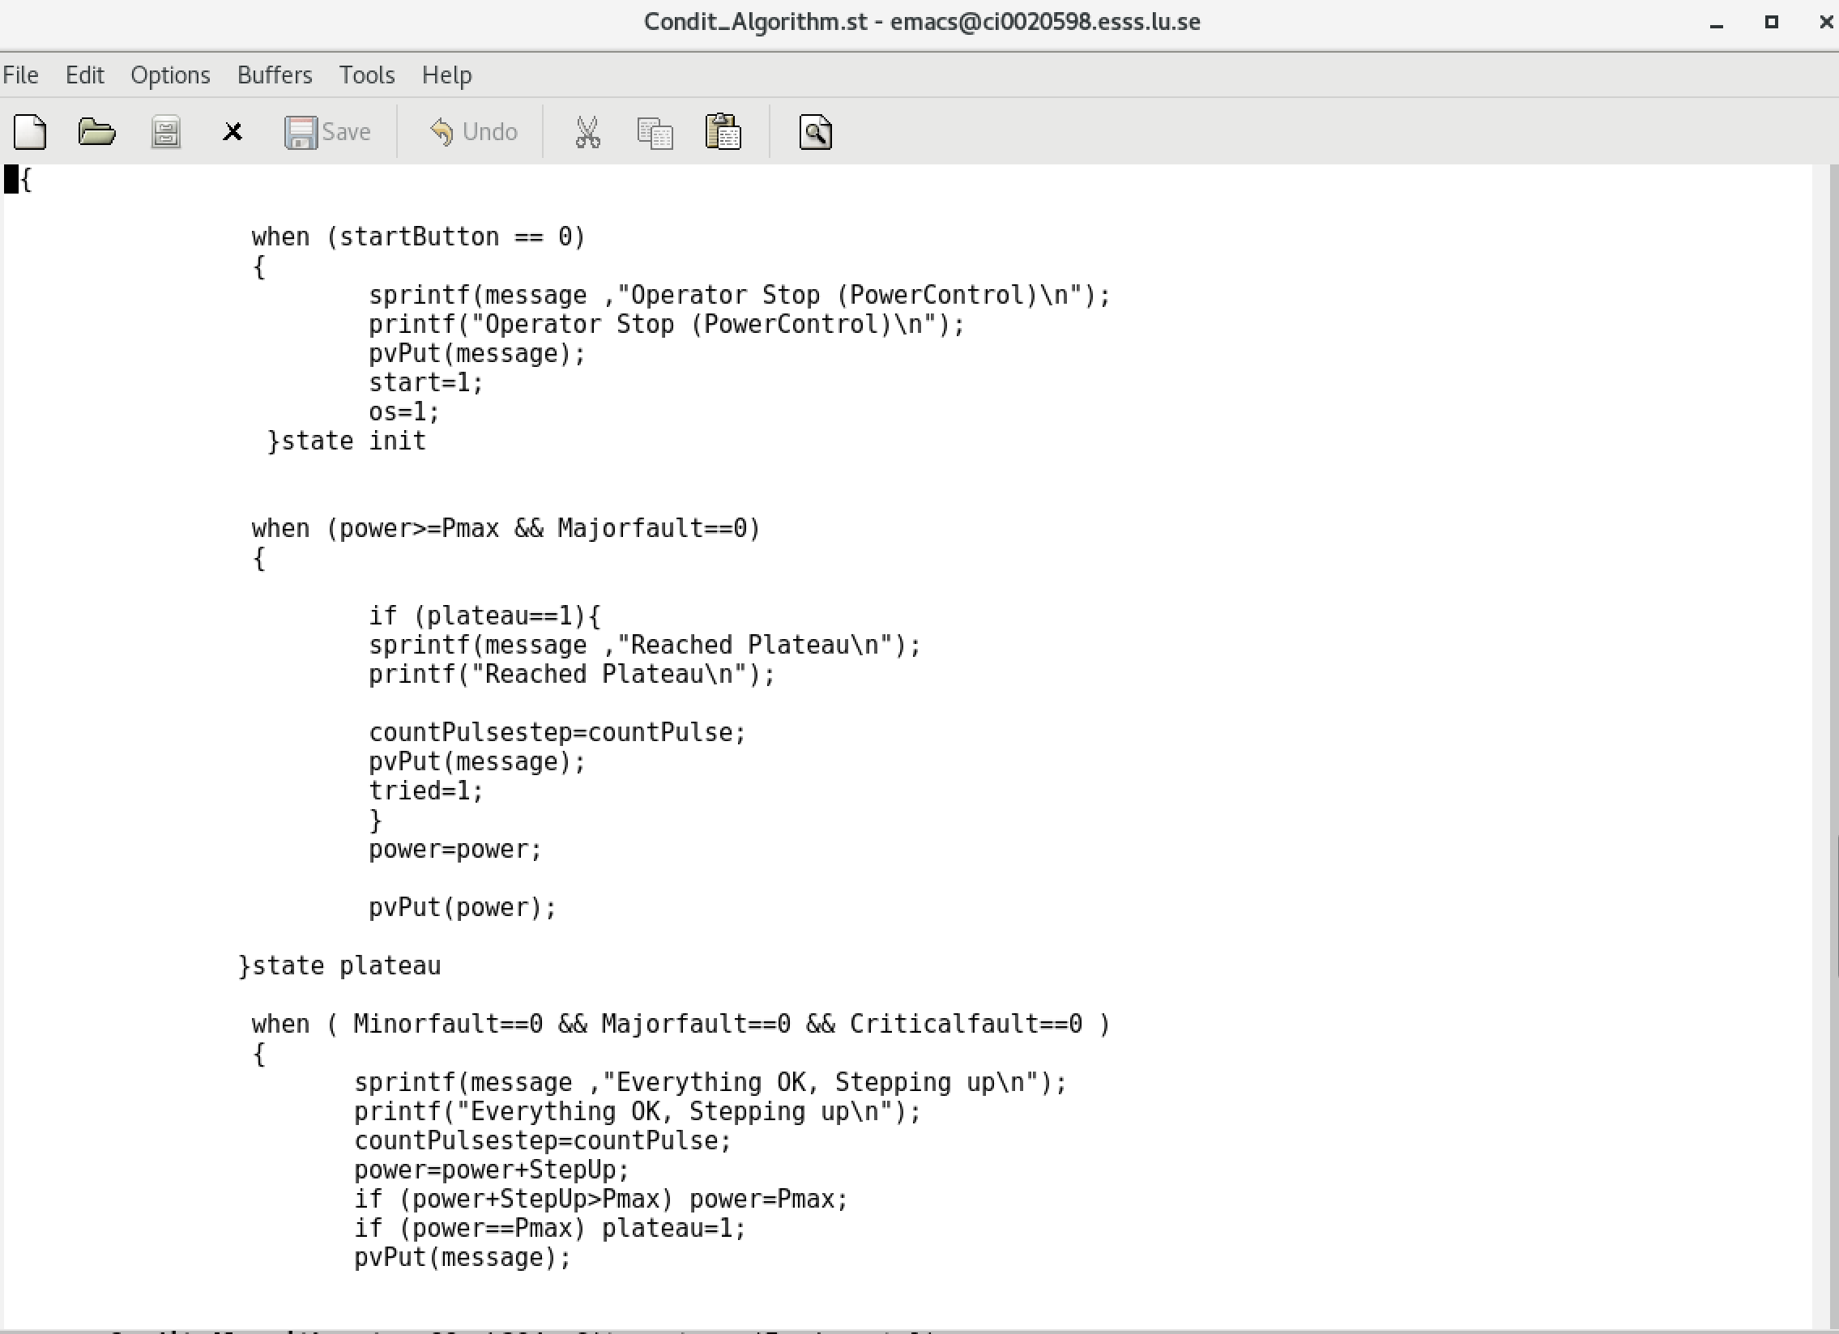
IOC Architecture
.db file
System – Software interface
snl Algorithm
PVs
Critical Fault
Vacuum
Thermocouples
Elctron Pick-Ups
Arc-Detectors
RF -bi-directional Couplers
Pick Ups
Major Fault
Minor Fault
Power to Klystron

Slide 5
Conditioning Method
We define the pulse width vector W= [w_{min} ,w₂, w₃, ..... w_{max} ] .Each w_{i} constitutes a cycle and a power vector P= [P_{min} , P₂, P₃ .... P_{max} ] is assigned to each cycle. Each value of the power vector is assigned to the klystron (for a number of pulses ) and the readback of vacuum and RF interlocks is checked . Depending if there is an interlock or not power is set accordingly.
Before reaching the next cycle P_{max} is assigned for a given amount of time (plateau)
RF Control System
$$\left[\begin{matrix}W_{min} \\ W_{2} \\ \begin{aligned}W_{3} \\ . \\ . \\ . \\ W_{max}\end{aligned}\end{matrix}\right]$$
$$\left[\begin{matrix}P_{min}→ & P_{2}→ & P_{3}→ & ⋯→ & P_{max}\end{matrix}\right]$$
$$\left[\begin{matrix}P_{min}→ & P_{2}→ & P_{3}→ & ⋯→ & P_{max}\end{matrix}\right]$$
$$\left[\begin{matrix}P_{min}→ & P_{2}→ & P_{3}→ & ⋯→ & P_{max}\end{matrix}\right]$$
Vacuum Control System
$$\left[\begin{matrix}P_{min}→ & P_{2}→ & P_{3}→ & ⋯→ & P_{max}\end{matrix}\right]$$

Slide 6
Algorithm Flowchart

Slide 7
Example
Major fault
Vacuum level passed 2st threshold
- Power Decreases
Critical fault
-(readback from temperature sensors) RF System Shuts of the RF power
vacuum
Hard Threshold (upper)
(RF is shut down)
Hard Threshold (lower)
(RF shutdown limit)
Soft Threshold (upper)
(Power Decreases)
Soft Threshold (down)
(Power Stable)
Minor fault
Vacuum level passed 1st threshold
- Power kept on same level.
Power
Power Floor
Time

Slide 8
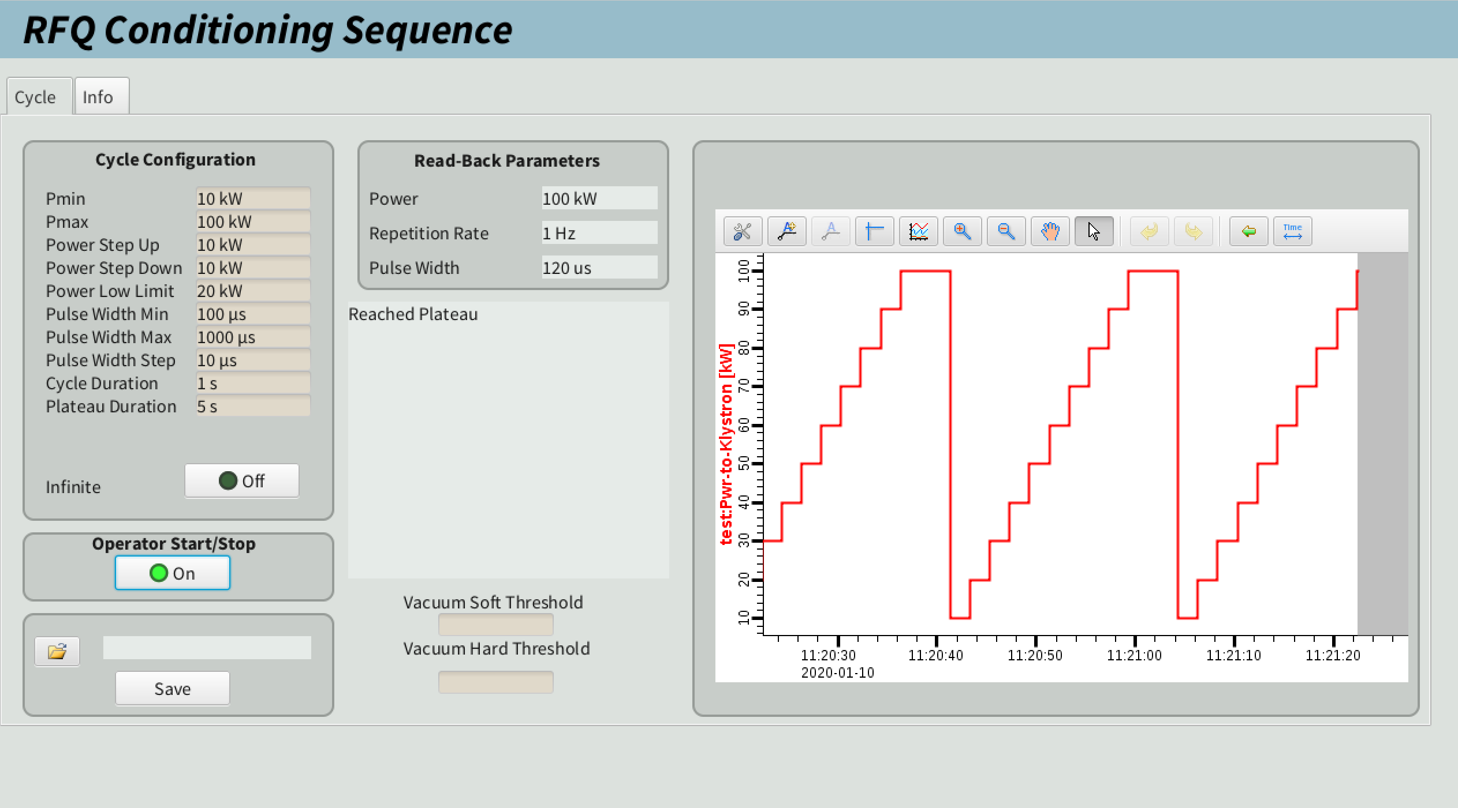
Application Menu (1/3)
Read-out Klystron Power
Temperature and vacuum
Signal Interlock,
RF power configuration
Plots
Execution
Save a Screenshot
8

Slide 9
Application Menu (2/2)

Slide 10
Testing EPICS module
Testing OPI running
in parallel with Conditioning application
for local testing
Simulates an RF pulse and injects
faults

Slide 11
Status And Future Steps
Design of OPI -DONE
Algorithm Integrated
Set-up mock up functional environment.
Local Tests for algorithm verification
Manual and Documentation On going
Integrated Tests (Test stand 2 as a first step)
List of PVs from Control Systems
Creation of Generic module
Milestone I
Milestone II
Milestone III

Slide 12
Back Up Slide

