Slide 1
RFQ Controls Status
Philippe Rabis
Slides by Thomas Fay

Slide 2
Introduction
I think ICS has some room for improvement in communication of system statuses to stakeholders, hopefully this helps somewhat.
This time slot won't give sufficient duration for many details.
Intention here is mostly to provide a rapid-fire overview.
Several internal ICS projects need to reach "usable" maturity for RFQ commissioning (Calibration Service, Critical PV access authorisation, IOC deployment).

Slide 3
RFQ Sub-Systems
RF: LLRF, LPS, Auxiliary systems (pin-diode, electron pickup, etc.)
Cavity: Water Cooling + Local Protection System.
Vacuum Controls.
High-level Controls: RF Pickup calibration, RF conditioning, etc.
Beam Instrumentation: no beam instrumentation.
Software services: calibration, critical PV access authorisation, etc.
G02 (Gallery)
FEB100
MPS
Modulator
Electronics
Water-cooling skid
RF
RF LPS
Klystron
LLRF
FEB90
RFDS
PSS
G01 (Tunnel)
Water-cooling manifold & instrumentation
RFQ cavity
RF power couplers
Vacuum gate valves
ACCT
ISRC
RF pick-ups
Vacuum gauges
LEBT chopper
Tuners
Vacuum pumps
MEBT chopper

Slide 4
Status: RF LPS - Fast Interlock Module
Description: Fast (< 10µs) local protection of accelerator cavities from RF induced damage.
Interfaces: Vacuum, Arc Detectors, RF Pickups
HW: MTCA based, IOxOS IFC1410 + 2 FMCs (ADC3117 & DIO3118)
Software: ~85% of required functionality present in IOC.
Pending Dependencies:
Rack power and interface cables from Interface Project
Remaining work: > 2 weeks.

Slide 5
Status: RF LPS - Slow Interlock Module
Description: Slow (<100 ms) local protection of accelerator cavities from RF induced damage.
Interfaces: Cavity LPS, Klystron
Hardware: PLC-based, procurement complete.
Dependencies:
Interface cabling (Infrastructure).
Calibration Service (ICS).
Critical PV access authorisation (ICS).
Remaining controls work < 2 weeks.

Slide 6
Status: LLRF
Description: Regulation of cavity RF field.
Interfaces: Solid State Amplifier, Water Cooling System.
Hardware: MTCA based, all procured and expected back this week from ESS Bilbao.
Software: ~75% of required functionality in place but much outstanding.
Pending dependencies.
Power and interface cabling (Infrastructure).
Supporting software services (ICS).
Remaining work > 1 month

Slide 7
RF Auxiliaries
Description: Small auxiliary RF systems:
Electron pickup, pin-diode, solid state amplifier, circulator control unit, power supplies for: Klystron Ion Pump, Filament & Electron Magnet, and more.
Hardware: mixture, mostly XT-Pico and RS-485/232 devices.
Software: Mostly ok with usable IOCs developed for auxiliary systems.
Pending dependencies:
Software services (ICS).
Power and interface cabling (Infrastructure).
Comments: Solid state amplifier status for RFQ unknown.
Remaining work: 2-6 weeks.

Slide 8
Status: Water Cooling Controls
Description: Process control of RFQ water cooling system.
Interfaces: RFQ Cavity LPS, LLRF.
Hardware: PLC-based, all procurement complete.
80% of field devices connected (beamline components outstanding).
90% of software tested.
Dependencies: water manifold repairs + interface cabling to beamline components.
Remaining controls work < 1 week.

Slide 9
Status: Cavity Local Protection System
Description: Monitors RFQ cavity temperatures.
Interfaces: RFQ Water Cooling, RF LPS (slow).
Hardware: PLC-based, 90% procured.
Software: 70% tested.
Pending Dependencies:
Power in rack DTL-020Row:CnPw-U-001 (Infrastructure)
Interface cabling to beamline components (Infrastructure)
Critical PV access authorisation (ICS).
Remaining work: < 1 week

Slide 10
Status: Vacuum Controls
Description: Pump, gauge and valve control of the RFQ vacuum.
Hardware: PLC based, all procurement complete.
Software: Well developed, but some development still anticipated.
Pending Dependencies:
Power and Interface cabling (Infrastructure).
Software Services (ICS).
Remaining work: 4-6 weeks (dedicated resources assigned).

Slide 11
Status: Critical PV access authorisation
Draft implementation in review in ICS.
Remaining work: 1-2 weeks discussion and implementation to have system available for users.

Slide 12
Status: High-level Controls
Description: Software-based high-level controls consuming PVs from existing lower-level IOCs.
Remaining work: 1-2 weeks discussion and implementation to have system available for users.
ICS priorities are on low-level "device-support" IOCs rather than high-level IOCs currently.
AD WP3 will contribute in this area to move things forward.
Dependencies: Calibration Service (ICS).
Remaining work: > 2 weeks.

Slide 13
Status: Calibration Service
Description: The software layer providing pre-defined calibration data from offline database to online IOCs.
Schedule for this project is unclear.
Primary driver of this project is ICS Software group but support from ICS HWI and Infrastructure groups is required.

Slide 14
Status: IOC Deployment
Description: the policies, tools and conventions around IOC Deployment need further development.
Current Status: Steady progress and agreement made on many topics but some remaining key areas need to reach maturity.
Driver: Timo + ICS HWI group + Infrastructure Group.
Remaining work: 4-6 weeks.

Slide 15
Status: Scalable workflow GUIs for EPICS control (OPIs)
Description: the current (temporary) workflows in place for production OPIs are not scalable and need replaced.
Primary driver of this topic is: Thomas Fay
Work on this topic to commence shortly (next two weeks).
Remaining work: 1-2 weeks.

Slide 16
Summary
Most systems are far developed.
But significant work remains, particularly on RF systems.
Key dependency on ICS internal projects for Software Services.
Key dependency on Infrastructure project for RFQ-related infrastructure. DTL infrastructure is less urgent.

Slide 17
Key Risks
One systems integrator split between RFQ and DTL sections.
This precludes parallelisation of many RFQ + DTL activities.
ICS internal project dependencies.

Slide 18
RFQ Integration Status and Plans
Prerequisites:
power, cables
terminations
return of cooling skid from repair then (re)SAT (end February)
https://confluence.esss.lu.se/display/LG/RFQ+Test+Plan

Slide 19
Timeline
Start of RFQ Conditioning
SRR2A
Start of Beam Commissioning
SRR2B
Jan
Feb
Mar
Apr
May
Jun
Jul
Aug
Sep
Oct
Nov
Dec
2020
RFQ Conditioning
4 wks
SRR2A Follow-Up
2 wks
Beam Commissioning to the MEBT FC
9 wks
PSS1 Re-Validation
3 wks
DTL1 and MEBT Bunchers Conditioning
4 wks
SRR2B Follow-Up
2 wks
Beam Commissioning to the DTL1 FC
6 wks

Slide 20
Planning Comments
Not many of the RFQ activities are easily parallelised across multiple shifts.
Exception to this may be RF conditioning of the RFQ cavity.
Recent developments to focus efforts to RFQ + MEBT are welcomed.
The more "slack" given to the DTL schedule, the faster the RFQ (and MEBT) progress.

Slide 21
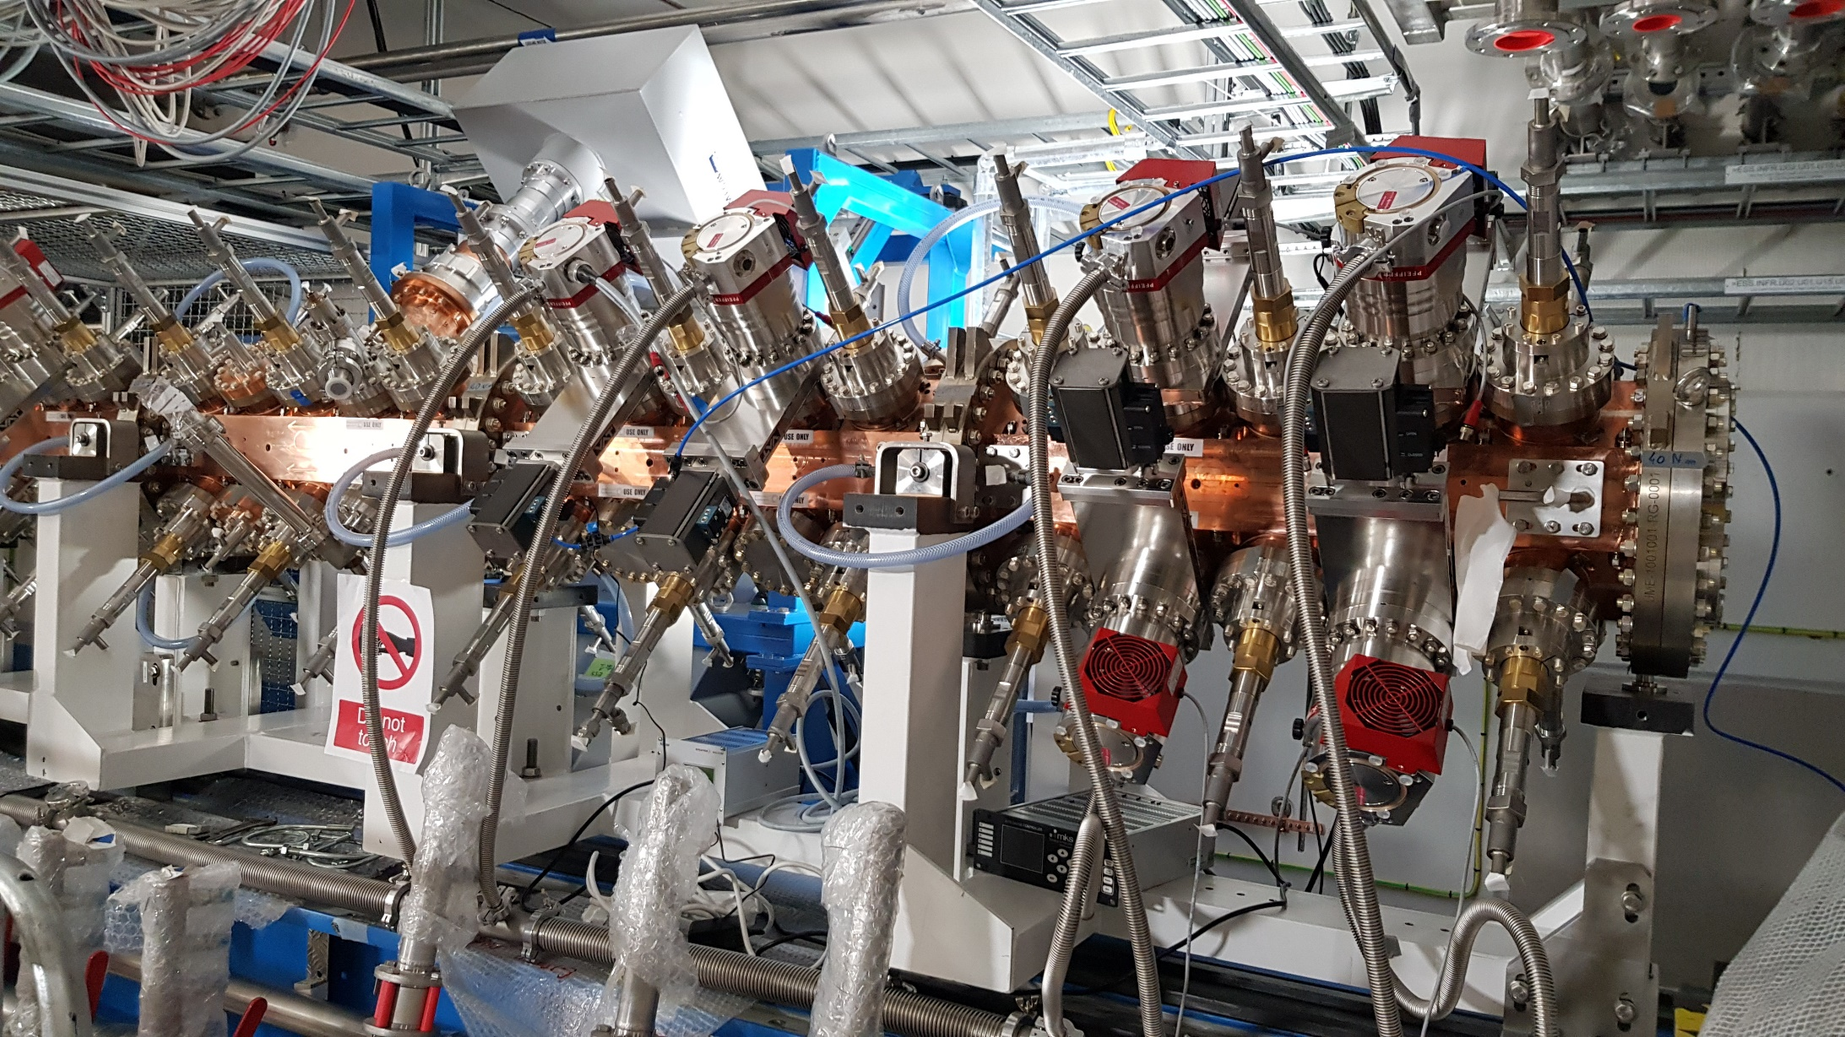
RFQ Integration Status and Plans

Slide 22
Thank you for your attention!
Questions:

