Slide 1
MEBT Integration Status and Plans
Joao Paulo Martins
Control Systems Engineer
European Spallation Source ERIC
2020-01-30

Slide 2
Introduction
(Extracted from Thomas Fay/Philippe Rabis’ presentation)
I think ICS has some room for improvement in communication of system statuses to stakeholders, hopefully this helps somewhat.
This time slot won't give sufficient duration for many details.
Intention here is mostly to provide a rapid-fire overview.
Several internal ICS projects need to reach "usable" maturity for RFQ commissioning and beam to MEBT FC (Calibration Service, Critical PV access authorisation, IOC deployment).

Slide 3


MEBT Integration Status and Plans
Summary
MEBT Control System Overview
EPICS Integration Aspects
MEBT Chopper Controls
MEBT Magnets Controls
Conclusion

Slide 4
MEBT Integration Status and Plans
Summary
MEBT Control System Overview
EPICS Integration Aspects
MEBT Chopper Controls
MEBT Magnets Controls
Conclusion

Slide 5
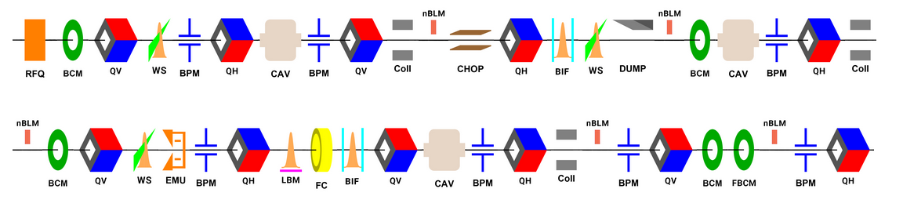
MEBT Control System Overview
MEBT at a glance
The full-scale MEBT:
Eleven (11) Magnets (quadrupoles with combined H/V correctors);
Three (3) RF cavities (bunchers);
Chopper;
Nine (9) different types of diagnostics instruments;

Slide 6
MEBT Control System Overview
The Full Scale Control System
Controls Hardware
Mag.
Chopper
Buncher
BPM
BCM
nBLM
FC
EMU
WS
SC
BSM
NPM
x 11
x 3
x 7
x 4
x 4
x 3
x 3
x 2
PLC
PLC
MTCA
MTCA
MTCA
MTCA
MTCA
MTCA
MTCA
MTCA
LLRF
VM
VM
ECAT
ECAT
ECAT
ECAT
ECAT
MTCA
PLC
PLC
PLC
RFLPS
MTCA
VM
SSA
Control

Slide 7
MEBT Control System Overview
Estimation of the number of IOCs
Controls Software: an (rough) estimation of the number of IOCs:
  Not considering MPS, Vacuum and various soft IOCs running on VMs;
Quad. Control IOC (1)
Ster. Control IOC (22)
Mag. LPS (1)
Chopper IOC (1)
Chopper LPS (1)
Total = 26
SSA Control IOC (3)
RFLPS - SIM IOC (1)
RFLPS - FIM IOC (3)
LLRF IOC (3)
Total = 10
BPM IOC (2)
BCM IOC (2)
nBLM IOC (4)
FC IOC (1)
EMU IOC (1)
EMU LPS IOC (1)
SC IOC (3)
SC LPS IOC (1)
WS IOC (3)
NPM IOC (2)
BSM IOC (1)
Total = 21
Total ~= 57 IOCs and counting…

Slide 8
MEBT Control System Overview
The Full Scale Control System
Controls Hardware
Mag.
Chopper
Buncher
BPM
BCM
nBLM
FC
EMU
WS
SC
BSM
NPM
x 11
x 3
x 7
x 4
x 4
x 3
x 3
x 2
PLC
PLC
MTCA
MTCA
MTCA
MTCA
MTCA
MTCA
MTCA
MTCA
LLRF
VM
VM
ECAT
ECAT
ECAT
ECAT
ECAT
MTCA
PLC
PLC
PLC
RFLPS
MTCA
VM
SSA
Control

Slide 9
MEBT Control System Overview
The system for first phase (SSR2A)
Controls Hardware
Mag.
Chopper
Buncher
BPM
BCM
nBLM
FC
EMU
WS
SC
BSM
NPM
x 11
x 3
x 7
x 4
x 4
x 3
x 3
x 2
PLC
PLC
MTCA
MTCA
MTCA
MTCA
MTCA
MTCA
MTCA
MTCA
LLRF
VM
VM
ECAT
ECAT
ECAT
ECAT
ECAT
MTCA
PLC
PLC
PLC
RFLPS
MTCA
VM
SSA
Control

Slide 10
MEBT Integration Status and Plans
Summary
MEBT Control System Overview
EPICS Integration Aspects
MEBT Chopper Controls
MEBT Magnets Controls
Conclusion

Slide 11
MEBT Integration Status and Plans
Summary
MEBT Control System Overview
EPICS Integration Aspects
MEBT Chopper Controls
MEBT Magnets Controls
Conclusion

Slide 12
EPICS Integration Aspects
ESS EPICS Environment (E3)
Motivation:
  Speed up IOC development;
  Standardization;
  To support different EPICS Base version, different EPICS modules versions, for different architectures;
What E3 is?
  A build facility for EPICS IOCs;
  A runtime environment for EPICS IOCs;
  A collection of EPICS modules (extensions) and IOCs maintained by ICS;
What E3 is not?
  The deployment system for the EPICS IOCs;
  Something that will prevent your IOC to run (if the workflow is followed);

Slide 13
EPICS Integration Aspects
ESS EPICS Environment (E3)
I have this IOC running on EEE, now I have to port it to E3;
  The structure is almost the same, for *most* of the IOCs this is a matter of minutes (or hours);
  HW & Integration Group is here to help you;
I need this EPICS extension on my IOC, is it compatible with E3?
  Please take a look to the pool of modules already supported on E3. Almost everything you need will be there (calc, stream, sequencer, mrfioc2, ecmc, ADCore, any many more);
  If not, HW & Integration Group is here to help you;
Is my IOC going to load the same modules after reboots, E3 updates, etc..?
  YES. Your IOC will load the modules according to the versions that YOU specified;
I need to learn how to develop with E3!
  There is extensive training material on Confluence: https://confluence.esss.lu.se/display/HAR/ESS+EPICS+environment+%3A+e3

Slide 14
EPICS Integration Aspects
ESS EPICS Environment (E3)
There is a lot to be developed and integrated yet, though:
  Deployment system;
  Critical PV access authorization;
  Calibration Service;
  MASAR service;
  Experiment data archiving;
ICS is committed to the deliver all the Control System Services with quality, but focus should be to run IOCs!
EPICS Base version 7.0.3.1 is the default; (https://confluence.esss.lu.se/x/4iN8Ew)
CS-Studio / Phoebos / BOY / Display Builder – still work to do;

Slide 15
EPICS Integration Aspects
Standard IOC Features
Autosave:
  Periodically saves the current value of pre-defined PVs into a text file;
  ICS Infra Group already have the permanent storage (with backup) for these files;
iocStats:
  Provides EPICS PVs with diagnostics about the running IOC: memory and CPU consumption, uptime, heartbeat signal;
  Enables remote reboot of the IOC;
recSync:
  Publish the list of PVs of the IOC to Channel Finder Service;
Archiving:
  Configuration of the archiving system is made outside the IOC: Archiver Appliance;
Alarms and Access Security:
  Built-in features of EPICS; Should be defined by system leader and implemented by integrator;

Slide 16
MEBT Integration Status and Plans
Summary
MEBT Control System Overview
EPICS Integration Aspects
MEBT Chopper Controls
MEBT Magnets Controls
Conclusion

Slide 17
MEBT Integration Status and Plans
Summary
MEBT Control System Overview
EPICS Integration Aspects
MEBT Chopper Controls
MEBT Magnets Controls
Conclusion

Slide 18

MEBT Chopper Controls
Architecture
VM
Output to MPS:
Chopper Status
(relay output)
MicroTCA Crate
Local Protection PLC
MicroTCA CPU
MicroTCA Event Receiver
Timing Events
Temperature Signals
Power Supply
Status
Fine delay
Digital out
Pulser PS (+)
MEBT Fast Chopper
MEBT Chopper Beam Dump
Pulser PS (-)
Trigger pulses
Serial commands
50 Ω
50 Ω

Slide 19
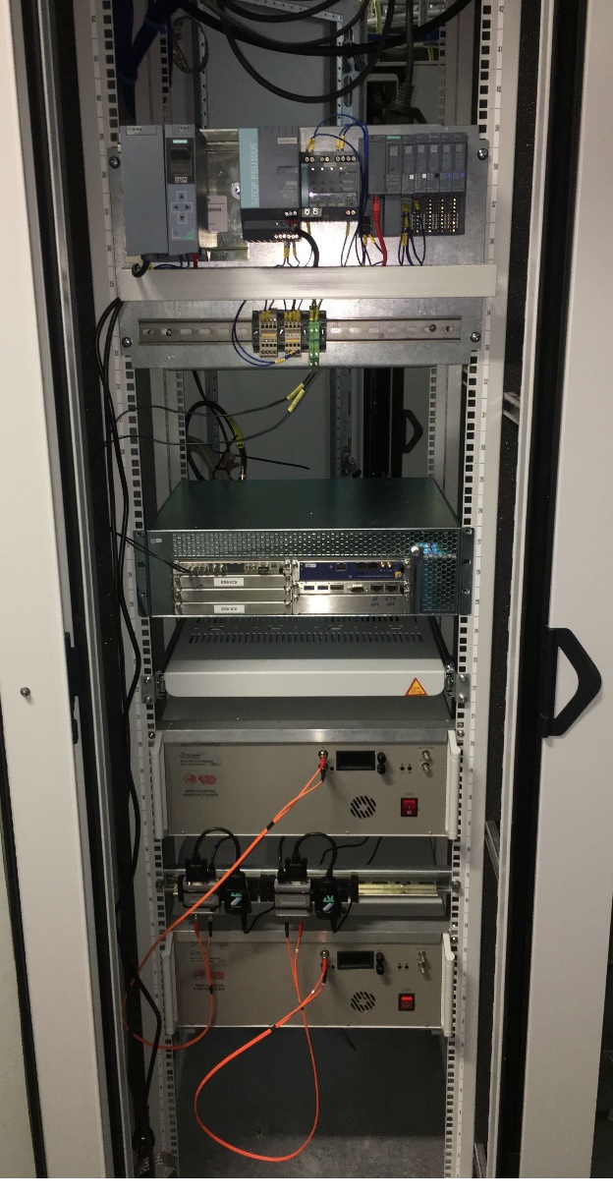
MEBT Chopper Controls
Status
Rack components were installed with temporary power;
Local tests performed:
  Pulsers communication;
  Event Receiver and fine delay outputs (standalone mode);
  PLC integration with EPICS;
Main OPI already in Display Builder format;
  PLC IOC OPI needs to be ported;
Next activities:
  Clear definition of timing events that will drive the MEBT Chopper;
  Integrated tests;
  Verification of PLC signals;

Slide 20
MEBT Chopper Controls
Future integration with FBIS
For the next phase: integration with FBIS;
  FBIS needs to know if emergency mode really happened;
  Overall status (LPS status) informed to MPS from the PLC;
  Digitalization of the voltage signals that goes to the loads;
Interface Control Document (under review):
  CHESS Document: ESS-1530169

Slide 21
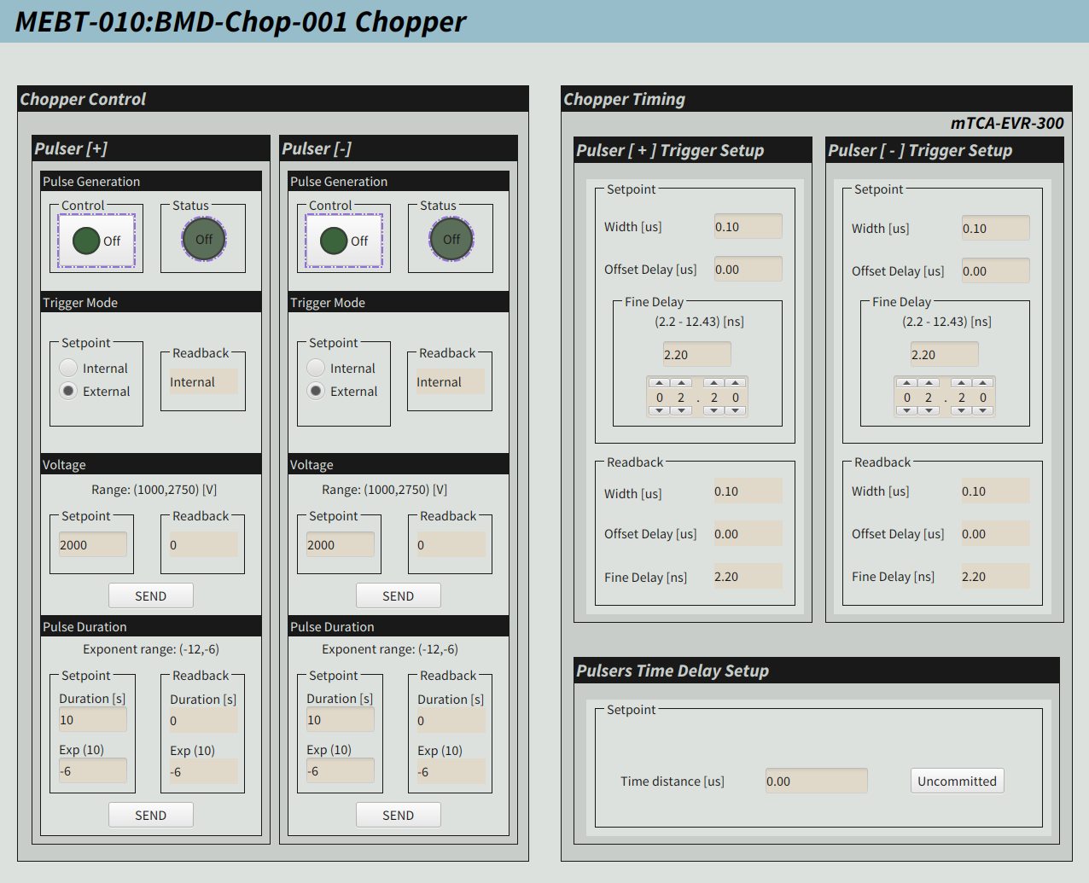
MEBT Chopper Controls
Operation
High-voltage pulsers configurable parameters (PVs):
  Manual/remote;
  Amplitude (1 kV to 2.75 kV);
  Pulse Width (1us to 20us);
Trigger configurable parameters:
  Coarse delay from event reception;
  Fine delay (nanosecond range);
  Distance between pulses *;
Event Receiver System (MRF EVR) is flexible and easily configurable, we need clear definition on when to trigger the pulsers from an operational point of view;
Fine
Delay
Coarse delay
t
Event reception
at the EVR
Electric trigger
at the EVR output

Slide 22
MEBT Chopper Controls
Operation
Timing System Events and HV Pulsers Outputs
PULSE
START
HV
Pulse
PULSE
COMING
PULSE
END
t
Pulse current before MEBT Chopper
t
Pulse current after MEBT Chopper
t
PULSE
COMING
PULSE
START
PULSE
END

Slide 23
MEBT Integration Status and Plans
Summary
MEBT Control System Overview
EPICS Integration Aspects
MEBT Chopper Controls
MEBT Magnets Controls
Conclusion

Slide 24
MEBT Integration Status and Plans
Summary
MEBT Control System Overview
EPICS Integration Aspects
MEBT Chopper Controls
MEBT Magnets Controls
Conclusion

Slide 25
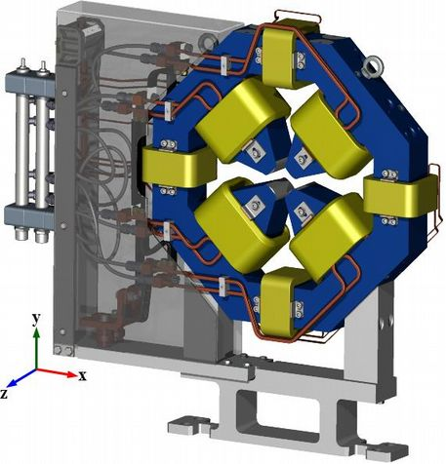
MEBT Magnets Controls
Architecture
MEBT Magnets combine quadrupole with horizontal and vertical corrector functions;
One dedicated power supply for each component: 11 x 3 = 33 PS;
  Unipolar PS with 300 A output for quadrupole;
  Bipolar PS for the H/V correctors;
One dedicated rack for each magnet;
Local Protection System implemented with Siemens PLC;
  EPICS IOC runs on virtual machine;

Slide 26
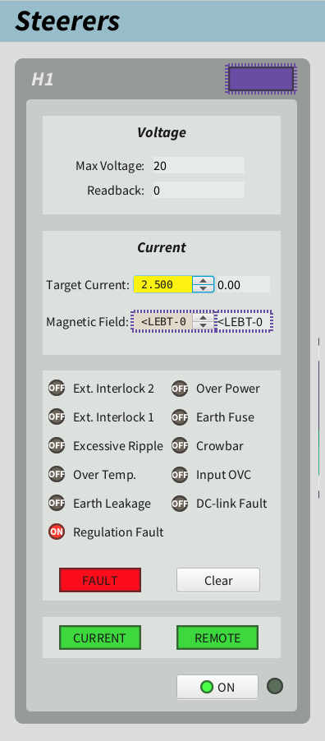
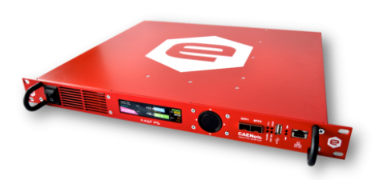
MEBT Magnets Controls
Steerers Controls
CAEN FAST PS has an embedded EPICS IOC;
  The integration is extremely facilitated by this feature;
The same power supply will be used in the LEBT;
OPIs already re-designed and compatible with Display Builder;
20 units placed in FEB racks;

Slide 27
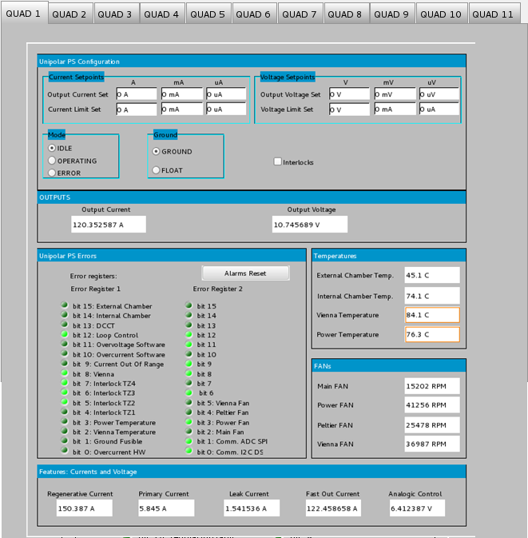
MEBT Magnets Controls
Quadrupole Controls
Dedicated unipolar quadrupole power supply;
Up to 300A output;
MODBUS interface;
FAT to happen soon!
IOC needs to be validated;
OPIs to be converted to Display Builder;

Slide 28
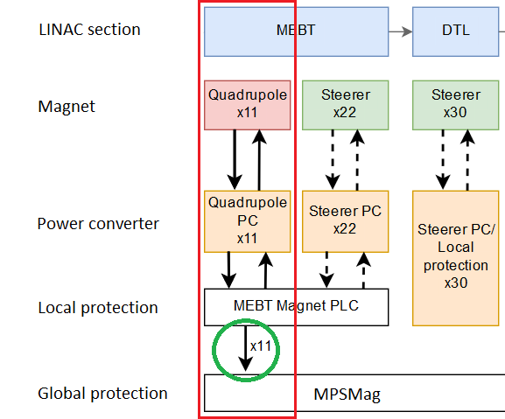
MEBT Magnets Controls
Local Protection System
Local Protection System implemented with Siemens S7 PLCs (CPU + distributed IO modules);
PLC monitors the following signals for each individual magnet:
  Magnet windings sensor (thermoswitch);
  Cooling water temperature;
  Cooling water flow;
  Power Supply status (hardwire);
In case of any faulty condition, local permit to the PS will be revoked and Machine Protection (MPSMag) will be notified;
MPSMag ICD (under review): ESS-0494755

Slide 29
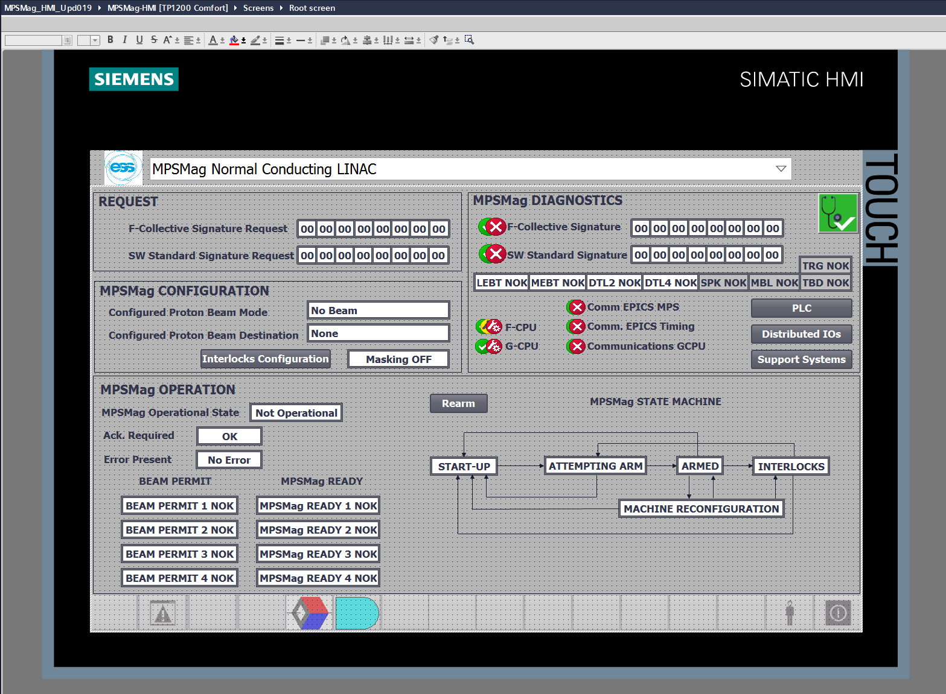
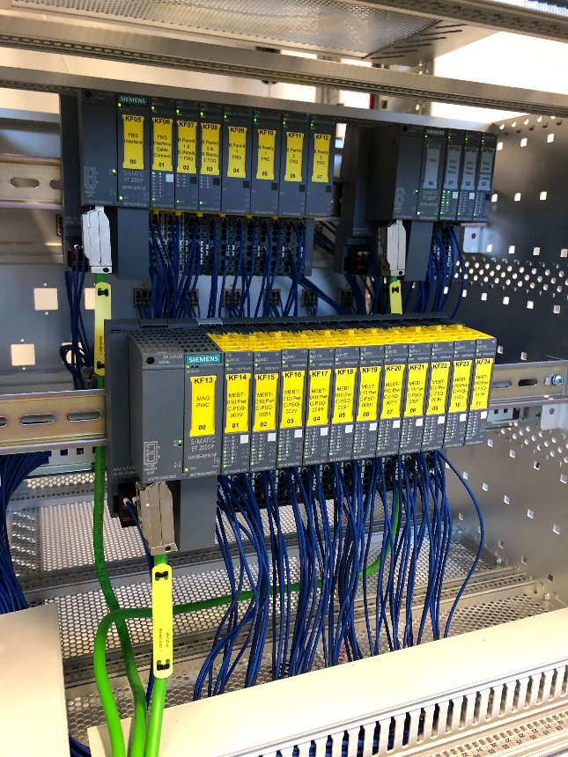
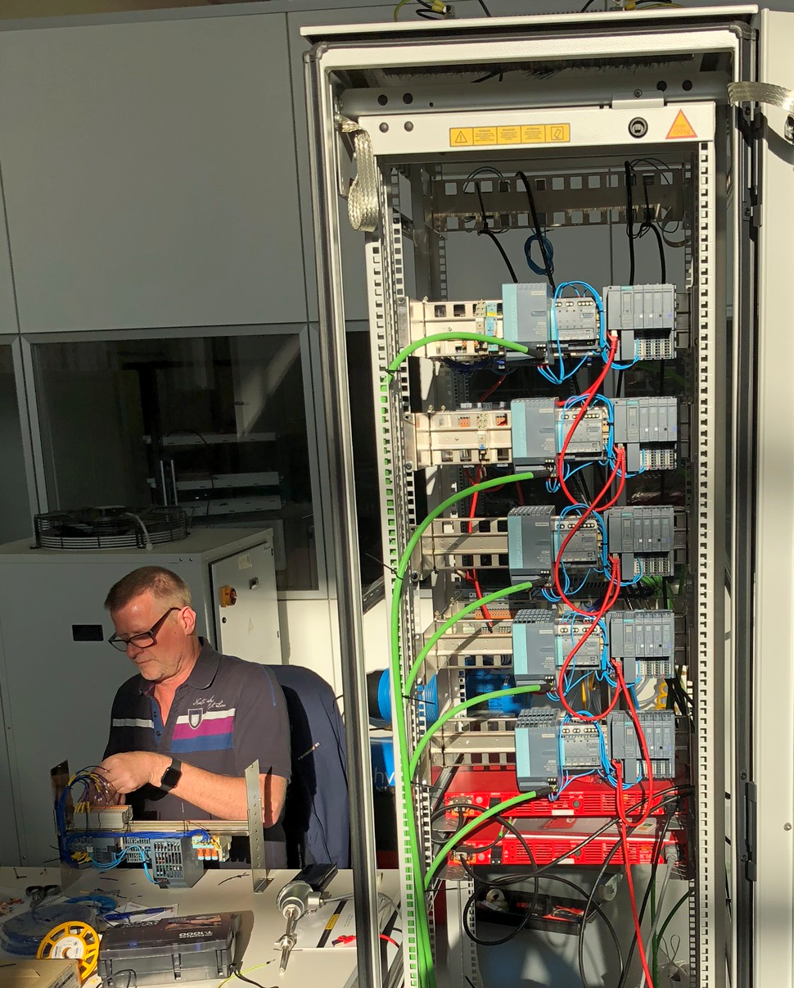
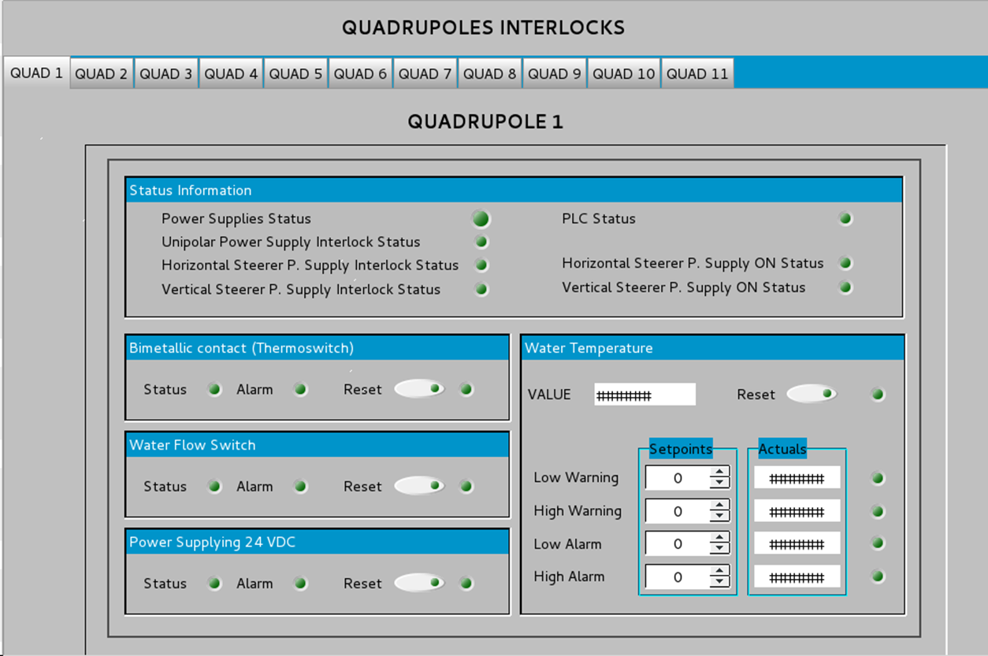
MEBT Magnets Controls
Local Protection System

Slide 30
MEBT Integration Status and Plans
Summary
MEBT Control System Overview
EPICS Integration Aspects
MEBT Chopper Controls
MEBT Magnets Controls
Conclusion

Slide 31
MEBT Integration Status and Plans
Summary
MEBT Control System Overview
EPICS Integration Aspects
MEBT Chopper Controls
MEBT Magnets Controls
Conclusion

Slide 32
Conclusion
Considering the first commissioning round
MEBT Chopper is almost ready for integrated tests;
Correctors Magnets PS needs firmware update and registration to the Control System, but after that they are ready for integrated tests;
Quadrupoles PS will be integrated and tested in Bilbao;
Diagnostics systems (FC, BPM, BCM) being developed and led by BI with the support of ICS;
ICS is fully committed to deliver high level services and controls;
HW&I Group feels enthusiastic about the next commissioning round: focus to “make system run”;
What still needs to be done:
  All OPIs ported/developed to Phoebus/Display Builder;
  IOC configurations for alarms, archiving and access control (need input from system owners);
  All sorts of adjustments and optimizations…
  Documentation;

Slide 33
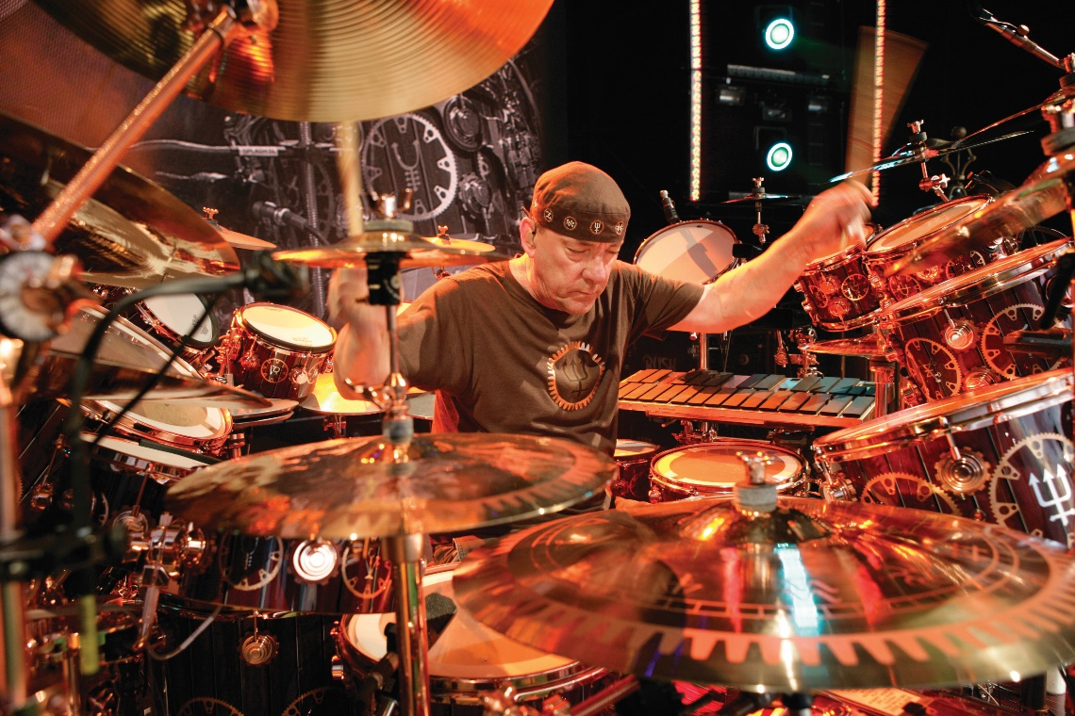
Questions / discussions;
Special thanks to Idoia Mazkiaran and ESS Bilbao team;
MUITO OBRIGADO!
“Courageous convictions will drag the dream into existence.”
- Neil Peart (1952 – 2020)
- Vital Signs, Rush – Moving Pictures

