Slide 1
Experience from the IFMIF RFQ Commissioning
F. Grespan L. Bellan M. Comunian
Lund, 29-30 Jan 2020
ESS Testing and Commissioning Workshop

Slide 2
Outline
Assembly a 10 m long RFQ in Rokkasho
Tuning a 10 m long RFQ in Rokkasho
RFQ RF Conditioning up to now
RFQ pulsed beam commissioning
Matching the Input beam
Accuwheater: “The snowiest city in the world, with an average of 26 feet — or eight meters — of snowfall every year, is Aomori City in Aomori Prefecture, Japan.“
«Rokkasho is not a place, it is an outpost.» A. Facco

Slide 3
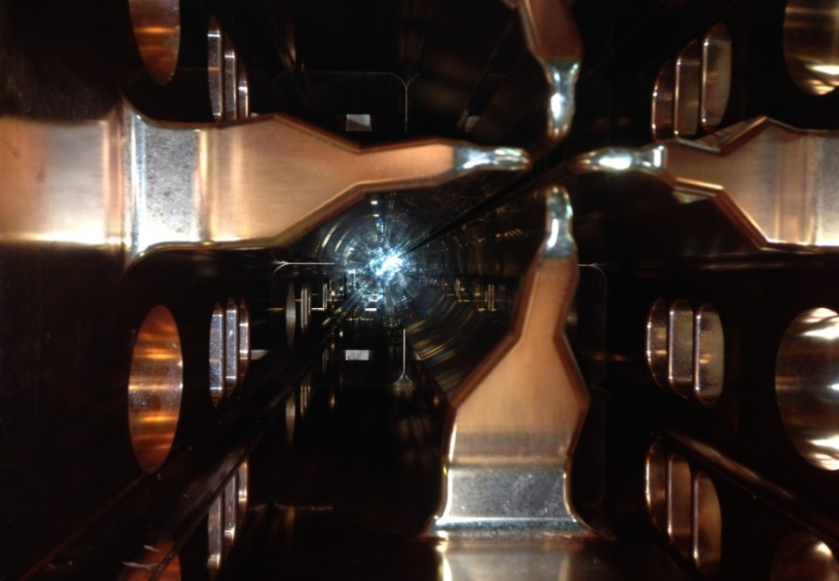
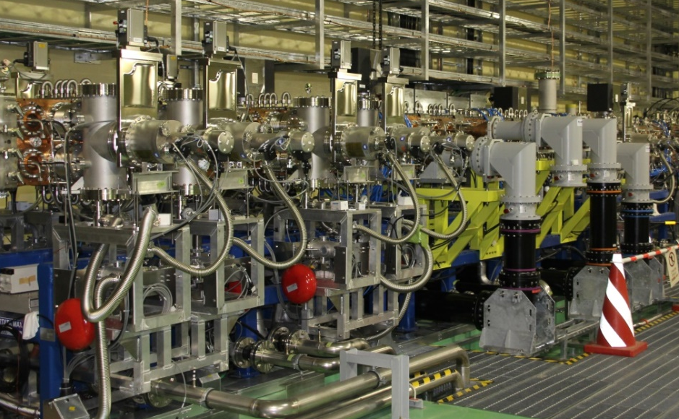
IFMIF-Lipac RFQ parameters
Input/output Energy | 0.1-5 | MeV
Duty cycle | cw
Deuteron beam current | 125 | mA
Operating Frequency | 175 | MHz
Length (5.7 λ) | 9.78 | m
Vg (min – max) | 79 – 132 | kV
R0 (min - max) ρ/R0=.75 | 0.4135 - 0.7102 | cm
Total Stored Energy | 6.63 | J
Cavity RF power dissipation | 550 | kW
Maximum dissipated power | 86 | kW/m
Power density (average-max) | 3.5-60 | kW/cm²
Q₀/Q_{sf}=0.82 | 13200
Shunt impedance (<V²>)L/P_{d} | 201 | kΩ −m
Frequency tuning | Water temp.
N cells (βλ/2) | 489

Slide 4
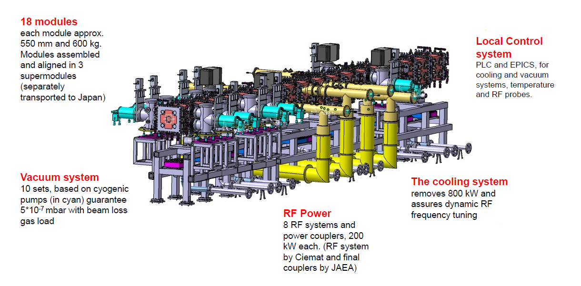
Assembly a 10 m long RFQ
RF Power
8 RF systems and power coupler
200 kW each (RF system by CIEMAT)

Slide 5
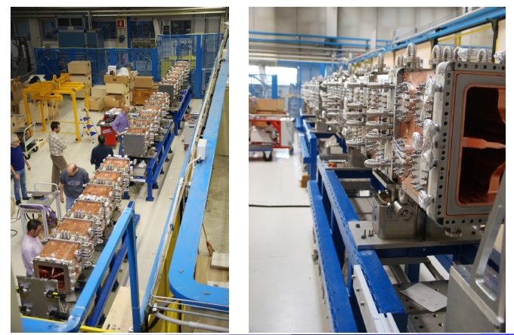
Assembly a 10 m long RFQ
RFQ pre-assembled in 3 super-modules (SMs) in Legnaro, aligned and vacuum tested.
Then shipped to Japan.

Slide 6
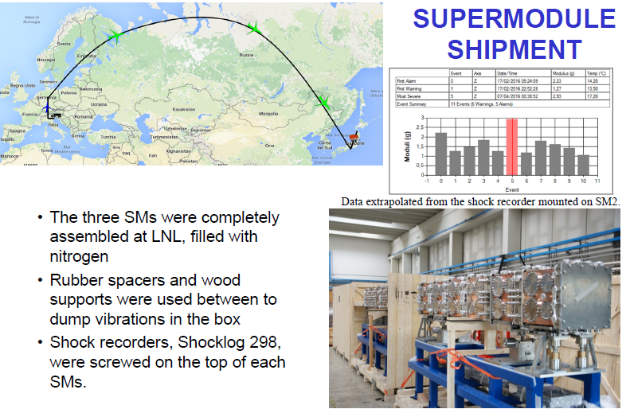
Assembly a 10 m long RFQ

Slide 7
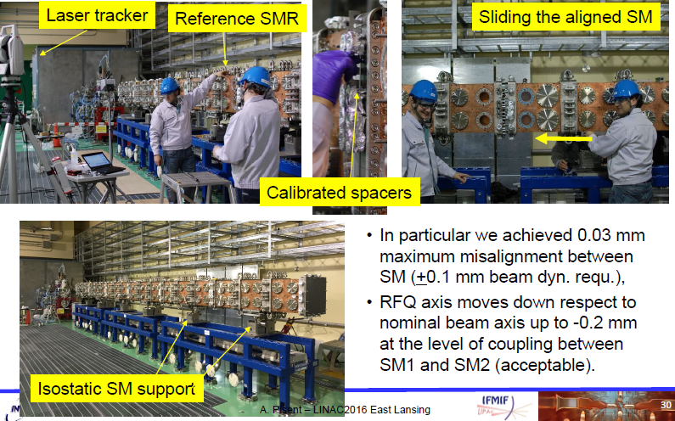
Assembly a 10 m long RFQ

Slide 8
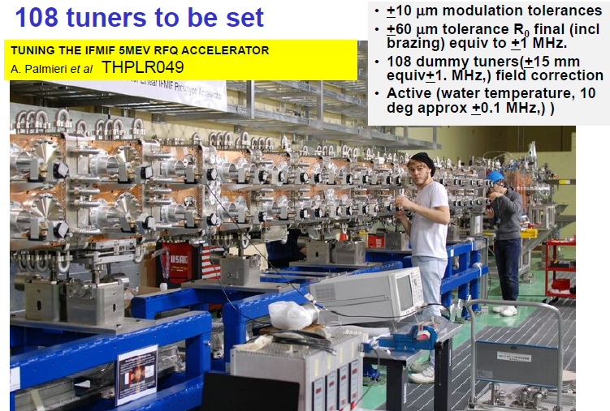
Tuning a 10 m long RFQ

Slide 9
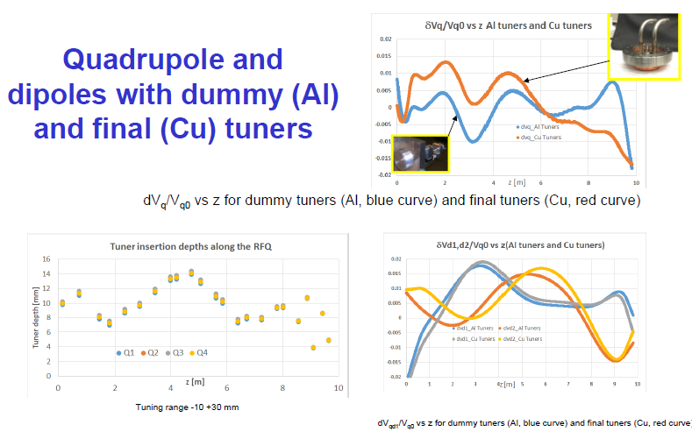
Tuning a 10 m long RFQ
Tuning performed without couplers and 3 m away from the LEBT in order to allow the conclusion of the LEBT beam characterization.
Coupler perturbation modeled with dedicated tuner penetration calculated with HFSS.

Slide 10
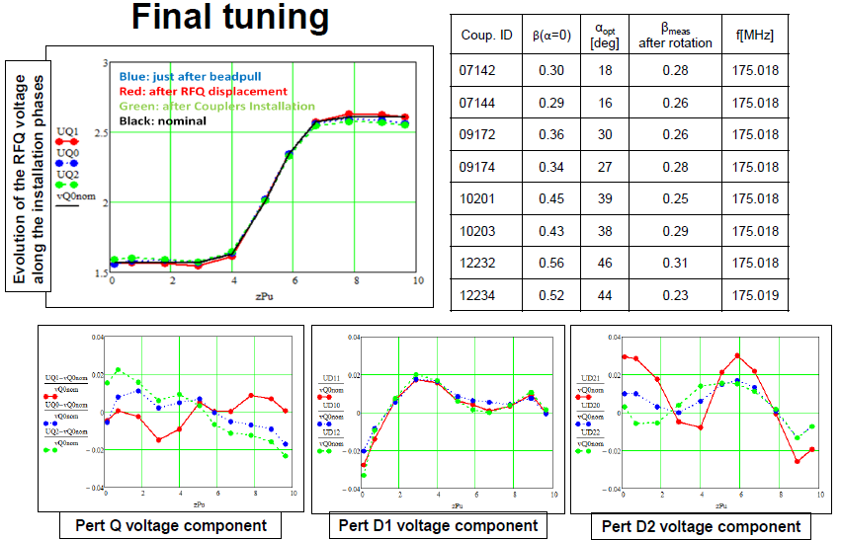
Tuning a 10 m long RFQ
Then moved to final position and checked.
The result voltage is now implemented in the BD simulation as well as the alignment data → RFQ simulated “as built”

Slide 11
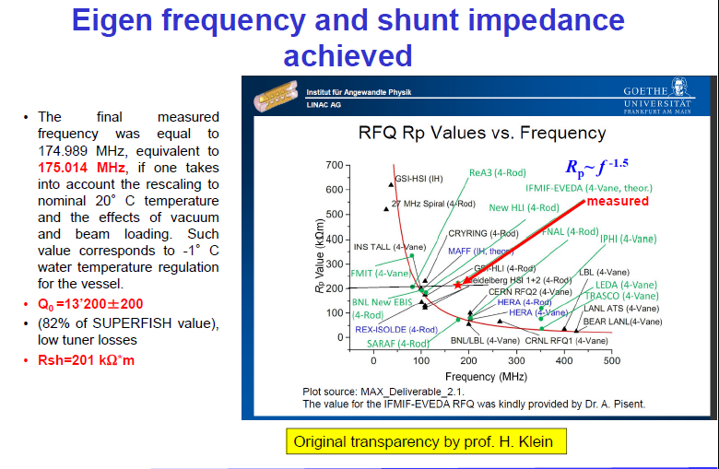
RF properties summary

Slide 12
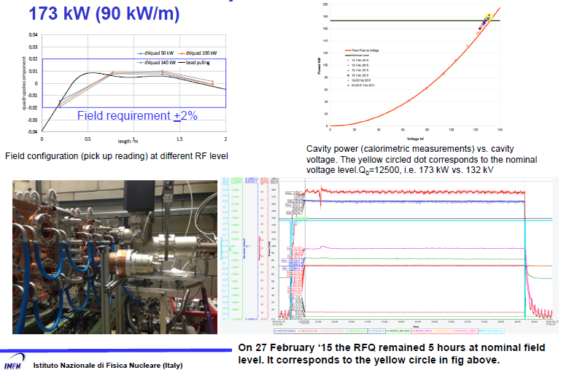
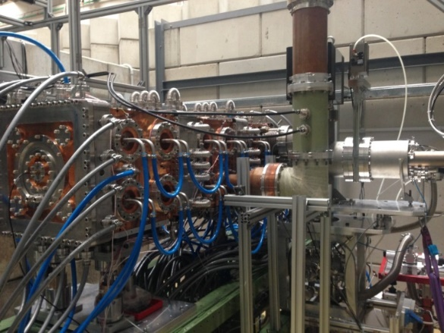
RFQ RF conditioning
CW operation at nominal voltage demonstrated in Legnaro on a 500 kW test stand to for 3 RFQ modules up to 200 kW maximum RF power. RFQ design validation (Max field limit = 1.8 E_{kp} and max power density = 86 kW/m).
Just one coupler
in the LNL test

Slide 13
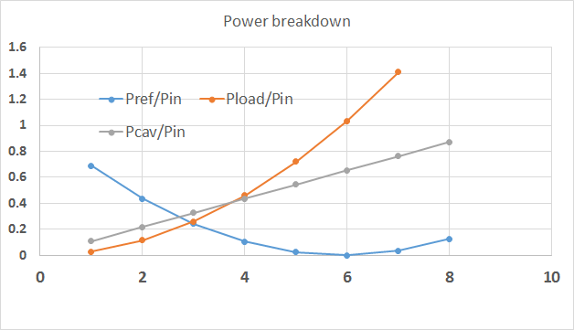
Phasing 8 RF chains
RF couplers optimized for beam operation
In conditioning mode without beam, 13% average reflected power from each chain
In case of chains amplitude or phase unbalance, significant reflected power comes back to circulators
RFQ
Amplitude unbalance (no beam)
Reflected power decreases with active chains number reaching a minimum with 6 chains. (Pref/Pin)
Cavity power increases with active chains number
Reflected power on any inactive chain increases with the number of active chains. It can reach 140% of the single chain input power, with 7 chains active (Pload/Pin)
In case of phase unbalance, calculations show that 400% of nominal power can be reached on unbalanced chain reflected power in case of 180 deg phase error.

Slide 14
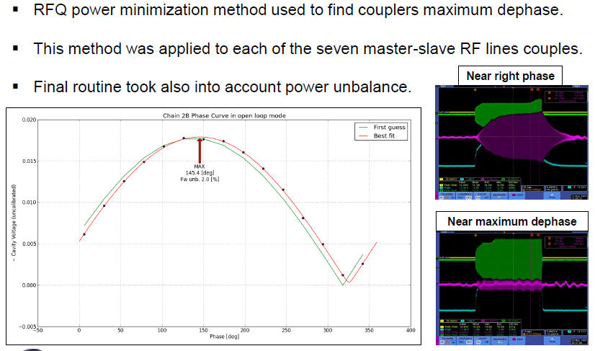
Phasing 8 RF chains

Slide 15
1° part of the conditioning (2017-2018)
Forward power vs cavity voltage during RFQ conditioning.
Peak and average cavity power.

Slide 16
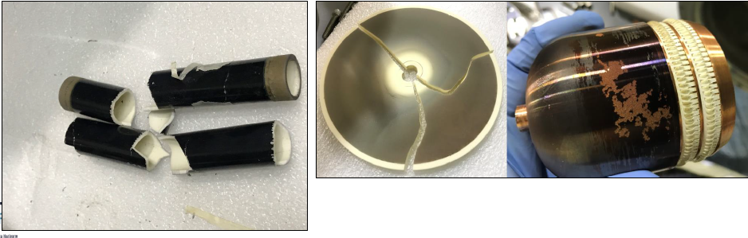
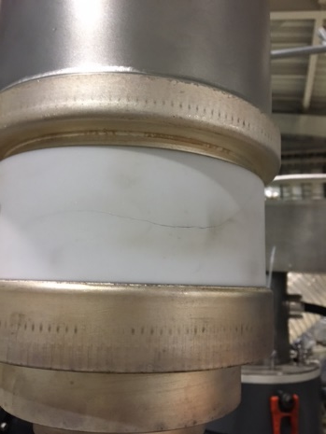
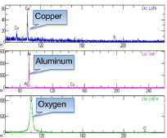
Slow down of the conditioning
Excessive protections do not allow conditioning process. But lack of protection can destroy components
Circulators dummy loads were dimensioned for 50 kW CW nominal power. In pulsed mode they should resist up to 250 kW peak power for less than 100 ms.
Difficult to keep circulators tuned in low duty cycle operation→reverse power cause HV instability tetrode failure
RF power injection with cooling system off and cooling interlock disabled: Viton® O’ring melting in one RF window without vacuum break, RF window disassembled and repaired
During a PPS test, involuntary RF power injection into cavity with interlock system disabled→ Uncontrolled arcing in one RF window caused alumina metallization and subsequent break. Post analysis confirmed copper deposition.

Slide 17
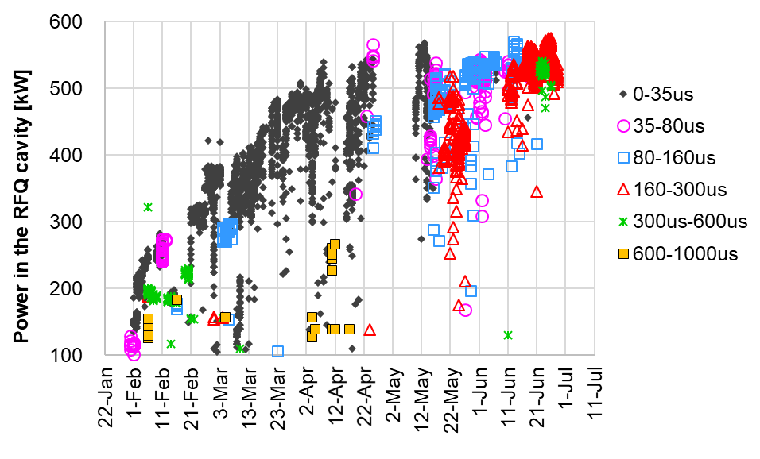
2° part of RF conditioning (2019)
132 kV (560 kW)
Efficiency of the conditioning was improved after HVPS control adjustment in May.
We reached in July 132 kV / 2.5 ms / 20 Hz (duty 5%).
At proton level, 60 ms / several Hz (duty approx. 20%).

Slide 18
Main feedbacks from conditioning
Hardware should be dimensioned both for conditioning operation and for normal operation.
Conditioning can requires RF operation different from beam-case.
Engineering of accelerator, RF system, vacuum system and beam diagnostics should be robust enough to survive thanks to system protection.
But it should also be flexible enough to permit operation far from ideal behavior.
RFQ acts as a perfect eight-ways combiner. During RF-RFQ system engineering, it is of crucial importance the analysis of all possible configurations modes even far from normal operational mode.
Phase flip or phase change of one over eight chains is one of the most critical configuration. This possibility should be taken into account in multi-amplifier cavity design.
High power couplers should be precisely phased to avoid high reflected power unbalance. A practical rule should be to limit couplers nominal coupling factor variation into +-4% range.
RF window cooling system should be directly connected to alumina.

Slide 19
Conditioning status and toward RF CW
RFQ conditioning at proton level (66 kV) reached 20% maximum duty cycle (20 ms, 10 Hz). Effect on cavity vacuum was negligible
RFQ conditioning at deuteron level (132 kV) reached 5% maximum duty cycle (5 ms, 10 Hz). Effect on cavity vacuum was negligible.
Increasing duty cycle, some temperature “hot” spot appeared on three couplers. Thermal camera was used to follow temperature variation during frequency tuning and “hot” spot are verified to be movable with frequency.
New 200 kW Circulators RF loads replaced the 50 kW old ones (before end of maintenance)
All circulators well tuned (before end of maintenance).

Slide 20
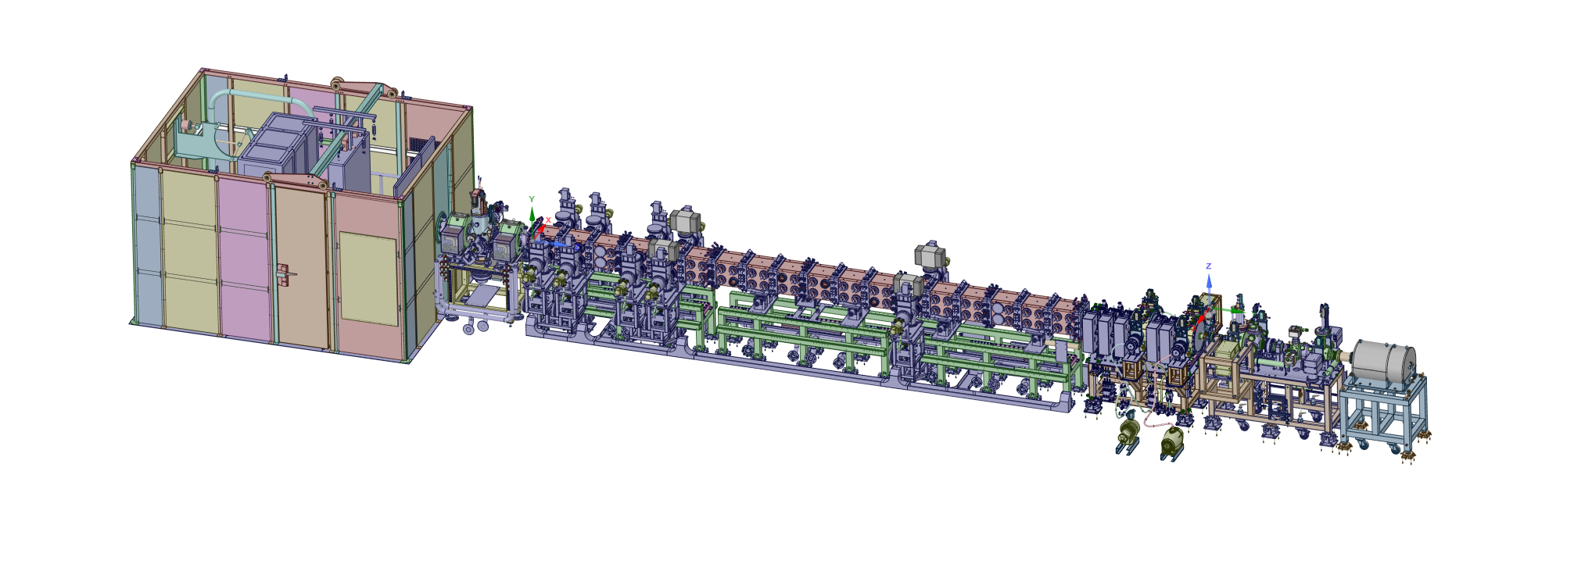
Phase-B beam commissioning of LIPAc
Injector
MEBT
RFQ
LPBD
0.1 MeV
5 MeV
D-Plate
Demonstrates acceleration of 5.0 MeV deuterons (2.5 MeV protons) by RFQ.
Target current is 125 mA deuteron in short pulse mode (half for proton).
The beam is stopped by Low Power Beam Dump (LPBD) with capacity of 1 ms / 1 Hz at
5 MeV, 125 mA (0.625 kW).
RF power of 560 kW is required as the wall load for deuteron acceleration (Vane voltage of 132 kV) and more than 1.2 MW for the beam operation.
Perform commissioning of the MEBT buncher as well as all the diagnostics.

Slide 21
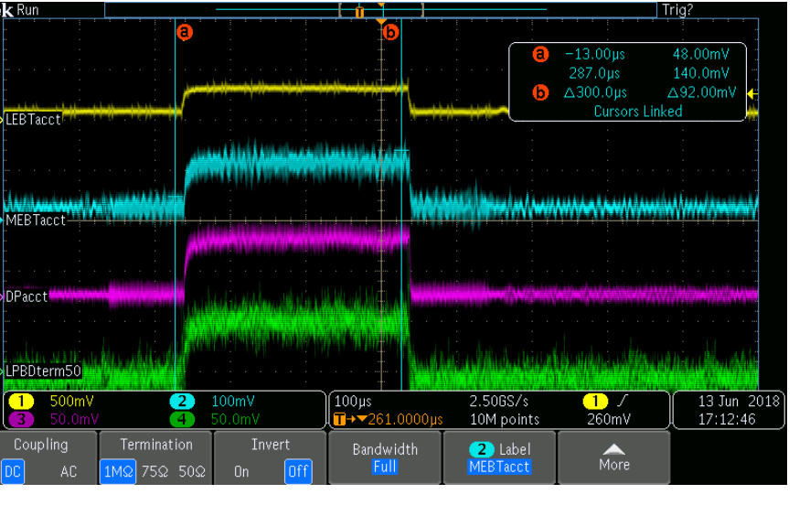
2 main milestones (1)
1st acceleration of protons through RFQ was succeeded on 13 June 2018. The 1st campaign was finished in the beginning of August.
  We achieved 40 mA at the exit of RFQ (300 us, 1 Hz), however, we required very strong steering at LEBT to obtain the best RFQ transmission.
With LEBT magnets at nominal values, no beam was extracted from RFQ. After some manual LEBT adjustment the following re-sults were obtained:
LEBT-ACCT = 5.3 mA,
MEBT-ACCT = 1.7 mA (30% transmission),
LPBD = 1.2 mA (20% transmission).
Weaker Sol2 value allows filling the RFQ acceptance compensating misalignment effects, taking advantage of the increased RFQ acceptance for low current beam.

Slide 22
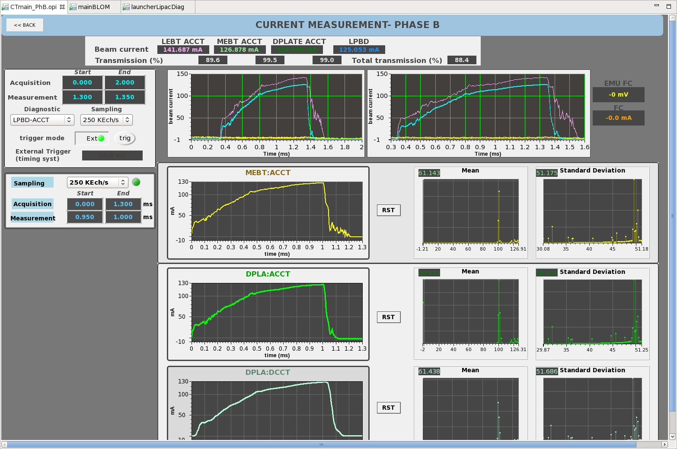
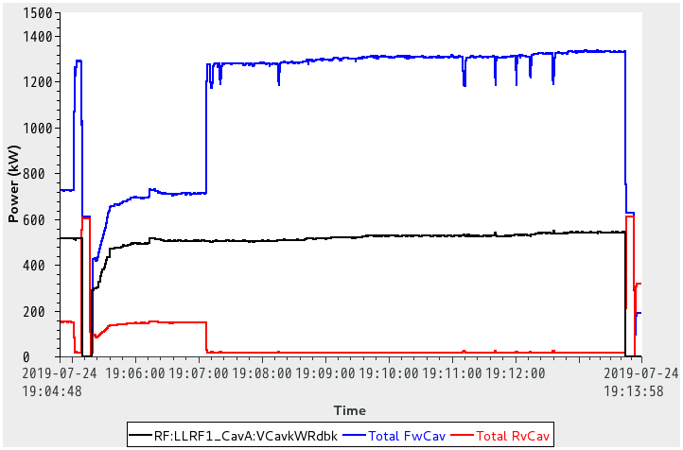
2 main milestones (2)
24th July: 1st time to achieve Deuterons current of 125 mA-1Hz-1ms at the exit of RFQ with 90% transmission.
  RF power system works properly to supply the total power more than 1.3 MW.
  Until 9th Aug, stable operation for several hours at 125 mA was succeeded.
Beam On
Total Forward
LEBT ACCT
LPBD
Power in RFQ
Total Reverse

Slide 23
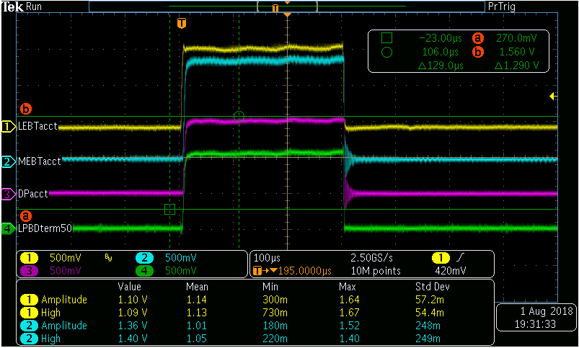
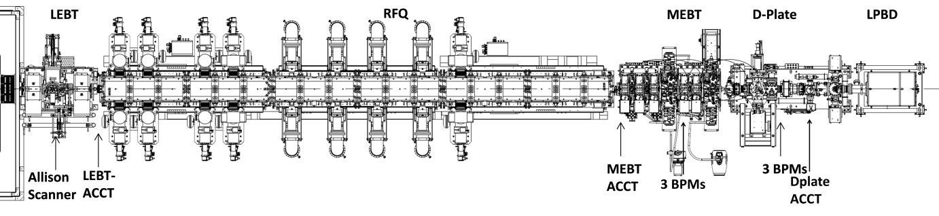
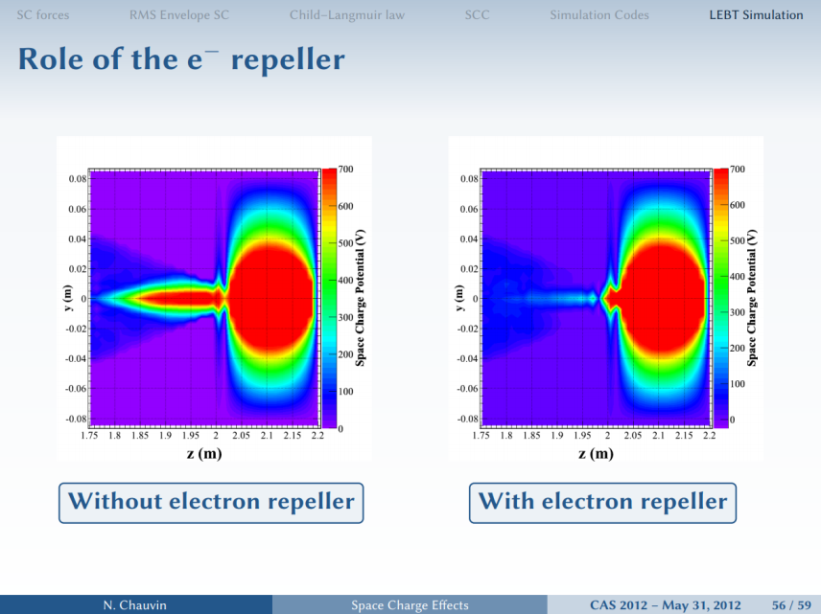
Diagnostic, repeller, chopper
After the first enthusiastic beam commissioning days we found:
Diagnostics: RGBLM and current monitors V_{scope}~50 Ω·I_{beam} we found for the LPBD 53 Ω, for the MEBT 67 Ω more different but less confusing.
RFQ repeller (-2.5 kV): we (accidentally) found the repeller electrode at the entrance of RFQ was not properly biased. After the investigation we found a failure of the connector.
All the high currents RFQ transmissions were affected (optimistically) as well as the neutralization of the LEBT-RFQ matching point

Slide 24
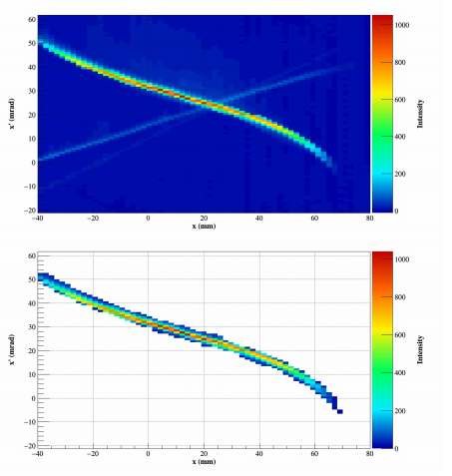
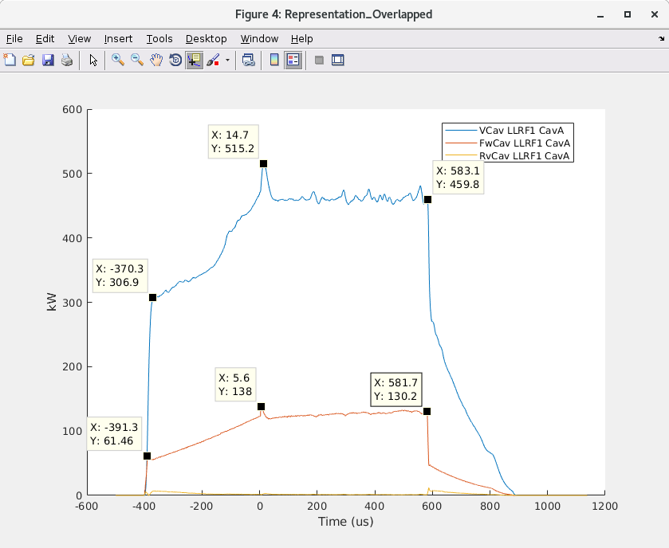
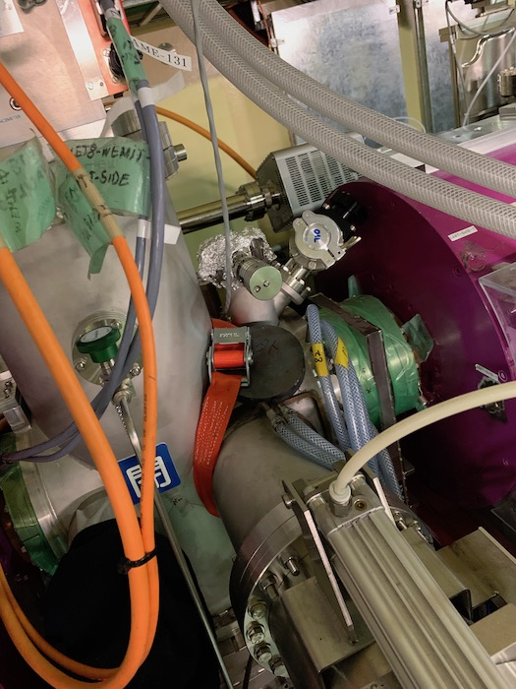
Diagnostic, repeller, chopper
Doppler shift spectrometer → % of contaminant direct measurement only for higher Duty Cycles. We estimated the contaminant components from the intensity on the emittance measurements
Chopper. Ok for protons (-4.5 kV). But for deuterons there was always a background current on the LEBT ACCT that required V < -9kV. 26th June a discharge occurred in the LEBT chopper → beam commissioning without chopper by extending RF pulse length. The 1 ms rising time of the source stressed LLRF loops.
We found some permanent magnets were installed in LEBT to suppress secondary electrons on FC. After removing that, the maximum RFQ transmission was obtained with zero steering.
After the optimization
Overshooting
~50 kW

Slide 25
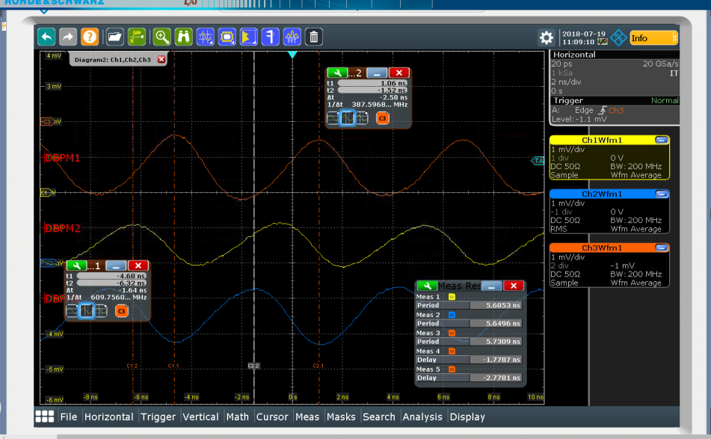
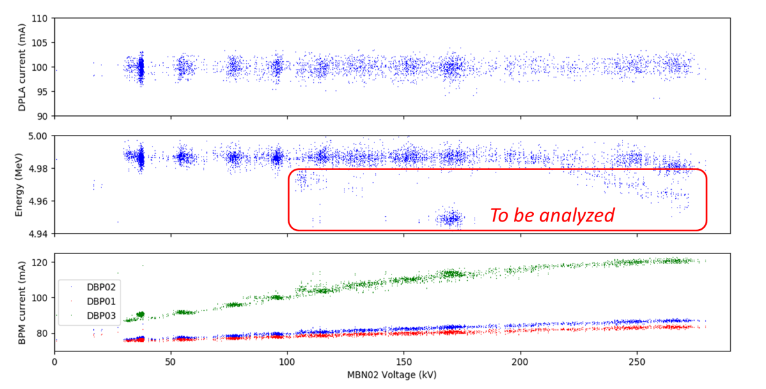
Energy out by TOF
Energy of first protons was measured with bunchers off. The TOF between the three D-Plate BPMs was performed with oscilloscope. The signals are two shifted sine waves at 175 MHz.
For Deuterons a routine from CIEMAT colleagues on the D-Plate BPMs was ready and MEBT bunchers were ON.
 | Distance (mm) | δt_{kj} [ns] | δt_{jk} [ns] | Energy [MeV]
BPM1-2 | 155.8 | 4.07 | 4.39 | 2.52
BPM1-3 | 1265.3 | 3.13 | 4.71 | 2.48

Slide 26
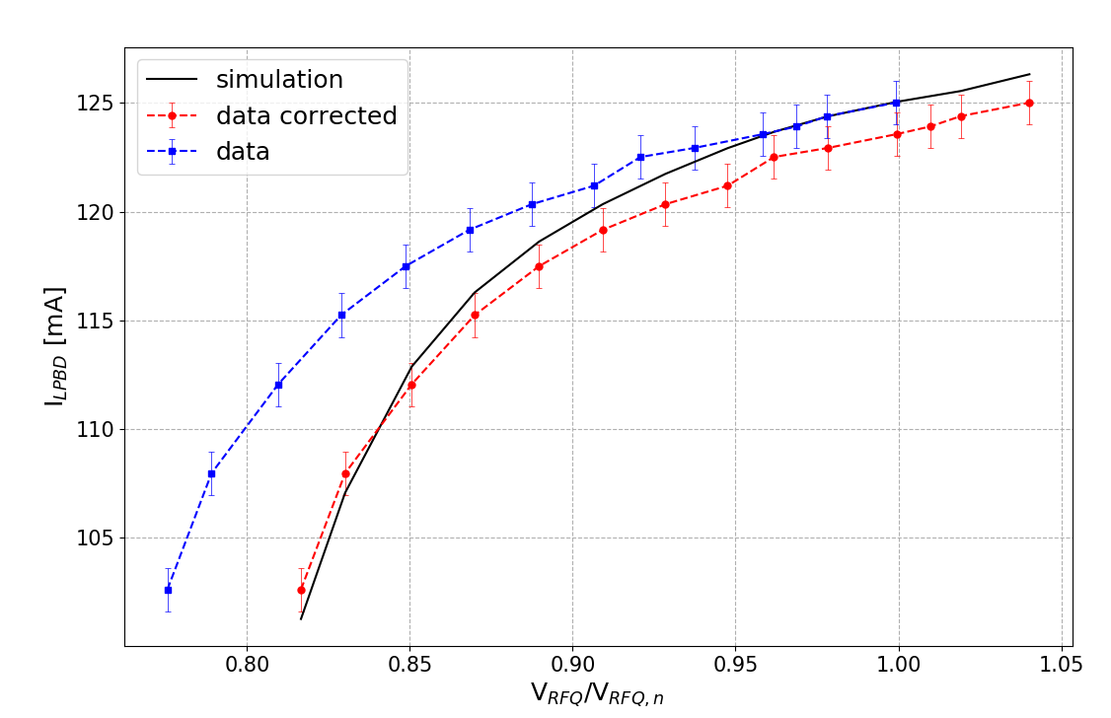
RFQ Transmission vs.Voltage
Transmission vs. Voltage curve is a key characteristic to validate the design of the RFQ
For protons the agreement was good at different currents
For deuterons the experimental curve present a different slope: transmission is too high at Vrfq< Vnom.
After testing different input distribution model, the best explanation is a 3-4kV offset in the voltage measurement, probably due to changed scale of the oscilloscope between proton and deuteros field level
deuterons
protons

Slide 27
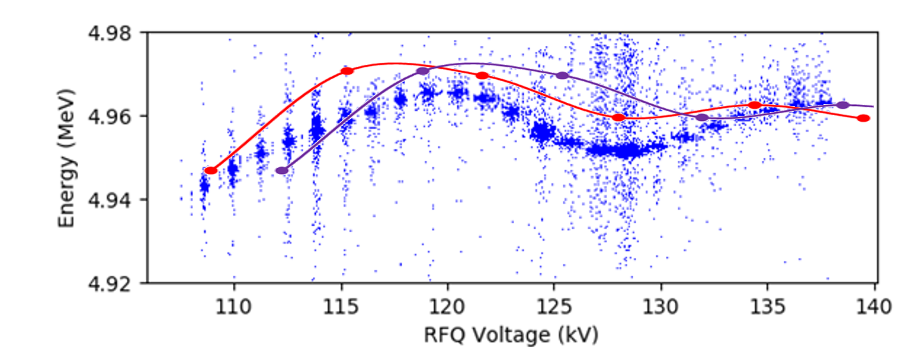
Some other interesting results from TOF
MEBT and Dplate teams measure the TOF via BPM (Thanks to CIEMAT colleagues).
-- recalibrated
-- 4.1 kV offset
The BPM measurements also show a calibration of about 4 kV with respect the real cavity voltage (in agreement with the calibration curve.)
That BPM curve is linked to the energy at the RFQ input. It seems that we are injecting between 1 kV – 0.7 kV higher than nominal input energy (100 kV).

Slide 28
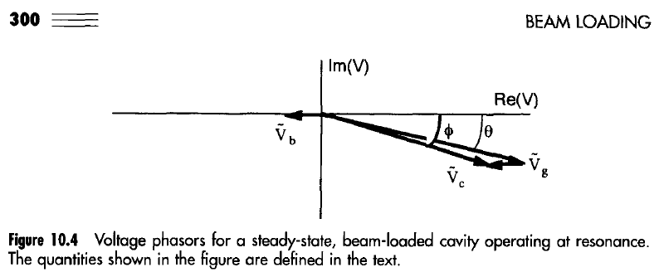
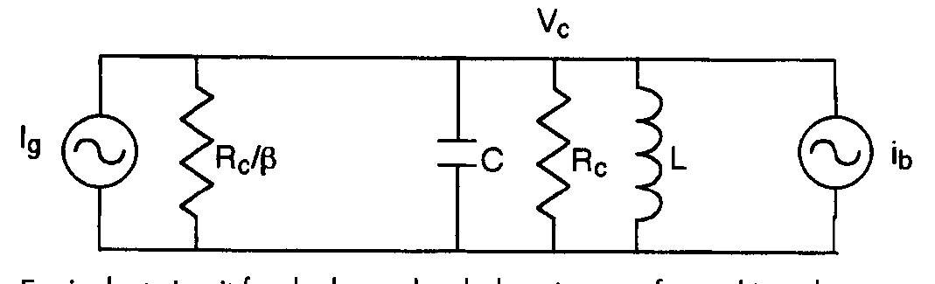
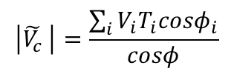
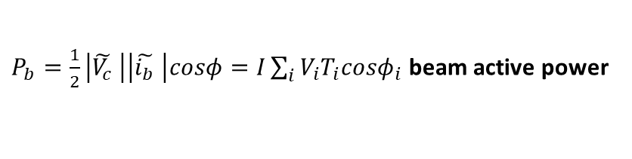
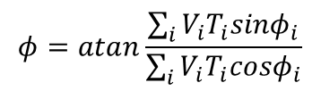
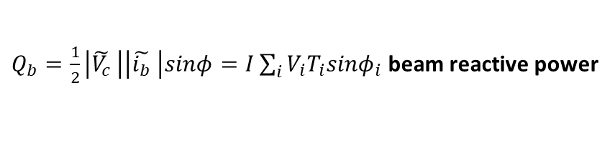

Beam loading
How the RF generator sees the multi-cell accelerating cavity and beam?
In particular, which is the effective synchronous phase between Vc and ib?
$P_{b}=\frac{1}{2}\left|\tilde{V_{c}} \right|\left|\tilde{i_{b}} \right|cosφ=I\sum_{i}{V_{i}T_{i}{cosφ}_{i}}$ beam active power
$Q_{b}=\frac{1}{2}\left|\tilde{V_{c}} \right|\left|\tilde{i_{b}} \right|sinφ=I\sum_{i}{V_{i}T_{i}{sinφ}_{i}}$ beam reactive power
Effective sync.phase
Effective accelerating voltage
Effective shunt impedance
$$φ=atan\frac{\sum_{i}{V_{i}T_{i}{sinφ}_{i}}}{\sum_{i}{V_{i}T_{i}{cosφ}_{i}}}$$
$$\left|\tilde{V_{c}} \right|=\frac{\sum_{i}{V_{i}T_{i}{cosφ}_{i}}}{cosφ}$$
$$r_{s}=\frac{{\left|\tilde{V_{c}} \right|}^{2}}{P_{Cu}}$$

Slide 29
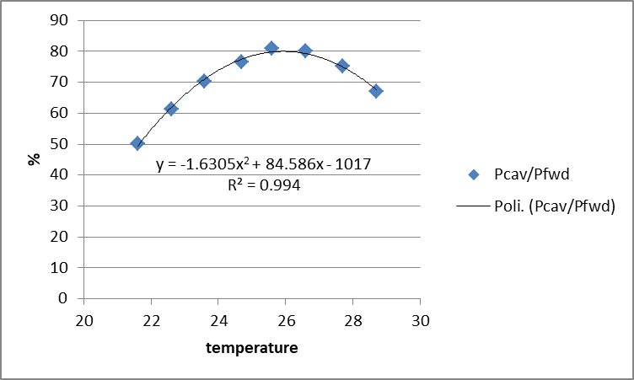
Beam Loading
For 125 mA D+ (or 62.5 mA H+) a +8.1 kHz optimum detuning is required to be at resonance with beam (beam “decreases” the resonant frequency)
To check it we took 3 different measurements:
  0. But first we checked the cavity resonance as function of temperature → -3kHz/°C

Slide 30
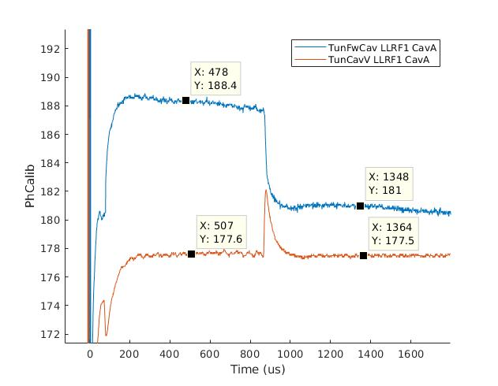
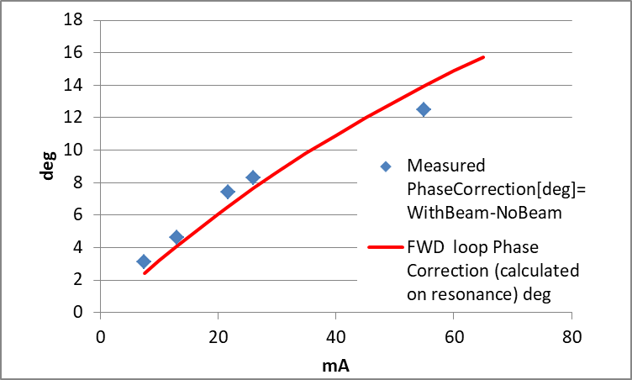
Beam Loading
For 125 mA D+ (or 62.5 mA H+) a +8.1 kHz optimum detuning is required to be at resonance with beam (beam “decreases” the frequency)
To check it we took 3 different measurements
  1. Measurement of the FWD loop phase correction required by beam entrance at different proton currents (close loop, resonant frequency without beam at 175 MHz)

Slide 31
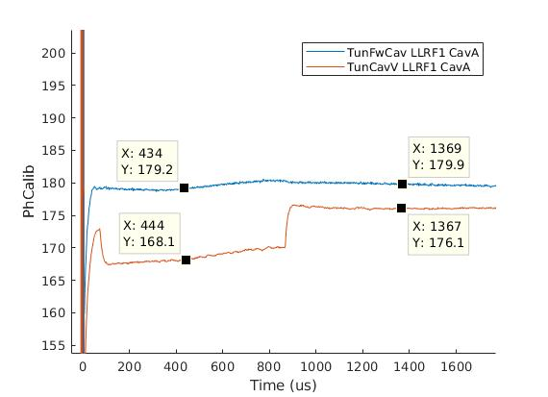
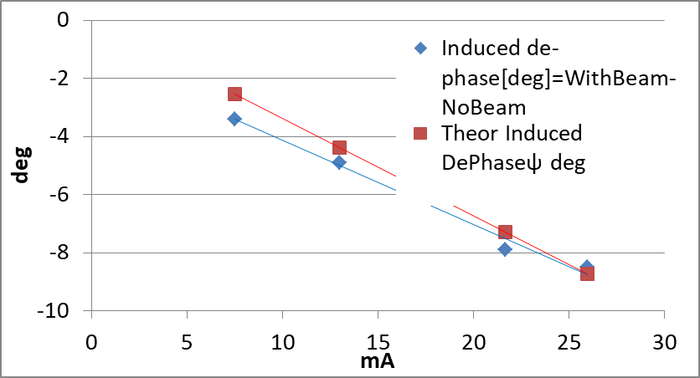
Beam Loading
For 125 mA D+ (or 62.5 mA H+) a +8.1 kHz optimum detuning is required to be at resonance with beam (beam “decreases” the frequency)
To check it we took 3 different measurements
  2. The beam induced de-phase in the cavity voltage (open loop, resonant frequency with out beam 175 MHz)

Slide 32
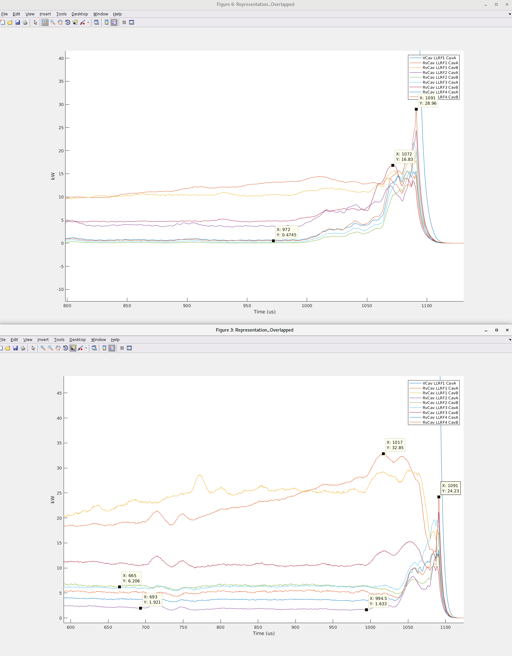
Beam Loading
For 125 mA D+ (or 62.5 mA H+) a +8.1 kHz optimum detuning is required to be at resonance with beam (beam “decreases” the frequency)
To check it we took 3 different measurements
  3. Minimization of the reverse power with beam, modulating the cavity frequency by temperature (Expected frequency shift with D+ 75 mA is -4.8 kHz that means 1.6 deg C temperature decrease to recover f_{RF}=175 MHz)
24.5 C
25.8 C

Slide 33
Some focus on Beam input matching

Slide 34
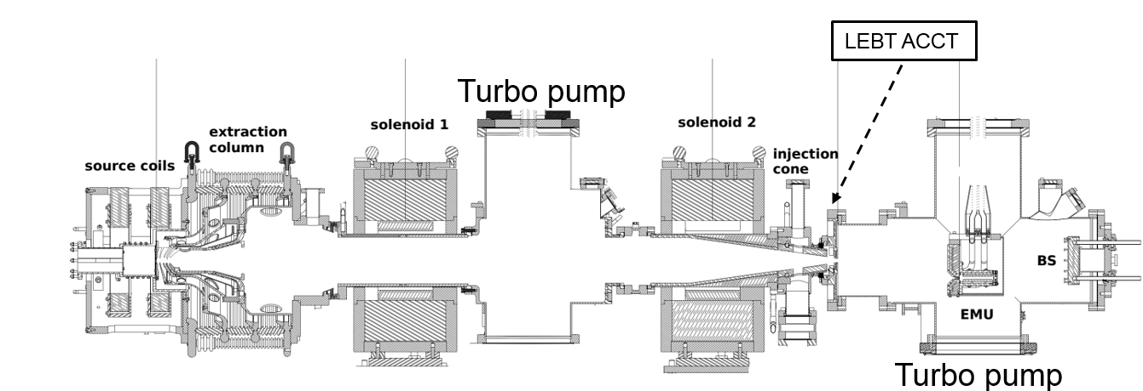


IFMIF-EVEDA Injector commissioning
ECR ion source type, 1 kW RF power @ 2.45 GHz [0]
Short LEBT, 2051 mm from PE. Balanced between Ion species separation power and minimization of emittance growth. Typical generalized perveance: $4.5×{10}^{−3}$ (158 mA given by D (93%) and its molecular ions)
Few diagnostics: ACCTs, Allison scanner type emittancemeter (EMU, one plane), cct cameras (but only useful at high DC), Doppler shift spectrometer, vacuum gauges and Four Grid Analyser and RGA
No IRIS, just RFQ cone as scraper.
$$≅2.05 m$$
db2
sol1
diagn. box1
sol2
[0] “Final design of the IFMIF injector at CEA/Saclay,” R. Gobin et al., in Proc. of IPAC 2013, pp. 3758–3760, JACOW, 2013.

Slide 35
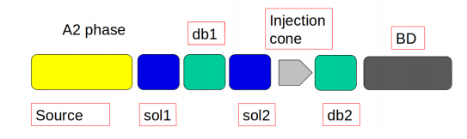
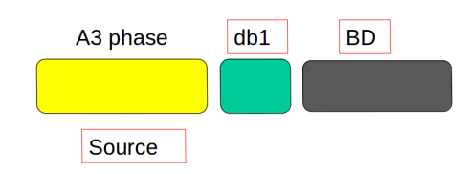
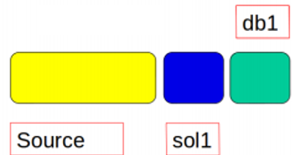

Commissioning steps
Check of all the injector components
Deep study and modellization of the S.C.C (space charge compensation)
Definition of experimental measurement uncertainties.
Definition of an experimental criteria to inject into the RFQ
Definition of simulation model uncertainties
Definition of injector working point for nominal beam perveance.
Implementation of a BD model with the study of the injector response with respect to the parameters variation (e.g. solenoids):
  Estimation of the beam characteristics at the RFQ entrance.
A1 phase
Injector commissioning phase (> 2 years)
EMU was moved here!
B1 phase

Slide 36

Model and software's
WARP for space charge compensation patterns and LEBT transport
IBISIMU extractor
Tracewin for matching routines and outputs
Toutatis for RFQ model (as built, RF tuning).

Slide 37


$ϕ_{tot}$(z) along axis
Secondaries from metallic boundaries
Ionization and charge exchanges with residual gas
e⁻
db2
e⁻
Each intercepting piece of metal will vary locally the s.c.c..
[1] “Final Design of the IFMIF-EVEDA Low Energy Beam Transport Line”, N. Chauvin, Proceedings of PAC09, 2018
[2] “Beam Dynamics Characterization of the IFMIF/EVEDA RFQ Input Beam”, L. Bellan, PhD Thesis, 2018
[3] “Étude de la compensation de la charge d’espace dans les lignes basse énergie des accélérateurs d’ions légers de haute intensité”, F. Gérardin, PhD Thesis, 2018

Slide 38





Example of results
High perveance D
High perveance H
85 mA H beam (nominal + contaminats)
The emittance depends on the solenoid values.
More divergent the beam from the source, higher the values of the emittance will be on the upper left side of the solenoid scan plots (where the matching point should be)
The emittance growth in the source is always lower than the emitttance growth caused by the non-linear part of the solenoids and due to the residual s.c. fields.
Meas.
sim.
EMU is here
RMS quantities difference < 10%
Meas.
sim.

Slide 39

Simulation-experimental criteria for RFQ input beam
Since in RFQ operation the EMU would be located in db1 between LEBT solenoids, we wanted to determine a fast experimental criteria to define if a certain beam from the source is acceptable for the RFQ injection, looking to the emittance measurement after Sol1 (NB: it’s a specific of injector and RFQ design)
EMU is here
At fixed solenoid value, several extractor configurations are studied.
The emittance between the two solenoid is measured.
To limit the emittance growth in the second half of the LEBT for any couple of solenoids, the emittance must be < 0.2 mm mrad normalized rms.
This should ensure a transmission of at least 90% of accelerated particles through the RFQ

Slide 40


Procedure for first “easy” beam injection
Low current H beam with 1/6 of nominal perveance (10 mA proton). Thus, beam mismatch accepted from 20% to 200%, boosted by the low current and the low emittance.
Probe beam generation without IRIS: design of a plasma electrode diameter with half aperture respect to the nominal one.
The MEBT was kept fixed during solenoid scan and steerers optimization.
The MEBT acts as an energy separator (H2+ and H not accelerated are eliminated) with a certain efficiency that needs to be simulated
However:
low current extraction implies low proton fraction.
Very focused electrostatic optics from the extraction
Low separation of H²⁺ and H⁺ at injection point of RFQ
Under estimation of the RFQ transmission
Average maximum proton perveance
Probe beam
EMU

Slide 41
Procedure followed for each RFQ injection point
Study of the point at the injector level (emittance measurements between the two solenoid). Is it compliant with the criteria?
Solenoid set to theoretical value.
Steerer optimization looking to the beam dump.
Solenoid scan + steerer optimization (routine).
Small MEBT tuning.

Slide 42





1/3 perveance proton current
Residual contaminants at RFQ injection
Post RFQ emittances (21.7 mA proton beam )
Meas.
Not compliant with the Sim.-exp. criteria
Sim.
Phase-space plane | yy’ [meas/sim] | xx’ [meas/sim]
$ε_{rms,n}$ [mm mrad] | 0.237 / 0.24 | 0.231 / 0.24
$β$ [mm/mrad] | 8.03 / 8.1 | 2.27 / 1.8
$$α$$ | -5.38/ -6.0 | -4.00 / -3.3
EMU

Slide 43




Nominal deuteron current (124 mA)
Meas.
Sim.
Transmission map through the RFQ with respect the LEBT solenoids.
EMU

Slide 44
Final considerations on simulations and experiments
The beam physics in the source and LEBT transport is one of the most challenging in terms of simulations: multi-species ions interacting with residual gas and metallic boundaries, fully immerse an electrostatic and magnetostatic fields. Even with the most powerful simulation tool, a much larger degree of approximation must be included in simulations as errors. It is a full-fledge plasma confinement simulation.
The situation in terms of precision can be considered even worst if we considered the experimental errors: as an example, in the IFMIF EVEDA injector Allison scanner emittancemeter the estimated error on the emittance value may span the 20% of the value!
However, despite these complexities, the first order optics (beam envelopes, transmissions, initial settings of the machine) are normally coherent with the easiest simulation models, at least the trends!
  If you start from the extraction with a large divergence beam, you will quickly gain emittance growth due to the nonlinear space charge effects which couples with the solenoids non linarites.
Every time we found a non-consistency of the experimental data with the simulation models, the problem belonged by the experimental setup (measurements and hardware faults)
It is essential to keep in mind the limits of the modelling in such complicate line in order to interpreter correctly the results.
Take all your free time to further experiment on beam commissioning of the front end
Focus on few important measurements! The post analysis will require a large effort.

Slide 45

Conclusions
We can conclude that the IFMIF EVEDA RFQ is working as expected, both from RF and beam dynamics point of you, passing succesfully many check points.
Thank you.

Slide 46
Back up

Slide 47






Example of results (2)
EMU is here
Meas.
Sim.
Meas.
Sim.
Iext = 70 mA H⁺ 50 keV
εn=0.250 π mm mrad
α=14.757, β=15.671 mm/π mrad
<x>=0.90 mm, <x’>=-6.28 mrad
Iext= 85 mA H⁺ 50 keV
Iext= 163 mA D⁺ 100 keV
X-X'
Emit [rms] = 0.19 mm mrad
Beta = 18.0 mm/mrad
Alpha = 1.4

Slide 48

Solenoid and steerer scan routine
Problem: large sensibility of the RFQ to misalignment. No information usable for precise and fast centering.
Implemented solution:
The RFQ + MEBT is used as a centering diagnostic.
In order to set the steerers for matching the input at the RFQ, we implement an automatic routine scan.
The routines changes the steerers (and solenoids) strengths 2 vertical and 2 horizontal looking at specified observable: current at the LPBD, transmission etc.. Time taken for completion, order of several hours!
Large part of the work involves the implementation of a back up file that can restart the routine from the last interruption (interlocks).
Results: it identify the needs of a large (> 50 A) vertical steerer strength.
Systematic mitigation of the misalignment effect.
Further improvement are foreseen and will be tested in the next campaign.

