Slide 1
Operations Planning (Scope: main control room activities)
Lali Tchelidze
Operations Section Leader
January 30, 2020

Slide 2
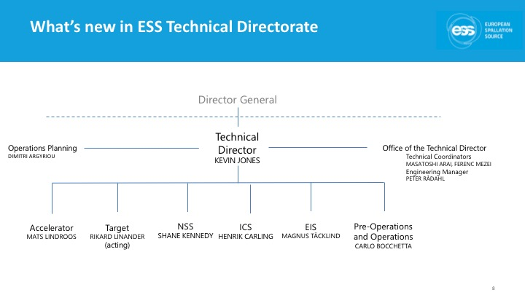
ESS Initial operations - organisation
ESS is in initial operations since 2019 and is gradually transitioning towards the operations.
ESS re-organisation occurred on October 1, 2019 mainly to strengthen ways to support installation work but also to establish a pre-operations and operations division led by the deputy technical director, Carlo Bocchetta.
Operations section is established (currently part of AD, but in charge of all activities in the ESS Main Control Room (MCR), e.g. operation of the neutron source and technical infrastructure). Note: the team is mostly new having four of the staff employed in the last four months.
MCR coordinator – Marc Munoz
MCR shift leader – Benjamin Bolling
MCR shift leader – Joe Christie
MCR shift leader – currently hiring
MCR operator – Peyman Ghaforian
MCR operator – Julien Riegert
MCR operator/shift leader – hiring again 2022 onwards
Operations section leader – Lali Tchelidze

Slide 3
Typical tasks (for operations section)
When in shut-down
Support the technical system teams as required (e.g. installation work, local/integrated tests, documentation, operating procedures).
Gain knowledge related to the technical systems.
Train operators/shift leaders for their main duties in control room.
Prepare control room tools for NC linac commissioning.
When in operation (including test and commissioning)
Staff the control room with 1 shift leader + 1 operator as required (note: minimum 1 authorized person is required for RF tests and 2 for beam commissioning).
Be responsible for operation of the safety systems from the start. Be responsible for operation of the systems gradually, as they get fully verified with the beam and declared operational.

Slide 4
Transition to operations
Installation to test&commissioning to operations
Transition
Handover
Design to Build
Installation to Test/
Commissioning
Test/Commissioning
to Operations
Design
Installation
Handover
Operate
IRR (Installation Readiness Review)
TRR (Test Readiness Review)
ORR (Operations Readiness Review)

Slide 5
Operations – meetings structure (from Isrc and LEBT commissioning)
Daily meetings (when in “operation”) in the control room (study leader & shift leader).
Typical agenda:
Summery of the last shift
Plan of the day
Weekly summary meetings (beam commissioning coordinator).
Bi-weekly Operations Coordination Team meetings (deputy technical director).

Slide 6
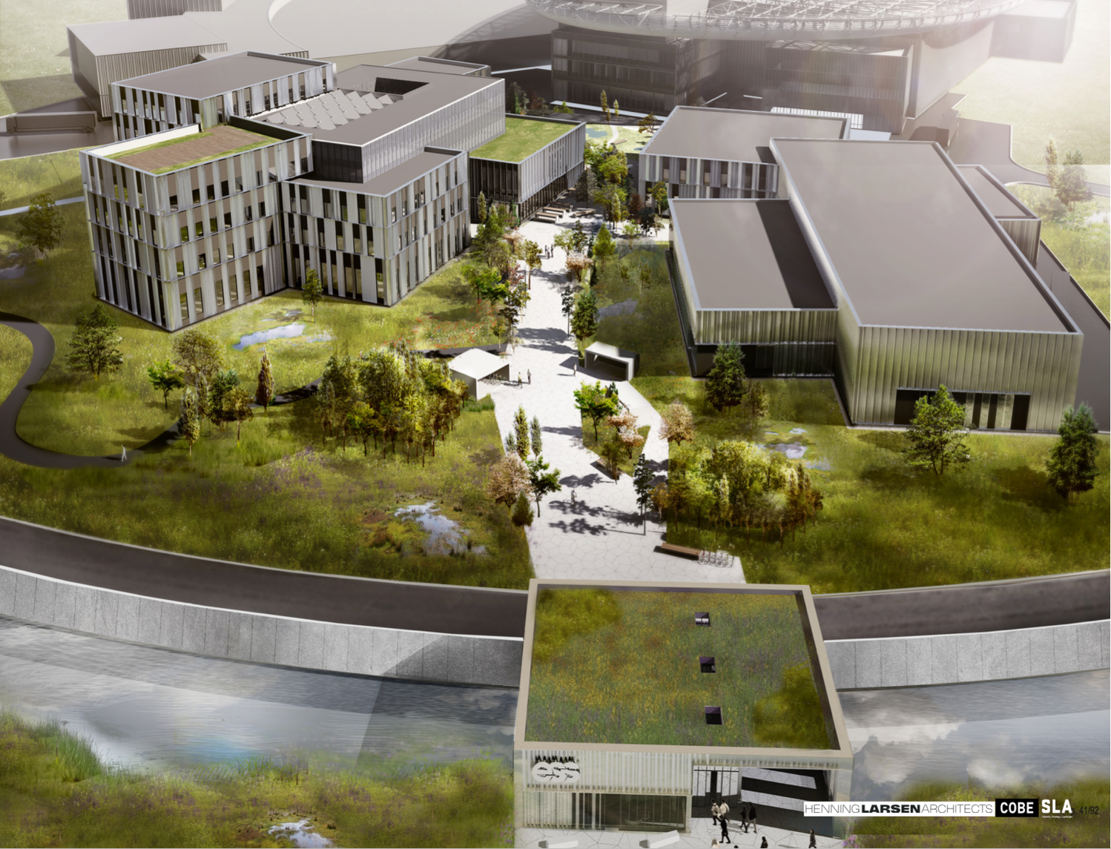
Campus
Thank you!

