Slide 1
ESS RFQ Conditioning Overview O. Piquet 29/01/2020

Slide 2
OUTLINE
Status of RFQ
Instrumentation for RFQ
Requirement for RFQ conditioning

Slide 3
OUTLINE
Status of RFQ
Instrumentation for RFQ
Requirement for RFQ conditioning

Slide 4
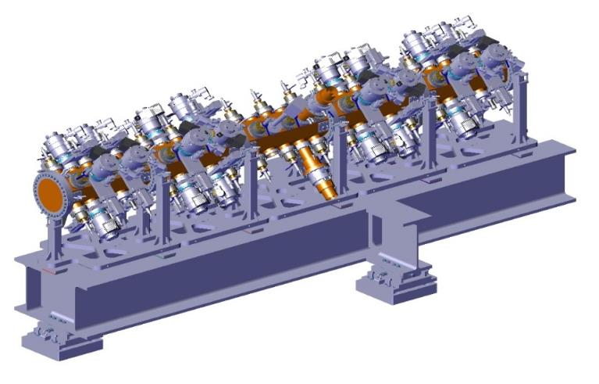
ESS RFQ
5 RFQ sections
Pick-ups (x22)
Tuners x60
Power couplersx2
RFQ support

Slide 5
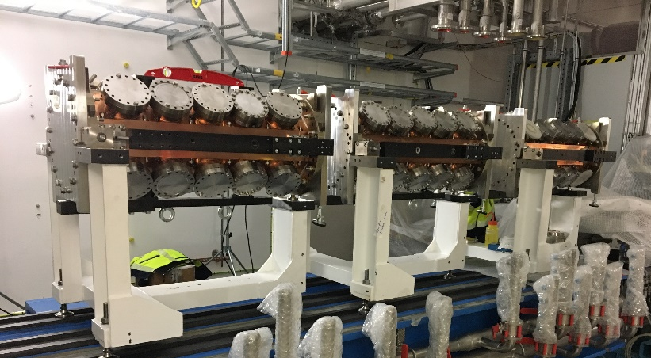
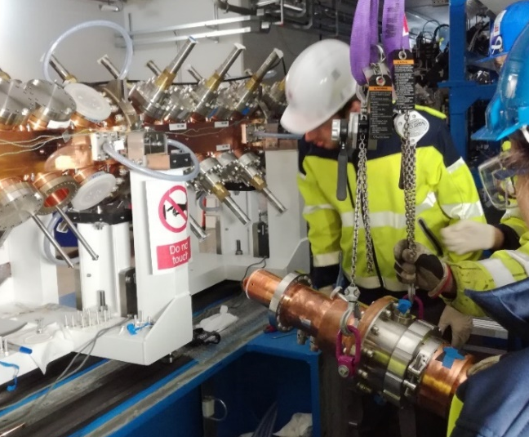
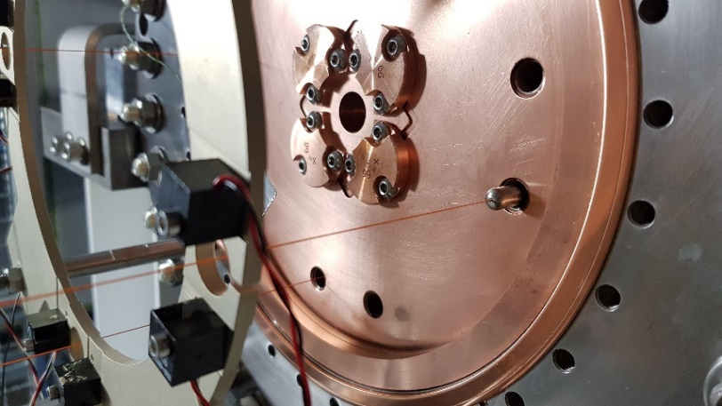
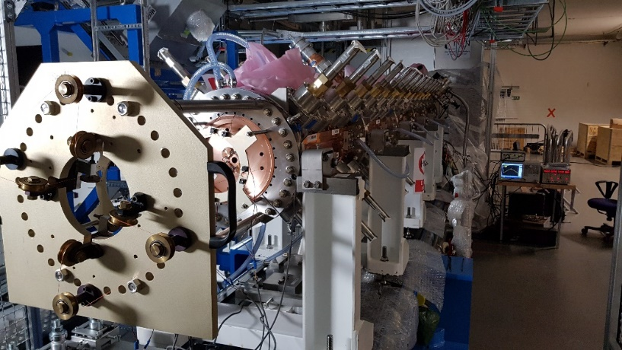
RFQ installation at ESS
Start of installation at ESS: August 29th :
End of assembly: September 28th
First beadpulll: October 8th for the RFQ extremities tuning
Tuning of slugs and couplers: From November 4th to 8th
Final beadpull (after vacuum system installation): December 4th

Slide 6
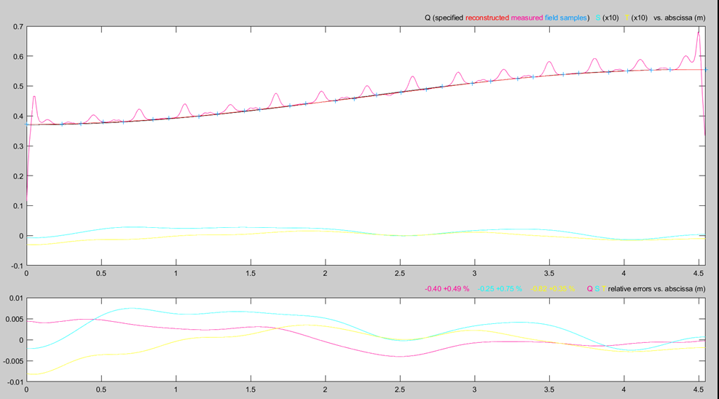
Final Tuning
RFQ voltage law tuned with tolerances less than 1% (requirement 2%)
Estimated RF power for nominal voltage=723kW
RFQ ready for conditioning (only pipes of cooling system must be installed)

Slide 7
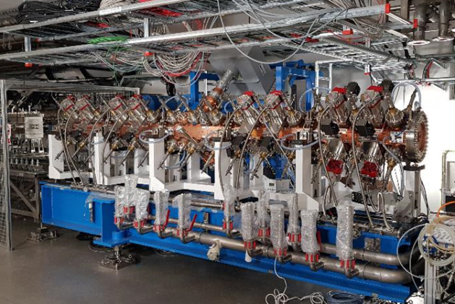
RFQ installation at ESS

Slide 8
OUTLINE
Status of RFQ
Instrumentation for RFQ
Requirement for RFQ conditioning

Slide 9
RFQ INSTRUMENTION
Instrumentation for RFQ
4 arc detectors: for each coupler, one for vacuum side and one for air side
2 electron pick-ups (one per coupler)
4 vacuum gauges (1 per coupler + 2 for RFQ )
32 temperature probes (PT100):
20 on RFQ’s section: 4 on each section = 1 per quadrant
4 on input plate
4 on output plate
4 on couplers (2 on each coupler and close to the ceramic windows)
4 RF signals: forward and reflected powers for each bidirectional coupler
22 pick-ups (1 for LLRF (1 spare) and 20 for the field monitoring)
4 Flowmeters for the couplers (one for each coupler’s channel)

Slide 10
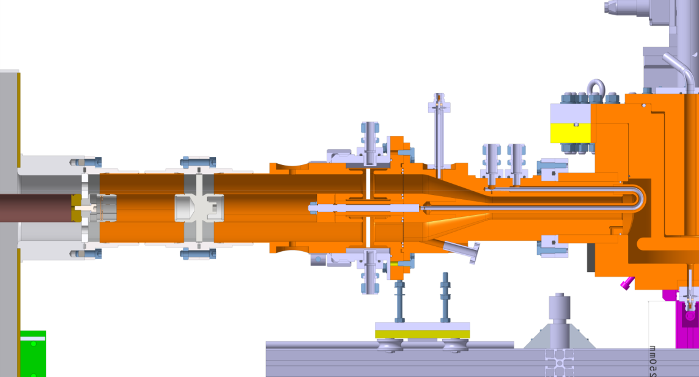
COUPLER INSTRUMENTION
Couplers: most breakable part of RFQ (windows and vacuum seals)
Coupler description:
Electron current measurement +
Vacuum gauge
Cooling for RF loop with Flowmeter
Cooling for ceramic window
with flowmeter
Coupling performed by rotating the coupler around its rotation axis
Air side arc-detector
Vacuum side arc-detector
2 arc detectors: one for vacuum side and one for air side
1 electron pick-up
vacuum measurement
flowmeter for each cooling channel (2)
2 temperature probes PT100
Fast interlock
Slow interlock

Slide 11
COUPLER INSTRUMENTION
Detection of the electron current (multipactor) close to the coupler windows
2 main functions:
provide measurement of electron current
compared the measured electron current with threshold and send a fast interlock in order to stop RF power in less than 20 µs.
How will be measured the light?
Which will the lowest measured level of light?
Detection of the light (arc) close to the coupler windows
2 main functions:
provide light measurement
compared the measured light with threshold and send a fast interlock in order to stop RF power in less than 20 µs.
Thresholds will be defined during RFQ conditioning

Slide 12
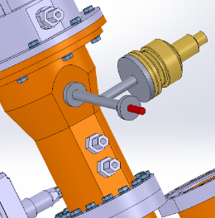
VACUUM ASPECT
4 vacuum measurements: 1 on each coupler and 2 on the RFQ
Gauges connected to a controller
Provide a vacuum measurements (required for
automatic conditioning procedure)
Use of relay for ‘’fast’’ interlock: 2 hardware
thresholds
Coupler
Gauge
Electron current measurement
Valves closed on LEBT and MEBT sides during RFQ conditioning
RGA connected on RFQ during conditioning (remote control)

Slide 13
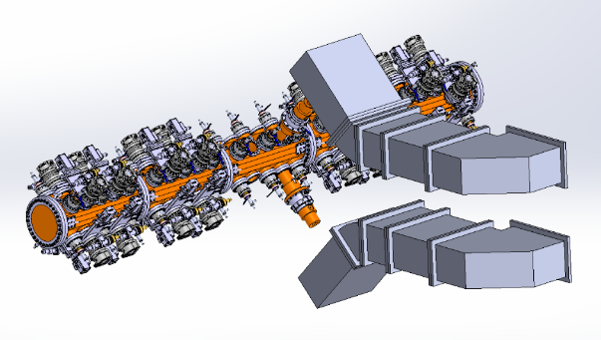
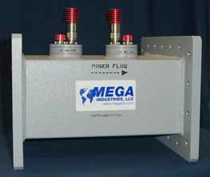
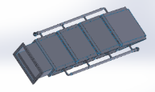
RF Distribution
Power RFQ RF distribution
Foward power
Reflected power
Flexible waveguide
Bidirectional coupler
Foward power
Bidirectional Coupler
Measurement of forward and reflected power for the 2 bidirectional couplers
Fast interlock in case of reflected power
Measurement of the power returned to the load on the magic tee
Fast interlock in case of power
Fast interlock: RF must be stop in less than 20µs

Slide 14
RF MEASURMENTS
22 pick-ups with female N connector are installed on the RFQ
With about 30dBm at the nominal cavity voltage
Pick-ups
1 pick-up (and 1 spare) for LLRF and sparks detection
20 pick-ups for cavity field monitoring
Pick-up location
Pick-up position for field monitoring / Pick-up position for LLRF
Pick up | z (m) | Quantity
Field Monitoring | 0.366 | 4
 | 1.281 | 4
 | 2.196 | 4
 | 3.111 | 4
 | 4.026 | 4
LLRF | 4.179 | 2 (1 for spare)

Slide 15
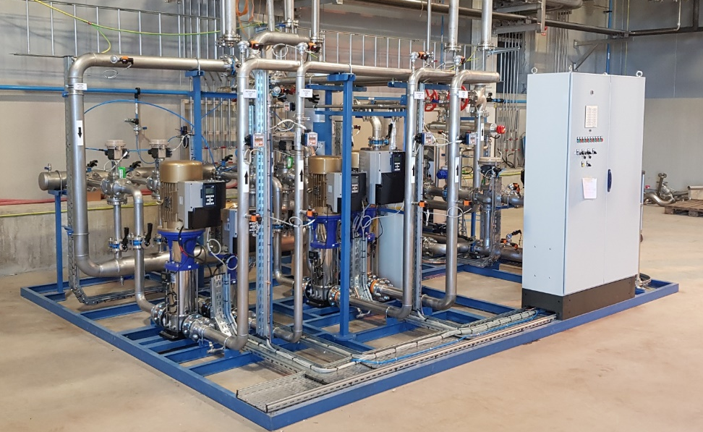
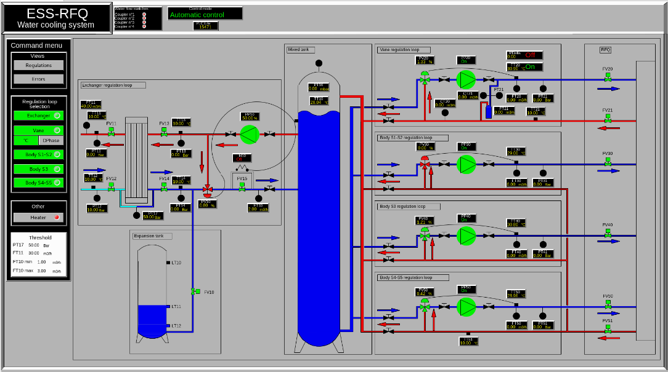
RFQ skid
Control the temperature of the RFQ (and couplers)
3 body circuits: Temperature regulation
1 vane circuit: Temperature or frequency regulation
Control flowmeters for the RFQ couplers ( 2 for each coupler)
Provide the information SKIDREADY to permit RF power
Use the frequency error provided by the LLRF (EPICS data) for the frequency regulation mode
EPICS views must be done by ESS

Slide 16
OUTLINE
Status of RFQ
Instrumentation for RFQ
Requirement for RFQ conditioning

Slide 17
RFQ SYSTEM
Functional diagram of the RFQ system
RF
distribution
RFQ
LLRF
Fast
RF switch
RF power
source
SKID
RFQ instrumentation
EPICS
vacuum
electron pick-ups
arc detectors
RF pick-ups
RF power measurements
temperature probes
….
EPICS
Fast and slow interlock
Cavity voltage and forward power
EPICS
EPICS
- Instrumentation control
- RF control
- Skid control
- Automatic RF Conditioning application
- Field monitoring
- Data acquisition and Post mortem analysis
ICS

Slide 18
RFQ INTERLOCKS
RF stop done by fast RF switch (less than 20µs)
Fast interlocks:
- electron current on coupler (*2)
- arc detection on coupler (*4)
- reflected power (*2)
- power on the load of the magic tee
- vacuum: coupler (*2) and RFQ (*2) (depends of the speed of the relay)
- sparks detection inside the RFQ (done by fast acquisition of RFQ voltage = RF system must detect a drop of cavity voltage faster than the normal falling time)
Slow interlocks:
- temperatures of the couplers and RFQ
- skid (OK)
- RF systems (OK)
- vacuum system(OK)
- …
Thresholds must be set remotely

Slide 19
EPICS CONTROL
Display of RF pulses (Forward and reflected powers for each bidirectional coupler, cavity voltage…), electron current, light… (1Hz refresh rate)
calculation of average value during RF pulse ( for archiver)
Digital scope (RF signals, electron current… on the same display)
Display of field monitoring (acquisition of the 20 pick-ups during the same pulse (average value or measurement at one synchronized time)), calculation according data processing then display)
Access to raw data for the different signals if needed
Post mortem analysis with trigger done by fast interlock (fast interlock counter)
Setting of all thresholds (vacuum, arc, electron current, temperature, reflected power, Maximum of power klystron…)
Application for automatic conditioning procedure (Power, Pulse definition, Sequence…)

Slide 20
EPICS CONTROL
Typical display: digital scope
choice of display several signals in the same screen (RF signals, electron current….) with different axis
definition of the range for the average value
measurement at one defined time
378
Display of Value for selected time
Process variable
for archiver
Cursor to defined duration for average calculation
377
Access of raw data for post processing
Export

Slide 21
EPICS CONTROL
Archiver for :
average values of power, cavity voltage, electron current, light vacuum…
temperature of RFQ
field monitoring results
threshold for vacuum, RF signals, temperature…
fast interlock (sparks) counter
skids parameters
LLRF parameters
RF power sources parameters
…
Display of archived data

Slide 22
RFQ FUNCTIONALTIES
Complex functionalities shared by LLRF, instrumentation, ICS, skid…
Automatic conditioning process of the RFQ: same procedure defined for the couplers qualification done at Saclay, but with frequency following mode:
When the RF power increases, the produced heating leads to a cavity deformation, so a frequency detuning. The cooling system is not fast enough to maintain the frequency of the cavity. The LLRF must track this detuning and change the RF frequency of the RF source in order to follow the cavity frequency
Automatic restart in case of fast interlock. Restart with the next RF pulse (in order to avoid strong detuning)
Cavity field regulation (with LLRF and skid control)
Automatic startup (defined at the end on the conditioning operation)
…

Slide 23
CONDITIONING PROCEDURE
Automatic procedure:
Start at low power (from 10kW to 750kW (TBC))
Start with short pulse (from 10µs to nominal pulse)
Start at low repetition rate (from 1Hz to nominal repetition rate)
Typically and basic conditioning procedure with 2 software thresholds for the vacuum (for each vacuum measurements : couplers and RFQ)
Vacuum
Hard threshold (upper)
higher Software threshold
Hard threshold (lower)
Lower Software threshold
Power
time

Slide 24
CONDITIONING PROCEDURE
Different parameters have to be defined for RFQ protection or/and conditioning procedure optimization
duration step, power step, pulse length, repetition rate…
vacuum thresholds for each vacuum measurement
threshold for each electron current and arc detector measurements
level of reflected power and power returned to the load
limitation of the klystron power (hardware if possible)
temperatures measured on RFQ and couplers are used as interlock
…
Some fast interlocks require automatic reset (by the next RF pulse in order to minimize conditioning duration)
Vacuum side arc detector
Electron current measurement
Reflected power
Sparks into RFQ
Vacuum
All the final thresholds used for RFQ protection will be validated at the end of the RFQ conditioning

Slide 25
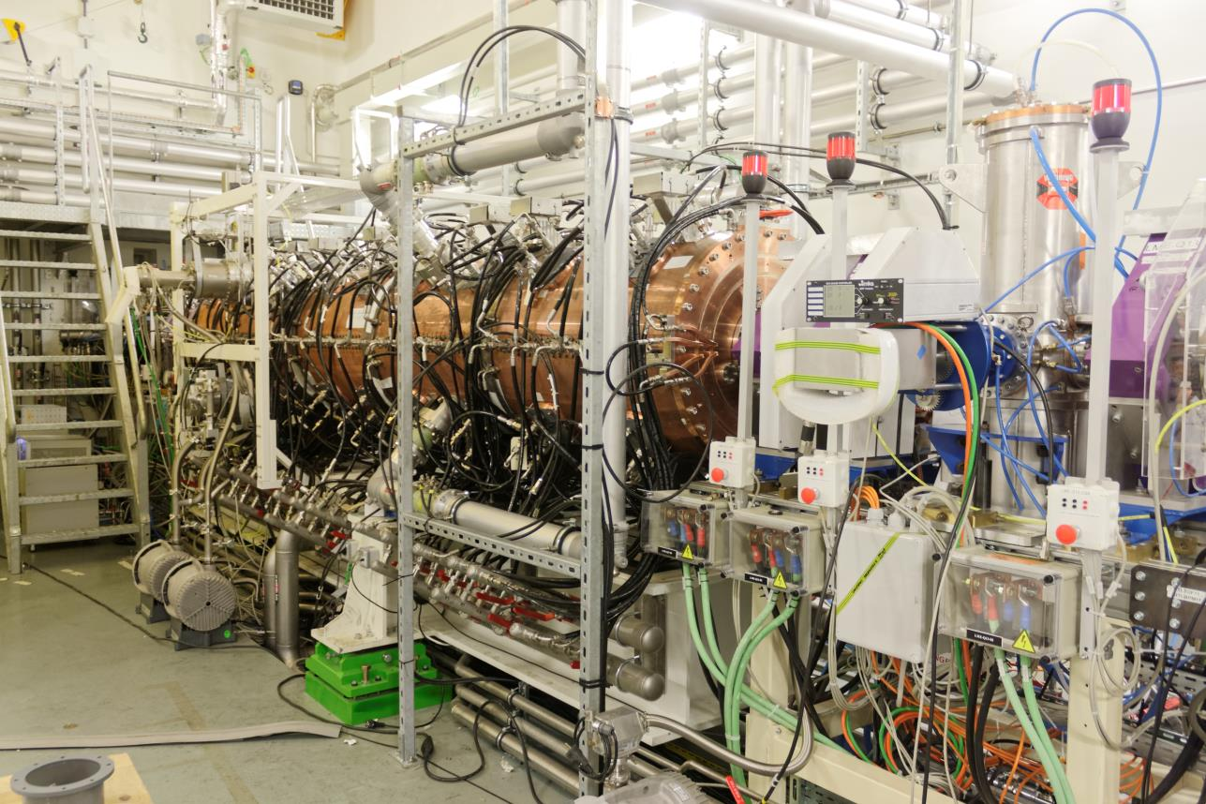
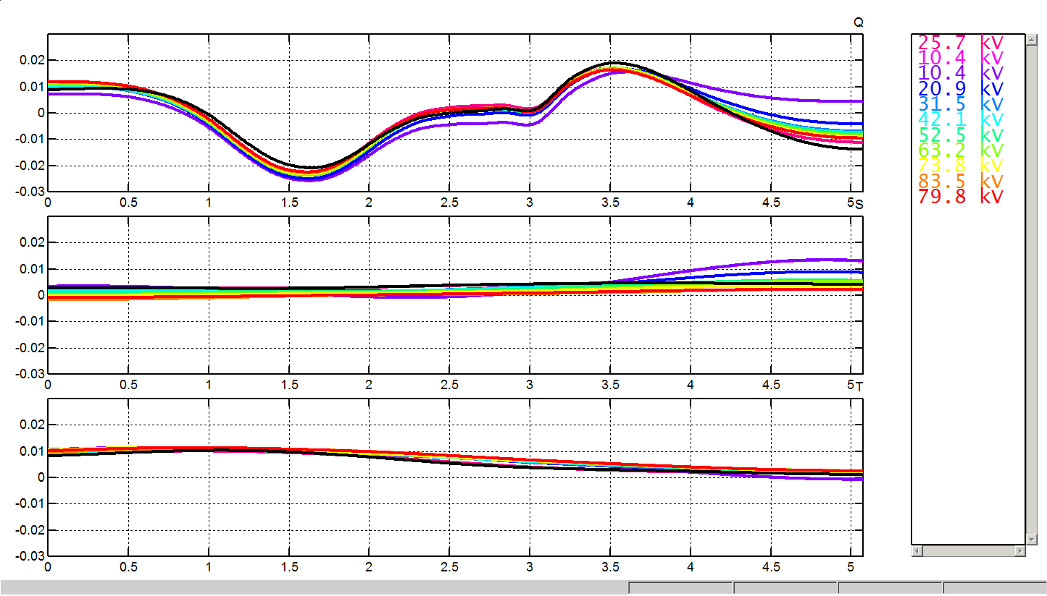
Field monitoring
Why field monitoring?
Check of no degradation of the voltage law obtained after the RF tuning (Beadpull)
Measurements done during RF conditioning and along RFQ operation
Skid Triple Body Circuits would help to correct the voltage profile (LINAC4 @ CERN)
SPIRAL2 example
16 pick-ups along the RFQ in order to measure the voltage law
Calibration of pick-ups measurement at low power (according the last bead-pull measurement )
Voltage reconstruction using the TLM
A variation of ±0.2% for the voltage law is measured when the voltage changes from 20 kV to 120 kV.

Slide 26
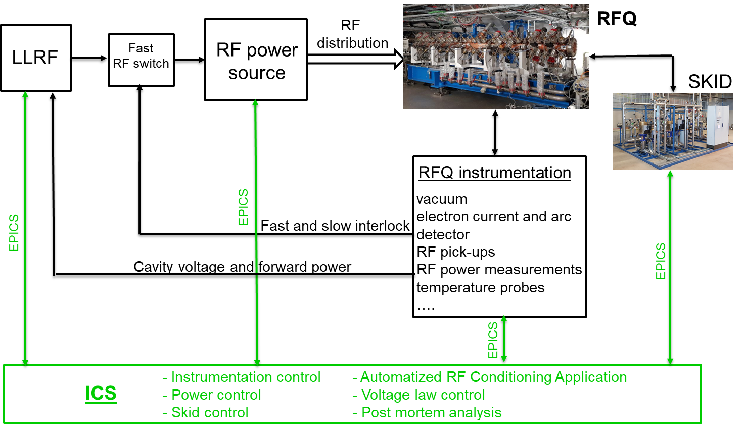
RFQ CONDITIONING
Plan for the RFQ startup
Validation of the instrumentation
control and setting of thresholds
speed of fast interlock
Validation of skid control
temperature mode
frequency mode
Validation of temperature acquisition
Validation of the RF systems (power source, LLRF, RF acquisitions…)
Validation of ICS
- displays, data acquisition, post mortem analysis…
Test of conditioning procedure WITHOUT RF CONNECTION (short circuit or load)
- automatic procedure
- fast interlock
- frequency following mode of LLRF…

Slide 27
RFQ CONDITIONING
Conditioning starting point
set the maximum power at ≈723kW for the RF source (nominal power defined during coupler tuning)
at low power, find the RFQ frequency with the help of cooling system and LLRF following mode
calibration of pick-ups for field monitoring compared to the last beadpull measurement
Conditioning target
cavity voltage (+5%) (TBC) with low spark rate (TBD)
if possible, voltage will be checked with X-rays measurement (X-rays detectors working in the 10keV-150keV range)
LLRF operation (cavity field control with fast and slow feedback)
cavity field profile ( and tuning of the temperatures for the different cooling systems, if required)

Slide 28
RFQ CONDITIONING
Definition of an automatic startup procedure (example)
set the temperature of the different water circuits
water circuits are in temperature mode
increase of RF power to the nominal value with the help of the frequency following mode (RFQ at the nominal voltage but not at the nominal frequency)
adjust the temperature of the vane circuit in order to tune the cavity to the nominal frequency
vane circuit is set in frequency mode
control of cavity voltage by LLRF
This procedure will be defined after the conditioning step. The main goal will be to minimize the startup duration
Cavity voltage checked with the commissioning step ( beam transmission according cavity voltage)
- if the nominal cavity voltage is not reached, conditioning step has to go on.

