Slide 1
Collaboration Progress Between IMP-ESS
Rihua Zeng
2019-12-09

Slide 2
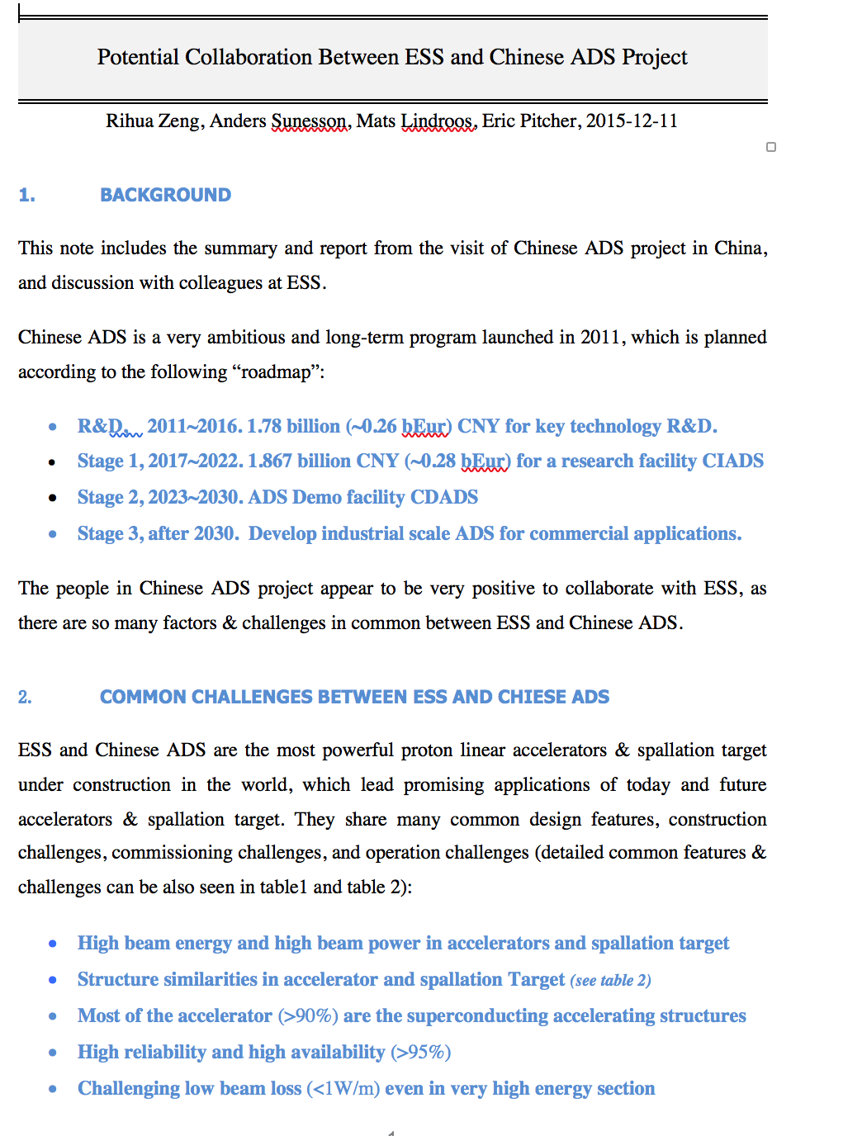
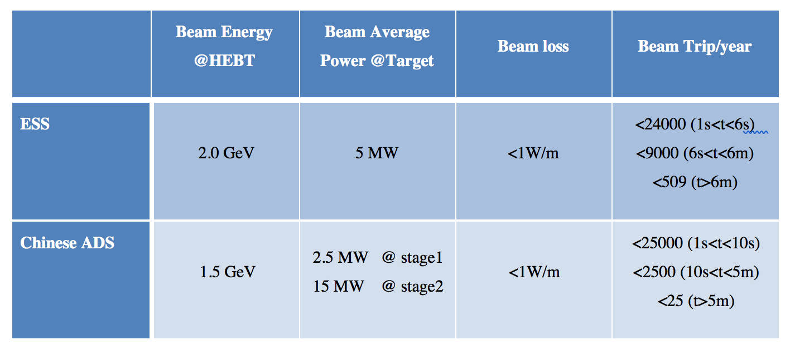
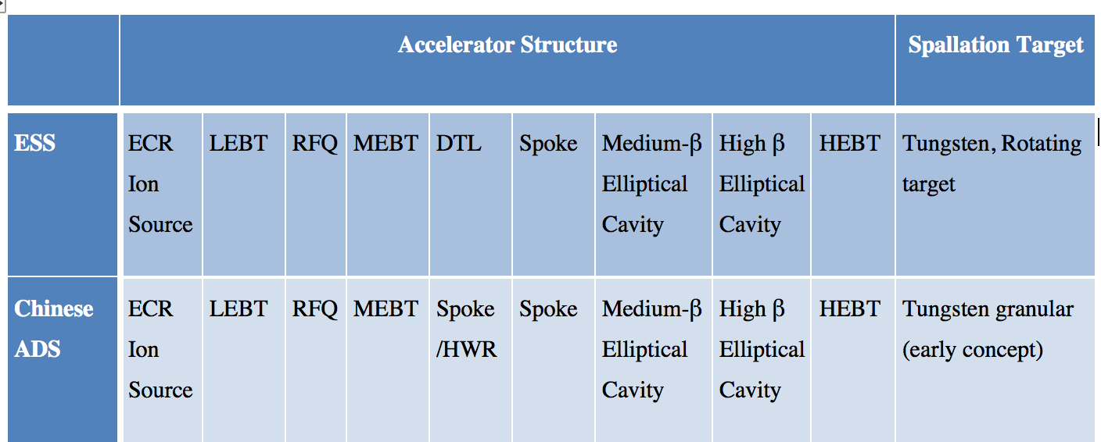
From Early Common Interests

Slide 3
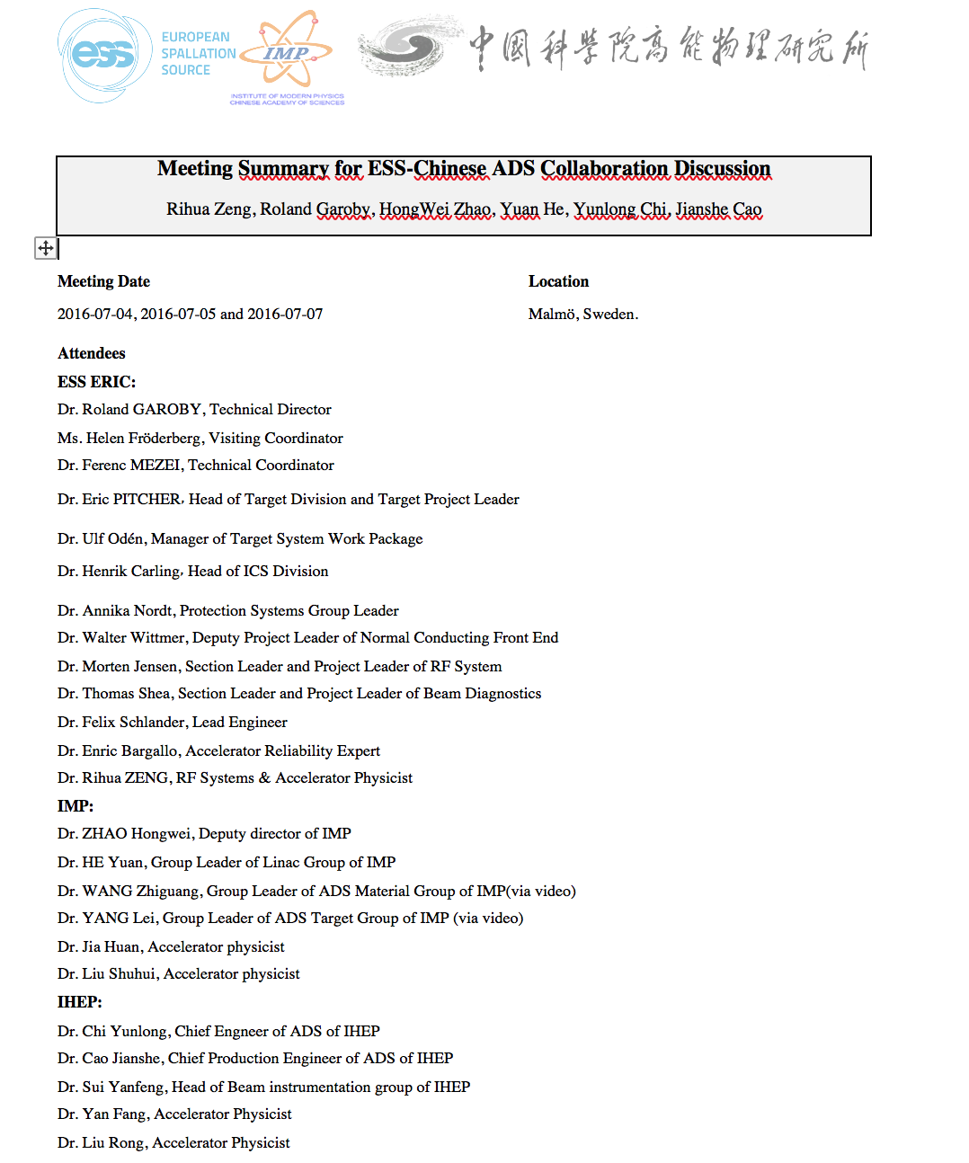
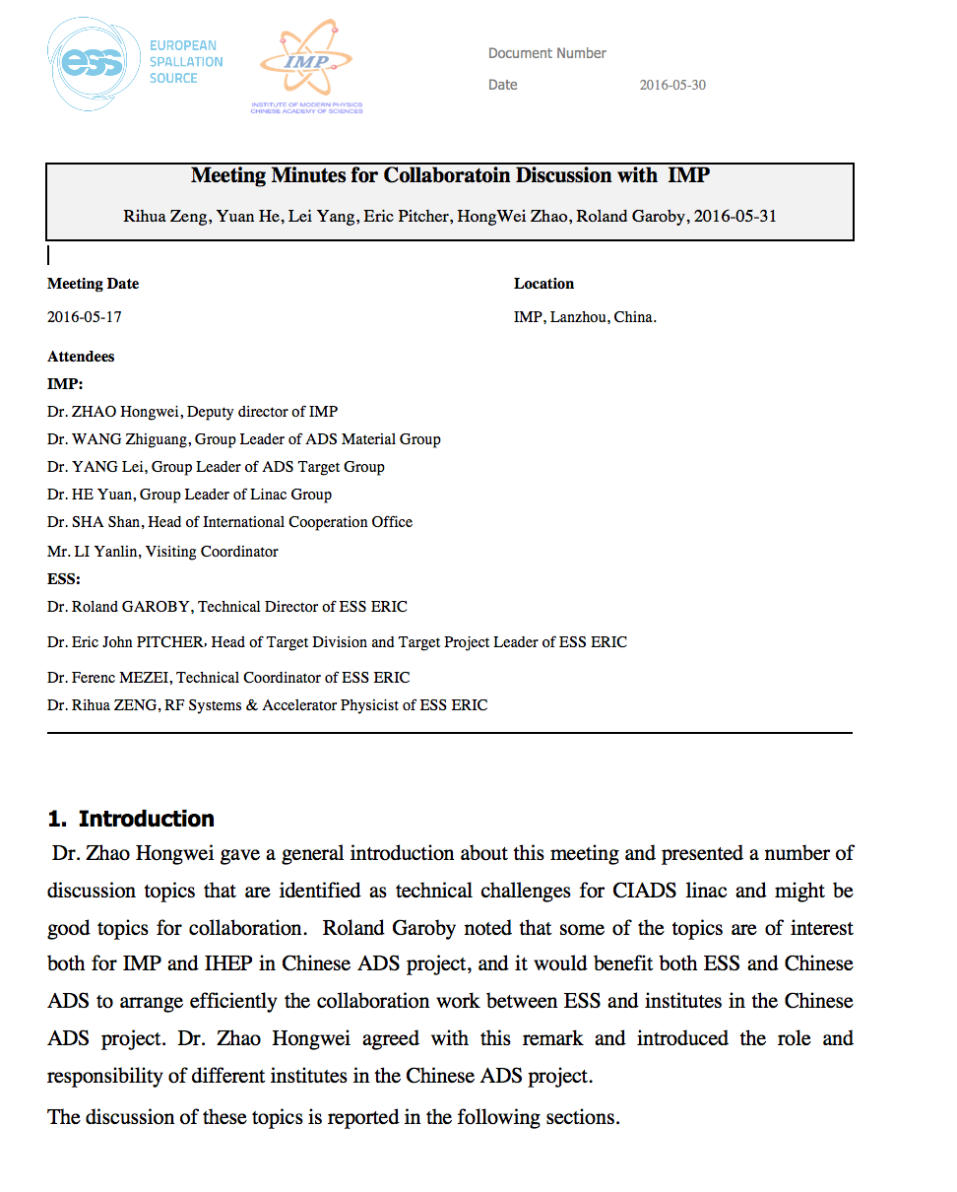
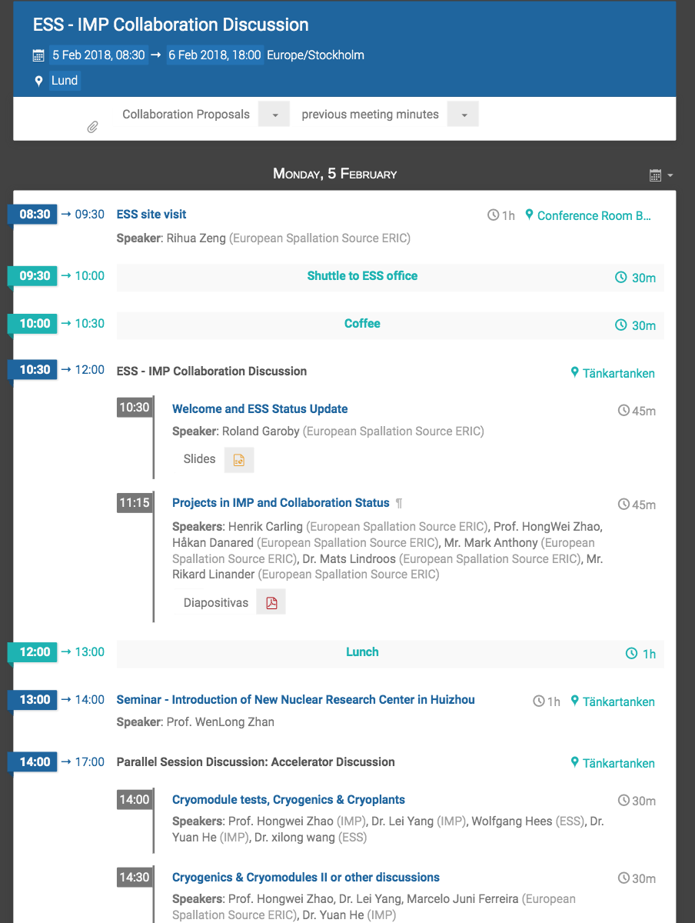
Effort to Pave the Collaboration Path
4 collaboration meetings and more than 20 mutual intensive visits since 2015, covering common interesting of collaboration:
identify technical challenges of both sides
make concrete collaboration proposals
7 proposal documents made, covering accelerator, target and ICS

Slide 4
Collaboration Projects
Four Projects Complete
Beam commissioning Activities of the Spoke Section of ESS linac
SRF Cavity Testing and Conditioning
Beam Diagnostics Calculation and Simulation
Quick Radioactivity Transport Evaluation with Transport Matrix Method
Four Projects Ongoing
APTM&GRID Development and Manufacture
Key Issues in High Energy Beam Transport Line and Cavity Failure in High Power Proton Accelerators
ICS Software Development
Testing and Commissioning support for RF Section

Slide 5
Beam Commissioning Activities of the Spoke Linac
Zhijun Wang, work in ESS as visiting scholar:
2018.04.01-2018.9.30
The preliminary beam commissioning plan of Spoke section
The detailed design of the longitudinal beam information measurement based on both BSM and BPM
other issues
The study of Transient study(not finished yet)
The cavities failure situation
The beam trip situation
The beam power ramp-up situation
Beam loading based beam phase measurement
Many useful discussion with various problems
Deeper understanding of the ESS project

Slide 6
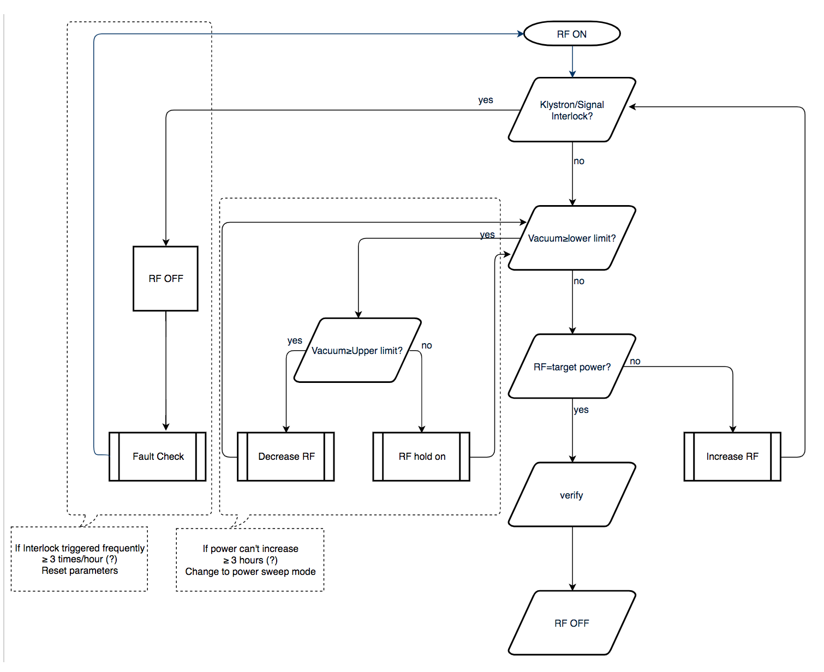
SRF Cavity Testing and Conditioning
Weiming Yue, work at ESS as visiting scholar
2018.04.16 ~ 2019.04.16

Slide 7
Beam Diagnostics Calculation and Simulation
Hongming Xie, work in ESS as visiting scholar:
2019.06.01-2019.11.26
1.Calculation and simulation about ESS IPMs.
2.Thermal simulations about ESS grids.
3.Bias potential simulation about APTM tests in J-parc.
4.Help Cyrille with near target APTMs and Grid.

Slide 8
Quick Radioactivity Transport Evaluation with Transport Matrix Method
Xuezhi Zhang, work for target and radiation safety from time to time

Slide 9
Key Issues in High Energy Beam Transport Line and Cavity Failure
Yuanshuai Qin, Main work in ESS as Joint-PhD:
2017.12.15-2019.12.15
Study on Key Issues in High Energy Beam Transport Line and Cavity Failure in High Power Proton Accelerators
Different beam current and beam energy at the tuning dump and the target
ESS-0680585
Design of the Transfer line to the ESS Target and Beam Dump at Reduced Beam Energy
ESS-0779005 and IPAC2019-MOPTS081
Study of possible errant orbits in A2T area
BPWP-540
Study on power loss at A2T with errors and raster scan

Slide 10
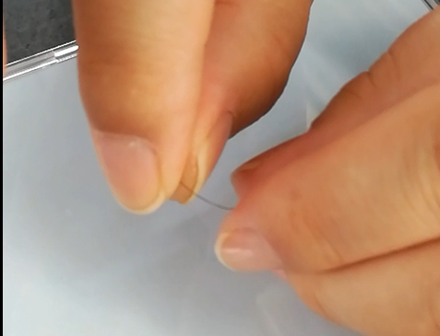
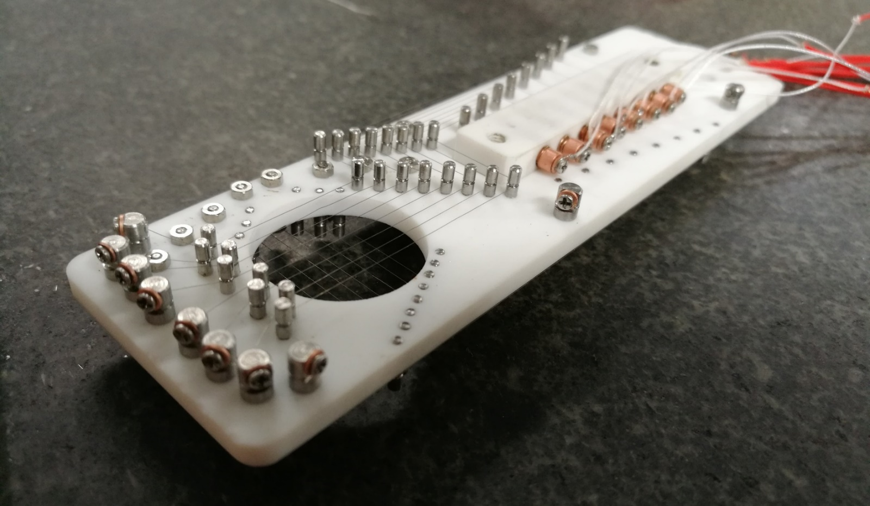
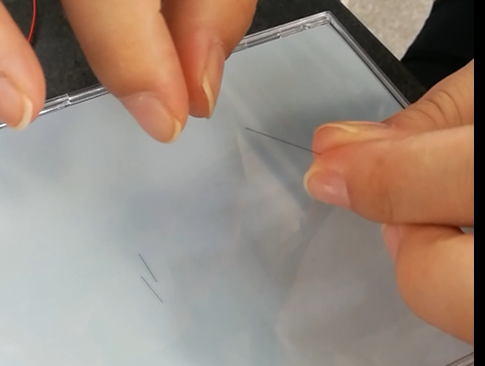
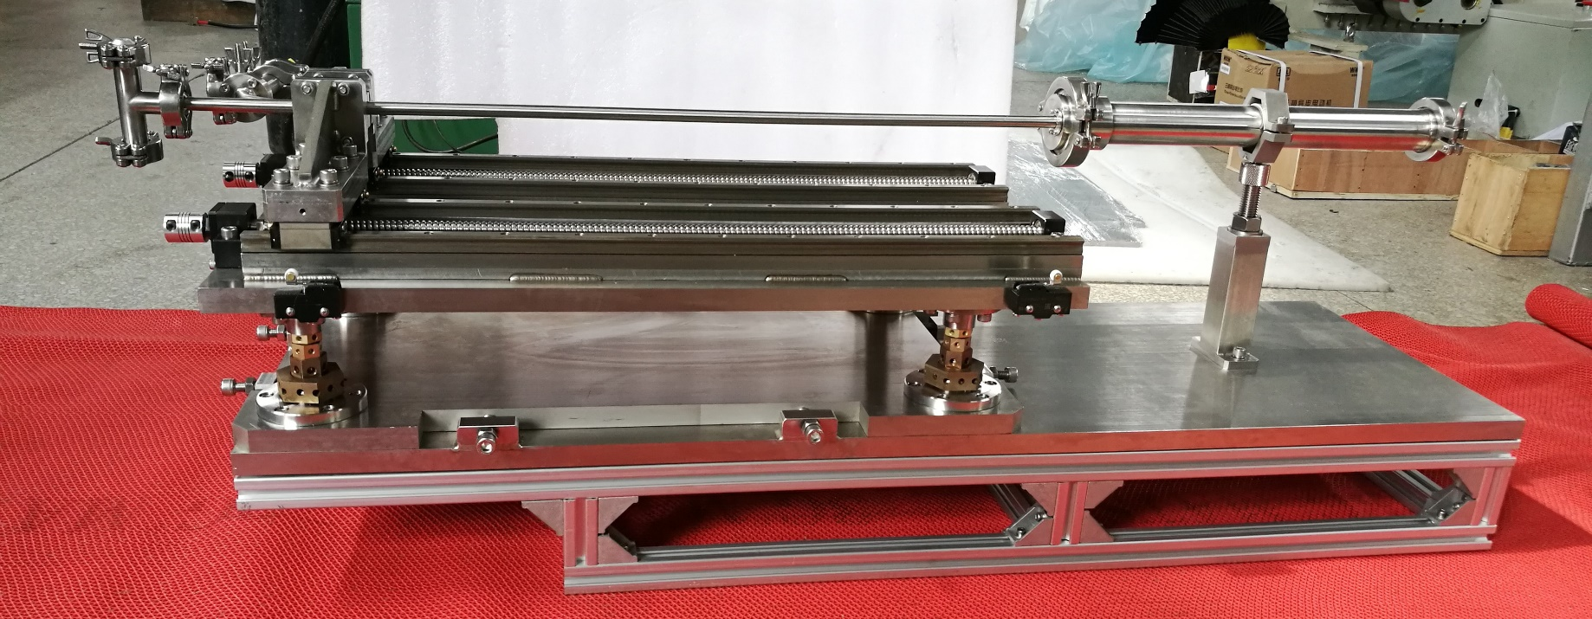
Grid and APTM Development
The Grid and APTM monitor prototype was successfully installed online last year and the test was successfully completed.

Slide 11
Testing and Commissioning in RF Section
Zheng Gao, work at ESS as visiting scholar
2019.07.30~ 2020.01.26
Develop auto-testing devices for LLRF systems
Procedures and guidelines Development for Phase Reference Line
Practical work in RF lab and TS2

Slide 12
ICS Software Development
HaiTao Liu,
just arrived last week
ICS software development

