Slide 1

Spallation target for CiADS
Xueying Zhang
Institute of Modern Physics (IMP), CAS

Slide 2
OUTLINE
Research Aims
Granular target
LBE target with window
Collaboration

Slide 3
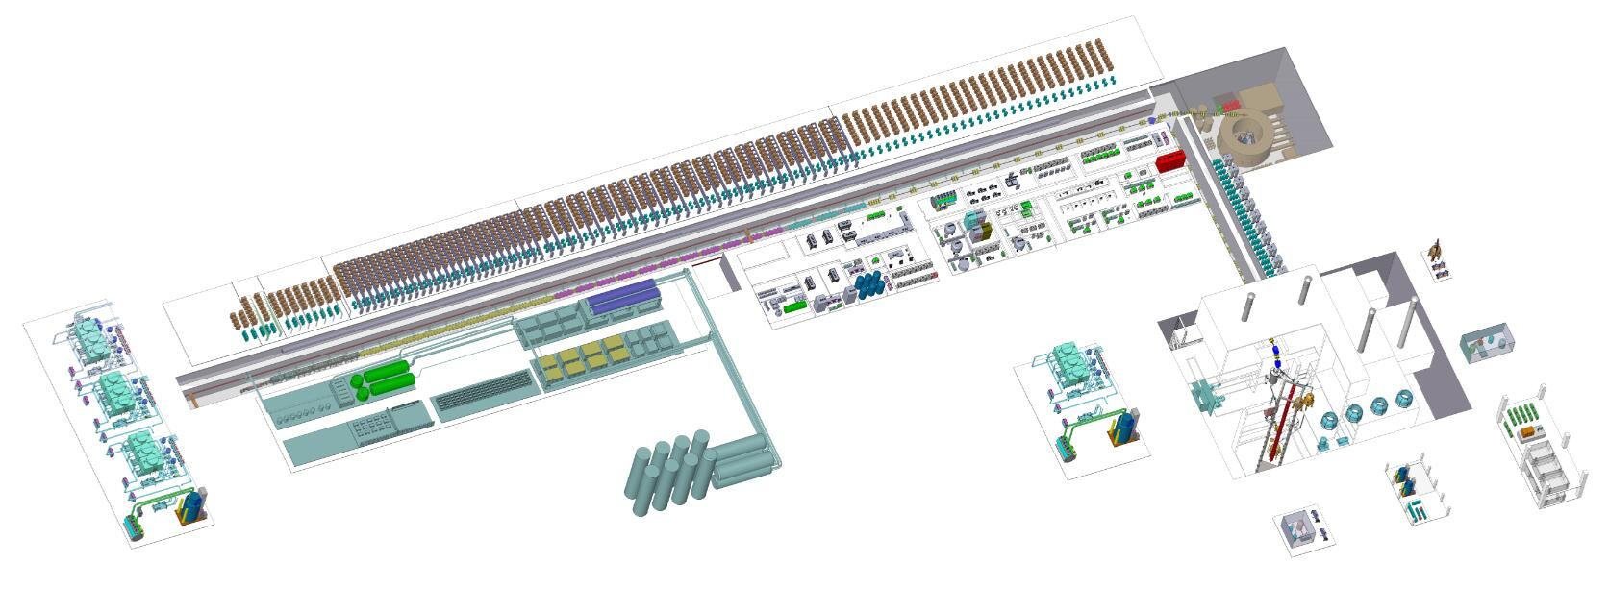
The preliminary Design of CiADS
China initiative Accelerator Driven System
The overall design of CiADS facility has been worked out
LINAC: 500 MeV@5 mA with CW mode
Spallation Target: spallation target, 2.5 MW
Sub-critical core: 10 MWt, LBE cooled

Slide 4
Target: Research strategy
Designing platform construction ⇒ Conceptual design
Comparing with the existing data and bench test experiments ⇒ Code V & V
Optimizing the codes ⇒ Optimizing the design
Constructing a prototype
Preliminary design
……
Starting with LBE target design, coming to a new type of granular target
LBE target with window as the backup of the granular target

Slide 5
OUTLINE
Research Aims
Granular target
LBE target with window
Collaboration

Slide 6
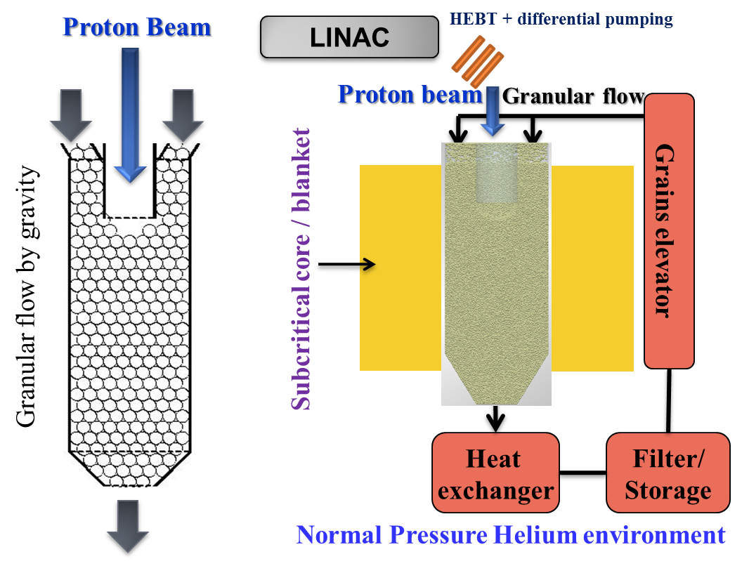
Granular Target Concept
In principle, it can stands for tens of MW beam power
Increasing flexibility to use other target materials to increase the neutron yields

Slide 7
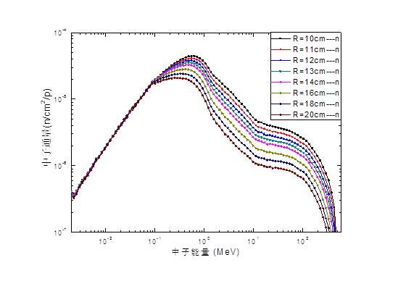
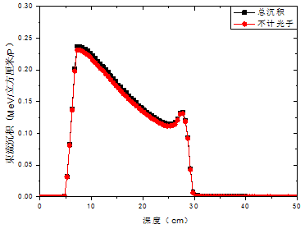
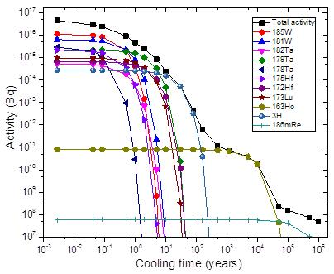
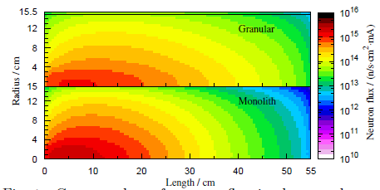
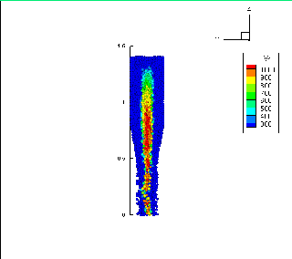
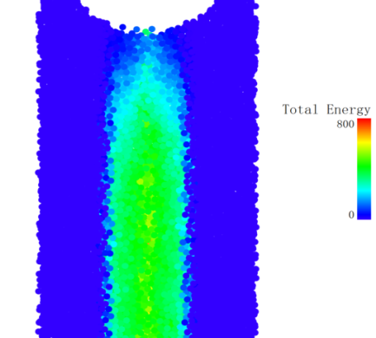
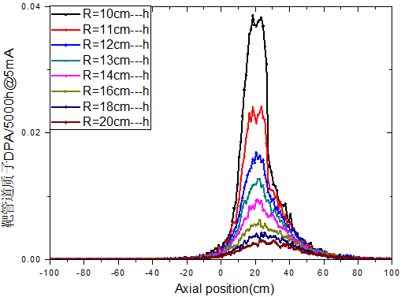
Granular Target Design
physics design
Sidewall leakage neutron spectrum
energy deposition
Secondary radioactive decay
Neutron flux distribution
Packing factor
Temperature distribution (2.5MW=250MeV@10mA)
Radiation damage of pipe
velocity distribution

Slide 8
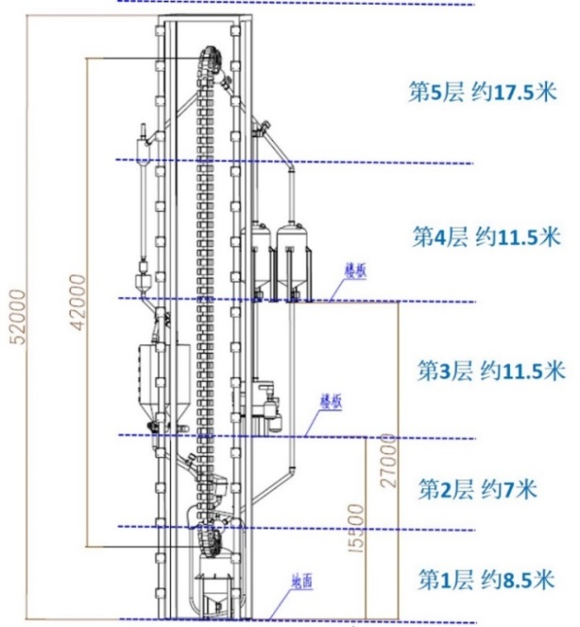
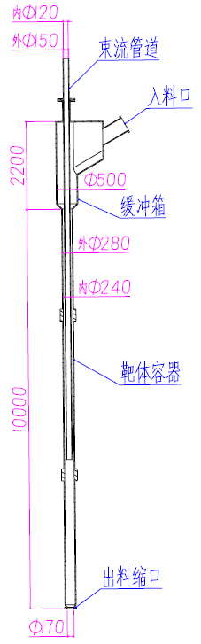
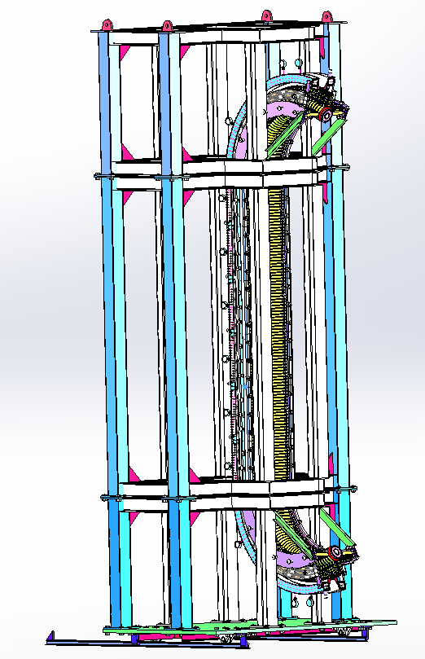
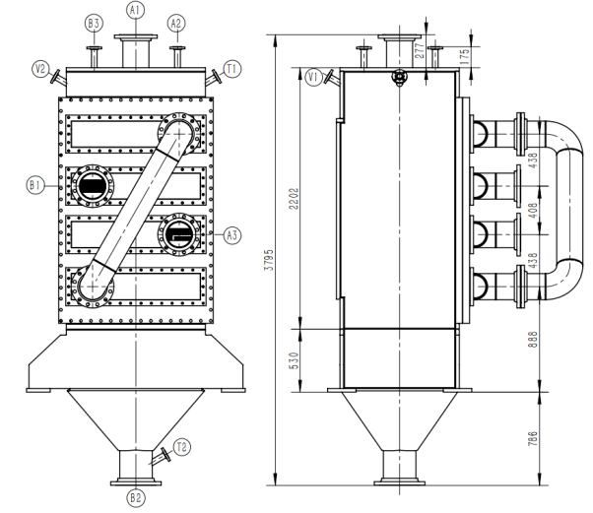
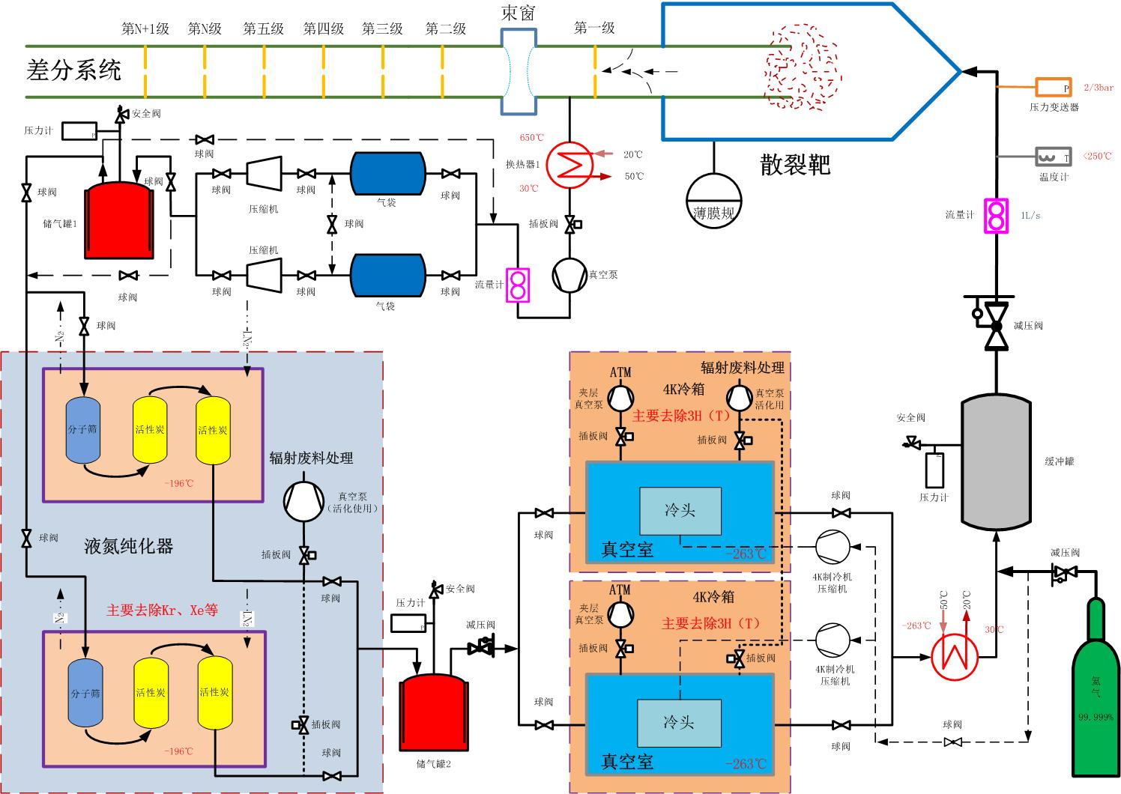
Granular Target Design
Main Parameters
Granular material | Tungsten/Tungsten alloy
Structure material | Tungsten alloy/SiC
Granular size | ~1mm
Inlet temperature | ~250 C
MAX Outlet temperature | ~650 C
Proton beam | 500eV@5mA=2.5MW
Intensity of beam | >100 μA/cm^2
Diameter of beam spot | ~10cm
Average velocity of granular flow | ~0.5m/s

Slide 9
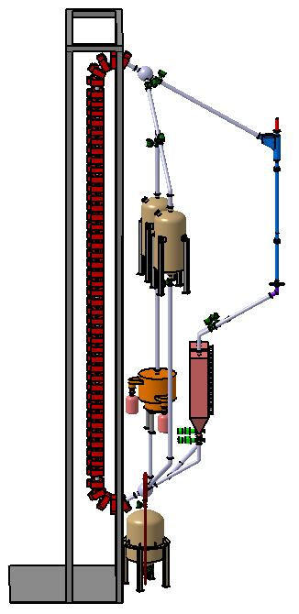
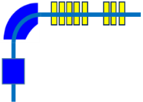
Granular Target Design
Granular flow loop
Spallation target
Beam-Target interface
Electromagnetic lift
Heat Exchanger
Remote handling system
Target safety system
Granular flow loop
Beam-Target interface
beam diagnostics
Storage vessel
Guanular flow monitor
EM
lift
Target
Neutron monitor
Grain filter
Heat exchanger
Emergency container

Slide 10
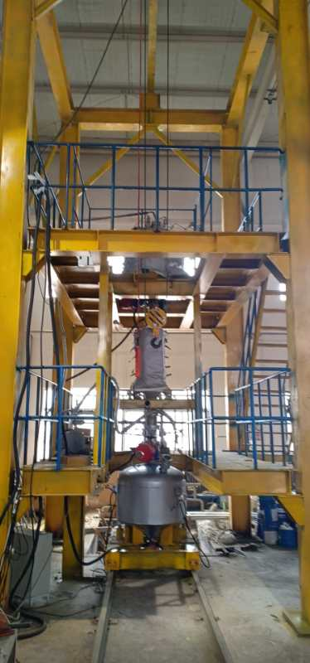
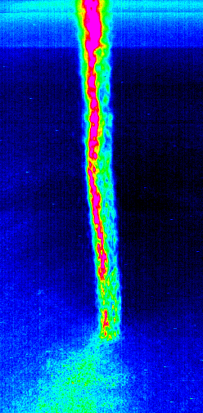
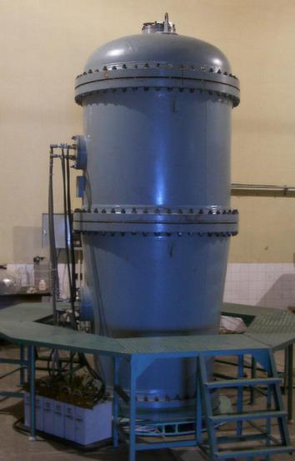
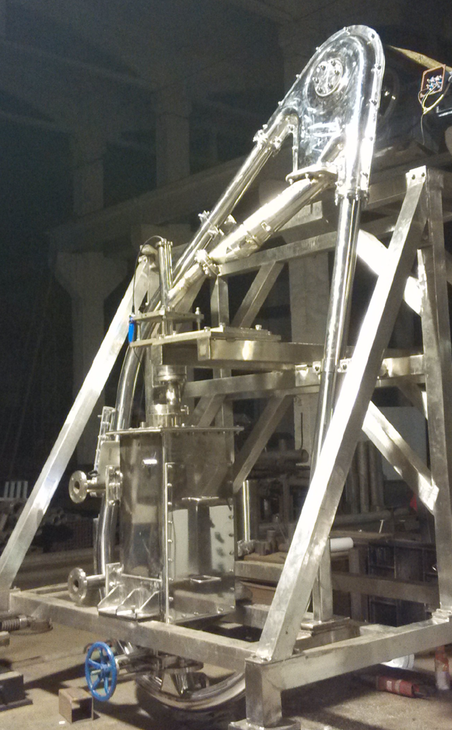
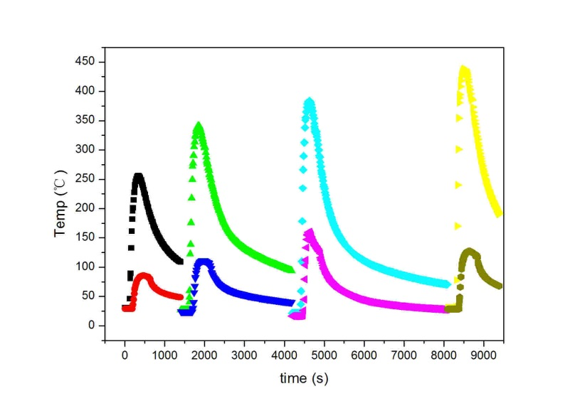
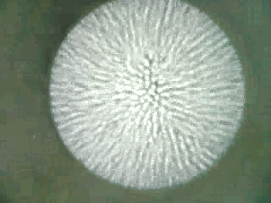
Test Bench – Granular Flow
Temperatures field of outlet
The difference between inlet and outlet
Heat exchanger test
Coupled with electron beam
(2MeV@10mA, cover gas: He@1atm)

Slide 11
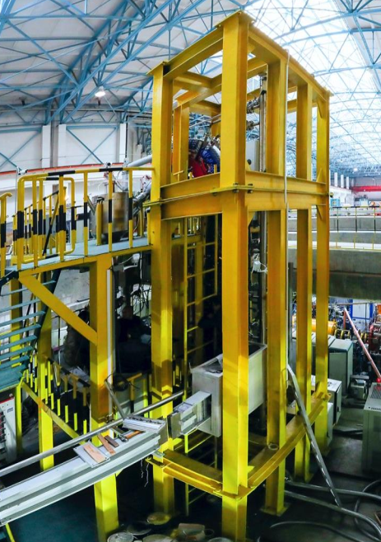
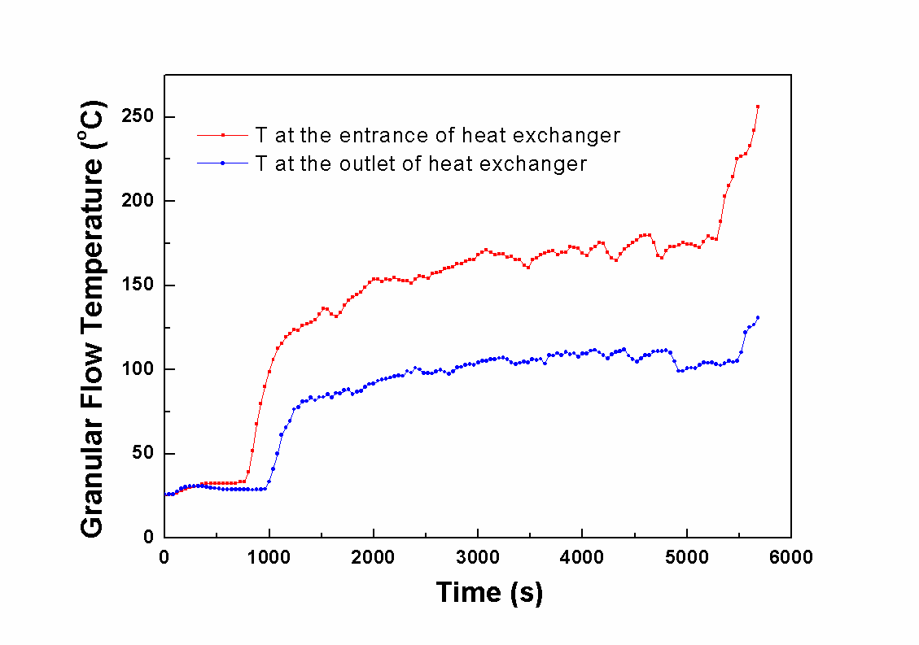
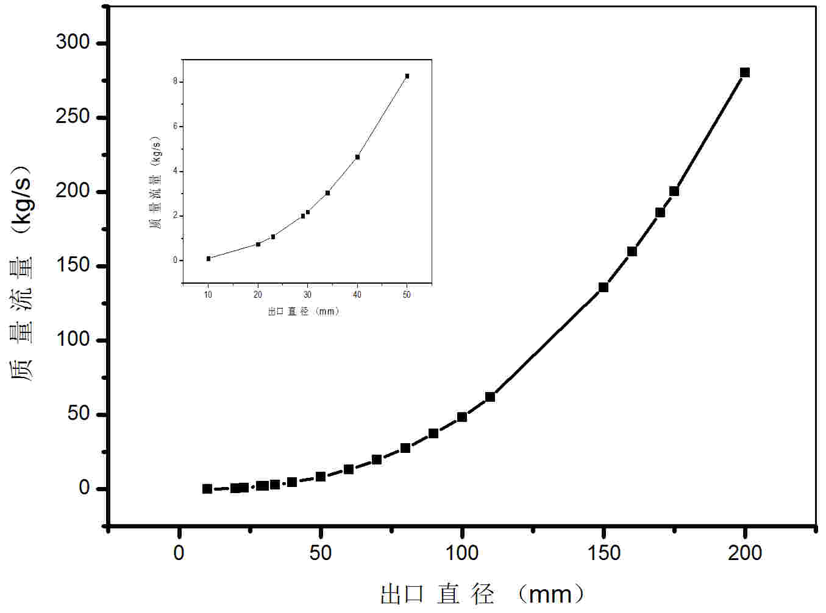
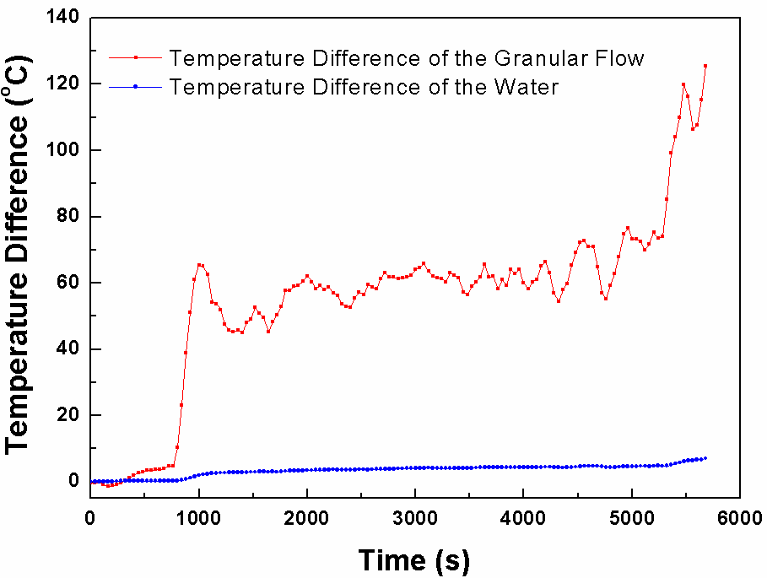

Test Bench – Granular Flow
Integrated principle prototype
The temperature of grain
The temperature of cooling water

Slide 12
OUTLINE
Research Aims
Granular target
LBE target with window
Collaboration

Slide 13

LBE Target with Windows
Main Parameters
Diameter of Beam | 10cm
Beam Energy | 500MeV
Beam Current | 0.5mA
LBE average flow | ~30 kg/s
LBE max velocity | 0.63 m/s
Window Thickness | 2mm （T91）
Temp. Difference of Heat Exchanger | 50K
Max velocity of cold fluid | 1.52m/s
Wall Thickness of Heat Exchanger | 1.75mm
shielding
Heat exchanger
EM pump
Beam pipe and window
Nozzle
LBE vessel
Support structure;

Slide 14
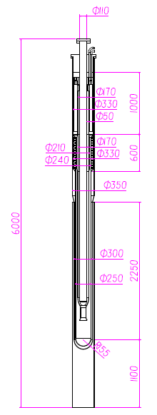
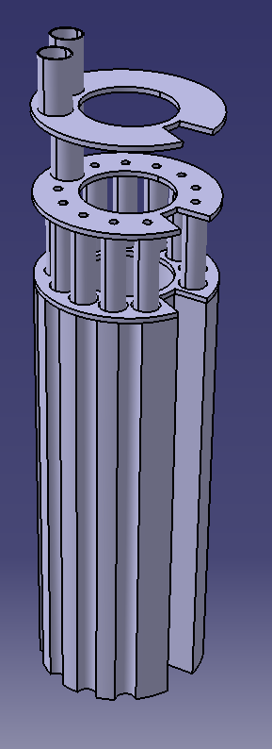
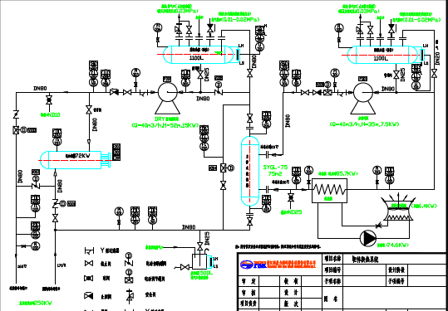
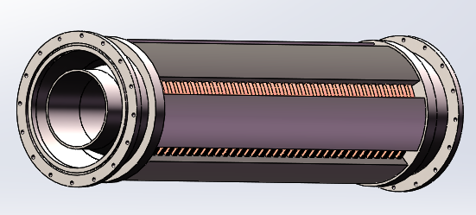
LBE Target with Windows Design
IMPORTANT REMARKS:
Temperature, hydrodynamics and structure coupled analysis employed
Highest beam power limited by window

Slide 15
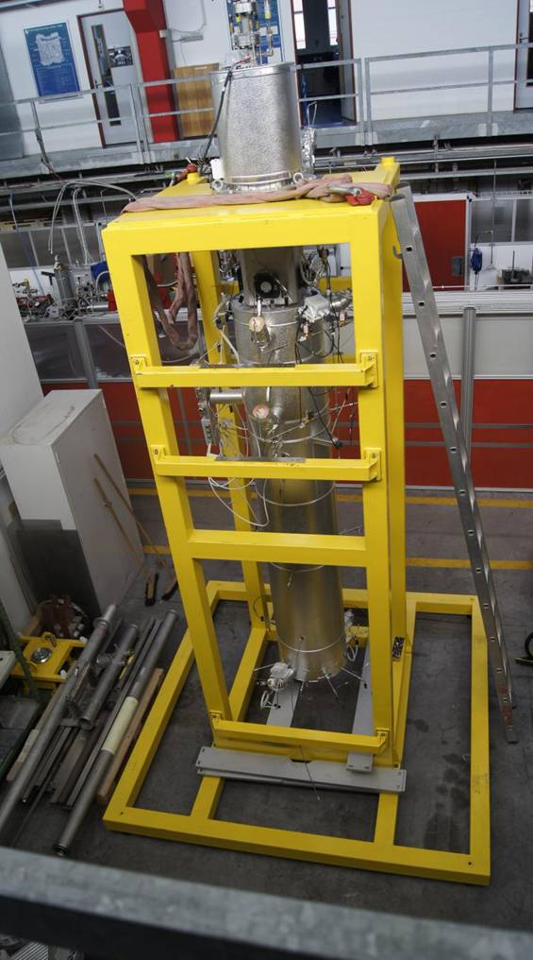
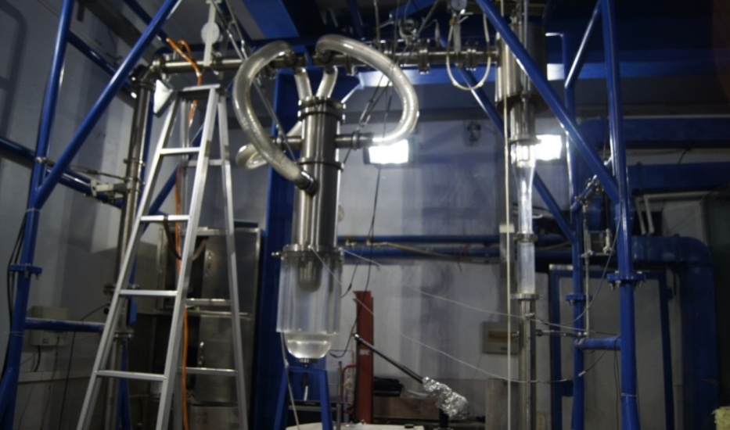
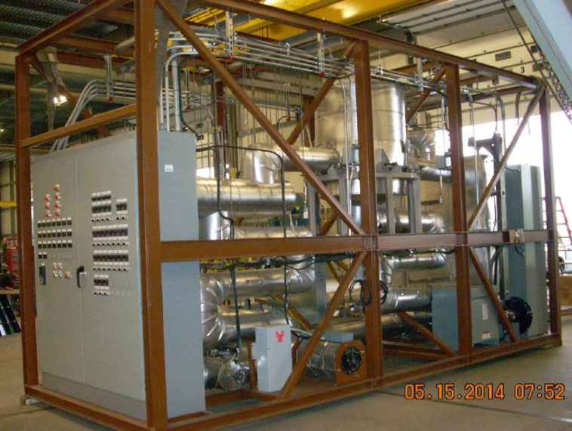
Test Bench - LBE
A water loop for window/windowless LBE target has been established, and is used to investigate flow behavior. 8.4 – 20 m³/h flow range
A liquid metal test stand, LiMeTS has been shifted to IMP from PSI
A LBE test loop, STELA is built to study the thermal-hydraulics, circulation methods, measurement techniques, etc.
Constructing a prototype
LiMeTS from PSI
STELA
Water flow experimental loop of window target
Spallation target experimental loop for the ADS

Slide 16
OUTLINE
Research Aims
Granular target
LBE target with window
Collaboration

Slide 17
Collaboration
1 Remote Handling Systems design and engineering
Active Cells Facility
Process Cell and Maintenance Cell
Shipment casks
Changing target technology
Technical Galleries
2 Accelerator-Target Interface design and technique
Beam window
Beam scan unit
Target protecting and beam diagnostics in front target
3 Helium system
filter unit
radiation purification unit
……
Notes:
Alumium 6061
95 ligt limits
25 usv/h
3 3 minits
7 types casks
Double gate .

Slide 18
Thank You!
&
Welcome to Collaboration !

