Slide 1








Enabling Science using Neutrons at the European Spallation Source
Arno Hiess and Carina Lobley
Scientific Activities Division
European Spallation Source ERIC

Slide 2








European Spallation Source - Vision
“Build and operate the world’s most powerful neutron source, enabling scientific breakthroughs in research related to materials, energy, health and the environment, and addressing some of the most important societal challenges of our time.”
Neutron Methods
Science & Research
User
Access
Idea by user
Proposal, sample, labs
Experiment, sample env.
Data, modelling
Publication by user

Slide 3
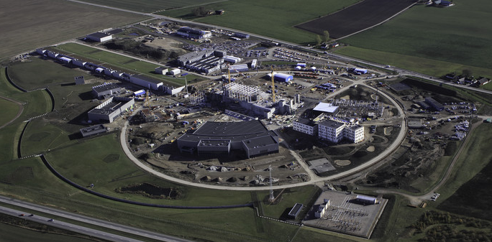
Arial View - October 2019
Logistic center in operation
Temporary offices used since June 2018
Construction of target building
Installations on-going in accelerator tunnel
Lab/Workshop building construction started
Instrument hall for long instruments handed over
Campus building construction well advanced

Slide 4
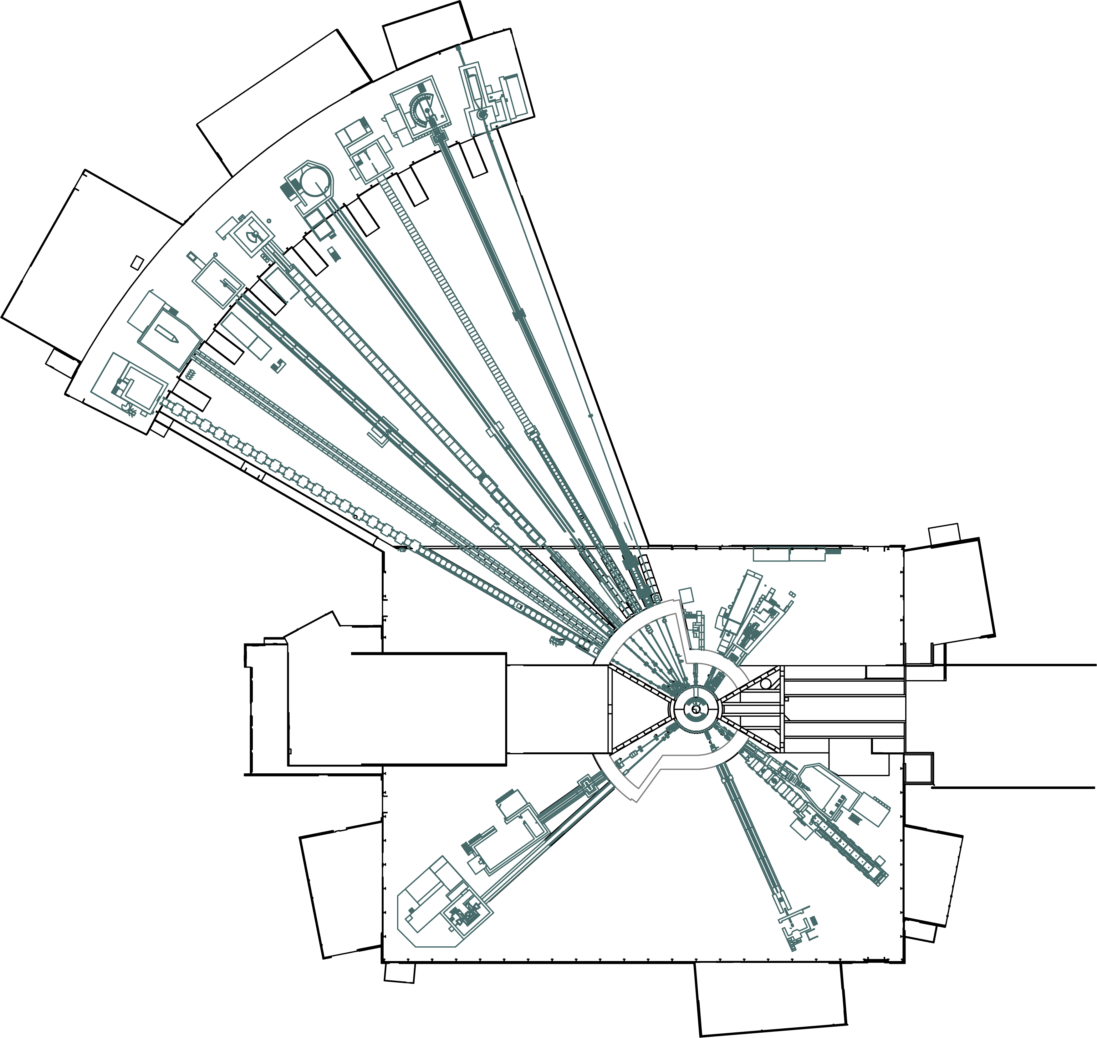











Instrument Suite
T-REX
HEIMDAL
MAGiC
SANS | LoKI, SKADI
Reflectometry | ESTIA, FREIA
Powder Diffraction | DREAM, HEIMDAL
Single-Crystal Diffraction | MAGiC, NMX
Imaging & Engineering | ODIN, BEER
Direct-Geometry Spectroscopy | CSPEC, T-REX
Indirect-Geometry Spectroscopy | BIFROST, MIRACLES, VESPA
MIRACLES
BIFROST
CSPEC
BEER
NMX
LoKI
FREIA
ODIN
ESTIA
SKADI
DREAM
VESPA
ESS Instrument Layout (August 2018)

Slide 5
15 Instruments selected so far
3 -> 8 -> 15 Ramp up from 2023
ODIN Imaging Instrument
SKADI General Purpose SANS
LoKI Broadband SANS
Surface Scattering
FREIA Horizontal Reflectom.
ESTIA Vertical Reflectom.
HEIMDAL Powder Diffract.
DREAM Powder Diffract.
Monochromatic Powder Diffract.
BEER Engineering Diffract.
Extreme Conditions Diffract.
MAGiC Magnetism Diffract.
NMX Macromolecular Diffract.
CSPEC Cold Chopper Spec.
Broadband Spectrometer
T-REX Thermal Chopper Spec.
BIFROST Xtal Analyser Spec.
VESPA Vibrational Spec.
MIRACLES Backscatt. Spec.
High-Resolution Spin-Echo
Wide-Angle Spin-Echo
Particle Physics Beamline
Large-Scale Structures
Spectroscopy
Diffraction
life sciences | magnetism & superconductivity
soft condensed matter | engineering & geo-sciences
chemistry of materials | archeology & heritage conservation
energy research | particle physics

Slide 6


Science Focus Teams
Instrument Management Teams
Internal and external science area experts form a core to lead the scientific life at ESS; orthogonal and complementary to the instrument based line management structure.

Slide 7
European Neutron User Communities – By Country
Total number of principal investigators per country per year

Slide 8
European Neutron User Communities – Science Method
Percentage of beam days in Europe

Slide 9






European Neutron User Communities – Science Areas
1%
3%
Percentage of experiments in Europe

Slide 10
ESS User Access – Policies Under Development
Scientific Evaluation and Access Policy
Policy documents will be high level, outlining the basic principles.
Users will be provided with guidelines to detail how to comply with the policy.
User Office will work to procedures to ensure application of the policy.
Policy for User Scientific Publications
Policy for Scientific Data

Slide 11
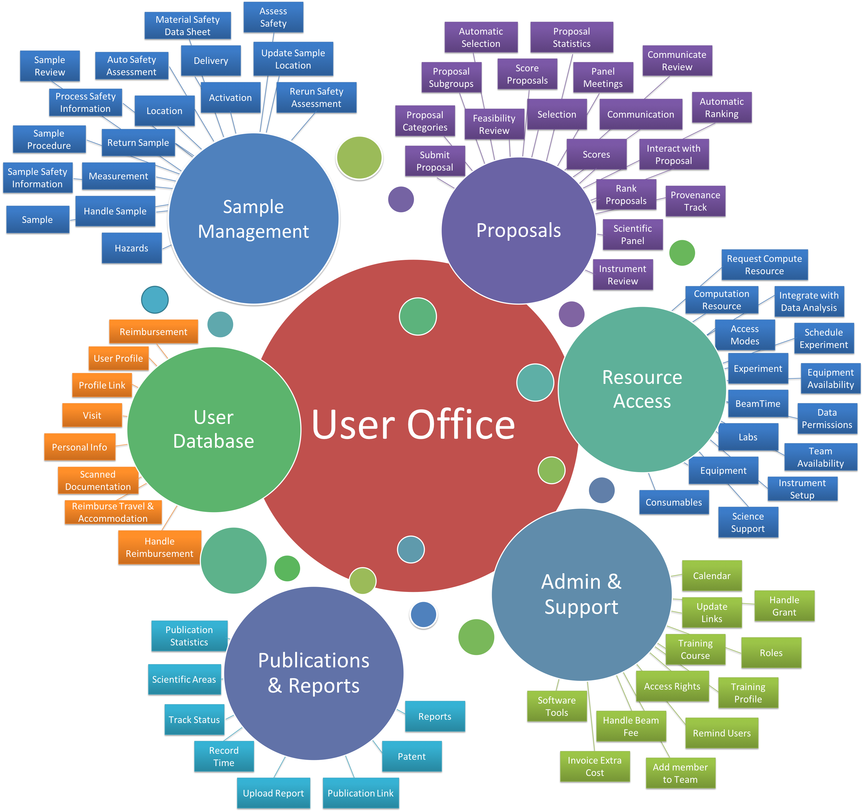
The User Office will support the user for all their interactions with ESS.
DMSC and SCUO are developing user office software to facilitate the many user functions that need to be supported.

Slide 12
Summary
ESS are planning first science on three instruments in 2023:
  LoKI: Broadband SANS for life science and soft condensed matter
  ODIN: Imaging for life science, soft condensed matter, magnetism, superconductivity, engineering, geosciences, archaeology and cultural heritage
  DREAM: powder diffraction for materials chemistry, magnetism, superconductivity , energy research, engineering and geosciences
15 instruments have been selected and specified, to complement the needs of the EU neutron community
To complement the instrument management structure, ESS is building a vibrant science culture through Science Focus Teams
The ESS User Office is developing the policies, guidance and procedures as well as the software required for supporting user operations

Slide 13
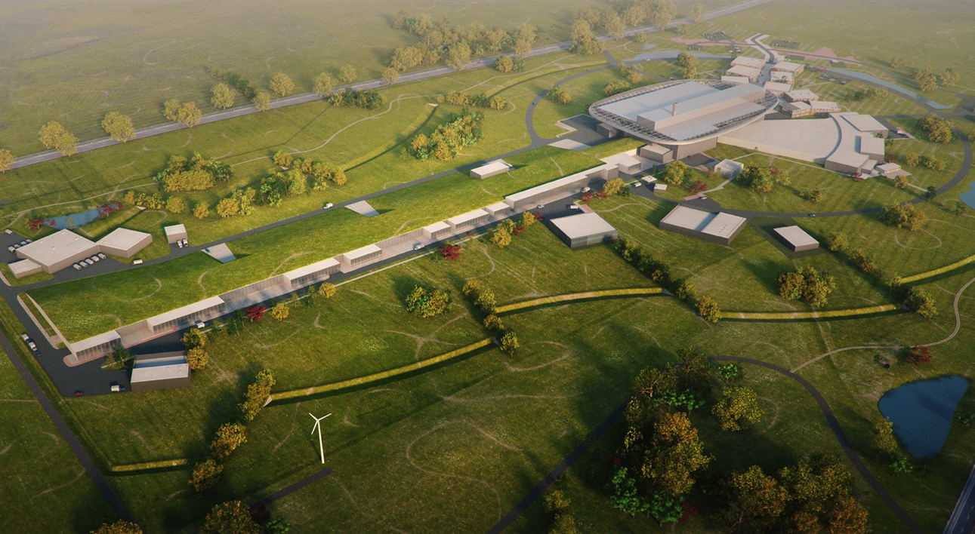
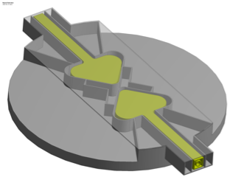
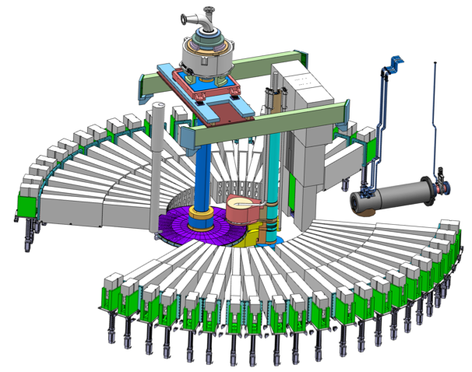
The European Spallation Source
Flat moderator delivering smaller and brighter neutron beams
High Power Accelerator means more neutrons
High brightness and tuneable resolution makes new measurements possible
An Innovative Target Station that can host >30 instruments

Slide 14
Long-pulse performance
λ = 5 Å
ESS 5MW
2018 design
10
×10¹³
Possibilities of pulse shaping
Brightness (n/cm²/s/sr/Å)
ESS-TDR 5MW
updated engineering model
5
ESS 2MW
JPARC
1 MW
SNS
2 MW
ISIS TS1
128 kW
ISIS TS2
32 kW
ILL 57 MW
0
time (ms)
1
2
3
4

Slide 15
Time Distance Diagram and Instrument Length
more neutrons per second than any steady state source …
Time distance diagram of white beam instrument with Pulse Shaping Chopper

