Slide 1
FREIA: HIGH POWER TEST STAND
Rutambhara Yogi & FREIA Group
ESS RF Group Unit Leader for Spoke Power and RF Distribution
FREIA Group Unit Leader, Uppsala University

Slide 2

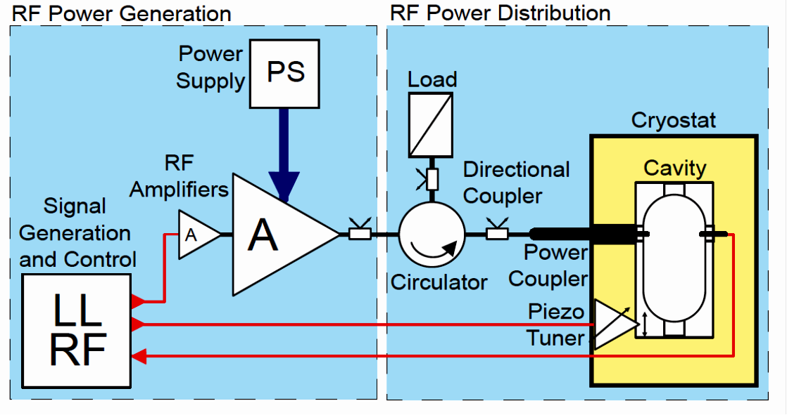
Schematic óf ESS Linac
Number of spoke cavities = 26
Number of spoke cryomodules = 13
Courtesy: Sabastien Bouson
(IPN Orsay)
Maximum power coupled to beam = 320 kW (Optimus)
Maximum power of Spoke Amplifier = 400 kW
Superconducing spoke Cryomodule
Base line for ESS RF design

Slide 3
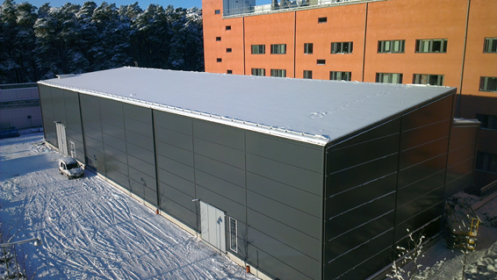
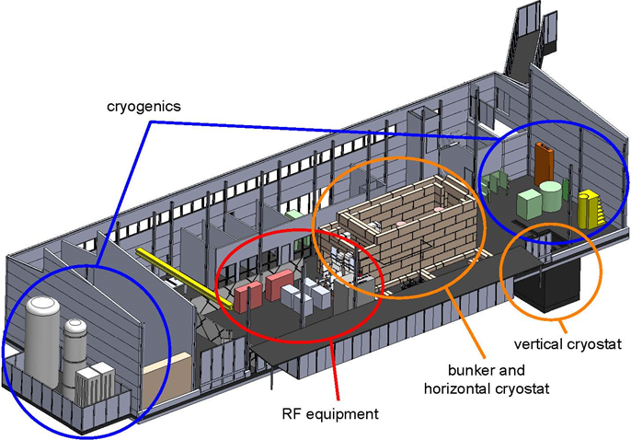
FREIA Laboratory
Facility for Research, Instrumentation and Accelerator Development
ESS RF Development at FREIA
Development of Spoke Linac Amplifier
- Technology demonstrators (Tetrode and
Solid State)
Design of RF Distribution system for ESS Linac
- Technology demonstrator for Circulator at
352 MHz, 400 kWp
High power testing of spoke prototype cavity
Acceptance test for spoke crymodules at
high power (proposal submitted)
RF Power Stations

Slide 4
ESS Specifications for Spoke Linac Amplifier
Maximum RF power coupled to beam = 320 kW
Considering LLRF overhead = 15% (12.5% power overhead: Simulink model)
RF loss in distribution system = 5%,
Power of RF Power Station = 390 kW ≈ 400 kW
Beam pulse width = 2.86 ms, repetition rate = 14 Hz,
Natural fill time = t_{f} = 2Q_{L} / ω = 135 µs, (Q_{L} = 1.5 x 10⁶ )
RF pulse width = 2.86 ms + beam filling time = 3.1 ms ≈ 3.5 ms
Duty factor of the amplifier = 4.3 % ≈ 5% (For Amplifier specifications )
Spoke cavity band-width = 2.34 kHz
system band-width ≈ 100 times larger than spoke resonator
band-width for tuning and regulation delay.
3 dB bandwidth > 250 kHz.

Slide 5
RF Power Station Specifications
Specifications:
Frequency = 352 MHz
Peak power = 400 kW
Average power = 20 kW
Pulse width = 3.5 ms
Pulse repetition frequency = 14 Hz
Courtesy Erk Jensen
As Amplifier doesn’t exist at ESS
specifications,
Technology demonstrator is required !
Amplifier selection affects Accelerator cost
Capital cost: (amplifiers, power supplies,
RF Distribution, decide gallery requirements)
Running cost: (efficiency, cooling, replacement, maintenance schedule)
352

Slide 6
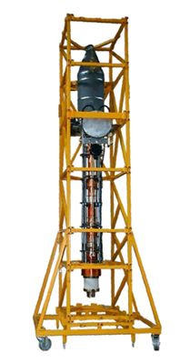
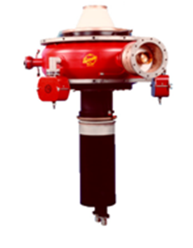
Klystrons: Very high peak power than requied.
Base line for ESS design: Single cavity – single power source
IOTs: Exists for peak power < 100 kW.
Solid State Amplifiers: At Soleil
Large foot print 4.7 m x 4.7 m for 200 kW CW
Compared all the possible RF Transmitters like Tetrode, Klystron, IOT, Solid state amplifier and selected Tetrode for the first RF power station (availability, price, footprint). [Reported in SLHiPP2012, Katania]

Slide 7
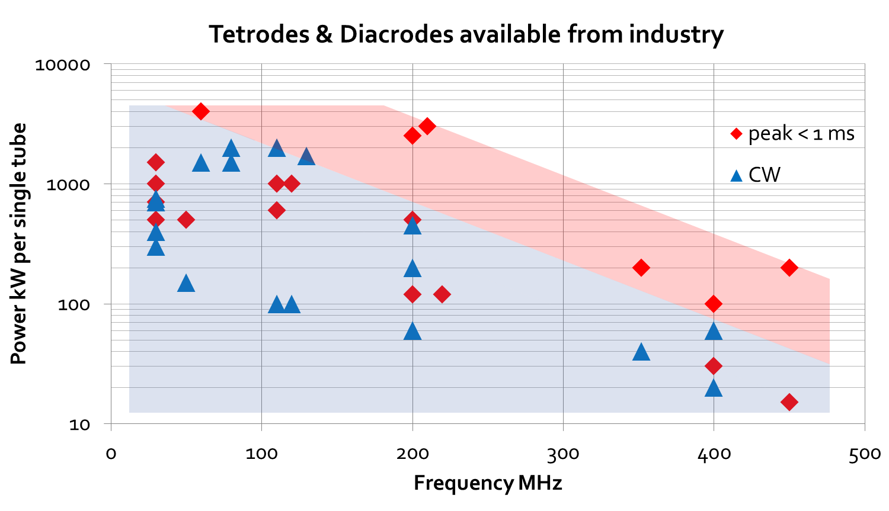
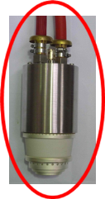

ESS
Tested for 200 kW,
CW
Tested for 100 kW,
for 100 µs
352
Courtesy: Eric Montesinos (CERN)

Slide 8
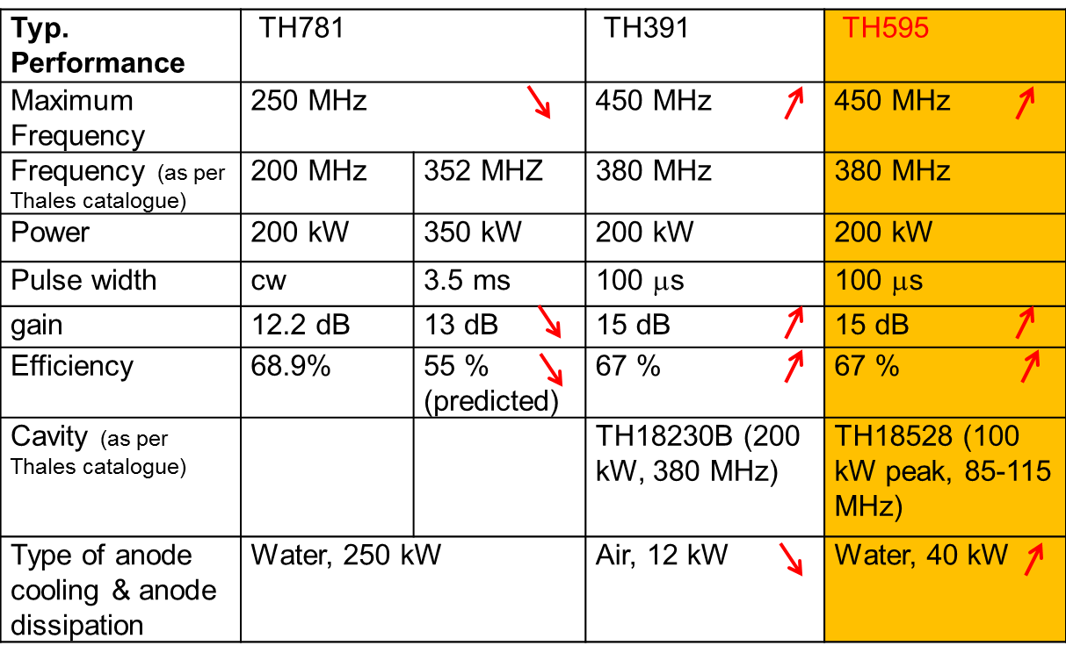
Comparison of Tetrodes
TH781, TH391 and TH595 tetrodes can be used at ESS specifications.
TH595 is sellected for first RF Power Station at FREIA.
Output of two TH595 shall be combined using Hybrid coupler.
[Reported in SLHiPP2013,
Belgium]
If we consider TH781 and TH595,
Diff in DC power = 36.36 kW – 29.85 kW = approx. 6 kW
Cost diff per yr = 26 x 6 kW x 5000 hr x 0.086 EUR /kW-hr = 67 kEUR = 587 kSEK
Cost diff for 40 yrs = 23480 kSEK

Slide 9
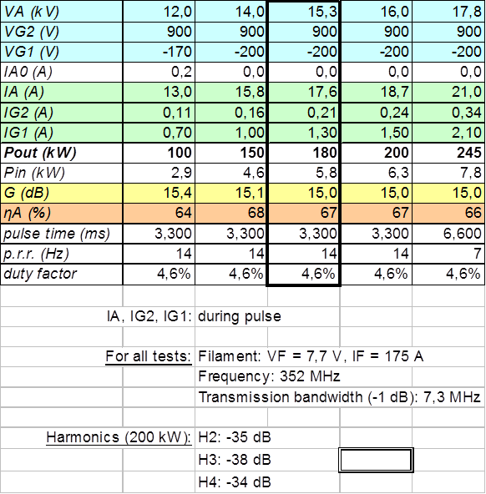
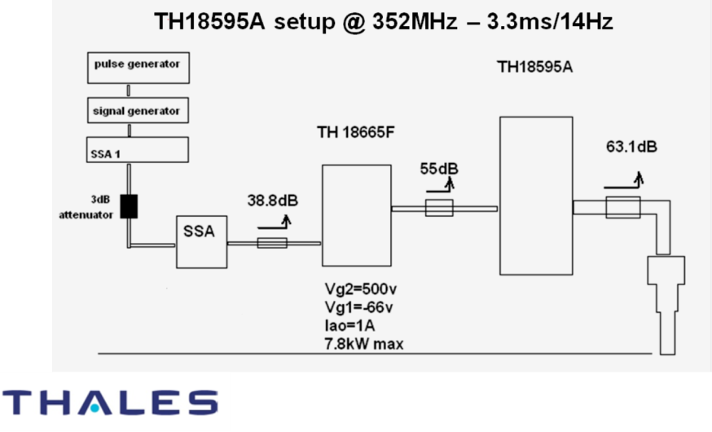
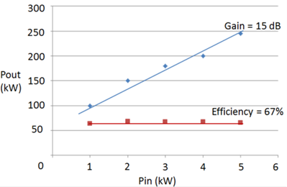

Test results of Technology Demonstrator
Thus TH595 is selected for first RF Power Station !

Slide 10
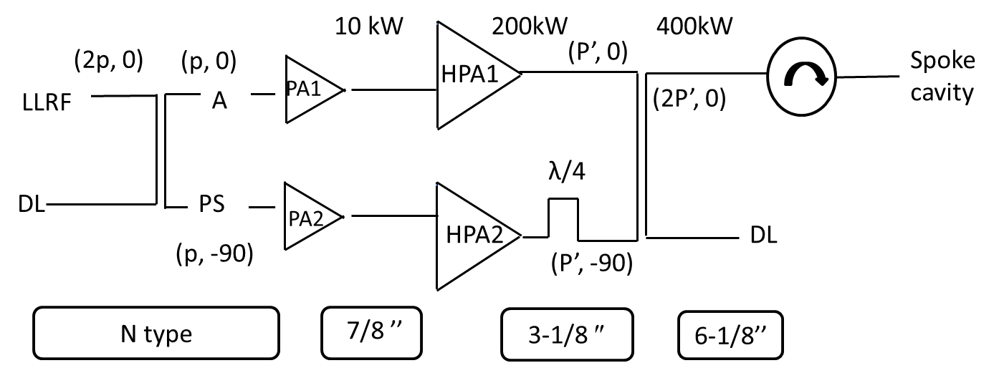
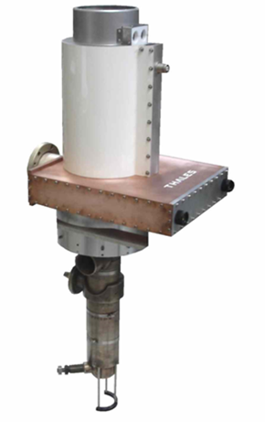
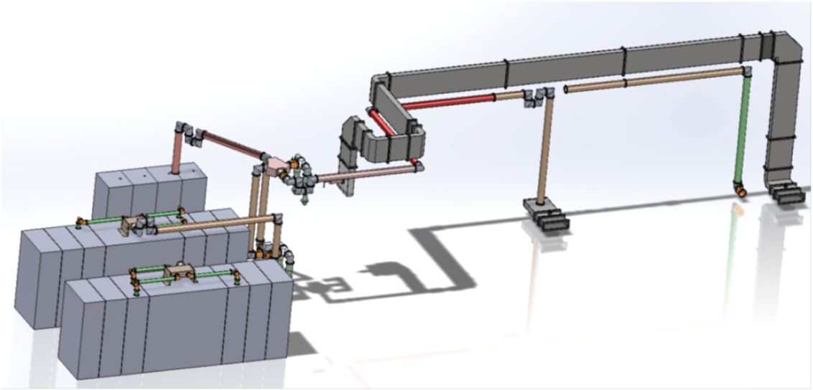
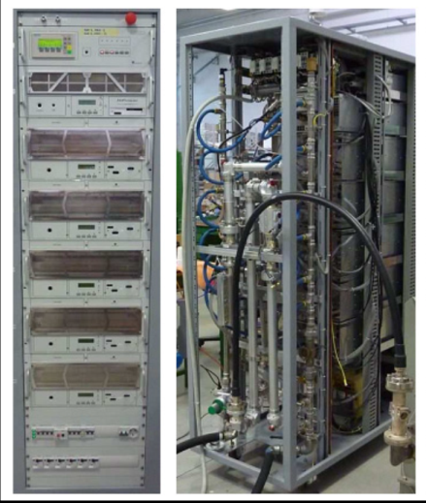
Tetrode RF Power Station (400 kW)
Due to λ/4 section, both Tetrodes see same phase
of reflected signal
Schematic of RF Power Station Layout
Preamplifier:
Solid state Amplifier
conservative gain of 13 dB
(aging of Tetrode)
Foot print:
5.4 m x 1.2 m

Slide 11

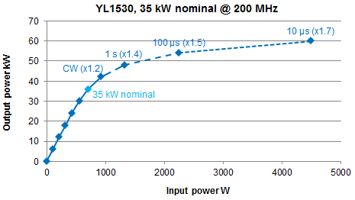
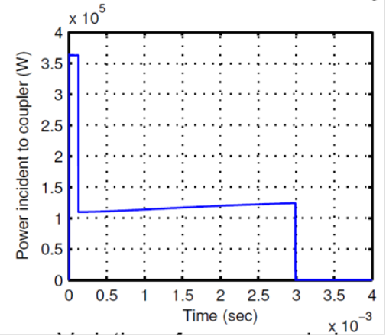
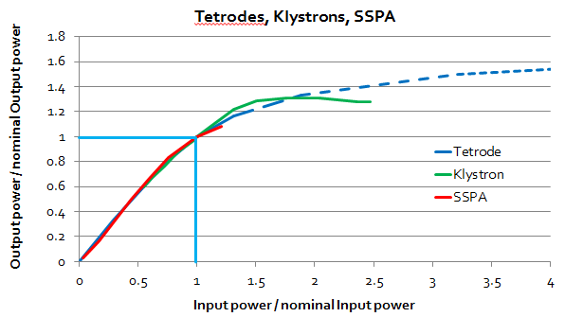
Study: Use of gain excursion curve
Tetrodes can provide more than 1.5 times the nominal power for short time, with same power supply voltages, but more input power:
Ref: Report by Vitaliy Goryashko
Instead of continuous sweep of power ,
Pulses of power can be applied.
Test in FREIA & propose to ESS.

Slide 12
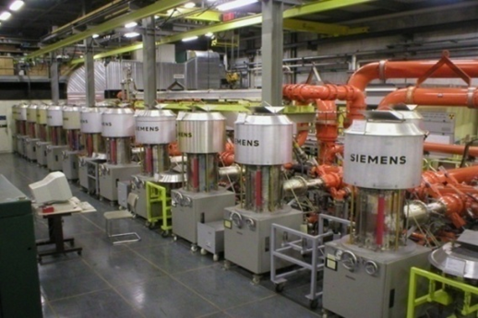
Study: Circulator-less operation of Tetrode
Tetrode doesn’t need circulator for protection like either IOT or Klystron
Collaboration with Eric Montesinos (CERN)
Study completed for 200 kW output power: Tetrode RF power station can handle 100% reflection for output power of 200 kW
Maximum Anode to ground voltage= 34 kV (for 100 % in phase reflection)
<< Vbreak down of Tetrode.
Study is in progress for Pout = 400 kW with 100 % reflection
Photograph of SPS, CERN
650 kW cw @ 200 MHz

Slide 13
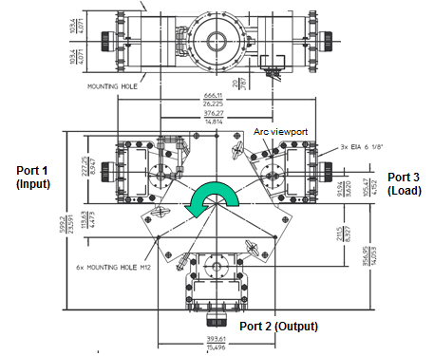

Circulator: Technology Demonstrator
New Circulator design to avoid pressurization, without NRE
To decrease field strength, increase in diameter of ferrite disk
25 % increase in size of circulator
Technically good & 44% cheaper than their budgetary quotation
27% cheaper than their competitor
For FREIA first chain: all coax ports
For ESS Spoke Linac and FREIA second chain: port 1 (Amplifier) and port 3 (Load) will be coax
Port 2 will be WR2300 (half-height)

Slide 14
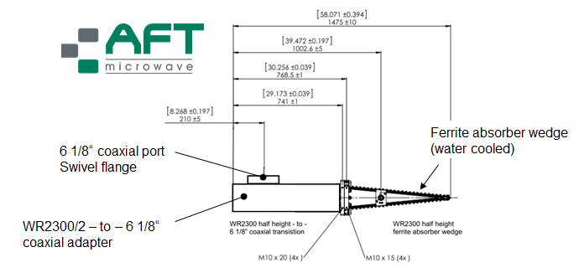
High Power Loads
FREIA will have both technologies for loads
Ferrite Load
# Robust design for high
reliability and long life time
# RF absorption is independent
of water quality
Resistive water cooled loads
# Single resistive load for 400 kWp @ 352 MHz not available.
# Combine 2 loads with in-house developed combiner (Combiner not
available off the shelf)

Slide 15
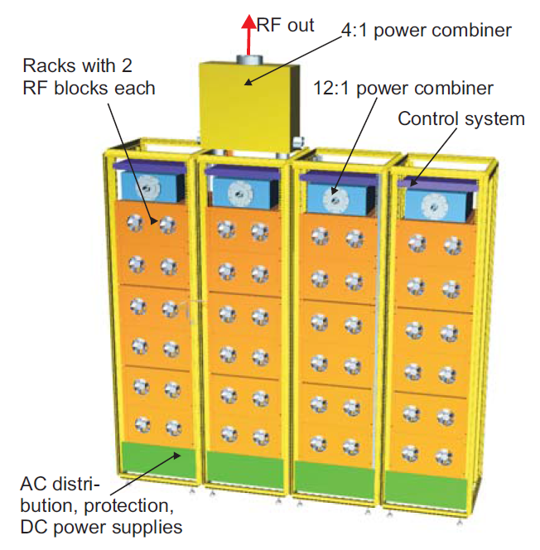

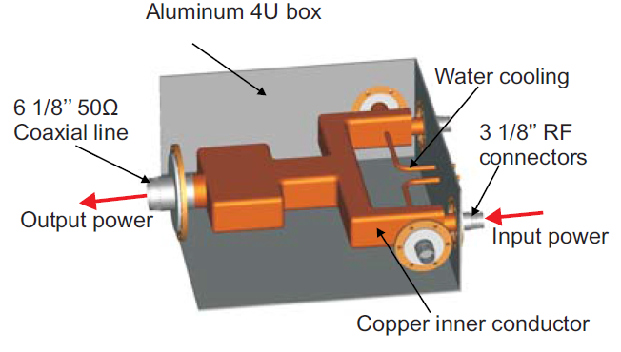
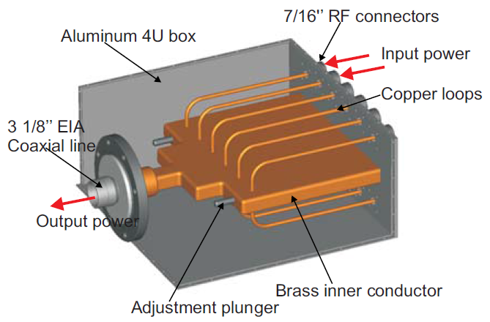
Technology demonstrator: Solid State RF Power Station
Second stage power combiner: 100 kW input, 4 inputs
Schematic of RF Power Station 400 kW
High power RF Power Station using solid state technology under development by Siemens Research centre.
Expected delivery Jan / Feb 2014
First stage power combiner: 8 kW input, 12 inputs
Claim of Siemens:
The RF power station doesn’t need circulator for operation.
ESS Amplifier technology will be proposed after testing tetrode and solid state RF power stations.

Slide 16
Features:
Footprint: 2 sq m (Four 19 inch cabinets)
Efficiency from wall plug to RF: 60%
Circulator not required
DC Power Supplies: 4 x 24 kW, 48 V
Power combiners:
- First stage power combiner:
8 kW input, 12 inputs
- Second stage power combioner:
96 kW input, 4 inputs.
RF Modules packed into 6 U high rack
Control system fits into 3 U high rack

Slide 17

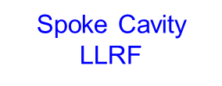
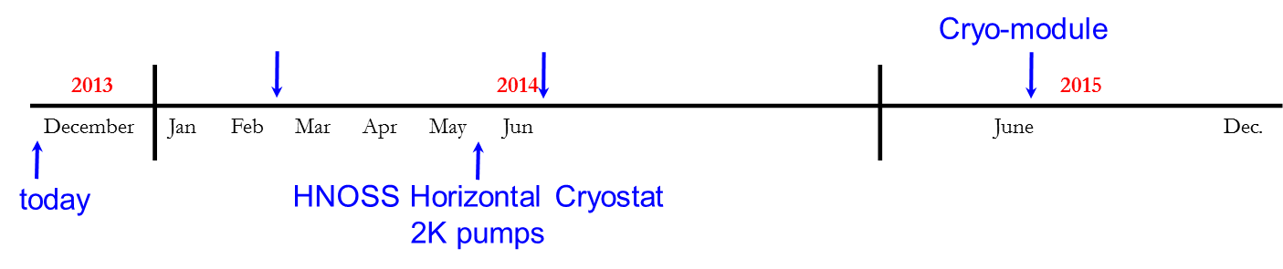
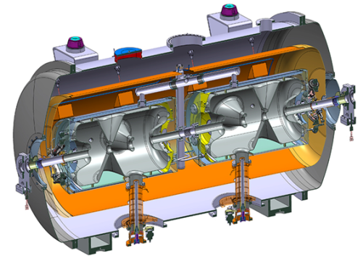
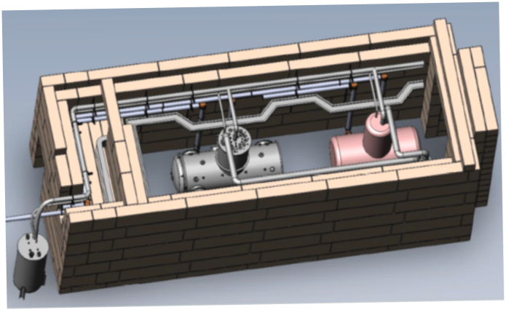
Schedule at FREIA
Bunker is designed sothat the average radiation level < 1 μSv/h outside the bunker
Horizontal test cryostat
Liquid Helium production: 140 l/h
Delivery of liquid N2 and He to external

Slide 18
Testing
Work-shop was organised at Uppsala during 20-21 Nov 2013 to discuss testing about:
Testing of RF power stations
Testing of spoke cavities
Testing of spoke cryomodules.
Main emphasis for testing will be:
To test specifications
To test reliability of system
To test availability

Slide 19
Thank you !

Slide 20
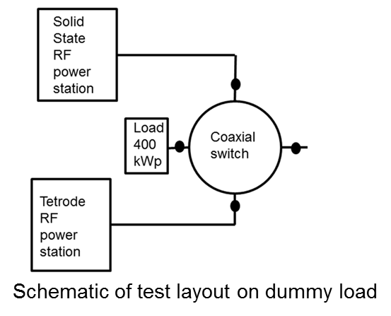
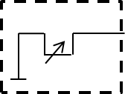
High power tests at FREIA
RF power station test on load
Test of preamplifier (10 kW peak / 0.5 kW avg)
Test of amplifier (200 kW peak / 10 kW avg)
Test of Tetrode RF power station (400 kW peak / 20 kW avg)
Test of Solid state RF power station (400 kW peak / 20 kW avg)
Solid state RF power station test on Mismatch load
Test with variable short with all phases
Test with mismatched load
Test with arc: Eric Montesinos(CERN) will provide the device.
(Transmission line section in which arc will be created by a RF short circuit device)
Lstub (mm) | Reflection coefficient
20 | 0.95
40 | 0.85
80 | 0.59
120 | 0.37
160 | 0.20
200 | 0.04
Load
ZL

Slide 21

Tetrode RF power station test on Mismatch load
Circulatorless operation of tetrode: Under study.
collaboration with Eric Montesions (CERN)
Test it at FREIA and then propose for ESS.
Test with variable short with all phases
for total peak power 200 kW.
Coupler Conditioning (400 kW)
Detune the cavity (by few kHz)
Start from low power and small pulse width and then slowly reach full power (352 MHz, 400 kW, 3.5 ms)
RF test of cavity
Apply RF power needed to build maximum Eacc = 9 MV/m
Start from low power and small pulse width and then slowly reach full power (352 MHz, 400 kW, 3.5 ms)
Maximum Power = 100-200 kW, pulse width = 3.5 ms

