Slide 1
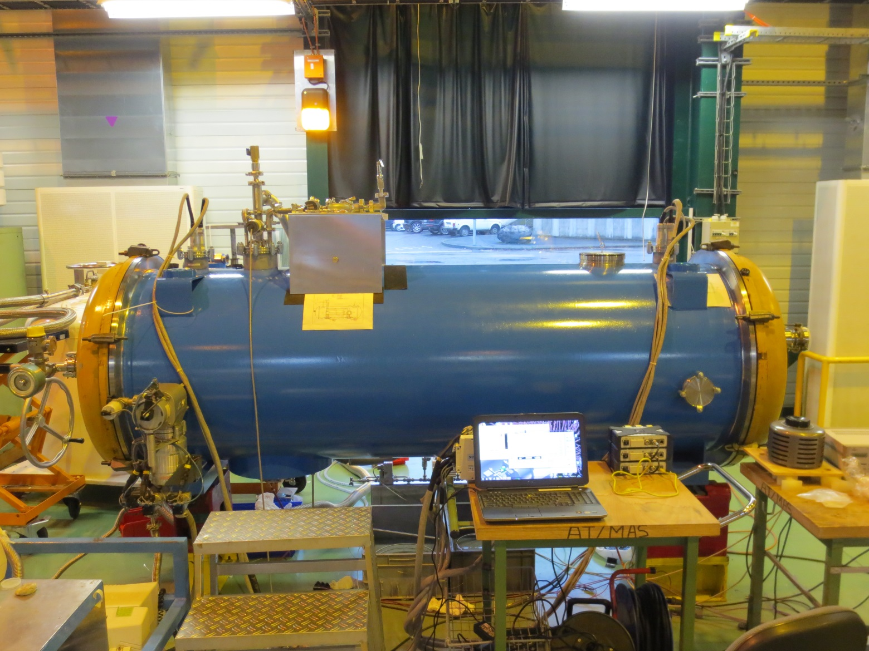
SPL Mock-up: Thermo-Mechanical Results of the First Test
Rossana Bonomi
Rossana.Bonomi@cern.ch
Bonomi, ESS Retreat Meeting, Lund, 10-11/12/2013

Slide 2
Outline
Intro
SPL Mock-up Test: Motivations
Test Set-up
Preliminary Results
Improvements / Next steps
Bonomi, ESS Retreat Meeting, Lund, 10-11/12/2013

Slide 3
The SPL Short Cryomodule
Courtesy of CNRS
Bonomi, ESS Retreat Meeting, Lund, 10-11/12/2013
Notes:
Short recall on the SPL SCM =
Dropped as a project by cern but kept as a R&D study
SC linac high power for neutrino factory and neutron science
Representative of half high-beta cryomodule
Some critical parts for what concerns the thermal management have to be tested before construction ..

Slide 4
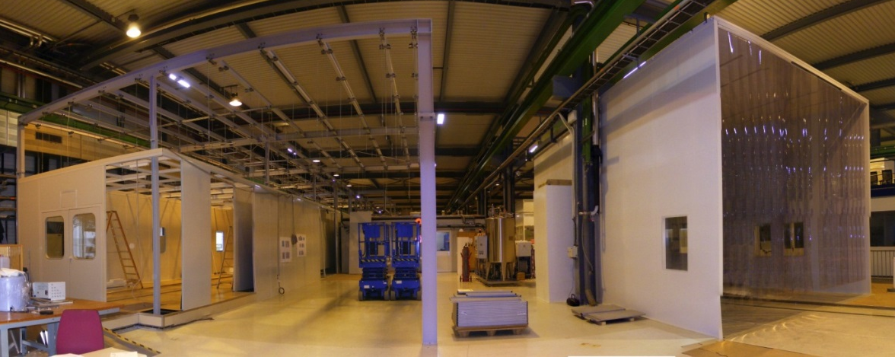
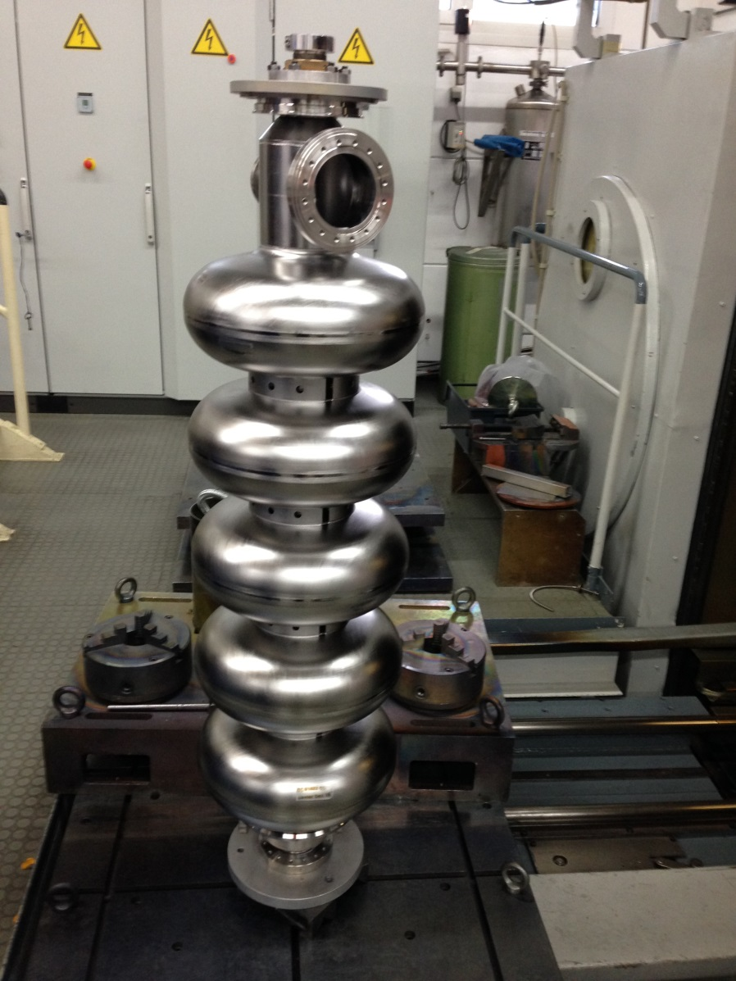
SPL Short Cryomodule Status
SM18 at CERN - Clean room upgrade (class 10)
First SC RF 5-cell cavity from RI
2014
2015
Assembly tooling
Courtesy of V. Parma
Courtesy of O. Capatina
Courtesy of CNRS
Bonomi, ESS Retreat Meeting, Lund, 10-11/12/2013
Notes:
SPL Project status
Upgrades of infrastructure at cern for assembly/test
Assembly tooling being study by CNRS in the framework of the french collaboration
First cavity in Nb received recently (Nuria+Nacho)
Overall schedule:
Clean room ready in 2014
Start production of tooling
Cavity testing in 2014
Cavity assembly beginning 2015
Cryomodule assembly end of 2015

Slide 5
SPL Mock-up Motivation
Need validation of:
Cavity supporting system
Assembly realignment of cold mass via vessel interface
Alignment measuring device (OWPM)
Thermal contractions
DWT active cooling
..a mock-up has been
built for this testing purposes
Bonomi, ESS Retreat Meeting, Lund, 10-11/12/2013
Notes:
Critical parts to be tested:
Supporting scheme
Alignment system
Concerning the thermo-mech performance

Slide 6
Principal Components
Cold mass filled with LN2
Double-walled tubes cooled by GN2
Intercavity supports (spherical bearings + sliding cylinders)
Vacuum vessel
LN2 dewar, vacuum pumps
Acquisition systems
Bonomi, ESS Retreat Meeting, Lund, 10-11/12/2013
Notes:
List of principal components with external view and internal schematics ..

Slide 7
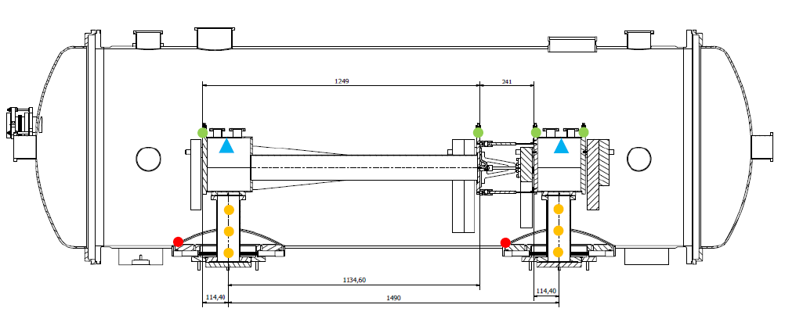
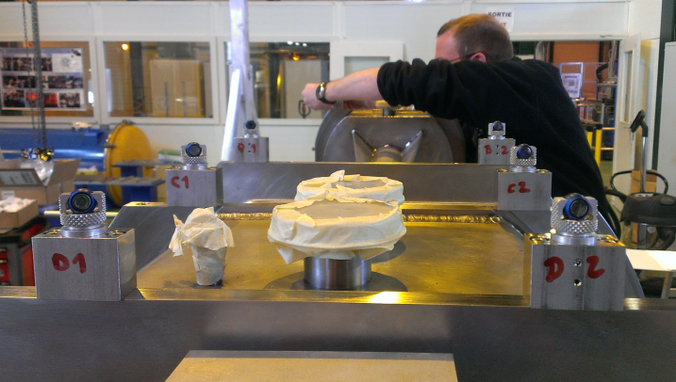
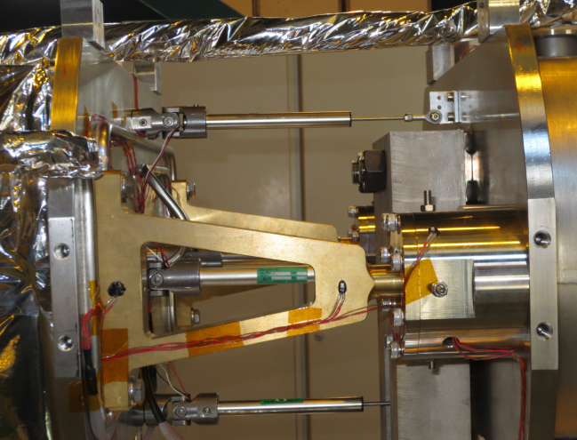
Instrumentation
Thermal:
Temperature sensors (Pt100)
Heaters (65 W)
Level gauges (Pt100)
Mechanical:
Displacement sensors
Strain gauges
Targets for laser tracker
Notes:
Instrumentation list:
Thermal
Mechanical
Levels LN2

Slide 8
Control / Safety Devices
GN2 flow rate varied via flow-controllers (30 l/min max) at the gas line outlet
Heating resistance on external DWT flanges controlled via rheostats manually
LN2 flow rate controlled manually and independently via on-off valves
Safety valves on inlet-outlet lines, cold mass
Relief plate on vacuum vessel
Non-return valve on vent line
Notes:
Components for control:
Flow-controllers for GN2
Heaters manual for DWT flanges
Safety devices

Slide 9
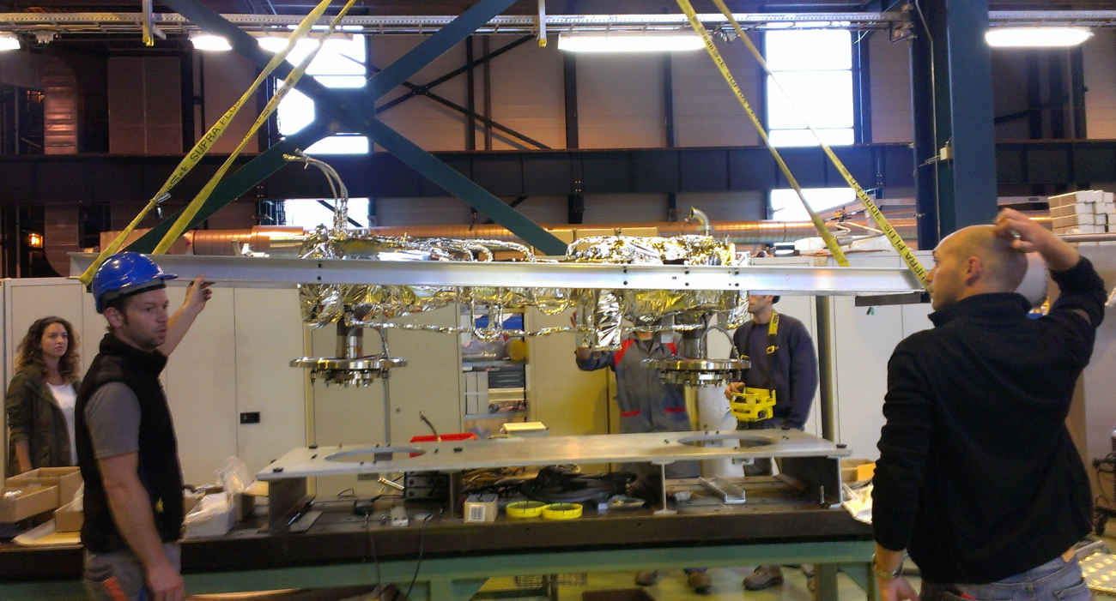
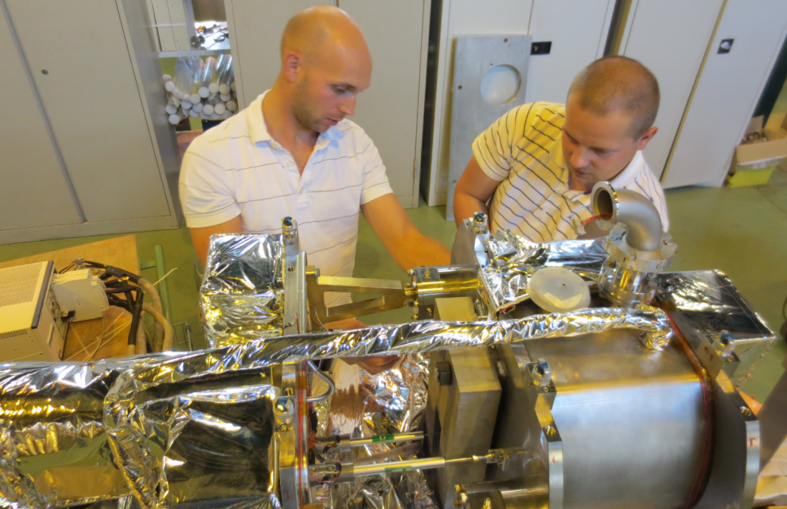
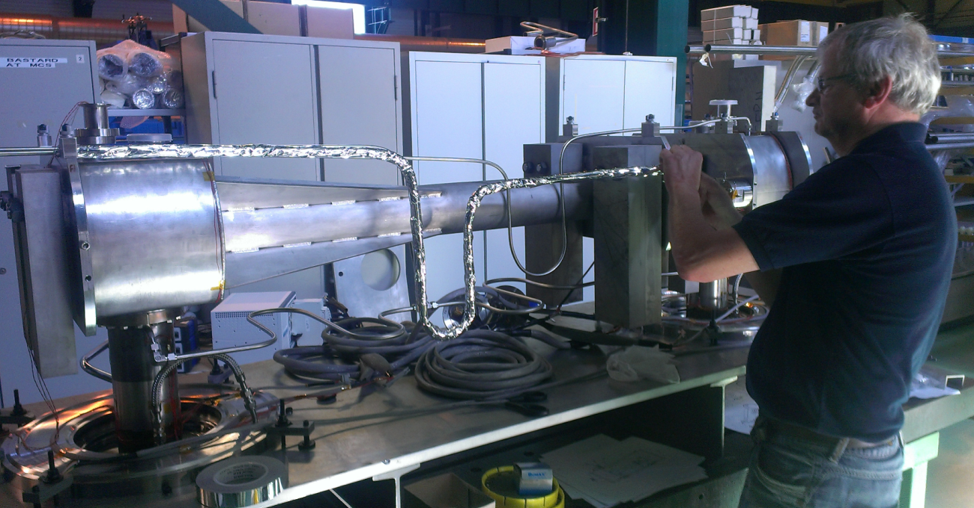
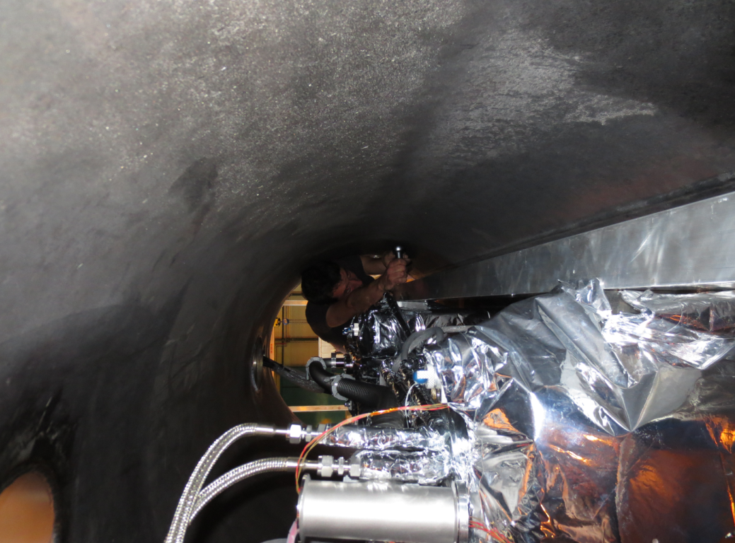
Test Set-up
Bonomi, ESS Retreat Meeting, Lund, 10-11/12/2013

Slide 10
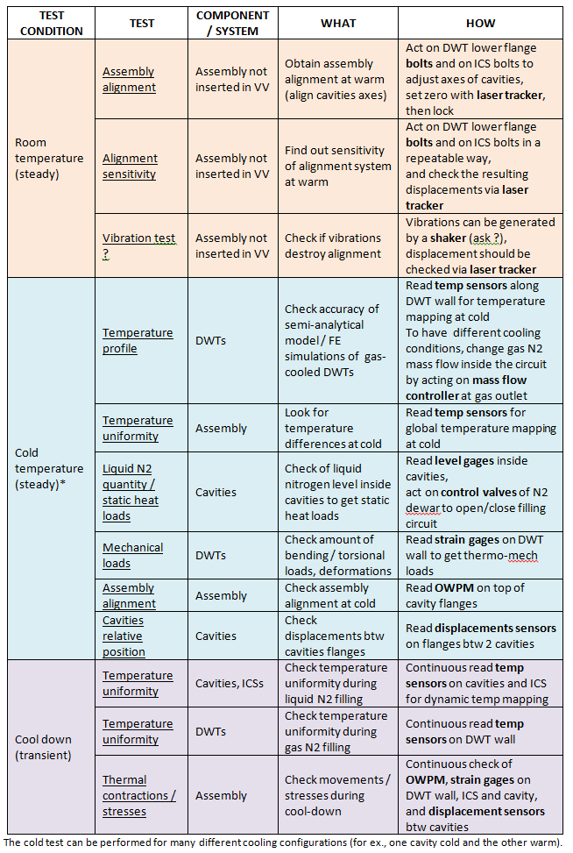
Test Performed
Approximatively 3 weeks of testing between October-November 2013
Various configurations of cooling conditions tested
No RF power
Temperatures, stresses and displacements were recorded continuously
(1 Hz rate)
Test Program as of 10/2013
Notes:
What we did
Acquisition systems recorded at 1 Hz
And the program agreed before starting the test in october

Slide 11
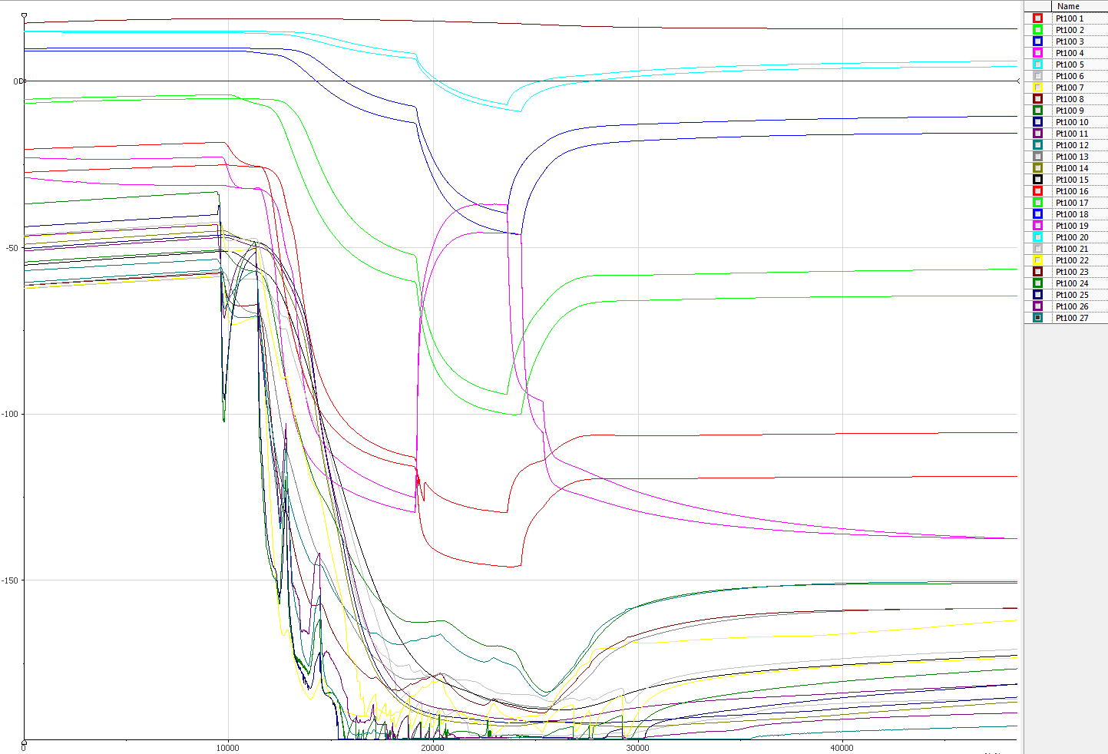
Results Temperatures Evolution
Measured
31/10/2013
23 temperature sensors
+ 4 level sensors
Example of cold mass filling
Temperature [ºC]
50 degrees
~ 3 hours
Cumulative time [s]
Notes:
Just an example of temperature evolution in time
Filling of cavities, gas coolind of coupler, ..

Slide 12
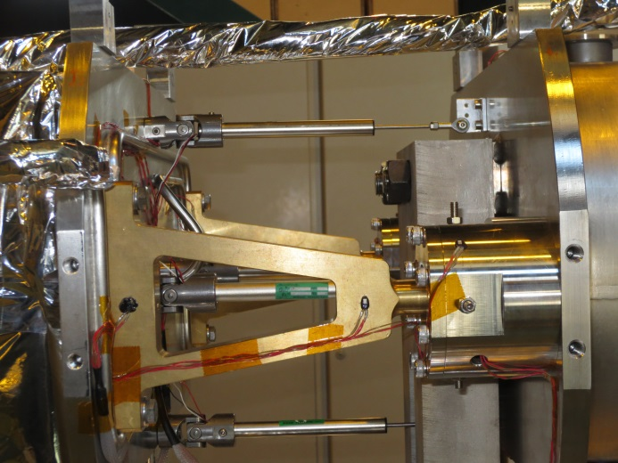
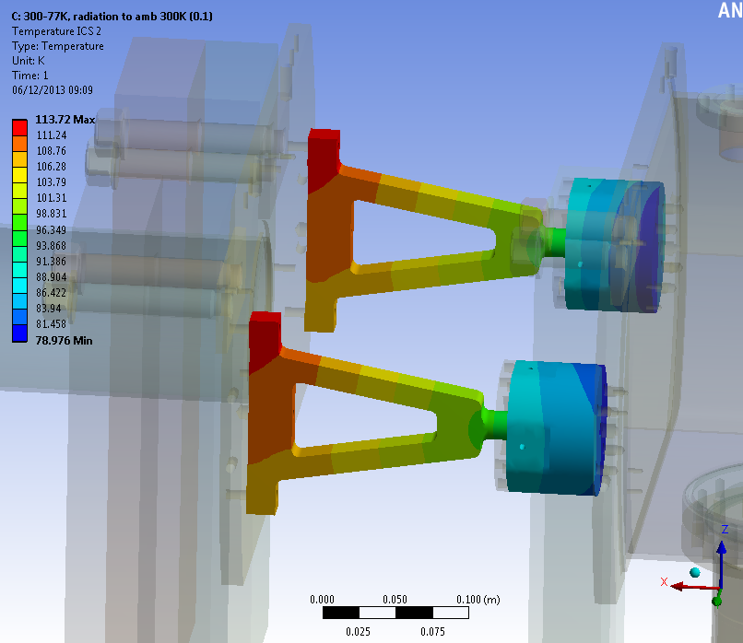
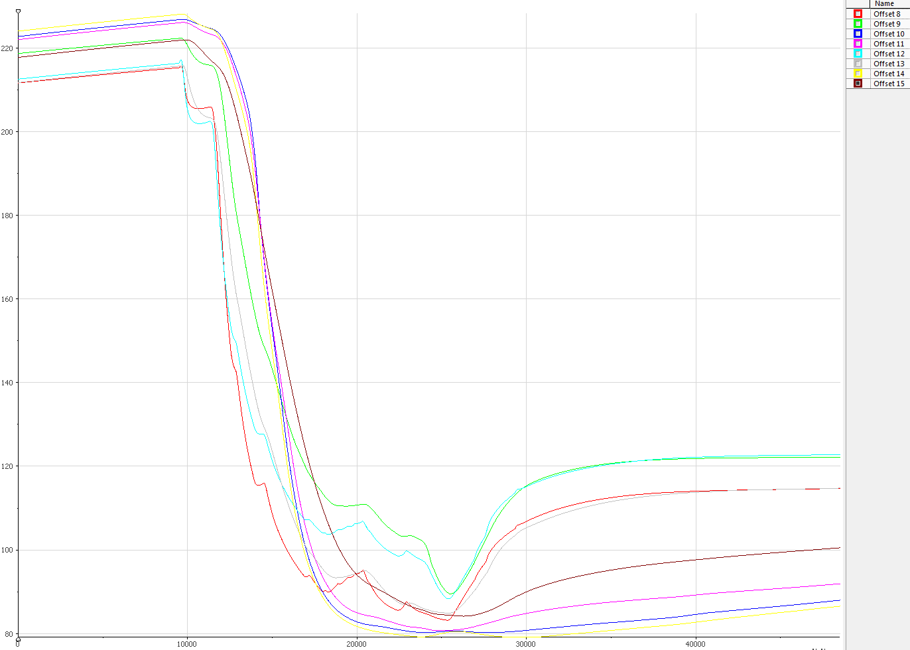
Results Intercavity Supports
T10
T8
T9
Numeric Estimation
T14
T12
T13
Measured
31/10/2013
Agreement between estimations and measures
As expected, no thermal difformity
Cooling rates comparable to other components
Bonomi, ESS Retreat Meeting, Lund, 10-11/12/2013
Notes:
Numerical estimations vs measurements
Agreement in the sense that no difformity is measured
And cooling rates are comparable to those of other components

Slide 13
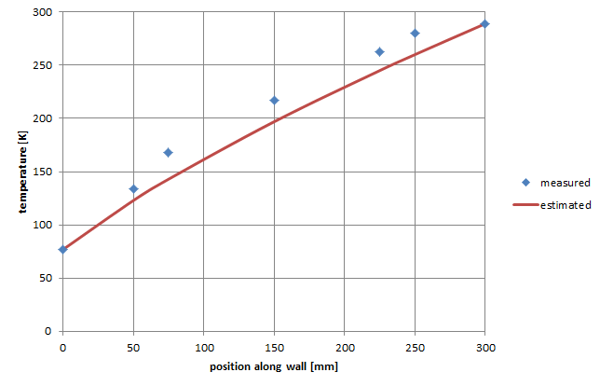
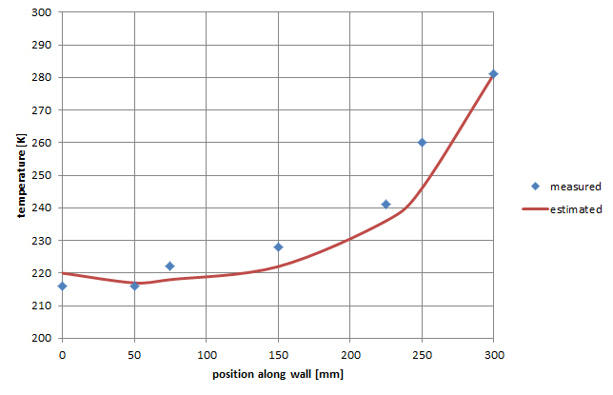
Results Double-walled Tube
Measured
30/10/2013
Temperature profiles of DWT
No gas cooling
300 mg/s gas cooling
(220K inlet temp)
Good agreement between estimations (semi-analytical model) and measures
Temperature difference is within expectations
Bonomi, ESS Retreat Meeting, Lund, 10-11/12/2013
Notes:
Despite the difficulty of finding steady conditions during test,
We have very good agreement btw analytical and measurements,
For both cooled and not cooled cases\
We needed to make few assumptions on the inlet gas temperature based on the other registered temperatures

Slide 14
Results Heat Loads Estimation
Subassembly | Heat load @ 77 K [W] | Analsyis details | Comments
Double-walled tubes (2x) D = 100 mm L = 300 mm 1.5 and 2 mm thick walls Copper on stainless steel | 21.4 / 1.4 | Conduction through wall (300-77 K) No gas cooling / With gas cooling (18 l/min) No RF power | Semi-analytical
 | 0.2 | Radiation from 300K DWTs surfaces (blackbodies) View factor 0.026 | Analytical
Lines Gas and liquid lines Inlet-outlet DN = 20 mm Various lengths Stainless steel | 0.3 | Conduction through lines (300-77 K) | Analytical
Vacuum vessel | 6 | Radiation vacuum vessel – cold mass (MLI) Rescaled from LHC measurements* 3.5 m2 cold mass | Analytical
Instrumentation cables | < 2 | Educated guess
TOT for SPL Mock-up [W] | 30 / 10 | No gas cooling / With gas cooling
Conduction
22 / 2 W
* C. Maglioni, V. Parma’s technical note: “Assessment of static heat loads in the LHC arc, from the commissioning of sector 7-8”, LHC Project Note 409, 2008 (VV→ TS 1.7 W/m² - TS → CM 0.1 W/m²)
Notes:
Estimation from analytical, LHC measurements etc
Biggest contribution is due to conduction when no DWT cooling !!
Great difference btw cool/no cool of couplers => necessary active cooling

Slide 15
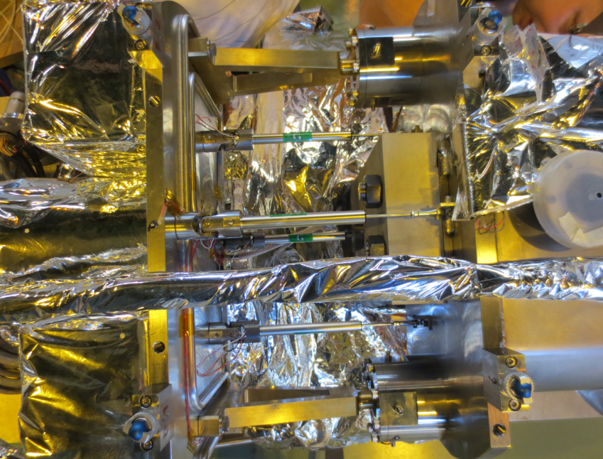
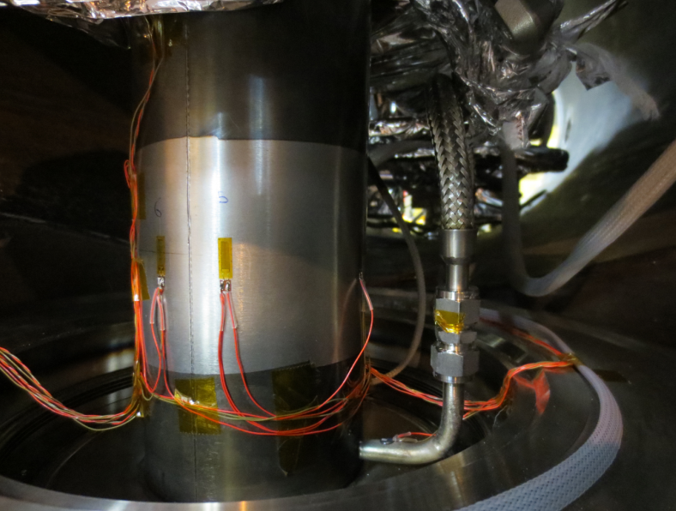
Results Mechanical Measurements
No constraints appearing on ICSs during cool-down
Max displacement between cold masses 4 mm as expected
Max bending stress measured on coupler 20 MPa correspondent to expected friction in ICSs
Work in progress ..
(all mechanical results seem to be as expected)
Bonomi, ESS Retreat Meeting, Lund, 10-11/12/2013

Slide 16
Summary
Validation of:
Cavity supporting system
Assembly-realignment of cavities via vessel interface
Alignment measuring device (OWPM)
Thermal contractions
DWT active cooling
..Further testing is needed !
Bonomi, ESS Retreat Meeting, Lund, 10-11/12/2013
Notes:
Cosa e’ stato fatto e cosa no

Slide 17
Improvements / Next Steps
Latest improvements put in place
GN2 line
Smaller, better insulated line
Temperature sensor on gas inlet line
Second dewar to extract colder GN2
Targets
Further cleaning to avoid condensing gases
Vacuum leaks fixed
Other possible improvements / modif
Separator inside the cryostat
Flowmeters on vent line for accurate measurement of static loads
..
..Possible mitigations to experienced problems
Bonomi, ESS Retreat Meeting, Lund, 10-11/12/2013
Notes:
Cosa stiamo cambiando
Cosi prevediamo di aggiungere in futuro (reservoir? OWPM?)

Slide 18
Thank you
Tack för din uppmärksamhet !
Acknowledgements
A. Vande Craen, W. Zak, M. Souchet,
A. Guimet, J.B. Deschamps, A. Bastard, P. Coelho
M. Guinchard + team
L. Dufay, F. Girardot
C. Charrondiere, E. Rasoaseheno
C. Parente, D. Gonnard
J. Bjorklund
T. Koettig
S. Le Naour, D. Duarte
E. Montesinos, R. Wegner
Bonomi, ESS Retreat Meeting, Lund, 10-11/12/2013

Slide 20
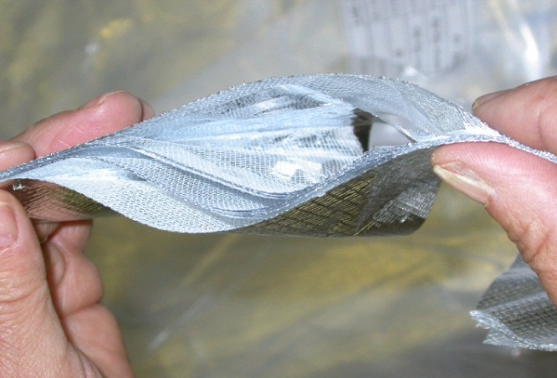
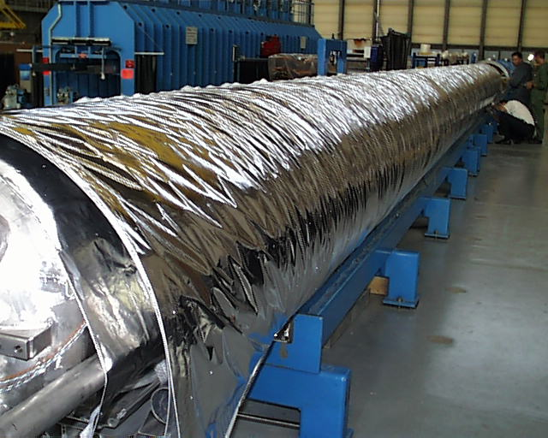
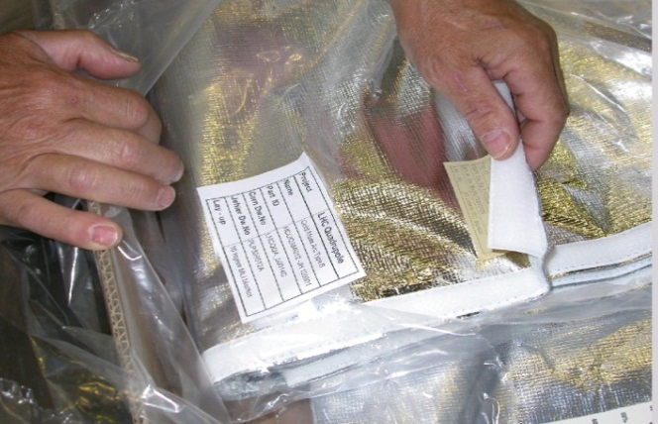
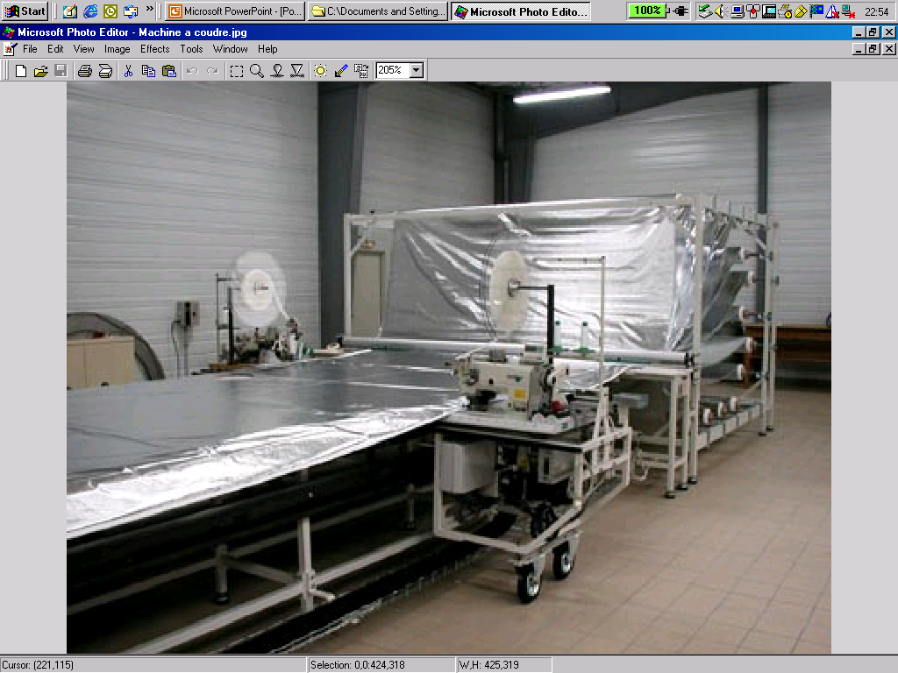
LHC Multi layer insulation (MLI)
Features:
1 blanket (10 reflective layers) on cold masses (1.9 K)
2 blankets (15 reflective layers each) on Thermal Shields (50-65 K)
Reflective layer: double aluminized polyester film
Spacer: polyester net
Stitched Velcro™ fasteners for rapid mounting and quality closing
Interleaved reflectors and spacers
Velcro™ fasteners
1 blanket on CM, 2 on thermal shield
Blanket manufacturing

Slide 21
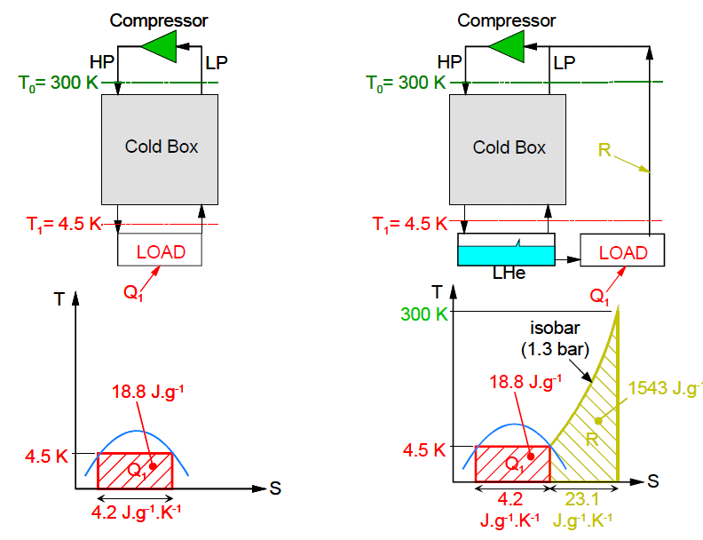
Thermodynamic efficiency of DWT gas cooling
Electrical power for liquefaction of 1 g/s helium: 6200 W_{el}
Carnot COP @ 4.5 K: 66 W_{el}/W_{th}
1 g/s liquid helium is equivalent to 100 W_{th} @ 4.5 K *
He refrigeration He Liquefaction
(Figure from: « An Introduction to Cryogenics », Ph.Lebrun, CERN/AT 2007-1)
* U. Wagner s presentation: http://cdsweb.cern.ch/record/808372/files/p295.pdf

