Slide 1

Long Pulse Klystron Modulators
and
IOT Power Supplies
based on the
SML (Stacked Multi-Level) topology
advantages and challenges over conventional topologies
Carlos A. Martins
RF Electrical Power Systems
www.europeanspallationsource.se
December 11th, 2013

Slide 2
Introduction
Klystron / IOT modulator strategy
Two parallel paths:
  1.- Use commercial klystron modulators (without imposing the topology)
  330 kVA (2 klystrons in parallel);
  2.- Develop a new topology that could be used to power IOT’s and klystrons (with minimal modifications)
  660 kVA (4 klystrons / IOT’s in parallel)

Slide 3
The Stacked Multi-Level (SML) topology
- Principle
One module
AC grid
50Hz
400V
High Voltage
DC or long pulsed
One module:
HF
Transf.
Filter
AC /
DC
DC /
DC
DC /
AC
AC /
DC
AC grid
50Hz
400V
DC-link
1.1 kV
AC
15 kHz
1 kV
AC
15 kHz
25 kV
AC + DC
15 kHz
25 kV
DC
(25 kV,
klystrons)
(12.5 kV,
IOT’s
Capacitor bank
1 kV

Slide 4
The Stacked Multi-Level (SML) topology
- Principle
Complete system. Multiple stacked modules connected:
In parallel at the input (grid) side; - In series at the output (HV) side;
DC
(115 kV,
klystrons)
(50 kV,
IOT’s
Module #1
HF
Transf.
Filter
AC /
DC
DC /
DC
DC /
AC
AC /
DC
DC-link
1.1 kV
AC
15 kHz
1 kV
AC
15 kHz
25 kV
AC + DC
15 kHz
25 kV
Capacitor bank 1 kV
Module #N
HF
Transf.
Filter
AC /
DC
DC /
DC
DC /
AC
AC /
DC
DC-link
1.1 kV
AC
15 kHz
1 kV
AC
15 kHz
25 kV
AC + DC
15 kHz
25 kV
Capacitor bank 1 kV

Slide 5
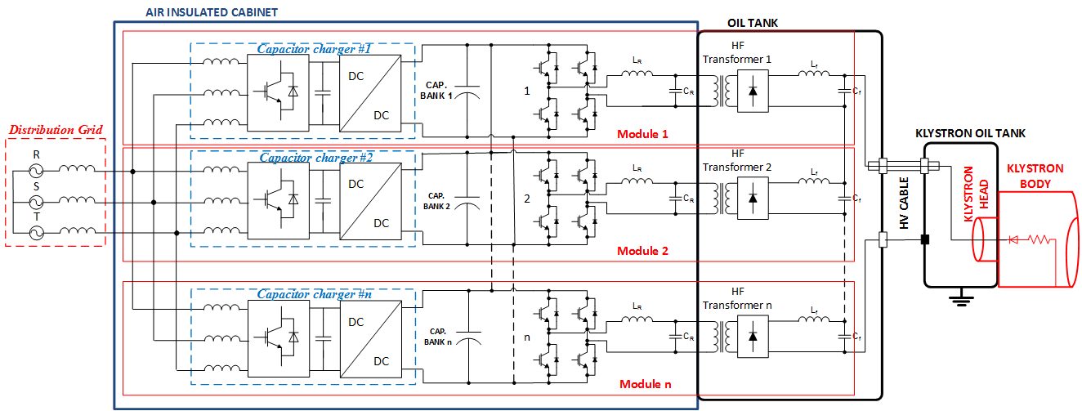
The Stacked Multi-Level (SML) topology
400V,
3-phase, 50Hz
~1 kV
~1 kV
~1 kV
Sinusoidal current absorption;
Power factor correction;
Precise capacitor charging;
Regulation of charging power (flicker free);
Pulse forming;
Droop compensation;
Arc protection
Galvanic isolation;
Voltage amplification;
Modulator main functions by sub-system

Slide 6
The Stacked Multi-Level (SML) topology
400V,
3-phase, 50Hz
~1 kV
~1 kV
~1 kV
Special HV components & assembly:
in an oil tank: klystrons;
in a dry HV deck: IOT’s
Standard “of-the-shelf” LV components
Key points:
Modular concept, allowing increasing the power by adapting the number of modules, keeping their size and weight under control;
Compatible both with PULSED and CW operations and with different types of RF amplifiers (Klystrons, IOT’s, tetrodes, etc.);
Up to 660 kVA average power possible, allowing the supply of 4 x 1.2MW klystrons / IOT’s in parallel;
Lower cost due to usage of standard LV components into a great extent (price target: ~500 €/kWav);
No active power electronic devices placed inside oil tanks (facilitates maintenance);
Reduced footprint/volume due to minimal sub-systems count (sub-systems integrate multiple functions);
Improved efficiency (~94%), due to minimal number of conversion stages;
Excellent AC grid power quality (flicker-free, sinusoidal current absorption, unitary power factor);

Slide 7
Other important advantages
ESS will be able to specify an open topology and assure full technical competence on the topology:
facilitates maintenance;
construction of the full scale prototype and series production could be undertaken by a much broader number of companies (even with limited past experience in designing of modulators);

Slide 8
Development of a reduced scale prototype
in collaboration with Lund Technical University
Developed to serve both as a klystron modulator and as an IOT HV Pulsed power supply(*)
Klystron modulator
IOT HV pulsed power supply
Pulse voltage: 115 kV;
Pulse current: 20 A;
Pulse power (elect): 2.3 MW;
Pulse width: 3.5 ms;
Pulse repetition rate: 14 Hz;
Average power output: 115 kW;
Average power grid: 126 kVA;
DC (or slow pulsed) voltage: 50 kV;
Pulse current: 34 A;
Pulse power (elect): 1.95 MW;
Pulse width: 3.5 ms;
Pulse repetition rate: 14 Hz;
Average power output: 98 kW;
Average power grid: 104 kVA;
(*)
- Same LV power electronics in air insulated cabinets;
- Different HV tank assembly;
400V,
3-phase, 50Hz
LV power electronics
HV tank assembly

Slide 9
Status of the reduced scale prototype development
Done (by Dec. 9th 2013):
- Detailed thermal calculations and selection of main components;
Power circuit schematics;
Preliminary mechanical layout;
Control loop studies and simulation for the LV stage (AC grid side + cap. charger);
Selection and purchase of digital controller;
Purchase of power converter stacks; Contact of a local assembly company ;
First meeting with Stangenes held on Sept. 10th for discussions on HV oil tank assembly;
To be done (from Jan. 2014 to end 2014):
Launch call for tenders for: 1)- HV tank assembly; 2)- HV dummy load;
Detailed mechanical layout and cabling;
Control loop studies and simulation of the HV stage (Max Collins, consultant);
Modeling of parasitic elements in HV tank assembly and mitigation;
Simulation of the entire circuit with controls;
Programming of the controller;
Testing and validation;
Construction and equipment of a HV power electronics lab at LTH;

Slide 10
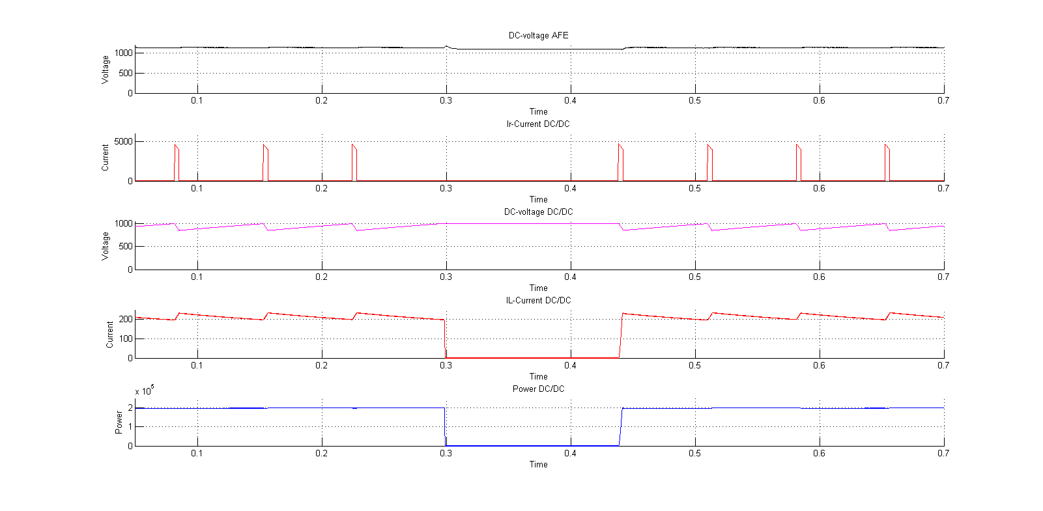
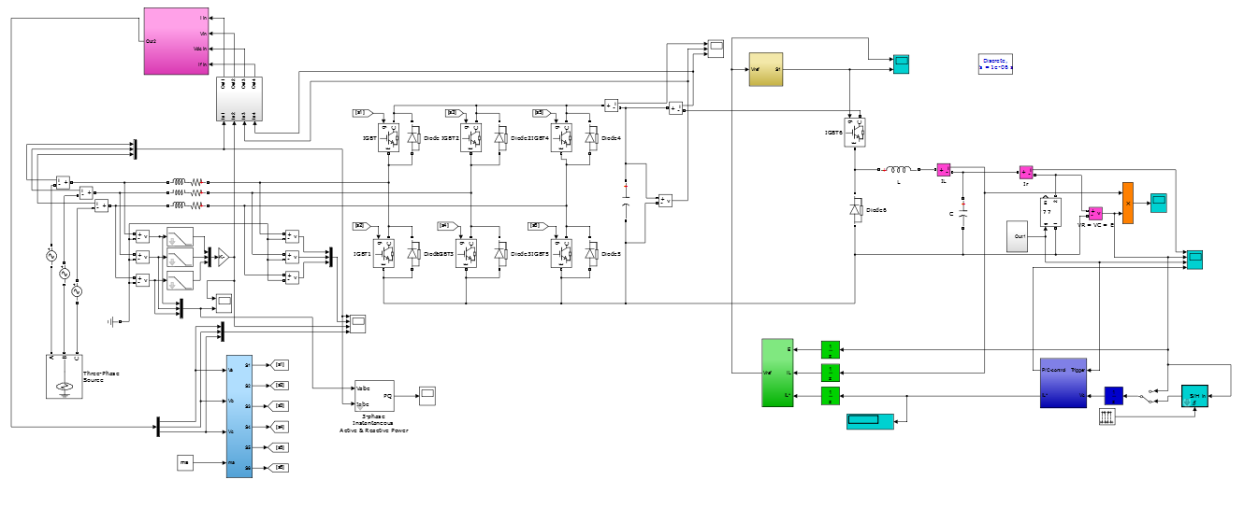
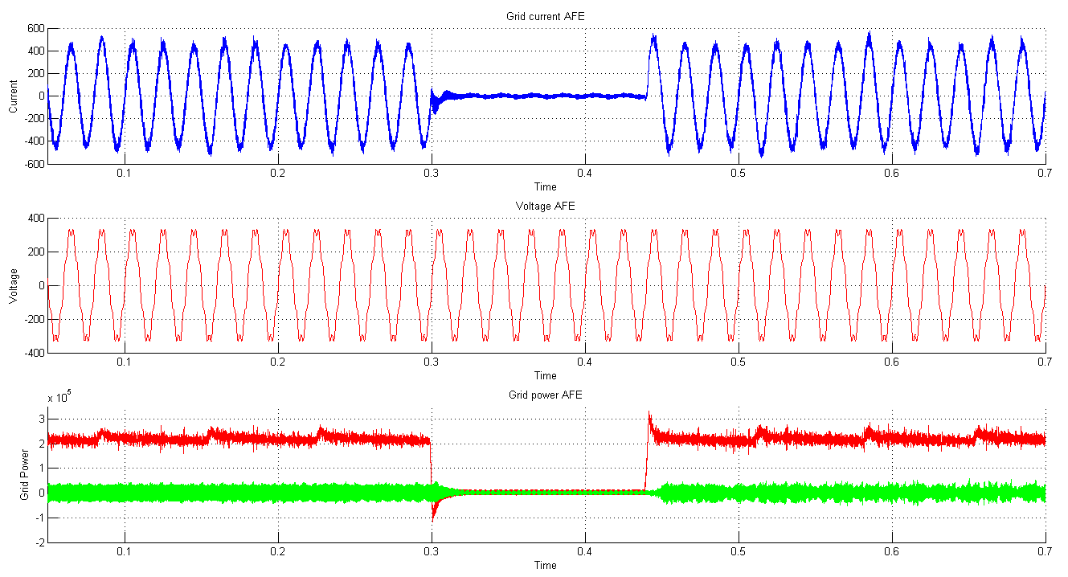
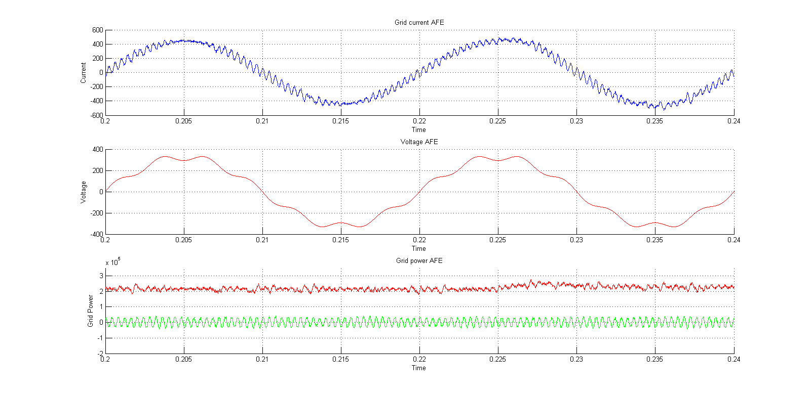
Simulation Results: AC grid front end (1 module)
ZOOM

Slide 11
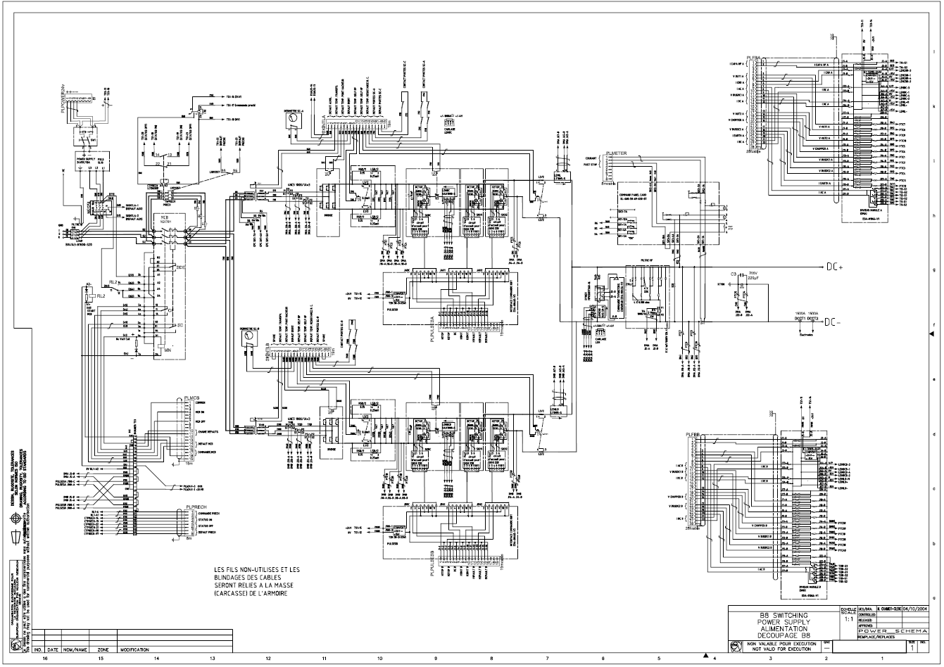
Power circuit schematics (in Dec. 9th 2013)
To be detailed into something like this…
(wiring diagram)

Slide 12
Mechanical layout of the reduced scale prototype
(preliminary)
Note:
For the full scale system, the different blocks shown would expand naturally, keeping the same mechanical layout arrangement

Slide 13
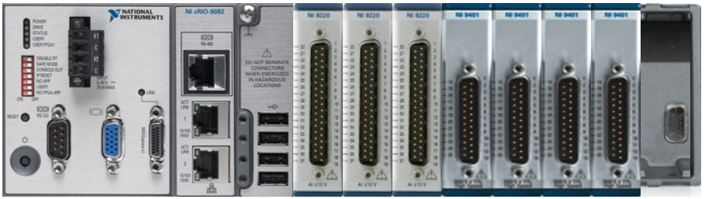
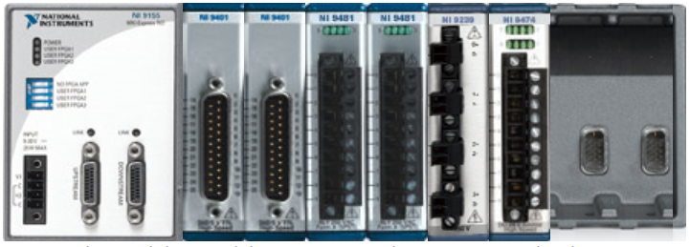
The Controller: Compact RIO from National Instruments
NI cRIO-9082 Real Time
Volt. Meas. NI-9220, with Dsub
- 100 kS/s, 16 bit, per channel
- 3 x 16 channels
Digital Output NI-9401, with DSub terminals
- 100ns, 5V/TTL, per channel (SE)
- 4 x 8 channels
Arrival at ESS by now !!!
NI 9155
MXI-Express RIO
Relay NI-9481
- 250Vac/2A
- 2 x 4 channels
Digital Output NI-9474
- 1us, 5 to 30V,
- 8 channels, sourcing output
Digital Input. NI-9401, with DSub
- 100ns, 5V/TTL, per channel (SE)
- 2 x 8 channels
Voltage Output NI-9269
- 100 kS/s/channel (+/-10V)
- 4 channels, 16 bit

Slide 14
Thank you.

